Slide 1
Executive Summary
The report contained herein is an analysis of marks of 14 students at the University du Quebec a Montreal (UQAM) handled by professor Duberri. The analysis came at a time when the Professor required the services of the firm to help home gain insights from the student grade submitted at the end of the term. The requirement is to wrangle the data and pass it through an analysis that will help the exam department get quick insights and make decisions s based on this dataset.

Slide 2
Dataset description
The dataset provided contains a row of 14 student records whose marks were obtained after conducting a series of 3 types of exams that included, assignments, midterm and final exams. All the threes exams were computed out of the possible highest score of 100. The dataset also contains a total of six variables that include:
First name
Last name
Student name
Assignment marks
Midterm marks
Final Exam marks

Slide 3
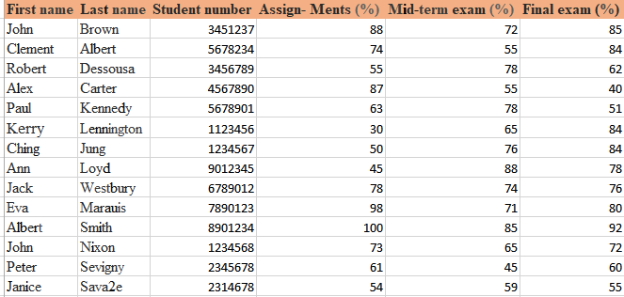

Slide 4
Aims and objectives
The aims and objectives of this analysis are as follows:
To sort the student data in alphabetical order based on first name or last name values
To compute the weighted total for each student
To compute the grade band for each student
To computer the student grade distribution and statistical summary

Slide 5
The methodology
In order to fully meet the expected above aims and requirements, the dataset had to be wrangles by taking it through a process of cleaning,, getting any missing values, null entries or unrequired value formats in the wrong columns. The primary tool of analysis in this case is Microsoft excel tool, that acts as the primary dataset and storage of these records. During the analysis period, a number of analyses was done on the dataset that included checks on measures of central tendencies and the summary statistics. Further, certain in-built excel functions like means, averages, modes, summations were used.

Slide 6
Problem One: Sorting the student data in alphabetical order
In order to solve the above problem, the data was organised and labelled correctly with the correct naming as initially required in the report. The process to active this includes the following:
Highlighting all the columns in the student data
Going to the data tab in ether excel navigation window
Click sort under sort and filter
The select sort by First name in the drop down
The result is the sorted student list by first name

Slide 7
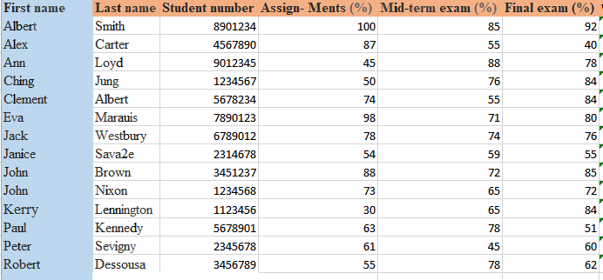

Slide 8
Problem two: Compute the weighted total for each student
To achieve this the sum values of each student have to embed across the columns of the three exams

Slide 9
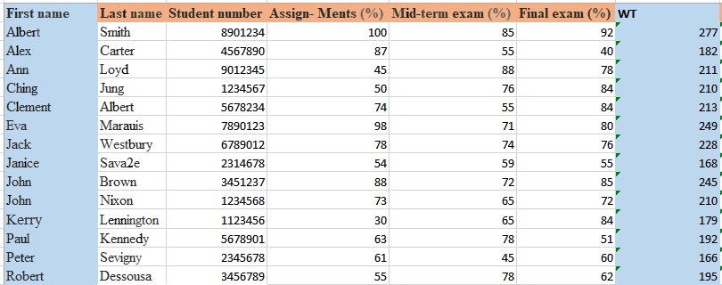

Slide 10
Problem three: Compute the grade for each student
To achieve this requirement, a new column had to be inserted next to the weighted total marks for the student,

Slide 11
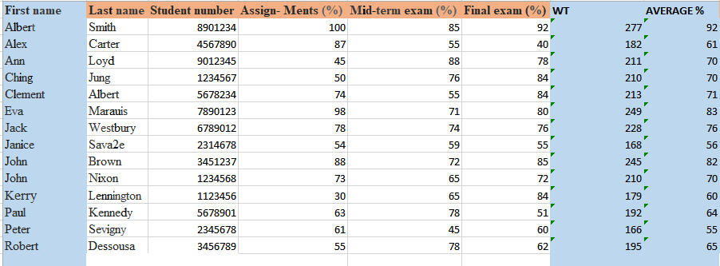

Slide 12
Problem four: statistical distribution of each student grade:
To achieve this , a new column called student grade bands so established and then a new function that reads from the next tables containing the grade band is inserted and then read across using the excel VLOOKUP function to read this data into the newly created column list for grade bands;

Slide 13
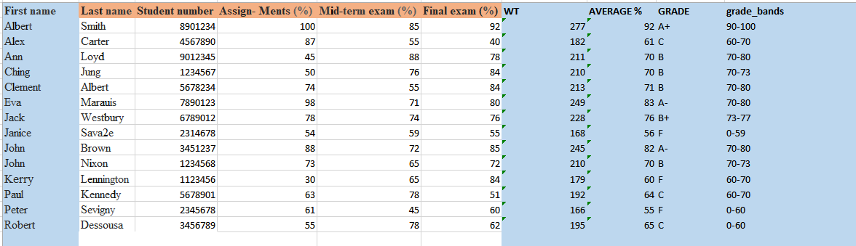

Slide 14
Data presentations
A summary presentation of this data was also visualised to reveal some of the quickest trends. For instance, the analysis of the top student’s ordered against their weighted marks revealed the following data. It can be observed that Albert and Eva were leading at the front while Janis and Peter came at the last.

Slide 15
Further, analysis of the groupings by grades revealed the grade B had the highest number of students while grade B+ only had 1 student. In terms of marks and rankings of all students, again it can be observed that Albert, Eva and John scored the highest marks

Slide 16
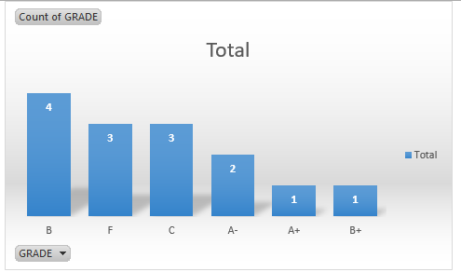

Slide 17
