Slide 1
Ghost Evidence Tracker
By Evandita Wiratama Putra (2206059572)

Slide 2
What is a Ghost Evidence Tracker?
A device inspired from a game so called ‘Phasmophobia’. Phasmophobia is a horror game where we as the player are tasked to find the type of a ghost while staying alive
The ghost evidence tracker main purpose is to help the player identify what type of ‘ghosts’ they are investigating
There are currently 24 types of ghosts and to identify which is which, we need to find the correct evidence
There are a total of 7 evidence we can use and each of the 24 ghosts only have 3 unique evidence

Slide 3
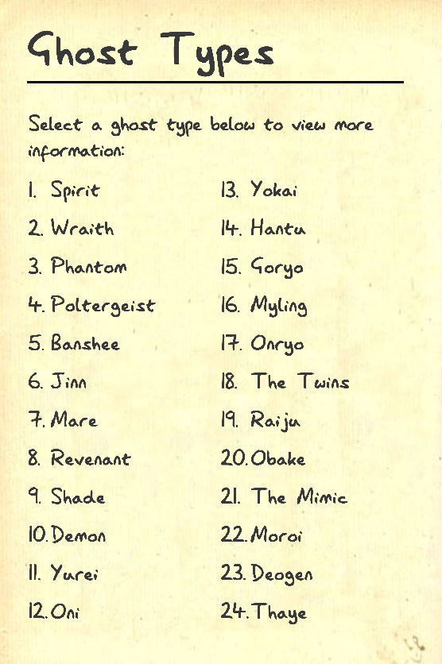
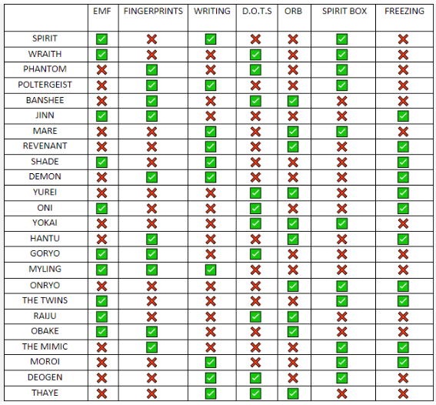
What are the 24 types of Ghosts?

Slide 4
What are the 7 evidences?

Slide 5
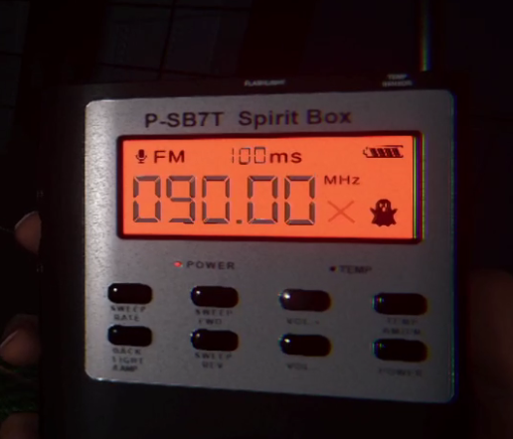
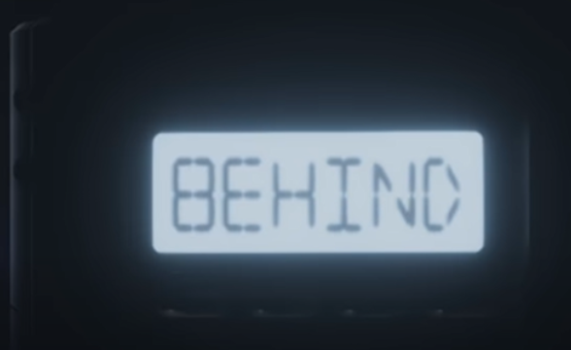
Spirit Box

Slide 6

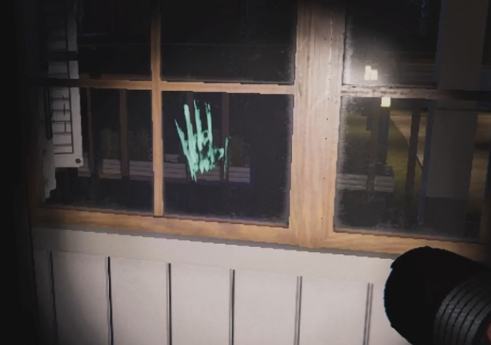
Fingerprints

Slide 7

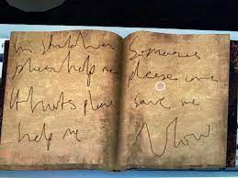
Ghost Writing

Slide 8
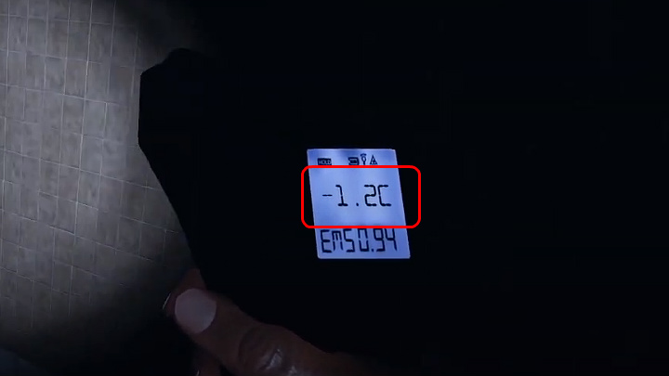
Freezing Temperature

Slide 9
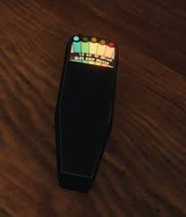
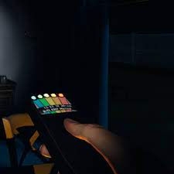
EMF Level 5

Slide 10
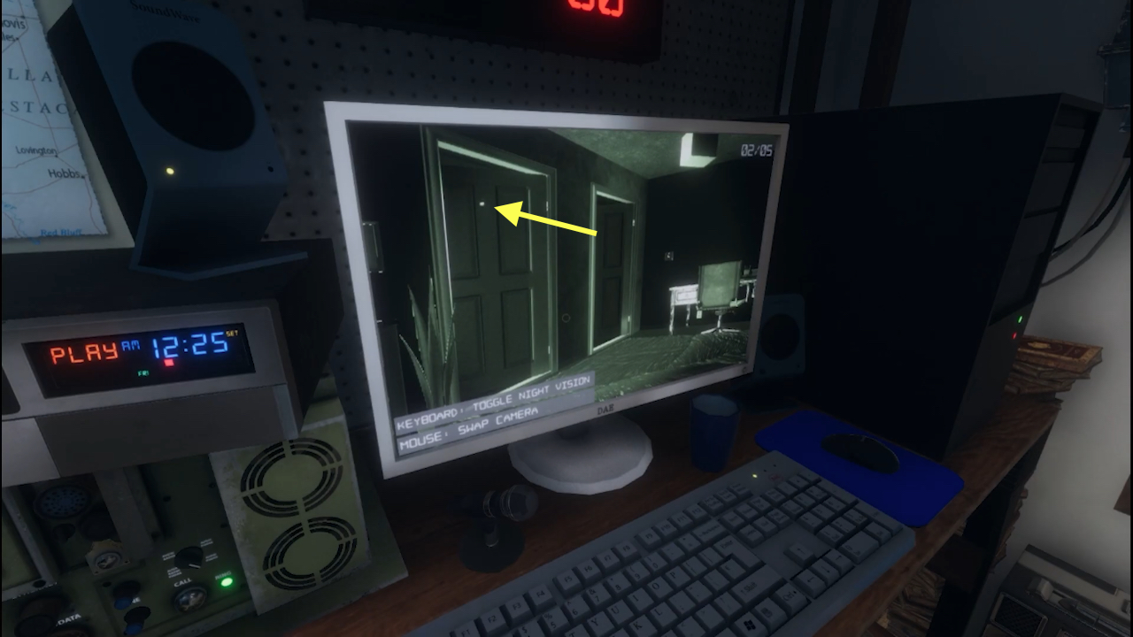
Ghost Orbs

Slide 11
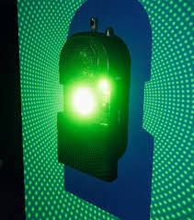
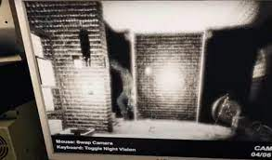
DOTS Projector

Slide 12
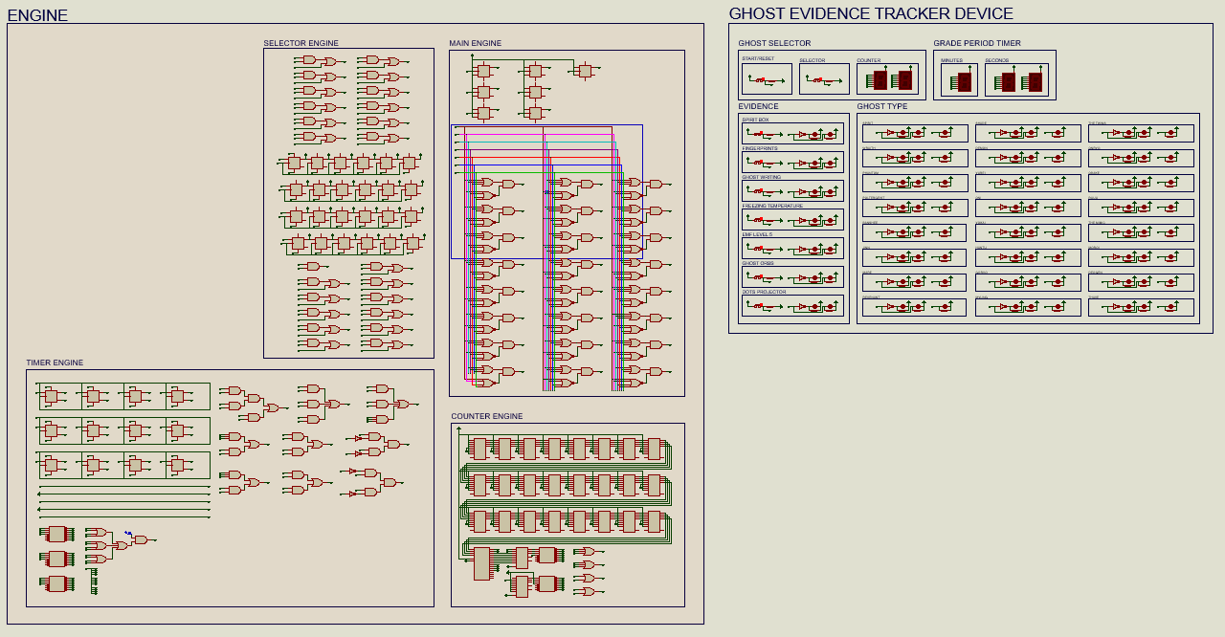
Device Reveal !!!

Slide 13
Module Implementation
Module 1 – Introduction to Digital Systems
Module 2 – Boolean Algebra and Basic Logic Gates
Module 3 – Karnaugh Map
Module 4 – Complex Logic Gates
Module 5 – Decoder and Encoder
Module 7 – Digital Arithmetic Circuit
Module 8 – Flip Flop and Latch
Module 9 – Register and Counter
Link Truth Table and K Map - https://docs.google.com/spreadsheets/d/1-4rx_pFkumVo2GR-SKC0J6SGKFYtAgiiJYQnB9yyFMk/edit?usp=sharing

Slide 14
Thank You

