Slide 1
Skip Lists
Project 6 Presentation
Group 16

Slide 2
catalog
1
Introduction
2
Algorithm
3
Testing Results
4
Looking Forward

Slide 3
01
Introduction

Slide 4
Introduction
Skip Lists
Skip list is a data structure that supports searching , insertion and deletion in O(logN) expected time.
A Skip List is an ordered list that can be binary searched.

Slide 5
Top
-INF
21
37
INF
L3
-INF
7
21
37
71
INF
L2
-INF
7
14
21
32
37
71
85
117
INF
L1
Properties:
The bottom linked list contains all the elements
If an element appears in a linked list at Level i, it also appears in lists below Level i.
Each node contains two Pointers, one to the next element in the same list and one to the element at the next level below.

Slide 6
02
Algorithm

Slide 7
Search
When search for k:
If k = key, done!
If k < next key, go down a level
If k ≥ next key, go right
Example : find 117
-INF
21
37
INF
L3
-INF
7
21
37
71
INF
L2
-INF
7
14
21
32
37
71
85
117
INF
L1

Slide 8
Insert
Perfect Skip Lists are too structured to support efficient updates.
We expect 1/2 the items to be carried up to the next level.
So when we want to insert one element we can use random coin flips to determine K(how many levels the element occupies) .
Example:insert 117,K=2
-INF
21
37
INF
L3
-INF
7
21
37
71
117
INF
L2
-INF
7
14
21
32
37
71
85
1177
INF
L1

Slide 9
Insert
If K>maxlevel
maxlevel = K;
Example:insert 117,K=4
-INF
117
INF
L4
-INF
21
37
117
INF
L3
-INF
7
21
37
71
117
INF
L2
-INF
7
14
21
32
37
71
85
1177
INF
L1

Slide 10
Delete
When delete K:
We just need to find k on every levels and delete them.
Example : delete 71
-INF
21
37
INF
L3
-INF
7
21
37
71
INF
L2
-INF
7
14
21
32
37
71
85
117
INF
L1

Slide 11
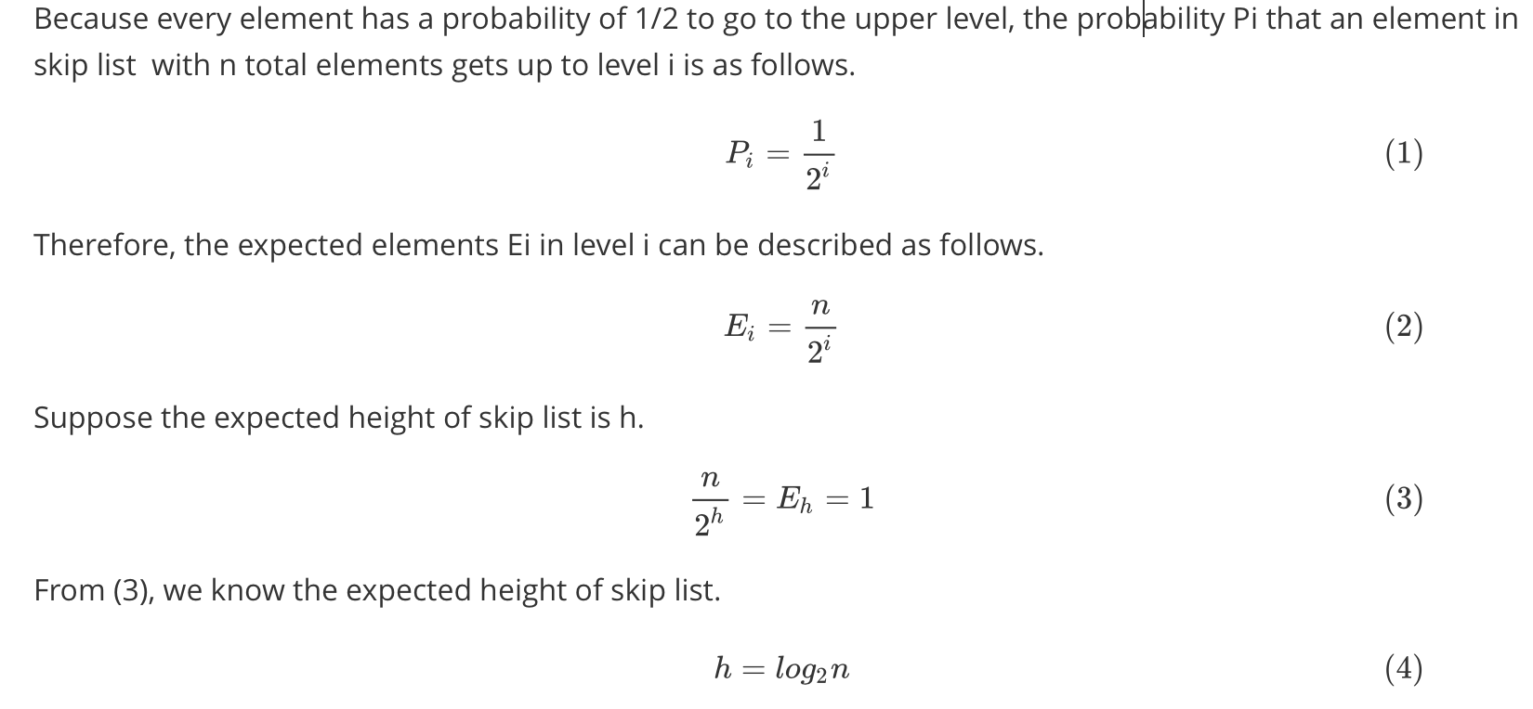
Proof of operation time bounding in skip list
First, we prove that the expected height of skip list is O(logn).

Slide 12
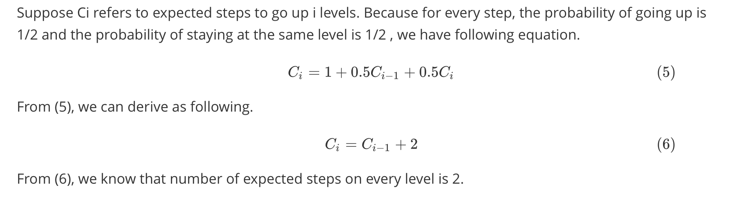
Proof of operation time bounding in skip list
Second, we prove that the average number of steps on every level is 2.
Suppose Ci refers to expected steps to go up i levels. Because for every step, the probablility of going up is 1/2 and the probability

Slide 13
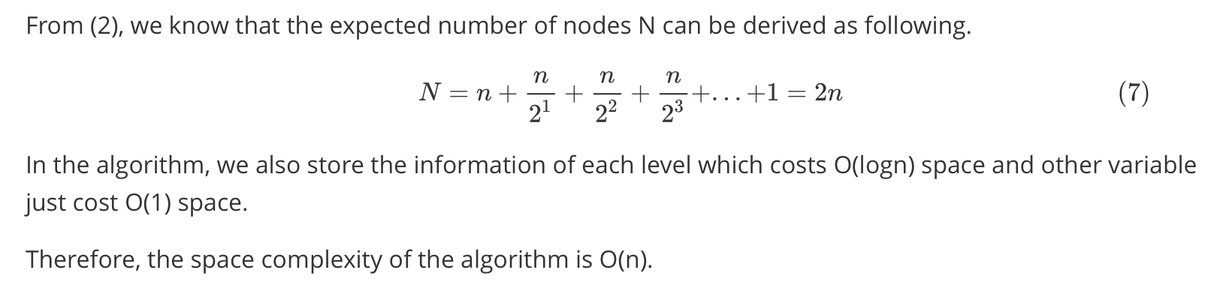
Time complexity(average case)
Total steps = Expected height * Average steps on each level
= O(logn) * 2
= O(logn)
Space complexity

Slide 14
03
Testing Result

Slide 15
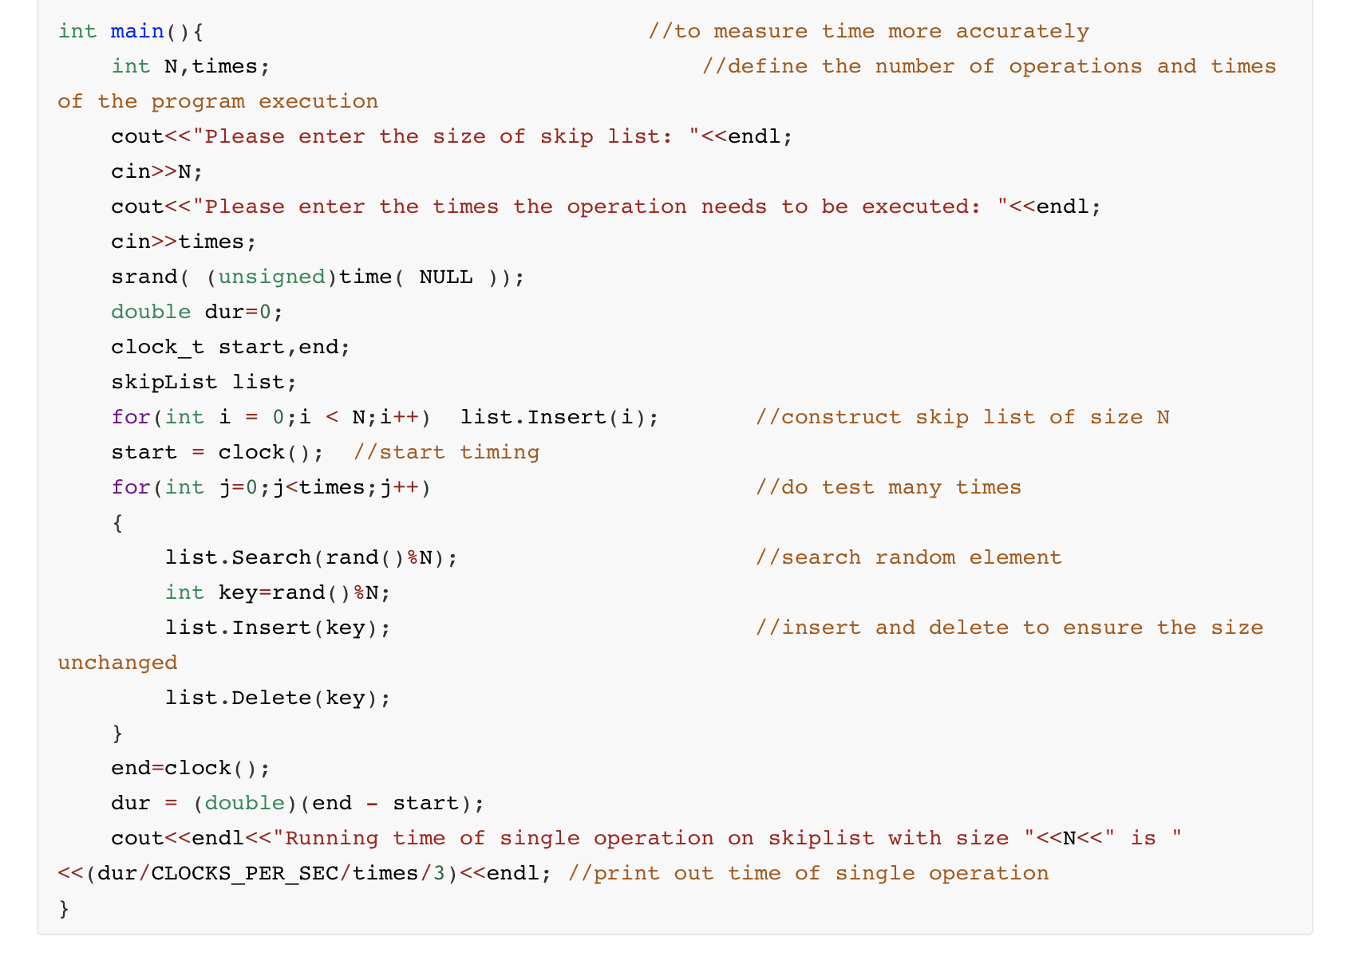
Test Program
A. Construct skip list of size n by
inserting n items. (Not start timing now)
B. Search an inserted item, insert
a random item and delete it.( Repeat for many times)
C.Calculate average time for every skip list operation.

Slide 16
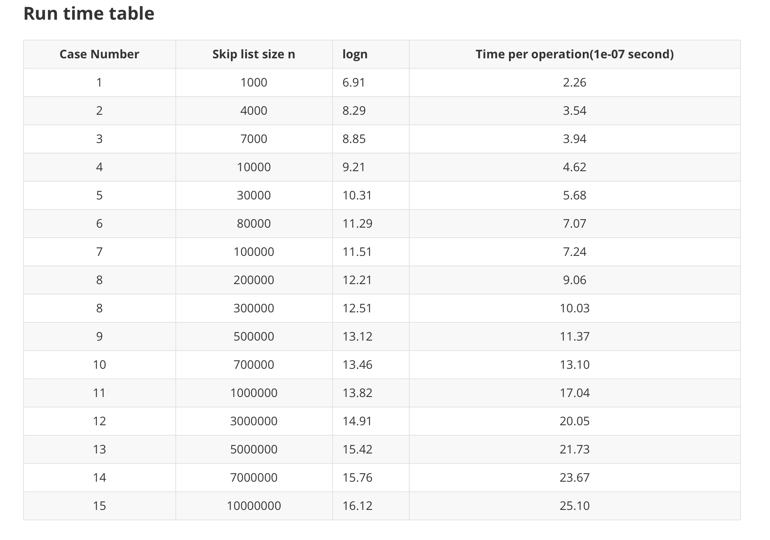

Slide 17
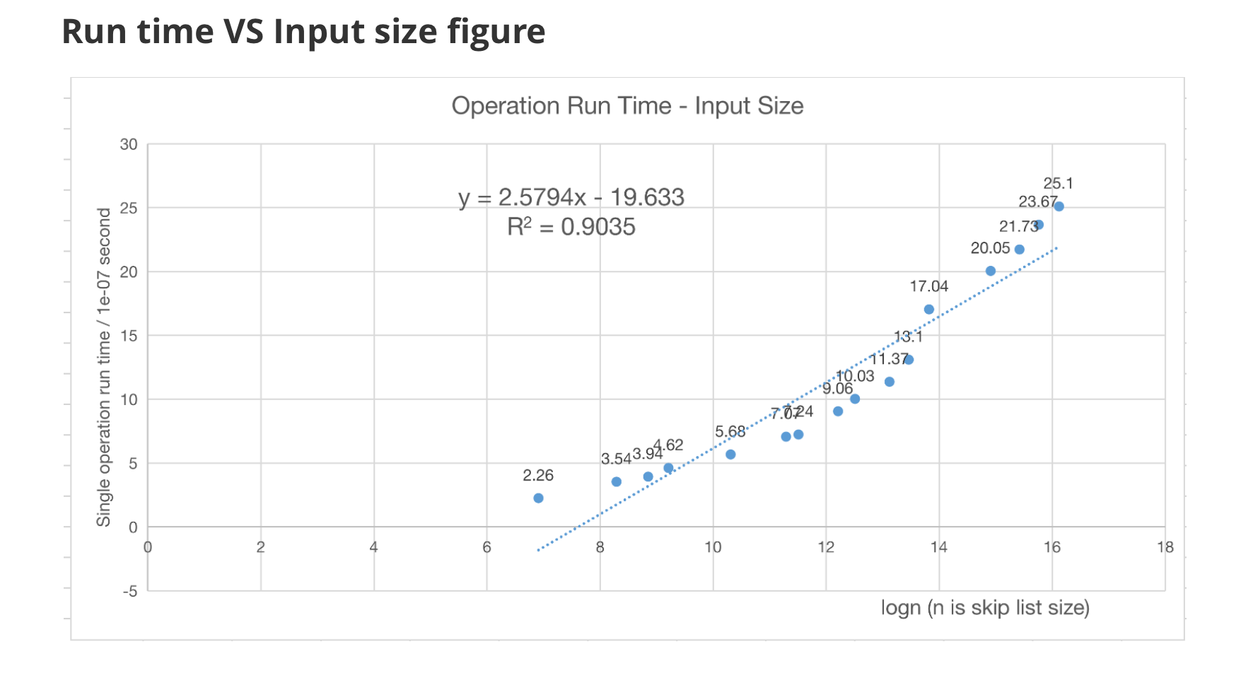
From the figure, because the R^2 equals 0.9035,
we can say that single operation run time of skip list is promotional to logn (n is the size of skip list).
Experimentally, we can get the conclusion that the expected time for the skip list operations is O(logn).

Slide 18
04
Looking Forward

Slide 19
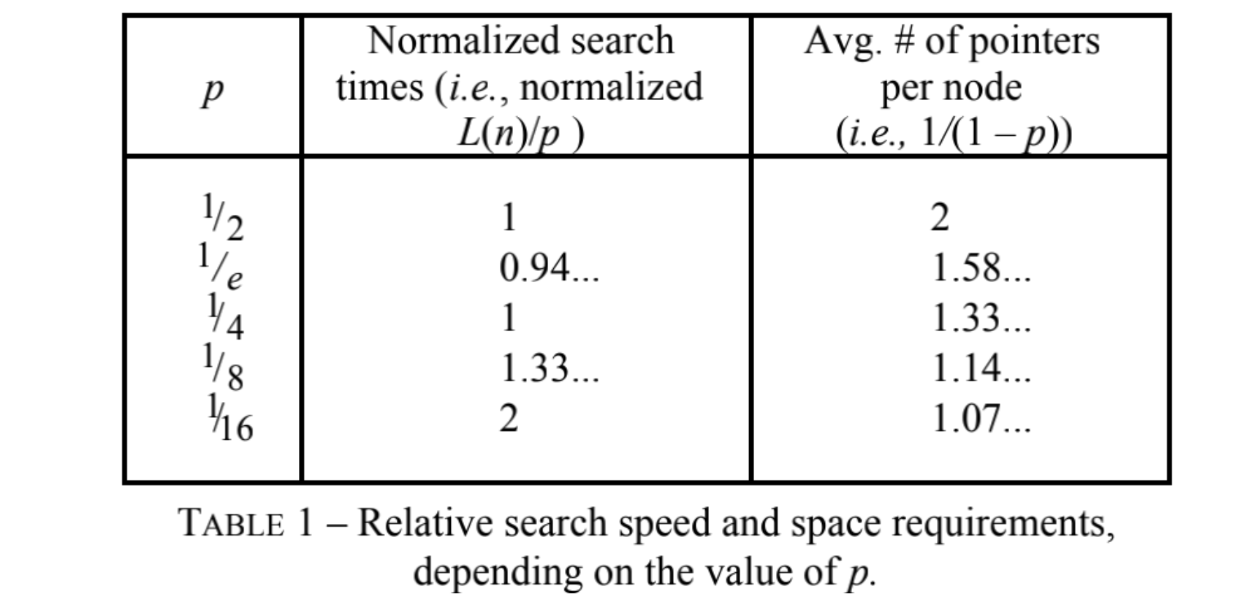
p = 1/2 ? Further possible improvements
Usually, the going upper probability p is set to be 1/2 because symmetry always works well.
However, that may not be true thereotically and experimentally.
Refering to some essays, it's not easy to illustrate rigorous details of choosing the best p.
The following is a picture extracted from Pugh W. Skip lists: a probabilistic alternative to balanced trees[J]. Communications of the ACM, 1990, 33(6): 668-676.
From the table, we can know that p=1/e
works best in the value above when
considering time bound.
For a better implement, p=1/e
might be more efficient
but it need some complex math proof.

Slide 20
THANKS
Project 6 Presentation
Group 16

