Slide 1
The Battle of Neighborhoods

Slide 2
Background:
A Chinese couple have earned a lot of money during their lives in China, they want to go to Toronto relax a few years. They ask me if I have a good idea where to open the mall it the best.
Problem:
So the problem is ——In the city of Toronto, if a property developer is looking to open a new shopping mall, where would you recommend that they open it?

Slide 3
We need:
The neighborhoods in Toronto.
Latitude and longitude coordinates of those Neighborhoods.
Foursquare API to get Venue data.

Slide 4
Methodology
k-means is the methodology we use.

Slide 5
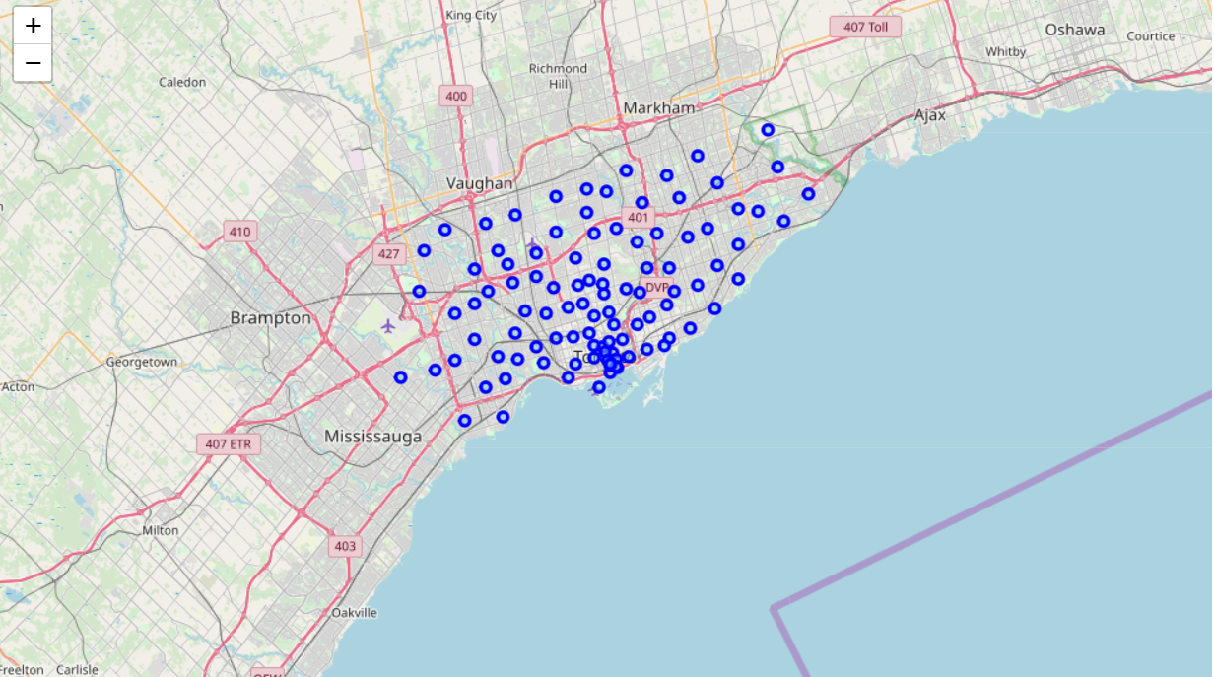
The plot of Neighborhoods in Toronto

Slide 6
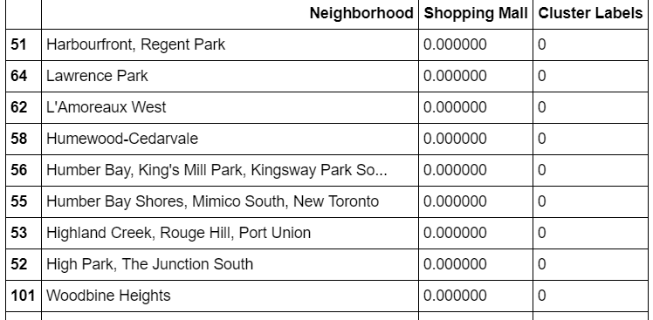
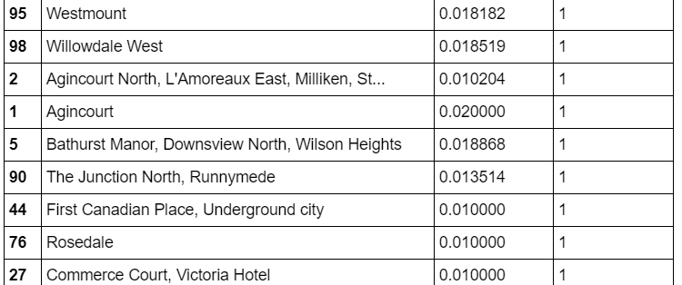
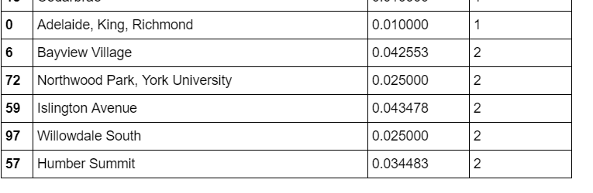
The section of clusters data

Slide 7
Thank you !

