Slide 1

Practice #1: Perceptron Learning Gradient-Descent Methods (Batch, Stochastic, Mini-batch)
[SKT AI Course: Deep Learning Basics]
TA: Jun-Sik Choi & Jee-Seok Yoon
Instructor: Heung-Il Suk
hisuk@korea.ac.kr
http://www.ku-milab.org
Department of Brain and Cognitive Engineering,
Korea University
September 18, 2017

Slide 2
Contents
Rosenblatt’s Perceptron with Vanilla Gradient Descent
Widrow-Hoff’s Perceptron with Vanilla Gradient Descent
Widrow-Hoff’s Perceptron with Stochastic Gradient Descent

Slide 3
Rosenblatt’s Perceptron with Vanilla Gradient Descent

Slide 4
Rosenblatt’s Perceptron Conceptual Diagram

Slide 5
Class Perceptron
Class Variables
eta : learning rate
epochs : # of epochs to train
weights : connection weight variables, a numpy ndarray
errors : # of wrong prediction, a python list

Slide 6
Class Perceptron
Class Methods
__init__(self, eta=0.01, epochs=10)
initialize Perceptron with learning rate and training epochs
fit(self, X, y)
training perceptron with training data X and label y for number of epochs
X: {array-like}, shape=[num_samples, num_features]
y : {array-like}, shape=[num_samples]
net_input(self, X)
provide data to perceptron and return perceptron's output before activation
predict(self, X)
return perceptron's prediction

Slide 7
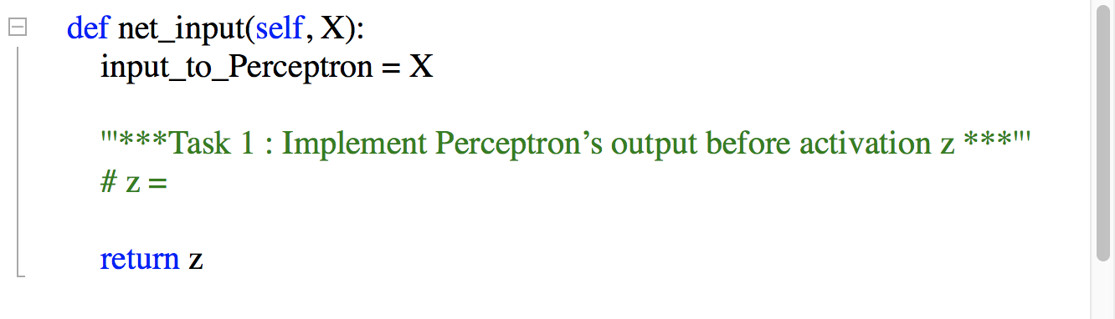

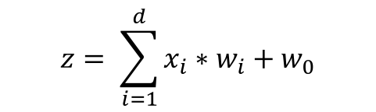
Implement major methods of Class Perceptron (1)
Task 1: Implement Perceptron's output z before activation in net_input(self, X)
$$z= \sum_{i=1}^{d}{x_{i}∗w_{i}}+w_{0}$$

Slide 8
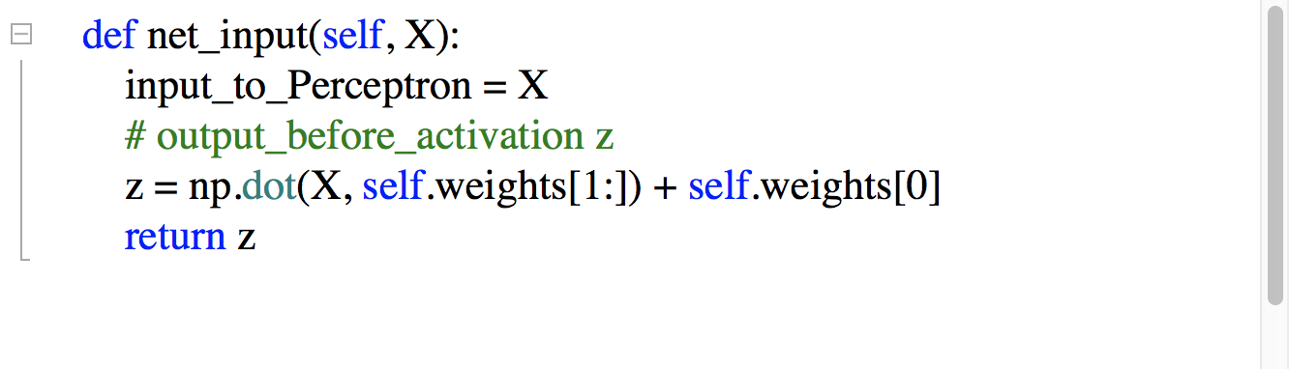
Answer
Task 1: Implement Perceptron's output z before activation in net_input(self, X)
$$z= \sum_{i=1}^{d}{x_{i}∗w_{i}}+w_{0}$$

Slide 9
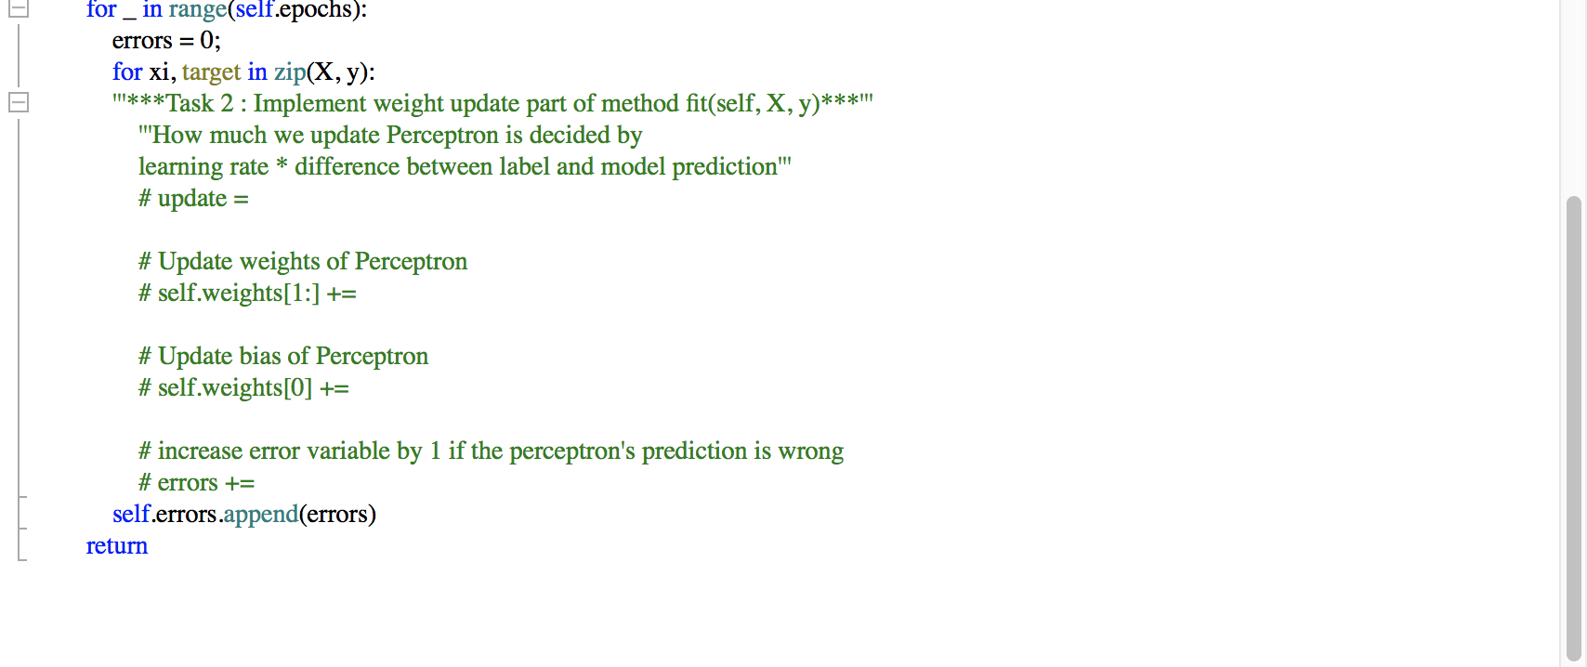
Implement major methods of Class Perceptron (2)
Task 2: Implement weight update part of method fit(self, X, y)

Slide 10
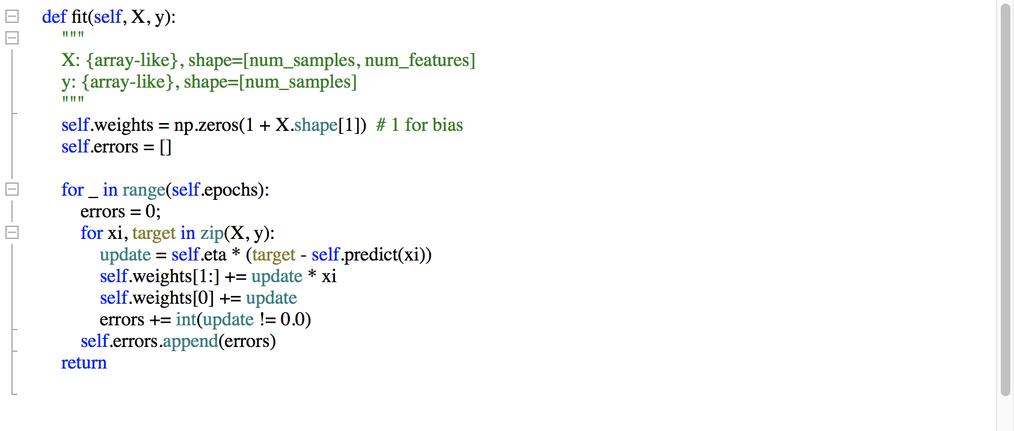
Answer
Task 2: Implement weight update part of method fit(self, X, y)

Slide 11
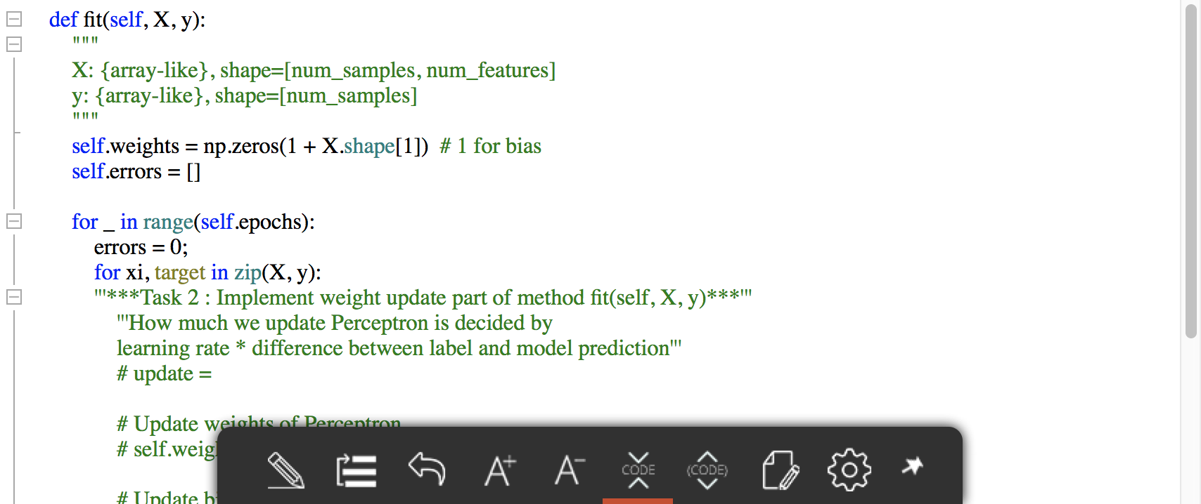
Training
Task 3: Implement weight update part of method fit(self, X, y)

Slide 12
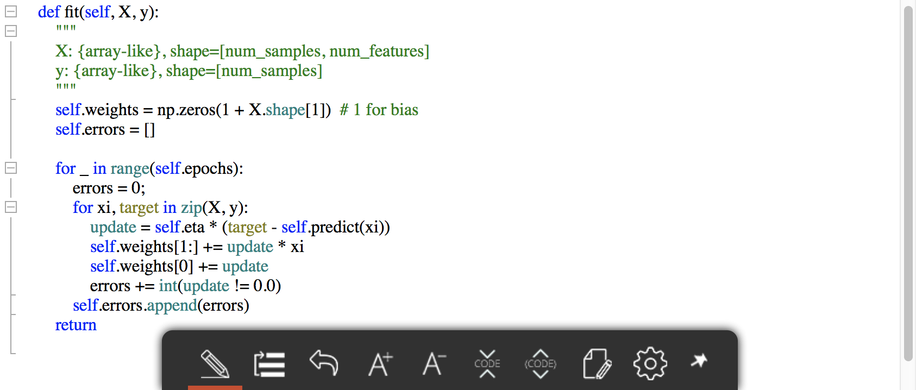
Answer
Task 3: Implement weight update part of method fit(self, X, y)

Slide 13
Thank you
For your attention!!!
(Q & A)
hisuk (AT) korea.ac.kr
http://www.ku-milab.org

