Slide 1

Practice #4: Transfer Learning Finetuning, Pre-trained model as feature extractor
[SKT AI Course: Deep Learning Basics]
TA: Jun-Sik Choi & Jee-Seok Yoon
Instructor: Heung-Il Suk
hisuk@korea.ac.kr
http://www.ku-milab.org
Department of Brain and Cognitive Engineering,
Korea University
September 20, 2017

Slide 2
Contents
Fine-tuning pre-trained model
Pre-trained model as a feature extractor

Slide 3
Fine-tuning pre-trained model

Slide 4
Pre-trained Model
18 layer ResNet

Slide 5
torchvision.transforms
Torchvision provides simple ways to transform images and tensors.
transforms.Compose : Composes transforms together
transforms.Scale : Rescale the input PIL.Image to the given size.
transforms.CenterCrop : Crops the given PIL.Image at the center.
transforms.RandomCrop : Crop the given PIL.Image at a random location.
transforms.RandomSizedCrop : Crop the given PIL.Image to random size and aspect ratio.
transforms.Pad : Pad the given PIL.Image on all sides with the given “pad” value.
transforms.Normalize : Normalize an tensor image with mean and standard deviation.
transforms.ToTensor : Convert a PIL.Image or numpy.ndarray to tensor.
transforms.ToPILImage : Convert a tensor to PIL Image. → You can apply several transformations together to given dataset using Compose

Slide 6
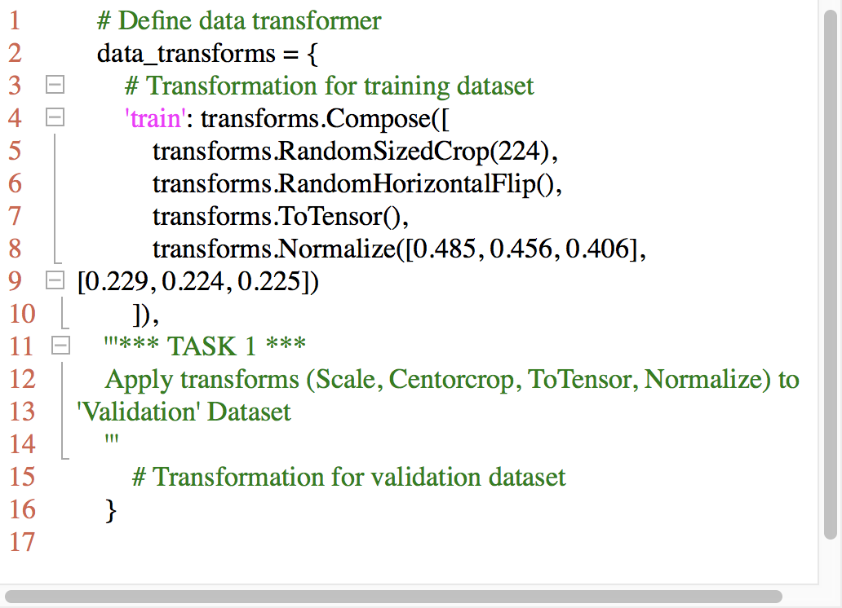
Task #1
Apply transforms (Scale, Centorcrop, ToTensor, Normalize) to 'Validation' Dataset
Scale Image to size 256 x 256 x 3
Centercrop Image to size 224 x 224 x 3
Transform Image to Tensor
Normalize Tensor
Mean : [0.485, 0.456, 0.406]
Std : [0.229, 0.224, 0.225]

Slide 7
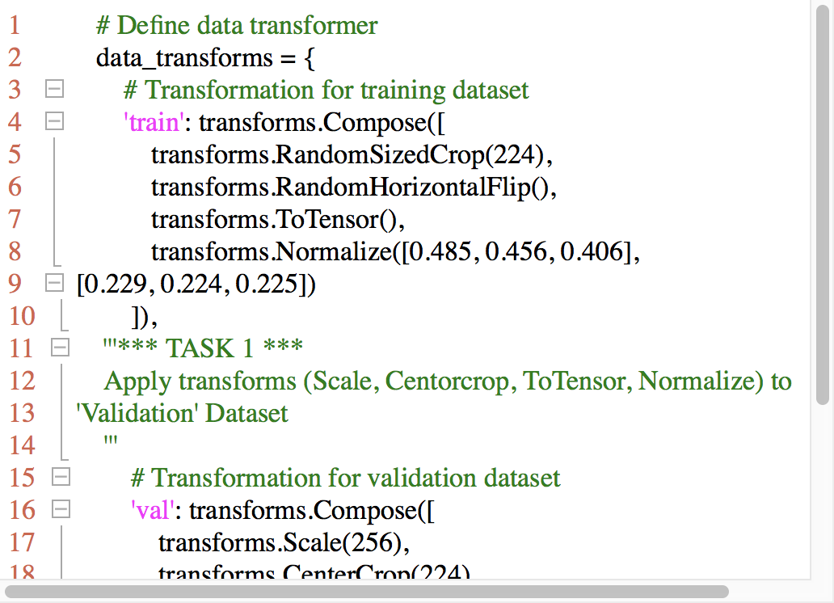
Answer
Apply transforms (Scale, Centorcrop, ToTensor, Normalize) to 'Validation' Dataset
Scale Image to size 256 x 256 x 3
Centercrop Image to size 224 x 224 x 3
Transform Image to Tensor
Normalize Tensor
Mean : [0.485, 0.456, 0.406]
Std : [0.229, 0.224, 0.225]

Slide 8
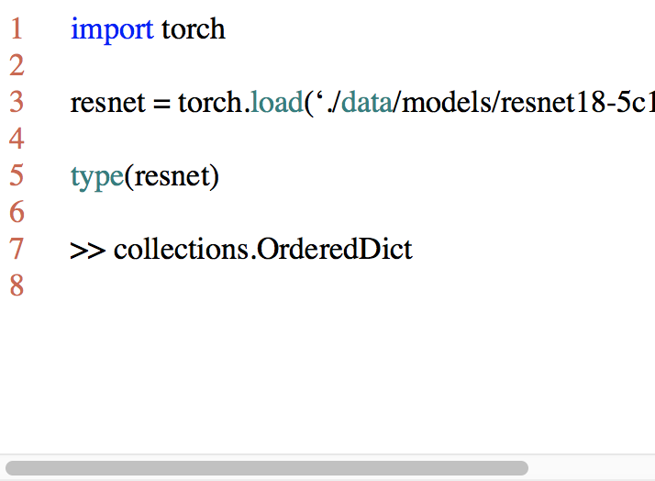
Load and modify model
load_state_dict(state_dict)
Copies parameters and buffers from state_dict into this module and its descendants.
The keys of state_dict must exactly match the keys returned by this module’s state_dict() function.
→ loaded model is an Ordered Dictionary.

Slide 9
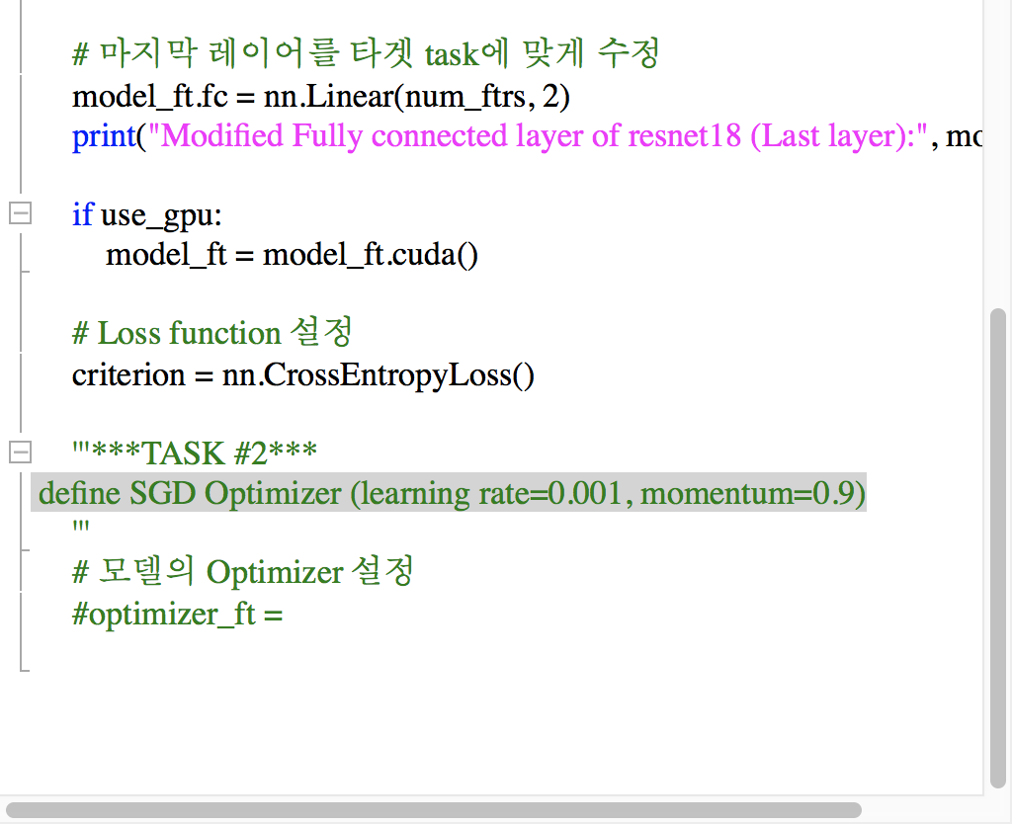
Task #2
2.1 Copy parameter from './data/models/resnet18-5c106cde.pth' to model_ft
2.2 Define SGD Optimizer

Slide 10
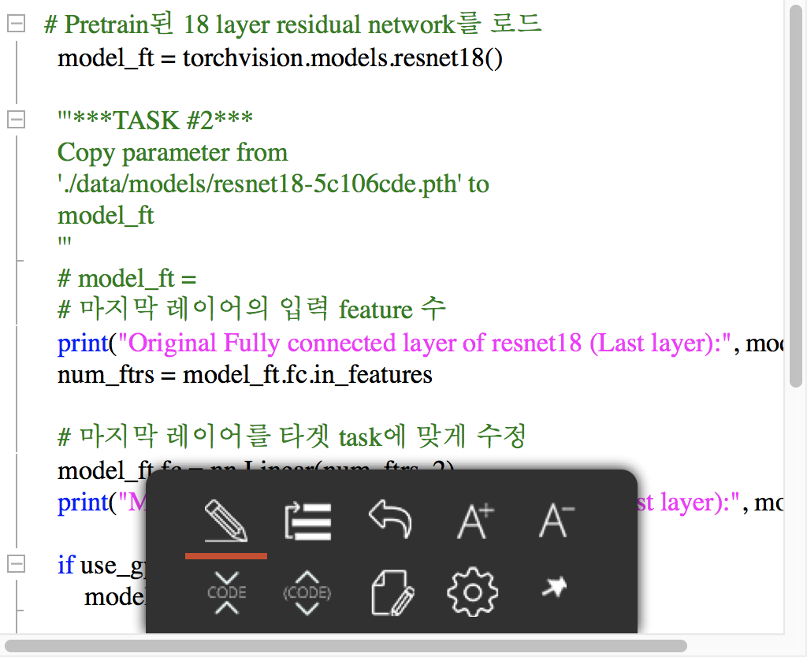
Answer
2.1 Copy parameter from './data/models/resnet18-5c106cde.pth' to model_ft
2.2 Define SGD Optimizer

Slide 11
Finetuning & evaluation
18 layer ResNet

Slide 12
Pre-trained Model
18 layer ResNet

Slide 13
Pre-trained model as a feature extractor

Slide 14
dd
dd

Slide 15
Thank you
For your attention!!!
(Q & A)
hisuk (AT) korea.ac.kr
http://www.ku-milab.org

