Slide 1

Practice #1 Perceptron & Feed-Forward Neural Networks
[SKT AI Course: Deep Learning Basics]
Heung-Il Suk
hisuk@korea.ac.kr
http://www.ku-milab.org
Department of Brain and Cognitive Engineering,
Korea University
September 00, 2017

Slide 2
Contents
Rosenblatt’s Perceptron with Vanilla Gradient Descent
Widrow-Hoff’s Perceptron with Vanilla Gradient Descent
Widrow-Hoff’s Perceptron with Stochastic Gradient Descent
Feed-Forward Neural Network

Slide 3
Rosenblatt’s Perceptron with Vanilla Gradient Descent

Slide 4
Rosenblatt’s Perceptron Conceptual Diagram

Slide 5
Class Perceptron
Class Variables
eta : perceptron’s learning rate
epochs : Number of epochs to train
weights : Perceptron's weight variables, a numpy ndarray
errors : Number of wrong prediction, a python list
Class Methods
__init__(self, eta=0.01, epochs=10) : initialize Perceptron with learning rate and training epochs
fit(self, X, y) :
training perceptron with training data X and label y for number of epochs
X: {array-like}, shape=[num_samples, num_features]
y : {array-like}, shape=[num_samples]
net_input(self, X) : provide data to perceptron and return perceptron's output before activation
predict(self, X) : return perceptron's prediction

Slide 6
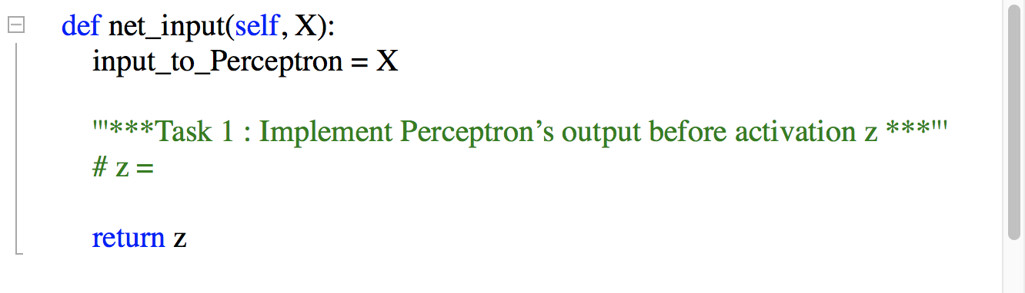

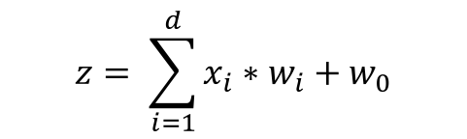
Implement major methods of Class Perceptron (1)
Task : Implement Perceptron's output z before activation in net_input(self, X)
$$z= \sum_{i=1}^{d}{x_{i}∗w_{i}}+w_{0}$$

Slide 7
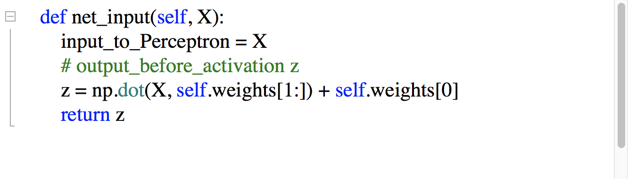
Answer
Task : Implement Perceptron's output z before activation in net_input(self, X)
$$z= \sum_{i=1}^{d}{x_{i}∗w_{i}}+w_{0}$$

Slide 8
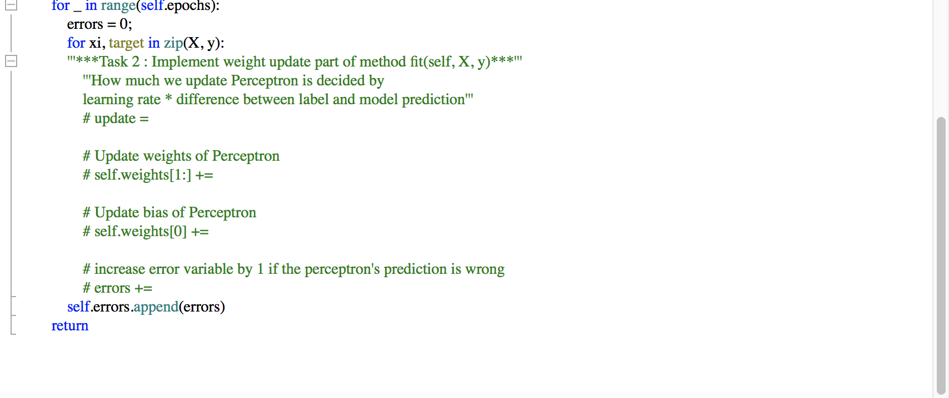
Implement major methods of Class Perceptron (2)
Task : Implement weight update part of method fit(self, X, y)

Slide 9
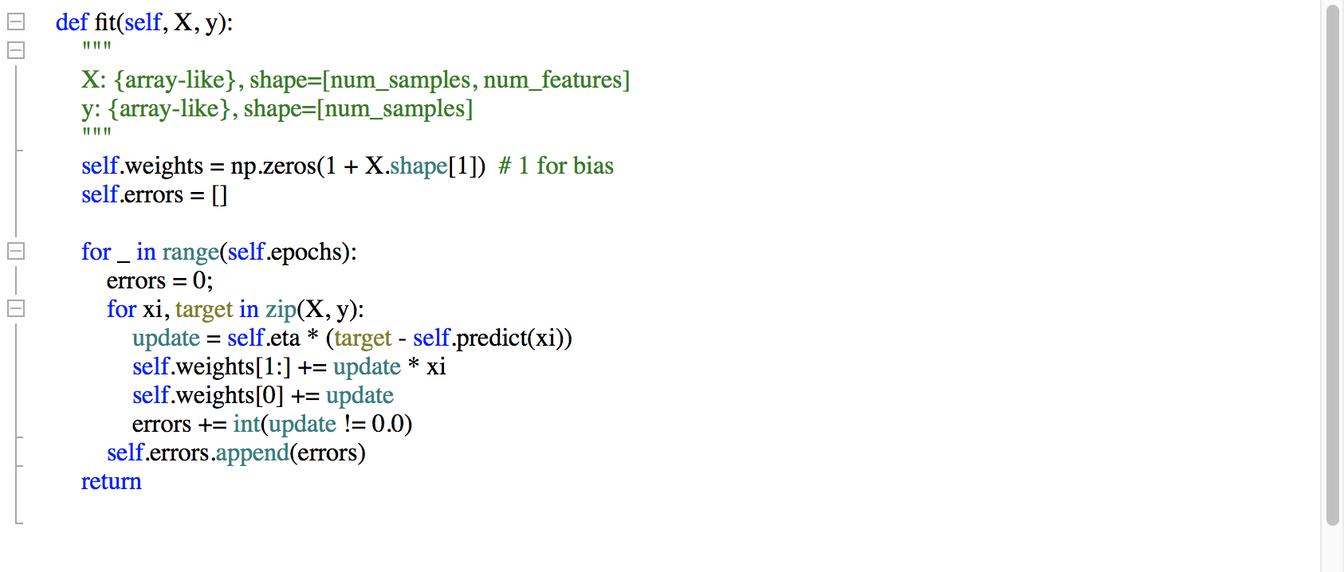
Answer
Task : Implement weight update part of method fit(self, X, y)

Slide 10
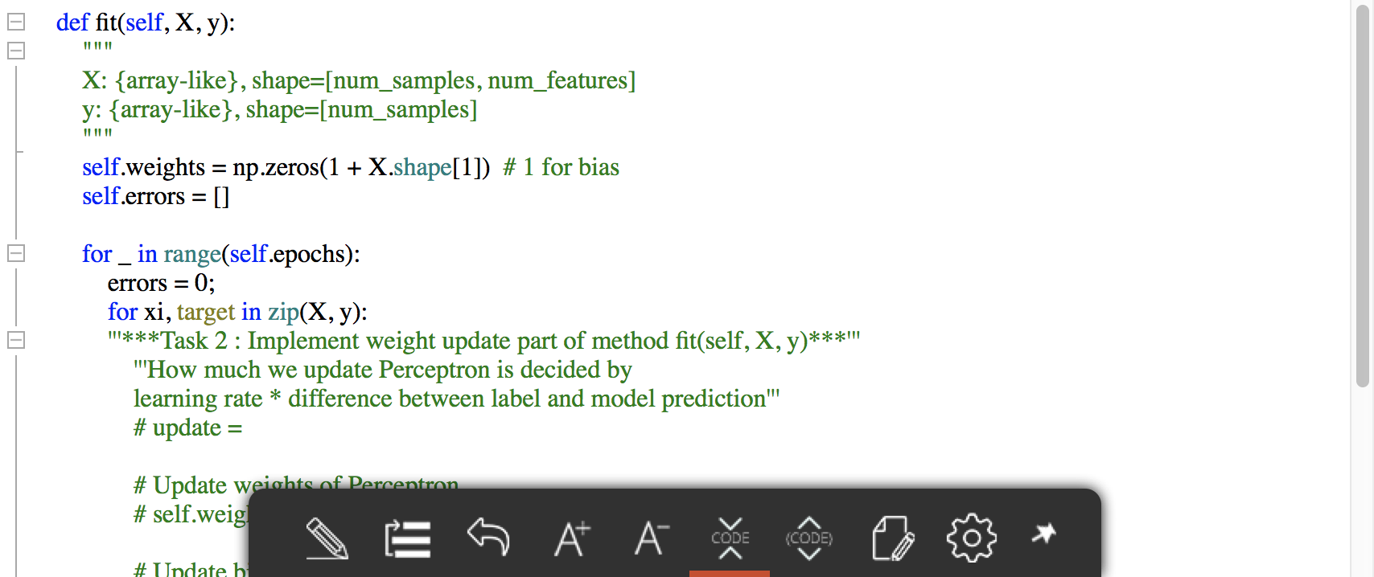
Training
Task : Implement weight update part of method fit(self, X, y)

Slide 11
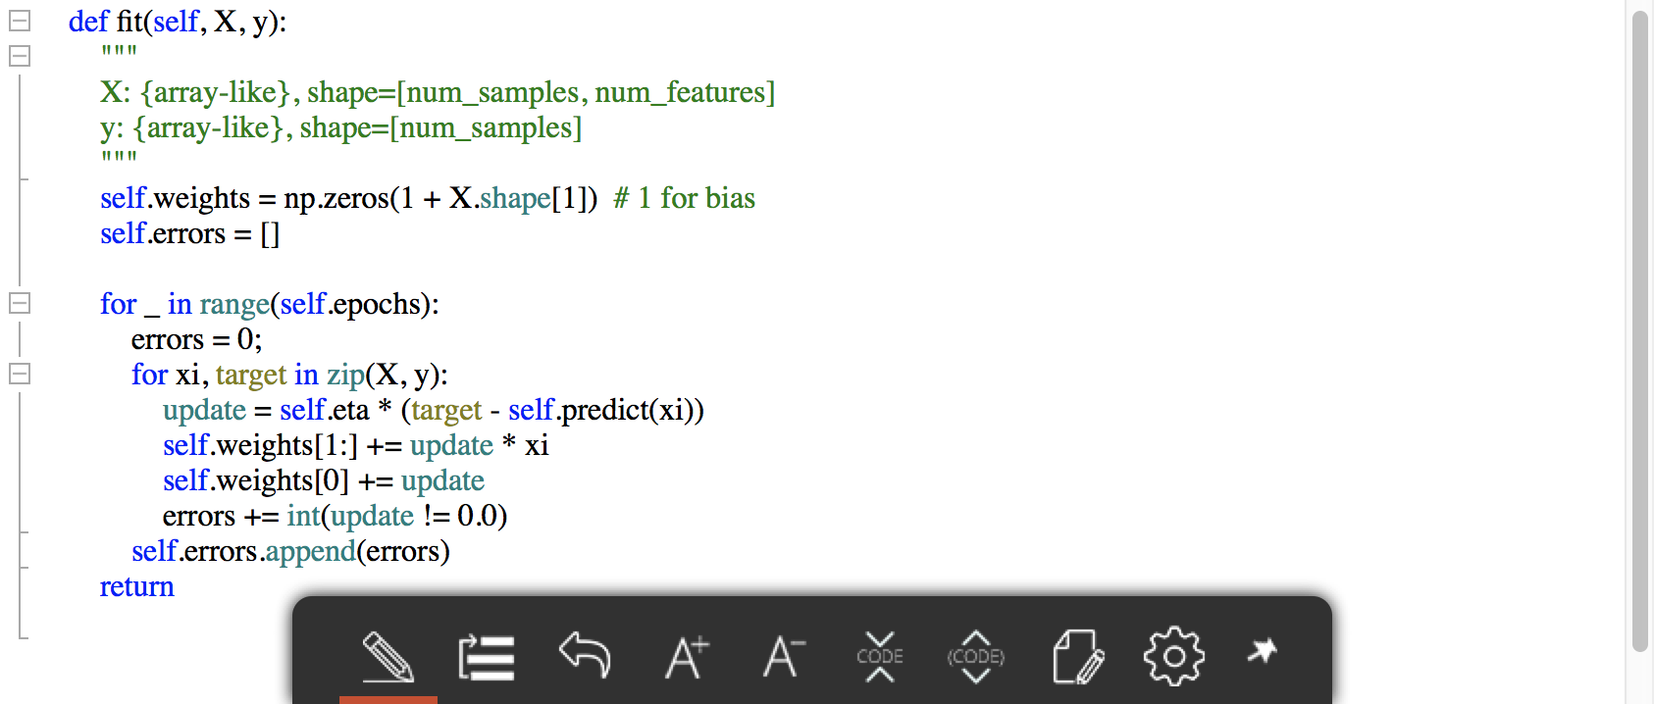
Answer
Task : Implement weight update part of method fit(self, X, y)

Slide 12
Thank you
For your attention!!!
(Q & A)
hisuk (AT) korea.ac.kr
http://www.ku-milab.org

