Slide 1

Practice #4: Transfer Learning Fine-tuning, Pre-trained Model as Feature Extractor
[SKT AI Course: Deep Learning Basics]
TA: Jun-Sik Choi & Jee-Seok Yoon
Instructor: Heung-Il Suk
hisuk@korea.ac.kr
http://www.ku-milab.org
Department of Brain and Cognitive Engineering,
Korea University
September 20, 2017

Slide 2
Contents
Fine-tuning Pre-trained Model
Pre-trained Model as a Feature Extractor

Slide 3
Fine-tuning Pre-trained Model

Slide 4
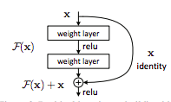
Pre-trained Model
18-layer ResNet
Originally Trained with ImageNet with 1,000 Classes
Use residual connection for efficient training and better performance
Top-1 error on ImageNet validation: 27.88%
For detailed architecture → Pretrained_ResNet_Structure
We will fine-tune this model to classify Bee/Ant (two Classes, not included in ImageNet)
Figure 1. Residual connection

Slide 5
torchvision.transforms
Torchvision provides simple ways to transform images and tensors.
transforms.Compose : Composes transforms together
transforms.Scale : Rescale the input PIL.Image to the given size.
transforms.CenterCrop : Crops the given PIL.Image at the center.
transforms.RandomCrop : Crop the given PIL.Image at a random location.
transforms.RandomSizedCrop : Crop the given PIL.Image to random size and aspect ratio.
transforms.Pad : Pad the given PIL.Image on all sides with the given “pad” value.
transforms.Normalize : Normalize an tensor image with mean and standard deviation.
transforms.ToTensor : Convert a PIL.Image or numpy.ndarray to tensor.
transforms.ToPILImage : Convert a tensor to PIL Image. → You can apply several transformations together to given dataset using Compose

Slide 6
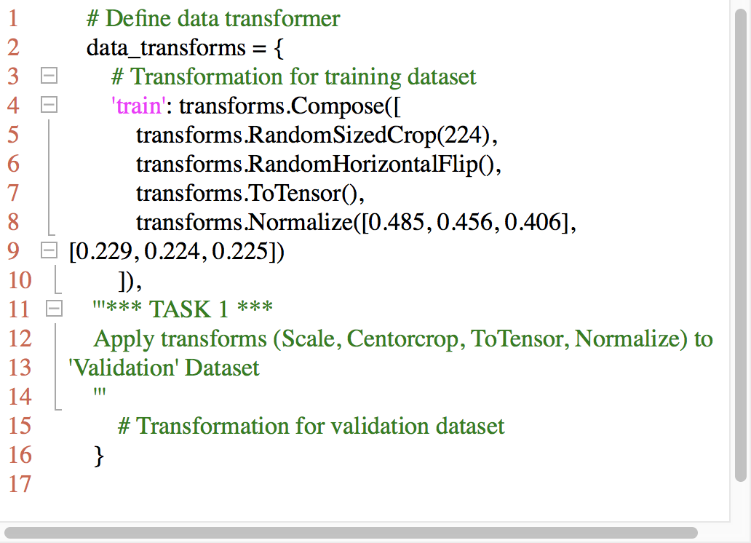
Task #1 data_load.py
Apply transforms (Scale, Centorcrop, ToTensor, Normalize) to 'Validation' Dataset
Scale Image to size 256 x 256 x 3
Centercrop Image to size 224 x 224 x 3
Transform Image to Tensor
Normalize Tensor
Mean : [0.485, 0.456, 0.406]
Std : [0.229, 0.224, 0.225]

Slide 7
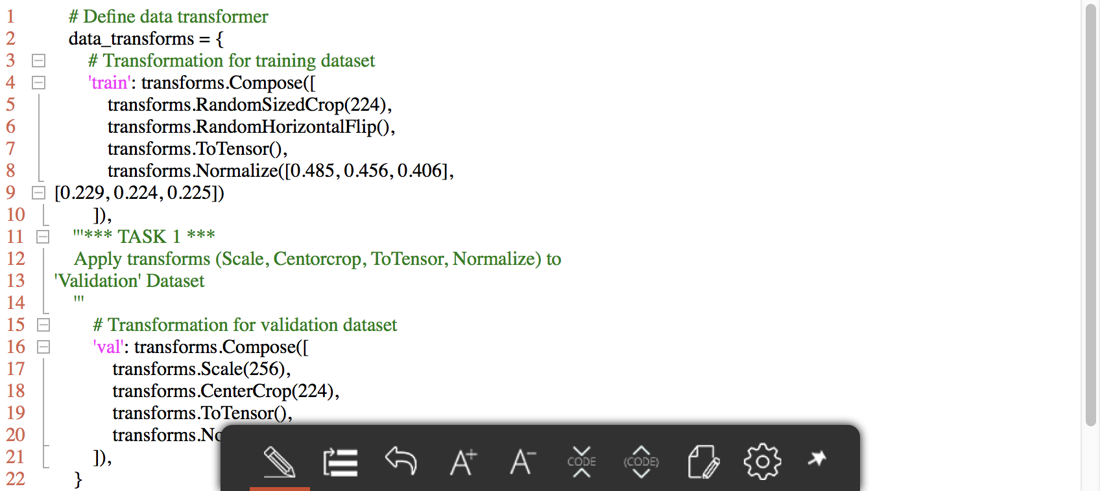
Answer

Slide 8
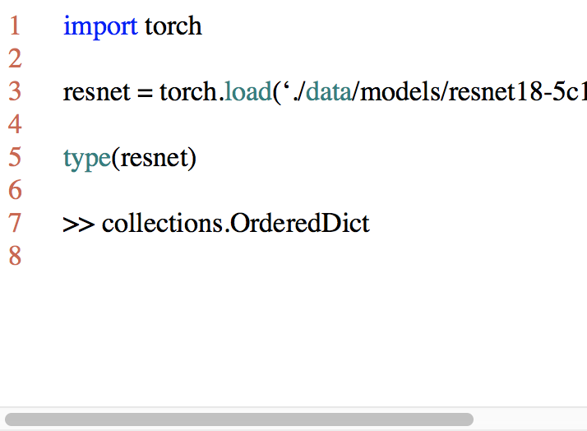
Load and modify model
load_state_dict(state_dict)
Copies parameters and buffers from state_dict into this module and its descendants.
The keys of state_dict must exactly match the keys returned by this module’s state_dict() function.
→ loaded model is an Ordered Dictionary.

Slide 9
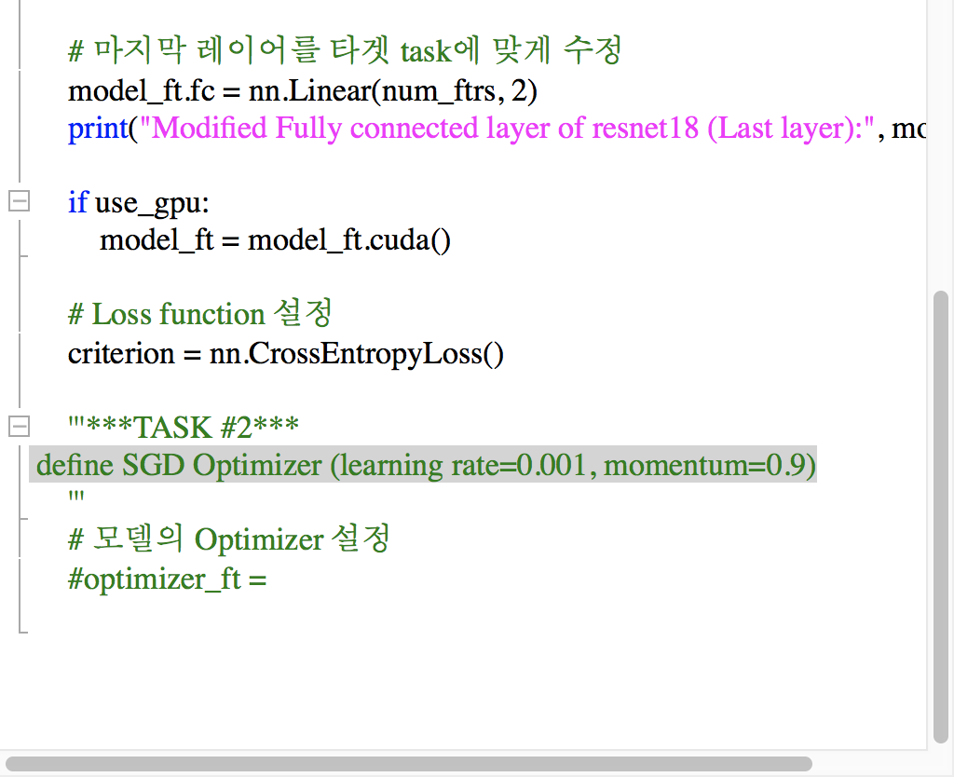
Task #2 finetuning.py
Task 2.1 Using load_state_dict, Copy parameters from './data/models/resnet18-5c106cde.pth' to model_ft
** Check How we change the last layer (fully connected layer) of the pre-trained model.
Task 2.2 Define SGD Optimizer
Learning rate = 0.001
momentum = 0.9

Slide 10
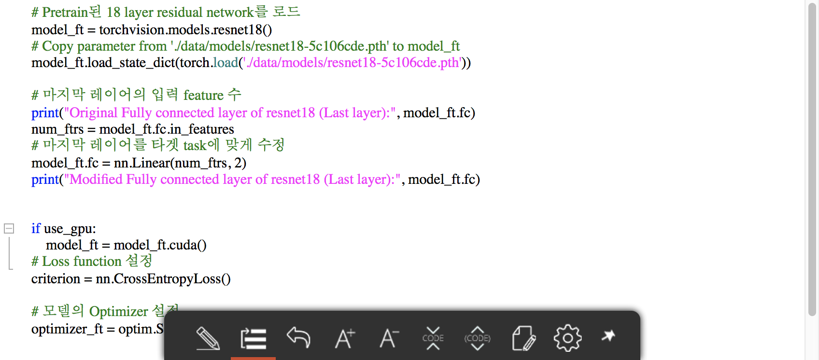
Answer

Slide 11
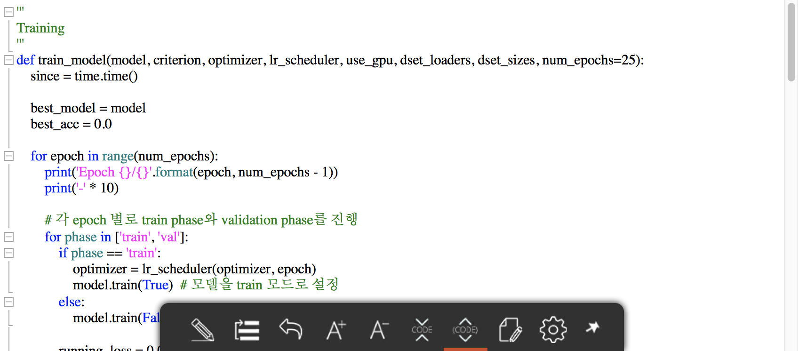
Train_model

Slide 12
Task #3
Task 3.1 Read train_model() and exp_lr_scheduler() in functions.py
Task 3.2 Write your own codes to train model_ft in finetuning.py

Slide 13
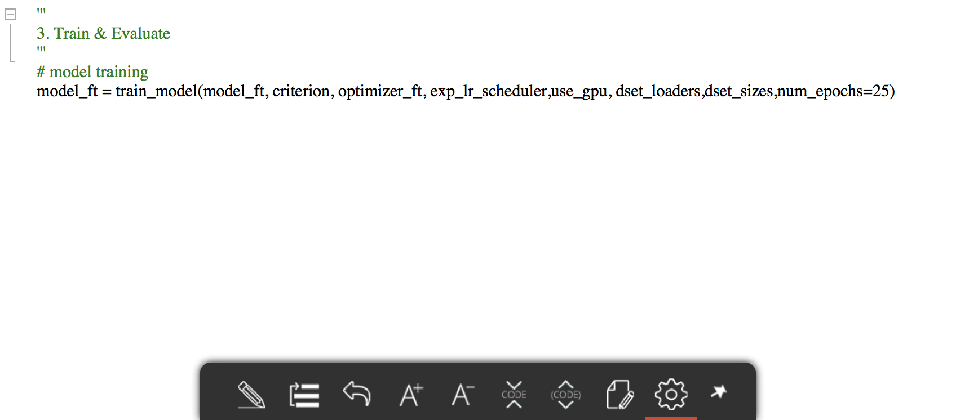
Answer

Slide 14
Fine-tuning & evaluation
Comment
#from feature_extractor import feature_extract
#feature_extract()
Run main.py
Check the model predict well on new tasks (Bee / Ant Classification)

Slide 15
Pre-trained Model as a Feature Extractor

Slide 16
Use ResNet as Feature Extractor
This time, we will use ResNet-18 as a feature extractor.
Not fine-tuning existing model, we freeze the ResNet-18 except the last layer..
The pre-trained model only act as a feature extractor.
The last layer (fully-connected layer) is the only layer to be trained.

Slide 17
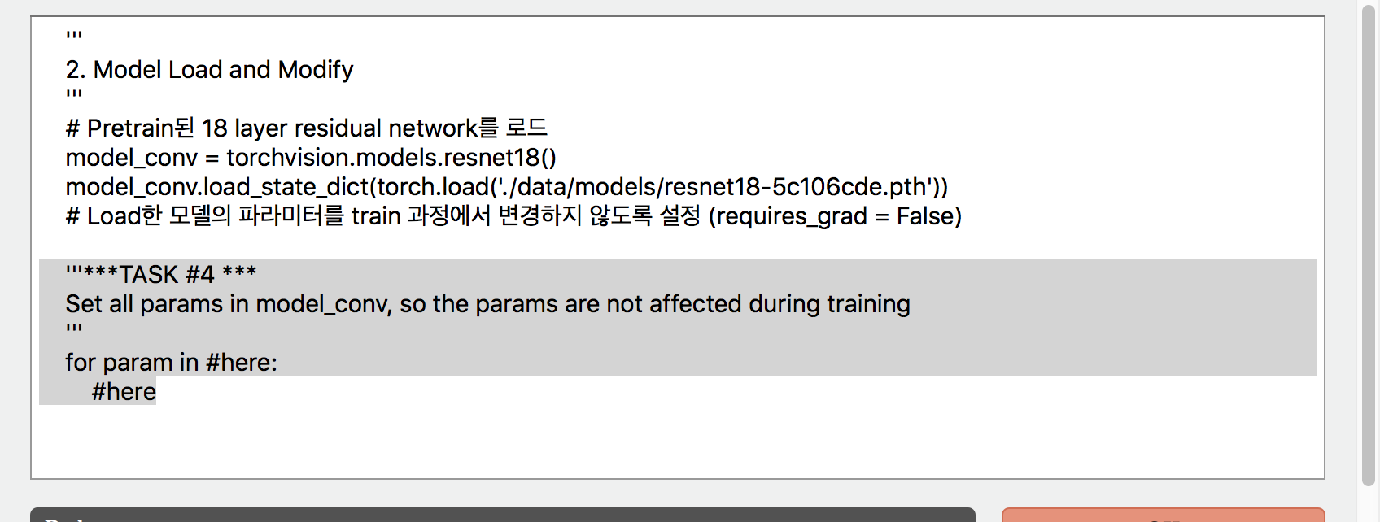
Task #4 feature_extractor.py
If requires_grad = False for a certain parameter, the parameter is not affected during backpropagation.
You can see the parameters of the model through model.parameters()

Slide 18
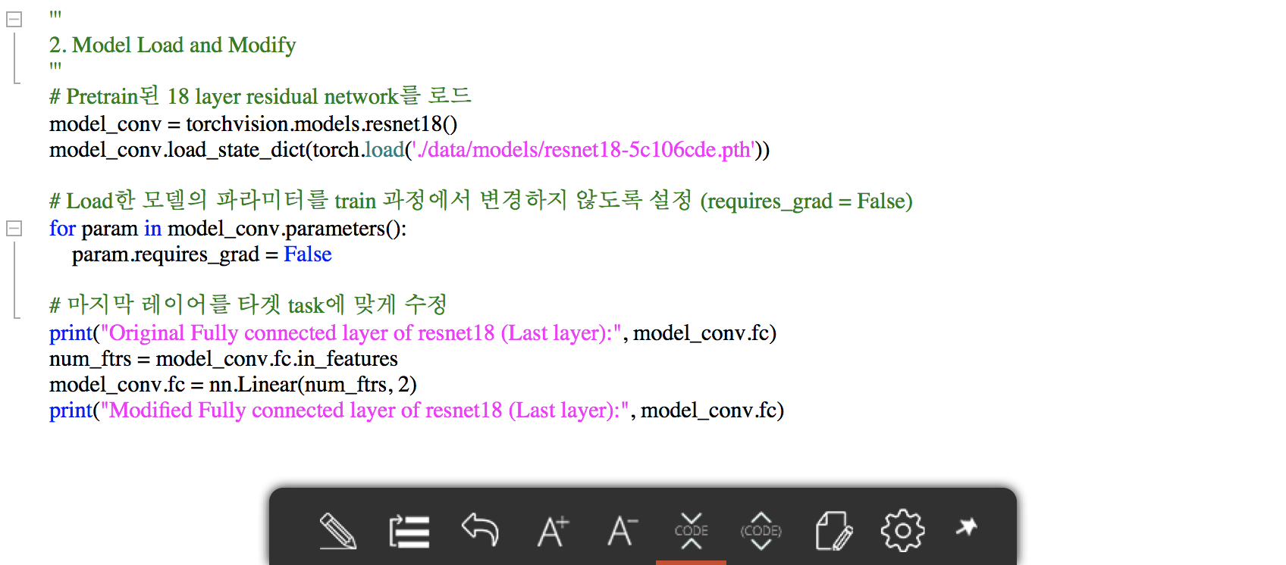
Answer

Slide 19
Training the last layer
Comment
#finetuning()
Run main.py
Check the model predict well on new tasks (Bee / Ant Classification)

Slide 20
Thank you
for your attention!!!
(Q & A)
hisuk (AT) korea.ac.kr
http://www.ku-milab.org

