Slide 1

Practice #5: Generative Adversarial Network
[SKT AI Course: Deep Learning Basics]
TA: Jun-Sik Choi & Jee-Seok Yoon
Instructor: Heung-Il Suk
hisuk@korea.ac.kr
http://www.ku-milab.org
Department of Brain and Cognitive Engineering,
Korea University
September 21, 2017

Slide 2
Generative Adversarial Network
Notes:
Vector → Matrix! That’s it!

Slide 3
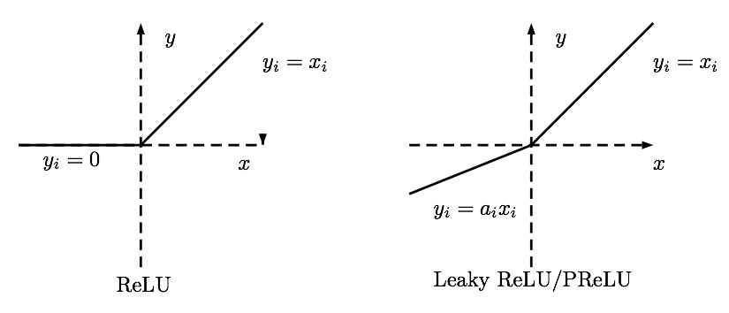
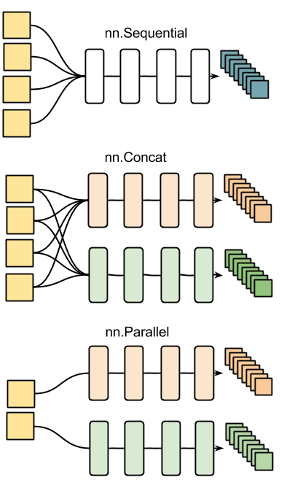
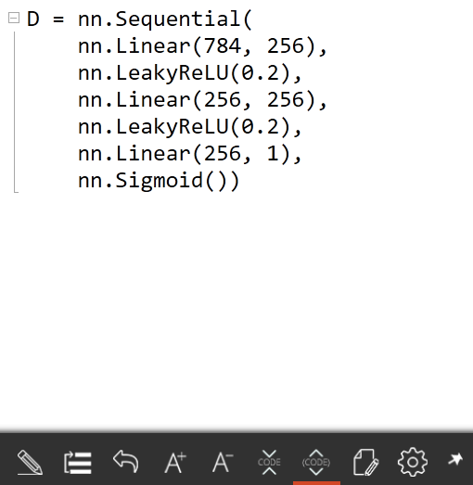
Overview of Discriminator Model

Slide 4
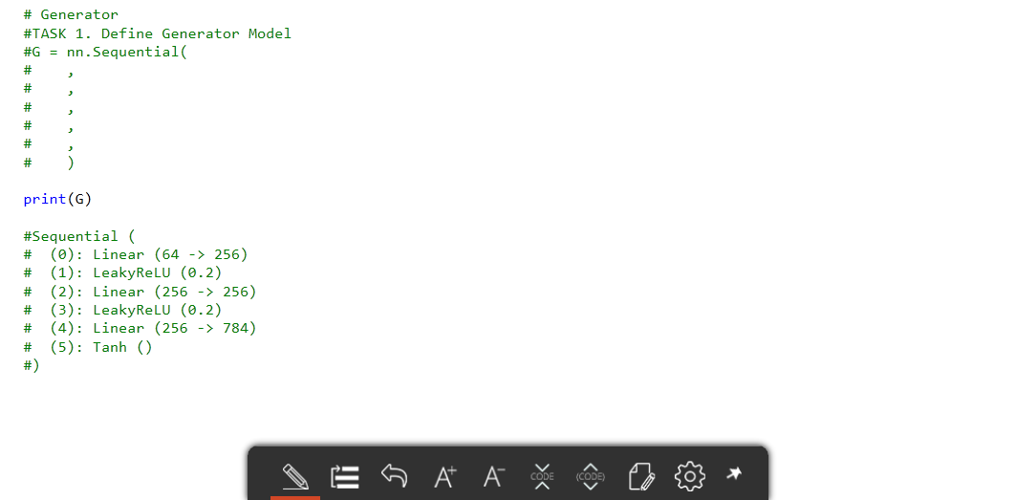
Implement major methods of GAN
Task 1: Define Generator Model

Slide 5
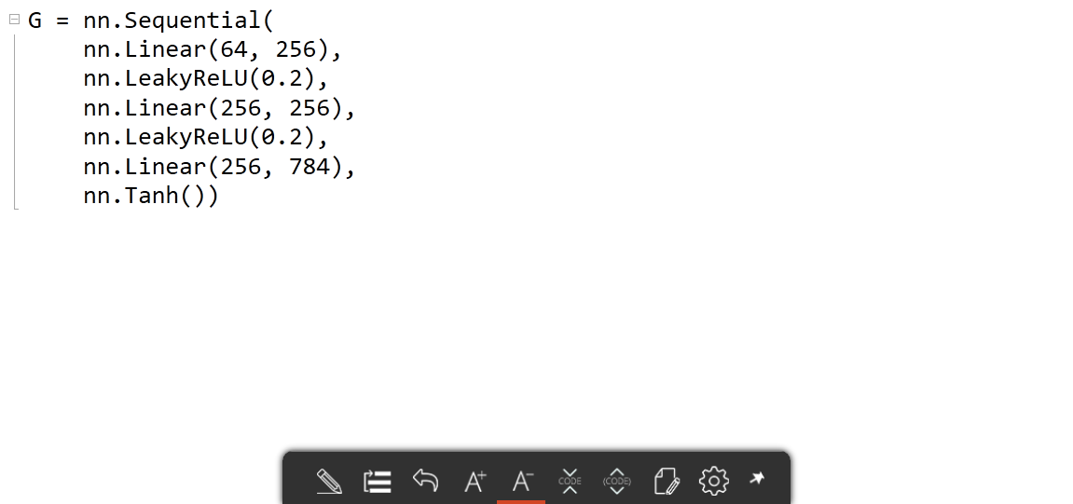
Answer
Task 1: Define Generator Model

Slide 6
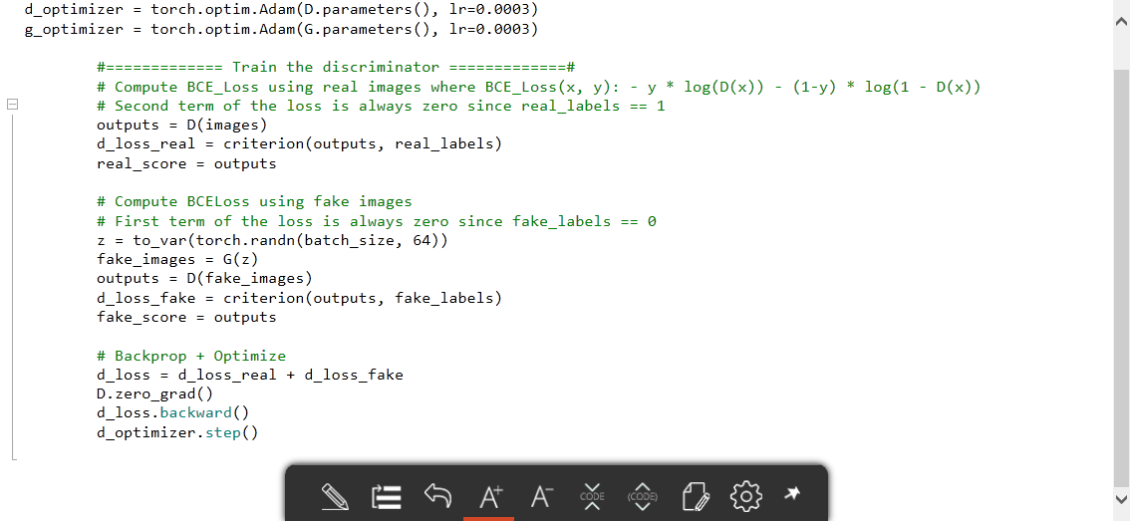
Overview of Training a Discriminator Model

Slide 7
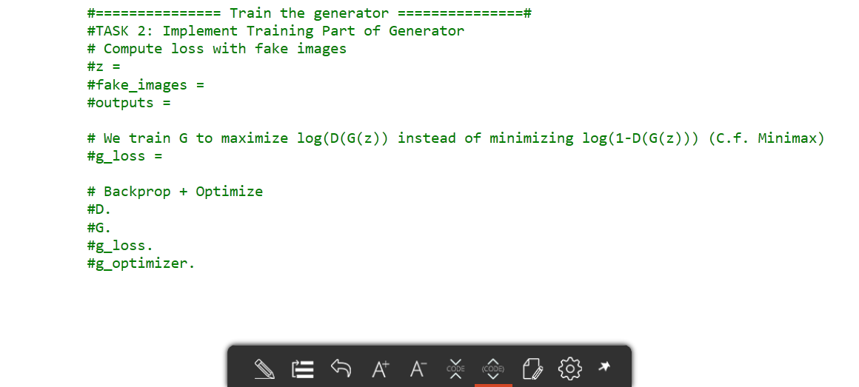
Implement major methods of GAN
Task 2: Implement Training Part of Generator

Slide 8
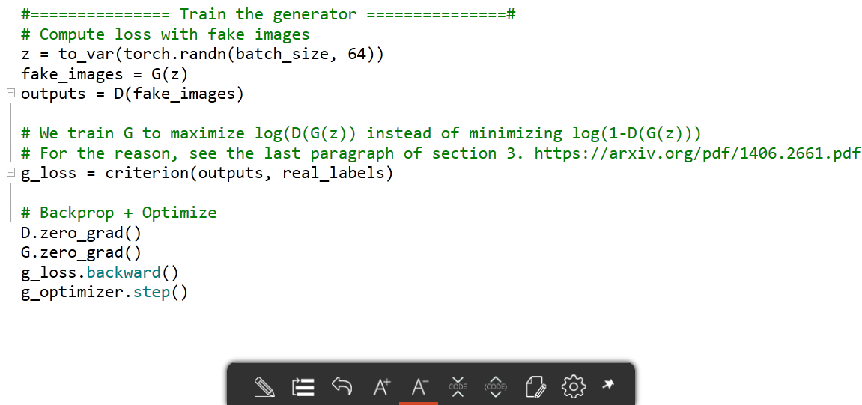
Answer
Task 1: Define Generator Model

Slide 9
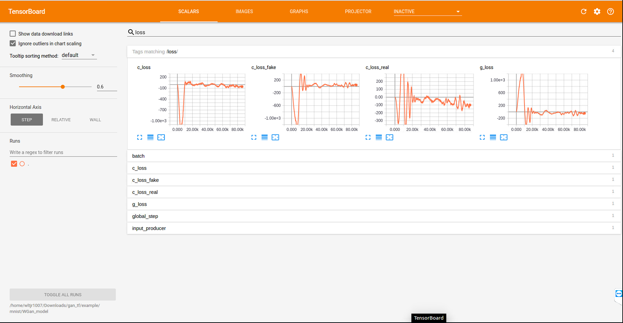
Tensorboard
tensorboard –logdir=‘path’
tf.summary.scalar
tf.summary.images
….
T-FMI 와이파이 환경에서
http://172.23.249.90:6006
접속
Notes:
Vector → Matrix! That’s it!

Slide 10
Thank you
for your attention!!!
(Q & A)
hisuk (AT) korea.ac.kr
http://www.ku-milab.org

