Slide 1
Hate Speech & Toxicity Detection
An End-to-End NLP Classification System
Jerin Pious • Evan Tomy | Advanced Machine Learning | Conestoga College

Slide 2
Agenda
01
The Problem
02
Dataset & Approach
Scale of online toxicity and why current approaches fail
Jigsaw dataset and DistilBERT-based ML pipeline
03
System & Deployment
04
Timeline & Outcomes
End-to-end architecture and AWS cloud infrastructure
8-week roadmap and expected deliverables
02

Slide 3
The Scale of Online Toxicity
4.76B
500M+
41%
Social media users globally [1]
Tweets sent per day [2]
Americans experienced online harassment [3]
Existing approaches consistently fail because they lack linguistic depth.
We need advanced ML to detect hate speech at scale.
03

Slide 4
Why Current Approaches Fall Short
Keyword Filters
Classic ML (TF-IDF)
Miss context, sarcasm, and coded language. Cannot adapt to evolving online discourse.
No semantic understanding. High false-positive rates make them impractical for production.
Rule-Based Systems
Manual Moderation
Brittle and easily bypassed with slang or spelling variations. Require constant manual updates.
Impossible at scale. Causes moderator burnout and inconsistent enforcement.
04

Slide 5
Who Benefits
Social Platforms
Brands & Advertisers
Automate real-time content moderation at scale across Reddit, Twitter, YouTube
Protect brand safety by screening user-generated content before publication
Developers & Researchers
Regulators & NGOs
REST API for integrating toxicity detection into any application
Compliance with EU Digital Services Act and Canada's Online Harms Act
05

Slide 6
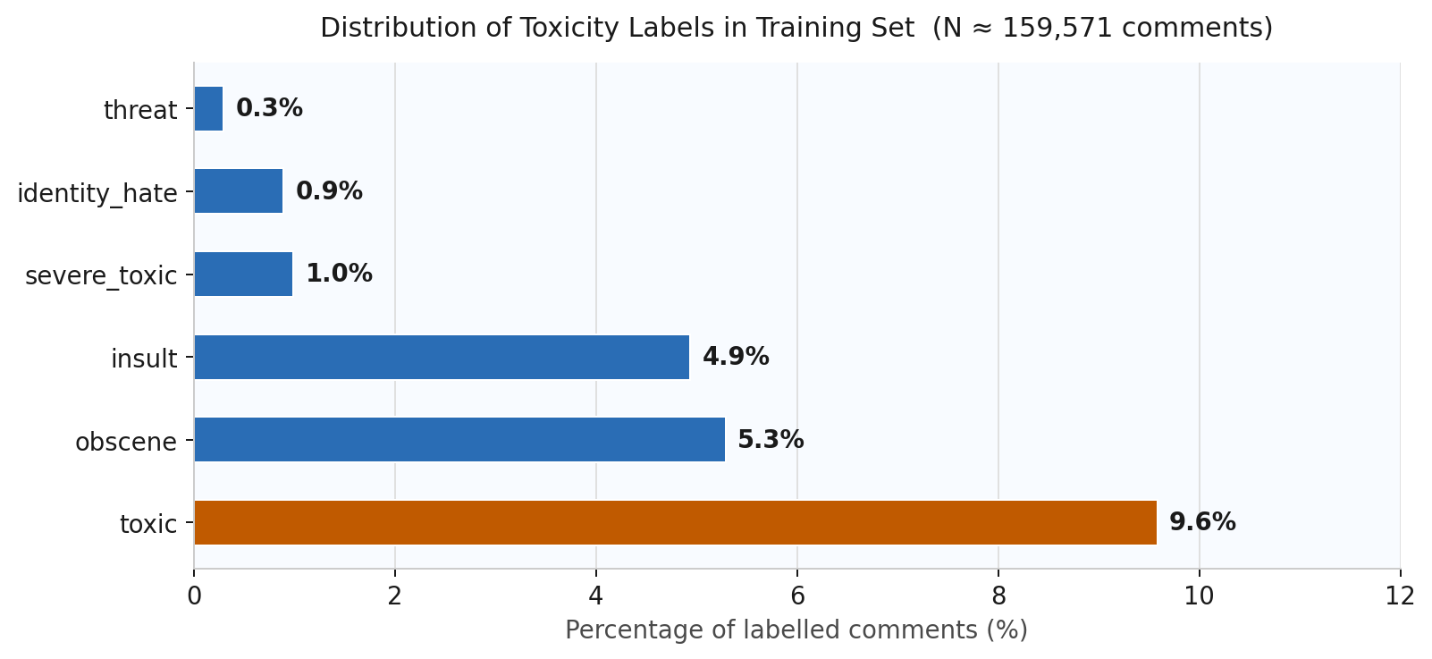
Jigsaw Toxic Comment Dataset [4]
~160,000
Labeled Wikipedia comments
6 Labels
toxic, severe_toxic, obscene, threat, insult, identity_hate
~90%
Non-toxic comments — mitigated via class-weighted loss, back-translation augmentation & synthetic data generation
CC0
Fully open for research use
06

Slide 7
Our ML Approach
Key Advantages
PRIMARY MODEL
DistilBERT
40%
Smaller
Fine-tuned for multi-label classification with a sigmoid output head. Selected for its 40% smaller size and 60% faster inference speed, making it the right fit for free-tier deployment on a 1GB RAM instance [5]
Fewer parameters than BERT-base (67M vs 110M)
60%
Faster
Inference speed advantage over BERT-base
BASELINES FOR COMPARISON
B1 TF-IDF + Logistic Regression
B2 LSTM + GloVe embeddings
6-Label
Output
Multi-label sigmoid head for 6 toxicity classes
07

Slide 8
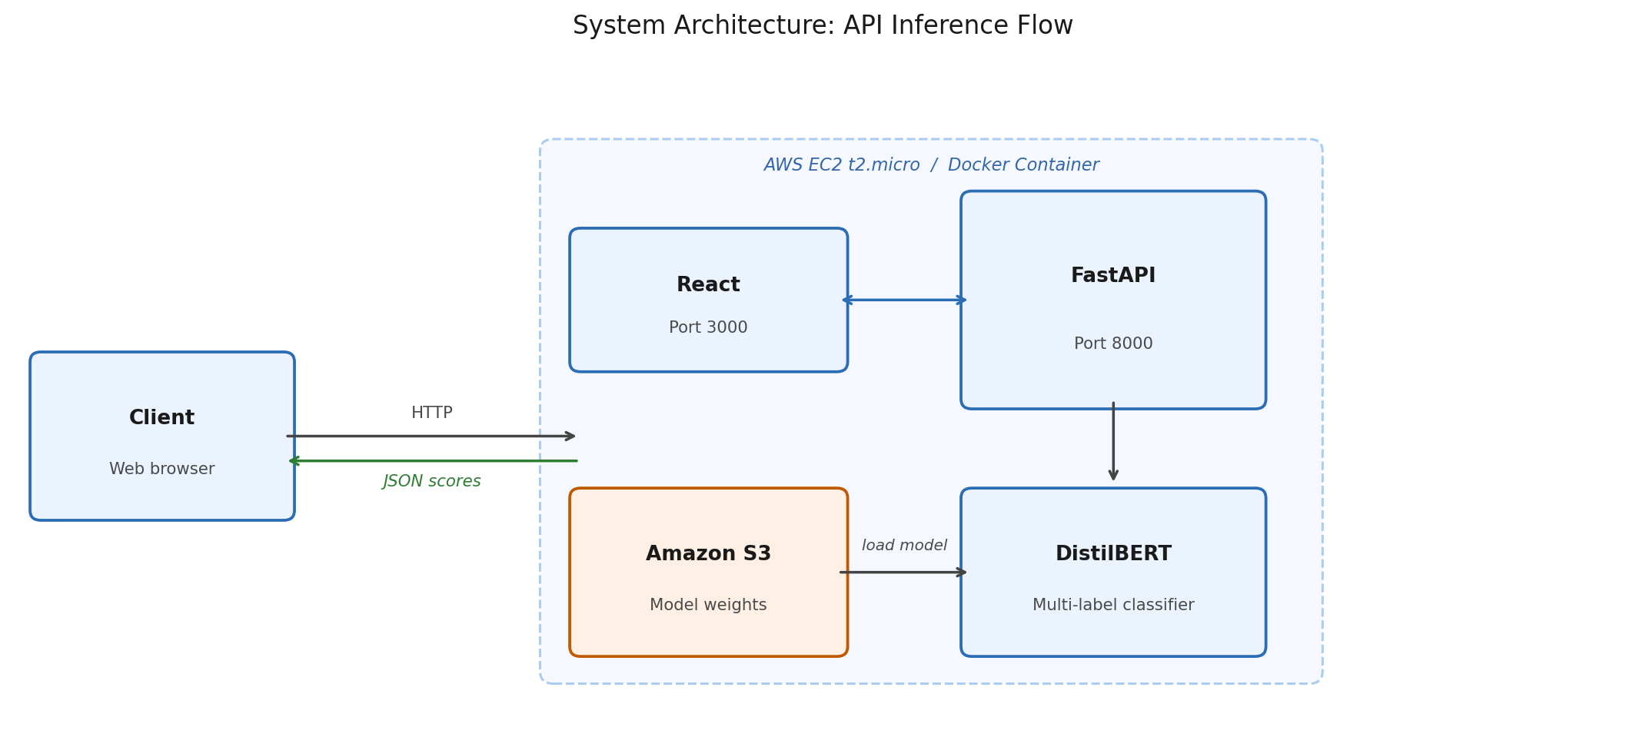
System Architecture
08

Slide 9
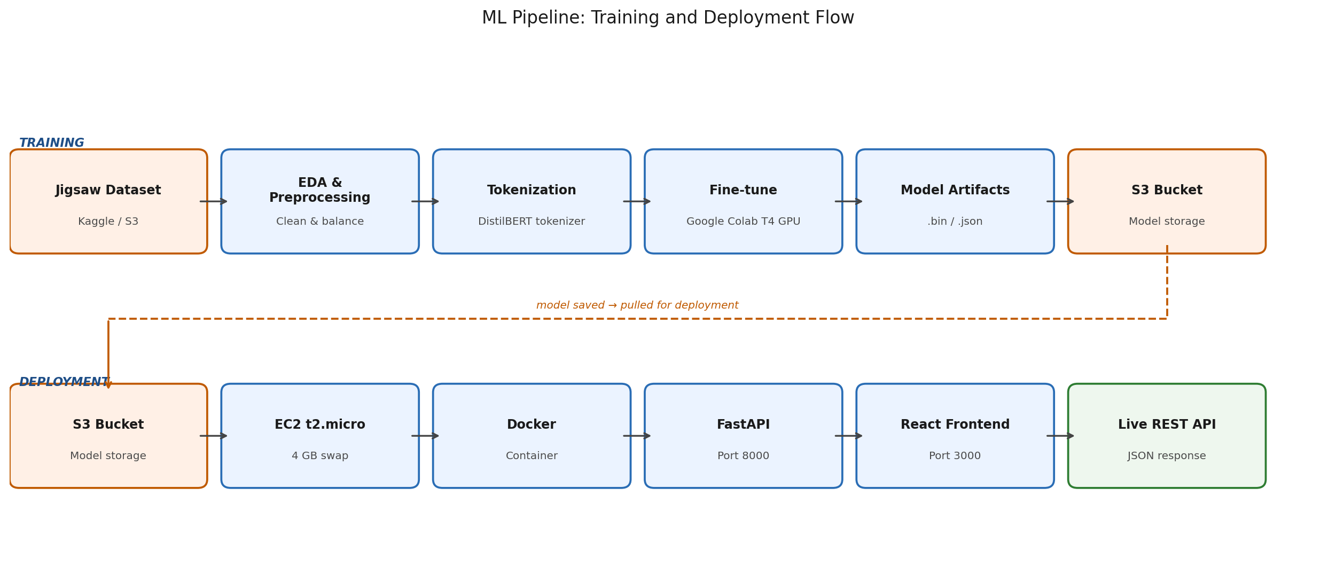
ML Pipeline
09

Slide 10
AWS Cloud Deployment
Amazon S3
Google Colab
AWS EC2 t2.micro
Dataset storage & model artifacts
Free T4 GPU for model training
Free tier hosting, always-on
4GB Swap Partition
Docker
React Frontend
Prevents OOM faults on 1GB RAM
Containerized deployment on EC2
Served directly from EC2
10

Slide 11
Team Workflow & Project Management
Version Control
Task Management
GitHub (Private Repository)
Feature-branch workflow to ensure no direct commits to main
Pull request + peer review required before merge GitHub issues will be used to track bugs and assign tasks.
GitHub Projects (Kanban Board)
To Do → In Progress → Review / QA → Done
Weekly sprint planning at start of each lab session
Task owners tracked per milestone
Communication
Team Responsibilities
Synchronous
Weekly in-person meetings during lab sessions or other scheduled Times
Asynchronous
WhatsApp group — daily updates and quick decisions
Jerin Pious
Model architecture · DistilBERT fine-tuning · SHAP · evaluation
Evan Tomy
Data pipeline · EC2 · Docker · FastAPI backend · React frontend
11

Slide 12
8-Week Development Timeline
Jun 23 – Aug 17, 2026 · Course Weeks 7–14
Wk 1–2
Proposal & Setup
Project proposal, setup, dataset acquisition, GitHub repo setup
Wk 3–4
Data Pipeline
EDA, preprocessing, tokenization, baseline models
Wk 5–6
Modeling
Fine-tune DistilBERT on Google Colab, export weights to S3
Wk 7
Optimization
SHAP explainability, threshold tuning, error analysis
Wk 8
Deployment & Final Delivery
EC2/FastAPI/React live · Full report, demo video, final presentation
12

Slide 13
Expected Outcomes
ROC-AUC > 0.95
Live REST API
Explainable AI
Matching the Jigsaw competition standards
Deployed on AWS EC2 free tier
SHAP token-level attributions for model interpretability
13

Slide 14
References
[1] DataReportal. (2023). Digital 2023: Global Overview Report. https://datareportal.com/reports/digital-2023-global-overview-report
[2] Internet Live Stats. (2023). Twitter Usage Statistics. https://www.internetlivestats.com/twitter-statistics/
[3] Anti-Defamation League. (2021). Online Hate and Harassment: The American Experience 2021 — 41% of Americans experienced online harassment. https://www.adl.org/resources/report/online-hate-and-harassment-american-experience-2021
[4] Kaggle / Google Jigsaw. (2018). Toxic Comment Classification Challenge Dataset (CC0). https://www.kaggle.com/c/jigsaw-toxic-comment-classification-challenge
[5] Sanh, V., Debut, L., Chaumond, J., & Wolf, T. (2019). DistilBERT, a distilled version of BERT: smaller, faster, cheaper and lighter. arXiv:1910.01108. https://arxiv.org/abs/1910.01108
15

Slide 15
Thank You
Questions & Discussion
Jerin Pious • Evan Tomy | Advanced Machine Learning | Conestoga College

