Slide 1

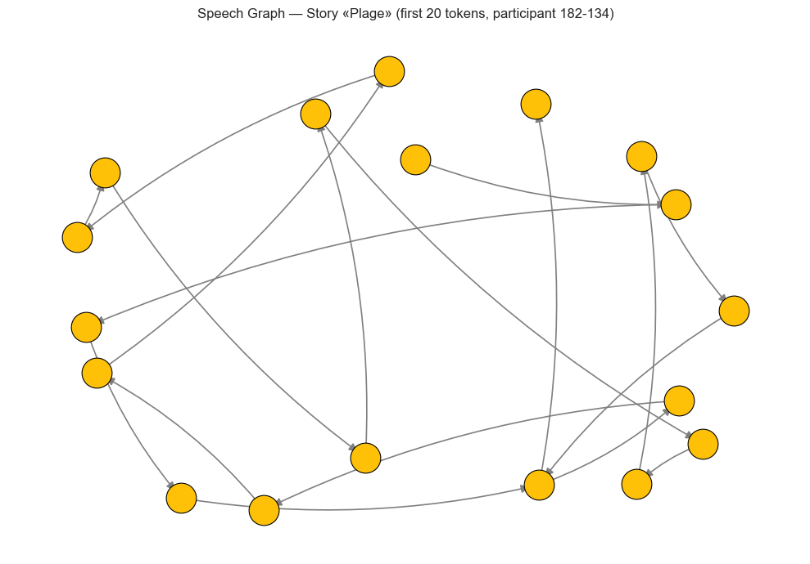
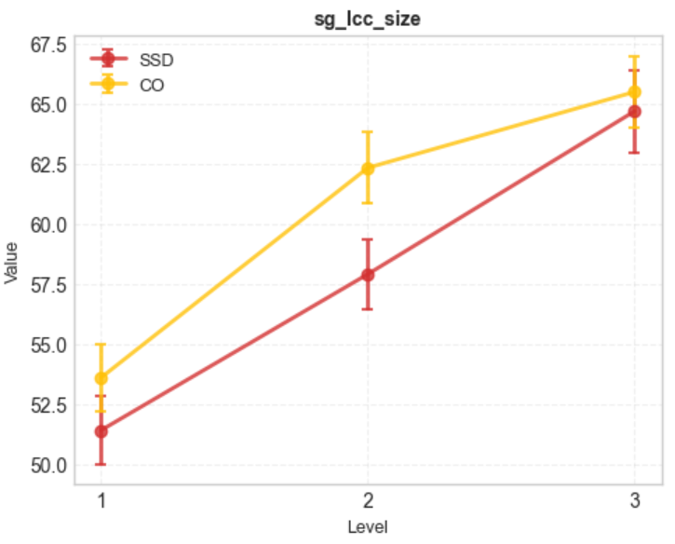

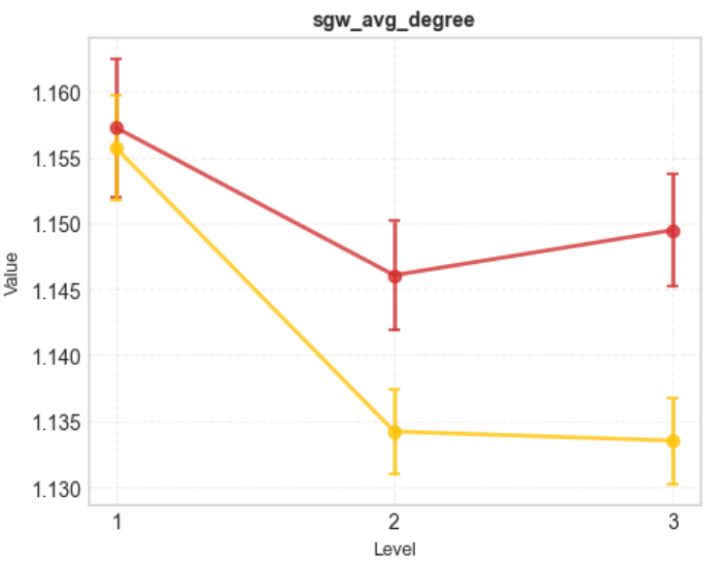
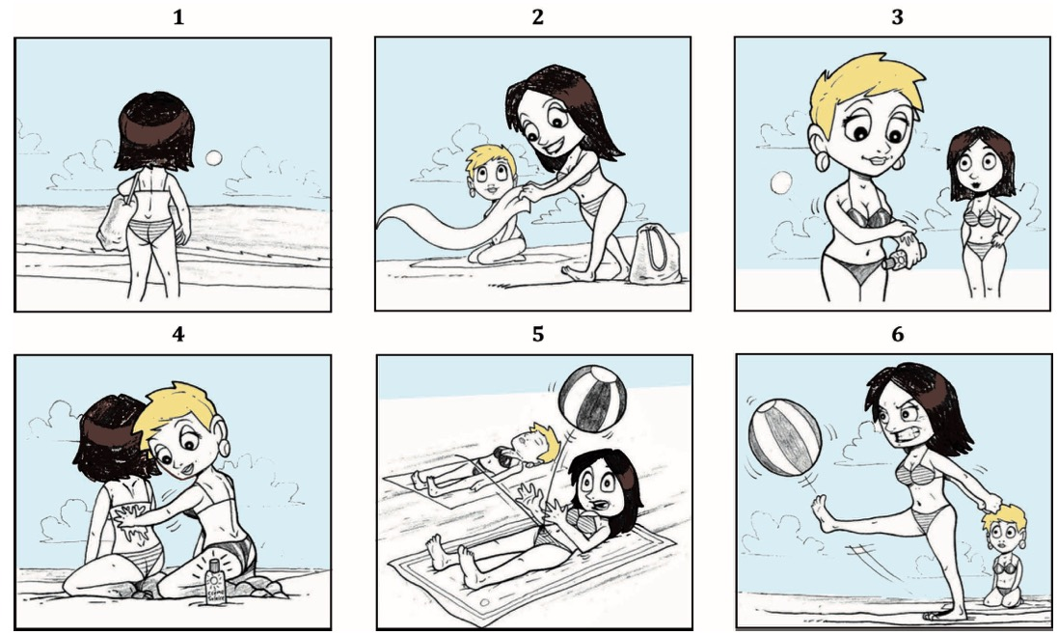
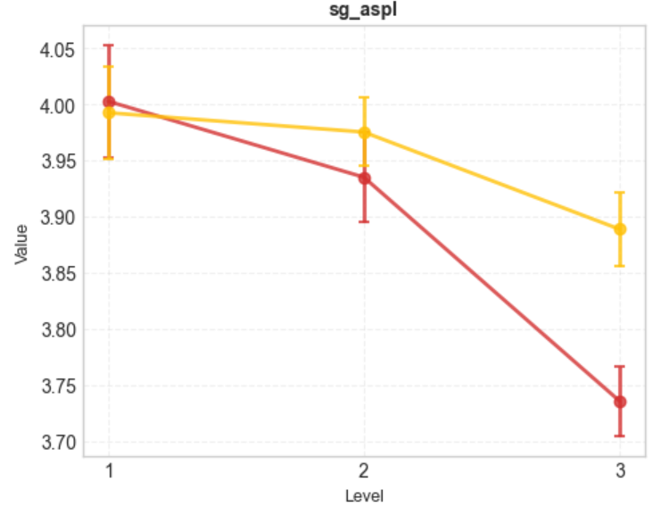




Modeling empathy in multi-agent reinforcement learning: an AI tool to study sustainability in common-pool resource dilemmas
Evann Rabeau^{1,2,3,*}, Jérôme Iste⁴
¹Université Laval, Canada; ² VITAM – Centre de recherche en santé durable, Canada; ³Centre de recherche CERVO, Canada; 4 Institut des systèmes intelligents et robotique
Introduction
SpeechGraph Method
Individuals with schizophrenia spectrum disorder (SSD) exhibit a range of cognitive and behavioral impairments, including frequent challenges with language production.
language impairments have been linked to poorer functioning in people with SSD.
Characterizing these difficulties is therefore key to understanding the disorder, yet language disturbances remain difficult to quantify objectively.
While previous research studied language disturbances of individual with SSD using SpeechGraph, no study has used this method during natural yet controlled verbal exchanges.
OBJECTIVE:
To determine whether increasing narrative complexity differentially impacts the structural organization of speech in individuals with schizophrenia spectrum disorders (SSD) during a joint task
PROCESSING SCHEME FOR THE STST DATA
Transcription of the interaction
Segmentation of the verbatim in individual words
Application of the SpeechGraph method on the verbatim (Mota, 2014)
“ok → so → there → is → a → a → women → from → behind → who → looks → at → a → towel”
there
is
a
$$\text{Edges}\text{ : }\text{E}$$
$\text{N}\text{odes}\text{ : }$V
Average Degree = $\overline{k}= \frac{2 |E|}{|V|}$
Largest Strongly Connected Component = $|V_{\left\{LSCC\right\}}|$
ASPL = $\frac{1}{(\left|V_{LCC}\right| \left(\left|V_{LCC}\right| −1 \right)}\sum_{u ≠v}{d(u,v)}$
  Methods
Results
PARTICIPANTS
51 participants with SSD
Diagnoses: Schizophrenia, schizoaffective disorder, delusional disorder, psychosis NOS, brief psychotic disorder, schizophreniform disorder
68 community controls
Largest Strongly Connected Component
Number of nodes in the largest strongly connected component (directed). Meaning, how many nodes are reachable following the oriented edges only in the intended direction. Reflects how much of the vocabulary is reachable through word transitions
THE STORYTELLING IN SEQUENCE TASK (STST; Fossard et al. 2018)
The participant holds a set of 6 images forming a story.
The interaction partner holds the same images in a random order.
The participant is asked to tell the story such that the interaction partner can place their images in the correct order.
The interaction partner can provide feedback (ex: ”ok”) or ask for clarifications if needed.
The same procedure is repeated for all of the 9 stories.
Group: F = 4 ; p = .044*
Level: F = 35 ; p < .001***
GroupxLevel: F = 0.70; p = .48
Mean number of connections per node (directed). Captures how many distinct word transitions each word participates in
Average Degree
Group: F = 9 ; p = .003*
Level: F = 11 ; p < .001***
GroupxLevel : F = 17; p = .018
Participant
Interaction partner
EXAMPLE OF A CARTOON FROM THE STST
Average Shortest Path Length (ASPL)
Mean shortest path between all node pairs in the LCC. Longer paths suggest more sequential, less repetitive speech patterns
Group: F = 4 ; p = .05
Level: F = 12 ; p < .001***
GroupxLevel : F = 2.4; p = .04*
Conclusion
Fossard et al. (2018)
The significant Group × Referential complexity interactions suggest that SSD participants become increasingly “locked” into locally dense lexical neighborhoods as referential demands rise, whereas controls streamline their discourse graph structure under the same conditions
Results align with theories of disorganized language production in schizophrenia and demonstrate that graph-based metrics can offer meaningful insights into narrative disturbances
FUTUR DIRECTION
link with perspective taking ? Theory of mind ? Thought disorder assessment ?
Manipulation of the level of referential complexity of the story
Level 1 : a single character
Level 2 : two main characters with different gender expression
Level 3 : two main characters wit the same gender expression
QR code
The QR code allows to : access the data and analysis, access relevant article in full pdf, download a digital version of this poster, access a page to leave comments and suggestions, and to download the CV of the main author !

