Slide 1



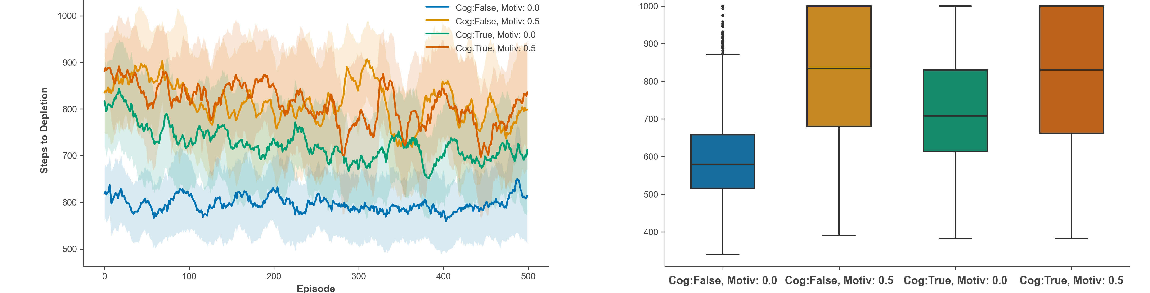
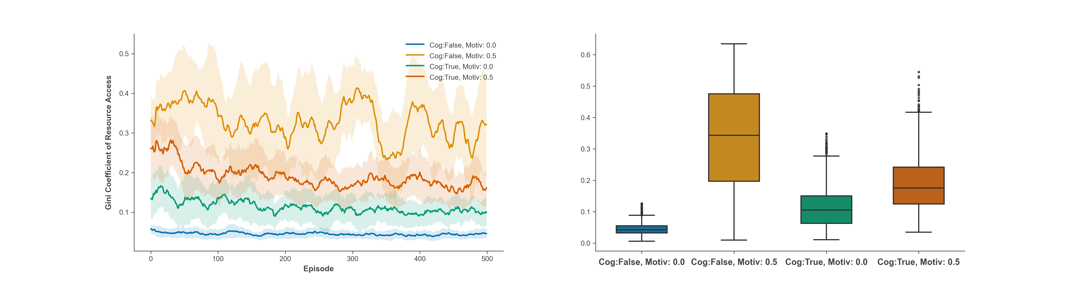
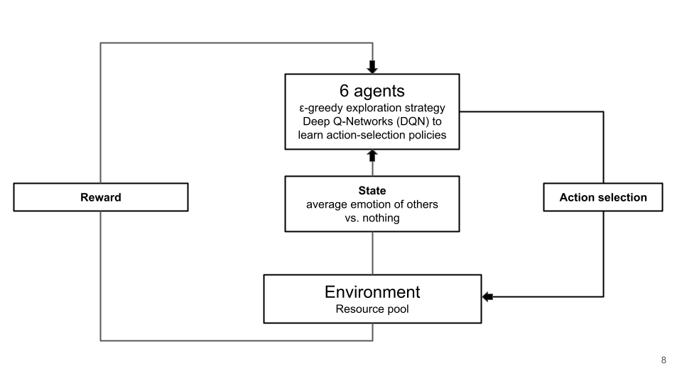
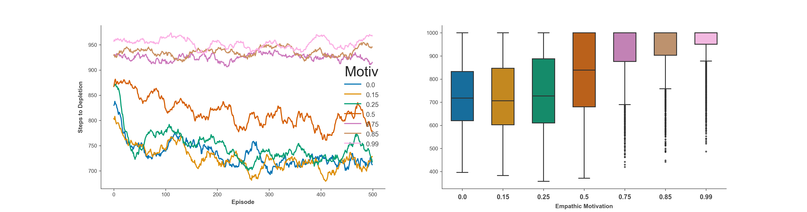
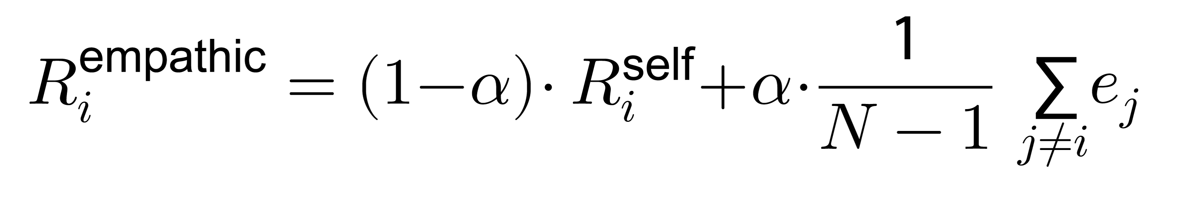
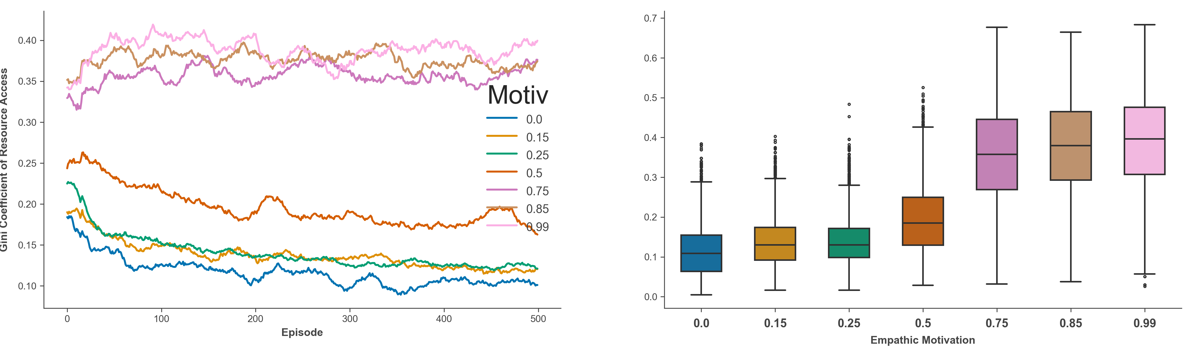

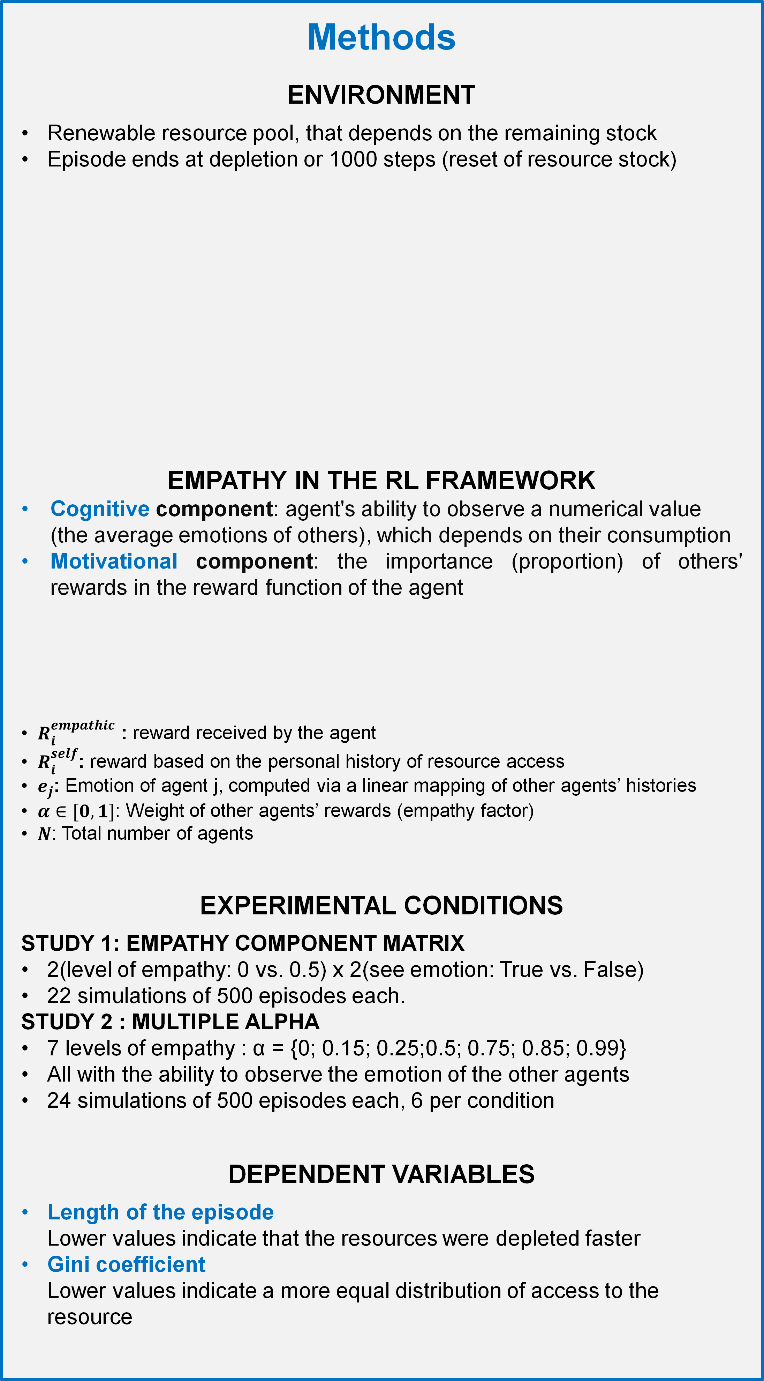
Multi-agent reinforcement learning investigation of the mechanistic role of empathy on pro-environmental behavior
Jérôme Iste^{1,2,3,*}, Evann Rabeau^{1,2*}, Ismael T. Freire³, Mehdi Khamassi³
¹Université Paris Cité, France; ² Sorbonne Université, France; ³ ISIR – Institut des Systemes Intelligents et de Robotiques
*Authors with equal participation
Introduction
How can we avoid the Tragedy of the Commons (Hardin, 1968)?
Prior reinforcement learning simulation studies showed that modifications of agents’ reward structures or observations can induce cooperation, conventions, and sustainability (Perolat et al., 2017; Wang et al., 2019; Zhu & Kirley, 2019).
OBJECTIVE:
Using multi-agent reinforcement learning, we study the influence of the components of empathy (cognitive, affective, motivational) on common-pool resource dilemmas. We expect the conjunction of the ability to observe and be motivated by others’ emotions to reduce overconsumption and increase fairness (Perolat et al., 2017; Wang et al., 2019; Zhu & Kirley, 2019).
Study 1: empathy reduces overconsumption
A two-way ANOVA revealed significant main effects of the ability to see emotions, F(1, 8) = 68.29, p < .001, η² = 0.12, and empathic motivation, F(1, 8) = 396.53, p < .001, η² = 0.72.
There was also a significant interaction, F(1, 8) = 75.53, p < .001, η² = 0.14.
A two-way ANOVA revealed significant main effects of the ability to see emotions, F(1, 8) = 68.29, p < .001, η² = 0.12, and the empathic motivation, F(1, 8) = 396.53, p < .001, η² = 0.72.
There was also a significant interaction F(1, 8) = 75.53, p < .001, η² = 0.14.
Episode length as a function of the empathic properties and episodes
Episode length as a function of the empathic properties
Methods
ENVIRONMENT
Renewable resource pool, that depends on the remaining stock
Episode ends at depletion or 1000 steps (reset of resource stock)
EMPATHY IN THE RL FRAMEWORK
Cognitive component: agent's ability to observe a numerical value (the average emotions of others), which depends on their consumption
Motivational component: the importance (proportion) of others' rewards in the reward function of the agent
$R_{i}^{empathic }$: reward received by the agent
$R_{i}^{self}$: reward based on the personal history of resource access
$e_{j}$: Emotion of agent j, computed via a linear mapping of other agents’ histories
$α∈[0,1]$: Weight of other agents’ rewards (empathy factor)
$N$: Total number of agents
EXPERIMENTAL CONDITIONS
STUDY 1: EMPATHY COMPONENT MATRIX
2(level of empathy: 0 vs. 0.5) x 2(see emotion: True vs. False)
22 simulations of 500 episodes each.
STUDY 2 : MULTIPLE ALPHA
7 levels of empathy : α = {0; 0.15; 0.25;0.5; 0.75; 0.85; 0.99}
All with the ability to observe the emotion of the other agents
24 simulations of 500 episodes each, 6 per condition
DEPENDENT VARIABLES
Length of the episode
Lower values indicate that the resources were depleted faster
Gini coefficient
Lower values indicate a more equal distribution of access to the resource
Fairness as a function of empathic properties and episodes
Fairness as a function of empathic properties.
Study 2: more altruistic motivation, less depletion
There is a positive Spearman correlation between the number of steps before depletion and the empathic motivation parameter (rs(22) = 0.92, p < 0.001).
There is a positive Spearman correlation between fairness and the empathic motivation parameter (rs(22) = 0.96, p < 0.001).
Episode length as a function of the degree of altruism (α) and episode
Episode length as a function of the degree of altruism (α)
Fairness as a function of the degree of altruism (α) and episode
Fairness as a function of the degree of altruism (α)
Conclusion
Study 1
1. Cognitive and motivational components influence behavior,
2. empathic motivation is the main driver of sustainability.
3. perceiving others’ emotions increases fairness in resource distribution.
Study 2
Increasing the weight of others’ rewards enhances sustainability but reduces fairness among agents.

Slide 2
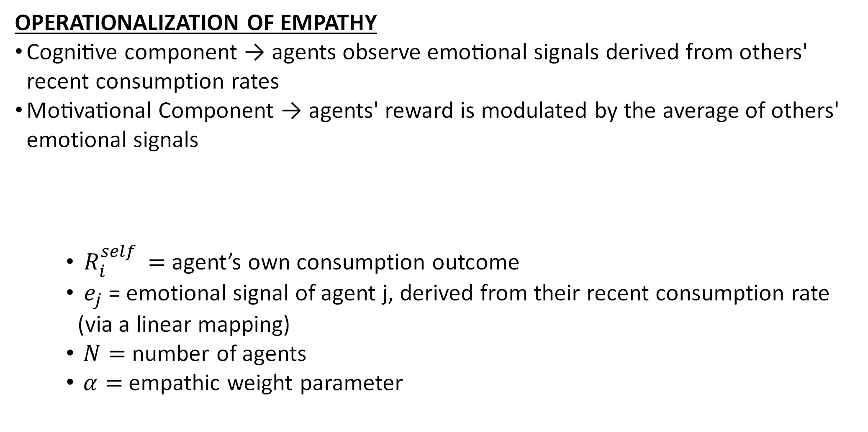
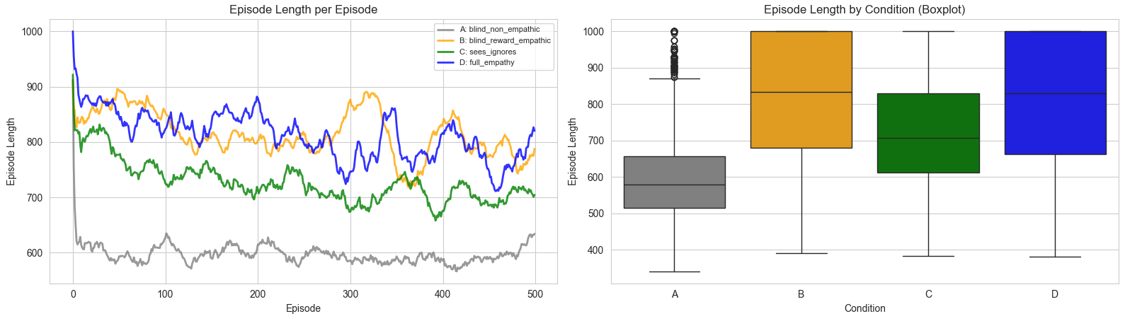
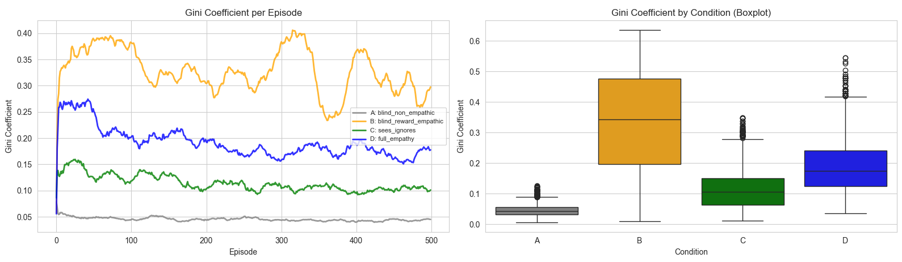
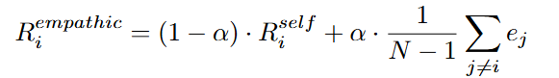
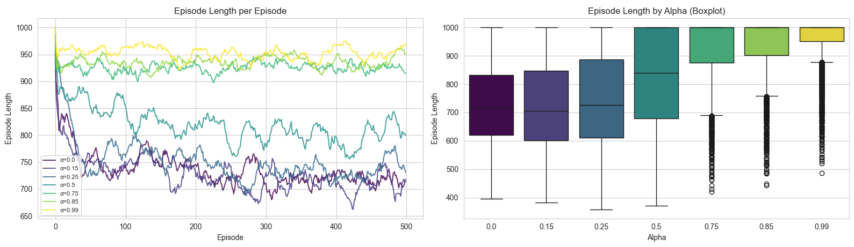
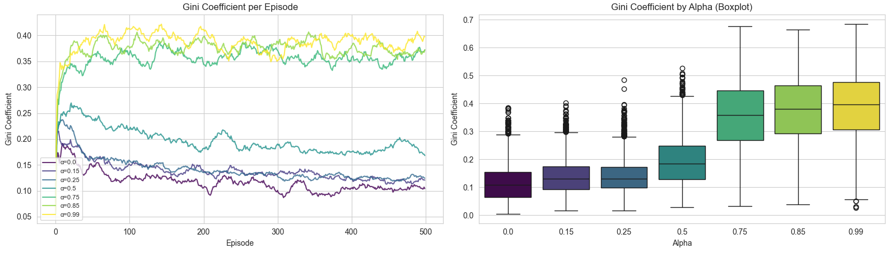
Multi-agent reinforcement learning investigation of the mechanistic role of empathy on pro-environmental behavior
Iste Jérôme^{1,2,3,*}, Rabeau Evann^{1,2*}, Ismael T. Freire³, Mehdi Khammassi³
¹Université Paris Cité, France; ² Sorbonne Université, France; ³ ISIR – Institut des Systems Intelligents et de Robotiques
*Authors with equal participatation
Introduction
Results study 1
The ecological crisis is commonly conceptualized as the Tragedy of the Commons (Hardin, 1968) where common pool resources risk being depleted because of individual's consumption.
Empathy has been identified as a crucial factor, but the causal role of it's mechanisms are difficult to test empirically at scale (Lynne et al. 2016). What is the role of the cognitive, affective and motivational component ?
Prior work showed that modifications of agents’ reward structures or observations can induce cooperation, conventions, and sustainability (Perolat et al., 2017; Wang et al., 2019; Zhu & Kirley, 2019). Using multi-agent reinforcement learning, we study the influence of the components of empathy (cognitive, affective, motivational) on common-pool resource dilemmas. We expect the conjunction of the ability to observe and be motivated by others’ emotions to reduce overconsumption.
EPISODE LENGTH : TRAJECTORY AND DISTRIBUTION
2(see_emotion: True vs. False) x 2(alpha_level: 0 vs. 0.5)
Intraction : rapport
Effet see_emotion
Effet alpha_level
  Methods
GINI COEFFICIENT : TRAJECTORY AND DISTRIBUTION
ENVIRONNEMENT
Single renewable common-pool resource shared among 6 agents
Resources regenerate dynamically based on the amount of resources left in the pool
Episodes end at full depletion of the pool of resource or after a fixed number of steps (1000)
Resource stock resets each episode, but agents retain learned policies
AGENTS
All agents use Deep Q-Networks (DQN) to learn action-selection policies
ε-greedy strategy: starts exploratory, then shifts toward exploitation
Agents share identical network architectures and hyperparameters
Manipulation of empathy level : α
Manipulation of the ability to observe others emotions : yes (true) or no (false)
2(see_emotion: True vs. False) x 2(alpha_level: 0 vs. 0.5)
Intraction : rapport
Effet see_emotion
Effet alpha_level
OPERATIONALIZATION OF EMPATHY
Cognitive component → agents observe emotional signals derived from others' recent consumption rates
Motivational Component → agents' reward is modulated by the average of others' emotional signals
  $R_{i}^{self }=$agent’s own consumption outcome
  $e_{j}$= emotional signal of agent j, derived from their recent consumption rate (via a linear mapping)
  $N=$ number of agents
  $α=$ empathic weight parameter
Results Study 2
EPISODE LENGTH : TRAJECTORY AND DISTRIBUTION
STUDY 1 : MULTIPLE ALPHA
7 levels of empathy
All with the ability to observe the emotion of the other agents
STUDY 2 : EMPATHY COMPONENT MATRIX
Linear regression : slope = 253, R² = 0.93, p < 0.001*** < 0.0167
GINI COEFFICIENT : TRAJECTORY AND DISTRIBUTION
BLIND, NON EMPATHIC | BLIND, REWARD EMPATHIC
SEES emotion, ignores them | SEES emotion, Reward Empathic
DEPENDANT VARIABLES
Length of the episode (maximum of a 1000 before the episode ends)
Gini coefficient
Linear regression : slope = 0.31., R² = 0.93, p < 0.001*** < 0.0167
Conclusion
Study 1 : Empathy has an effect one resource consumption and fairness. Both cognitive and motivational properties have an effect but the motivational factor appears to be a stronger driver of sustainability.
Study 2 : The effect of the motivational factor is such that increasing others' utility in the learning process increases sustainability but also decreases the fairness of the repartition of resources among agents.
Main take away : empathic concern might be the main driver of empathetic effects on pro-environmental behaviors. However, the ability to see emotions seems to increase fairness when agents are altruisticaly motivated.

