Slide 1

YARN 11711335 Zhang Yifan 11712019 Yu Tiancheng
Yet Another Resource Negotiator

Slide 2
Outline
Introduction
Motivation for YARN
YARN Architecture
Application Workflow
Real-world Performance
Performance Optimizations

Slide 3
Introduction
What is Hadoop?
What is MapReduce?
What is YARN?

Slide 4
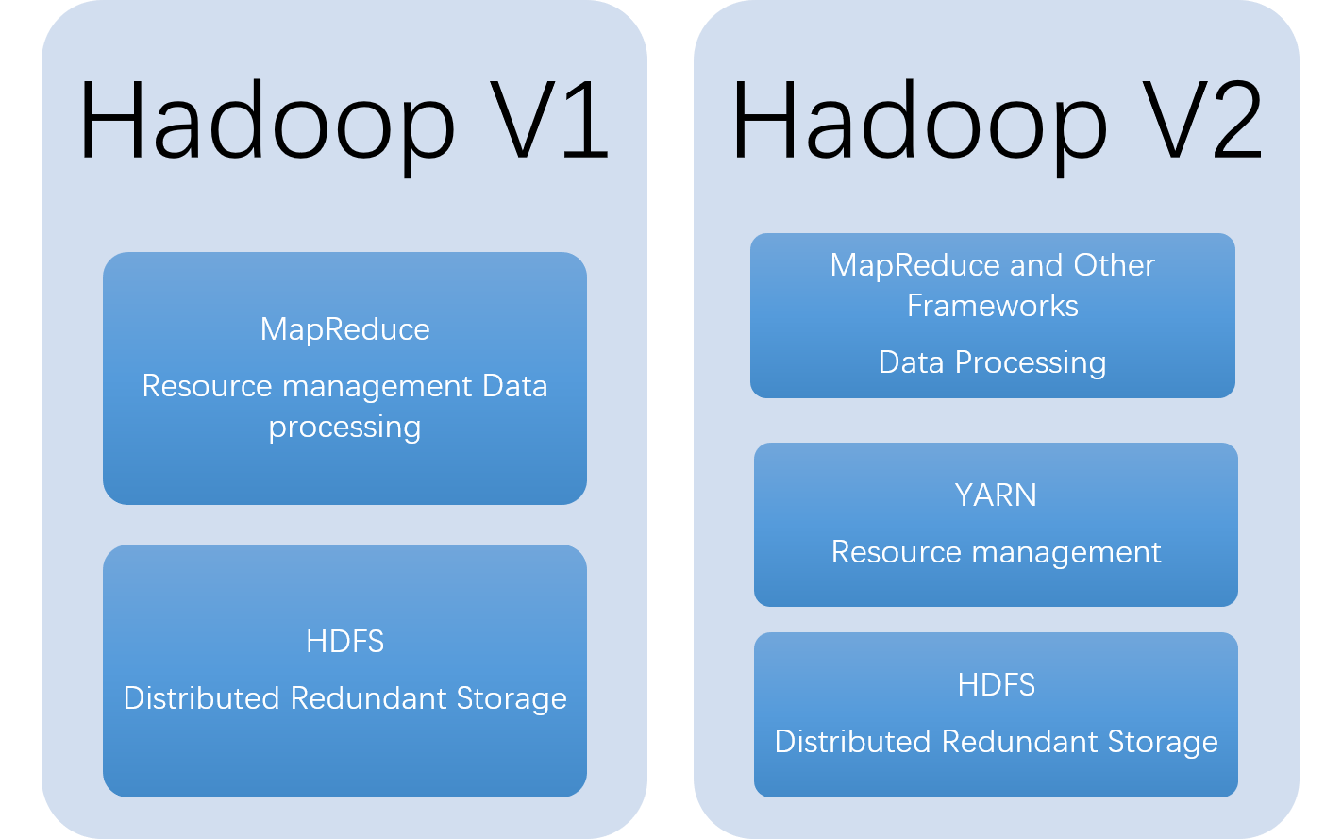
What Is YARN?

Slide 5

MapReduce 2
MP API
Framework
MapReduce 1
API
Framework
Resource Management
YARN
YARN API
Resource Management

Slide 6
Map Reduce V1 Execution Framework
Job Tracker
Client
Task Tracker
(Tasks)
Task Tracker
(Tasks)
Task Tracker
(Tasks)
Client

Slide 7
Motivations for V2
R1: Scalability
R2: Multi-tenancy
R3: Serviceability
R4: Locality awareness
R5: High Cluster Utilization
R6: Reliability/Availability
R7: Secure and auditable operation
R8: Support for Programming Model Diversity.
R9: Flexible Resource Model
R10: Backward compatibility

Slide 8
The New Architecture
Resource Manager
Client
Node Manager
Container
Application Master
Node Manager
Container
Application Master
Client
Node Manager
Container
Container

Slide 9
The New Architecture
YARN
Components
Clients
Resource Manager
Container
Node Manager
Application Master

Slide 10
YARN Daemons
Global Resource Manager
Scheduler
Application manager
Allocating Resources
Applications
Managing Jobs
Application Master

Slide 11
Application Master
Manages application life and task scheduling
Resource Manager
interacts
Application Master
interacts
Node Manager

Slide 12
Node Manager
Per node agent
Manages single node resource allocations
Node Manager
monitors
Resource Usage
CPU, Memory, Disk

Slide 13
Container/Slot
Basic unit of resource allocation
Example: Container x = 2GB, 1CPU
Fine grained resource

Slide 14
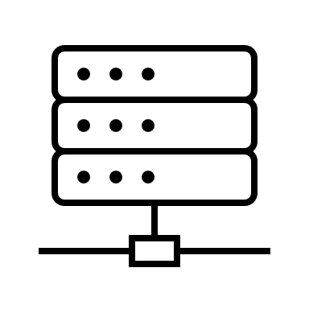


Example
Node Manager
HDFS
Container
Client
Node Manager
Container
Resource Manager
Node Manager
App Master
Node Manager

Slide 15
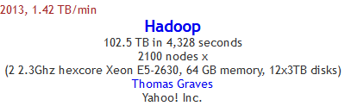
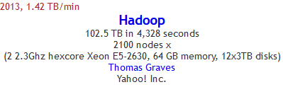
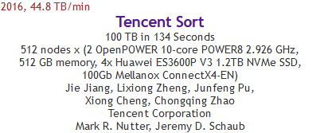

YARN’s Real-World Performance
Hadoop held both the Daytona and Indy GraySort benchmark records in 2013.
The current record is held by Tencent Sort.
Daytona GraySort Indy GraySort
Source: sortbenchmark.org

Slide 16
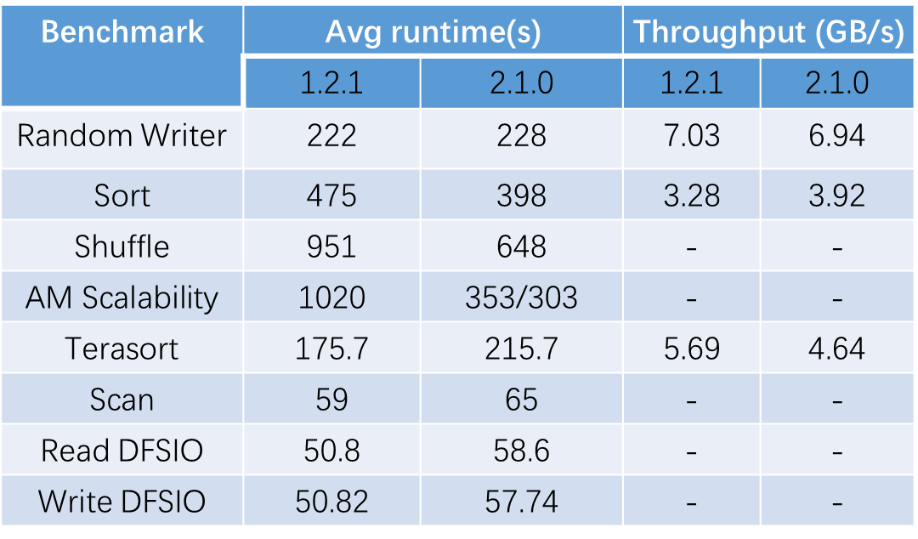
MapReduce Benchmarks
This benchmark compares the YARN performance in Hadoop 2.1.0 to the standard Hadoop-1 release 1.2.1
The Sort and Shuffle performs better on YARN
The Scan and Read / Write DFSIO performs worse
Why?

Slide 17

Benefits of Preemption
Consider a cluster running CapacitiyScheduler, with two queues:
Queue A: 80% of total capacity
Queue B: 20% of total capacity
Submit one MapReduce jobs to each queue
What will happen if:
Fixed capacity for each queue
Queues may take 100% of capacity, no preemption
Queues may take 100% of capacity, preemption

Slide 18
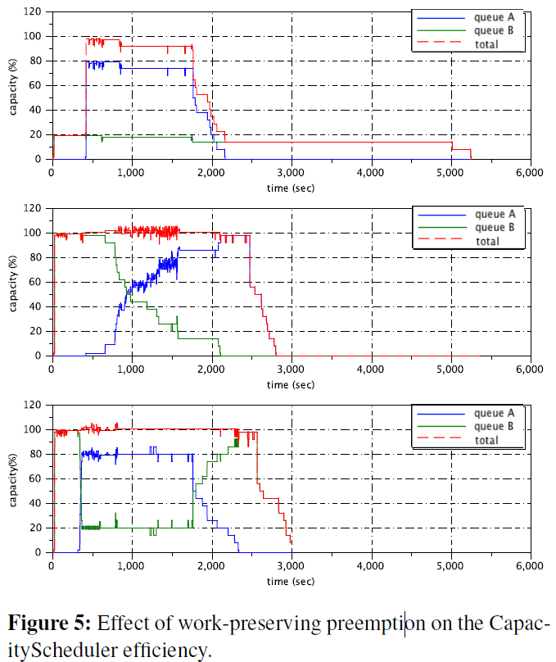

Benefits of Preemption
Submit Job A
Submit Job B
Each of the graphs shows the result of the scheduling policies
Work-preserving preemption allows the scheduler to overcommit resources without worrying about starvation
Fixed capacity wastes resources
No preemption cause capacity rebalancing take a long time
Finish
Finish
Finish

Slide 19

Questions?

