Slide 1
Document
Classification
based on
LDA
Latent Dirichlet Allocation
Chunyuan Li
Jiarui Xing

Slide 2
Document Classification
based on
LDA
Latent Dirichlet Allocation
Chunyuan Li
Jiarui Xing

Slide 3
Document Classification
based on
LDA
Latent Dirichlet Allocation
Chunyuan Li
Jiarui Xing

Slide 4
Document
Classification
based on
LDA
Latent Dirichlet Allocation
Chunyuan Li
Jiarui Xing

Slide 5
Document
Classification
based on
LDA
Latent Dirichlet Allocation
Chunyuan Li
Jiarui Xing

Slide 6
Contents
Introduction to LDA
Experiment Design
Experiment Result

Slide 7
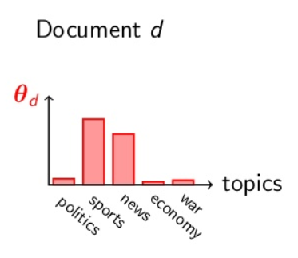
Introduction to LDA
LDA Document Generation Model (Simplified)
Doc-Topic distribution
First Step:
choose a topic from document-topic distribution
Pick a topic k
One word
Topic-word distribution
Figure: datasciencecentral.com/profiles/blogs/a-tale-about-lda2vec-when-lda-meets-word2vec
Notes:
Modeling Document Generation Process

Slide 8
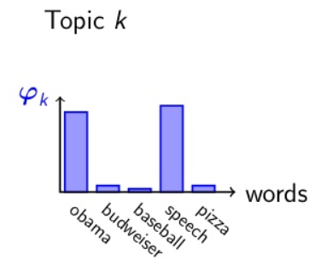
Introduction to LDA
LDA Document Generation Model (Simplified)
Doc-Topic distribution
Pick a topic k
One word
Topic-word distribution
Second Step:
choose a word from topic-word distribution

Slide 9
Introduction to LDA
LDA Document Generation Model (Simplified)
Doc-Topic distribution
Pick a topic k
One word
Topic-word distribution
Do it N times to generate a document with N words
N words

Slide 10


Introduction to LDA
LDA Document Generation Model (Simplified)
Doc-Topic distribution
$$α$$
Pick a topic k
One word
Topic-word distribution
$$β$$
N words

Slide 11
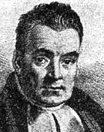
Document Classification Based on LDA
Basic Idea
game, video, Nintendo, Japan, …
words
As different documents have difference in the usage of words (e.g. term frequency/tf-idf), they should also differ in topics!
{Nintendo, game, video,…}
topics
Wikipedia: Pokémon
{media, franchise, company,…}
words
statistical, math, inference, …
{Bayesian, statistical, inference}
topics
{prior, posterior, use,…}
Wikipedia: Bayesian Inference

Slide 12
Document Classification Based on LDA
Basic Idea
As different documents have difference in the usage of words (e.g. term frequency or tf-idf), they should also differ in topics!
Document
Implementation: LDA as Vectorization!
Transform a document into distribution of topics
0.12 | 0.08 | 0.01 | 0.23 | … | 0.01 | 0.01 | 0.02 | 0.23 | 0.13
Topic Distribution

Slide 13
Experiment Design
When should LDA work better (than other document vectorization methods)?
With lower vector dimension?
# of words
Each topic referring to several words, which may represent a document in lower dimensions (than tf and tf-idf).
# of topics

Slide 14
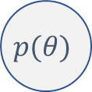

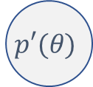
Experiment Design
When should LDA work better (than other document vectorization methods)?
With lower vector dimension?
$$\hat{θ}$$
data
Each topic referring to several words, which may represent a document in lower dimensions (than tf and tf-idf).
With small dataset?
Prior helps us avoid overfitting (think of pseudo-count in coin flipping case)
$$p(θ)$$
$$p′(θ)$$
data

Slide 15

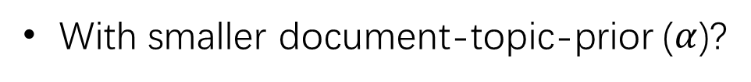

Experiment Design
When should LDA work better (than other document vectorization methods)?
Weather
Climate
Large $α$
With lower vector dimension?
Temperature
Each topic referring to several words, which may represent a document in lower dimensions (than tf and tf-idf).
With small dataset?
Prior helps us avoid overfitting(think of pseudo-count in coin flipping case)
Climate
Geometry
With smaller document-topic-prior ($α$)?
Small $α$
“Sparse” topics work better
Season

Slide 16
Experiment Design
Experiment Pipeline
TF
TFIDF
Multinomial Naïve
Bayes Classifier
TF+NMF
TFIDF+NMF
Corpus*
TF+most frequent terms
TFIDF+most “frequent” terms
LDA
*
State of the union address
Scripts of The Simpsons
Same dimension

Slide 17

Experiment Design
Experiment Pipeline
TF
TFIDF
Multinomial Naïve
Bayes Classifier
TF+NMF
TFIDF+NMF
Corpus*
TF+most frequent terms
TFIDF+most “frequent” terms
LDA
*
State of the union address
Scripts of The Simpsons
Dataset
size
$$α$$
Dimen-sion

Slide 18
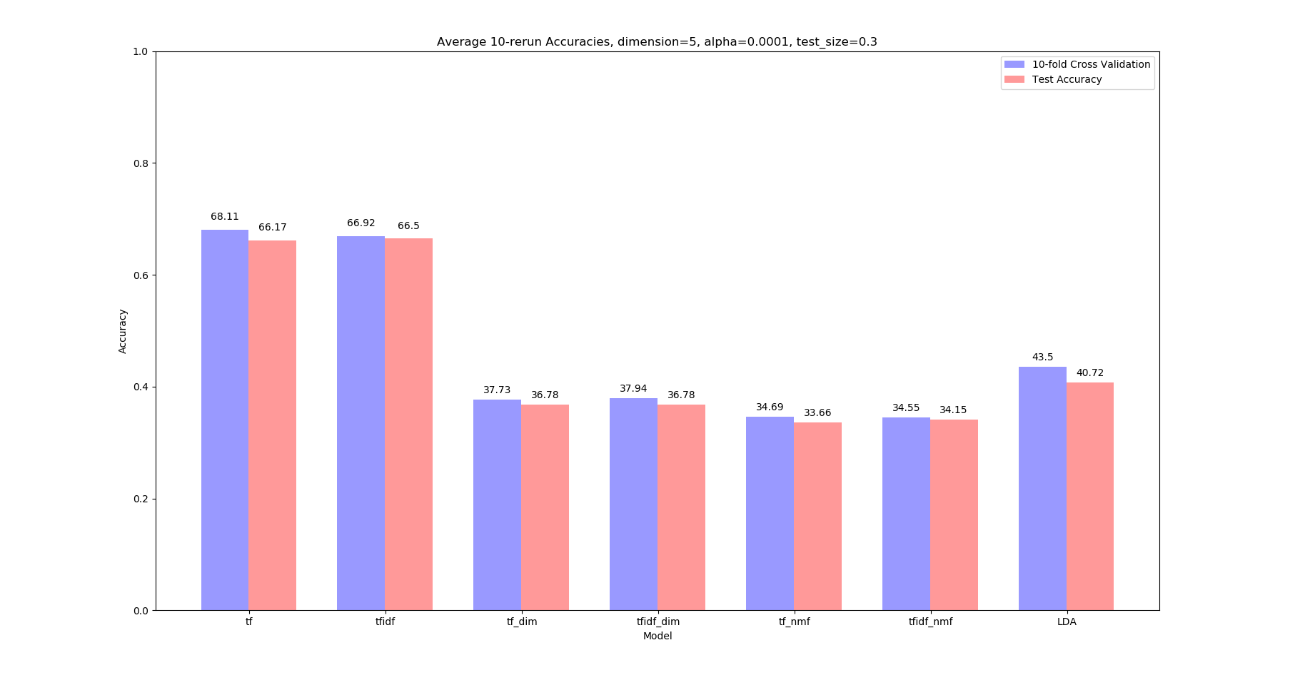
Experiment Result
Accuracies with $α=0.0001,0.01,1,10$

Slide 19
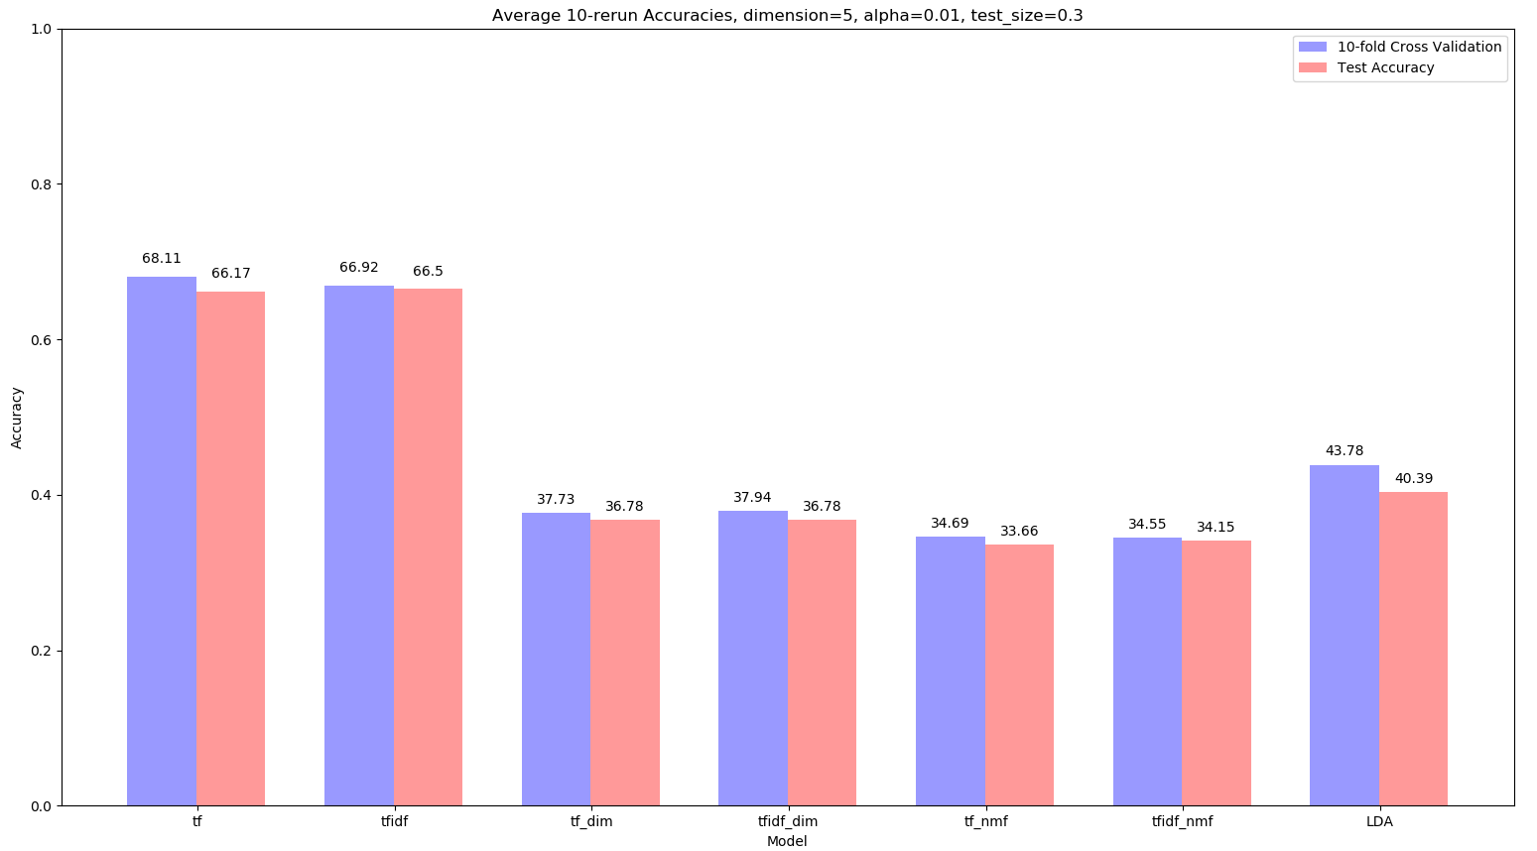
Experiment Result
Accuracies with $α=0.0001,0.01,1,10$

Slide 20
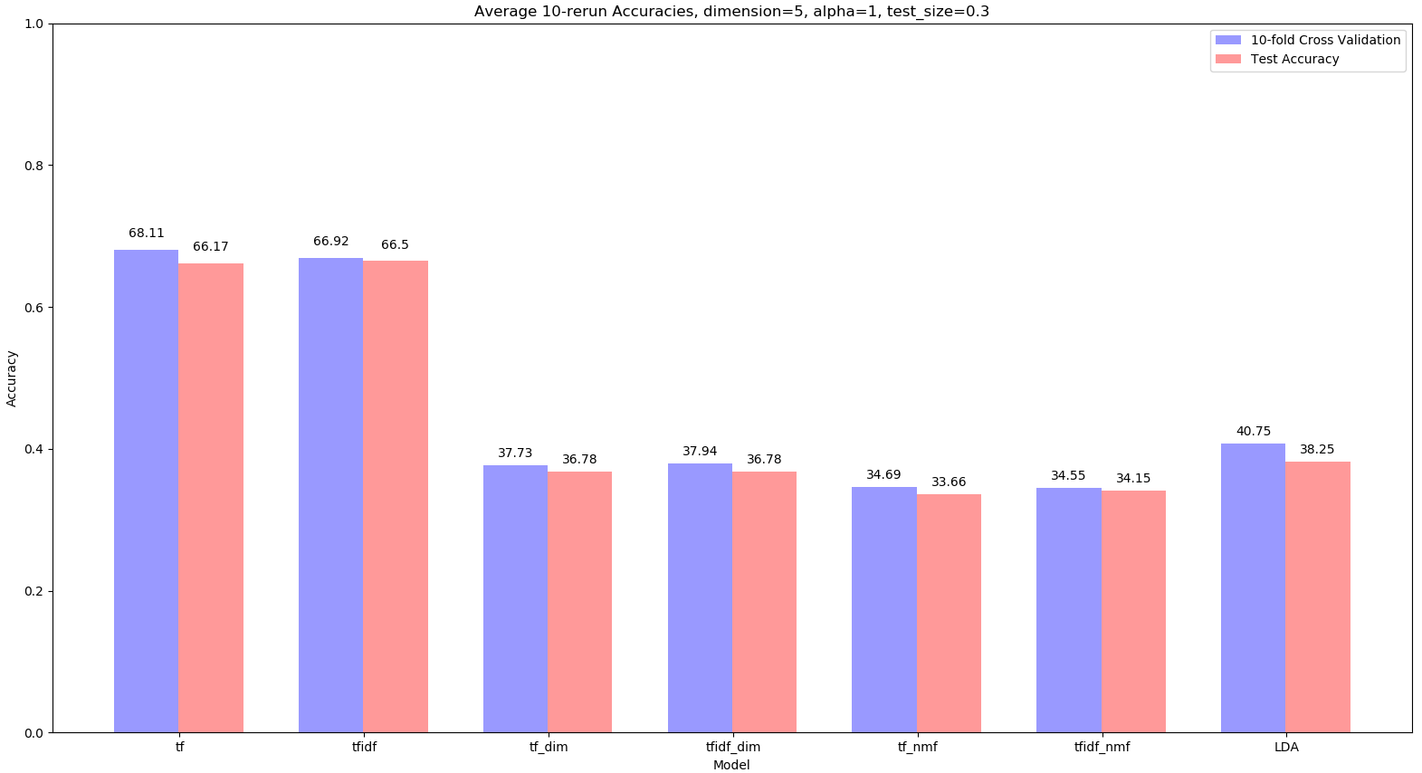
Experiment Result
Accuracies with $α=0.0001,0.01,1,10$

Slide 21
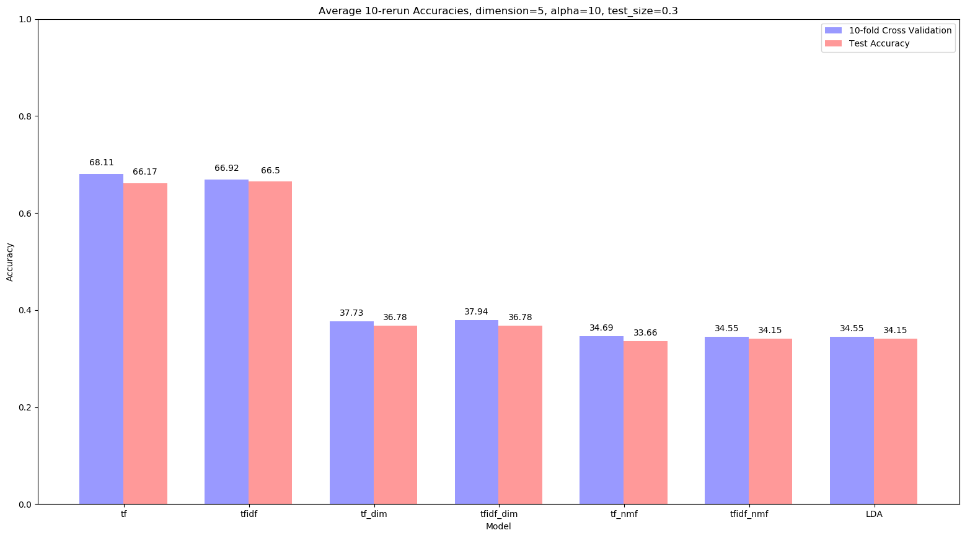
Experiment Result
Accuracies with $α=0.0001,0.01,1,10$

Slide 22
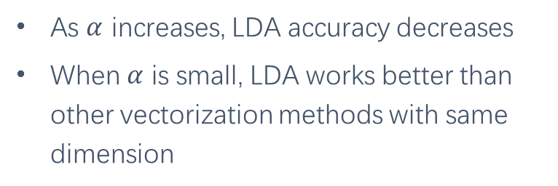
Experiment Result
Accuracies with $α=0.0001,0.01,1,10$
Conclusions
As $α$ increases, LDA accuracy decreases
When $α$ is small, LDA works better than other vectorization methods with same dimension

Slide 23
Experiment Result
Accuracies with train set ratio=0.7, 0.5, 0.2

Slide 24
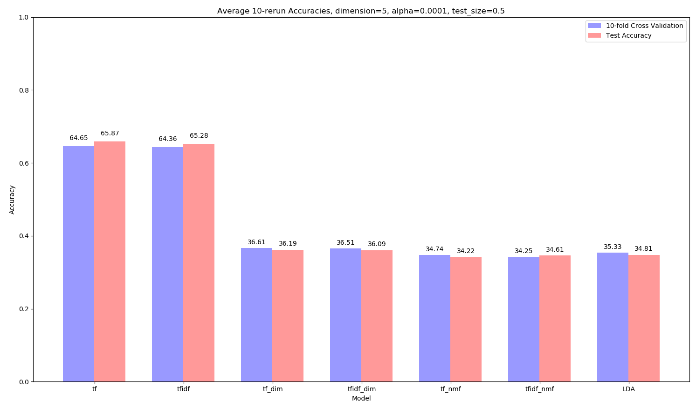
Experiment Result
Accuracies with train set ratio=0.7, 0.5, 0.2

Slide 25
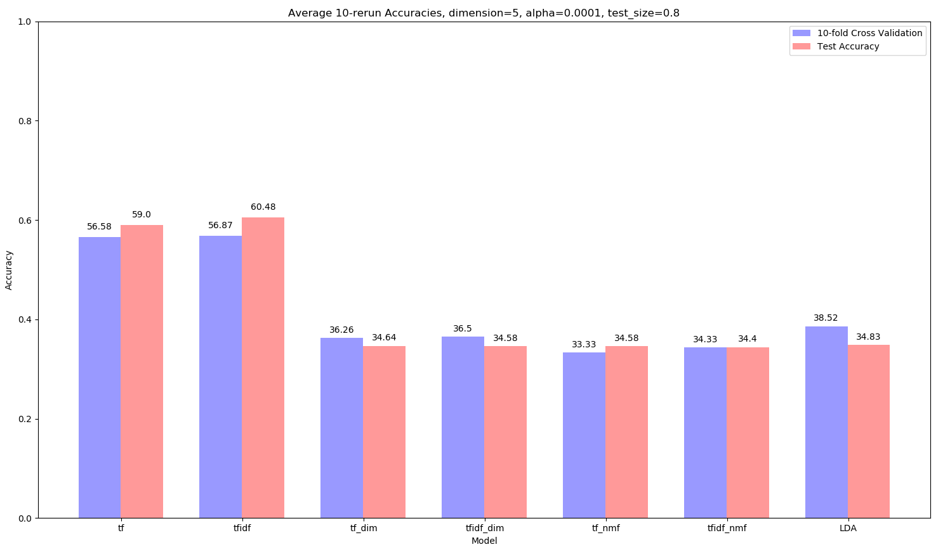
Experiment Result
Accuracies with train set ratio=0.7, 0.5, 0.2

Slide 26
Experiment Result
Accuracies with train set ratio=0.7, 0.5, 0.2
Conclusions
With size of training set decreasing, Accuracies of TF and TF-IDF decrease (of course)
Accuracies of methods with fixed dimension other than LDA keep nearly unchanged.
Surprisingly, LDA works better than others only with larger dataset!

Slide 27

Experiment Result
Accuracies with dimension(# of topics)=5, 10, 20

Slide 28
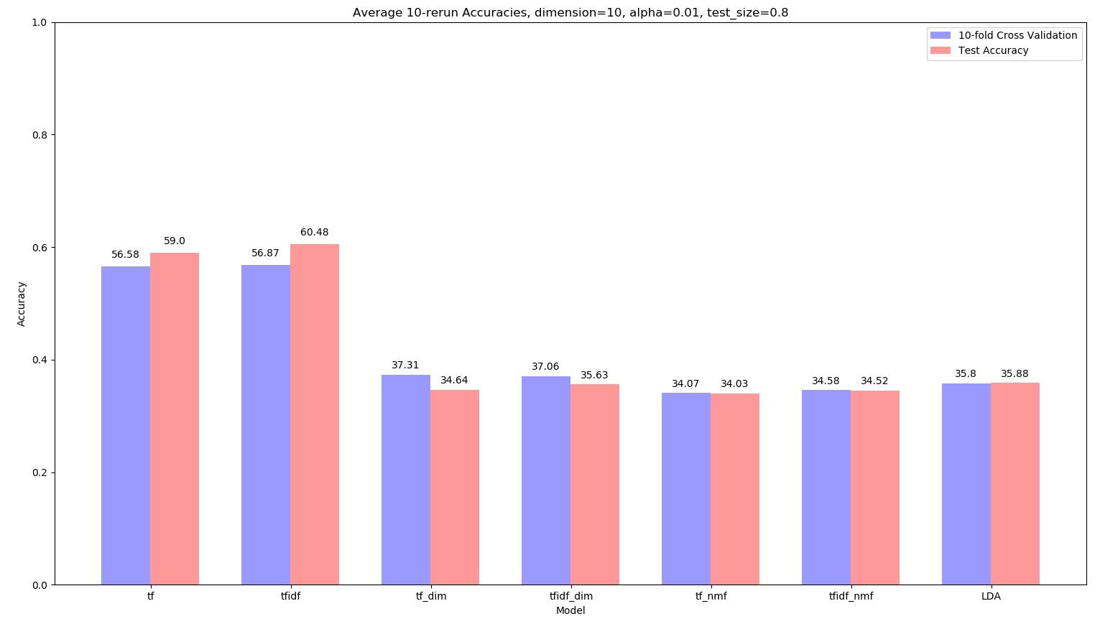
Experiment Result
Accuracies with dimension(# of topics)=5, 10, 20

Slide 29
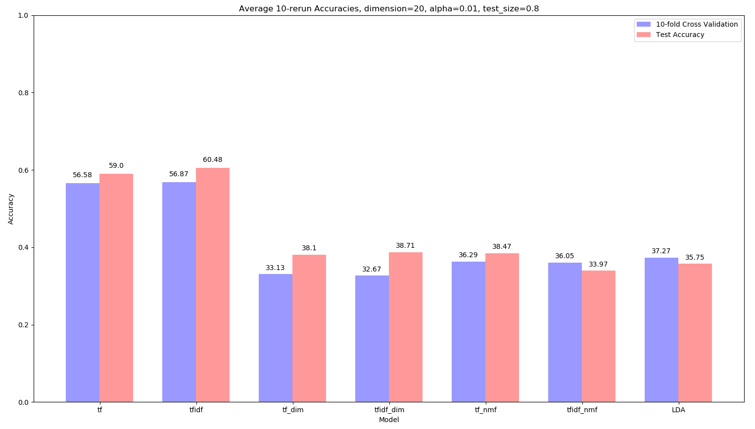
Experiment Result
Accuracies with dimension(# of topics)=5, 10, 20

Slide 30
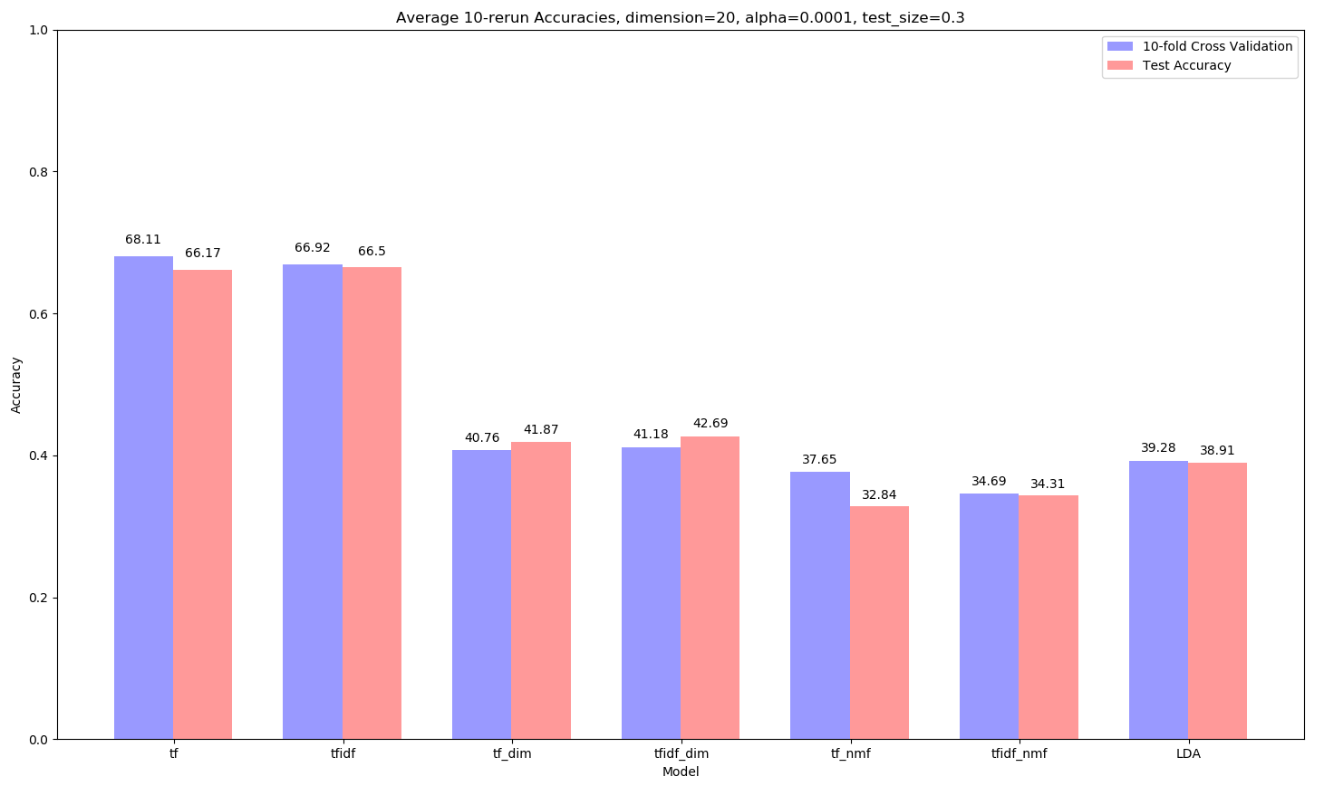
Experiment Result
Accuracies with dimension(# of topics)=5, 10, 20
Conclusions
With dimension increasing, accuracies of other dimension-fixed methods increase (of course)
However, that of LDA keep nearly unchanged.
LDA doesn’t work better than others.

Slide 31
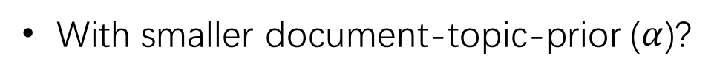
Experiment Result
Conclusions
When should LDA work better (than other document vectorization methods)?
With smaller document-topic-prior ($α$)?
Yes!
With small dataset?
No!
With lower vector dimension?
Not better than using other dimension reduction methods.

Slide 32
Questions?

