Slide 1
CSE 517A
Application Project
Milestone 1
Forest Cover Type Prediction
Chunyuan Li
Jiarui Xing

Slide 2
Contents
Dataset Introduction
Visualization
Data Preprocessing
Trying Different Models
4.1 Regularizers
4.2 Models
5. Result Interpretation

Slide 3
Dataset Introduction
From Kaggle Forest Cover Type Prediction Task
Task:
predict the forest cover type (the predominant kind of tree cover) from strictly cartographic variables (as opposed to remotely sensed data).
Data Fields:
Name | Meaning | Format
Elevation | Elevation in meters | Continious values
Aspect | Aspect in degrees azimuth
Slope | Slope in degrees
Horizontal_Distance_To_Hydrology | Horz Dist to nearest surface water features
Vertical_Distance_To_Hydrology | Vert Dist to nearest surface water features
Horizontal_Distance_To_Roadways | Horz Dist to nearest roadway
Hillshade_9am | Hillshade index at 9am, summer solstice | (0 to 255 index)
Hillshade_Noon | Hillshade index at noon, summer solstice
Hillshade_3pm | Hillshade index at 3pm, summer solstice
Horizontal_Distance_To_Fire_Points | Horz Dist to nearest wildfire ignition points | Continious values
Wilderness_Area | Wilderness area designation | (4 binary columns, 0 = absence or 1 = presence)
Soil_Type | Soil Type designation | (40 binary columns, 0 = absence or 1 = presence)
Cover_Type | Forest Cover Type designation | (7 types, integers 1 to 7)

Slide 4
Visualization

Slide 5
Basic Data Preprocessing
from sklearn.feature_selection import VarianceThreshold
# 2.1 Quantify(Dummy var)
allX = pd.get_dummies(allX, dummy_na=True)
bool_cols = [col for col in allX
if allX[[col]].dropna().isin([0, 1]).all().values]
# 2.1 Normalization: centering and unification(??), for only continuous data
allX[continuousCols] = allX[continuousCols].apply(lambda x: (x - x.mean()) / (x.std()))
allX = allX.fillna(0)
# 2.3 Remove features with low variance
allX_columns = allX.columns
selector = VarianceThreshold(threshold=(0.05))
allXDimDeArray = selector.fit_transform(allX)
allX = pd.DataFrame(allXDimDeArray)
# 2.4 Add Bias Dimension
allXCount = len(allX[allX.columns[0]])
allX['Bias'] = pd.Series(np.ones(allXCount), index=allX.index)
# 2.5 Split(Train/ Test)
from sklearn.cross_validation import train_test_split
trainX, testX, trainY, testY = train_test_split(allX, allY, random_state=1)
# 2.4 Fill missing data (by taking average)
trainX = trainX.fillna(trainX.mean())
testX = testX.fillna(testX.mean())
# 2.7 Split(Continuous/ Discrete)
testXDis = testX[discreteCols]; testXCon = testX[continuousCols]
trainXDis = trainX[discreteCols]; trainXCon = trainX[continuousCols]

Slide 6
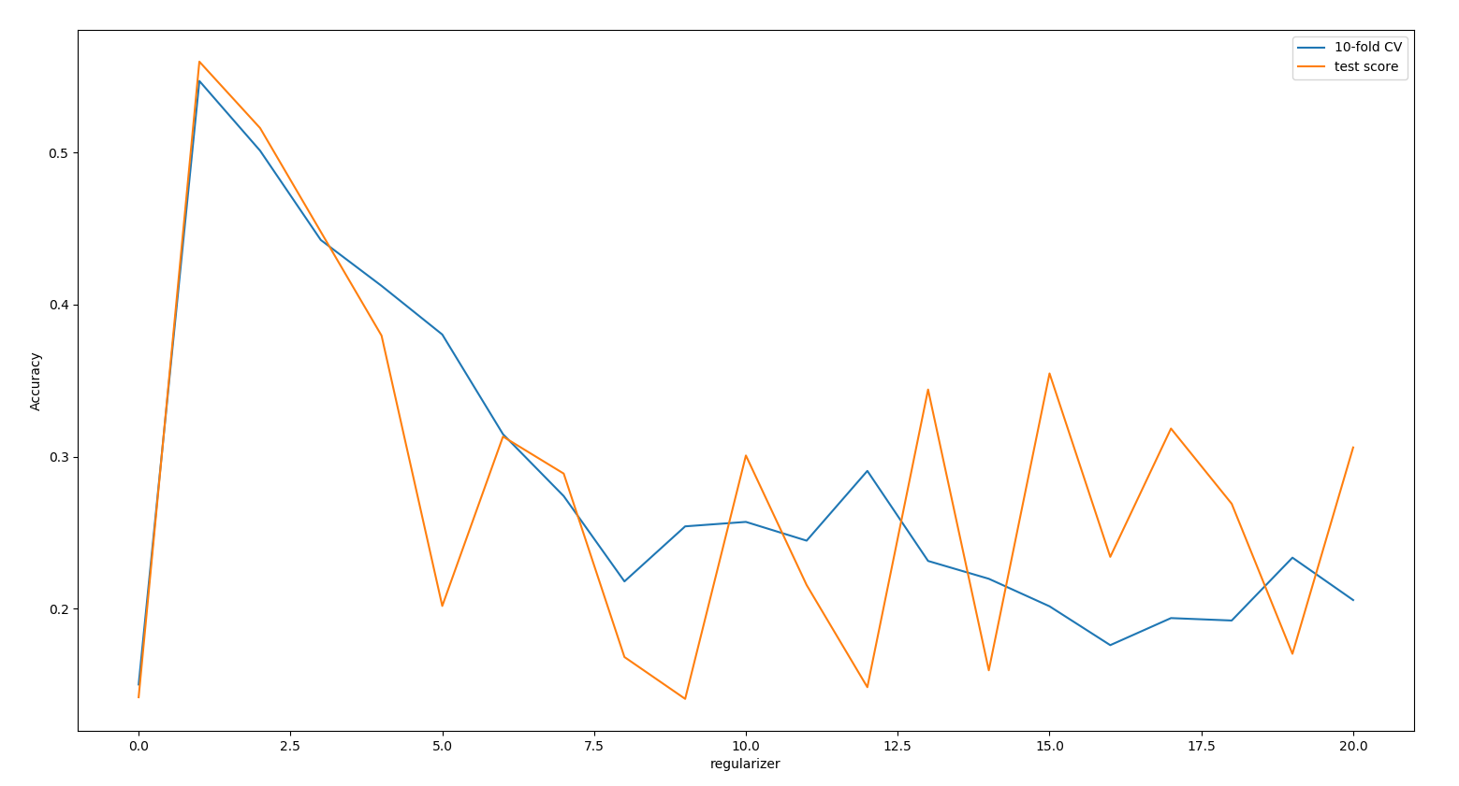

Trying Different Models
When the coefficient of regualizer is increasing, the accuracy first increases (less overfit) but then deceases (too simple model).
Best coefficient seems near 2
Ridge reg’s regularizers ($\left[0.001,20\right]$)

Slide 7
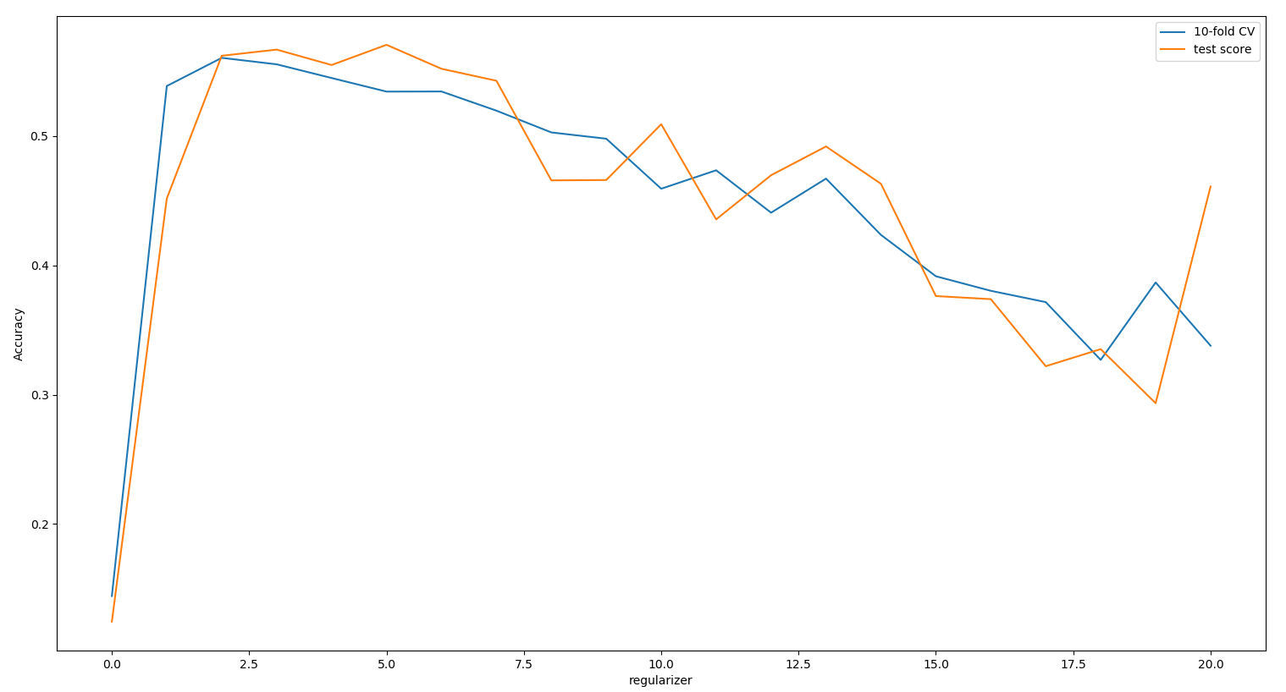

Trying Different Models
When the coefficient of regualizer is increasing, the accuracy first increases (less overfit) but then deceases (too simple model).
Best coefficient seems near 1
Ridge reg’s regularizers ($\left[0.001,5\right]$)

Slide 8
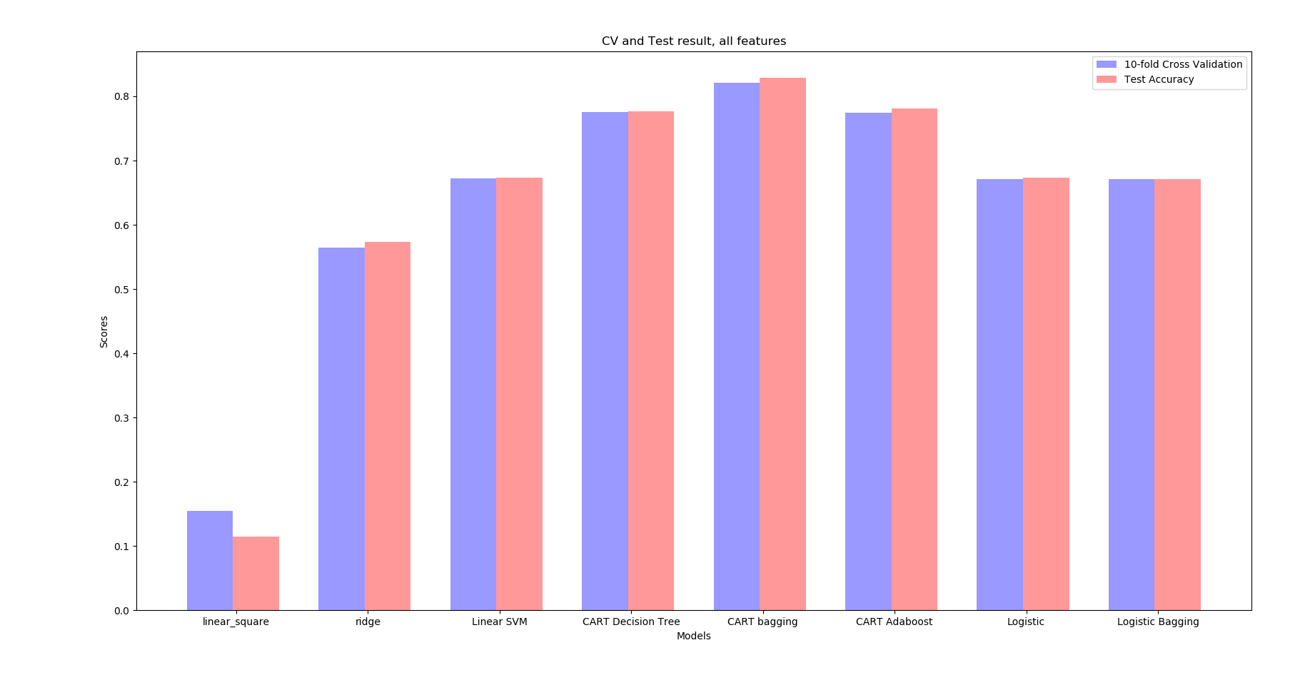
Trying Different Models
Accuracy of OLS are extremely low (easily affected by outliers?)
The effect of ensemble learning is not obvious.
Different Models

Slide 9
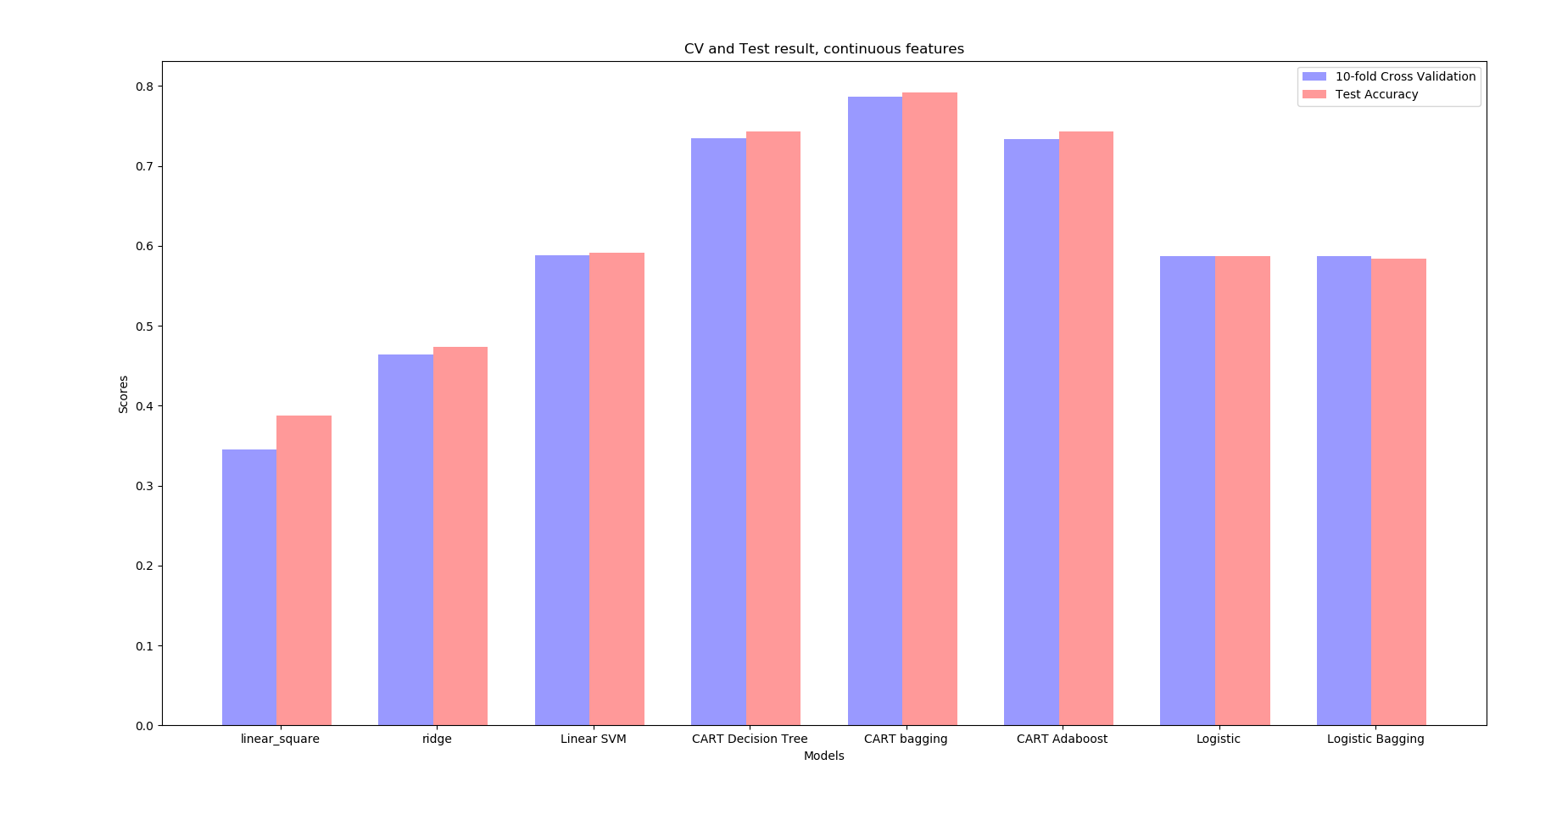
Trying Different Models
Accuracy of OLS increases a lot (don’t know why)!
Accuracy of ridge, SVM and Logistic regression decrease a little
Accuracy of CART tree doesn’t change much
Different Models (continuous features only)

Slide 10
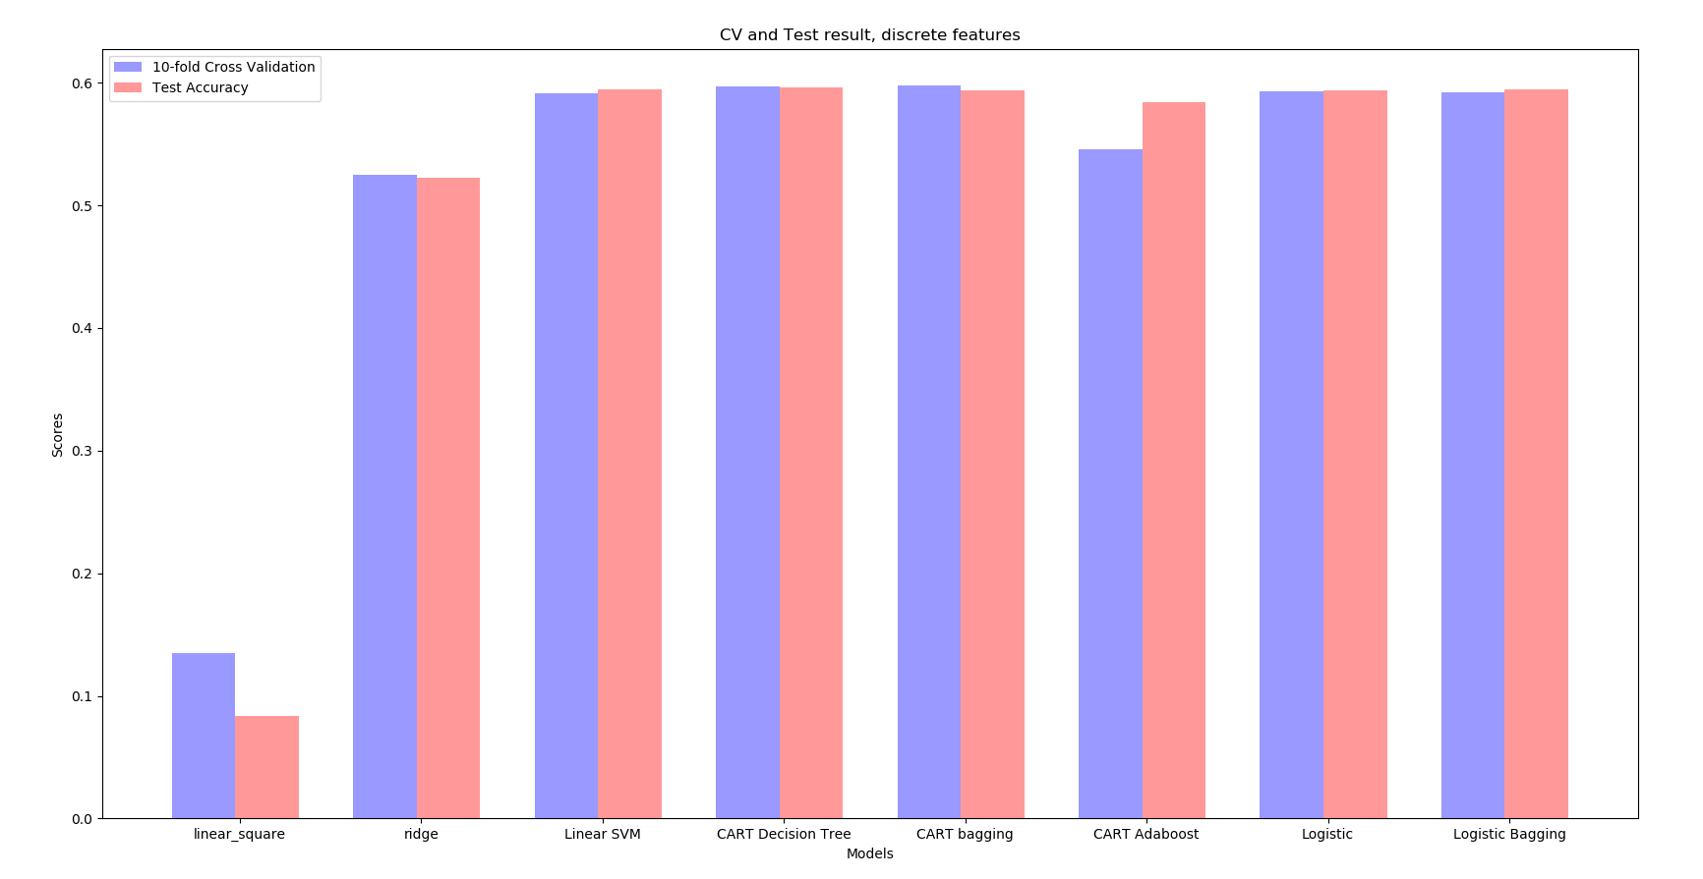
Trying Different Models
Accuracy of OLS close to that of using all features (don’t know why)!
Accuracy of all other models decrease
Different Models (discrete features only)

Slide 11
Advanced Data Preprocessing
Discretize: One-Hot Encoding
from sklearn.preprocessing import OneHotEncoder
enc = OneHotEncoder()
enc.fit(allXCon)
allXConENC = enc.transform(allXCon).toarray()
allXENC = np.concatenate((allXConENC, np.array(allXDis)),axis=1)

Slide 12
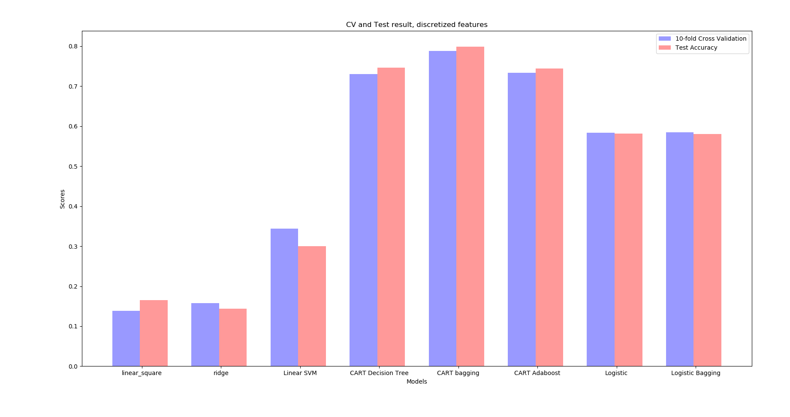
Advanced Data Preprocessing
Accuracy of SVM and decision tree don’t change much
Accuracy of OLS and ridge decrease!
Discretize: One-Hot Encoding

Slide 13
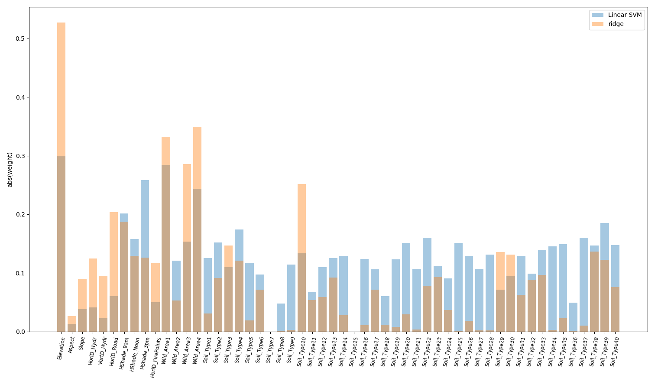
Interpretation of Model
Comparing effect of different features(with taking abs() and normalization)
Ridge mainly make use of continuous features, while SVM uses feature more “fair”
Some features (e.g. soli_type_7 and soli_type_7) have no effect

Slide 14
Conclusions
When using ridge regression and increasing the coefficient of regualizer, the accuracy first increases (less overfit) but then deceases (too simple model). $λ≈0.25$ is a good choice for our data.

