Slide 1
Forest Cover Type Prediction
Milestone 2
CSE 517A
Application Project
Chunyuan Li
Jiarui Xing

Slide 2
Contents
Model Training, Evaluation & Comparison:
Used Models
Optimizing Hyperparameters
Multiclass Classification: one-vs-one / one-vs-rest
Model Evaluation Measures and Results
Clustering and Visualization
Evaluation Metric: Purity
Number of clusters vs Purity
K-means vs RBF Kernel K-means
Decrease number of features

Slide 3

Model Training, Evaluation & Comparison
Models used:
GP with RBF and Matern kernel
SVM with RBF and polynomial kernel
CART decision tree with bagging, as a comparison
Hyperparameters:
GP hyperparameters are automatically optimized in scikit-learn
Choose SVM kernel hyperparameters by telescope search and cross validation

Slide 4
Model Training, Evaluation & Comparison
One-vs-one / one-vs-rest:
One-vs-rest preform badly due to class imbalance
 | One-vs-rest |  | One-vs-one
 | 10 fold validation accuracy | Test accuracy | 10 fold validation accuracy | Test accuracy
GP (RBF kernel) | 36.0% | 37.0% | 66.2% | 70.0%
GP (Matern kernel) | 37.0% | 53.0% | 66.1% | 70.0%

Slide 5
Model Training, Evaluation & Comparison
Accuracy and standard derivation:
Negative log probability cannot be used for one-vs-one classifiers
Use standard derivation of cross validation to capture uncertainty

Slide 6
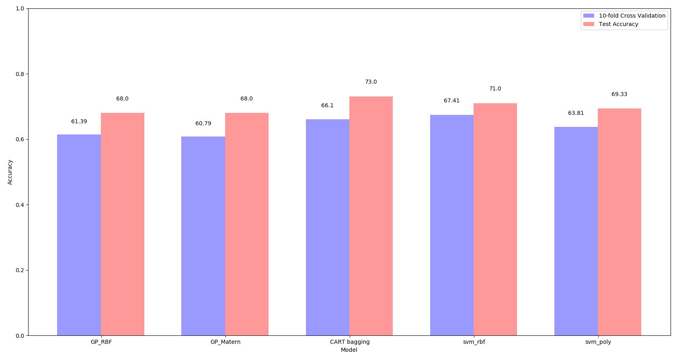
Model Training, Evaluation & Comparison

Slide 7
Model Training, Evaluation & Comparison
Accuracy and standard derivation:
Accuracy: SVM with RBF kernel has the highest test accuracy
Standard derivation of 10 fold cross validation:
Model | Standard derivation | Testing Accuracy | Training+Validation +Testing Time (s)
SVM (with RBF kernel) | 0.0323 | 71.0% | 16.64
SVM (with Polynomial kernel) | 0.0326 | 69.33% | 15.84
GP (with RBF kernel) | 0.0302 | 68.0% | 16.55
GP (with Matern kernel) | 0.0307 | 68.0% | 16.82
CART Decision Tree | 0.0509 | 73.0% | 16.99

Slide 8
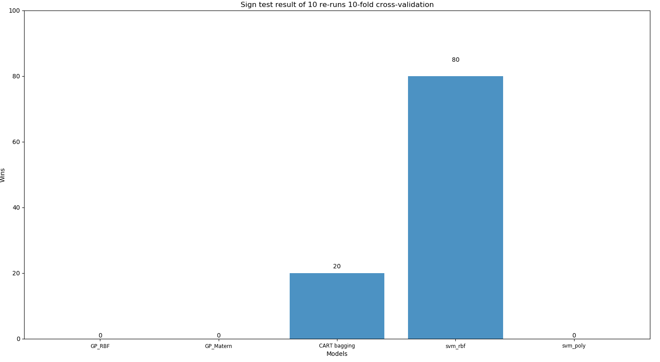
Model Training, Evaluation & Comparison
Sign Test

Slide 9
OPTIONAL: Clustering
Cluster the features of your dataset (not using the labels).
Evaluate the clusters using the observed data/labels.

Slide 10
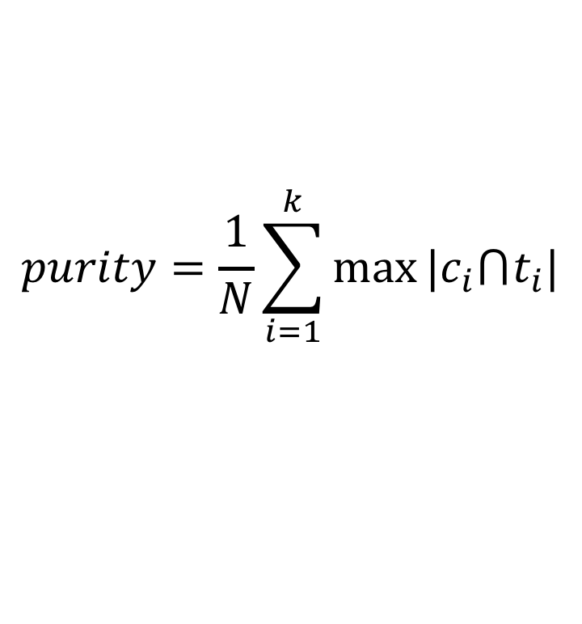
Evaluation metric: Purity
$$purity=\frac{1}{N}\sum_{i=1}^{k}{max⁡|c_{i}⋂t_{i}|}$$
N – number of samples
k – number of clusters
c_{i} – i^{th} cluster
t_{i} – classification type of each cluster

Slide 11
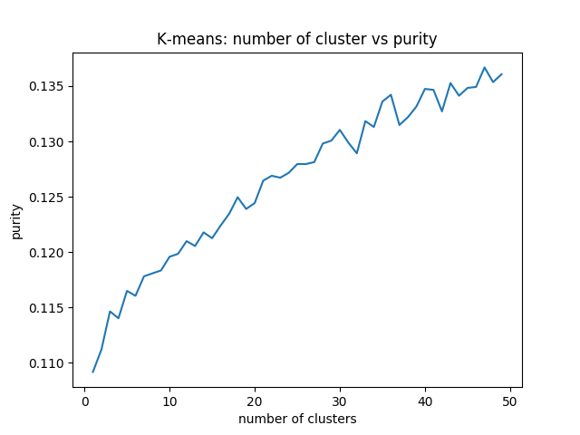
Number of clusters vs Purity
purity

Slide 12
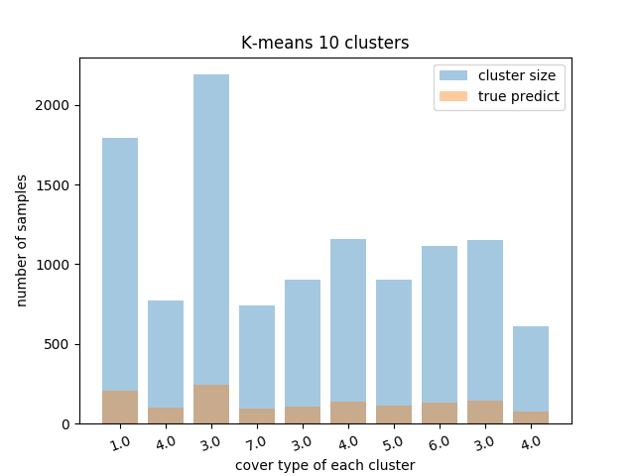
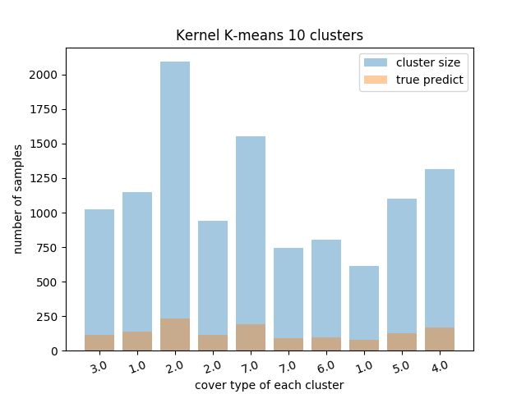
K-means vs RBF Kernel K-means
Purity 0.1191
0.1194

Slide 13
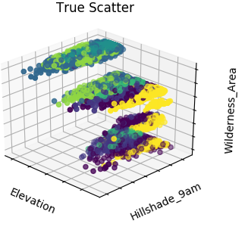
Limitation of K-means
Spherical variance assumption
Curse of Dimension
Minimizing the squared Euclidean distance (not a good metric in high dimensions)
Linear separability of the clusters

Slide 14
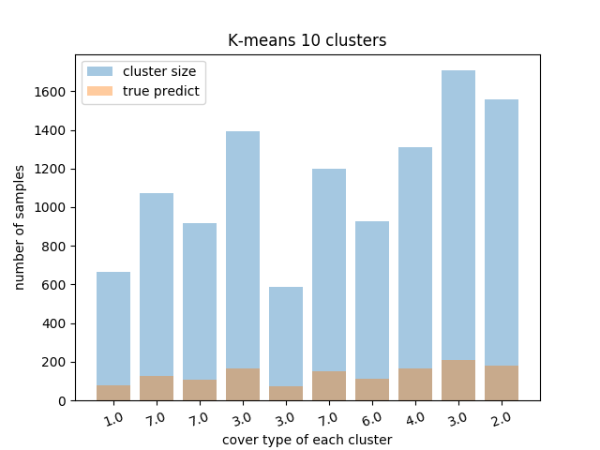
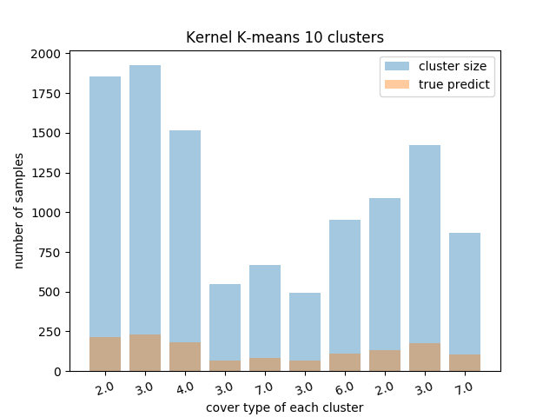
Decrease number of features
Purity 0.12
0.12

Slide 15
Thanks
Q&A

