Slide 1
Data Analytics Project Home Depot Product Search
Tong Wei, Fengxi Liu, Jinrong Liu

Slide 2
Overview
Kaggle Competition
Programming Language - R Language
Development Platform - Rstudio

Slide 3
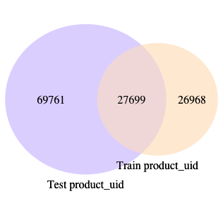
Data Exploration
train.csv and test.csv overlap
Create venn diagram to represent the relationship between Product IDs across both.

Slide 4
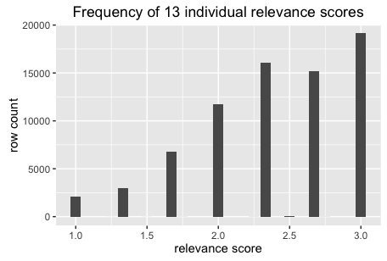
Data Exploration
train.csv Data Exploration
Frequency of 13 individual relevance scores

Slide 5
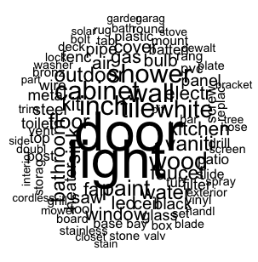
Data Exploration
train.csv Data Exploration
Words cloud in train.csv search terms
Reference scripts:
[1]Brian Carter, Home Depot First Data Exploration, https://www.kaggle.com/briantc/home-depot-product-search-relevance/homedepot-first-dataexploreation-k/comments
[2]RG·, Beginner Data Analysis, https://www.kaggle.com/dsoreo/home-depot-product-search-relevance/testing-r/comments

Slide 6
Data Selection
product_descriptions.csv – merge with train.csv and test.csv respectively
attribute.csv – eliminated because of missing values
Predict the relevance according to matching words

Slide 7


Preparing Data – Cleanup Data
Step 1: Lowercase
Function: tolower
train[] <- lapply(train, tolower)
Result:
Before lowercase
After lowercase

Slide 8
Preparing Data – Cleanup Data
Step 2: Remove Special Characters (White Space/Tab)
Do it while importing csv file. And there is no need to remove the whitespace between words in a tuple

Slide 9
Preparing Data – Cleanup Data
Step 3: Remove Stop Words and Stem (Porter Stem)
Use package “qdap”
Use loop to change every word
Use stemmer in the loop

Slide 10
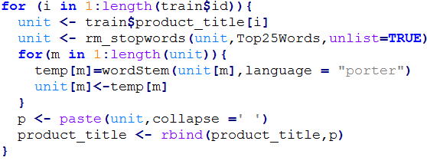
Preparing Data – Cleanup Data
Code:
Result:
Before
After

Slide 11
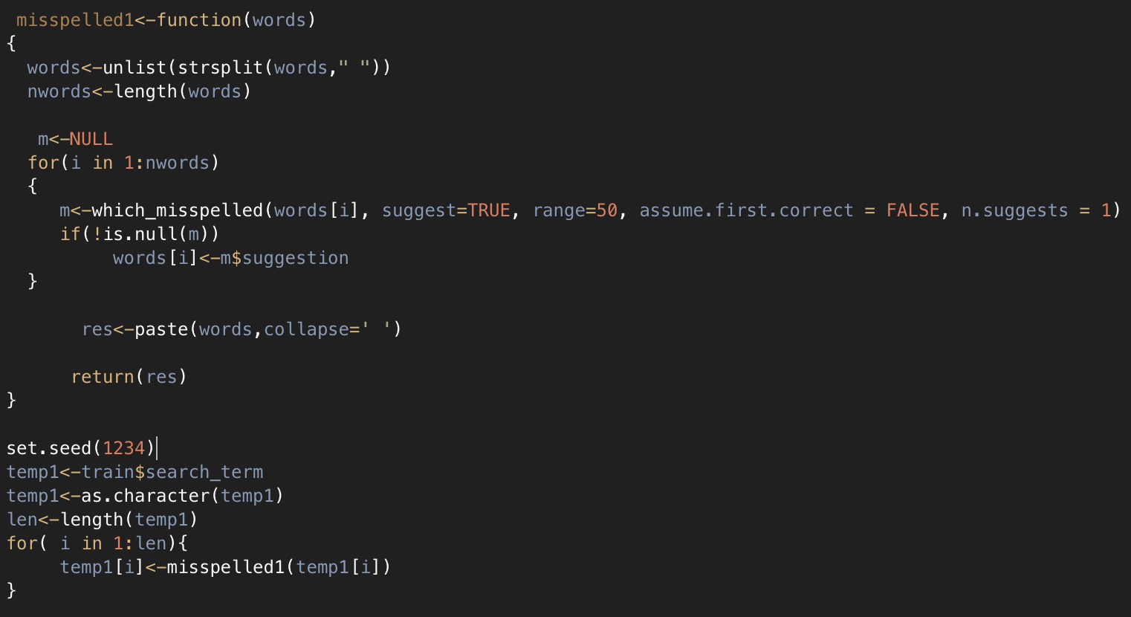
Preparing Data – Cleanup Data
Correct Misspelled Words
Use package “qdap”

Slide 12
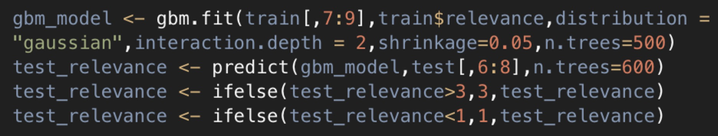
Model Selection & Evaluation
Model Selection - use gbm model
Model Evaluation - use k-fold cross validation

Slide 13

Error Calculation
Root Mean Squared Error (RMSE)
Result - 0.50507

Slide 14
Improvement
Add attribute with train and test, numerical values in attribute file should be normalized
Try more models to improve our result
Special characters

Slide 15
THANK YOU!

