Slide 1

TECH REVIEW - URBAN HEALTH ENVIRONMENT CONSULTANT TOOL
CSE583 Team Project Aishwarya | Jingheng Chen | Sam Wang | Jiafei Zhang

Slide 2

Presentation Overview
URBAN HEALTH INDEX
UW CSE 583 COURSE PROJECT
Examine and Visualize the aggregated effect of 8 specific urban indicators on life expectancy at census tract level for policy makers
Mapping
Data Analysis Visualization
UI Design
Backend ML
UI Frame - Shiny
Mapping UI – folium
Mapping data process –geopandas
Data Vis: Matplotlib
ML: scikit-learn
User Story
Use Cases
Design Demo
Preliminary Solution
Project Idea
User Investigation
Design Draft
Components
Tech Review
URBAN HEALTH ENVIRONMENT CONSULTANT TOOL
Idea and Background
User Investigation
Components
Tech Review
Slide 02/08
Design Demo

Slide 3
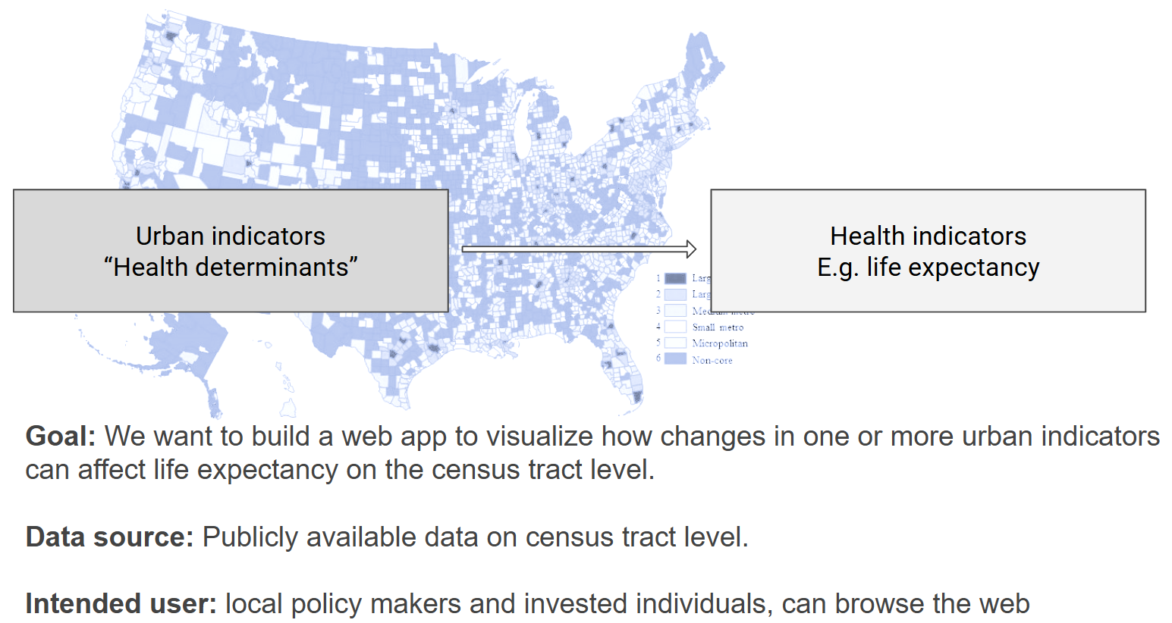
URBAN HEALTH INDEX
UW CSE 583 COURSE PROJECT
Backgrounds
URBAN HEALTH ENVIRONMENT CONSULTANT TOOL
Idea and Background
User Investigation
Components
Tech Review
Slide 02/08
Design Demo

Slide 4
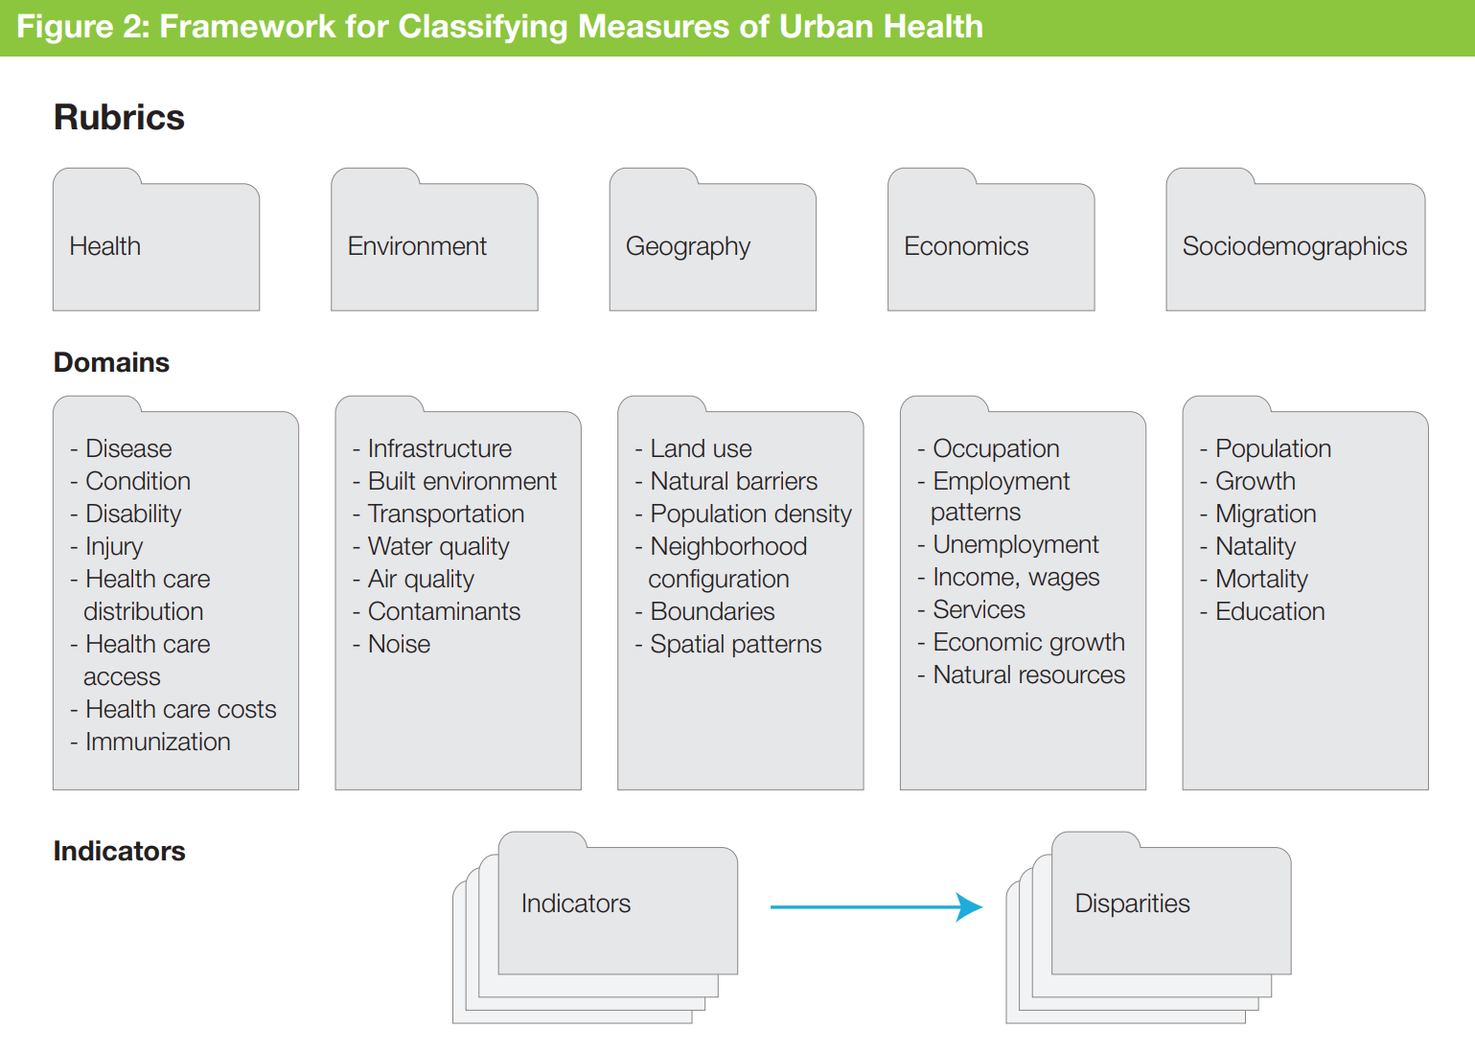
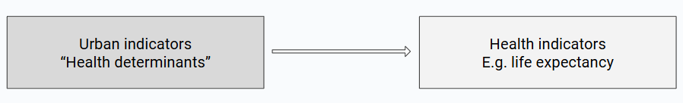
URBAN HEALTH INDEX
UW CSE 583 COURSE PROJECT
Project Idea
Visualize the integrated effect of 8 specific urban indicators on life expectancy at census tract level for policy makers.
Fig. Framework and feature chosen for urban health
URBAN HEALTH ENVIRONMENT CONSULTANT TOOL
Idea and Background
User Investigation
Components
Tech Review
Slide 02/08
Design Demo

Slide 5
URBAN HEALTH INDEX
UW CSE 583 COURSE PROJECT
Use case 1: City-level policy maker may want to 1. get an overview of the life expectancy across each census tract in the city. They want to quickly 2. get an idea of how each part of the city is performing (in terms of life expectancy) so they can better understand the geographical health disparities in the city. In addition, they may want to 3. know the census tracts that have the poorest life expectancy. The expected interaction between this user will be:
Input: user selects 1 out the 10 metropolitan areas
Output: the webpage displays a choropleth map containing the census tracts in this metropolitan area, shaded according to the life expectancy, and a list of the 5 census tracts that have the lowest life expectancy.
User Investigation
Our intended users are local policy makers and invested individuals who are interested in learning about their city and/or neighborhood’s overall health status (life expectancy) and how it is influenced by certain urban indicators.
Use case 2: Community level policy maker -- the policy maker may want to zoom in on a certain census tract that they are interested in and 1. look at the latest values and performance of the urban health indicators, and 2. know what and how to improve (this includes 2. knowing what are the most urgent and important indicators to improve to make a difference, 3. what are the suggested proportioning of making changes for each indicator, and 4. how much the general health performance would be improved as a result). The expected interaction between this user will be:
Input: user select a census tract from the choropleth map by clicking the shape of the census tract
Output: a panel displaying the life expectancy in the census tract, its percentile in the distribution of life expectancy across all census tracts, and values of the urban indicator measurements.
URBAN HEALTH ENVIRONMENT CONSULTANT TOOL
Idea and Background
User Investigation
Components
Tech Review
Slide 02/08
Design Demo

Slide 6
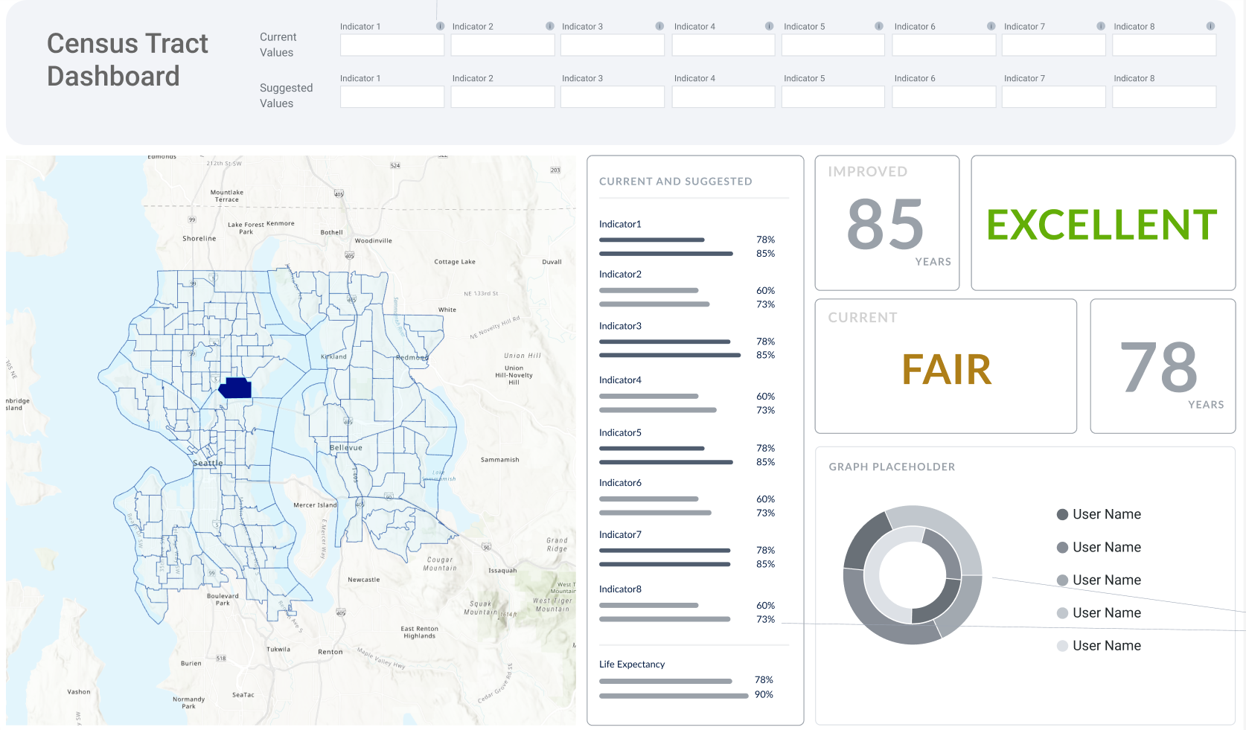
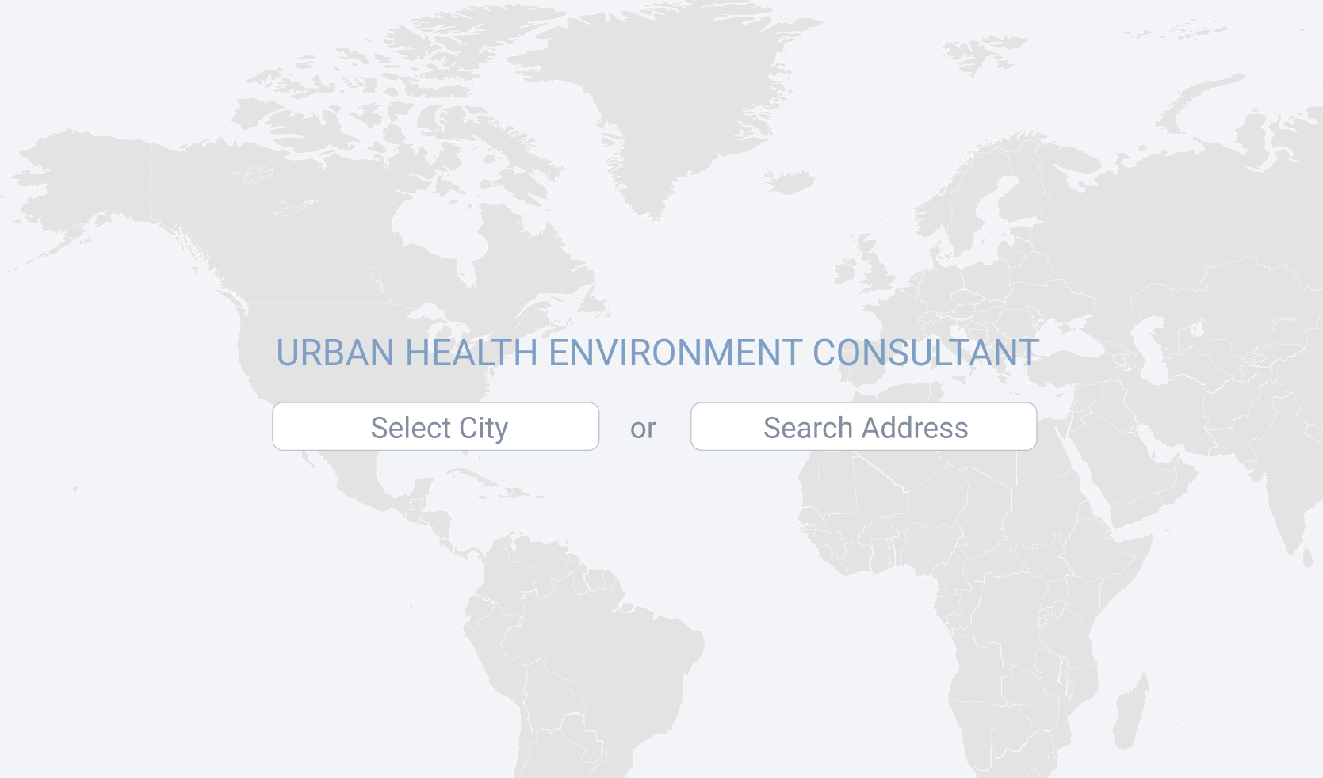
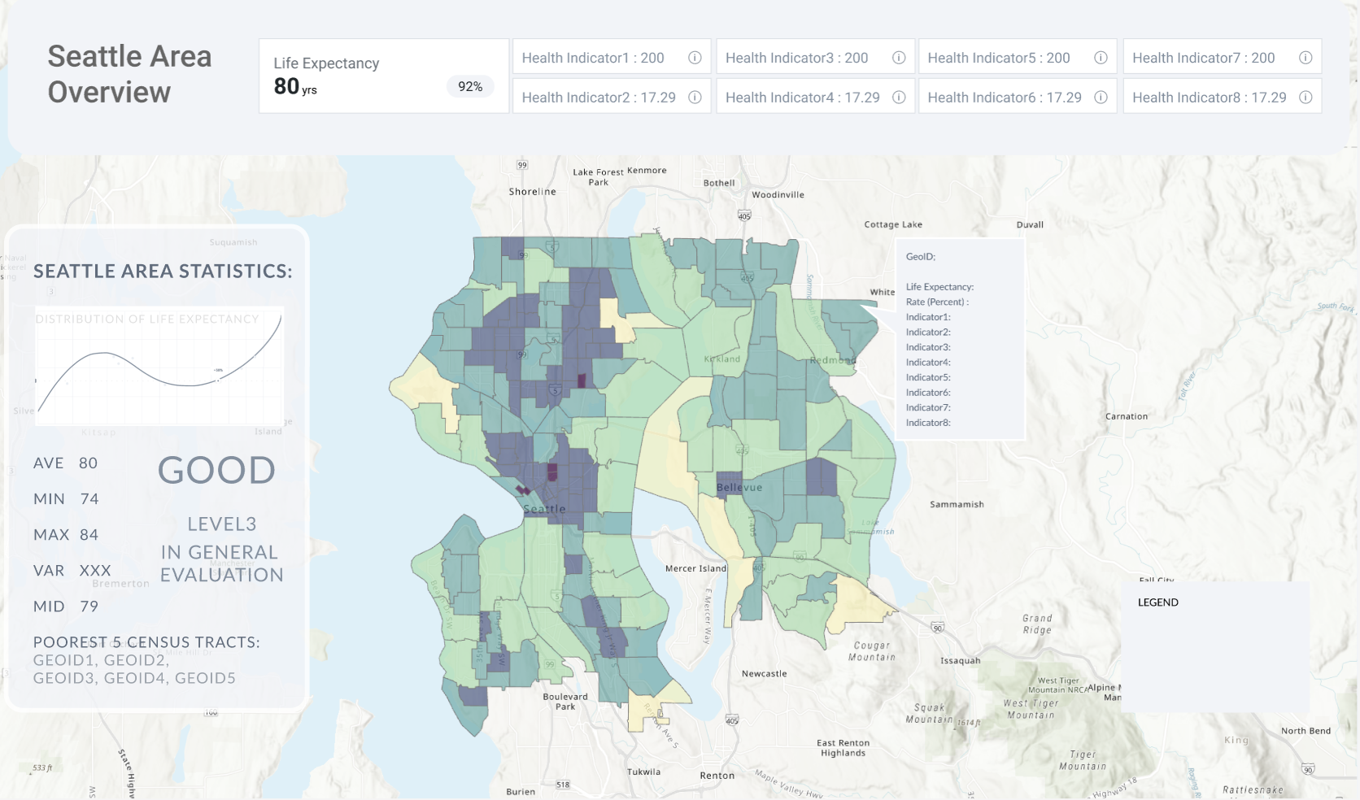
Type in a specific address within these 10 cities and see the census tract analysis
Showing improved health performance following suggested indicator improvements
URBAN HEALTH INDEX
UW CSE 583 COURSE PROJECT
Design Demo
Click to see specific census tract’s data vis
Click to see indicator’s info
Select from 10 metro polytan cities and landing to city level mapping
URBAN HEALTH ENVIRONMENT CONSULTANT TOOL
Idea and Background
User Investigation
Components
Tech Review
Slide 02/08
Design Demo

Slide 7
URBAN HEALTH INDEX
UW CSE 583 COURSE PROJECT
Components
Components | Available technologies in Python (bolded are the ones we chose)
Backend: A machine learning model that links urban indicators to life expectancy; an algorithm design for giving suggested best values for a census tract. | Scikit-learn
Data frames that allows querying data; data analysis and visualization tools | Pandas, matplotlib, seaborn
Interactive map (to display the shaded census tract shapes on top of a street map, etc) | Folium, plotly, pyleaflet
A web application framework | Python Shiny, Django, Flask
URBAN HEALTH ENVIRONMENT CONSULTANT TOOL
Idea and Background
User Investigation
Components
Tech Review
Slide 02/08
Design Demo

Slide 8
UI Design:
User portal to specify geographic region of interest and choose relevant health indicators
UI features that will be involved
Drop down menu that allows the user to select a metropolitan area
A database that stores the census level data
Interactive map to display the shaded census tract shapes on top of a street map
A display panel that shows the average life expectancy in a metropolitan area
A display panel that pops up to display the life expectancy, percentile, and urban indicator values when a census tract is selected
A machine learning model that uses urban indicators to predict life expectancy
Slide bars that allows users to change values of the urban indicator values
A display panel that display the “predicted” life expectancy when urban indicator values are changed
Tools that support creation and implementation of the UI features:
Folium: a python library that supports creation of interactive maps with connectivity to OpenStreetMap geographic information, and leaflet.js. Advantages of using folium over other libraries like plotly is that it can integrate with html web development for rich visualizations.
Inputs: map interactivity attribute specification e.g. map coloring overlay, or click on chart, vs. hover infographic.
Outputs: described interaction relative to the intended geographic area
Shiny Python : an open source web framework to build web applications using python. This will be essential for the user interactivity component of our project. Once the data analysis, visualization and spatial mapping components are complete. Shiny python will be used to host our tool and for end users to interact with the tool directly.
Inputs: shiny app account info, rsconnect-python package installation, user interface (UI) specification, and server logic. See figure below.
Outputs: A cloud-hosted web application displaying interactive maps and data visualization plots for which users can specify feature parameters.
URBAN HEALTH INDEX
UW CSE 583 COURSE PROJECT
Tech Review
Spatial Mapping: mapping the health indicators to the geographic area information
Geopandas: Used to transform spatial data into a dataframe that can be manipulated and analyzed in python
Inputs: shape files from the census database
Outputs: a geographic data frame that can be passed as an object to other tools like folium to create maps or to other libraries for data analysis.
Folium: a python library that supports creation of interactive maps with connectivity to OpenStreetMap geographic information, and leaflet.js.
Inputs: geographic data frame, and map design and attribute information (e.g. type of map, coloring, zoom scale etc.)
Outputs: interactive map with the specified attributes combined with the spatial layering from the geographic data frame.
Data Analysis Visualization of Health Metrics:
Pandas: open source python data analysis and manipulation tool
Matplotlib: used to create static and interactive python data visualization, helpful to create numeric plots and visualizations for health indicator metrics
URBAN HEALTH ENVIRONMENT CONSULTANT TOOL
Idea and Background
User Investigation
Components
Tech Review
Slide 02/08
Design Demo

Slide 9
THANKS

