Slide 1
Presentation Requirements
Questions that you found interesting and what motivated you to answer them
Where and how you found the data you used to answer these questions
The data exploration and cleanup process (accompanied by your Jupyter notebook)
The analysis process (accompanied by your Jupyter notebook)
Your conclusions, including a numerical summary and visualizations of the summary
The implications of your findings: what do your findings mean?
DELETE THIS AFTER PRESENATION SLIDES ARE FINALIZED

Slide 2
State and Local Fiscal Recovery Funds (SLFRF) Spending vs. Vaccination Rates
Group 7:
Kendal Bergman, Joanna DeLaune, Aaliyah Lockett, Greg Michalak, Evan Sprecher

Slide 3
ARPA and SLFRF
State and Local Fiscal Recovery Funds (SLFRF) refers to the $350 billion allocated for state and local governments under the American Rescue Plan Act of 2021 (ARPA)
Some states used almost all the money available to them by the end of Q4 2022.
Other states have neither spent nor obligated (planned to use) the vast majority of money available to them.
Statutory Eligible Uses for Funds
Respond to COVID-19 public health emergency OR its negative economic impacts
Programs for essential workers such as premium pay or grants for employers
Replace reduced government revenue due to the COVID-19 public health emergency
Make investments in water, sewer, or broadband infrastructure

Slide 4
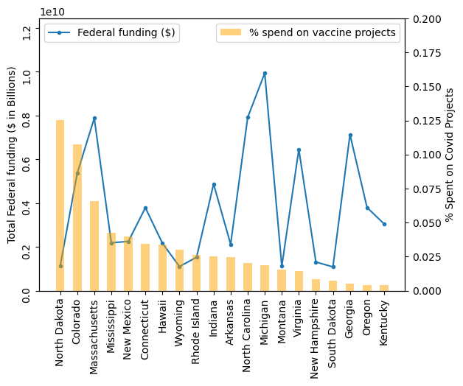
Questions that you found interesting and what motivated you to answer them
Did states that used this money on programs to improve the vaccine uptake for their residents have higher rates of vaccination?
Q1: Did states that spent a higher total $ amount of fed budget on vaccine projects have higher rates of vaccination?
Q2: Did states that had more vaccine-related projects have higher rates of vaccination?

Slide 5



Where and how you found the data you used to answer these questions
CDC - "COVID-19 Vaccinations in the United States, Jurisdiction"
https://data.cdc.gov/Vaccinations/COVID-19-Vaccinations-in-the-United-States-Jurisdi/unsk-b7fc
csv downloaded 5/11/23
EARN/EPI - "EARN SLFRF Workbook for Q4 2022" compiled by Dave Kamper of the Economic Policy Institute (dkamper@epi.org) from Treasury reports by states and local jurisidictions who received funding, and other data sources as detailed in the workbook.

Slide 6
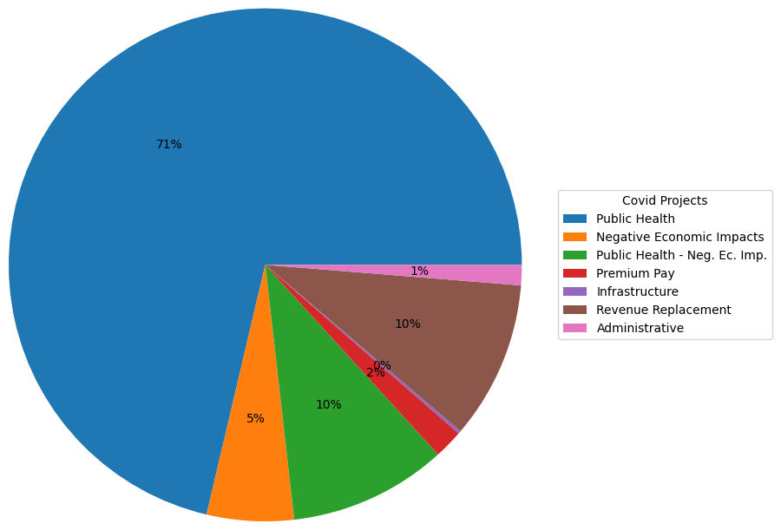
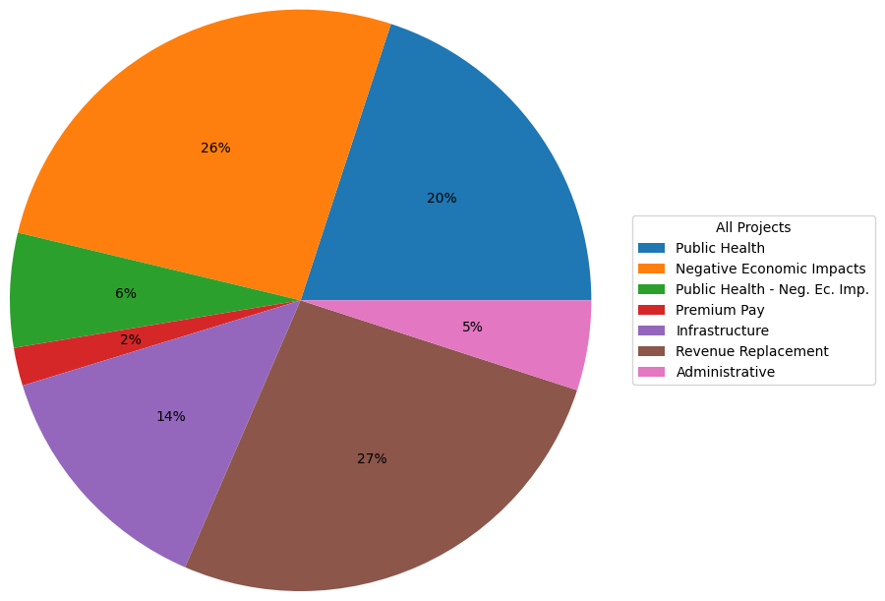
Spending Categories – Vaccine Programs vs. All

Slide 7
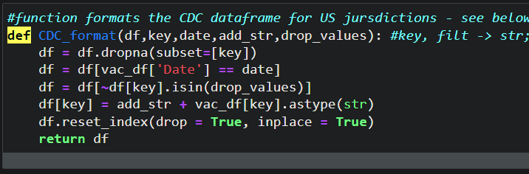
Data exploration and cleanup
Methods:
Import raw data as csv
Drop rows with NA values
Clean column values with string replace functions
Cast strings as numeric where needed
Pandas groupby to sum or count values
Created reduced DFs for specific visuals
Created calculated percentage columns within relevant DataFrames
Defined functions: DRY!

Slide 8
The analysis process
Delete this slide after the analysis plots are in their respective slides
Here’s where we show, don’t tell:
Slides showing state heatmaps.
Then bar charts for categories by state (spending or count of charts for top 3 or 4 vaccinator states).
Then at least 1 correlation/regression plot? Would be moreso to showcase our ability to use the method.

Slide 9
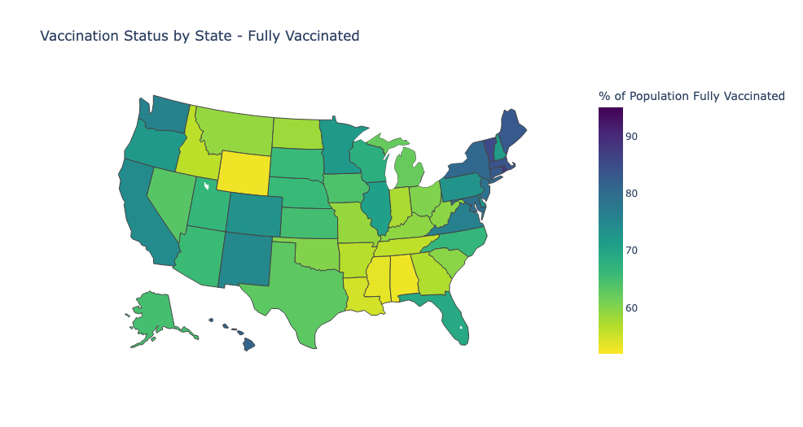
Vaccination Status by State
Mean – 68% (WI)
Min – 53% (AL)
Max – 87% (RI)

Slide 10
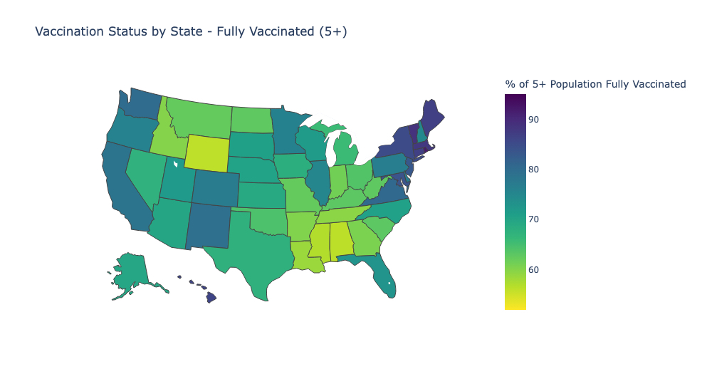
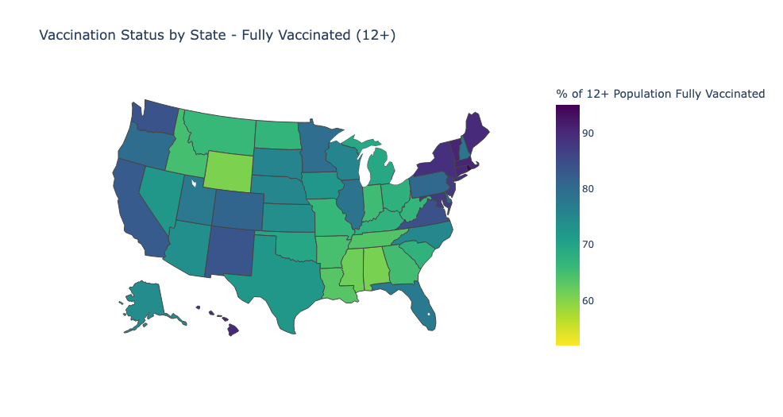
Vaccination Status by State – Age Groups
Ages 5 and up
Ages 12 and up

Slide 11
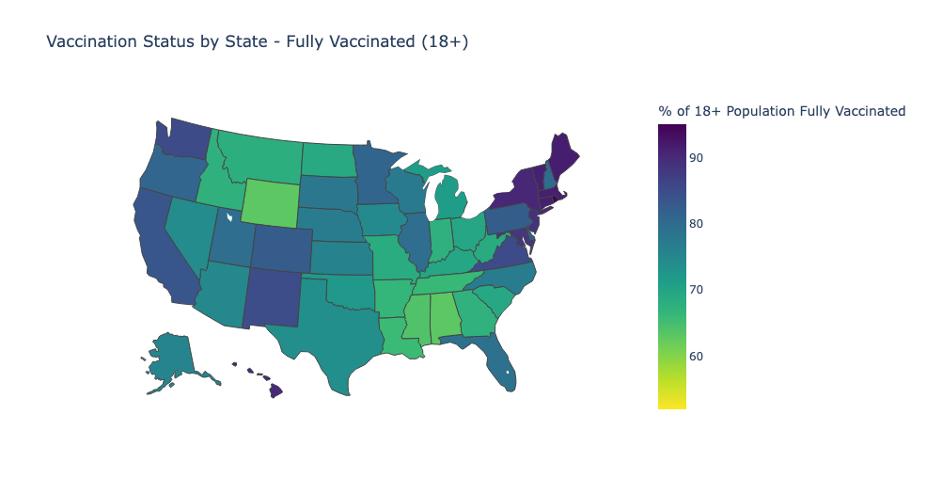
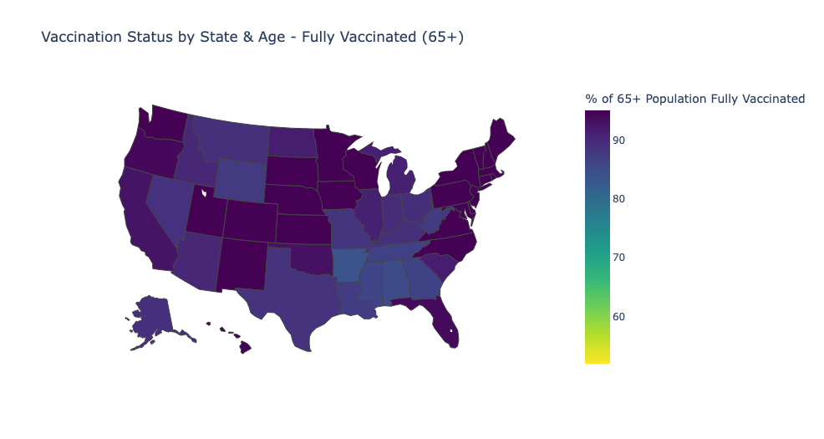
Vaccination Status by State – Age Groups Continued
Ages 18 and up
Ages 65 and up
Notes:
Min/Max for 65+ is – 84%-95%; average of 65+ series complete across all states is 92%. Not a lot of difference in the numbers of 65+ people fully vaccinated by state. Does this hold true for the bivalent booster?

Slide 12
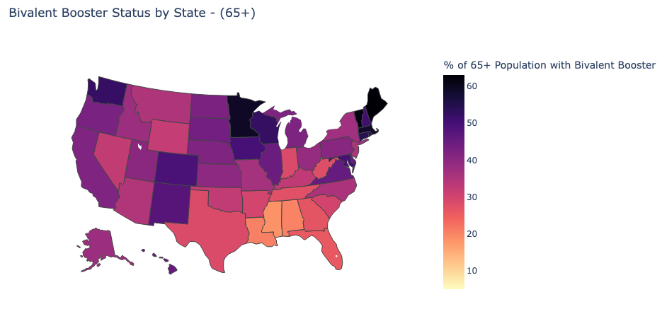
Bivalent Booster Status – 65 plus
Notes:
Unlike fully vaccinated, the highest percentage of 65plus folks we see with a bivalent booster is around 60%. The lowest percentage we see is about 18 percent in Mississippi, and the highest we see is around 62% in Maine. So overall percentages are lower, and there is a greater distribution of percentages across states (62-18, vs 95-84)

Slide 13
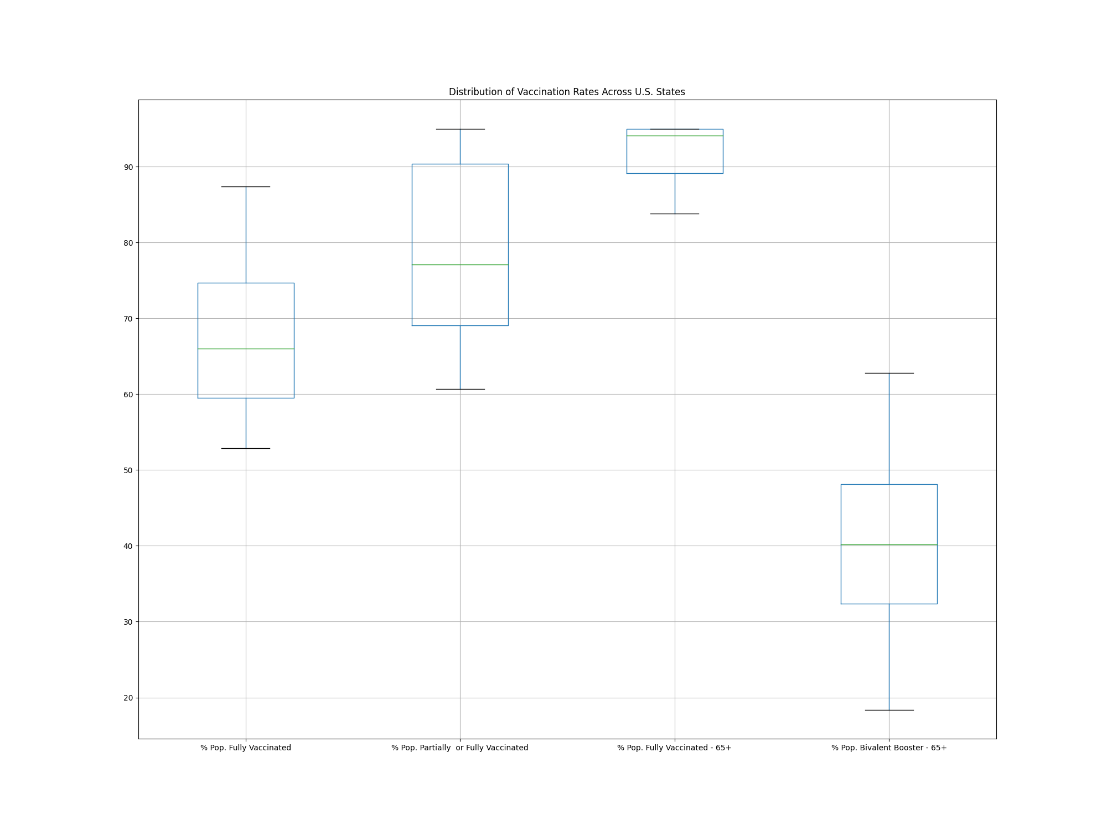

Slide 14
Correlation/Regression plots here. Pick the 2 most “interesting” plots.
Or whichever plots provide easiest talking point for the speaker.
Make a clear statement that there are many variables affecting the regression plots.

Slide 15
Your conclusions, including a numerical summary and visualizations of the summary
Joanna to pick the top 2 or three conclusions here.
Talking about what we did NOT conclude is great too! Or other topics that were out of scope of either the data set or our analysis.
(EARN workbook data conclusion) There was no noticeably trend across states for total Fed $ granted and whether states spent more or less on vaccine-related projects.
(Kendal’s data conclusions)
(Greg’s data conclusions)
Insert repeated copy of the most significant graphs from our analysis to bring the audience back to what was stated earlier in presentation. (if it helps)

Slide 16
Implications and Next Steps
(We should put our slide deck together before filling this out because this will need to align with the outcome of our analysis and analysis conclusion presented).
(What would potential next steps be if this presentation was the “scoping phase”) This will depend on our individual conclusions, really.

