Slide 1
State and Local Fiscal Recovery Funds (SLFRF) Spending vs. Vaccination Rates
Group 7:
Kendal Bergman, Joanna DeLaune, Aaliyah Lockett, Greg Michalak, Evan Sprecher

Slide 2
ARPA and SLFRF
State and Local Fiscal Recovery Funds (SLFRF) refers to the $350 billion allocated for state and local governments under the American Rescue Plan Act of 2021 (ARPA)
Some states used almost all the money available to them by the end of Q4 2022.
Other states have neither spent nor obligated (planned to use) the vast majority of money available to them.
Statutory Eligible Uses for Funds
Respond to COVID-19 public health emergency OR its negative economic impacts
Programs for essential workers such as premium pay or grants for employers
Replace reduced government revenue due to the COVID-19 public health emergency
Make investments in water, sewer, or broadband infrastructure

Slide 3
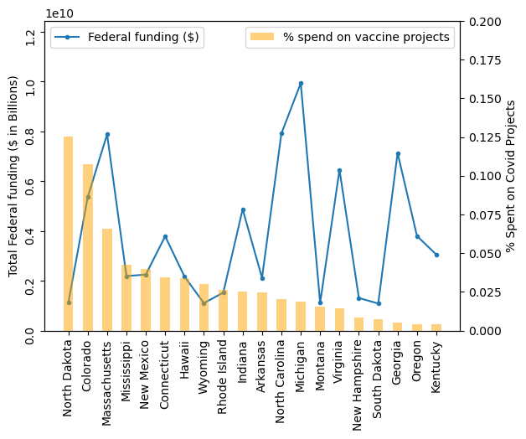
Questions that you found interesting and what motivated you to answer them
Did states that used this money on programs to improve the vaccine uptake for their residents have higher rates of vaccination?
Q1: Did states that spent a higher total $ amount of fed budget on vaccine projects have higher rates of vaccination?
Q2: Did states that had more vaccine-related projects have higher rates of vaccination?

Slide 4



Where and how you found the data you used to answer these questions
CDC - "COVID-19 Vaccinations in the United States, Jurisdiction"
https://data.cdc.gov/Vaccinations/COVID-19-Vaccinations-in-the-United-States-Jurisdi/unsk-b7fc
csv downloaded 5/11/23
EARN/EPI - "EARN SLFRF Workbook for Q4 2022" compiled by Dave Kamper of the Economic Policy Institute (dkamper@epi.org) from Treasury reports by states and local jurisidictions who received funding, and other data sources as detailed in the workbook.

Slide 5
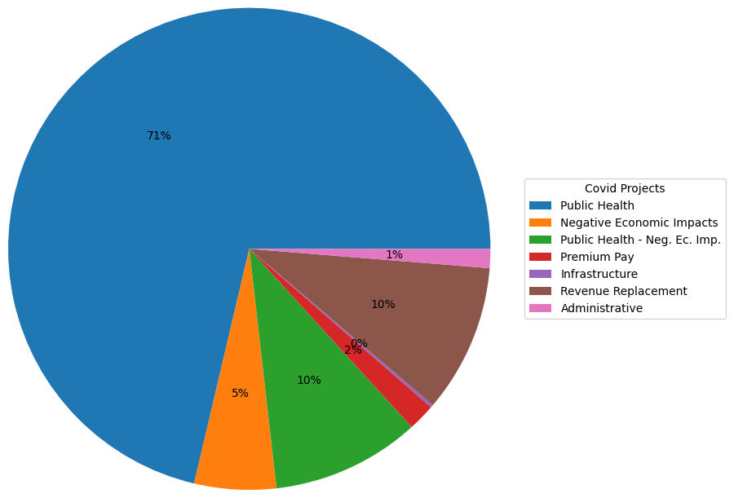
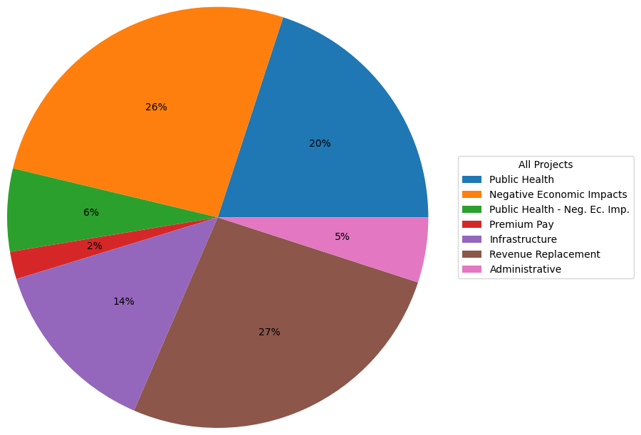
Spending Categories – Vaccine Programs vs. All

Slide 6
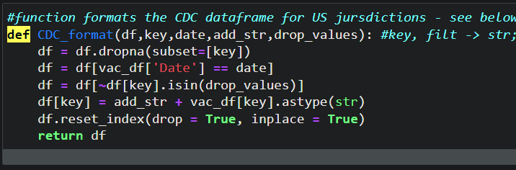
Data exploration and cleanup
Methods:
Import raw data as csv
Drop rows with NA values
Clean column values with string replace functions
Cast strings as numeric where needed
Pandas groupby to sum or count values
Created reduced DFs for specific visuals
Created calculated percentage columns within relevant DataFrames
Defined functions: DRY!

Slide 7
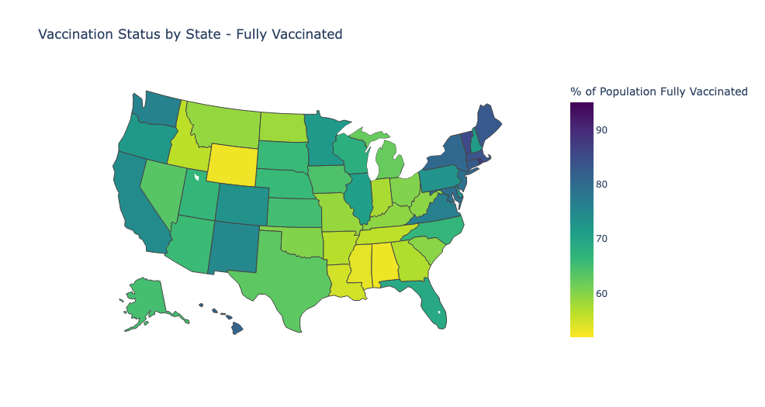
Vaccination Status by State
Mean – 68% (WI)
Min – 53% (AL)
Max – 87% (RI)

Slide 8
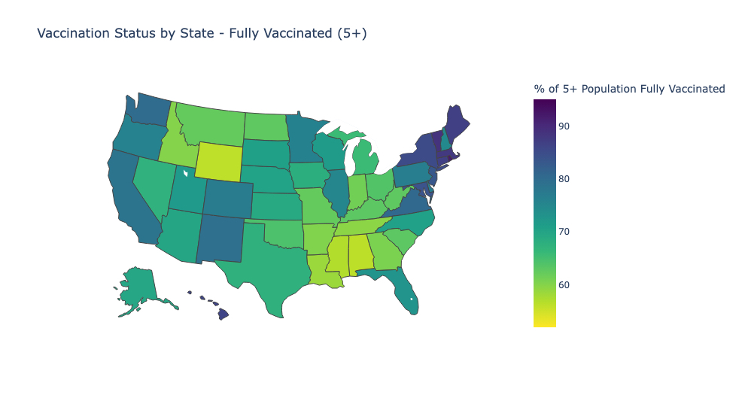
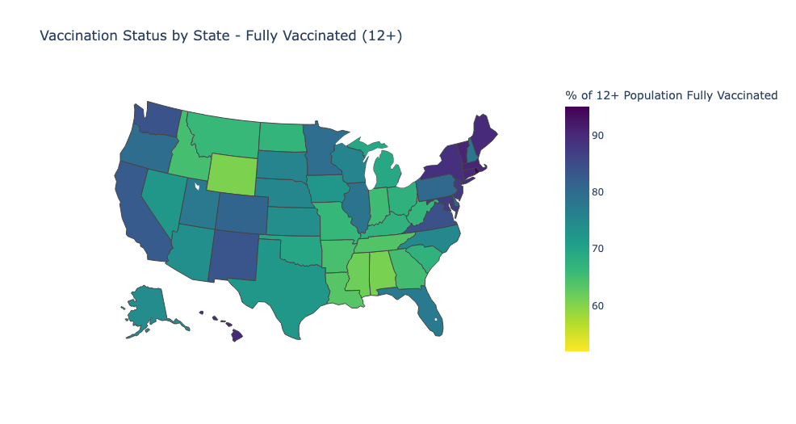
Vaccination Status by State – Age Groups
Ages 5 and up
Ages 12 and up

Slide 9
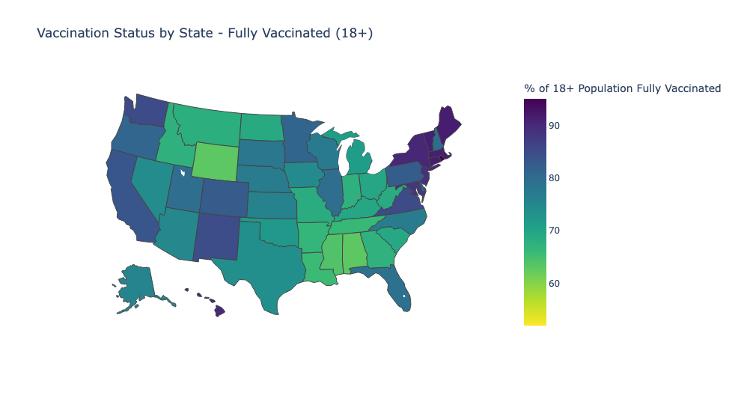
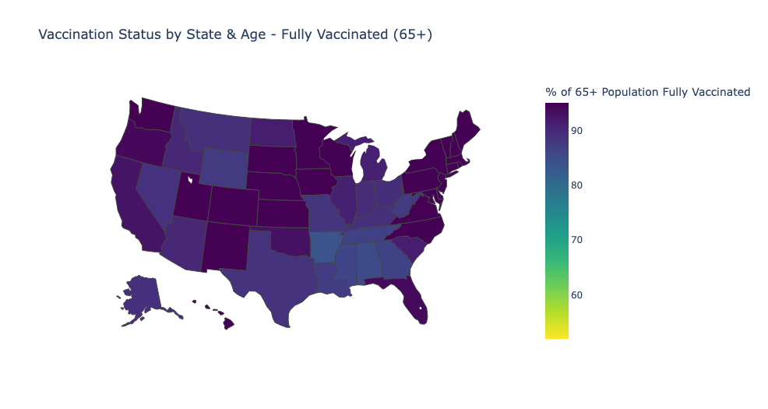
Vaccination Status by State – Age Groups Continued
Ages 18 and up
Ages 65 and up
Notes:
Min/Max for 65+ is – 84%-95%; average of 65+ series complete across all states is 92%. Not a lot of difference in the numbers of 65+ people fully vaccinated by state. Does this hold true for the bivalent booster?

Slide 10
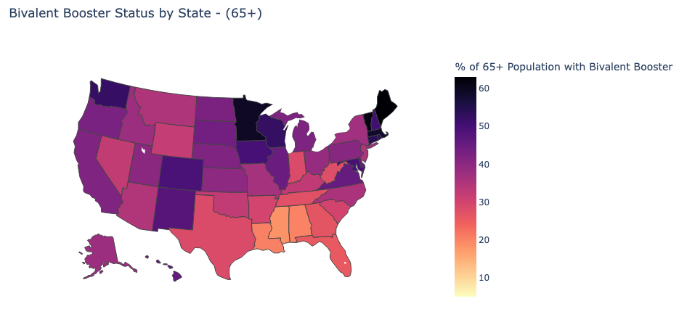
Bivalent Booster Status – 65 plus
Notes:
Unlike fully vaccinated, the highest percentage of 65plus folks we see with a bivalent booster is around 60%. The lowest percentage we see is about 18 percent in Mississippi, and the highest we see is around 62% in Maine. So overall percentages are lower, and there is a greater distribution of percentages across states (62-18, vs 95-84)

Slide 11
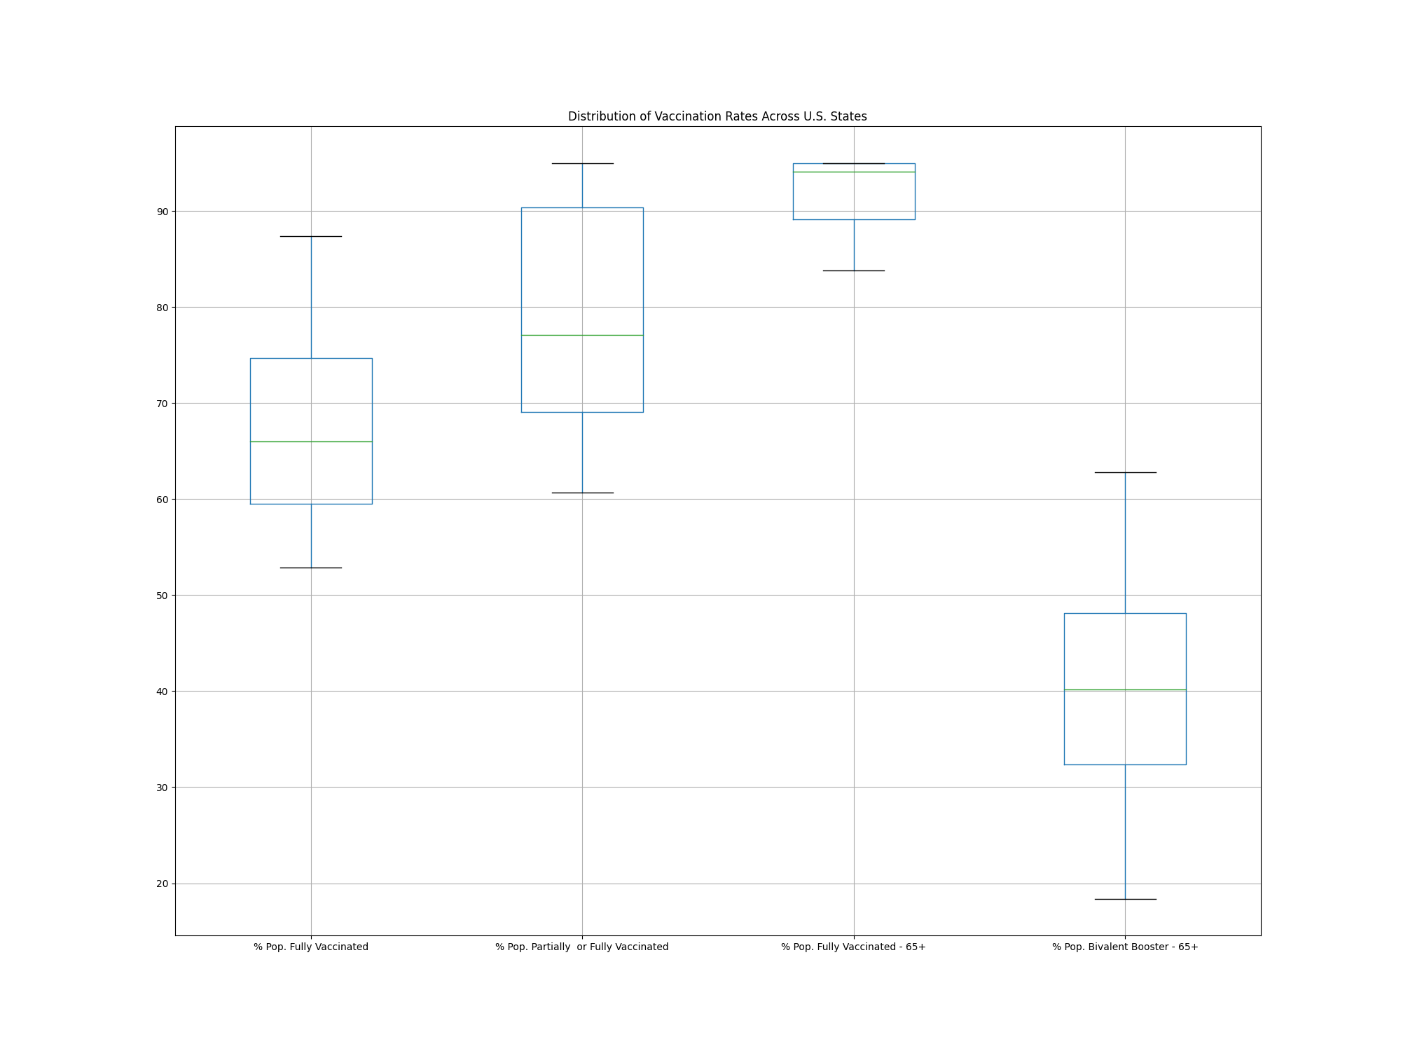
Notes:
Read off tiny text: “Distribution of Vaccination Rates Across U.S. States” Box plots are, from left to right: % of Population Fully Vaccinated, % of Population Partially or Fully Vaccinated (at least one dose), % of Population Age 65+ Fully Vaccinated, and % of Population Age 65+ with Bivalent Booster
This chart shows the dramatic drop-off in uptake of the bivalent booster in even the 65+ age group which had extremely high participation in the initial vaccination series.

Slide 12
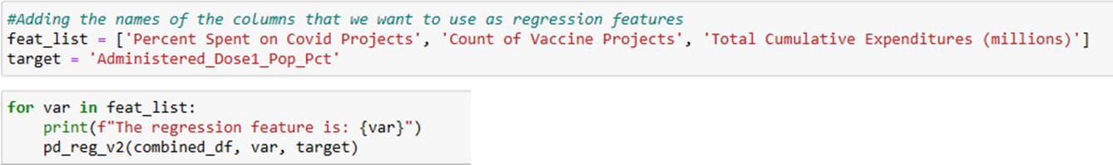
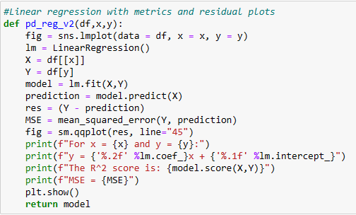
Regression analysis
Method was used to find relationship between EARN and vaccination data
EARN and vaccine data were merged by state
Sklearn linear regression library and Seaborn lmplot
Output targets were vaccination rates for 1 dose and completed vaccination series
Input features were spending levels and number of projects aimed at delivering vaccines
Function reported the linear model and diagnostics, as well as the visualizations

Slide 13
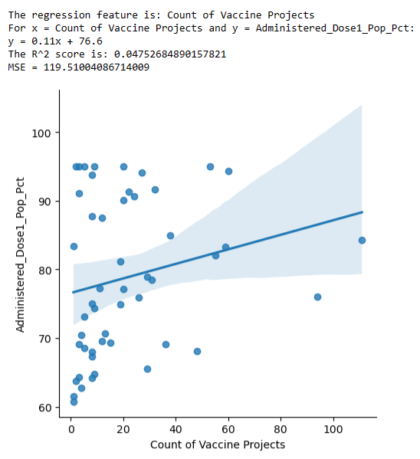
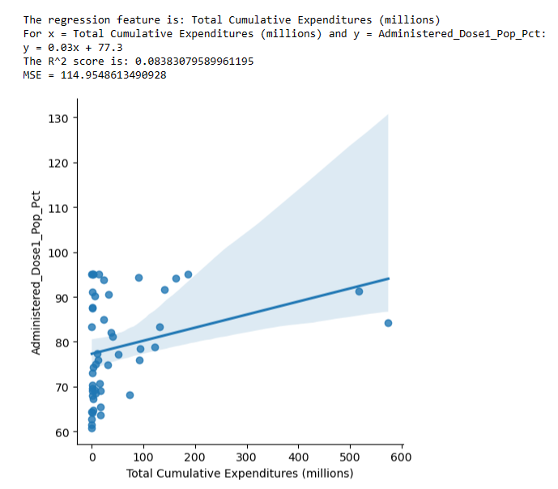
Effect on first dose delivered

Slide 14
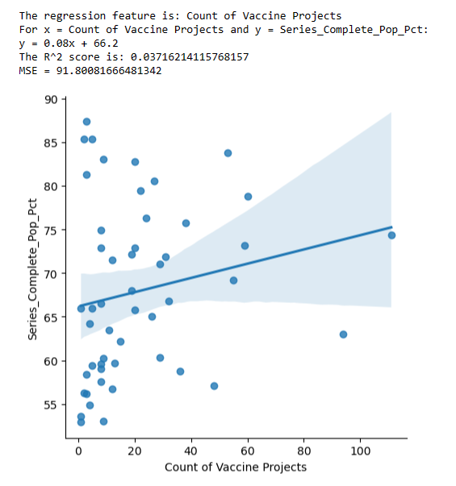
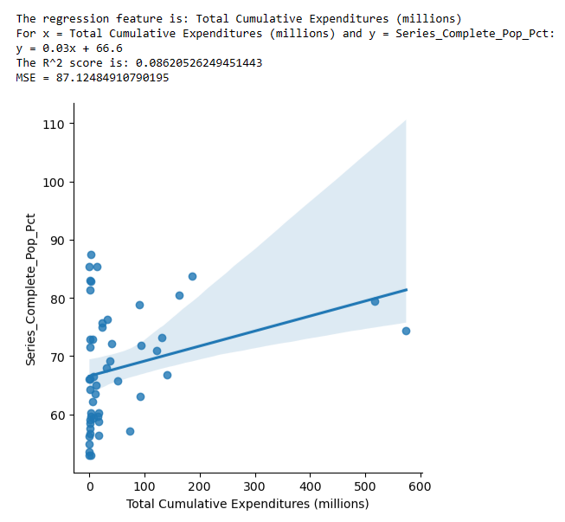
Effect on complete vaccination series

Slide 15
Conclusions
There is not a strong correlation between state or local government use of SLFRF money for vaccination projects and vaccination rates in those states, at least on the variables we measured.
What are some possible reasons for this?
Other funding: States may have used other funding to vaccinate residents
Timing: Many people may have received initial vaccinations before most SLFRF programs were launched
Notes:
ARPA was not passed until March 2021 and the interim rule on how funds should be spent was not in place until May 2021. Many people may have received their initial dose of vaccine or even complete series before projects funded by this program were planned and launched.

Slide 16
Implications and Next Steps
To find out more about the effectiveness of vaccine programs and/or SLFRF funding, a more granular approach to the analysis is needed.
Other analyses that may be of interest:
Bivalent Vaccine: Run the regression using vaccination rates with the bivalent vaccine (which came later). We did not do this only because we would have had to acquire additional data and there were time constraints on our project.
Change in Vaccination Rates: Determine an appropriate effective date when SLFRF money should be considered “in use” and investigate the change in vaccination rates between that date and the end of Q4 2022.

Slide 17
Other Avenues of Inquiry
EARN/SLFRF Data
Analyze with other datasets to examine how programs affected:
Unemployment and economic recovery
Infrastructure improvements in states that used funds
Essential worker pay and retention
Observe if there is a correlation in which party controlled the legislature and governor’s mansion and whether a state used more of its SLFRF funding allocation.
CDC Vaccination Data
Investigate vaccine differential: some states vaccinated many non-residents, while others had many residents who were vaccinated elsewhere
Bivalent vaccine drop-off: did it differ geographically? Any identifiable causes?
Notes:
Refer to box plot on Slide 13 for bivalent vaccine drop-off

