Slide 1
Mapping Vector-borne Illnesses
Collaborators:
Ryan Cornelius, Miranda Dahl, Kevin Miller, Timothy Salazar, Evan Sprecher

Slide 2
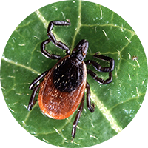
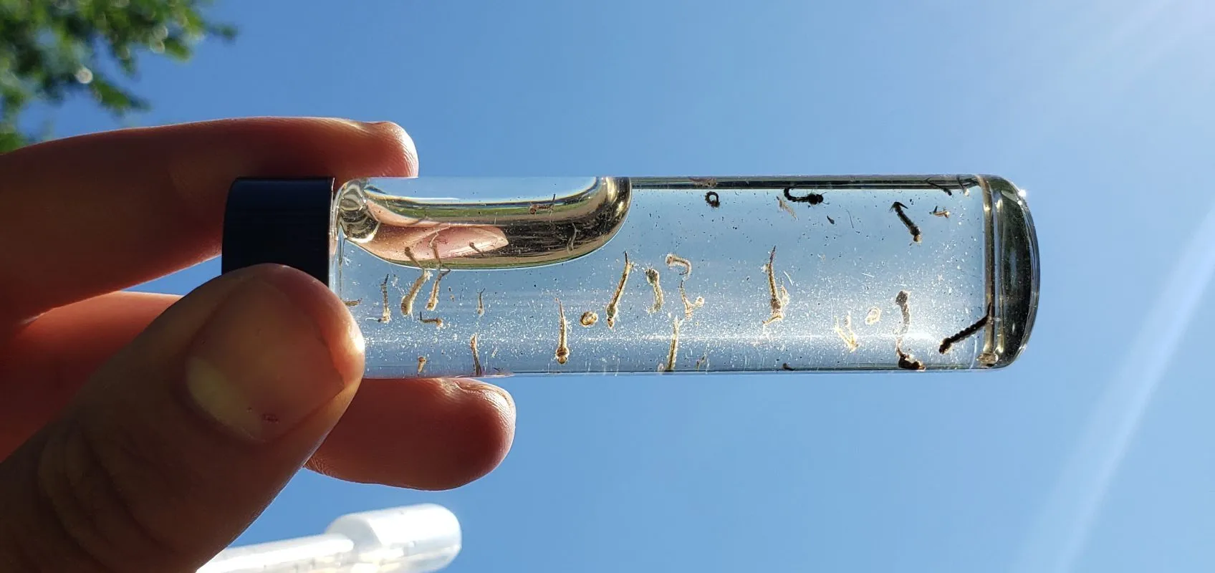
Project Objective and Scope
Objective:
(Observe the year-over-year rates of specific vector-borne illnesses as they relate to average county temperatures and precipitation levels.)
Scope:
(data for USA counties only)
(illnesses analyzed were West Nile Virus and Lyme Disease)

Slide 3
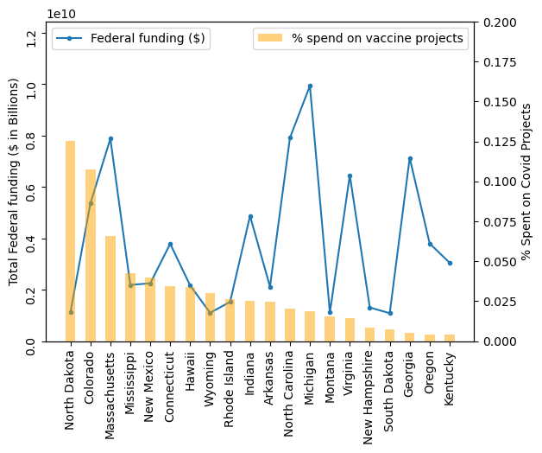
(Questions asked of the Datasets)
How did temperature and precipitation levels relate to rates of vector-borne illnesses for different regions of the US?
Was there a noticeable difference year-over-year in illness rates where temperature or precipitation levels increased/decreased?
(Include high-level visual for audience attention.)

Slide 4


Data Sources
NCEI – National Centers for Environmental Information
County yearly averages for temperature and precipitation data
https://www.ncei.noaa.gov/access/monitoring/climate-at-a-glance/county/mapping
CDC – Centers for Disease Control
West Nile virus case incidence data
https://www.cdc.gov/westnile/statsmaps/historic-data.html
Lyme Disease case incidence data:
https://www.cdc.gov/lyme/datasurveillance/lyme-disease-maps.html#print

Slide 5
Data Loading and Cleaning
Methods:
Scrape web tables to Pandas DataFrames
Use regex and .replace to clean column data
.loc and .iloc to append state and county columns
…
Remap data tables to horizontal year format

Slide 6
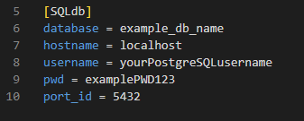
Database and Flask API Setup
Manually import output CSV data to local postgres database
Use Flask to reflect the existing postgres tables to API routes:
Flask references config.ini for logging into local SQL server (avoid pushing sensitive user login info!)
Output reflected tables in dictionary format for consuming the API with JavaScript

Slide 7
Show Project Visuals here
(Run the .html in Live server)

Slide 8
(Other analysis?)
Describe any additional analysis performed here
Include visual graph/correlation/table on the right side of the slide

Slide 9
Conclusions/Further Directions
Lyme disease was clustered in relatively cooler areas, but relatively cooler areas does not imply lyme disease
Clusters in NorthEast and Upper Midwest
West Nile virus was all over the map, literally
Any statistical correlation?
Did we find that population density was ultimately the greatest contributing factor?
Thoughts on inconsistencies in case reporting per county?
Alternative hypotheses
Current predictors
Scale/resolution
Temporal window (assumptions about
Other predictors

Slide 10
Next Steps for Analysis
(After reviewing data, note any potential next steps for analysis here. Assume this project was the “scoping” phase for refining the analysis.)

