Slide 1
Mapping Vector-borne Illnesses
Collaborators:
Ryan Cornelius, Miranda Dahl, Kevin Miller, Timothy Salazar, Evan Sprecher

Slide 2
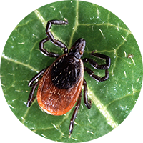
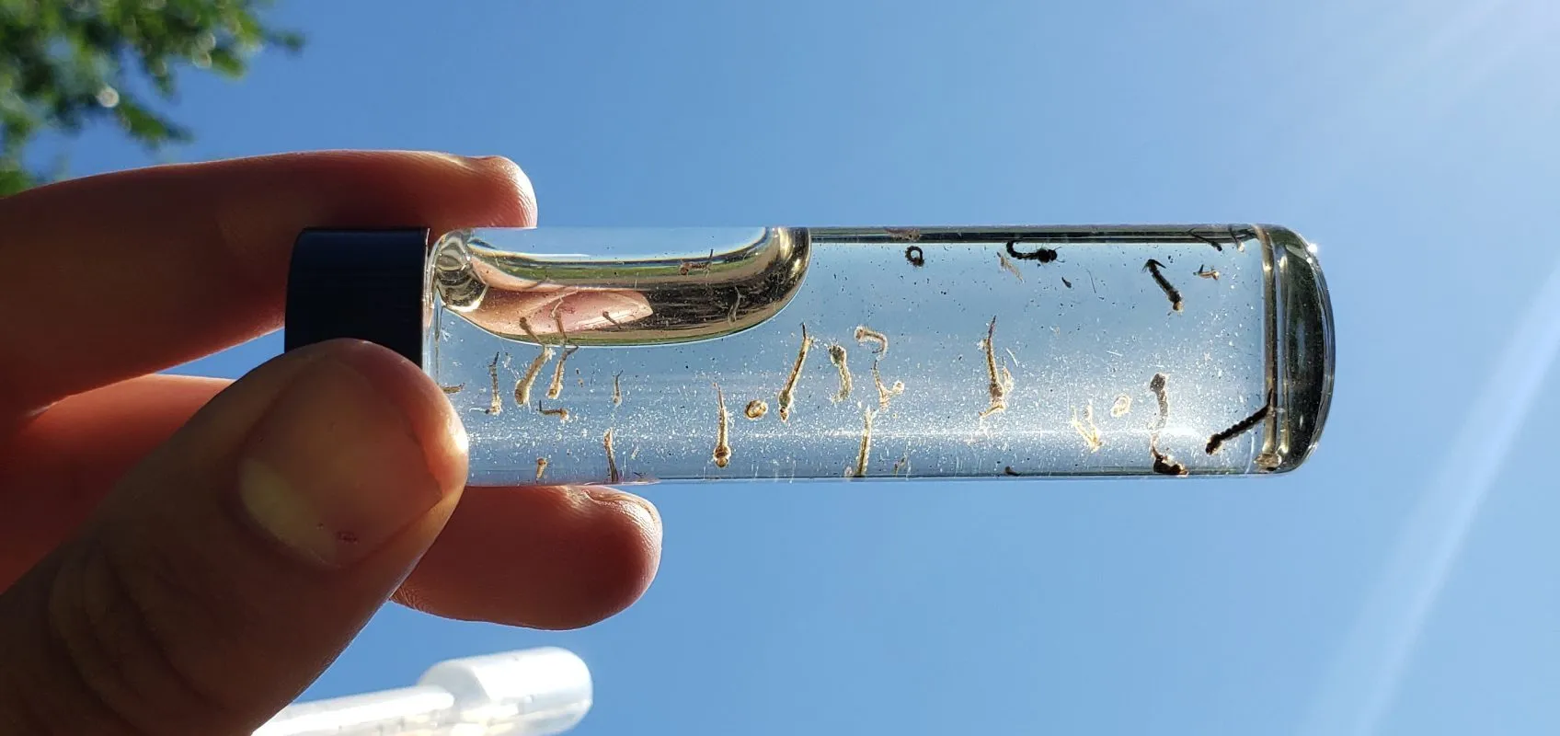
Project Objective and Scope
Objective:
Observe year-over-year rates of specific vector-borne illnesses as related to average county temperatures and precipitation levels.
Scope:
Data for USA counties only
Illnesses analyzed were West Nile Virus and Lyme Disease

Slide 3
Questions asked of the Datasets
How did temperature and precipitation levels relate visually to rates of vector-borne illnesses for different regions of the US?
Was there a noticeable difference year-over-year in illness rates where temperature or precipitation levels increased/decreased?
(Screen share line chart of state illness rates)

Slide 4


Data Sources
NCEI – National Centers for Environmental Information
County yearly averages for temperature and precipitation data
https://www.ncei.noaa.gov/access/monitoring/climate-at-a-glance/county/mapping
CDC – Centers for Disease Control
West Nile virus case incidence data
https://www.cdc.gov/westnile/statsmaps/historic-data.html
Lyme Disease case incidence data:
https://www.cdc.gov/lyme/datasurveillance/lyme-disease-maps.html#print

Slide 5
Data Loading and Cleaning
Extract:
Web scrape Temp/Precip and illness data into Pandas Dataframes and CSV files
Transform: Clean data using regex and .replace(). Reorganize columns.
Load:
Import cleaned data to PostgreSQL server.
Transmit: Reflect Postgres tables to Flask app.py using SQLAlchemy.
Read CSV tables in JavaScript.
Notes:
Methods:
Scrape web tables to Pandas DataFrames
Use regex and .replace to clean column data
.loc and .iloc to append state and county columns
Remap data tables to horizontal year format

Slide 6
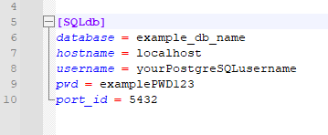
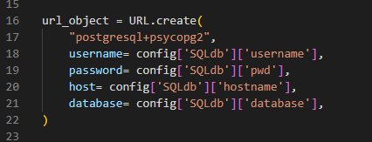
Database and Flask API Setup
Manually import output CSV data to local postgres database
Use Flask to reflect the existing postgres tables to API routes:
Flask references config.ini for logging into local SQL server (avoid pushing sensitive user login info!)
Output reflected tables in dictionary format for consuming the API with JavaScript

Slide 7
JavaScript Visuals
(Run the .html in Live server for JS visuals)

Slide 8
Results and Preliminary Conclusions
Lyme disease clusters in North-East and Upper Midwest
Lyme disease was clustered in relatively cooler areas, but relatively cooler areas do not imply Lyme disease
Similar pattern with precipitation
Interaction effect?
West Nile virus was all over the map, literally
Much lower infection prevalence relative to Lyme disease
No clear qualitative pattern with climate variables
Reporting biases?
Nonneuroinvasive WNV v. neuroinvasive WNV
70-80% of WNV infections are subclinical or asymptomatic per CDC
Lyme disease data is reported by county of residence, not county of exposure
Centers for Disease Control and Prevention. (April 25, 2023). West Nile Virus: Clinical Laboratory Evaluation. Retrieved from https://www.cdc.gov/westnile/healthcareproviders/healthCareProviders-ClinLabEval.html
Centers for Disease Control and Prevention. (November 15, 2022). Lyme Disease: Surveillance Frequently Asked Questions (FAQs). Retrieved from https://www.cdc.gov/lyme/stats/survfaq.html
Centers for Disease Control and Prevention. (April 4, 2023.). West Nile Virus: Surveillance Resources. Retrieved from https://www.cdc.gov/westnile/resourcepages/survResources.html

Slide 9
Next Steps for Visualization & Analysis
Alternative hypotheses
Current predictors
Scale/resolution
3 month window versus 1 month or 12 month, etc.
Temporal window
Is summer the most sensitive phase of the life cycle?
Other predictors
Population density
Quantitative methodologies
Generalized linear mixed model
Account for repeated measures, overdispersion, and missing levels of categorical variables (reporting biases)
Visualization
Slider to seamlessly visualize change across years
Choropleth map for county boundaries
Regression plots to quantitatively

