Slide 1
Mapping Vector-borne Illnesses
Collaborators:
Ryan Cornelius, Miranda Dahl, Kevin Miller, Timothy Salazar, Evan Sprecher

Slide 2
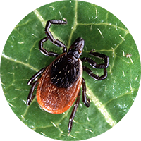
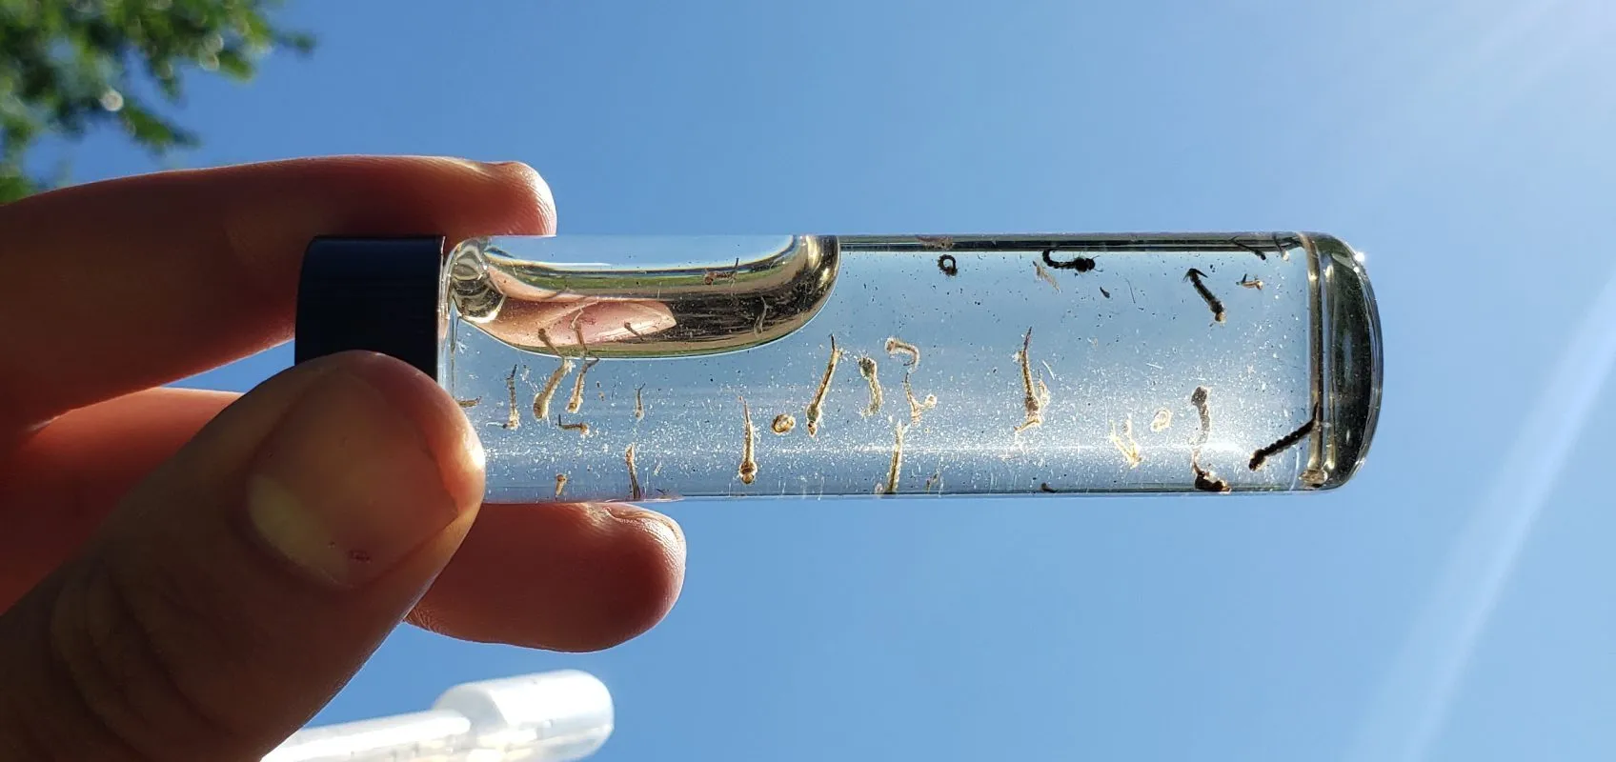
Project Objective and Scope
Objective:
Observe year-over-year rates of specific vector-borne illnesses as related to average county temperatures and precipitation levels.
Scope:
Data for USA counties only
Illnesses analyzed were West Nile Virus and Lyme Disease

Slide 3
Questions asked of the Datasets
How did temperature and precipitation levels relate visually to rates of vector-borne illnesses for different regions of the US?
Was there a noticeable difference year-over-year in illness rates where temperature or precipitation levels increased/decreased?
(Screen share line chart of state illness rates)

Slide 4


Data Sources
NCEI – National Centers for Environmental Information
County yearly averages for temperature and precipitation data
https://www.ncei.noaa.gov/access/monitoring/climate-at-a-glance/county/mapping
CDC – Centers for Disease Control
West Nile virus case incidence data
https://www.cdc.gov/westnile/statsmaps/historic-data.html
Lyme Disease case incidence data:
https://www.cdc.gov/lyme/datasurveillance/lyme-disease-maps.html#print

Slide 5
Data Loading and Cleaning
Extract:
Web scrape Temp/Precip and illness data into Pandas Dataframes and CSV files
Transform: Clean data using regex and .replace(). Reorganize columns.
Load:
Import cleaned data to PostgreSQL server.
Transmit: Reflect Postgres tables to Flask app.py using SQLAlchemy.
Read CSV tables in JavaScript.
Notes:
Methods:
Scrape web tables to Pandas DataFrames
Use regex and .replace to clean column data
.loc and .iloc to append state and county columns
Remap data tables to horizontal year format

Slide 6
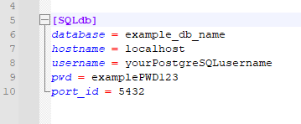
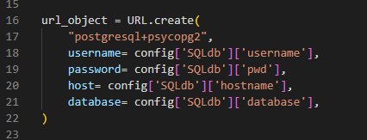
Database and Flask API Setup
Manually import output CSV data to local postgres database
Use Flask to reflect the existing postgres tables to API routes:
Flask references config.ini for logging into local SQL server (avoid pushing sensitive user login info!)
Output reflected tables in dictionary format for consuming the API with JavaScript

Slide 7
JavaScript Visuals
(Run the .html in Live server for JS visuals)

Slide 8
Conclusions/Further Directions
Lyme disease was clustered in relatively cooler areas, but relatively cooler areas does not imply lyme disease
Clusters in NorthEast and Upper Midwest
West Nile virus was all over the map, literally
Any statistical correlation?
Did we find that population density was ultimately the greatest contributing factor?
Thoughts on inconsistencies in case reporting per county?
Alternative hypotheses
Current predictors
Scale/resolution
Temporal window (assumptions about
Other predictors

Slide 9
Next Steps for Analysis
(After reviewing data, note any potential next steps for analysis here. Assume this project was the “scoping” phase for refining the analysis.)

