Slide 1
Presentation outline
Evan: Project Introduction
Objective/Purpose
Dataset
Scope (of dataset)
Travis: Start high level with visual of Timothy’s scatter plot showing all data points for model prediction.
Timothy: Then model 2 and random forest DOE Pareto.
Kyle: Clustering last as it ties to overall data again and 2 year range.

Slide 2
Predicting NFL Player Position with ML
Collaborators:
Kyle Murphy, Timothy Salazar, Travis Steinkopf, Evan Sprecher
Notes:
Evan presents

Slide 3
Purpose and Scope
Objective:
Use machine learning’s supervised predictive model ability to analyze NFL player data for predicting player position:
QB, WR, RB, TE
Visually compare data clusters to contrast grouping per position with Unsupervised ML.
Scope:
Model/Visual | Year range | Years analyzed
Model 1 | 2021 - 2022 | 2
Circle Diagrams | 2021 - 2022 | 2
Model 2 | 2013 – 2022 | 10
Random Forest Pareto | 2013 – 2022 | 10
Cluster by position | 2013 – 2022 | 10
Notes:
Evan presents

Slide 4
Questions asked of the Datasets
Can you apply machine learning to accurately predict an NFL players position?
Which players fall between predicted clustering? Why?
Which player stats had the most significant contribution to getting a successful prediction?
Notes:
Evan presents

Slide 5

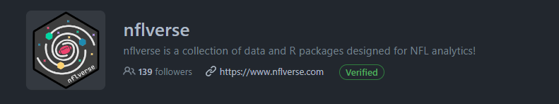
Data Sources
Source 1 – fantasy-csv-data github
Weekly player stat lines
Recent years: 2021 - 2022
https://github.com/bendominguez0111/fantasy-csv-data/tree/master/weekly/2021
Source 2 – nfl-data-py module
Clean dataframes
Past 10 years: 2013 - 2022
https://github.com/cooperdff/nfl_data_pyImport Weekly player stat lines
Notes:
Evan presents

Slide 6
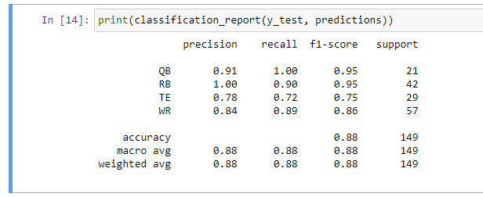

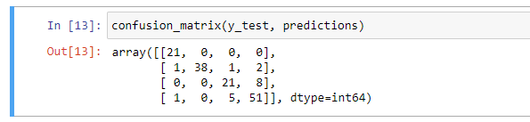
Model 1: Predicting Player Position
Model 1 inputs two years worth of data into the Supervised learning model.
Set N/As to mean of entire column of that stat line.
Initial model for baseline of optimization – Logistic Regression Classifier
Notes:
Travis presents

Slide 7
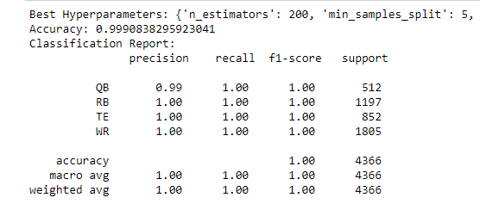
Model 2: Increase Input Data, Change Classifier
Model 2 inputs 10 years worth of data for the same stat lines as model 1.
Set N/As to median of that position for that week.
Iterates on initial model for optimization and further exploration:
Random Forest Classifier
Hyperparameter tuning using RandomizedSearchCV 🤘🏻
Notes:
Timothy presents

Slide 8
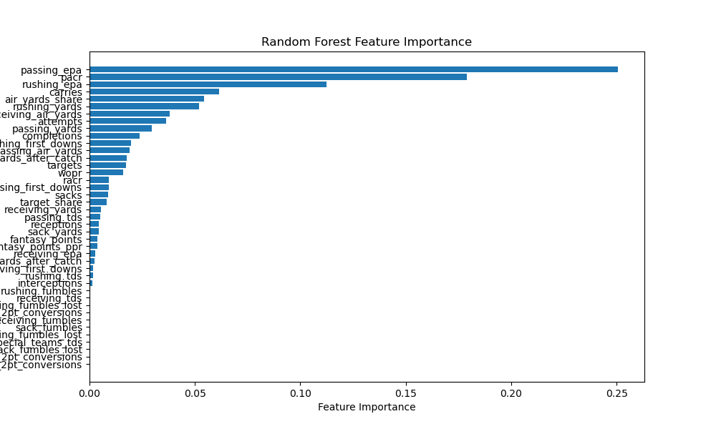
Random Forest for Feature Importance
Notes:
Timothy presents

Slide 9
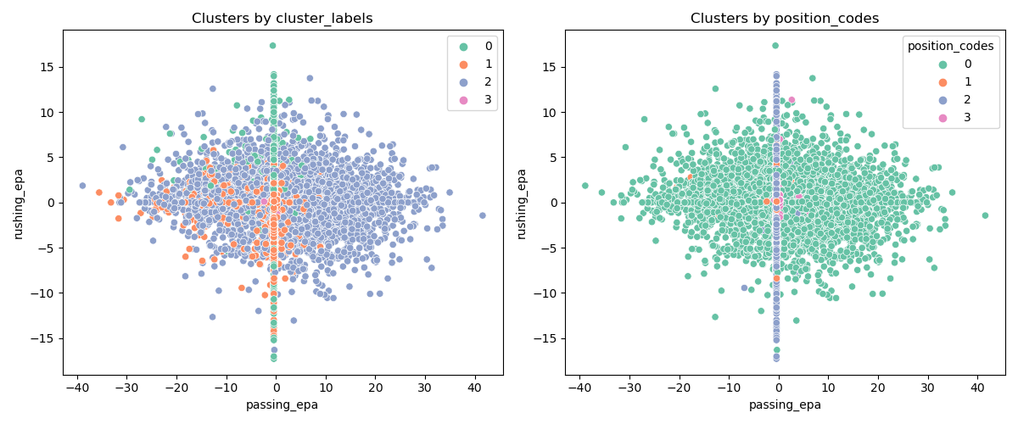
Unsupervized K Means Clustering
Notes:
Timothy presents
Unsupervised Learning, predicted vs. actual

Slide 10
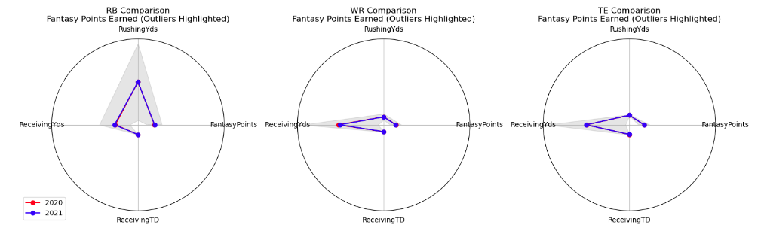
High-Level Data Trends
High-level Radar charts of positional data in the analyzed datasets.
Notes:
Kyle presents

Slide 11
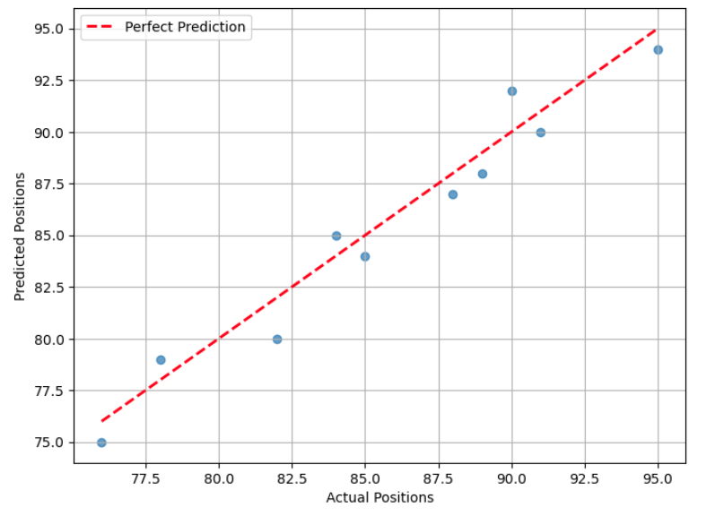
Conclusions Summarized
Predictive models and accuracy improvement:
Improvement from 88% to 99% with additional yearly data and new classification method.
Exploratory Analysis:
Most significant indicators of position were stat lines: passing EPA, PACR, rushing EPA.
Future iterations to drop additional columns.
Stat trends per position:
Radar charts showed that Running back position most ambiguous for Fantasy Football relevant stats.
Notes:
Kyle to present
PACR = Passing (yards) Air (yards) Conversion Ratio - the number of passing yards per air yards thrown per game
EPA = assigned to quarter back, value added by the offence on a play.
Rushing EPA = Expected points added on rush attempts (incl. scrambles and kneel downs).

Slide 12
Questions

