Slide 1

NIST With Not-So-Deep Neural Networks
UCSB, January 20, 0018

Slide 2
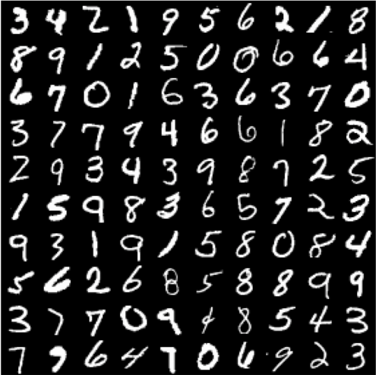
The MNIST Dataset
A collection of handwritten numerical characters with labels.
Each image is greyscale (1-channel) and 256x256.
The dataset is large (70000 labeled images) separated into a 60000 training images and 10000 testing images.
Goal is to build a model that will learn to predict the labels by showing it many examples.

Slide 3
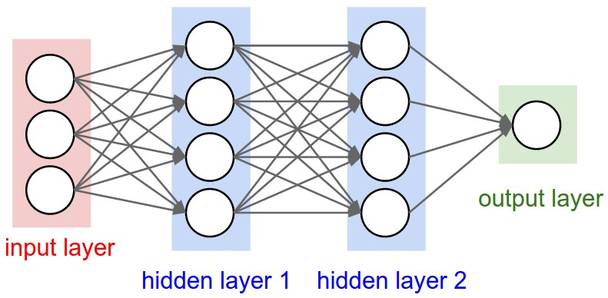
Feed Forwards Neural Networks

Slide 4
Feed Forwards Neural Networks
A highly descriptive statistical model.
Represented as a computational graph with nodes arranged in layers and edges connecting nodes in adjacent layers.
First layer is called the input layer. Last node is called the output layer.
Today, I’ve provided a black box implementation this for you to use. If we have time, we can talk about the mathematical details on how these work.

Slide 5
ML Summer Internships
Nilesh.Mishra@logmein.com

Slide 6
https://github.com/frankwang95/sbhacks_mnist.git

