Slide 1
Módulo: Expresión diferencial
Bioinformática y Estadística 2
Dra. Evelia Coss
Dra. Alejandra Medina
21 al 24 de Febrero, 2023

Slide 2
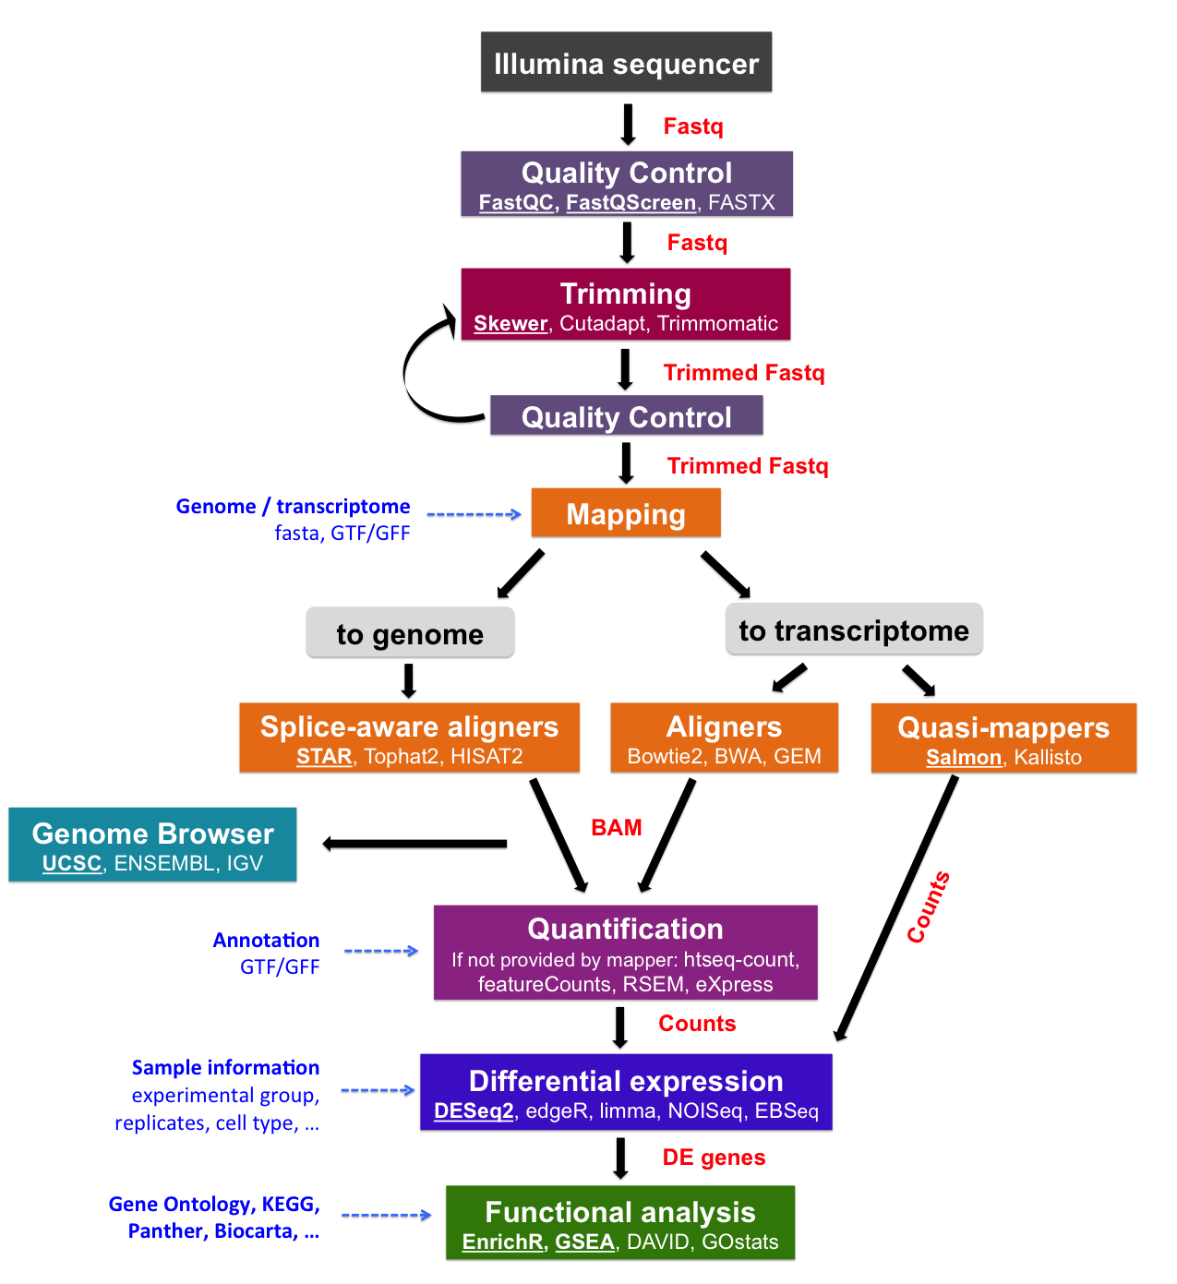
Pipeline bioinformática
Dónde estamos...
mRNA-Seq data analysis workflow “https://biocorecrg.github.io/RNAseq_course_2019/workflow.html”

Slide 3
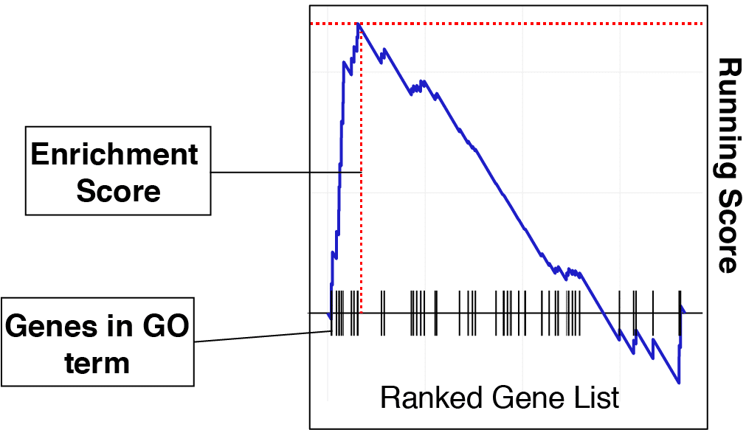
Gene Set Enrichment Analysis (GSEA)
Análisis de funcional de genes expresados.
Comparación con una distribución hipergeométrica.
Ejemplo con m&ms
https://www.youtube.com/watch?v=udyAvvaMjfM
https://bioinformaticsbreakdown.com/how-to-gsea/

Slide 4
GSE function workflow
Input
gene_list = Ranked gene list ( numeric vector, names of vector should be gene names)
GO_file= Path to the “gmt” GO file on your system.
pval = P-value threshold for returning results
Paquetes
fgsea, clusterProfiler, EnrichR, Gprofiler2, GORilla, topGO, AnnotationHub, goseq

Slide 5
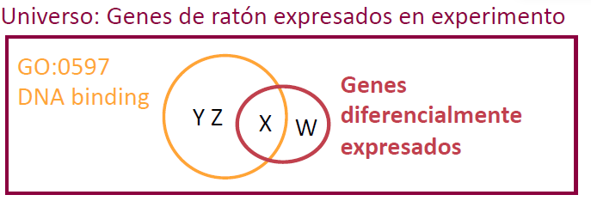
Comparaciones
Universo
Genes expresados

Slide 6
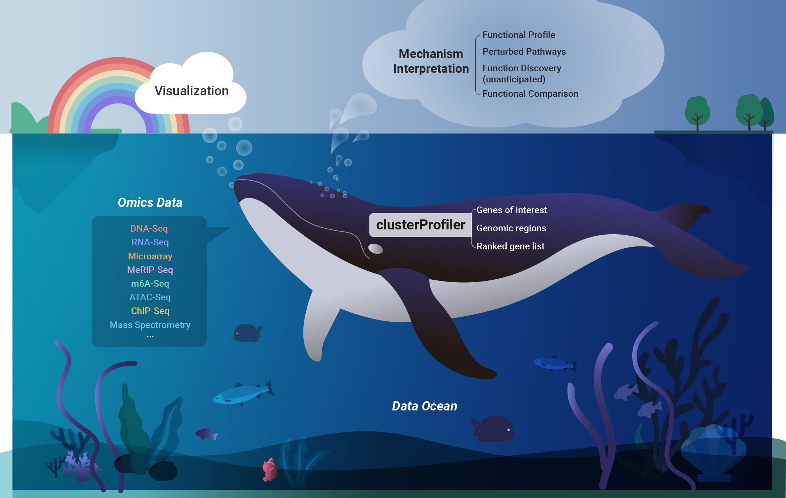
https://github.com/YuLab-SMU/clusterProfiler

Slide 7
GOterm
BP : Biological process
Oligopeptide transport, response to abiotic stimulus, cell cycle
MF : Molecular function
Identical protein binding, endopeptidase activity
CC : Celular component
Apoplast, cell wall, extracellular region, cell surface
KEGG pathway
Rutas metabólicas / enzimáticas.

Slide 8
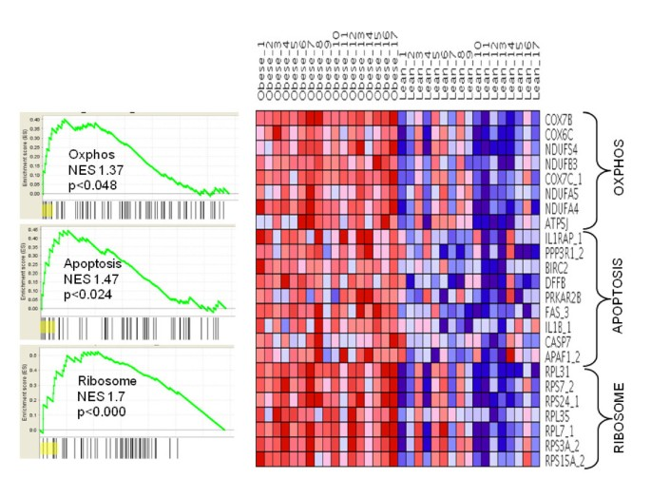
Gene expression profiling in whole blood identifies distinct biological pathways associated with obesity
GSEA
Ghost, et al. 2010. BMC Medical Genomics

Slide 9
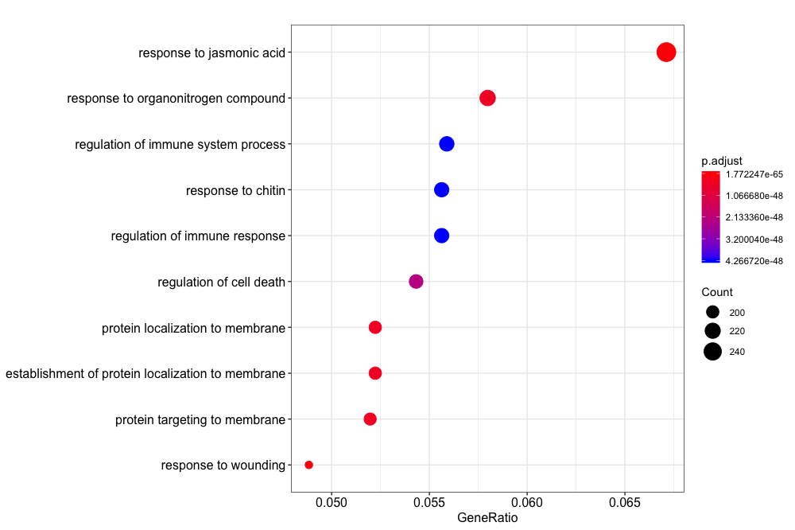
Tus primeros pasos

Slide 10
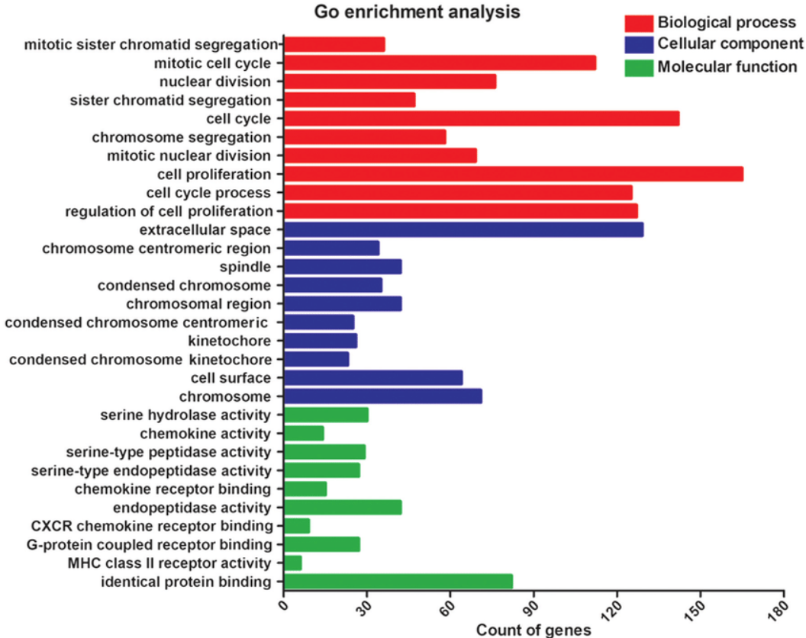
GOterm
Identification of putative drugs for gastric adenocarcinoma utilizing differentially expressed genes and connectivity map
Che, et al. 2018. Molecular Medicine Reports

Slide 11
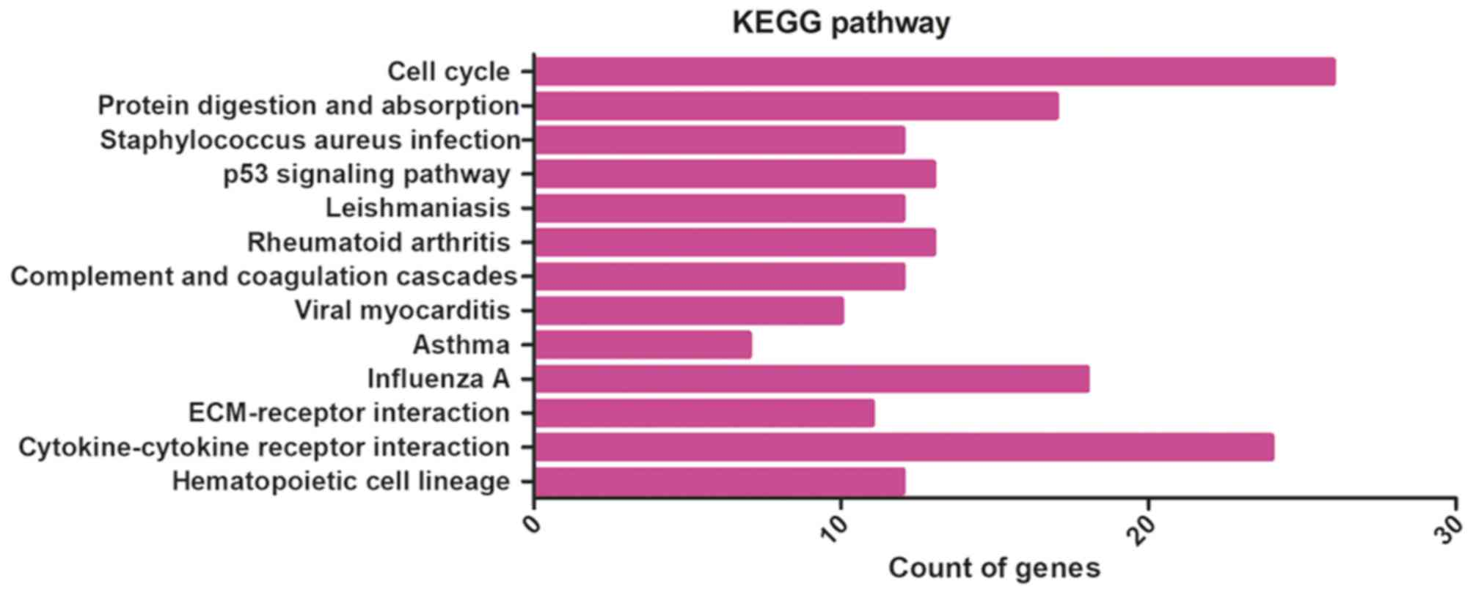
Identification of putative drugs for gastric adenocarcinoma utilizing differentially expressed genes and connectivity map
KEGG pathway
Che, et al. 2018. Molecular Medicine Reports

Slide 12
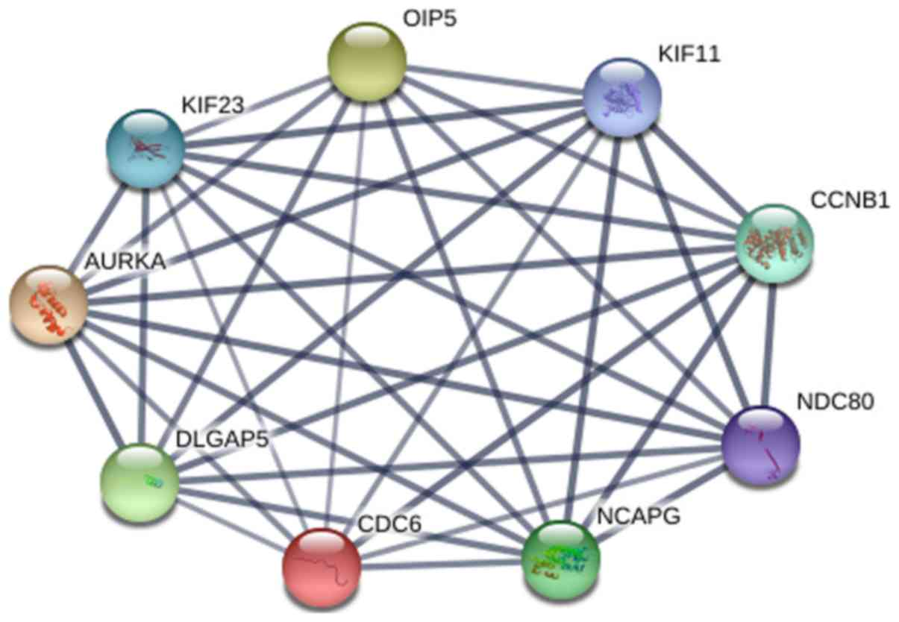

Identification of putative drugs for gastric adenocarcinoma utilizing differentially expressed genes and connectivity map
Redes
String-db.org
Che, et al. 2018. Molecular Medicine Reports
https://www.spandidos-publications.com/10.3892/mmr.2018.9758

Slide 13
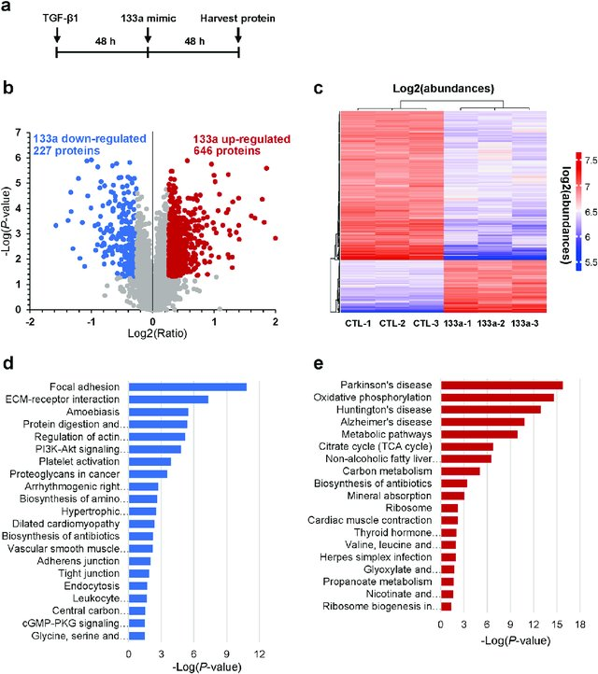
Transforming growth factor (TGF)-β1-induced miR-133a inhibits myofibroblast differentiation and pulmonary fibrosis
Wei, et al. 2019. Cell Death & Disease

