Slide 1
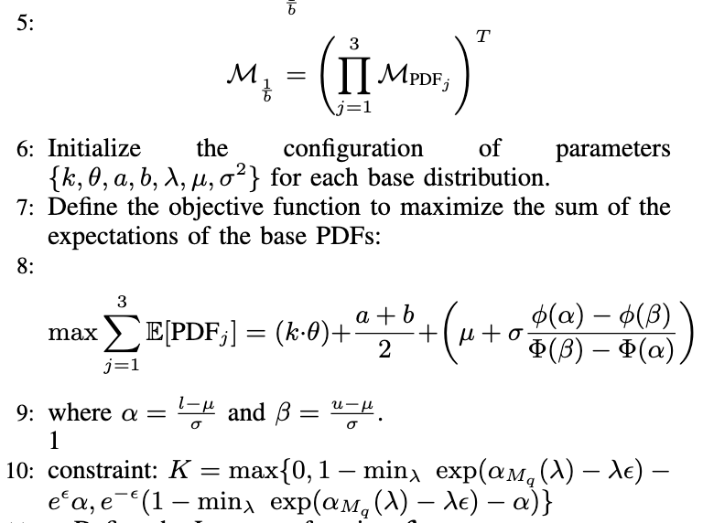
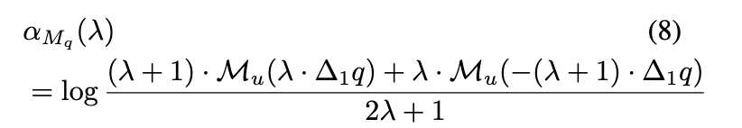
Theory (predict z from S or D; where S from D)
(S is training set) | True label b=0 (not from S) | True label b=1 (from S)
Predicted A=0 | ✅ | beta
Predicted A=1 | alpha | ✅

Slide 2
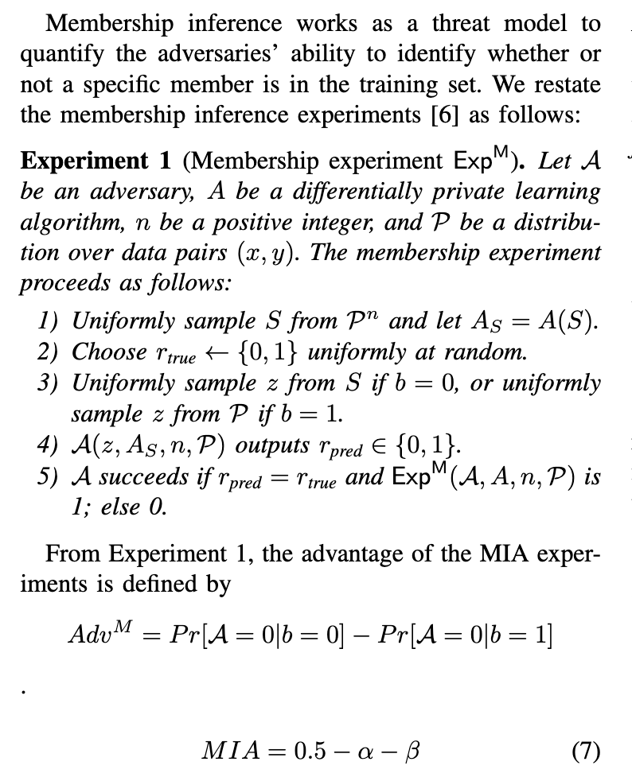
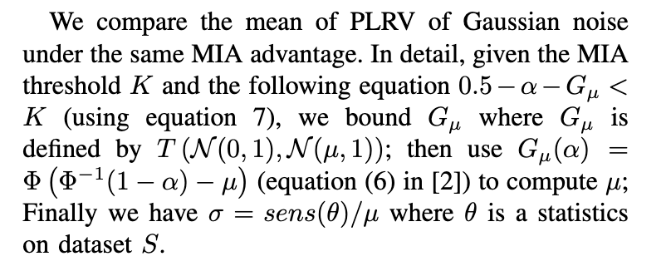
Noise parameter → mia→ gaussian

Slide 3
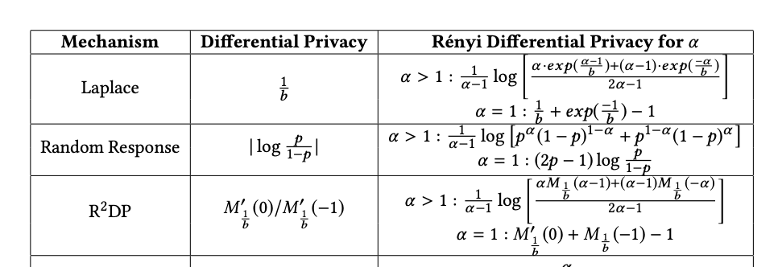
MIA implementation pseudocode
1 compute mean of loss in the training set: x1
2 if mean of loss in the test set x2 has x2>x1: not in the training set.
3 compute accuracy
mean of np.log(acc)
4 compute clipbkd

Slide 4
Experiments settings
Exp1 – Exp 4: fix T=1
1 fix sensitivity=1; vary K[0.1~0.4]
plot figure for both PLRV and Gaussian: [x]MIA -- [y]ACC_{best}
2 fix K=0.4; vary sensitivity[0.1~1.0]
plot figure for both PLRV and Gaussian: [x]MIA -- [y]ACC_{best};
3 fix K=0.4;fix sensitivity =1; vary eps=[0.1, 0.2, 0.3, 0.4, 0.5, 1, 1.5, 2, 2.5, 3, 8]
find noise parameters with best acc for different epsilon;
4 the optimal noise visualization;
Exp 5: vary T=[1,5,10,20,100]; fix K=0.4.
Suggestions: add condition: delta<1.

Slide 5
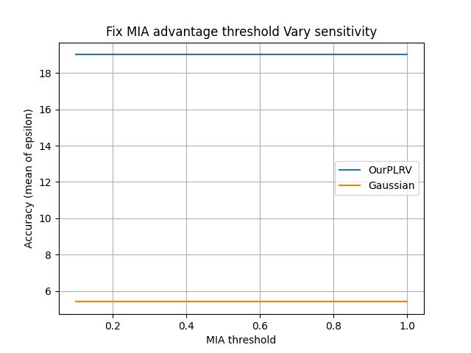
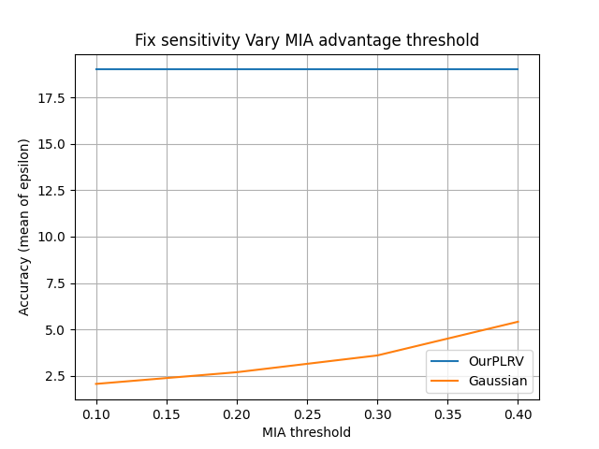
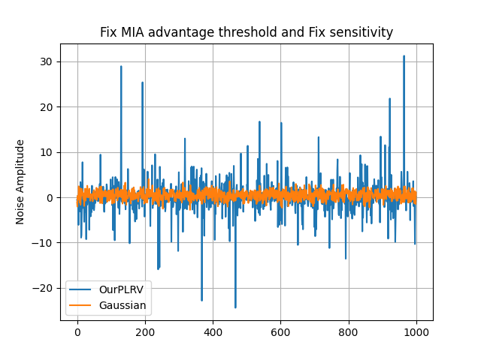
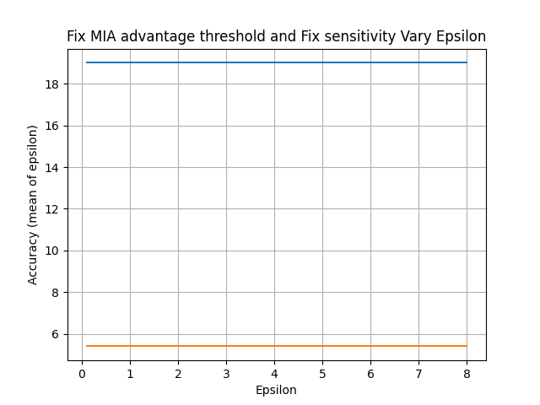
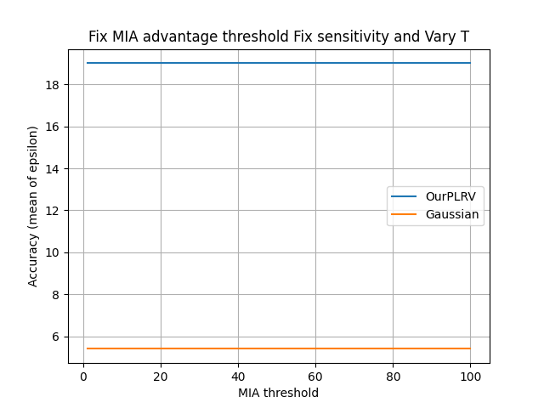
1
2
4
3
5

Slide 6
observations
CV dataset | model | Mia(gaussian/lmo) | Eps_lb(g/l) | notes
fmnist | 2f | 0.011/0.012 | 0.07069/0.11306
fmnist | lr | 0.01077/0.01099 | 0.07844/0.13255
p100 | 2f | 0.01096/0.01157 | 0.070692/0.07844
p100 | lr | 0.0/0.0 | -
param = {'a1': 0.1, 'a3': 0.1, 'a4': 0.1, 'G_theta': 7.5, 'G_k': 1.0, 'E_lambda': 0.1, 'U_b': 2.0, 'U_a': 1.0, 'epsilon': 2.402, 'mia': 0.0022600000000000398, 'obj': 19.0, 'sensitivity': 1.0}
sigma_Gaussian = 0.49256859462010105
Notes:
fmnist 2f
noise_type: gaussian, noise: 0.49256859462010105, pois_ct: 1, clip norm: 1, epslb: 0.07069183042278623, p0: 0.18064889524117578, p1: 0.7427740923950366
noise_type: lmo, noise: 2.402, pois_ct: 1, clip norm: 1, epslb: 0.11306628622436739, p0: 0.05833393605895176, p1: 0.5597609077584368
fmnist lr
noise_type: gaussian, noise: 0.49256859462010105, pois_ct: 1, clip norm: 1, epslb: 0.0784436569510958, p0: 0.1459843772491097, p1: 0.7009052752423728
noise_type: lmo, noise: 2.402, pois_ct: 1, clip norm: 1, epslb: 0.13255082046919806, p0: 0.0357561683487172, p1: 0.5066088490093041
P100 2f
P100 lr

Slide 7
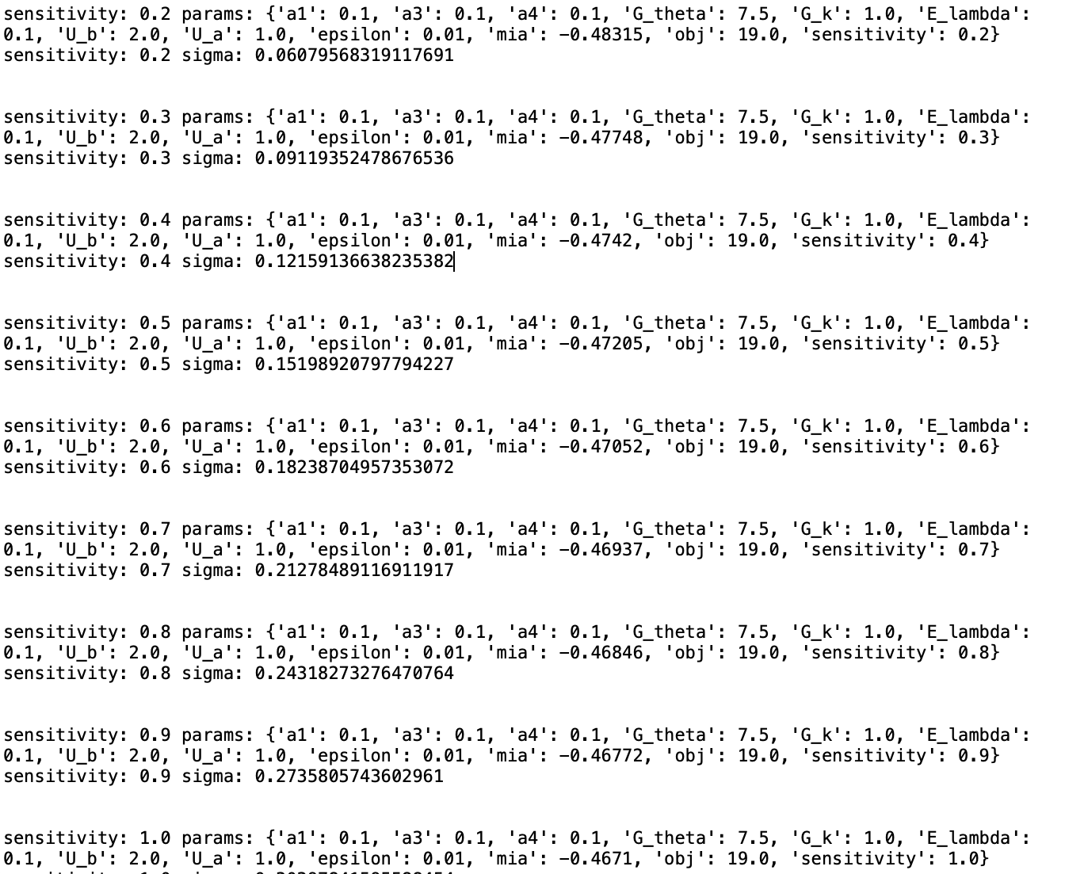
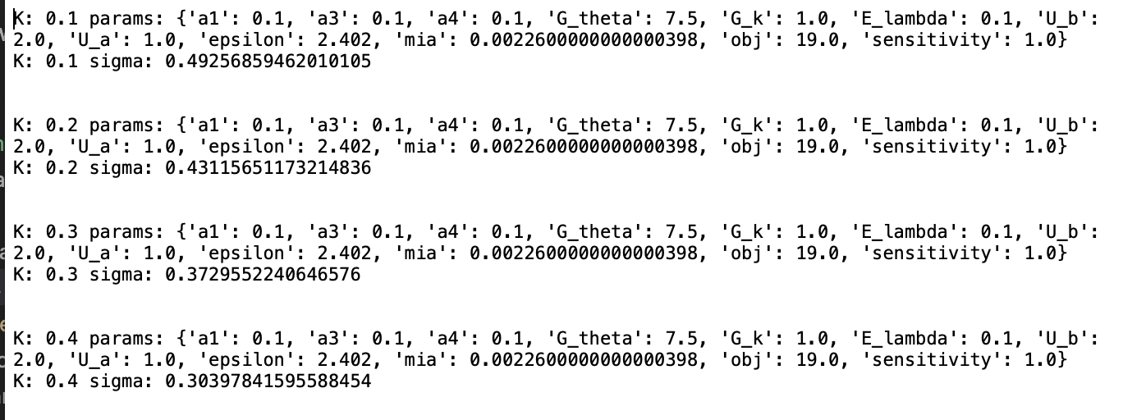
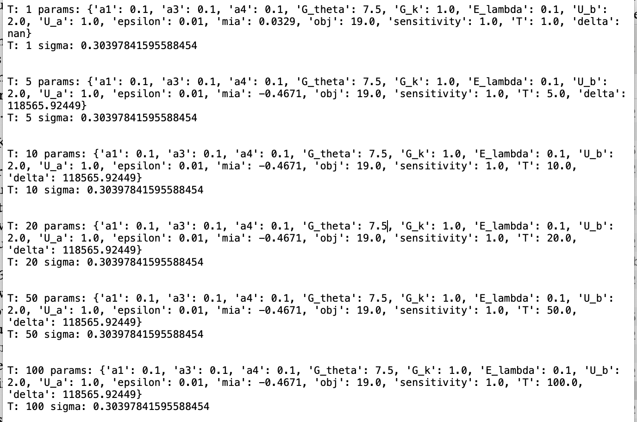
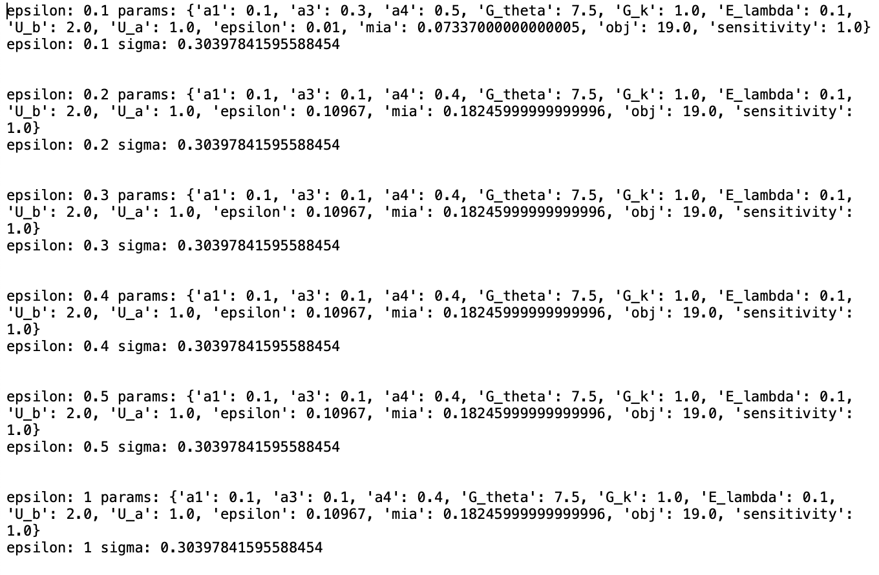

Slide 8
more experiments (with gamma+uniform only)
CV dataset | model | Mia(gaussian/lmo) | Clipbkd(g/l)
fmnist | 2f
fmnist | lr | 0.01108/0.01111 | 0.0431/0.03757
p100 | 2f | 0.04815/0.04746 | 0.105751/0.05518
p100 | lr
Notes:
fmnist lr
noise_type: gaussian, noise: 0.49256859462010105, pois_ct: 1, clip norm: 1, epslb: 0.04305064773534301, p0: 0.550534593260514, p1: 0.23272950098907452
noise_type: lmo, noise: 2.402, pois_ct: 1, clip norm: 1, epslb: 0.03757127149925946, p0: 0.49339115099069586, p1: 0.23272950098907452

Slide 9
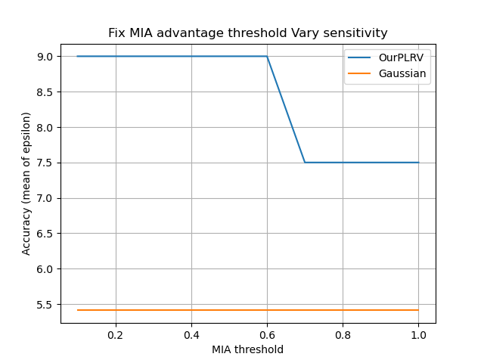
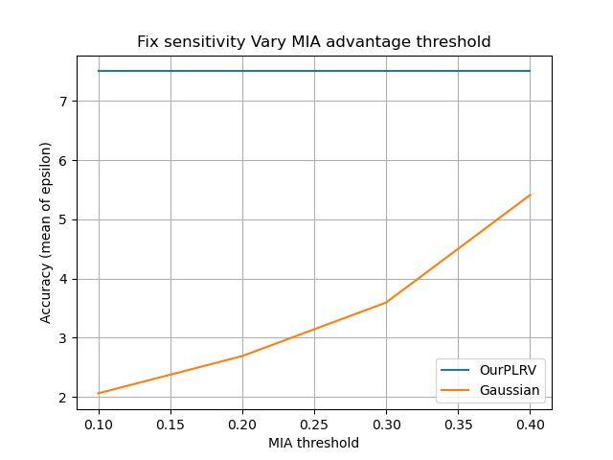
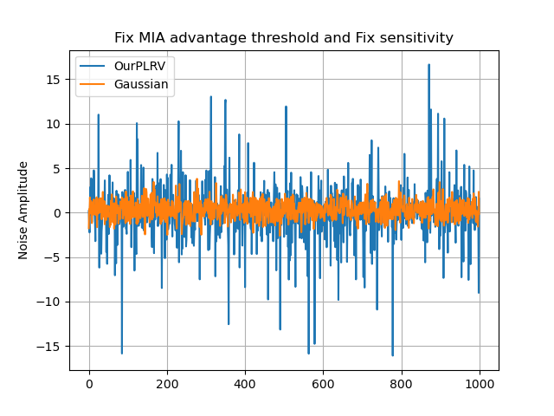
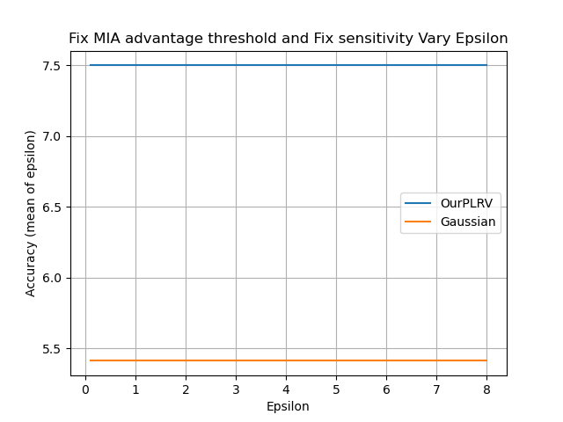


Slide 10
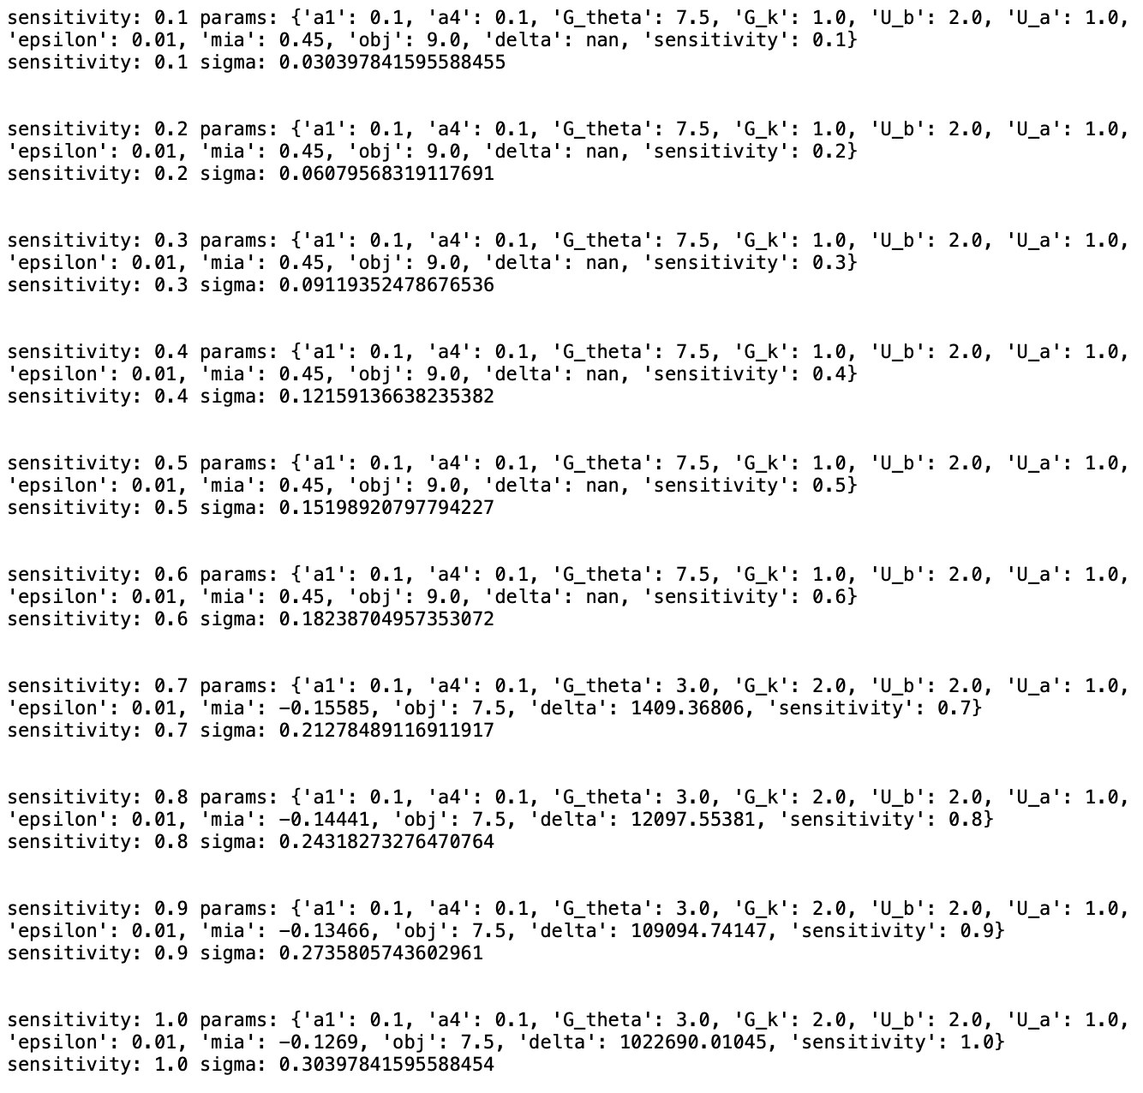
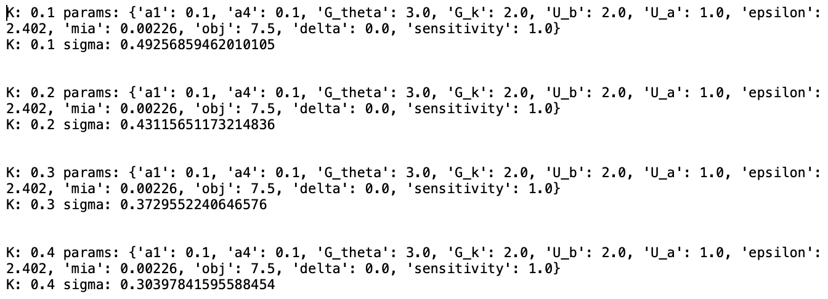
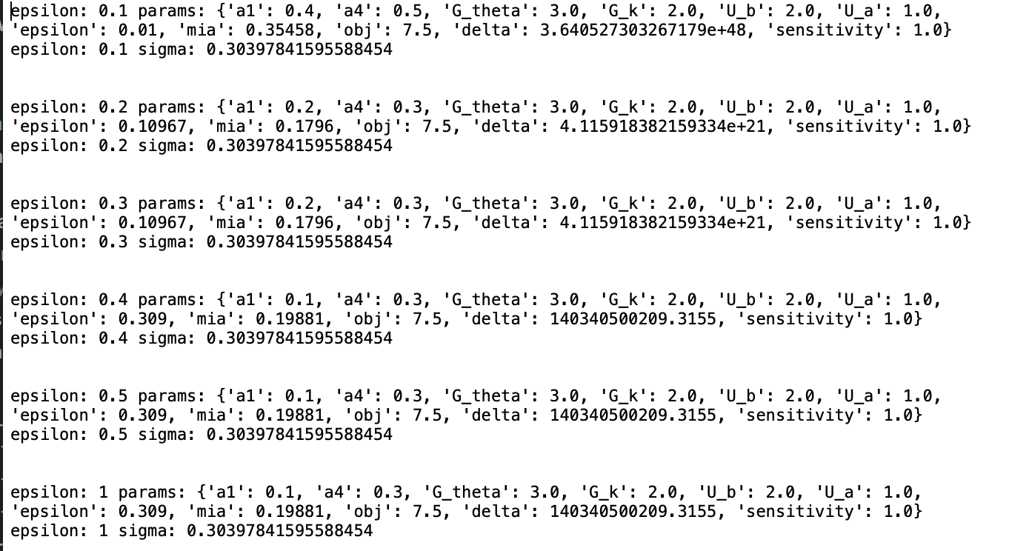
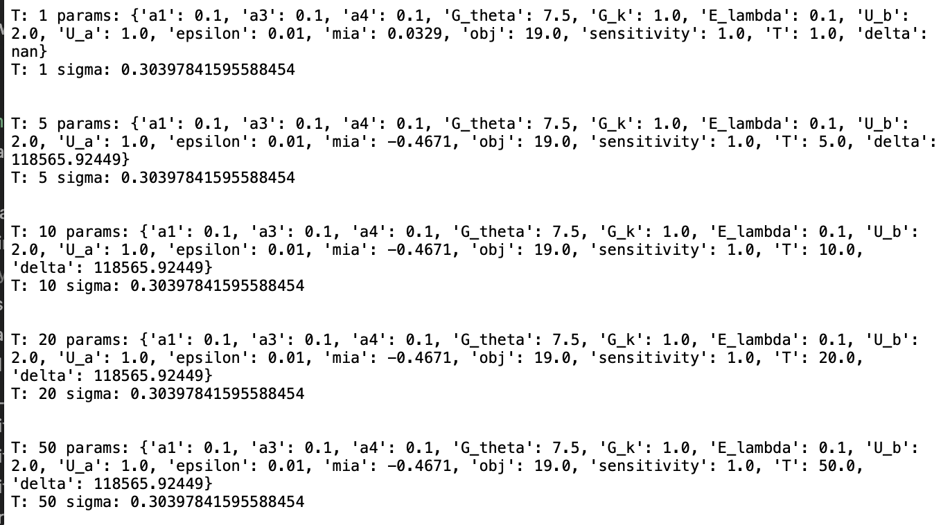

Slide 11
review
The max advantage is 1-µ(n,D), which may be small in practice.
Q1: our max advantage is 0.5.
Q2: even our mia advantage is fixed, this difference of this advantage is expected to be small.
use a stronger attack as the constrain. For example, clipbkd.
use the two-distributions based lmo to expand the search range?

Slide 12
Update our advantage as 1-alpha-beta
# for each T, generate multiple lmo (K=0.1-1) and gaussian noise
# sigma=0.5; conditiong for delta
# T=1, 5, 10, 20, 50, 100, 500, 1000 [CV task (pertrain);]
## real MIA results are needed !!! (figure out the delta)
# problem is that we don't know the connection of K and mia advantage
# 1 fix T: find good clipping value; (vary K in grid search and return noise paramters for each K)
# also run the real mia for all the lmo noises (for each K); e.g., k=0.1, mia=0.3;
# 2 vary sigma [0.1 ~ 10] and document the real mia results. e.g., sigma=0.1, mia=0.4;
# 3 fix mia as the x axis.

