Slide 1
程序的性能优化
王晶
jwang@ruc.edu.cn，信息楼124
2023年11月

Slide 2
Today
Overview
Generally Useful Optimizations
Code motion/precomputation
Strength reduction
Sharing of common subexpressions
Example: Bubblesort
Optimization Blockers
Procedure calls
Memory aliasing
Exploiting Instruction-Level Parallelism
Dealing with Conditionals

Slide 3
关于性能
There’s more to performance than asymptotic complexity（复杂度）
Constant factors matter too!
Easily see 10:1 performance range depending on how code is written
Must optimize at multiple levels:
算法、数据类型、函数、循环
Must understand system to optimize performance
How programs are compiled and executed，编译
How modern processors + memory systems operate，架构+存储
How to measure program performance and identify bottlenecks，瓶颈分析
How to improve performance without destroying code modularity and generality，模块化和通用性

Slide 4
优化编译器
Provide efficient mapping of program to machine
register allocation
code selection and ordering (scheduling)
dead code elimination
eliminating minor inefficiencies
Don’t (usually) improve asymptotic efficiency
up to programmer to select best overall algorithm
big-O savings are (often) more important than constant factors
but constant factors also matter
Have difficulty overcoming “optimization blockers”
potential memory aliasing
potential procedure side-effects

Slide 5
Today
Overview
Generally Useful Optimizations
Code motion/precomputation
Strength reduction
Sharing of common subexpressions
Example: Bubblesort
Optimization Blockers
Procedure calls
Memory aliasing
Exploiting Instruction-Level Parallelism
Dealing with Conditionals

Slide 6
Generally Useful Optimizations
Optimizations that you or the compiler should do regardless of processor / compiler
代码移动Code Motion
Reduce frequency with which computation performed
If it will always produce same result
Especially moving code out of loop
void set_row(double *a, double *b,
long i, long n)
{
long j;
for (j = 0; j < n; j++)
a[n*i+j] = b[j];
}
long j;
int ni = n*i;
for (j = 0; j < n; j++)
a[ni+j] = b[j];

Slide 7
Compiler-Generated Code Motion (-O1)
void set_row(double *a, double *b,
long i, long n)
{
long j;
for (j = 0; j < n; j++)
a[n*i+j] = b[j];
}
long j;
long ni = n*i;
double *rowp = a+ni;
for (j = 0; j < n; j++)
*rowp++ = b[j];
set_row:
testq %rcx, %rcx # Test n
jle .L1 # If 0, goto done
imulq %rcx, %rdx # ni = n*i
leaq (%rdi,%rdx,8), %rdx # rowp = A + ni*8
movl $0, %eax # j = 0
.L3: # loop:
movsd (%rsi,%rax,8), %xmm0 # t = b[j]
movsd %xmm0, (%rdx,%rax,8) # M[A+ni*8 + j*8] = t
addq $1, %rax # j++
cmpq %rcx, %rax # j:n
jne .L3 # if !=, goto loop
.L1: # done:
rep ; ret

Slide 8
Reduction in Strength
Replace costly operation with simpler one
Shift, add instead of multiply or divide
16*x --> x << 4
Utility machine dependent
Depends on cost of multiply or divide instruction
On Intel Nehalem, integer multiply requires 3 CPU cycles
Recognize sequence of products
int ni = 0;
for (i = 0; i < n; i++) {
for (j = 0; j < n; j++)
a[ni + j] = b[j];
ni += n;
}
for (i = 0; i < n; i++) {
int ni = n*i;
for (j = 0; j < n; j++)
a[ni + j] = b[j];
}

Slide 9
Share Common Subexpressions
Reuse portions of expressions
GCC will do this with –O1
/* Sum neighbors of i,j */
up = val[(i-1)*n + j ];
down = val[(i+1)*n + j ];
left = val[i*n + j-1];
right = val[i*n + j+1];
sum = up + down + left + right;
long inj = i*n + j;
up = val[inj - n];
down = val[inj + n];
left = val[inj - 1];
right = val[inj + 1];
sum = up + down + left + right;
3 multiplications: i*n, (i–1)*n, (i+1)*n
1 multiplication: i*n
leaq 1(%rsi), %rax # i+1
leaq -1(%rsi), %r8 # i-1
imulq %rcx, %rsi # i*n
imulq %rcx, %rax # (i+1)*n
imulq %rcx, %r8 # (i-1)*n
addq %rdx, %rsi # i*n+j
addq %rdx, %rax # (i+1)*n+j
addq %rdx, %r8 # (i-1)*n+j
...
imulq %rcx, %rsi # i*n
addq %rdx, %rsi # i*n+j
movq %rsi, %rax # i*n+j
subq %rcx, %rax # i*n+j-n
leaq (%rsi,%rcx), %rcx # i*n+j+n
...

Slide 10
Optimization Example: Bubblesort
Bubblesort program that sorts an array A that is allocated in static storage:
an element of A requires four bytes of a byte-addressed machine
elements of A are numbered 1 through n (n is a variable)
A[j] is in location &A+4*(j-1)
for (i = n-1; i >= 1; i--) {
for (j = 1; j <= i; j++)
if (A[j] > A[j+1]) { temp = A[j]; A[j] = A[j+1]; A[j+1] = temp;
}
}

Slide 11
Bubblesort
比较遍数
数据 | 1 | 2 | 3 | 4
587 | -632 | -632 | -632 | -632
-632 | 587 | 234 | -34 | -34
777 | 234 | -34 | 234 | 234
234 | -34 | 587 | 587 | 587
-34 | 777 | 777 | 777 | 777
从小到大排序

Slide 12
Translated (Pseudo) Code
i := n-1
L5: if i<1 goto L1
j := 1
L4: if j>i goto L2
t1 := j-1
t2 := 4*t1
t3 := A[t2] // A[j]
t4 := j+1 t5 := t4-1
t6 := 4*t5
t7 := A[t6] // A[j+1]
if t3<=t7 goto L3
t8 := j-1
t9 := 4*t8
temp := A[t9] // temp:=A[j]
t10 := j+1
t11:= t10-1
t12 := 4*t11
t13 := A[t12] // A[j+1]
t14 := j-1
t15 := 4*t14
A[t15] := t13 // A[j]:=A[j+1]
t16 := j+1
t17 := t16-1
t18 := 4*t17
A[t18]:=temp // A[j+1]:=temp
L3: j := j+1
goto L4
L2: i := i-1
goto L5
L1:
for (i = n-1; i >= 1; i--) {
for (j = 1; j <= i; j++)
if (A[j] > A[j+1]) { temp = A[j];
A[j] = A[j+1]; A[j+1] = temp;
}
}
Instructions
29 in outer loop
25 in inner loop

Slide 13
Redundancy in Address Calculation
i := n-1
L5: if i<1 goto L1
j := 1
L4: if j>i goto L2
t1 := j-1
t2 := 4*t1
t3 := A[t2] // A[j]
t4 := j+1 t5 := t4-1
t6 := 4*t5
t7 := A[t6] // A[j+1]
if t3<=t7 goto L3
t8 :=j-1
t9 := 4*t8
temp := A[t9] // temp:=A[j]
t10 := j+1
t11:= t10-1
t12 := 4*t11
t13 := A[t12] // A[j+1]
t14 := j-1
t15 := 4*t14
A[t15] := t13 // A[j]:=A[j+1]
t16 := j+1
t17 := t16-1
t18 := 4*t17
A[t18]:=temp // A[j+1]:=temp
L3: j := j+1
goto L4
L2: i := i-1
goto L5
L1:

Slide 14
Redundancy Removed
i := n-1
L5: if i<1 goto L1
j := 1
L4: if j>i goto L2
t1 := j-1
t2 := 4*t1
t3 := A[t2] // A[j]
t6 := 4*j
t7 := A[t6] // A[j+1]
if t3<=t7 goto L3
t8 :=j-1
t9 := 4*t8
temp := A[t9] // temp:=A[j]
t12 := 4*j
t13 := A[t12] // A[j+1]
A[t9]:= t13 // A[j]:=A[j+1]
A[t12]:=temp // A[j+1]:=temp
L3: j := j+1
goto L4
L2: i := i-1
goto L5
L1:
Instructions
20 in outer loop
16 in inner loop

Slide 15
More Redundancy
i := n-1
L5: if i<1 goto L1
j := 1
L4: if j>i goto L2
t1 := j-1
t2 := 4*t1
t3 := A[t2] // A[j]
t6 := 4*j
t7 := A[t6] // A[j+1]
if t3<=t7 goto L3
t8 :=j-1
t9 := 4*t8
temp := A[t9] // temp:=A[j]
t12 := 4*j
t13 := A[t12] // A[j+1]
A[t9]:= t13 // A[j]:=A[j+1]
A[t12]:=temp // A[j+1]:=temp
L3: j := j+1
goto L4
L2: i := i-1
goto L5
L1:

Slide 16
Redundancy Removed
i := n-1
L5: if i<1 goto L1
j := 1
L4: if j>i goto L2
t1 := j-1
t2 := 4*t1
t3 := A[t2] // old_A[j]
t6 := 4*j
t7 := A[t6] // A[j+1]
if t3<=t7 goto L3
A[t2] := t7 // A[j]:=A[j+1]
A[t6] := t3 // A[j+1]:=old_A[j]
L3: j := j+1
goto L4
L2: i := i-1
goto L5
L1:
Instructions
15 in outer loop
11 in inner loop

Slide 17
Redundancy in Loops
i := n-1
L5: if i<1 goto L1
j := 1
L4: if j>i goto L2
t1 := j-1
t2 := 4*t1
t3 := A[t2] // A[j]
t6 := 4*j
t7 := A[t6] // A[j+1]
if t3<=t7 goto L3
A[t2] := t7
A[t6] := t3
L3: j := j+1
goto L4
L2: i := i-1
goto L5
L1:

Slide 18
Redundancy Eliminated
i := n-1
L5: if i<1 goto L1
j := 1
L4: if j>i goto L2
t1 := j-1
t2 := 4*t1
t3 := A[t2] // A[j]
t6 := 4*j
t7 := A[t6] // A[j+1]
if t3<=t7 goto L3
i := n-1
L5: if i<1 goto L1
t2 := 0
t6 := 4
t19 := 4*i
L4: if t6>t19 goto L2
t3 := A[t2]
t7 := A[t6]
if t3<=t7 goto L3
A[t2] := t7
A[t6] := t3
L3: t2 := t2+4
t6 := t6+4
goto L4
L2: i := i-1
goto L5
L1:
A[t2] := t7
A[t6] := t3
L3: j := j+1
goto L4
L2: i := i-1
goto L5
L1:

Slide 19
Final Pseudo Code
i := n-1
L5: if i<1 goto L1
t2 := 0
t6 := 4
t19 := i << 2
L4: if t6>t19 goto L2
t3 := A[t2]
t7 := A[t6]
if t3<=t7 goto L3
Instruction Count Before Optimizations
29 in outer loop
25 in inner loop
Instruction Count After Optimizations
15 in outer loop
9 in inner loop
A[t2] := t7
A[t6] := t3
L3: t2 := t2+4
t6 := t6+4
goto L4
L2: i := i-1
goto L5
L1:
These were Machine-Independent Optimizations.
Will be followed by Machine-Dependent Optimizations, including allocating temporaries to registers, converting to assembly code

Slide 20
Today
Overview
Generally Useful Optimizations
Code motion/precomputation
Strength reduction
Sharing of common subexpressions
Example: Bubblesort
Optimization Blockers
Procedure calls
Memory aliasing
Exploiting Instruction-Level Parallelism
Dealing with Conditionals

Slide 21
编译器优化的能力和局限性
Operate under fundamental constraint
Must not cause any change in program behavior
Except, possibly when program making use of nonstandard language features
Often prevents it from making optimizations that would only affect behavior under pathological conditions.
Behavior that may be obvious to the programmer can be obfuscated by languages and coding styles
e.g., Data ranges may be more limited than variable types suggest
Most analysis is performed only within procedures
Whole-program analysis is too expensive in most cases
Newer versions of GCC do interprocedural analysis within individual files
But, not between code in different files
Most analysis is based only on static information
Compiler has difficulty anticipating run-time inputs
When in doubt, the compiler must be conservative

Slide 22
Optimization Blocker #1: Procedure Calls
Procedure to Convert String to Lower Case
Extracted from 213 lab submissions, Fall, 1998
void lower(char *s)
{
size_t i;
for (i = 0; i < strlen(s); i++)
if (s[i] >= 'A' && s[i] <= 'Z')
s[i] -= ('A' - 'a');
}

Slide 23
Lower Case Conversion Performance
Time quadruples when double string length
Quadratic performance
lower1

Slide 24
Convert Loop To Goto Form
void lower(char *s)
{
size_t i = 0;
if (i >= strlen(s))
goto done;
loop:
if (s[i] >= 'A' && s[i] <= 'Z')
s[i] -= ('A' - 'a');
i++;
if (i < strlen(s))
goto loop;
done:
}
strlen executed every iteration

Slide 25
Calling Strlen
/* My version of strlen */
size_t strlen(const char *s)
{
size_t length = 0;
while (*s != '\0') {
s++;
length++;
}
return length;
}
Strlen performance
Only way to determine length of string is to scan its entire length, looking for null character.
Overall performance, string of length N
N calls to strlen
Require times N, N-1, N-2, …, 1
Overall O(N²) performance

Slide 26
Improving Performance
void lower(char *s)
{
size_t i;
size_t len = strlen(s);
for (i = 0; i < len; i++)
if (s[i] >= 'A' && s[i] <= 'Z')
s[i] -= ('A' - 'a');
}
Move call to strlen outside of loop
Since result does not change from one iteration to another
Form of code motion

Slide 27
Lower Case Conversion Performance
Time doubles when double string length
Linear performance of lower2
lower1
lower2

Slide 28
Optimization Blocker: Procedure Calls
Why couldn’t compiler move strlen out of inner loop?
Procedure may have side effects
Alters global state each time called
Function may not return same value for given arguments
Depends on other parts of global state
Procedure lower could interact with strlen
Warning:
Compiler treats procedure call as a black box
Weak optimizations near them
Remedies:
Use of inline functions
GCC does this with –O1
Within single file
Do your own code motion
size_t lencnt = 0;
size_t strlen(const char *s)
{
size_t length = 0;
while (*s != '\0') {
s++; length++;
}
lencnt += length;
return length;
}

Slide 29

单选题
1分
Which one is better?
long f()
long func1(){
return f()+f()+f()+f();
}
long func2(){
return 4*f();
}
此处添加选项内容
此处添加选项内容
A
func1
B
func2
提交

Slide 30
Optimization Blocker: Procedure Calls
Which one is better?
But if …
long f()
long func1(){
return f()+f()+f()+f();
}
long func2(){
return 4*f();
}
函数f()中改变counter值，调用次数不同函数返回值不同。
func1()中f()被调用4次，函数返回值分别为0，1，2，3，因此func1()返回值为0+1+2+3=6；
func2()中只调用f()一次，因此返回值为4*0=0
long counter = 0;
long f (){
return counter++;
}

Slide 31

Optimization Blocker: Procedure Calls
内联函数替换函数调用
使用inline关键字定义内联函数，编译器优化时将函数调用替换为内联函数体
inline long f(){
return counter++;
}
通过内联函数替换掉对函数f()的四次调用
编译器统一funclin中对全局变量counter的更新，产生优化版本funclopt();
long func1(){
return f()+f()+f()+f();
}
Long func1in(){
long t=counter++; //0
t+=counter++; //1
t+=counter++; //2
t+=counter++; //3
return t;
}
Long func1opt(){
long t=4*counter+6; //6
counter+=4; //4
return t;
}
Notes:
内联函数示例：
编译命令：gcc -o inlinefcall inlinefcall.c
#include "stdio.h"
long counter=0;
inline long f()
{
return counter++;
}
long f1(){
return counter++;
}
long func2(){
return f1()+f1()+f1()+f1();
}
long func1()
{
return f()+f()+f()+f();
}
main()
{
printf("inline f call:%ld\n",func1());
counter=0;
printf("f call:%ld\n",func2());
}

Slide 32
练习题5.3
long min(long x,long y){
cmin++;
return x<y?x:y;
}
long max(long x,long y){
cmax++;
return x<y?y:x;
}
void incr(long *xp,long v){
cincr++;
*xp+=v;
}
long square(long x){
csqu++;
return x*x;
}
A.
for (i=min(x,y);i<max(x,y);incr(&i,1))
t+=square(i);
B.
for (i=max(x,y);i>=min(x,y);incr(&i,-1))
t+=square(i);
C.
long low=min(x,y);
long high=max(x,y);
for (i=low;i<high;incr(&i,1))
t+=square(i);
改进1：使用内联函数
改进2：使用宏定义
inline
void inline_incr(long *xp,long v){
cincr++;
*xp+=v;
}
inline long inline_square(long x){
csqu++;
return x*x;
}
#define SQUA(X)(X*X)

Slide 33
单选题
1分
Which one is better?
void twiddle1()
{
*xp += *yp;
*xp += *yp;
}
void twiddle2()
{
*xp += 2**yp;
}
A
twiddle1
B
twiddle2
提交

Slide 34

Optimization Blocker:
Which one is better?
But if xp = yp? xp=2; yp=2
void twiddle1()
{
*xp += *yp;
*xp += *yp;
}
void twiddle2()
{
*xp += 2**yp;
}

Slide 35
Memory Matters
/* Sum rows is of n X n matrix a
and store in vector b */
void sum_rows1(double *a, double *b, long n) {
long i, j;
for (i = 0; i < n; i++) {
b[i] = 0;
for (j = 0; j < n; j++)
b[i] += a[i*n + j];
}
}
# sum_rows1 inner loop
.L4:
movsd (%rsi,%rax,8), %xmm0 # FP load
addsd (%rdi), %xmm0 # FP add
movsd %xmm0, (%rsi,%rax,8) # FP store
addq $8, %rdi
cmpq %rcx, %rdi
jne .L4
Code updates b[i] on every iteration
Why couldn’t compiler optimize this away?

Slide 36
Memory Aliasing
/* Sum rows is of n X n matrix a
and store in vector b */
void sum_rows1(double *a, double *b, long n) {
long i, j;
for (i = 0; i < n; i++) {
b[i] = 0;
for (j = 0; j < n; j++)
b[i] += a[i*n + j];
}
}
Value of B:
double A[9] =
{ 0, 1, 2,
4, 8, 16},
32, 64, 128};
double B[3] = A+3;
sum_rows1(A, B, 3);
double A[9] =
{ 0, 1, 2,
0, 8, 16},
32, 64, 128};
double A[9] =
{ 0, 1, 2,
0, 8, 16},
32, 64, 128};
double A[9] =
{ 0, 1, 2,
1, 8, 16},
32, 64, 128};
double A[9] =
{ 0, 1, 2,
3, 8, 16},
32, 64, 128};
double A[9] =
{ 0, 1, 2,
3, 0, 16},
32, 64, 128};
double A[9] =
{ 0, 1, 2,
3, 3, 16},
32, 64, 128};
double A[9] =
{ 0, 1, 2,
3, 6, 16},
32, 64, 128};
double A[9] =
{ 0, 1, 2,
3, 22, 16},
32, 64, 128};
double A[9] =
{ 0, 1, 2,
3, 22, 0},
32, 64, 128};
double A[9] =
{ 0, 1, 2,
3, 22, 32},
32, 64, 128};
double A[9] =
{ 0, 1, 2,
3, 22, 96},
32, 64, 128};
double A[9] =
{ 0, 1, 2,
3, 22, 224},
32, 64, 128};
init: [4, 8, 16]
i = 0: [3, 8, 16]
i = 1: [3, 22, 16]
i = 2: [3, 22, 224]
Code updates b[i] on every iteration
Must consider possibility that these updates will affect program behavior

Slide 37
Removing Aliasing
/* Sum rows is of n X n matrix a
and store in vector b */
void sum_rows2(double *a, double *b, long n) {
long i, j;
for (i = 0; i < n; i++) {
double val = 0;
for (j = 0; j < n; j++)
val += a[i*n + j];
b[i] = val;
}
}
# sum_rows2 inner loop
.L10:
addsd (%rdi), %xmm0 # FP load + add
addq $8, %rdi
cmpq %rax, %rdi
jne .L10
No need to store intermediate results

Slide 38
Optimization Blocker: Memory Aliasing
Aliasing
Two different memory references specify single location
Easy to have happen in C
Since allowed to do address arithmetic
Direct access to storage structures
Get in habit of introducing local variables
Accumulating within loops
Your way of telling compiler not to check for aliasing

Slide 39

优化编译器的能力和局限性
GCC胜任基本的优化，不适合执行激进的变换
GCC程序员需要强化代码优化，以简化编译器生成高效代码任务的方式编写程序
GCC-conscious programming

Slide 40
Today
Overview
Generally Useful Optimizations
Code motion/precomputation
Strength reduction
Sharing of common subexpressions
Example: Bubblesort
Optimization Blockers
Procedure calls
Memory aliasing
Exploiting Instruction-Level Parallelism
Dealing with Conditionals

Slide 41
Exploiting Instruction-Level Parallelism
Need general understanding of modern processor design
Hardware can execute multiple instructions in parallel
Performance limited by data dependencies
Simple transformations can yield dramatic performance improvement
Compilers often cannot make these transformations
Lack of associativity and distributivity in floating-point arithmetic

Slide 42
Benchmark Example: Data Type for Vectors
/* data structure for vectors */
typedef struct{
size_t len;
data_t *data;
} vec;
len
0
1
len-1
data
/* retrieve vector element
and store at val */
int get_vec_element
(*vec v, size_t idx, data_t *val)
{
if (idx >= v->len)
return 0;
*val = v->data[idx];
return 1;
}
Data Types
Use different declarations for data_t
int
long
float
double

Slide 43
Benchmark Computation
void combine1(vec_ptr v, data_t *dest)
{
long int i;
*dest = IDENT;
for (i = 0; i < vec_length(v); i++) {
data_t val;
get_vec_element(v, i, &val);
*dest = *dest OP val;
}
}
Compute sum or product of vector elements
Data Types
Use different declarations for data_t
int
long
float
double
Operations
Use different definitions of OP and IDENT
+ / 0
* / 1

Slide 44
Cycles Per Element (CPE)
Convenient way to express performance of program that operates on vectors or lists
Length = n
In our case: CPE = cycles per OP
T = CPE*n + Overhead
CPE is slope of line
psum1
Slope = 9.0
psum2
Slope = 6.0

Slide 45
Benchmark Performance
void combine1(vec_ptr v, data_t *dest)
{
long int i;
*dest = IDENT;
for (i = 0; i < vec_length(v); i++) {
data_t val;
get_vec_element(v, i, &val);
*dest = *dest OP val;
}
}
Compute sum or product of vector elements
Method | Integer |  | Double FP
Operation | Add | Mult | Add | Mult
Combine1 unoptimized | 22.68 | 20.02 | 19.98 | 20.18
Combine1 –O1 | 10.12 | 10.12 | 10.17 | 11.14
Combine1 –O3 | 4.5 | 4.5 | 6 | 7.8
Results in CPE (cycles per element)

Slide 46
Basic Optimizations
void combine4(vec_ptr v, data_t *dest)
{
long i;
long length = vec_length(v);
data_t *d = get_vec_start(v);
data_t t = IDENT;
for (i = 0; i < length; i++)
t = t OP d[i];
*dest = t;
}
Move vec_length out of loop
Avoid bounds check on each cycle
Accumulate in temporary

Slide 47
Effect of Basic Optimizations
void combine4(vec_ptr v, data_t *dest)
{
long i;
long length = vec_length(v);
data_t *d = get_vec_start(v);
data_t t = IDENT;
for (i = 0; i < length; i++)
t = t OP d[i];
*dest = t;
}
Method | Integer |  | Double FP
Operation | Add | Mult | Add | Mult
Combine1 –O1 | 10.12 | 10.12 | 10.17 | 11.14
Combine4 | 1.27 | 3.01 | 3.01 | 5.01
Eliminates sources of overhead in loop

Slide 48
Modern CPU Design
Instruction Control
Fetch
Control
Address
Instruction
Cache
Retirement
Unit
Register
File
Instruction
Decode
Instructions
Operations
Register Updates
Prediction OK?
Execution
Functional
Units
Branch
Arith
Arith
Arith
Load
Store
Operation Results
Addr.
Addr.
Data
Data
Data
Cache

Slide 49
Superscalar Processor
Definition: A superscalar processor can issue and execute multiple instructions in one cycle. The instructions are retrieved from a sequential instruction stream and are usually scheduled dynamically.
Benefit: without programming effort, superscalar processor can take advantage of the instruction level parallelism that most programs have
Most modern CPUs are superscalar.
Intel: since Pentium (1993)

Slide 50
Pipelined Functional Units
Stage 1
long mult_eg(long a, long b, long c) {
long p1 = a*b; long p2 = a*c; long p3 = p1 * p2;
return p3; }
Stage 2
Stage 3
 | Time
 | 1 | 2 | 3 | 4 | 5 | 6 | 7
Stage 1 | a*b | a*c |  |  | p1*p2
Stage 2 |  | a*b | a*c |  |  | p1*p2
Stage 3 |  |  | a*b | a*c |  |  | p1*p2
Divide computation into stages
Pass partial computations from stage to stage
Stage i can start on new computation once values passed to i+1
E.g., complete 3 multiplications in 7 cycles, even though each requires 3 cycles

Slide 51
Haswell CPU
8 Total Functional Units
Multiple instructions can execute in parallel
2 load, with address computation
1 store, with address computation
4 integer
2 FP multiply
1 FP add
1 FP divide
Some instructions take > 1 cycle, but can be pipelined
Instruction Latency Cycles/Issue
Load / Store 4 1
Integer Multiply 3 1
Integer/Long Divide 3-30 3-30
Single/Double FP Multiply 5 1
Single/Double FP Add 3 1
Single/Double FP Divide 3-15 3-15

Slide 52
x86-64 Compilation of Combine4
Inner Loop (Case: Integer Multiply)
.L519: # Loop:
imull (%rax,%rdx,4), %ecx # t = t * d[i]
addq $1, %rdx # i++
cmpq %rdx, %rbp # Compare length:i
jg .L519 # If >, goto Loop
Method | Integer |  | Double FP
Operation | Add | Mult | Add | Mult
Combine4 | 1.27 | 3.01 | 3.01 | 5.01
Latency Bound | 1.00 | 3.00 | 3.00 | 5.00

Slide 53
Combine4 = Serial Computation (OP = *)
Computation (length=8)
((((((((1 * d[0]) * d[1]) * d[2]) * d[3]) * d[4]) * d[5]) * d[6]) * d[7])
Sequential dependence
Performance: determined by latency of OP
1
d₀
*
d₁
*
d₂
*
d₃
*
d₄
*
d₅
*
d₆
*
d₇
*

Slide 54
循环展开Loop Unrolling (2x1)
void unroll2a_combine(vec_ptr v, data_t *dest)
{
long length = vec_length(v);
long limit = length-1;
data_t *d = get_vec_start(v);
data_t x = IDENT;
long i;
/* Combine 2 elements at a time */
for (i = 0; i < limit; i+=2) {
x = (x OP d[i]) OP d[i+1];
}
/* Finish any remaining elements */
for (; i < length; i++) {
x = x OP d[i];
}
*dest = x;
}
Perform 2x more useful work per iteration

Slide 55
Effect of Loop Unrolling
Method | Integer |  | Double FP
Operation | Add | Mult | Add | Mult
Combine4 | 1.27 | 3.01 | 3.01 | 5.01
Unroll 2x1 | 1.01 | 3.01 | 3.01 | 5.01
Latency Bound | 1.00 | 3.00 | 3.00 | 5.00
Helps integer add
Achieves latency bound
Others don’t improve. Why?
Still sequential dependency
x = (x OP d[i]) OP d[i+1];

Slide 56
Loop Unrolling with Reassociation (2x1a)
void unroll2aa_combine(vec_ptr v, data_t *dest)
{
long length = vec_length(v);
long limit = length-1;
data_t *d = get_vec_start(v);
data_t x = IDENT;
long i;
/* Combine 2 elements at a time */
for (i = 0; i < limit; i+=2) {
x = x OP (d[i] OP d[i+1]);
}
/* Finish any remaining elements */
for (; i < length; i++) {
x = x OP d[i];
}
*dest = x;
}
Compare to before
x = (x OP d[i]) OP d[i+1];
Can this change the result of the computation?
Yes, for FP. Why?

Slide 57
Effect of Reassociation
Method | Integer |  | Double FP
Operation | Add | Mult | Add | Mult
Combine4 | 1.27 | 3.01 | 3.01 | 5.01
Unroll 2x1 | 1.01 | 3.01 | 3.01 | 5.01
Unroll 2x1a | 1.01 | 1.51 | 1.51 | 2.51
Latency Bound | 1.00 | 3.00 | 3.00 | 5.00
Throughput Bound | 0.50 | 1.00 | 1.00 | 0.50
4 func. units for int +,
2 func. units for load
2 func. units for FP *,
2 func. units for load
Nearly 2x speedup for Int *, FP +, FP *
Reason: Breaks sequential dependency
Why is that? (next slide)
x = x OP (d[i] OP d[i+1]);

Slide 58
Reassociated Computation
x = x OP (d[i] OP d[i+1]);
What changed:
Ops in the next iteration can be started early (no dependency)
Overall Performance
N elements, D cycles latency/op
(N/2+1)*D cycles: CPE = D/2
d₀
d₁
*
d₂
d₃
1
*
d₄
d₅
*
*
d₆
d₇
*
*
*
*

Slide 59
Loop Unrolling with Separate Accumulators (2x2)
void unroll2a_combine(vec_ptr v, data_t *dest)
{
long length = vec_length(v);
long limit = length-1;
data_t *d = get_vec_start(v);
data_t x0 = IDENT;
data_t x1 = IDENT;
long i;
/* Combine 2 elements at a time */
for (i = 0; i < limit; i+=2) {
x0 = x0 OP d[i];
x1 = x1 OP d[i+1];
}
/* Finish any remaining elements */
for (; i < length; i++) {
x0 = x0 OP d[i];
}
*dest = x0 OP x1;
}
Different form of reassociation

Slide 60
Effect of Separate Accumulators
Method | Integer |  | Double FP
Operation | Add | Mult | Add | Mult
Combine4 | 1.27 | 3.01 | 3.01 | 5.01
Unroll 2x1 | 1.01 | 3.01 | 3.01 | 5.01
Unroll 2x1a | 1.01 | 1.51 | 1.51 | 2.51
Unroll 2x2 | 0.81 | 1.51 | 1.51 | 2.51
Latency Bound | 1.00 | 3.00 | 3.00 | 5.00
Throughput Bound | 0.50 | 1.00 | 1.00 | 0.50
Int + makes use of two load units
2x speedup (over unroll2) for Int *, FP +, FP *
x0 = x0 OP d[i];
x1 = x1 OP d[i+1];

Slide 61
Separate Accumulators
x0 = x0 OP d[i];
x1 = x1 OP d[i+1];
What changed:
Two independent “streams” of operations
Overall Performance
N elements, D cycles latency/op
Should be (N/2+1)*D cycles: CPE = D/2
CPE matches prediction!
1
d₀
1
d₁
*
d₂
*
d₃
*
d₄
*
d₅
*
d₆
*
d₇
*
*
What Now?
*

Slide 62
Unrolling & Accumulating
Idea
Can unroll to any degree L
Can accumulate K results in parallel
L must be multiple of K
Limitations
Diminishing returns
Cannot go beyond throughput limitations of execution units
Large overhead for short lengths
Finish off iterations sequentially

Slide 63
Unrolling & Accumulating: Double *
Case
Intel Haswell
Double FP Multiplication
Latency bound: 5.00. Throughput bound: 0.50
FP * | Unrolling Factor L
K | 1 | 2 | 3 | 4 | 6 | 8 | 10 | 12
1 | 5.01 | 5.01 | 5.01 | 5.01 | 5.01 | 5.01 | 5.01
2 |  | 2.51 |  | 2.51 |  | 2.51
3 |  |  | 1.67
4 |  |  |  | 1.25 |  | 1.26
6 |  |  |  |  | 0.84 |  |  | 0.88
8 |  |  |  |  |  | 0.63
10 |  |  |  |  |  |  | 0.51
12 |  |  |  |  |  |  |  | 0.52
Accumulators

Slide 64
Unrolling & Accumulating: Int +
Case
Intel Haswell
Integer addition
Latency bound: 1.00. Throughput bound: 1.00
Int + | Unrolling Factor L
K | 1 | 2 | 3 | 4 | 6 | 8 | 10 | 12
1 | 1.27 | 1.01 | 1.01 | 1.01 | 1.01 | 1.01 | 1.01
2 |  | 0.81 |  | 0.69 |  | 0.54
3 |  |  | 0.74
4 |  |  |  | 0.69 |  | 1.24
6 |  |  |  |  | 0.56 |  |  | 0.56
8 |  |  |  |  |  | 0.54
10 |  |  |  |  |  |  | 0.54
12 |  |  |  |  |  |  |  | 0.56
Accumulators

Slide 65
Achievable Performance
Method | Integer |  | Double FP
Operation | Add | Mult | Add | Mult
Best | 0.54 | 1.01 | 1.01 | 0.52
Latency Bound | 1.00 | 3.00 | 3.00 | 5.00
Throughput Bound | 0.50 | 1.00 | 1.00 | 0.50
Limited only by throughput of functional units
Up to 42X improvement over original, unoptimized code

Slide 66
Programming with AVX2
YMM Registers
16 total, each 32 bytes
32 single-byte integers
16 16-bit integers
8 32-bit integers
8 single-precision floats
4 double-precision floats
1 single-precision float
1 double-precision float

Slide 67
SIMD Operations单指令多数据
SIMD Operations: Single Precision
SIMD Operations: Double Precision
vaddsd %ymm0, %ymm1, %ymm1
%ymm0
+
+
+
+
+
+
+
+
%ymm1
vaddpd %ymm0, %ymm1, %ymm1
%ymm0
+
+
+
+
%ymm1

Slide 68
Using Vector Instructions向量指令
Method | Integer |  | Double FP
Operation | Add | Mult | Add | Mult
Scalar Best | 0.54 | 1.01 | 1.01 | 0.52
Vector Best | 0.06 | 0.24 | 0.25 | 0.16
Latency Bound | 0.50 | 3.00 | 3.00 | 5.00
Throughput Bound | 0.50 | 1.00 | 1.00 | 0.50
Vec Throughput Bound | 0.06 | 0.12 | 0.25 | 0.12
Make use of AVX Instructions
Parallel operations on multiple data elements
See Web Aside OPT:SIMD on CS:APP web page

Slide 69
What About Branches?
Challenge
Instruction Control Unit must work well ahead of Execution Unit to generate enough operations to keep EU busy
When encounters conditional branch, cannot reliably determine where to continue fetching
404663: mov $0x0,%eax
404668: cmp (%rdi),%rsi
40466b: jge 404685
40466d: mov 0x8(%rdi),%rax
. . .
404685: repz retq
Executing
How to continue?

Slide 70
Modern CPU Design
Instruction Control
Fetch
Control
Address
Instruction
Cache
Retirement
Unit
Register
File
Instruction
Decode
Instructions
Operations
Register Updates
Prediction OK?
Execution
Functional
Units
Branch
Arith
Arith
Arith
Load
Store
Operation Results
Addr.
Addr.
Data
Data
Data
Cache

Slide 71
Branch Outcomes
When encounter conditional branch, cannot determine where to continue fetching
Branch Taken: Transfer control to branch target
Branch Not-Taken: Continue with next instruction in sequence
Cannot resolve until outcome determined by branch/integer unit
404663: mov $0x0,%eax
404668: cmp (%rdi),%rsi
40466b: jge 404685
40466d: mov 0x8(%rdi),%rax
. . .
404685: repz retq
Branch Not-Taken
Branch Taken

Slide 72
Branch Prediction
Idea
Guess which way branch will go
Begin executing instructions at predicted position
But don’t actually modify register or memory data
404663: mov $0x0,%eax
404668: cmp (%rdi),%rsi
40466b: jge 404685
40466d: mov 0x8(%rdi),%rax
. . .
404685: repz retq
Predict Taken
Begin
Execution

Slide 73
Branch Prediction Through Loop
401029: vmulsd (%rdx),%xmm0,%xmm0
40102d: add $0x8,%rdx
401031: cmp %rax,%rdx
401034: jne 401029
Assume
vector length = 100
i = 98
Predict Taken (OK)
401029: vmulsd (%rdx),%xmm0,%xmm0
40102d: add $0x8,%rdx
401031: cmp %rax,%rdx
401034: jne 401029
i = 99
Predict Taken
(Oops)
401029: vmulsd (%rdx),%xmm0,%xmm0
40102d: add $0x8,%rdx
401031: cmp %rax,%rdx
401034: jne 401029
Read invalid location
Executed
i = 100
401029: vmulsd (%rdx),%xmm0,%xmm0
40102d: add $0x8,%rdx
401031: cmp %rax,%rdx
401034: jne 401029
Fetched
i = 101

Slide 74
Branch Misprediction Invalidation
401029: vmulsd (%rdx),%xmm0,%xmm0
40102d: add $0x8,%rdx
401031: cmp %rax,%rdx
401034: jne 401029
Assume
vector length = 100
i = 98
Predict Taken (OK)
401029: vmulsd (%rdx),%xmm0,%xmm0
40102d: add $0x8,%rdx
401031: cmp %rax,%rdx
401034: jne 401029
i = 99
Predict Taken
(Oops)
401029: vmulsd (%rdx),%xmm0,%xmm0
40102d: add $0x8,%rdx
401031: cmp %rax,%rdx
401034: jne 401029
i = 100
Invalidate
401029: vmulsd (%rdx),%xmm0,%xmm0
40102d: add $0x8,%rdx
401031: cmp %rax,%rdx
401034: jne 401029
i = 101

Slide 75
Branch Misprediction Recovery
401029: vmulsd (%rdx),%xmm0,%xmm0
40102d: add $0x8,%rdx
401031: cmp %rax,%rdx
401034: jne 401029
401036: jmp 401040
. . .
401040: vmovsd %xmm0,(%r12)
i = 99
Definitely not taken
Reload
Pipeline
Performance Cost
Multiple clock cycles on modern processor
Can be a major performance limiter

Slide 76
Branch Prediction Numbers
Default behavior:
Backwards branches are often loops so predict taken
Forwards branches are often if so predict not taken
Predictors average better than 95% accuracy
Most branches are already predictable.
Bonus material: http://stackoverflow.com/questions/11227809/why-is-processing-a-sorted-array-faster-than-an-unsorted-array

Slide 77
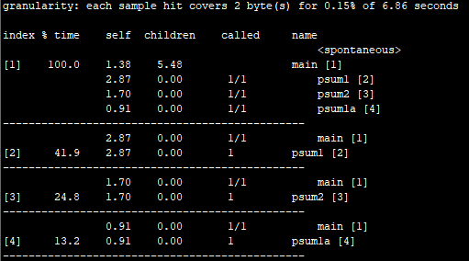
确信和消除性能瓶径
程序剖析
程序剖析(profiling)：是程序执行时收集性能数据的分析工具，方法是运行程序的一个版本，其中插入了工具代码，以确定程序的各个部分需要多少时间
GRPOF：给出函数执行时间和调用次数
为剖析编译和链接程序：使用-pg选项
例：gcc -O3 -pg prefixsum.c -o prefixsum
执行程序
例：prefixsum
调用GPROF分析
例：gprof prefixsum， 剖析报告显示函数执行 信息

Slide 78
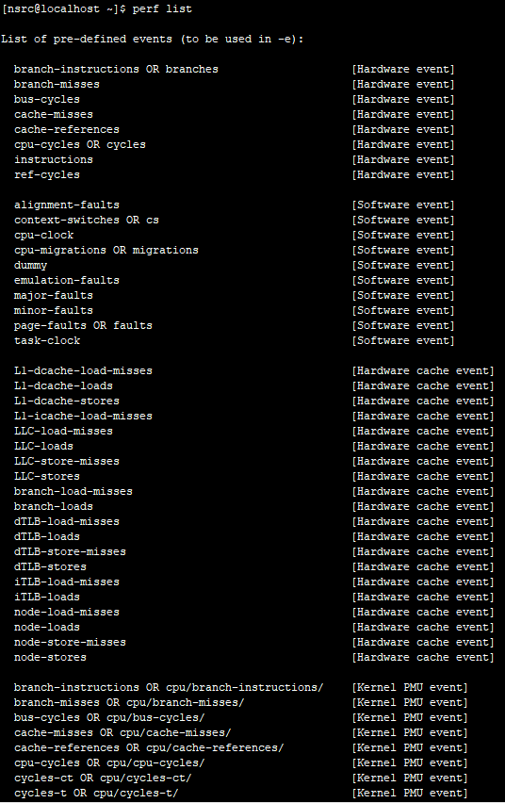
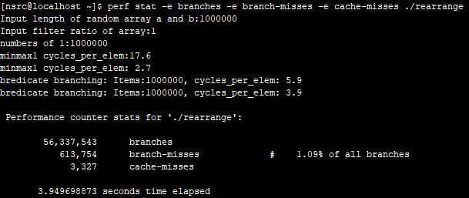
perf监测性能指标
Perf 是用来进行软件性能分析的工具，可以同时分析应用代码和内核，从而全面理解应用程序中的性能瓶颈。
Perf程序剖析示例：监测rearrange程序branch与cache misses
命令：perf stat -e branches -e branch-misses -e cache-misses ./rearrange
Perf主要监测指标：perf list

Slide 79
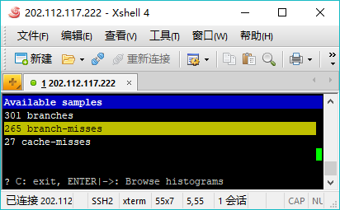
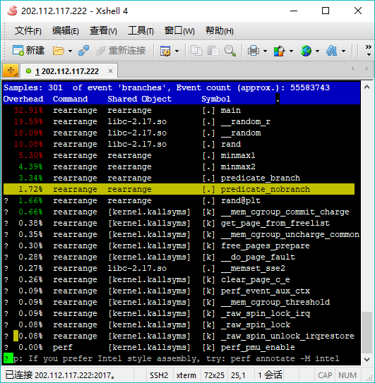
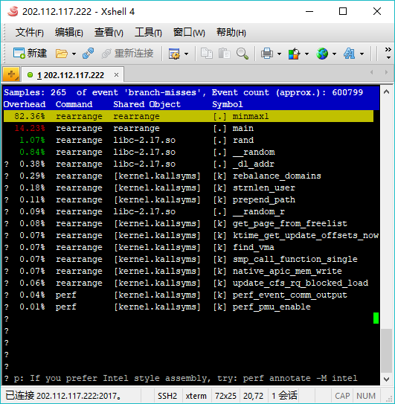
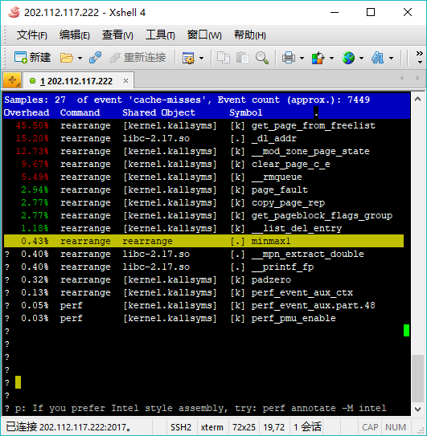
perf监测性能指标
Perf性能分析：监测程序性能并将其数据保存到perf.data中，使用perf report进行分析。
perf record和perf report可以更精确的分析一个应用，perf record可以精确到函数级别。并且在函数里面混合显示汇编语言和代码。
命令：
perf record -e branches -e branch-misses -e cache-misses ./rearrange
perf report

Slide 80
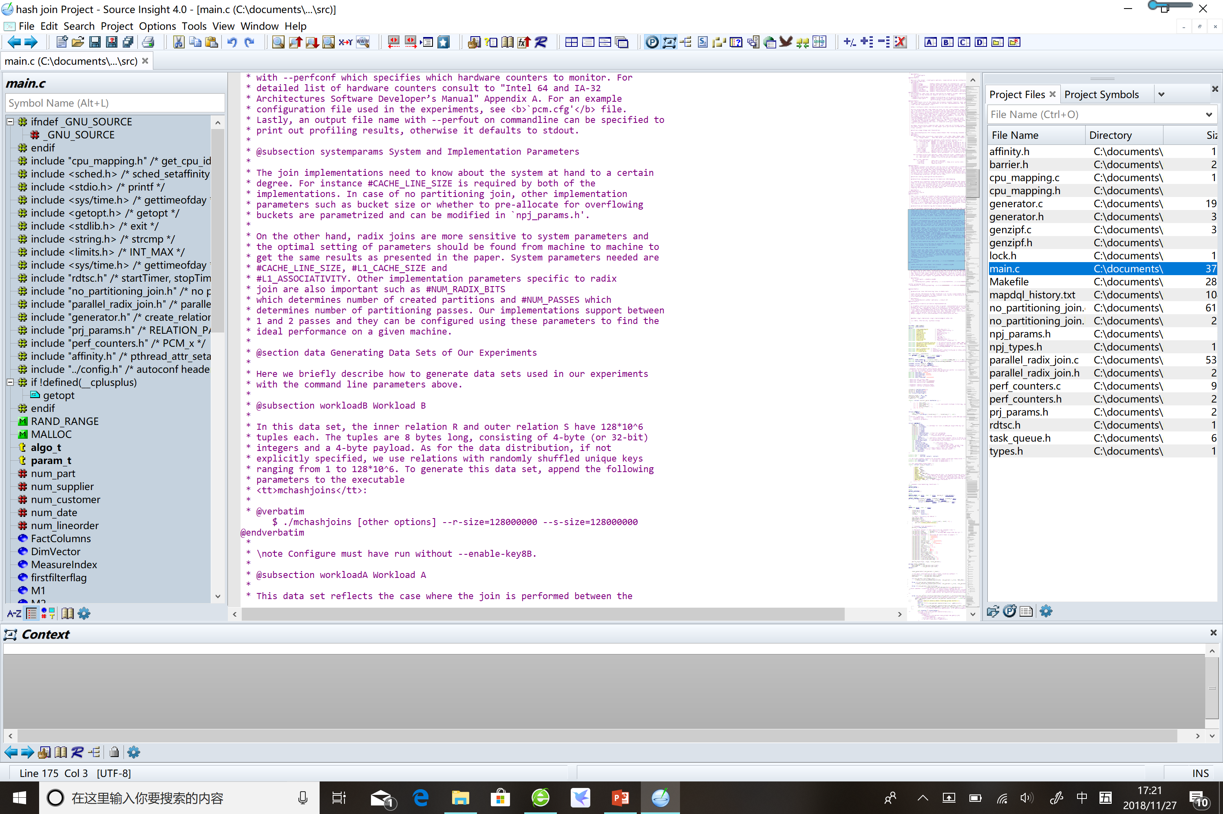
代码阅读工具
Source Insight

Slide 81


Slide 82


Slide 83
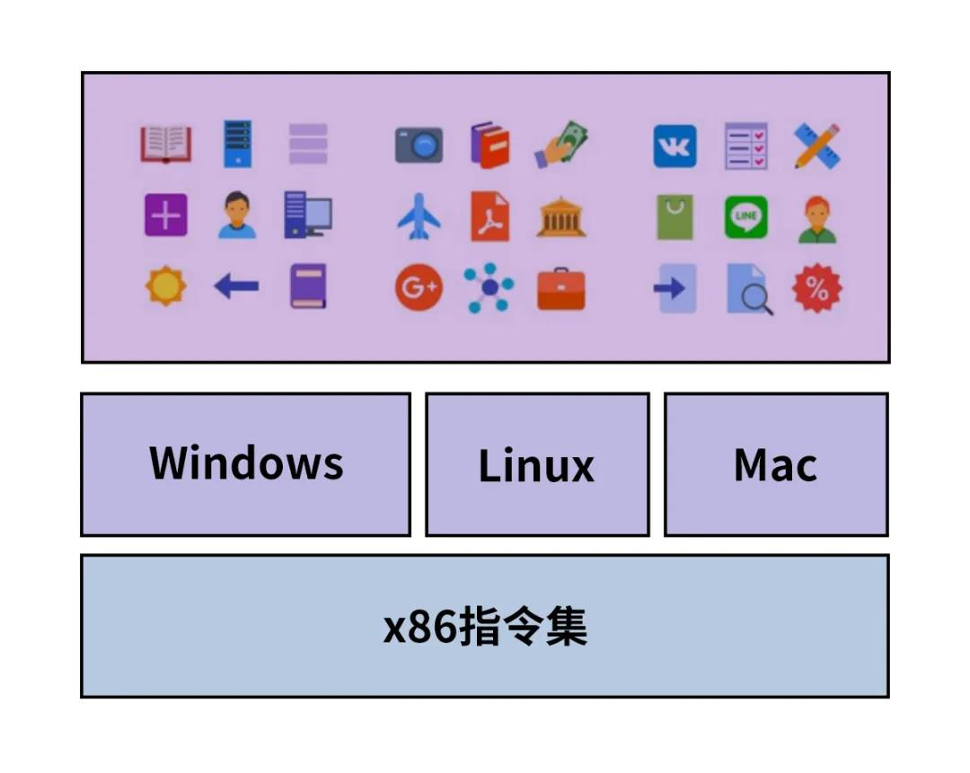

Slide 84



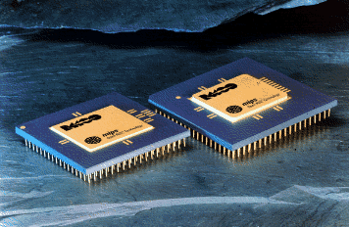
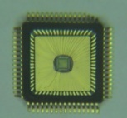
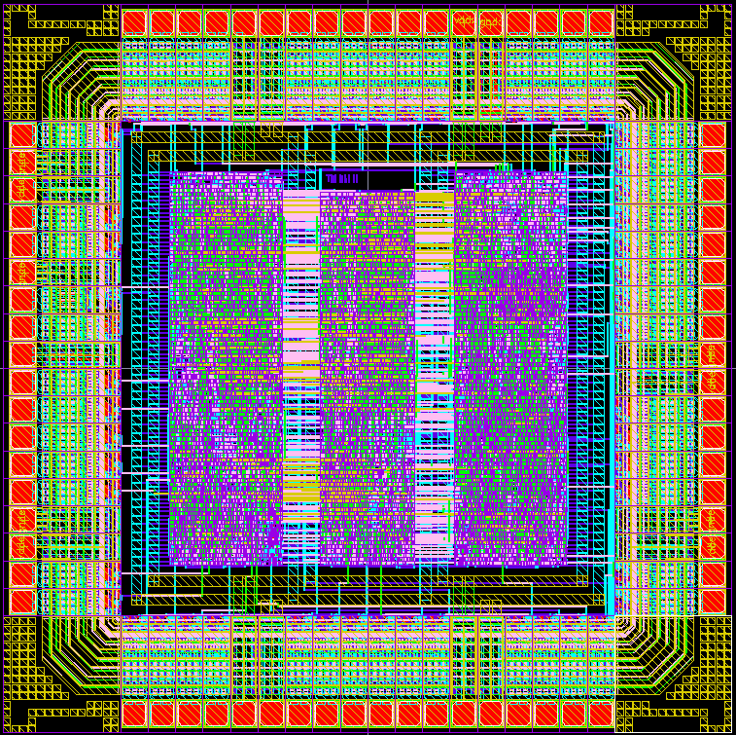
中国芯的发源地 中国第一款正向设计的自主CPU(1999)
我的中国芯
基准程序
软硬件协同设计环境
可重定目标的编译器
编译、汇编
汇编器生成器
指令系统体系结构
指令系统体系结构
模拟环境
指令系统结构评测环境
指令系统结构评测环境
软件
软件
指令系统
指令系统
Cache性能评测工具
硬件
Cache性能评测工具
硬件
性能评测
修改
指令
系统
结构
性能评测
应用需求
程序开发和调试环境
发现瓶颈
应用程序
FPGA
综合
FPGA
布局布线
FPGA验证
FPGA实现
系统设计
描述
系统划分
子模块
设计描述
逻辑综合
布局布线
GDSII
版图
芯片
芯片
系统验证
功能验证
性能考量
版图物理
验证
后验证
1999年12月 16位嵌入式微处理器核 50 MHz@0.35 μm
2001年1月 32位/16位微处理器核 200MHz@0.25 μm

Slide 85

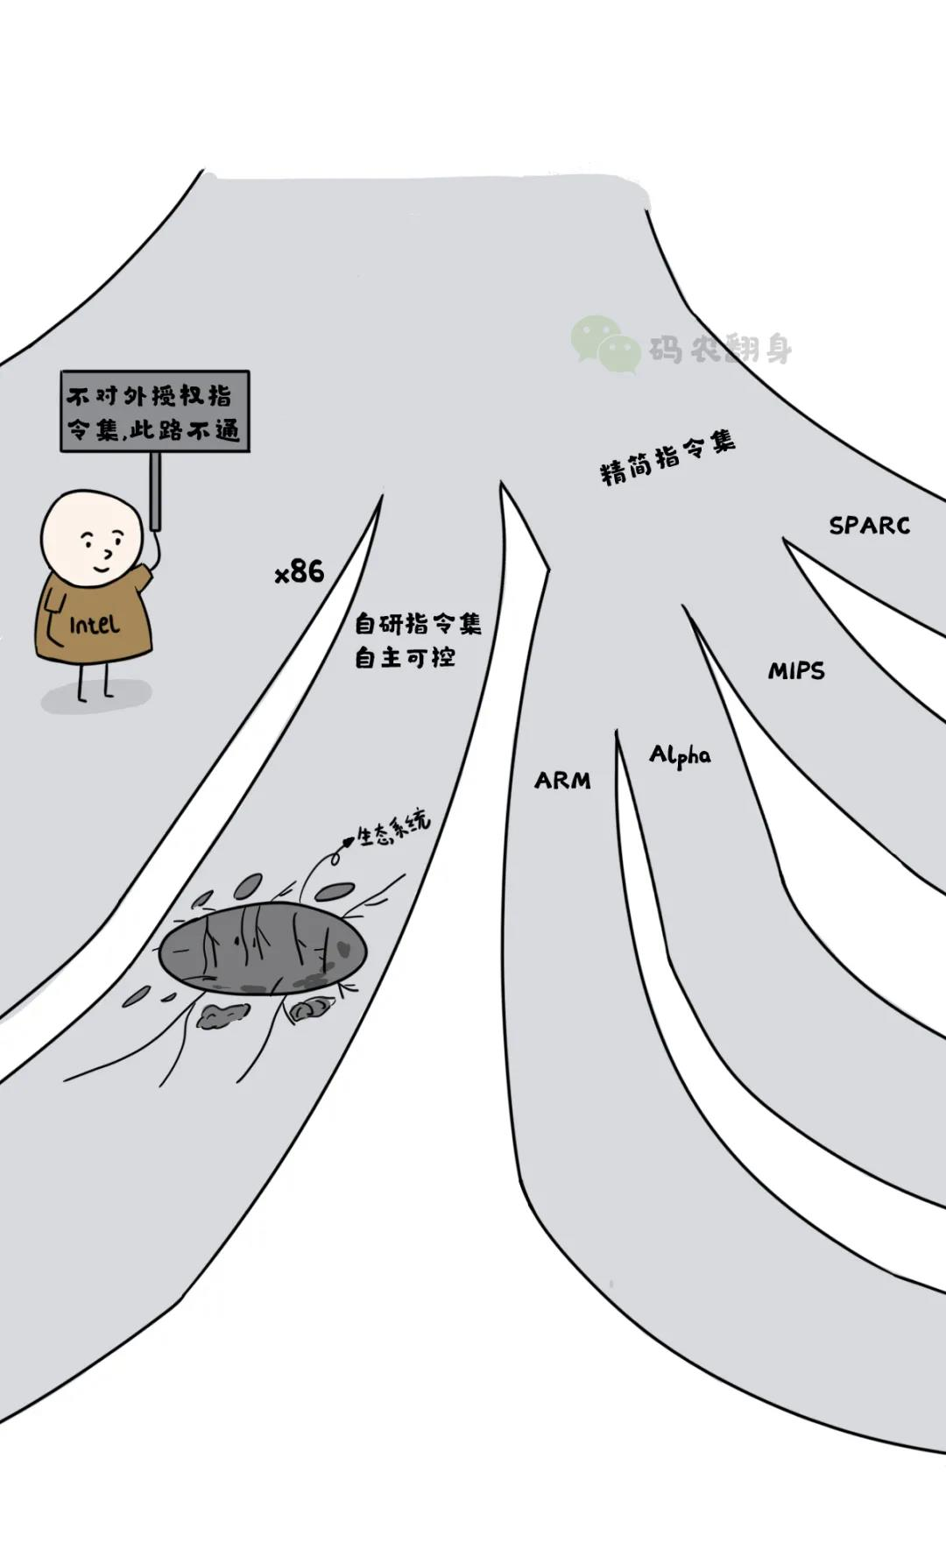

Slide 86

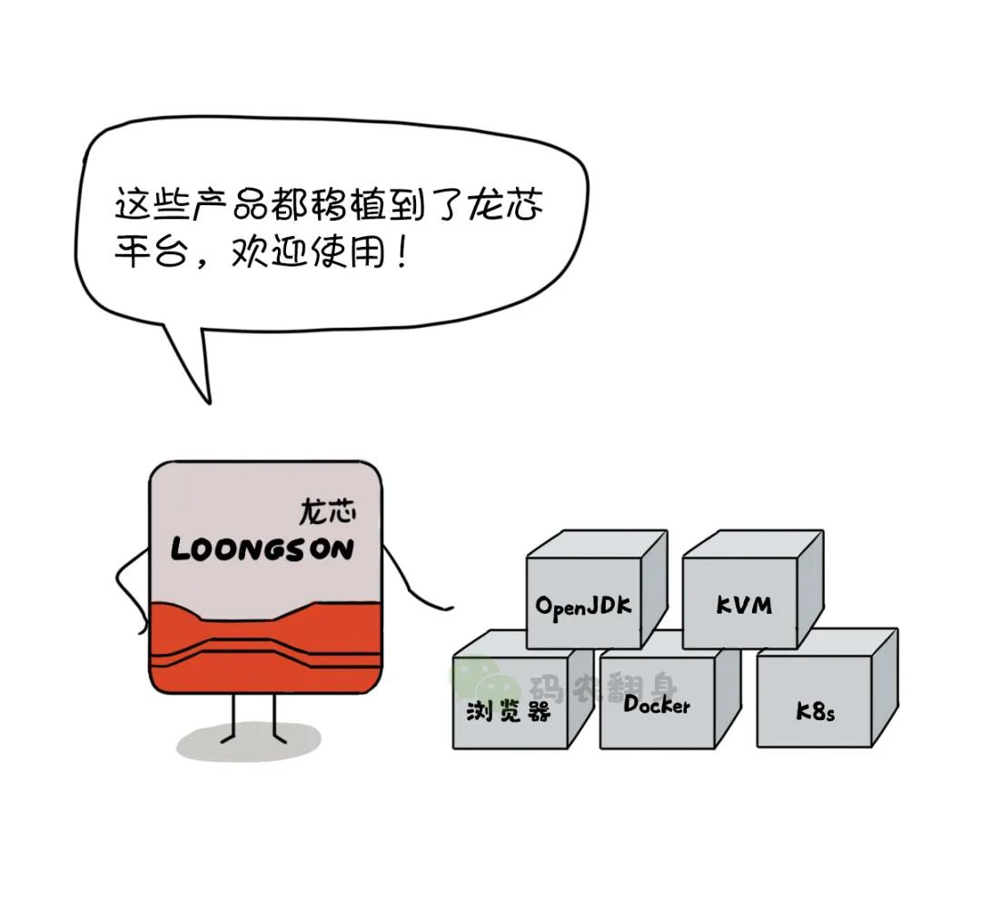

Slide 87



Slide 88
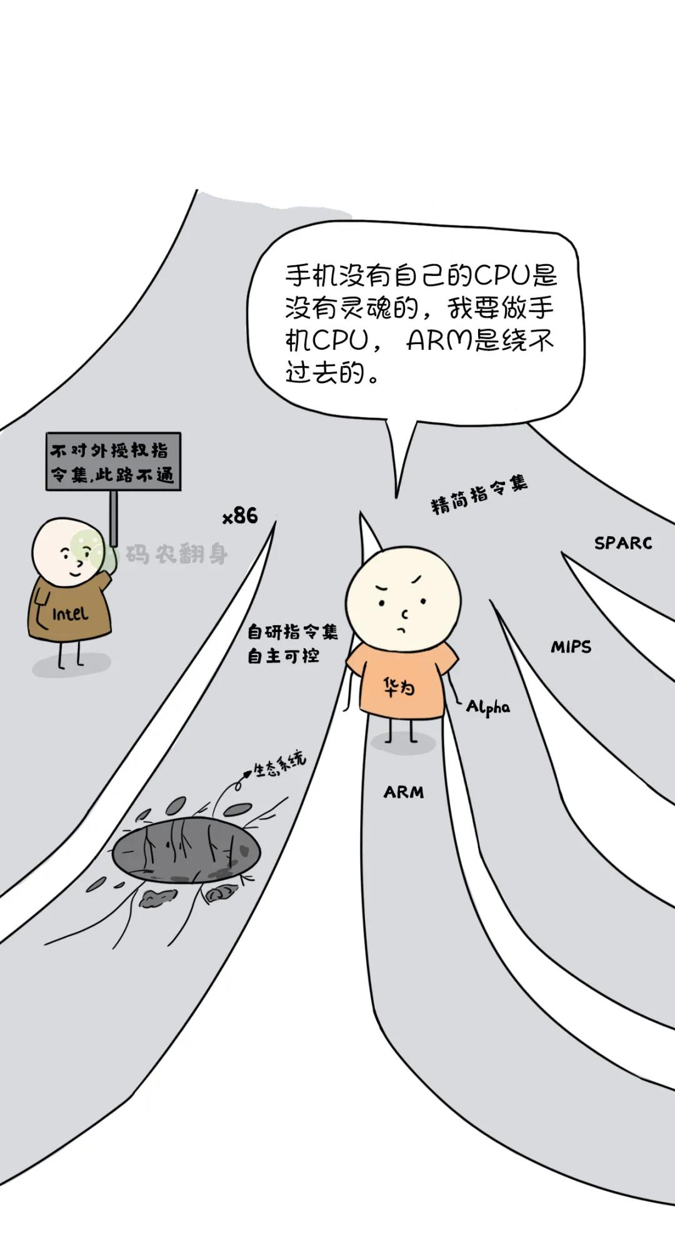

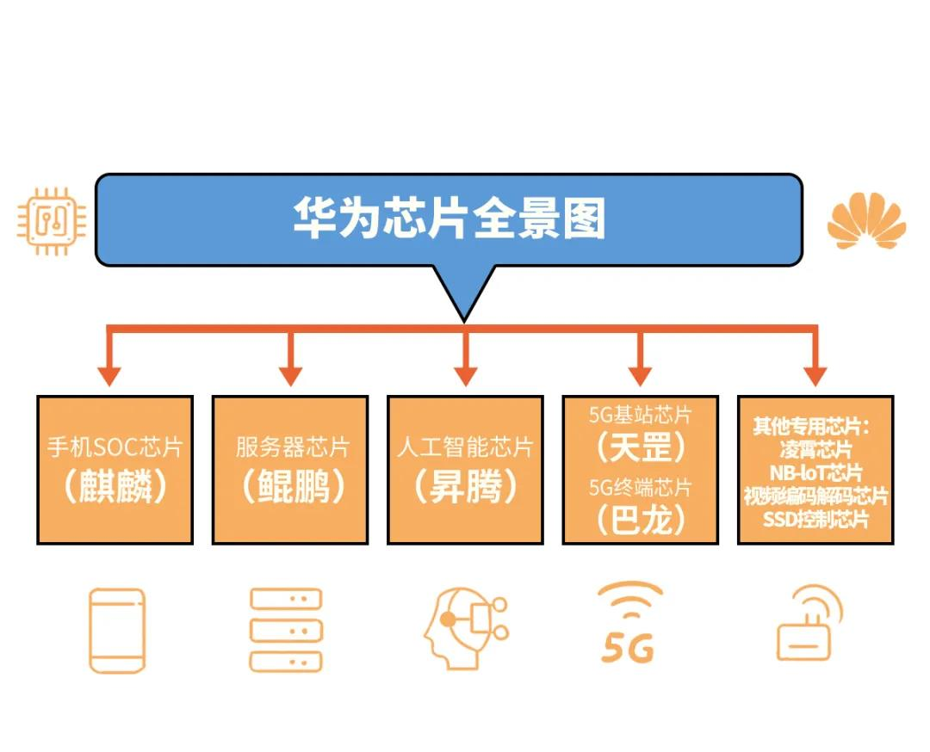

Slide 89
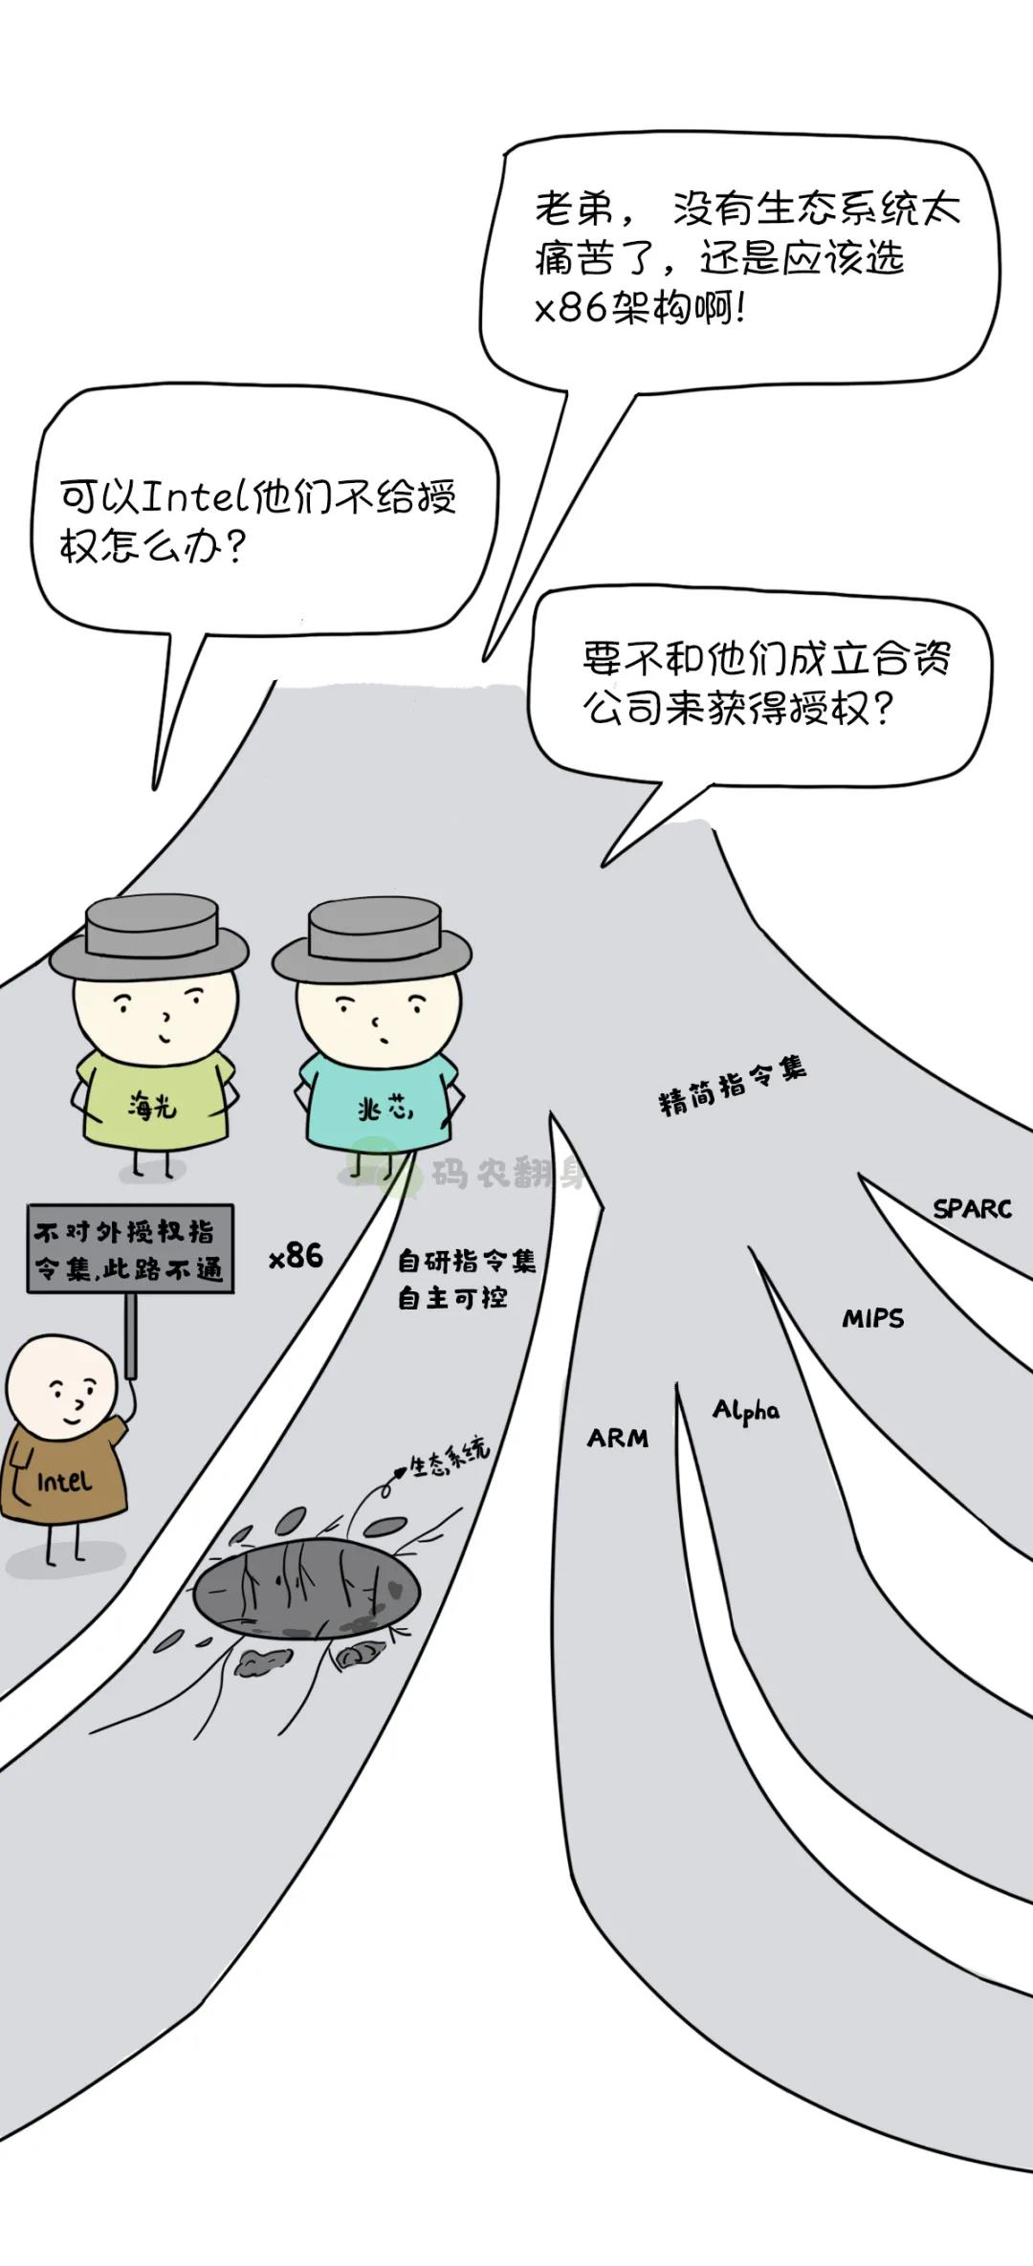


Slide 90
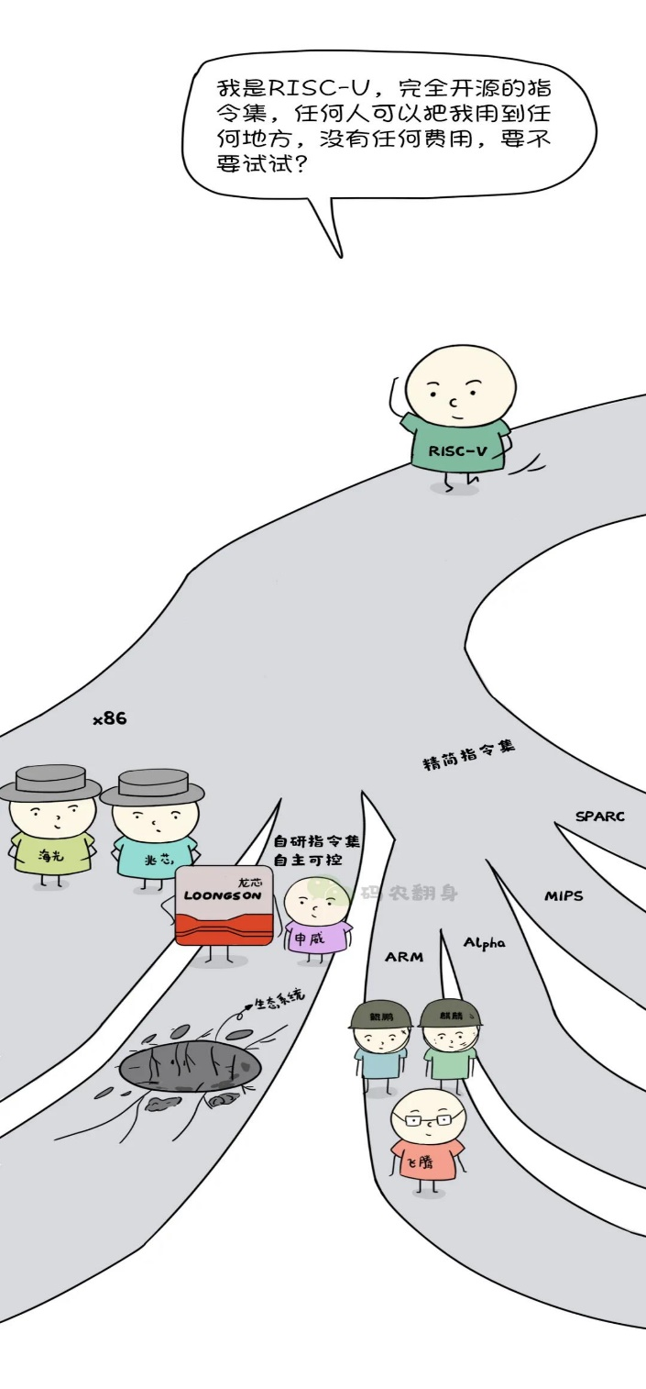


Slide 91
Getting High Performance
Good compiler and flags
Don’t do anything stupid
Watch out for hidden algorithmic inefficiencies
Write compiler-friendly code
Watch out for optimization blockers: procedure calls & memory references
Look carefully at innermost loops (where most work is done)
Tune code for machine
Exploit instruction-level parallelism
Avoid unpredictable branches
Make code cache friendly (Covered later in course)

Slide 92
Getting High Performance
Good compiler and flags
Don’t do anything stupid
Watch out for hidden algorithmic inefficiencies
Write compiler-friendly code
Watch out for optimization blockers: procedure calls & memory references
Look carefully at innermost loops (where most work is done)
Tune code for machine
Exploit instruction-level parallelism
Avoid unpredictable branches
Make code cache friendly (Covered later in course)

