Slide 1
信息的表示和处理(2)
王晶
jwang@ruc.edu.cn，信息楼124
2023年9月

Slide 2
Outline
Integers
Representation: unsigned and signed
Conversion, casting
Expanding, truncating
Addition, negation, multiplication, shifting
Summary

Slide 3
Unsigned Representation
Binary (physical)
Bit vector [x_{w-1},x_{w-2},x_{w-3},…x₀]
Binary to Unsigned (logical)
例如：N₁=01011，表示无符号数11;
N₂=11011 表示无符号数27;
N₃=00000 表示无符号数0。

Slide 4
Unsigned Representation
如果机器字长为n位，则无符号数的表示范围是：
0～(2^{n}-1)。
例如字长为8位，则无符号数的表示范围是0～255。
计算机的内存地址就是无符号数的例子。

Slide 5
Signed Representation
Binary原本的含义与非负整数正好对应
负数如何用binary表达？
解决思路：映射(mapping)
将负数段映射到一个不使用的非负数段
对有限范围的整数成立
最好不影响正数和0
且最好负数和映射到的整数在某种意义上是“等价”的，可以直接进行运算

Slide 6
补码的映射关系
UMax
15
UMax – 1
TMax + 1
Unsigned
Range
8
TMax
TMax
7
2’s Comp.
Range
0
0
0
–1
-1
–2
TMin
-8

Slide 7
Two-complement: Simple Example
-16 | 8 | 4 | 2 | 1
0 | 1 | 0 | 1 | 0
10 =
8+2 = 10
-16 | 8 | 4 | 2 | 1
1 | 0 | 1 | 1 | 0
-10 =
-16+4+2 = -10

Slide 8
Two’s Complement
Binary (physical)
Bit vector [x_{w-1},x_{w-2},x_{w-3},…x₀]
Binary to Signed (logical)
2’s complement
“模”就是2^{w}
因为binary形式的值是2^{w-1}+…，实际值是-2^{w-1}+…，二者相差2^{w}
w位，有2^{w}个状态，
所以模就是2^{w} ；
增加或减少2^{w}，值不变
Sign
Bit

Slide 9
补码 - 模运算（modular运算）
重要概念：在一个模运算系统中，一个数与它除以“模”后的余数等价。
现实世界中的模运算系统
时钟是一种模12系统
假定钟表时针指向10点，要将它拨向6点， 则有两种拨法：
① 倒拨4格：10- 4 = 6
② 顺拨8格：10+8 = 18 ≡ 6 (mod 12)
模12系统中： 10- 4 ≡ 10+8 (mod 12)
- 4 ≡ 8 (mod 12)
则，称8是- 4对模12的补码 （即：- 4的模12补码等于8）。
同样有 -3 ≡ 9 （mod 12）
-5 ≡ 7 （mod 12）等
结论1： 一个负数的补码等于模减该负数的绝对值。
结论2： 对于某一确定的模，某数减去小于模的另一数，总可以用该数加上另一数负数的补码来代替。
补码（modular运算）：+ 和– 的统一
Notes:
Supplement slide: More about 2’s complement.

Slide 10
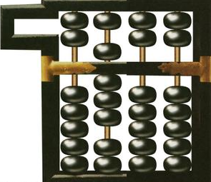
补码的表示
现实世界的模运算系统举例
例1：“钟表”模运算系统
假定时针只能顺拨，从10点倒拨4格后是几点？
10- 4 = 10+(12- 4) = 10+8 = 6 （mod 12）
例2：“4位十进制数” 模运算系统
假定算盘只有四档，且只能做加法，则在算盘上计算
9828-1928等于多少？
9828-1928=9828+(10⁴-1928)
=9828+8072
= 1 7900
=7900（mod 10⁴）
取模即只留余数，高位“1”被丢弃！相当于只有低4位留在算盘上。

Slide 11
Signed Representation
补码表示法
只要确定了“模”，就可找到一个与负数等价的正数（该正数即为负数的补数）来代替此负数，而这个正数可以用模加上负数本身求得，这样就可把减法运算用加法实现了。
例： 9-5=9+(12-5)=9+7=4 (mod 12)
65-25=65+(-25)=65+(100-25)=65+75=40 (mod 100)

Slide 12
补码和真值的关系
如果是非负数
二者一致
如果是负数，那么x的补码形式为
其真值为x
假设真值的绝对值为y，那么y = -x
y的二进制形式为

Slide 13
补码和真值的关系
等比数列求和 S_{n}=a₁(q^{n}-1)/(q-1)

Slide 14
Binary Number Property
Claim
1 + 1 + 2 + 4 + 8 + … + 2^{w-1} = 2^{w}
w = 0:
1 = 2⁰
Assume true for w-1:
1 + 1 + 2 + 4 + 8 + … + 2^{w-1} + 2^{w} = 2^{w} + 2^{w} = 2^{w+1}
= 2^{w}

Slide 15
Two’s Complement
真值绝对值
补码
What does it mean?
建立补码binary [x_{w-1},…,x₀]和真值binary [y_{w-1},…,y₀]之间每一位的关系
已知真值(-y)，求补码x，x的binary形式获得方法为
取y的binary [y_{w-1},…,y₀] （w-bits）
每一位都取反
最后加1
=>反过来已知补码x，求真值-y，也是同样的方法
=>[x_{w-1},…,x₀]+[y_{w-1},…,y₀]=2^{w}

Slide 16
求补码的快捷方式
设 x = 1010 时
则[x]_{补} = 2⁴⁺¹ 1010
= 11111 + 1 1010
= 100000
= 11111
+ 1
1010
1010
= 1,0110
10101 + 1
= 1,0110
当真值为 负 时
每位取反，末位加 1 求得

Slide 17
From a Number to Two’s Complement
真值-5
y=5
0101 (binary for 5)
1010 (after complement)
1011 (add 1)
补码x为1011

Slide 18
From Two’s Complement to Number
补码x=1011
1011 (two’s complement binary)
0100 (after complement)
0101 (add 1)
Y=0101, 真值-y=-5

Slide 19
Two’s Complement Encoding Examples
Binary/Hexadecimal Representation for -12345
Binary: 0011 0000 0011 1001 (12345)
Hex: 3 0 3 9
Binary: 1100 1111 1100 0110 (after complement)
Hex: C F C 6
Binary: 1100 1111 1100 0111 (add 1)
Hex: C F C 7

Slide 20
Numeric Ranges
Unsigned Values
UMin = 0
000…0
UMax = 2^{w} – 1
111…1
Two’s Complement Values
TMin = –2^{w–1}
100…0
TMax = 2^{w–1} – 1
011…1
E.g., w=4
0000 ~ 0111: 0~7
1000 ~ 1111: -8~-1
0000
1000
1001
1110
1111
0001
0010
0111
-8
-7
-6
-5
-4
-3
-2
-1
0
+1
+2
+3
+4
+5
+6
+7
-8
8个负数
7个正数
Notes:
0 makes 2’s complement uneven

Slide 21
Numeric Ranges
Unsigned Values
UMin = 0
000…0
UMax = 2^{w} – 1
111…1
Two’s Complement Values
TMin = –2^{w–1}
100…0
TMax = 2^{w–1} – 1
011…1
Other Values
Minus 1
111…1
Values for W = 16
Notes:
0 makes 2’s complement uneven

Slide 22
Values for Different Word Sizes
Observations
|TMin | = TMax + 1
Asymmetric range
UMax = 2 * TMax + 1
C Programming
#include <limits.h>
Declares constants, e.g.,
ULONG_MAX
LONG_MAX
LONG_MIN
Values platform specific

Slide 23
Alternative representations of signed numbers
Ones’ Complement (反码)
The most significant bit has weight 2^{w-1}-1
Sign-Magnitude (原码)
The most significant bit is a sign bit
that determines whether the remaining bits should be given negative or positive weight
对于正数，原码 = 补码 = 反码
对于负数 ，符号位为 1，其 数值部分
原码除符号位外每位取反末位加 1 补码
原码除符号位外每位取反 反码

Slide 24

填空题
5分
写出下列数字的补码
+0.1101B的补码是 [填空1] B
-0.1101B的补码是[填空2] B
-178的补码是[填空3] H（short类型)
-39的补码是[填空4] H （short类型)
-26的补码是[填空5] H （short类型)
作答

Slide 25
填空题
3分
下面给出了一组变量在计算机内的编码（补码），请写出他们的真值(16进制形式)。
FF3C（short类型）的真值是 [填空1]
FF86（short类型）的真值是 [填空2]
char x =10110111b，x的真值是 [填空3]
作答

Slide 26
Outline
Integers
Representation: unsigned and signed
Conversion, casting
Expanding, truncating
Addition, negation, multiplication, shifting
Summary

Slide 27
Integral data type in C
Signed type (for integer numbers)
char, short [int], int, long [int]
Unsigned type (for nonnegative numbers)
unsigned char, unsigned short [int], unsigned [int], unsigned long [int]
Java 没有无符号类型
Byte: signed char

Slide 28
Casting among Signed and Unsigned in C
C允许一种类型按照另一种类型的方式来理解
Type conversion (implicitly)
Type casting (explicitly)

Slide 29
Signed vs. Unsigned in C
Casting
Signed和unsigned类型之间的显式转换
即 U2T 和 T2U
int tx, ty;
unsigned ux, uy;
tx = (int) ux;
uy = (unsigned) ty;

Slide 30
Signed vs. Unsigned in C
Conversion
通过赋值语句或call语言（函数调用）来隐式转换
int tx, ty;
unsigned ux, uy;
tx = ux;
uy = ty;
int func () {…}
unsigned ux = func();

Slide 31
Mapping Signed ↔ Unsigned
Bits
0000
0001
0010
0011
0100
0101
0110
0111
1000
1001
1010
1011
1100
1101
1110
1111
Signed
0
1
2
3
4
5
6
7
-8
-7
-6
-5
-4
-3
-2
-1
Unsigned
0
1
2
3
4
5
6
7
8
9
10
11
12
13
14
15
T2U
U2T

Slide 32
Mapping Signed ↔ Unsigned
Bits
0000
0001
0010
0011
0100
0101
0110
0111
1000
1001
1010
1011
1100
1101
1110
1111
Signed
0
1
2
3
4
5
6
7
-8
-7
-6
-5
-4
-3
-2
-1
Unsigned
0
1
2
3
4
5
6
7
8
9
10
11
12
13
14
15
=
+/- 16

Slide 33
Conversion Visualized
2’s Comp. → Unsigned
Ordering Inversion
Negative → Big Positive
UMax
UMax – 1
TMax + 1
Unsigned
Range
TMax
TMax
2’s Complement Range
0
0
–1
–2
TMin

Slide 34
Relation between Signed & Unsigned
Two’s Complement
Unsigned
T2U
x
T2B
B2U
ux
X
Maintain Same Bit Pattern
w–1
0
ux
+
+
+
• • •
+
+
+
x
-
+
+
• • •
+
+
+
Large negative weight
becomes
Large positive weight

Slide 35
Mapping Between Signed & Unsigned
Two’s Complement
Unsigned
T2U
x
T2B
B2U
ux
X
Maintain Same Bit Pattern
Unsigned
U2T
Two’s Complement
ux
U2B
B2T
x
X
Maintain Same Bit Pattern
Mappings between unsigned and two’s complement numbers: keep bit representations and reinterpret

Slide 36
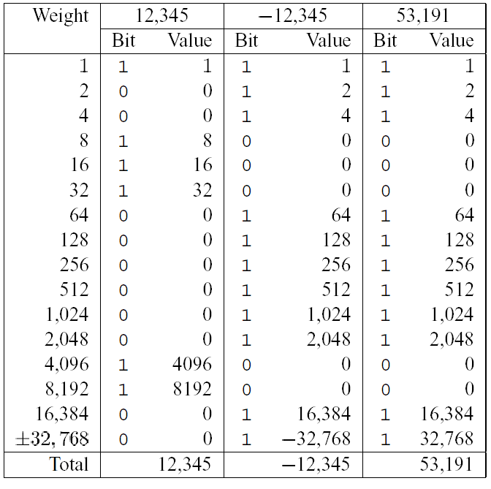
Casting from Signed to Unsigned
short int x = 12345;
unsigned short int ux = (unsigned short) x;
short int y = -12345;
unsigned short int uy = (unsigned short) y;
转换的结果
非负值不变
ux = 12345
负值被转为(更大的)正值
uy = 53191

Slide 37
Unsigned Constants in C
默认情况
常量被当作有符号数
如果希望是无符号数，在后面加上后缀U
0U, 4294967259U

Slide 38
Casting Convention
表达式比较
如果在一个表达式中混用unsigned和signed
会隐式地把有符号数专为无符号数
包括 <, >, ==, <=, >= 等比较符号
unsigned int i
for（i=n-1；i>= 0；i--）
for（i=n-1；i-sizeof（char） >= 0；i--）
int array[] = {1,2,3};
#define TOTAL sizeof(array) /* unsigned int */
void main() {
int d = -1;
if (d <= TOTAL)
printf("small\n");
else printf("large\n");
}

Slide 39
Casting Surprises
Expression Evaluation
If there is a mix of unsigned and signed in single expression, signed values implicitly cast to unsigned
Including comparison operations <, >, ==, <=, >=
Examples for W = 32: TMIN = -2,147,483,648 , TMAX = 2,147,483,647
Constant1 Constant2 Relation Evaluation
0 0U
-1 0
-1 0U
2147483647 -2147483647-1
2147483647U -2147483647-1
-1 -2
(unsigned)-1 -2
2147483647 2147483648U
2147483647 (int) 2147483648U

Slide 40
填空题
9分
W = 32: TMIN = -2,147,483,648 , TMAX = 2,147,483,647
Constant1 Constant2 Relation
0 0U [填空1]
-1 0 [填空2]
-1 0U [填空3]
2147483647 -2147483647-1 [填空4]
2147483647U -2147483647-1 [填空5]
-1 -2 [填空6]
(unsigned)-1 -2 [填空7]
2147483647 2147483648U [填空8]
2147483647 (int) 2147483648U [填空9]
作答

Slide 41
Casting Surprises
Expression Evaluation
If there is a mix of unsigned and signed in single expression, signed values implicitly cast to unsigned
Including comparison operations <, >, ==, <=, >=
Examples for W = 32: TMIN = -2,147,483,648 , TMAX = 2,147,483,647
Constant₁ Constant₂ Relation Evaluation
0 0U
-1 0
-1 0U
2147483647 -2147483647-1
2147483647U -2147483647-1
-1 -2
(unsigned)-1 -2
2147483647 2147483648U
2147483647 (int) 2147483648U
0 0U == unsigned
-1 0 < signed
-1 0U > unsigned
2147483647 -2147483648 > signed
2147483647U -2147483648 < unsigned
-1 -2 > signed
(unsigned) -1 -2 > unsigned
2147483647 2147483648U < unsigned
2147483647 (int) 2147483648U > signed

Slide 42
Outline
Integers
Representation: unsigned and signed
Conversion, casting
Expanding, truncating
Addition, negation, multiplication, shifting
Summary

Slide 43
Expanding the Bit Representation
Zero extension
在前面添加0
Sign extension
[x_{w-1},x_{w-2},x_{w-3},…x₀]
w
X
• • •
X
-
• • •
• • •
X ′
X ′
• • •
• • •
-
+
• • •
w+1

Slide 44
Sign Extension: Simple Example
Positive number
Negative number
-16 | 8 | 4 | 2 | 1
0 | 1 | 0 | 1 | 0
-16 | 8 | 4 | 2 | 1
1 | 0 | 1 | 1 | 0
10 =
-10 =
-32 | 16 | 8 | 4 | 2 | 1
0 | 0 | 1 | 0 | 1 | 0
-32 | 16 | 8 | 4 | 2 | 1
1 | 1 | 0 | 1 | 1 | 0
10 =
-10 =

Slide 45
From short to long
int fun1(unsigned word) {
return (int) ((word << 24) >> 24);
}
int fun2(unsigned word) {
return ((int) word << 24) >> 24;
}
w fun1(w) fun2(w)
0x00000076
0x87654321
0x000000C9
0xEDCBA987
练习：描述一下两个函数的行为区别
00000076 00000076
00000021 00000021
000000C9 FFFFFFC9
00000087 FFFFFF87

Slide 46
From long to short
int x = 53191;
short int sx = x;
int y = -12345;
Short int sy = y;
需要截断数据大小
从长类型到短类型转换需要特别注意

Slide 47
Truncating Numbers
 | Decimal | Hex | Binary
x | 53191 | 00 00 CF C7 | 00000000 00000000 11001111 11000111
sx | -12345 | CF C7 | 11001111 11000111
y | -12345 | FF FF CF C7 | 11111111 11111111 11001111 11000111
sy | -12345 | CF C7 | 11001111 11000111
X ′
• • •
• • •
X
• • •

Slide 48
Truncating Numbers
Unsigned Truncating
Signed Truncating
先当作无符号数去截断，然后转换为有符号数

Slide 49
Truncation: Simple Example
No sign change
Sign change
-16 | 8 | 4 | 2 | 1
0 | 0 | 0 | 1 | 0
-16 | 8 | 4 | 2 | 1
0 | 1 | 0 | 1 | 0
2 =
10 =
 | -8 | 4 | 2 | 1
 | 0 | 0 | 1 | 0
 | -8 | 4 | 2 | 1
 | 1 | 0 | 1 | 0
2 =
-6 =
2 mod 16 = 2
10 mod 16 = 10U mod 16 = 10U = -6
-16 | 8 | 4 | 2 | 1
1 | 1 | 0 | 1 | 0
-16 | 8 | 4 | 2 | 1
1 | 0 | 1 | 1 | 0
-6 =
-10 =
 | -8 | 4 | 2 | 1
 | 1 | 0 | 1 | 0
 | -8 | 4 | 2 | 1
 | 0 | 1 | 1 | 0
-6 =
6 =
-6 mod 16 = 26U mod 16 = 10U = -6
-10 mod 16 = 22U mod 16 = 6U = 6

Slide 50
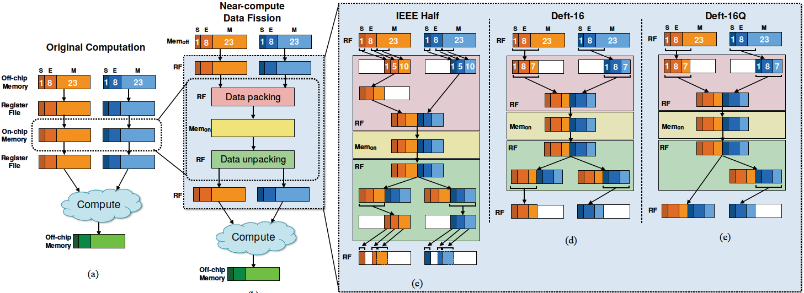
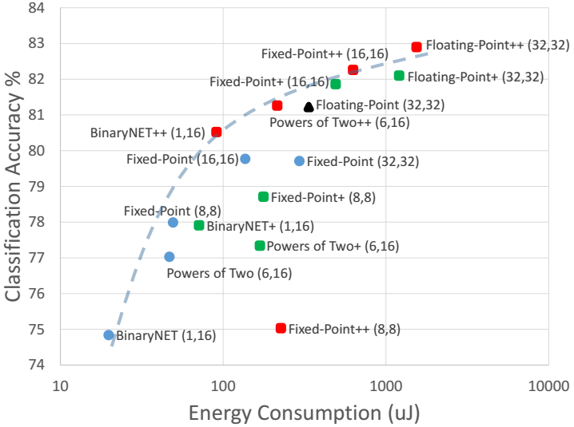
截断在人工智能中的应用
精度缩放，压缩数据减少计算和存储开销
精度损失很小，几乎可以忽略不计
典型的深度学习模型用8位数据就可以达到95%的精度

Slide 51
Advice on Signed vs. Unsigned
float sum_elements ( float a[], unsigned length )
{
int i;
float result = 0;
for ( i = 0; i <= length – 1; i++)
result += a[i] ;
}
当length=0时，应该返回0.0，但实际会遇到内存错误，为什么？

Slide 52
Advice on Signed vs. Unsigned
/* Prototype for library function strlen */
size_t strlen(const char *s); /*size_t is unsigned */
/* Determine whether string s is longer than string t */
/* WARNING: This function is buggy */
int strlonger(char *s, char *t) {
return strlen(s) - strlen(t) > 0;
}

Slide 53
FreeBSD’s implementation of getpeername (…)
/* Declaration of library function memcpy */
void *memcpy(void *dest, void *src, size_t n);
/* Kernel memory region holding user-accessible data */
#define KSIZE 1024
char kbuf[KSIZE];
/* Copy at most maxlen bytes from kernel region to user buffer */
int copy_from_kernel (void *user_dest, int maxlen) {
/* Byte count len is minimum of buffer size and maxlen */
int len = KSIZE < maxlen ? KSIZE : maxlen;
memcpy(user_dest, kbuf, len); // 如果maxlen是个负值
return len; }

Slide 54
Outline
Integers
Representation: unsigned and signed
Conversion, casting
Expanding, truncating
Addition
Summary

Slide 55
Unsigned Addition
u
Operands: w bits
• • •
+
v
• • •
True Sum: w+1 bits
u + v
• • •
Discard Carry: w bits
UAdd_{w}(u , v)
• • •
Decimal
Hex
Binary
Standard Addition Function
Ignores carry output
Implements Modular Arithmetic
s = UAdd_{w}(u , v) = u + v mod 2^{w}
0
0
0000
1
1
0001
2
2
0010
3
3
0011
4
4
0100
5
5
0101
6
6
0110
7
7
0111
unsigned char
1110 1001
+ 1101 0101
E9
+ D5
233
+ 213
8
8
1000
9
9
1001
A
10
1010
B
11
1011
C
12
1100
D
13
1101
E
14
1110
F
15
1111

Slide 56
Unsigned Addition
u
Operands: w bits
• • •
+
v
• • •
True Sum: w+1 bits
u + v
• • •
Discard Carry: w bits
UAdd_{w}(u , v)
• • •
Decimal
Hex
Binary
Standard Addition Function
Ignores carry output
Implements Modular Arithmetic
s = UAdd_{w}(u , v) = u + v mod 2^{w}
0
0
0000
1
1
0001
2
2
0010
3
3
0011
4
4
0100
5
5
0101
6
6
0110
7
7
0111
unsigned char
1110 1001
+ 1101 0101
E9
+ D5
233
+ 213
8
8
1000
9
9
1001
A
10
1010
1 1011 1110
1BE
446
B
11
1011
C
12
1100
1011 1110
BE
190
D
13
1101
E
14
1110
F
15
1111

Slide 57
Visualizing (Mathematical) Integer Addition
Add₄(u , v)
Integer Addition
4-bit integers u, v
Compute true sum Add₄(u , v)
Values increase linearly with u and v
Forms planar surface
v
u

Slide 58
Visualizing Unsigned Addition
Wraps Around
If true sum ≥ 2^{w}
At most once
Overflow
UAdd₄(u , v)
True Sum
2^{w+1}
Overflow
2^{w}
v
0
Modular Sum
u

Slide 59
Unsigned Addition
Write a function with the following prototype:
/* Determine whether arguments can be added without overflow */
int uadd_ok(unsigned x, unsigned y);
/*This function should return 1 if arguments x and y can be added without causing overflow*/
Overflow if (X+Y) < X

Slide 60
Unsigned Addition Forms an Abelian Group (阿贝尔群)
加法结果是封闭的（还在同样的数据范围内）
0 ≤ UAdd_{w}(u , v) ≤ 2^{w} –1
交换律
UAdd_{w} (t, UAdd_{w} (u,v)) = UAdd_{w} (UAdd_{w} (t, u ), v)
有一个单位元0
UAdd_{w} (u , 0) = u
每个元素都有一个加法逆元
Let UComp_{w} (u ) = 2^{w} – u
UAddw(u , UComp_{w} (u )) = 0

Slide 61
Two’s Complement Addition
Operands: w bits
u
• • •
+
v
• • •
True Sum: w+1 bits
u + v
• • •
Discard Carry: w bits
TAdd_{w}(u , v)
• • •
TAdd and UAdd have Identical Bit-Level Behavior
Signed vs. unsigned addition in C:
int s, t, u, v;
s = (int) ((unsigned) u + (unsigned) v);
t = u + v
Will give s == t
1110 1001
+ 1101 0101
E9
+ D5
-23
+ -43
1 1011 1110
1BE
-66
1011 1110
BE
-66

Slide 62
Signed Addition- overflow
位宽是4，其中1位符号位，3位数值位
5 5 -5 -5
+ 4 +(-4) + 4 +(-4)
9 1 -1 -9
0101 0101 1011 1011
+ 0100 +1100 + 0100 +1100
1001 0001 1111 0111
-7 1 -1 7

Slide 63
TAdd Overflow
Functionality
True sum requires w+1 bits
Drop off MSB
Treat remaining bits as 2’s comp. integer
True Sum
0 111…1
2^{w}–1
PosOver
TAdd Result
0 100…0
2^{w –1}
011…1
0 000…0
0
000…0
1 011…1
–2^{w –1}–1
100…0
1 000…0
–2^{w}
NegOver

Slide 64
Visualizing 2’s Complement Addition
NegOver
Values
4-bit two’s comp.
Range from -8 to +7
Wraps Around
If sum ≥ 2^{w–1}
Becomes negative
At most once
If sum < –2^{w–1}
Becomes positive
At most once
TAdd₄(u , v)
v
u
PosOver

Slide 65
Characterizing TAdd
Positive Overflow
Functionality
True sum requires w+1 bits
Drop off MSB
Treat remaining bits as 2’s comp. integer
TAdd(u , v)
> 0
v
< 0
< 0
> 0
u
Negative Overflow
2^{w}
(NegOver)
2^{w}
(PosOver)

Slide 66
Detecting Tadd Overflow
Task
Given s = TAdd_{w}(u , v)
Determine if s = Add_{w}(u , v)
Claim
Overflow iff either:
u, v < 0, s ≥ 0 (NegOver)
u, v ≥ 0, s < 0 (PosOver)
ovf = (u<0 == v<0) && (u<0 != s<0);
2^{w}–1
PosOver
2^{w –1}
0
–2^{w –1}–1
–2^{w}
NegOver

Slide 67
Detecting Tadd Overflow
int tadd_ok_bugy(int x, int y)
{
int sum = x + y ;
return (sum-x == y) && (sum-y == x)
} // 问题在哪？
e.g., [-8, 7), x=4, y=5
//应该如何正确判断加法溢出？
Notes:
tadd是阿贝尔群，结果封闭（越界则加上或减少2^w），所以sum-x = x+y-x永远等于y（因为y就在合法区间，不会加减2^w）。此函数无法判定溢出。
例如表示范围是-8～+7，x=4, y=5, sum=9=-7. sum-x = -7-4=-11=5=y（-11还是会被拉回到5）

Slide 68
Detecting Tadd Overflow
int tadd_ok (int x, int y)
{
int sum = x + y ;
return !((x>0&&y>0&&sum<0) || (x<0&&y<0&&sum>0))
}

Slide 69
Detecting Tsub Overflow
int tsub_ok(int x, int y)
{
return tadd_ok(x, -y) ;
} // 问题在哪？
e.g., x>0, y=TMin; x<0, y=TMin; x=0, y=TMin
//写一个正确版本
如果x是正数，判定是异号相加，肯定不溢出，但实际是正数-Tmin，肯定溢出。
如果x是负数，会判定溢出，实际不溢出。
如果x=0，会判定不溢出，实际溢出。
Notes:
Y=Tmin, -y越界，还是被当作y（负数），y的符号错了。
如果x是正数，判定是异号相加，肯定不溢出，但实际是正数-Tmin，肯定溢出。
如果x是负数，会判定溢出，实际不溢出。
如果x=0，会判定不溢出，实际溢出。

Slide 70
Detecting Tsub Overflow
int tsub_ok(int x, int y)
{
int diff = x-y;
return !(x>=0&&y<0&&diff<0 || x<0&&y>0&&diff>0) // 0-正数 不会溢出
}

Slide 71
Mathematical Properties of TAdd
Two’s Complement Under TAdd Forms a Group
Closed, Commutative, Associative, 0 is additive identity
Every element has additive inverse
Let
TAdd_{w}(u , TComp_{w} (u )) = 0

Slide 72
Mathematical Properties of TAdd
TAdd和Uadd：
TAdd_{w} (u , v) = U2T (UAdd_{w}(T2U(u ), T2U(v)))
因为二者有相同的位级表示
T2U(TAdd_{w} (u , v)) = UAdd_{w}(T2U(u ), T2U(v))
补码：连同符号位一起运算

Slide 73
Negating with Complement & Increment
x
1
0
0
1
1
1
0
1
In C
~x + 1 == -x
Complement
Observation: ~x + x == 1111…111 == -1
Increment
~x + 1
==~x + x + (-x + 1)
==-1 + (-x + 1)
== -x
+
~x
0
1
1
0
0
0
1
0
-1
1
1
1
1
1
1
1
1
x为负数时:
x的补码是原码除符号位外，
每位取反，末位加1
-x的补码是原码连同符号位，每位取反，末位加1

Slide 74
Arithmetic: Basic Rules
加法：
Unsigned/signed: 先正常加，再截断，二者在bit级的操作完全一样
Unsigned: 相加后模2^{w}
正常加法结果 + 可能减去2^{w}
Signed:相加后模2^{w}
正常加法结果 + 可能加上或减去2^{w}

Slide 75
课堂练习1
库函数calloc有如下声明：
Void *calloc (size_t nmemb, size_t size);
该函数为一个数组分配内存，该数组有nmemb个元素，每个元素为size字节，内存设置为0。如果nmemb或size为0，则返回NULL。
具体实现时，通过malloc分配内存，并用memset将内存设置为0.
你的代码应该没有任何由算术溢出引发的漏洞
Void *malloc (size_t size);
Void *memset(void *s, int c, size_t n);

Slide 76
void *calloc(size_t nmemb, size_t size) {
size_t asize = nmemb * size; /* Check for overflow */
if (nmemb == 0 || size == 0 || asize / nmemb != size) /* Error */
return NULL;
void *result = malloc(asize);
if (result != NULL) {
memset(result, 0, asize);
return result;
}
return NULL;
}

Slide 77
课堂练习2
Int x = random();
Int y = random();
Unsigned ux = (unsigned)x;
Unsigned uy = (unsigned)y;
Int为32位，对于下列每个C表达式，你要指出其是否总为1。如果是，请指出其数学原理；否则，举反例
(x<y) == (-x>-y)
((x+y)<<4) + y –x == 17*y + 15*x
~x+~y+1 == -(x+y)
(ux-uy) == -(unsigned)(y-x)
((x>>2)<<2) <= x

Slide 78
单选题
1分
int为32位
int x = random();
int y = random();
unsigned ux = (unsigned)x;
unsigned uy = (unsigned)y;
问：(x<y) == (-x>-y)的结果
A
0
B
1
提交

Slide 79
课堂练习2
(x<y) == (-x>-y)
否，当x=Tmin时不成立，-x=Tmin，还是小于-y
2. ((x+y)<<4) + y –x == 17*y + 15*x
是，补码的循环特性，即使一边溢出，或两边都溢出，最终左右还是会相等
3. ~x+~y+1 == ~(x+y)
是，~x+1+~y+1=–x-y
4. (ux-uy) == -(unsigned)(y-x)
是，有符号和无符号的加减法在binary层级是完全一样的，这个表达式相当于x==-(-x)是否成立？X=Tmin也是成立的。
5. ((x>>2)<<2) <= x
是，x为正数时，可能损失最后两位，变小；x为负数时，binary变小，值变小（绝对值变大）【补码映射是线性关系，增大变小的关系，正负数是一样的】

Slide 80
课堂练习3
你刚刚开始在一家公司工作，他们要用到一个数据结构，这个结构是将4个有符号字节封装为一个32位的unsigned。一个32位字中的字节从0（最低有效字节）编号到3（最高有效字节）。分配给你的任务是：编写一个函数，提取其中的按照制定的bytenum从中提取需要的有符号字节，将其符号扩展为一个32位int：
typedef unsigned packed_t;
/* Extract byte from word. Return as signed integer */
int xbyte (packed_t word, int bytenum);
你的前任（因为水平不够高被解雇了）编写了下面的代码：
/* Failed attempt at xbyte */
int xbyte (packed_t word, int bytenum) {
return (word >> (bytenum << 3)) & 0xFF;
}
这段代码错在哪里？
给出函数的正确实现，除了赋值语句外，只能使用左右移位和一个减法。
( (int)word<<((3-bytenum)<<3))>>24
Notes:
1）错在没有将byte进行符号扩展，前面都是0；
2）(word<<((3-bytenum)<<3))>>24

