Slide 1
PART 03 — Semantic Segmentation
AAE5303 — Robust Control Technology in Low-Altitude Aerial Vehicle
GE Haitong (segmentation) · ChatGPT_spokesperson

Slide 2
Semantic segmentation module
Baseline: milesial / Pytorch-UNet (U-Net, encoder–decoder + skip connections)
Data: UAVScenes AMtown02, interval=5 — paired RGB + semantic masks (14 valid classes)
Role in pipeline: dense per-pixel class labels for scene understanding (complements VO pose + 3D structure)
Deliverables: tuned hyperparameters, checkpoints, leaderboard JSON (mIoU / Dice / fwIoU), reproducible scripts

Slide 3
Pipeline (our implementation)
Download UAVScenes camera images + semantic labels → place under modules/segmentation/datasets/…
analyze_mask_classes.py → remap UAVScenes sparse IDs to contiguous 0..13 (remap_uavscenes_masks.py)
train_uavscenes_unet.py — AdamW, YAML config, per-epoch val metrics logged to JSON
predict_unet.py — batch inference; evaluate_masks.py — full-set metrics → metrics_best.json
export_leaderboard_json.py — course submission schema (percent scale)

Slide 4
Experiment configuration (final run)
Epochs: 80 | Batch size: 1 | Optimizer: AdamW | LR: 5e-5 | Weight decay: 1e-8
Input scale: 0.25 (resize) | AMP: off | Classes: 14 | Bilinear upsampling: off
Best validation mIoU (from log): 75.37% at epoch 72
Checkpoint for inference: selected by maximum val mIoU in uavscenes_training_log.json

Slide 5
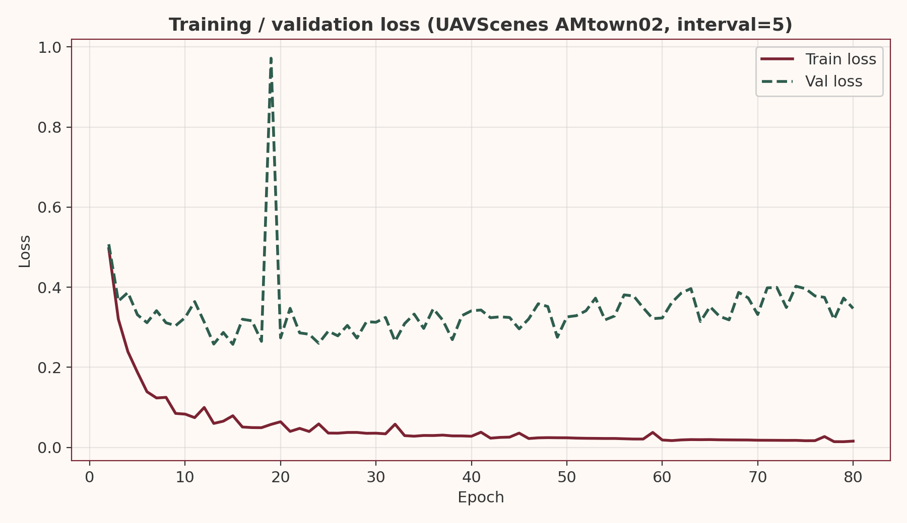
Real data — training / validation loss

Slide 6
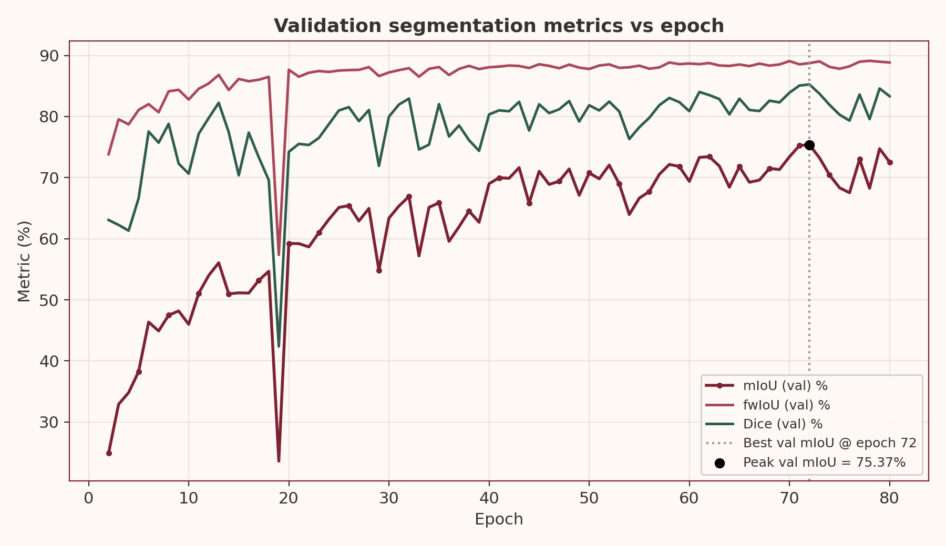
Real data — validation mIoU, Dice, fwIoU vs epoch

Slide 7
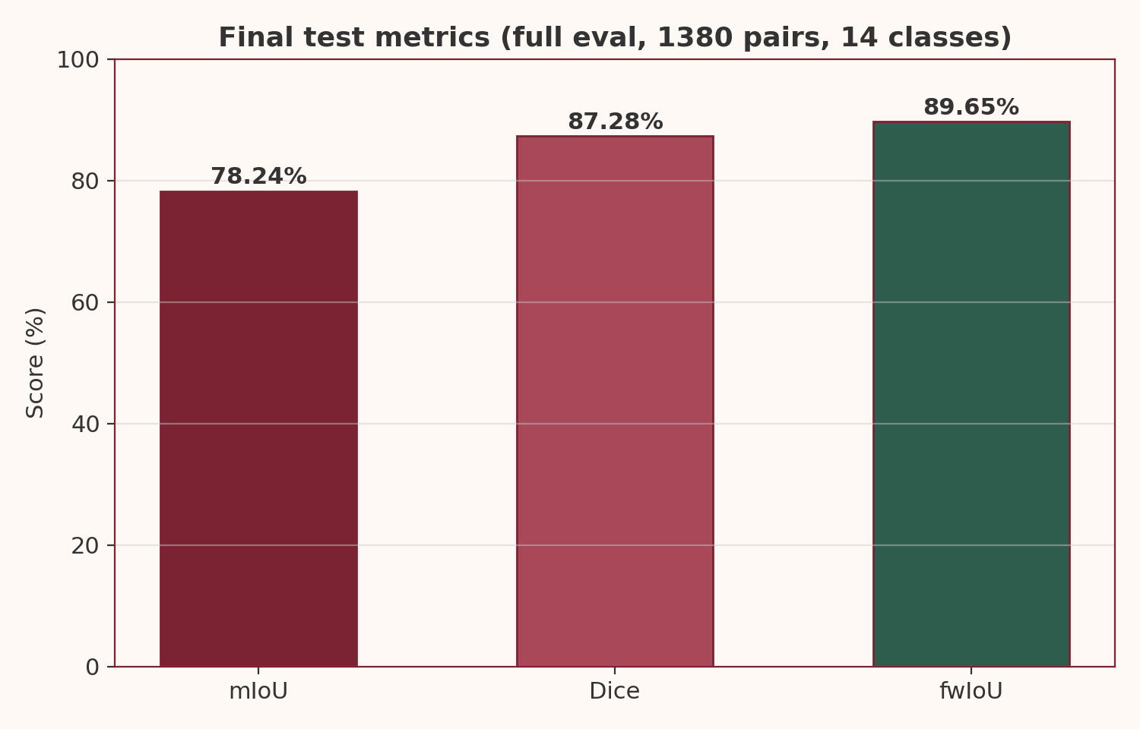
Real data — final test metrics (1380 pairs)

Slide 8
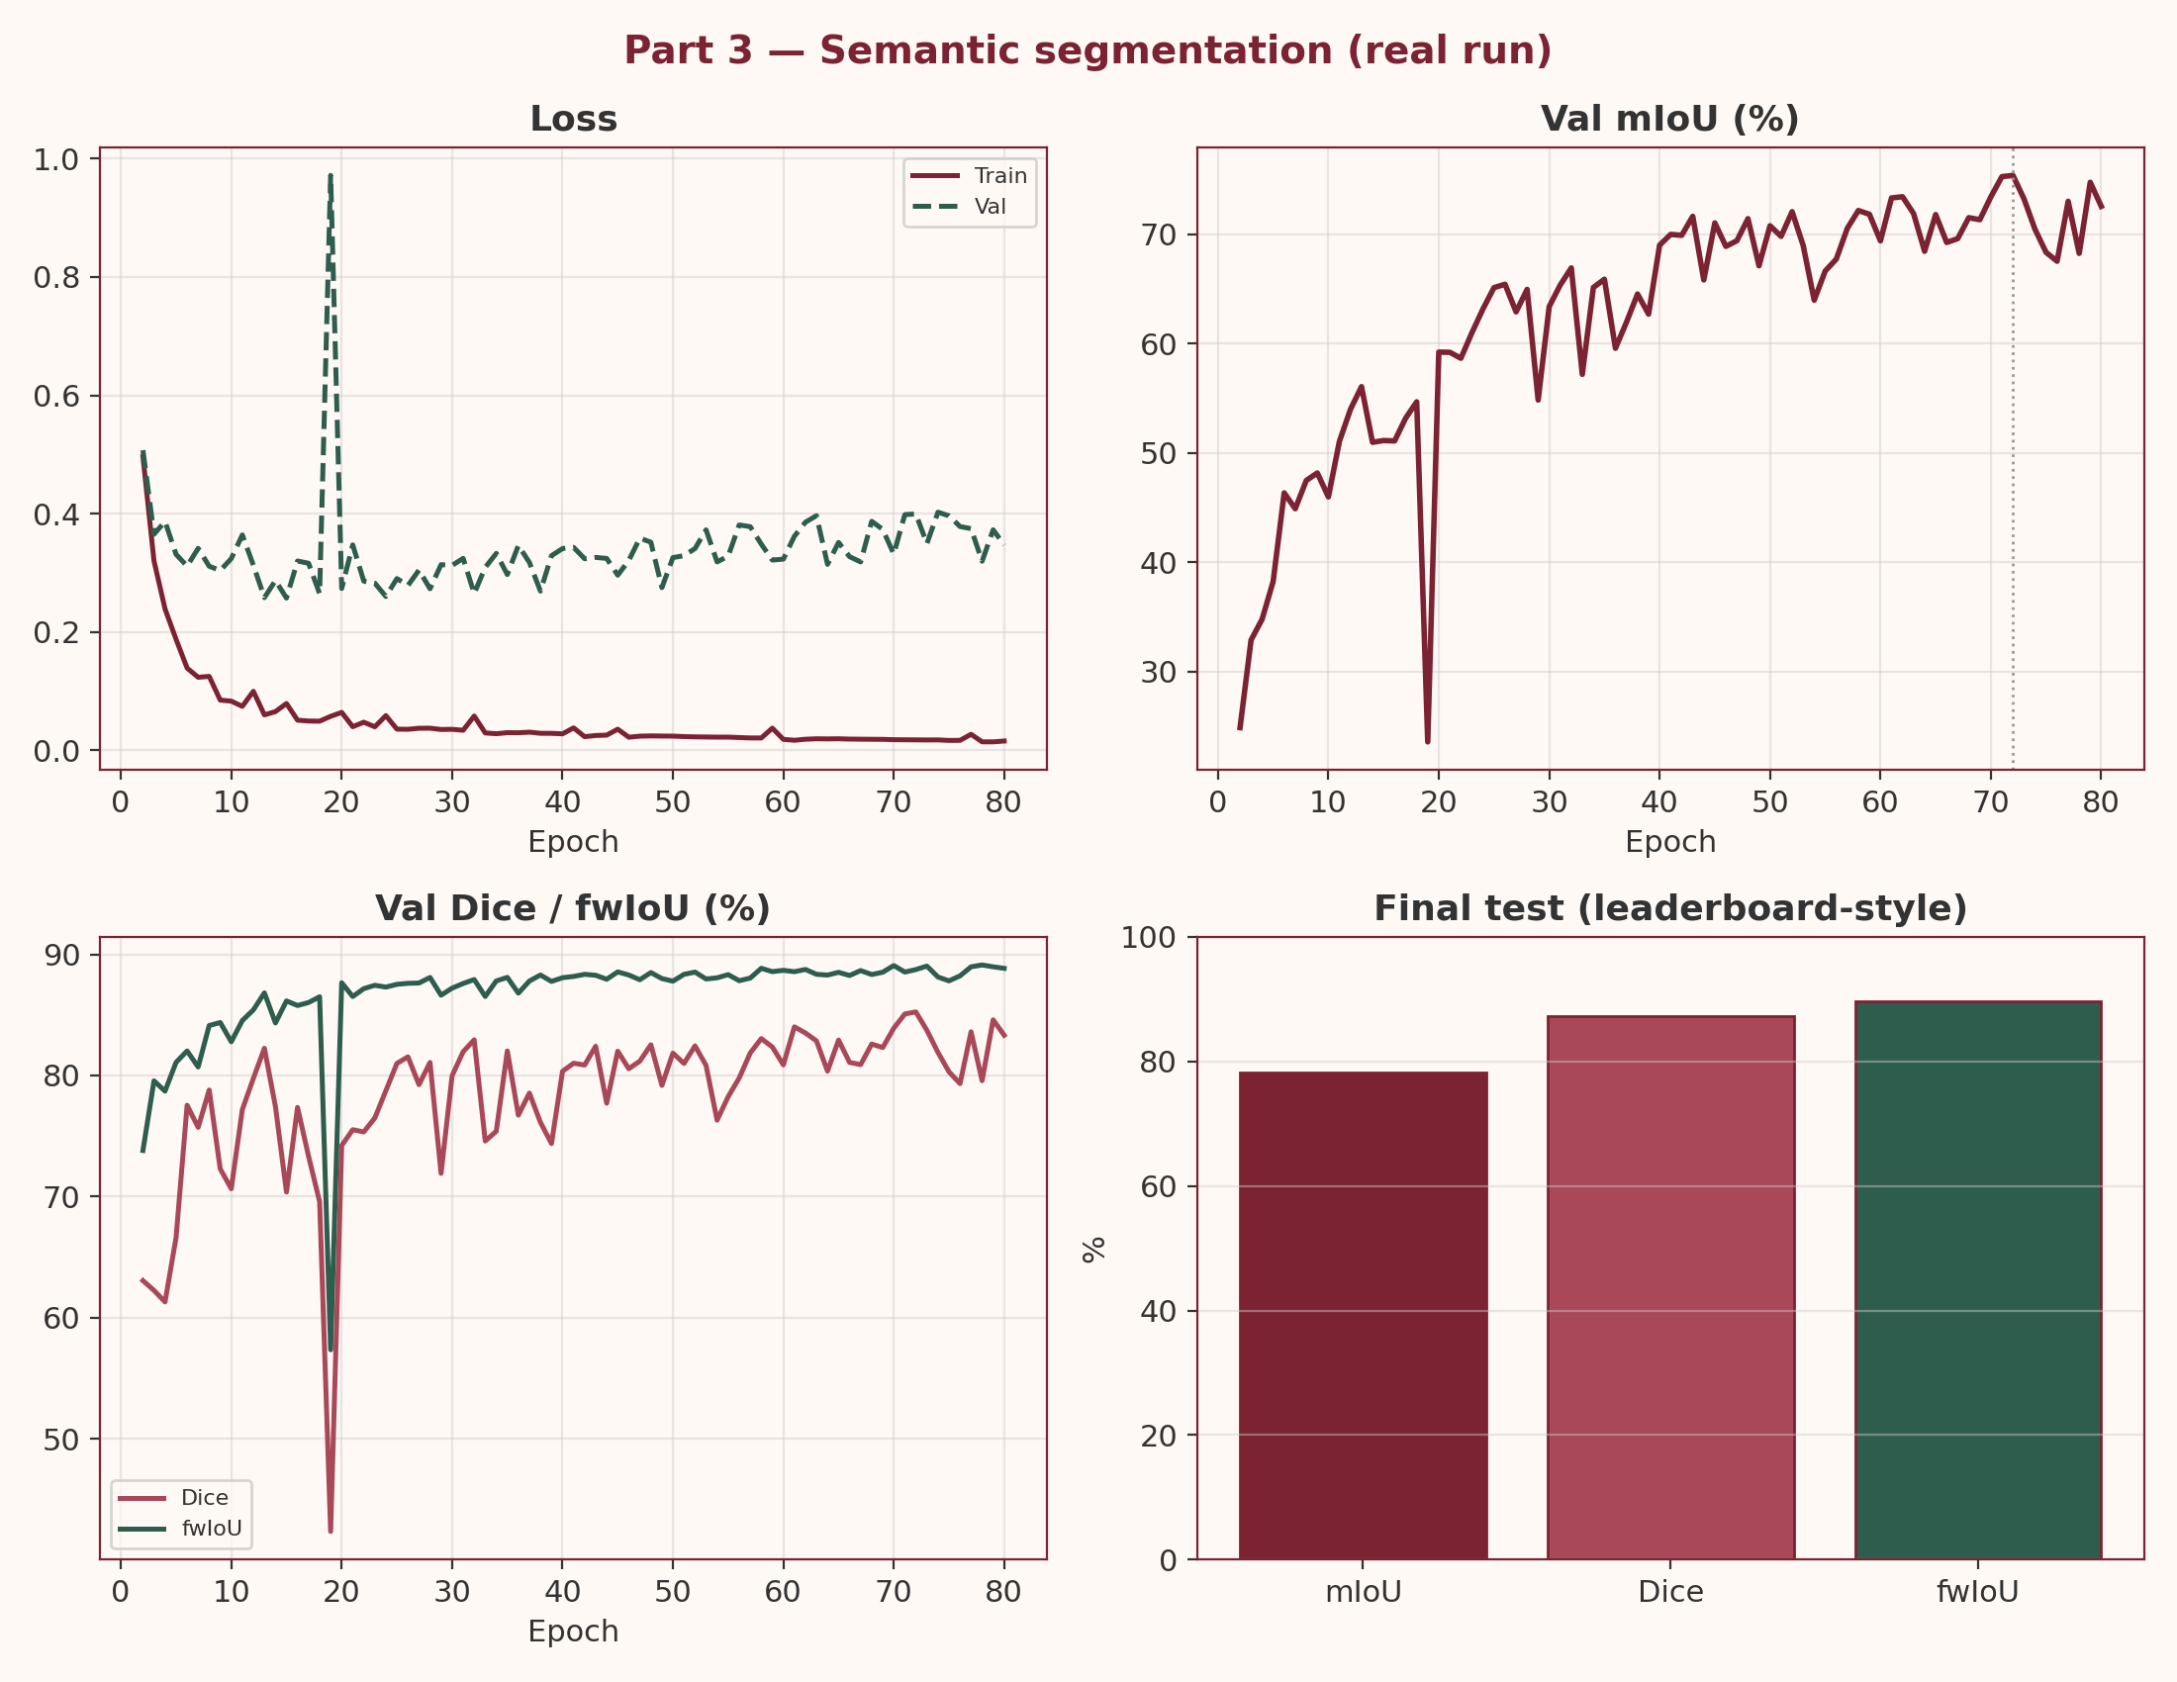
Real data — Part 3 dashboard (single slide summary)

Slide 9
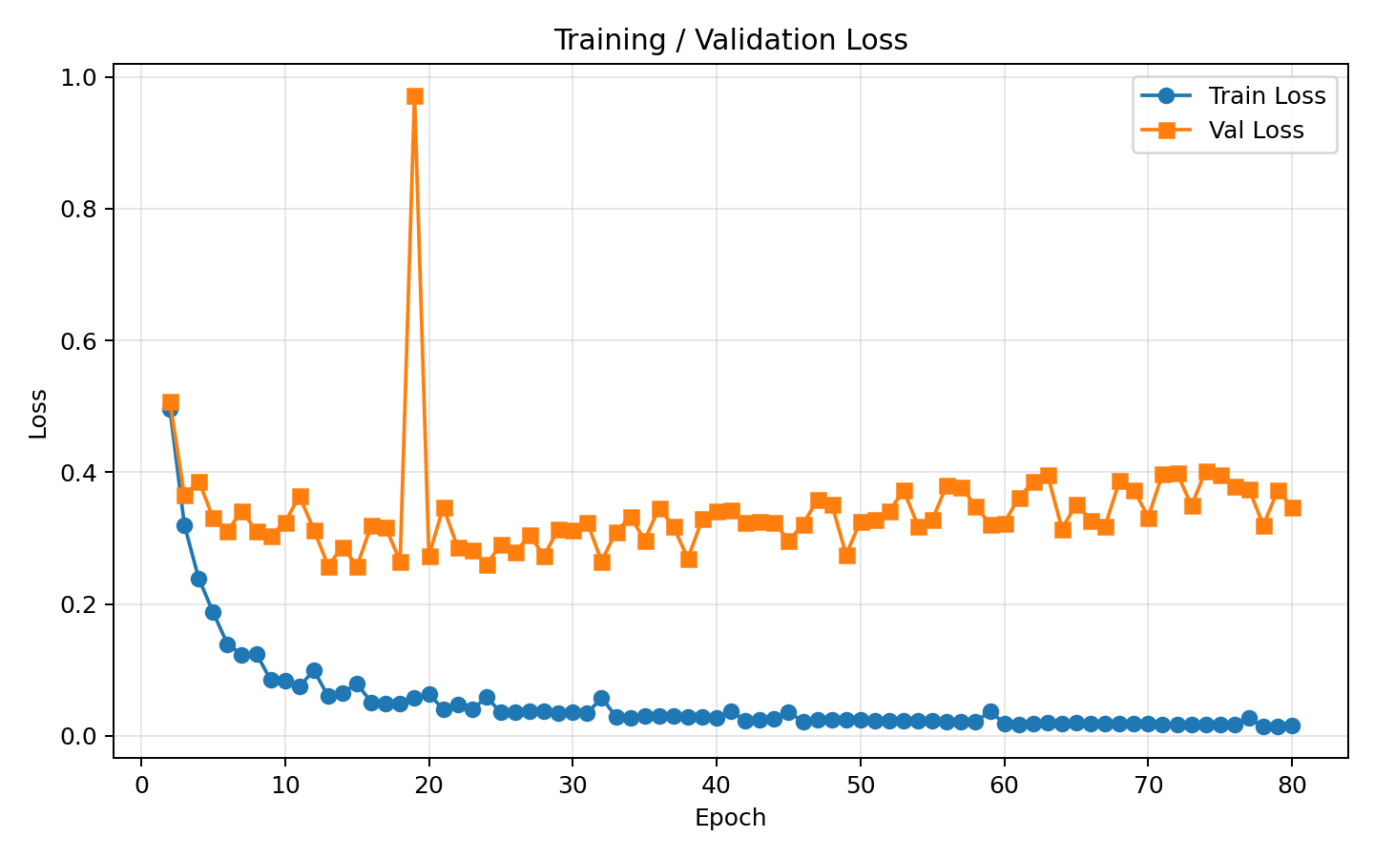
Same run — loss (plot_training_curves.py style)

Slide 10
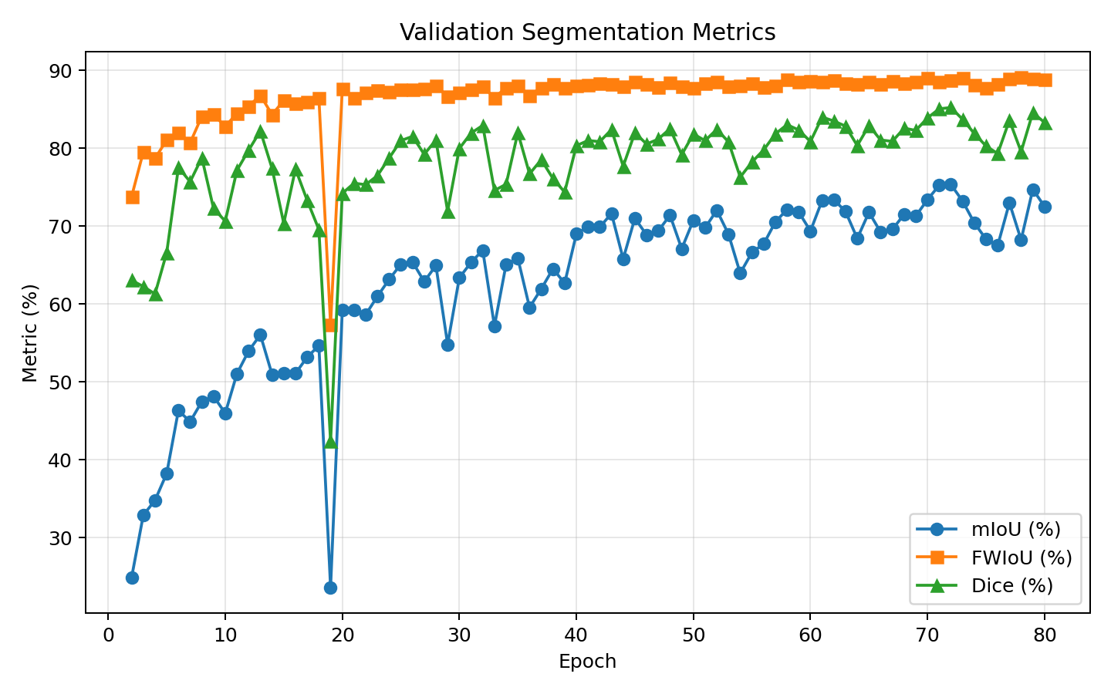
Same run — val metrics (plot_training_curves.py style)

Slide 11
Final results (test / leaderboard-style)
mIoU: 78.238%
Dice: 87.2757%
fwIoU: 89.6511%
Evaluated pairs: 1380 | Classes: 14
Figures above are generated from uavscenes_training_log.json and metrics_best.json (no synthetic metrics).

Slide 12
Key findings
Label remapping (sparse UAVScenes IDs → 0..13) is required for stable multi-class training.
AdamW + low LR + small input scale matches course UNet demo recommendations for this sequence.
Val mIoU peaks before the last epoch — model selection by best val checkpoint matters for reporting.
Fair comparison requires the same mask protocol and the official UAVScenes interval=5 split size.

