Slide 1
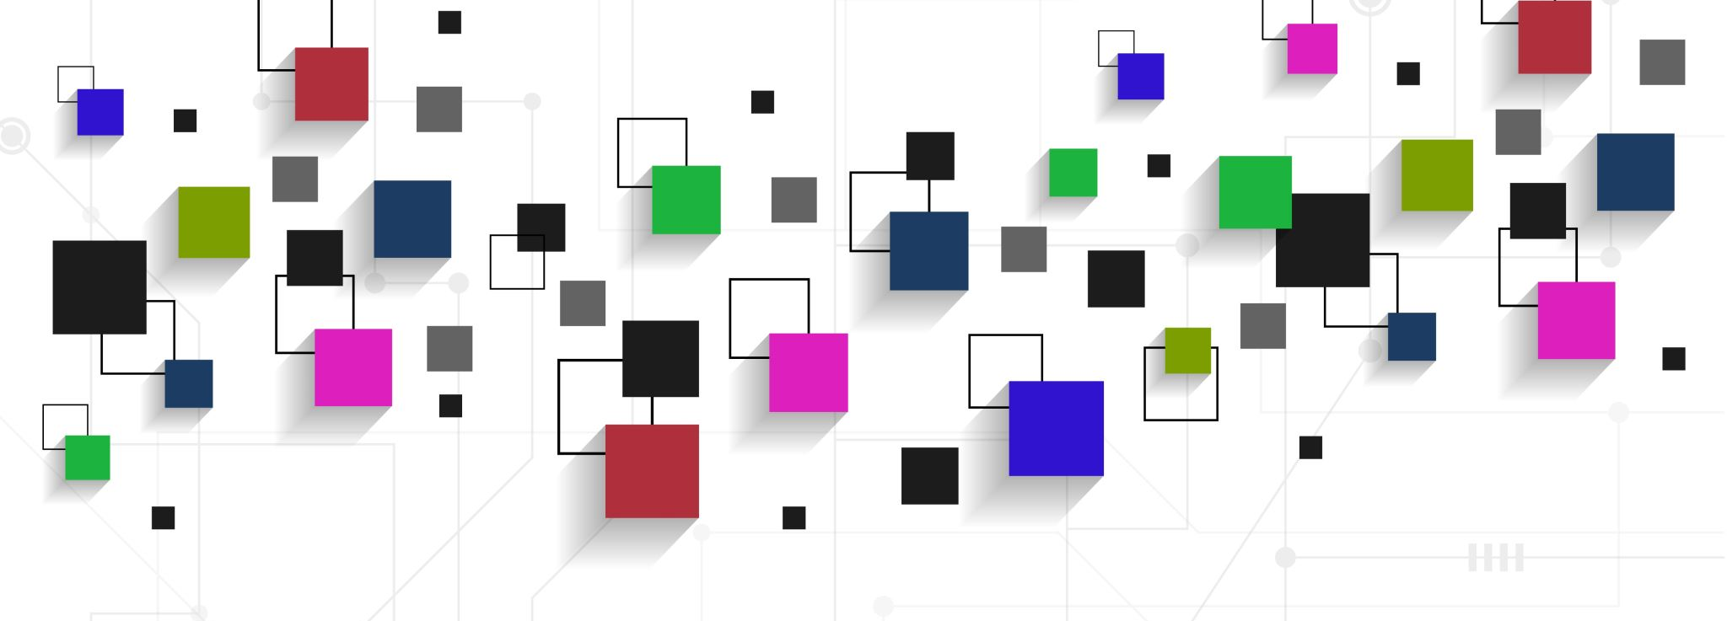
CI/CD FOR UdaPeople PROJECT
EVELYN ANYEBE

Slide 2
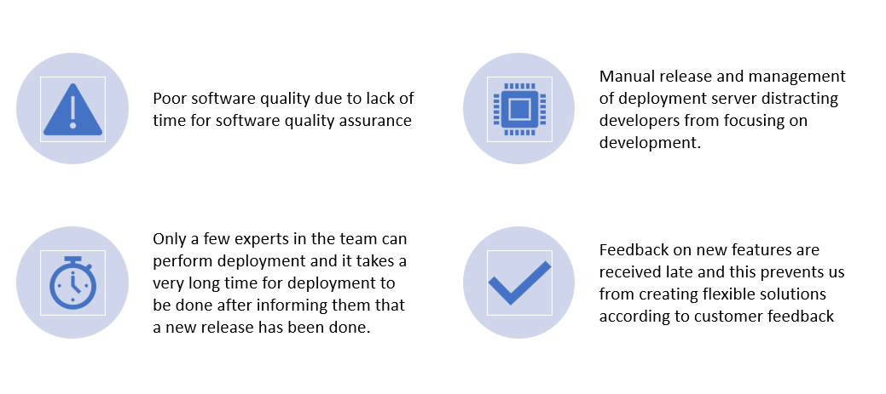
Our major Challenges

Slide 3
WHAT IS CI/CD
CI-CD is a common term used by developers and software engineering teams to describe the practices of continuous integration, continuous deployment, and continuous delivery.
Continuous integration is the practice of merging all developers working copies to shared mainline several times a day.
Continuous deployment is a software engineering approach in which updates and value are delivered frequently through automated deployments.
Continuous delivery is an engineering practice in which engineering teams produce and release value in short cycles.

Slide 4

BENEFITS OF CI/CD

Slide 5
COST AND REVENUE BENEFITS OF CI/CD
More production leading to more revenue
Save costs with automated infrastructure creation, scaling and clean up
New customers, contracts and more revenue

