Slide 1


Repetidora GTR 8000
Notes:
Instructor Guide
1-<number>
ASTRO® 25 Trunked Integrated Voice & Data System Release 7.4 Módulo 1: GTR 8000 Repeater Site
GTR 8000 Expandable Site Subsystem

Slide 2
Objetivos
Ao final deste treinamento, você estará capacitado a:
Identificar as configurações e os componentes da Repetidora GTR 8000
Programar as funções através do CSS
Notes:
Instructor Guide
1-<number>
ASTRO® 25 Trunked Integrated Voice & Data System Release 7.4 Módulo 1: GTR 8000 Repeater Site
GTR 8000 Expandable Site Subsystem

Slide 3
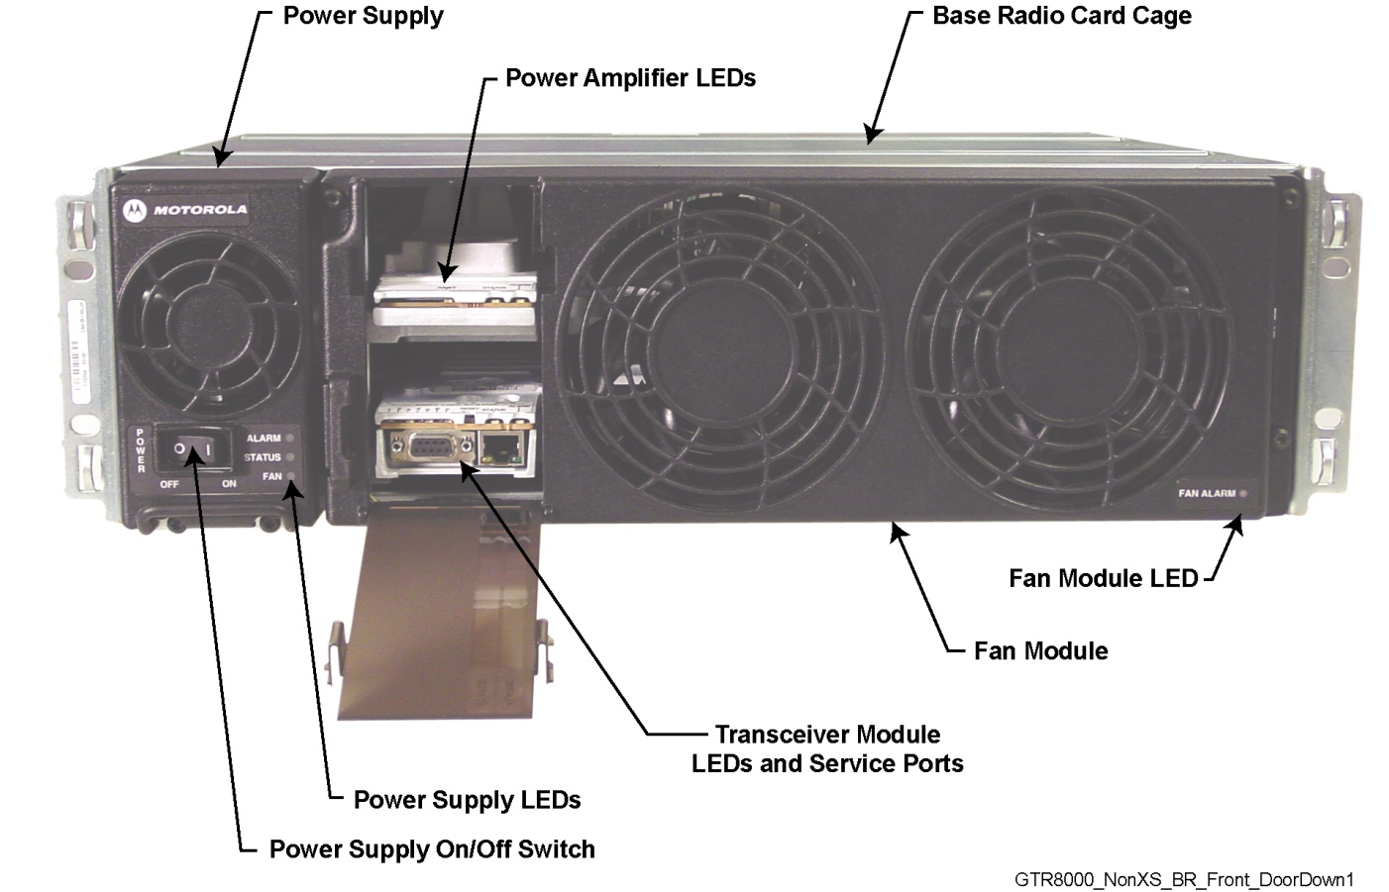
Repetidora GTR8000
Notes:
Instructor Guide
1-<number>
ASTRO® 25 Trunked Integrated Voice & Data System Release 7.4 Módulo 1: GTR 8000 Repeater Site
GTR 8000 Expandable Site Subsystem

Slide 4
Módulos da Repetidora
Os módulos da repetidora GTR 8000 são:
Transceptor (XCVR)
Amplificador de Potência
Ventilador
Fonte de Alimentação
Painel de conexão, Suporte de Placas, e Backplane
Notes:
Instructor Guide
2-<number>
ASTRO® 25 Trunked IV&D System Release 7.4 Module 4: GTR 8000 Expandable Site Subsystem
GTR 8000 Expandable Site Subsystem Workshop

Slide 5
Transceptor
Módulo Transceptor:
Placa de Controle
Placa RF
Interfaces Externas
Portas (Na frente e Atrás)
Switch
Notes:
Instructor Guide
2-<number>
ASTRO® 25 Trunked IV&D System Release 7.4 Module 4: GTR 8000 Expandable Site Subsystem
GTR 8000 Expandable Site Subsystem Workshop

Slide 6
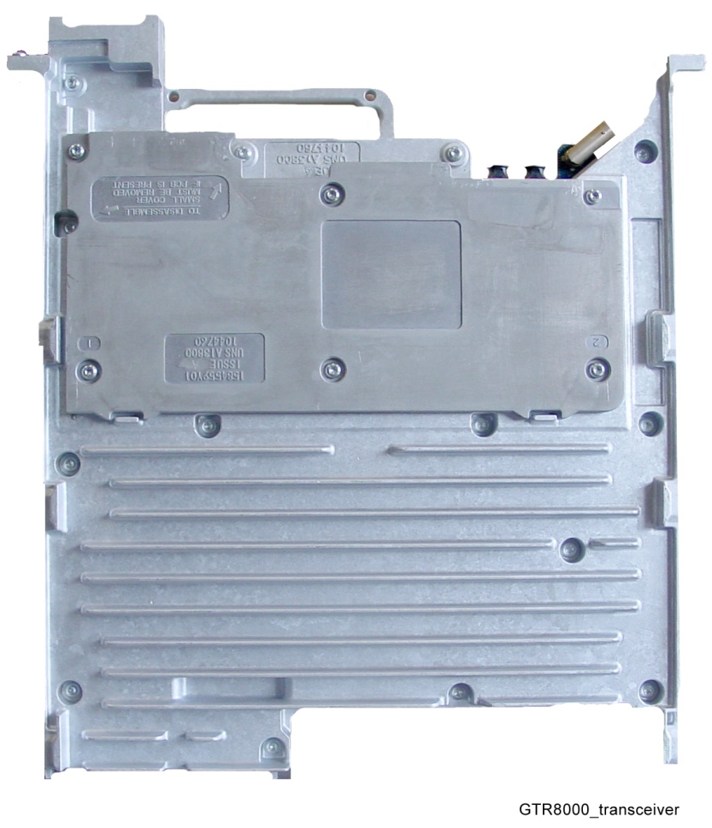
Módulo Transceptor
Proporciona as funções de controle, excitador e receptor.
O XCVR tem duas placas de circuitos:
  Placa de controle XCVR
  Placa de RF XCVR
Módulo Transceptor (XCVR) (Vista Frontal)
Notes:
Instructor Guide
2-<number>
ASTRO® 25 Trunked IV&D System Release 7.4 Module 4: GTR 8000 Expandable Site Subsystem
GTR 8000 Expandable Site Subsystem Workshop
Instructor Notes:
Suggested Teaching Strategy:
The transceptores (XCVR) module provides the controle, exciter, and receiver functions for the base rádio.
The XCVR generates the station reference, which typically needs to be locked to one of the many possible external sources.
The external source can be either the site controller TDM clocks, or the external reference operating at 5, 10, or 20 MHz.
The XCVR SPI bus allows communication with its receiver and exciter circuitry, as well as the power supply and power amplifier modules.
There are two circuit boards in the XCVR:
XCVR controle Board: Performs the controle management, digital signal processing, and transmit and receive data formatting for the base rádio.
XCVR RF Board: Contains DC power conversion/regulation, and performs receiver and exciter functions.

Slide 7
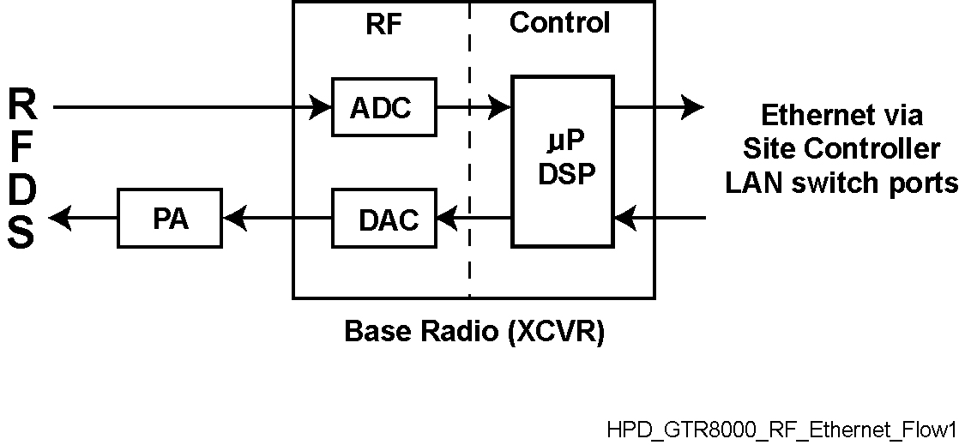
Transceptor
Ethernet através
da portas do
Controlador de sítio-Switch LAN
Rádio Base (XCVR)
Fluxo de Informação GTR 8000
Notes:
Instructor Guide
2-<number>
ASTRO® 25 Trunked IV&D System Release 7.4 Module 4: GTR 8000 Expandable Site Subsystem
GTR 8000 Expandable Site Subsystem Workshop
Instructor Notes:
The figure on the slide shows the information flow through the transceptores controle and RF sections.
The main operating software for the base rádio is loaded in the controle section of the XCVR.
As the main manager for the base rádio, the XCVR controle board provides operational controle over the other station modules.
It handles three types of information flow, in the following ways:
Serves as a gateway between the network and RF functionality, by distributing the RF payload to and from the network
Supports operational and diagnostic functions with digital controle data (for example: site information, channel assignments, and identification numbers for call processing)
Ensures the flow of other network management configuration information

Slide 8
Conexões Frontais do Transceptor
XCVR Porta/ Tipo | Conecta a este Dispositivo/Porta | Descrição
Service port, RJ-45 | PC de Serviço, porta LAN | Porta de serviço Etherner para acesso local usando CSS (Configuration Service Software). Também usado para download de software localizadas.
Service port, DB-9 | PC de Serviço, porta RS-232 | Porta de serviço serial para a configuração inicial da endereço IP da rádio base.
Notes:
Instructor Guide
2-<number>
ASTRO® 25 Trunked IV&D System Release 7.4 Module 4: GTR 8000 Expandable Site Subsystem
GTR 8000 Expandable Site Subsystem Workshop
Instructor Notes:
The transceptores external interfaces include seven external ports, a switch, and LEDs.
Two ports are accessible through a dropdown door to the left of the fans.
An asynchronous port, synchronous port, and a reference frequency input alignment port are located behind the fan module.

Slide 9
Funções do Switch Frontal do Transceptor
Ação do Usuário | Resultado
Pressione o switch por menos de 1 segundo | Acesso Desabilitado
Pressione o switch por mais de 3 segundos | Reinício do Módulo de controle do Transceptor
Notes:
Instructor Guide
2-<number>
ASTRO® 25 Trunked IV&D System Release 7.4 Module 4: GTR 8000 Expandable Site Subsystem
GTR 8000 Expandable Site Subsystem Workshop
Instructor Notes:
There is one multifunction switch on the front of the transceptores module, accessible through the dropdown door to the left of the fans.
Use light pressure when pressing the reset button

Slide 10
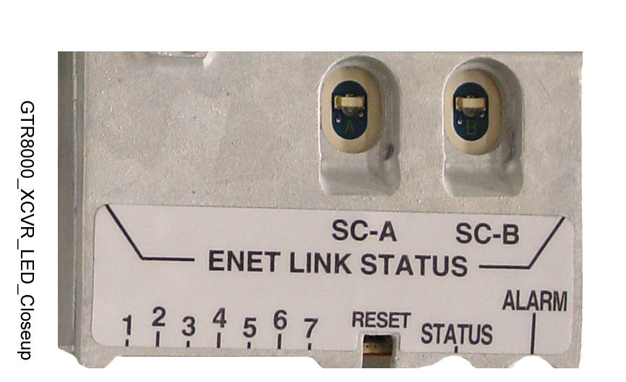
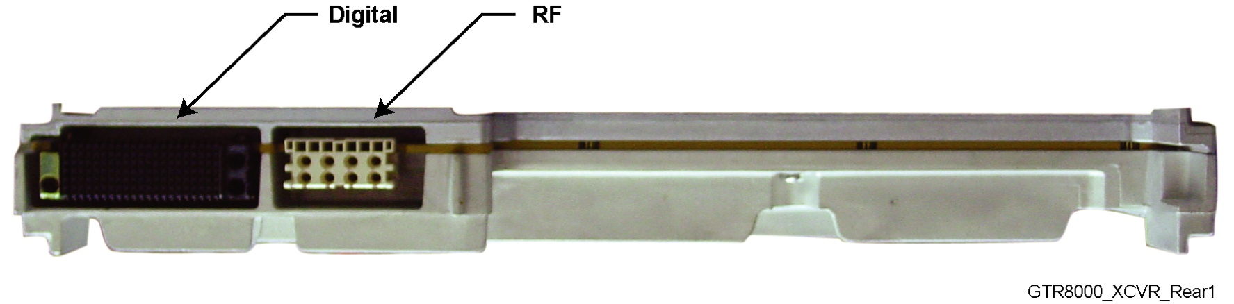
Transceptor
Botão de Reset GTR 8000
Módulo Transceptor GTR 8000 (Conexões do Backplane)
Notes:
Instructor Guide
2-<number>
ASTRO® 25 Trunked IV&D System Release 7.4 Module 4: GTR 8000 Expandable Site Subsystem
GTR 8000 Expandable Site Subsystem Workshop
Instructor Notes:
The transceptores interconnects to the backplane using a 120–pin HVDML digital connector and 8–pack RF connector.
These connections handle multiple signals including power, power supply communications, power amplifier communications, fan interface, and peripheral interface.
The digital connection receives alarm data and the TDM signals from the site controller, which are used to pass reference and controle data to the station.
In the expandable site subsystem configuration, the site controller and transceptores connect directly through a common backplane. The backplane connects the transceptores’s RF inputs with the associated receive multicouplers (Cabinet RMCs/LNAs).

Slide 11
Transceptor
LEDs do Transceptor GTR 8000 para os módulos que tem LEDs
Notes:
Instructor Guide
2-<number>
ASTRO® 25 Trunked IV&D System Release 7.4 Module 4: GTR 8000 Expandable Site Subsystem
GTR 8000 Expandable Site Subsystem Workshop

Slide 12
Condições de LEDs de Estados e Alarmes do Transceptor
Condição | Verde (LED de Estado) | Vermelho (Led de Alarme)
No Power | Off | Off
Lamp Test | On | On
Failure | Off | On
Impaired | On | Blinking
Booting Up | Off | Off
Online | On | Off
Notes:
Instructor Guide
2-<number>
ASTRO® 25 Trunked IV&D System Release 7.4 Module 4: GTR 8000 Expandable Site Subsystem
GTR 8000 Expandable Site Subsystem Workshop
Instructor Notes:
The Status LED is Verde, and the Alarm LED is red.
These LEDs are either off or on, depending on the condition of the transceptores.

Slide 13
LEDs de Estado do Enlace do Transceptor
Condição | LED Estado do Enlace
Enlace Inativo | Off
Enlace Estabelecido | Verde
Enlace Ativo | Âmbar
Notes:
Instructor Guide
2-<number>
ASTRO® 25 Trunked IV&D System Release 7.4 Module 4: GTR 8000 Expandable Site Subsystem
GTR 8000 Expandable Site Subsystem Workshop
Instructor Notes:
The Status LEDs are either off, Verde, or Âmbar depending on the condition of the link connection between the transceptores and site controller A or B.

Slide 14
Descrição: LEDs Rádio Base
Notes:
Instructor Guide
1-<number>
ASTRO® 25 Trunked Integrated Voice & Data System Release 7.4 Módulo 1: GTR 8000 Repeater Site
GTR 8000 Expandable Site Subsystem

Slide 15
LEDs das Condições do Software de controle do Transceptor
Condição | LED 1 | LED 2 | LED 3 | LED 4
Iniciando*
Teste de Leds | Âmbar | Âmbar | Âmbar | Âmbar
Receptor Inibido | Âmbar (piscando)
Receptor Ativo | Verde
Portadora Ilegal | Vermelho (piscando)
Canal de Controle (Operando) |  | Verde
Canal de controle (Failsoft) |  | Verde (piscando)
* Durante uma seqüência normal de inicialização, LEDs 1 ao 4 piscam da esquerda para direita e da direita para a esquerda continuamente por vários segundos.
Notes:
Instructor Guide
2-<number>
ASTRO® 25 Trunked IV&D System Release 7.4 Module 4: GTR 8000 Expandable Site Subsystem
GTR 8000 Expandable Site Subsystem Workshop
Instructor Notes:
The LEDs can be green, red, or Amber depending on the condition of the transceptores.

Slide 16
LEDs das Condições do Software de Controle do Transceptor
Condição | LED 1 | LED 2 | LED 3 | LED 4
Modo de Serviço |  |  | Âmbar
Transmissor Inibido |  |  | Âmbar (piscando)
Enlace para a Infra-estrutura Conectado |  |  |  | Verde
Enlace para a Infra-estrutura Desconectado |  |  |  | Verde (piscando)
Notes:
Instructor Guide
2-<number>
ASTRO® 25 Trunked IV&D System Release 7.4 Module 4: GTR 8000 Expandable Site Subsystem
GTR 8000 Expandable Site Subsystem Workshop

Slide 17
LEDs das Condições do Software de controle do Transceptor
Condição | LED 5 | LED 6 | LED 7
Teste de Leds | Âmbar | Âmbar | Âmbar
SWDL (Transferência de Software em progresso) | Verde
Alerta |  | Âmbar
Falha Minoritária de Hardware |  | Âmbar (piscando)
Falha Majoritária de Hardware |  | Vermelho (piscando)
Falha Crítica de Hardware |  | Vermelho
Notes:
Instructor Guide
2-<number>
ASTRO® 25 Trunked IV&D System Release 7.4 Module 4: GTR 8000 Expandable Site Subsystem
GTR 8000 Expandable Site Subsystem Workshop
Instructor Notes:
The color of all LEDs must be observed in order to interpret the condition of the transceptores.
For example:
If LED 5 is Verde, the condition is “Software download transfer in progress.”
If LED 6 is red, the condition is “Critical Hardware Failure.”

Slide 18
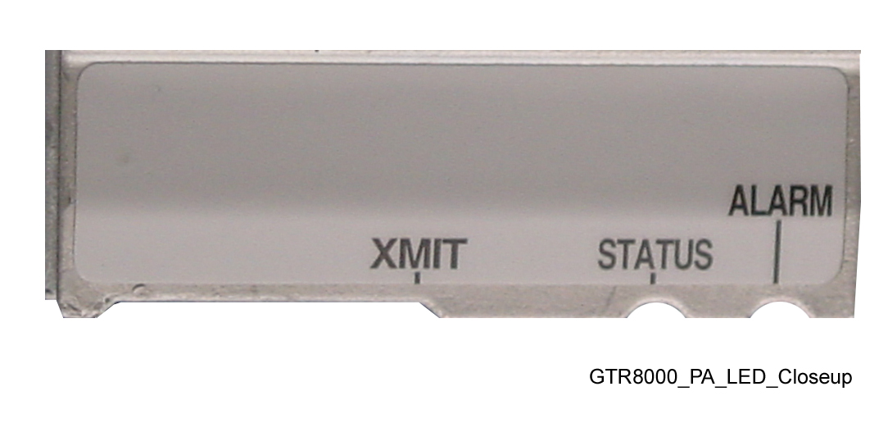
Amplificador de Potência
LEDs do Amplificador de Potência GTR 8000
Notes:
Instructor Guide
2-<number>
ASTRO® 25 Trunked IV&D System Release 7.4 Module 4: GTR 8000 Expandable Site Subsystem
GTR 8000 Expandable Site Subsystem Workshop
Instructor Notes:
The color of all the LEDs of the power amplifier must be observed in order to interpret the power amplifier’s condition.
For example:
If the Alarm LED is red and the Transmit and Status LEDs are Verde, the condition is “Lamp Test.”
If the Alarm LED is red and the Transmit and Status LEDs are not lit, the condition is “PA Failure”, and the power amplifier module should be replaced.

Slide 19
Condições dos LEDs de Amplificador de Potência
Condição | Transmissor (XMIT) | Estado | Alarmes
Sem Potência
Teste de Leds | Verde | Verde | Vermelho
Sem transmissão |  | Verde
Transmitindo a Potência de Saída Máxima Requerida | Verde | Verde
Transmitindo abaixo da Potência Requerida | Verde (piscando) | Verde
Falha de PA |  |  | Vermelho
Notes:
Instructor Guide
2-<number>
ASTRO® 25 Trunked IV&D System Release 7.4 Module 4: GTR 8000 Expandable Site Subsystem
GTR 8000 Expandable Site Subsystem Workshop

Slide 20
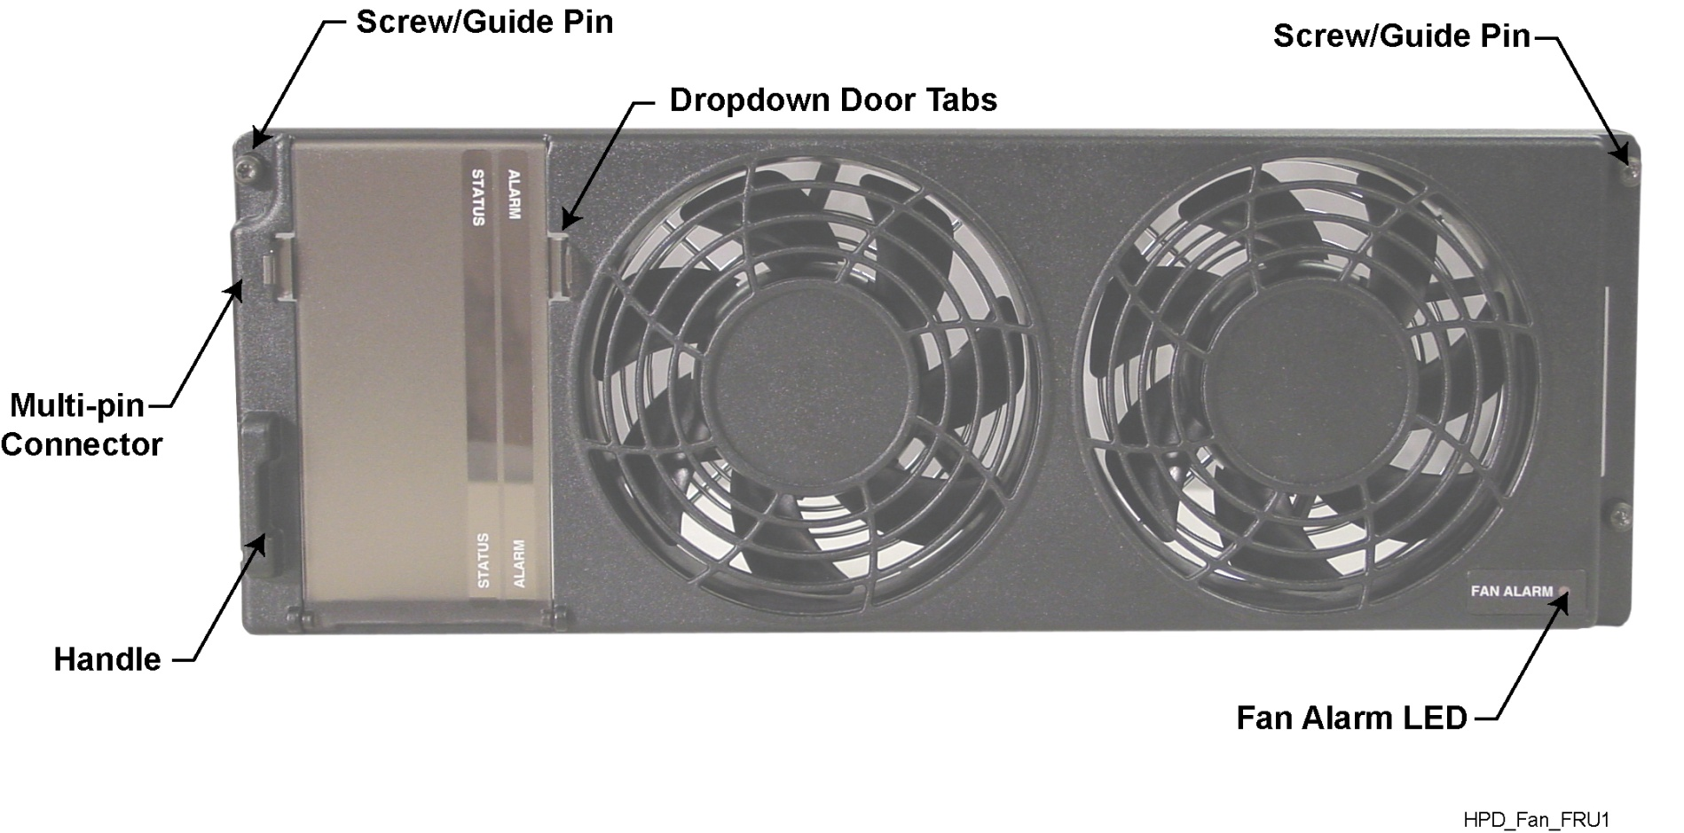
Módulo de Ventilação
O LED de Alarmes do Módulo de Ventilação GTR 8000
está no canto inferior direito
Notes:
Instructor Guide
2-<number>
ASTRO® 25 Trunked IV&D System Release 7.4 Module 4: GTR 8000 Expandable Site Subsystem
GTR 8000 Expandable Site Subsystem Workshop
Instructor Notes:
The fan module has one “Fan Alarm” LED visible on the lower right corner of its front panel.
The alarm is red during Lamp Test (for a second or less), and remains red if there is a fan failure.
A fan failure alarm occurs if the built-in speed sensor detects that either fan is operating 30% below rated speed.
A red fan alarm indicates that the fan module needs to be replaced within seven days.
Note: The base rádio operates at full capability for at least seven days after the fan alarm first occurs. This feature allows the system to operate normally without requiring an immediate service call.

Slide 21
Condições do LED do Módulo de Ventilação
Condição do LED | Alarme | Explicação de Estado
Off |  | Operacional ou desligado
Vermelho (por um segundo ou menos) | Vermelho | Teste de Leds
Vermelho (Constante) | Vermelho | Falha Se o sensor de velocidade interno detecta que quaisquer dos ventiladores está operando 30% abaixo da velocidade especificada. Necessita ser substituído nos próximos 7 dias.
Notes:
Instructor Guide
2-<number>
ASTRO® 25 Trunked IV&D System Release 7.4 Module 4: GTR 8000 Expandable Site Subsystem
GTR 8000 Expandable Site Subsystem Workshop
Instructor Notes:
Table in the slide explains the possible colors of the LED and what they mean.
The fan module has one LED, the Fan Alarm, located on the front in the corner.
The LED provides a visual image of the operating condition of the fan assembly.

Slide 22
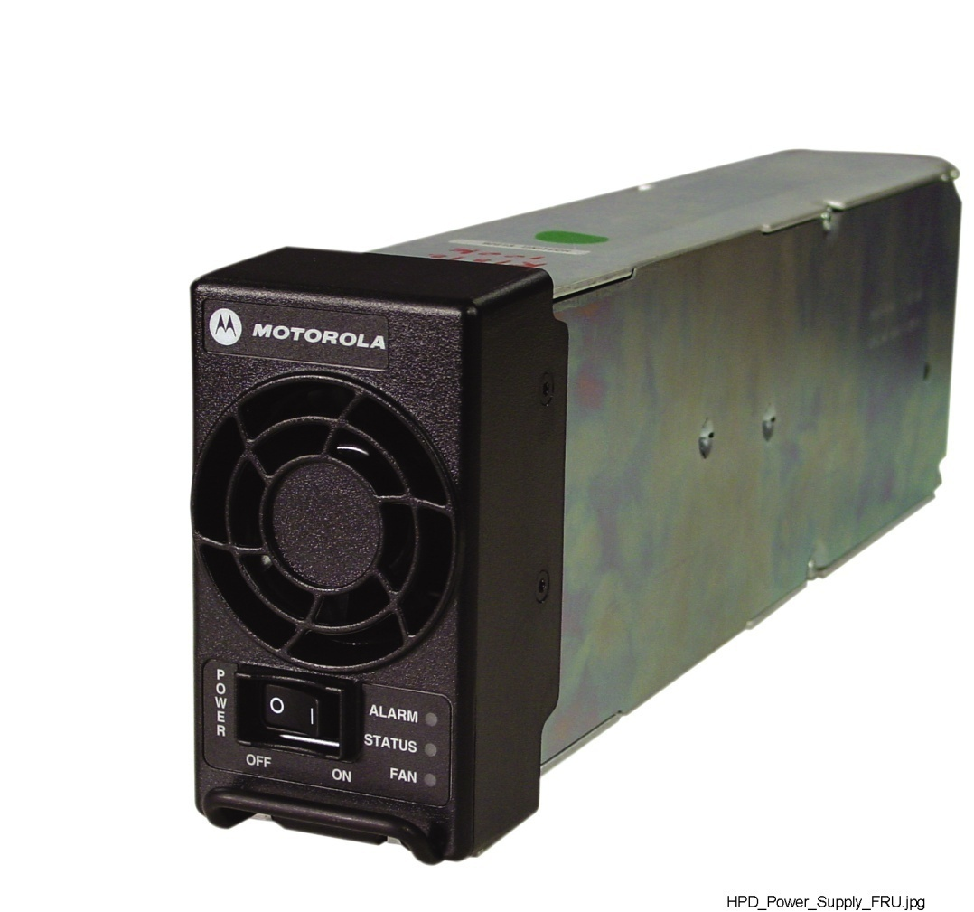
Fonte de Alimentação
Módulo de Fonte de Alimentação GTR 8000
Notes:
Instructor Guide
2-<number>
ASTRO® 25 Trunked IV&D System Release 7.4 Module 4: GTR 8000 Expandable Site Subsystem
GTR 8000 Expandable Site Subsystem Workshop
Instructor Notes:
The power supply module has three LEDs visible from the front panel. The color of all the LEDs must be observed in order to interpret its condition.
For example:
If the Alarm and Fan LEDs are red and the Status LED is Verde, the condition is “Lamp Test.”
If the Alarm LED is red, and the Fan and Status LEDs are not lit, the condition is “Power Supply Failure.”
If the Fan LEDs are red and the Status LED is Verde, the condition is “Power Supply fan Failure.”

Slide 23
Condições dos LEDs da Fonte de Alimentação
Condição | Ventilador | Estado | Alarme
Sem Potência
Teste de Leds | Vermelho | Verde | Vermelho
Ligado |  | Verde
Deteriorado |  | Verde | Vermelho (piscando)
Falha da Fonte de Alimentação |  |  | Vermelho
Falha do Ventilador da Fonte de Alimentação | Vermelho | Verde
Notes:
Instructor Guide
2-<number>
ASTRO® 25 Trunked IV&D System Release 7.4 Module 4: GTR 8000 Expandable Site Subsystem
GTR 8000 Expandable Site Subsystem Workshop

Slide 24
Equipamento e Ferramentas Requeridas
Caixa de Ferramentas Técnicas para troca da FRU
Pulseira anti-estática (ESD strap -Motorola P/N RSX4015A)
PC portátil com CSS e SWDL instalados
Cabo serial DM-9 direto
Cabo Ethernet
Chaves de fenda e phillips
Conjunto de pontas TORX
Notes:
Instructor Guide
2-<number>
ASTRO® 25 Trunked IV&D System Release 7.4 Module 4: GTR 8000 Expandable Site Subsystem
GTR 8000 Expandable Site Subsystem Workshop

