Slide 1
Security Radio Communications
Module 1
Duration: 1.5 Hours
Objectives
Train security guards to effectively communicate using two-way radios in daily operations and emergency scenarios:
  Understand radio basics and protocols.
  Learn emergency communication procedures.
  Hands-on training with radio drills.
Notes:
Opening: Welcome to Module 1: Security Radio Communications. This is the foundation of all team operations on shift. If we cant talk, we can’t respond. And if we can’t respond, we can’t protect.
Icebreaker (2-3 minutes): What is the funniest, or worst thing you’ve heard over the radio during a shift?
Overview: Today were going to introduce you to radio operations. While we’ll cover all the buttons, were going to concentrate on how to be professional on the radio. We’ll cover daily operations, but also shift into how to communicate in emergencies. History has shown most communication collapses happen during emergencies, as we’ll show in a real world scenario. We are here to protect lives by saving time through clear, concise communications.
Key Points to emphasize: Professionalism over casual chatter- Radio’s are not walkie talkies. They're tools for mission execution. Emergency Clarity- Emphasize that panic on the mic spreads. Calm, clear radio traffic saves lives.
Next slide prep: Next were going to start talking about operating and understanding your radio so you don't feel awkward on your next shift.

Slide 2
Basic Radio Operations
Powering on/off, volume control, selecting channels.
Understanding different radio models and setups.
Proper headset and accessory use.
Notes:
Before we can talk about how to communicate, we need to become familiar with the hardware. How clear on concise you are doesn’t matter if you radio battery is dead, or your hand mic is not connected. Let’s start with the basics.

Slide 3
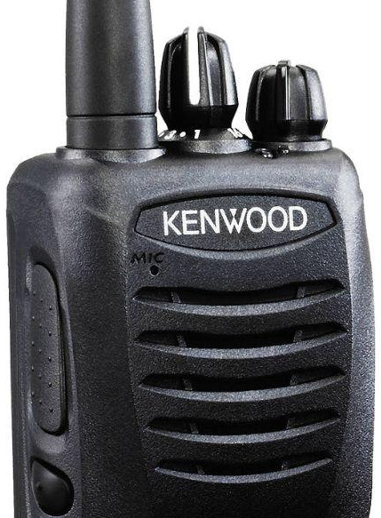
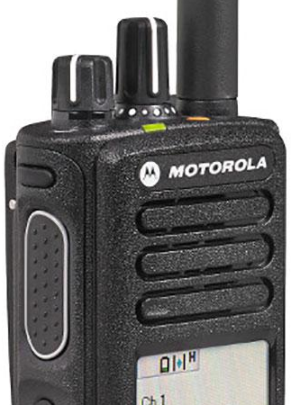
Standard Radio Models
Channel Select
Power/Volume
PTT Button
Notes:
Walkthrough Topics: Power on/off- Show location of power on/off & volume knob knob on visual reference. Channel Change Knob- Demonstrate switching channel. Emphasize Command Channel for Supervisors, Operations Channel for units in the field, Emergency Channel for critical incidents. Explain: “Hot Mic” scenario and how to avoid it.
Radio Model and set up: Show examples of different common use models (reference photo). Emphasize importance of familiarity with company model specific features. Note: menu variations, keypad lockouts, and menu functions.

Slide 4
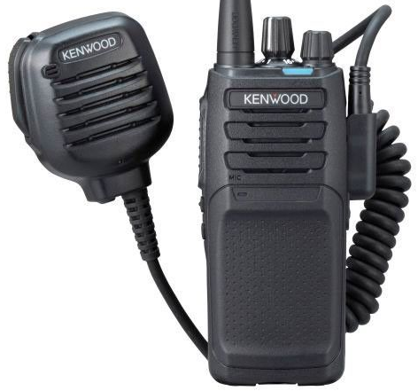
Hand Mic (aka “Puck” or “Biscuit”)
PTT Button
Speaker/Microphone Port
Notes:
Walkthrough: Show proper insertion and seating of hand mic cable. Show cable routing to reduce snags. Emphasize mic placement for optimum hearing, and reducing probability of accidental Hot Mic. Show earpiece and cable routing.

Slide 5
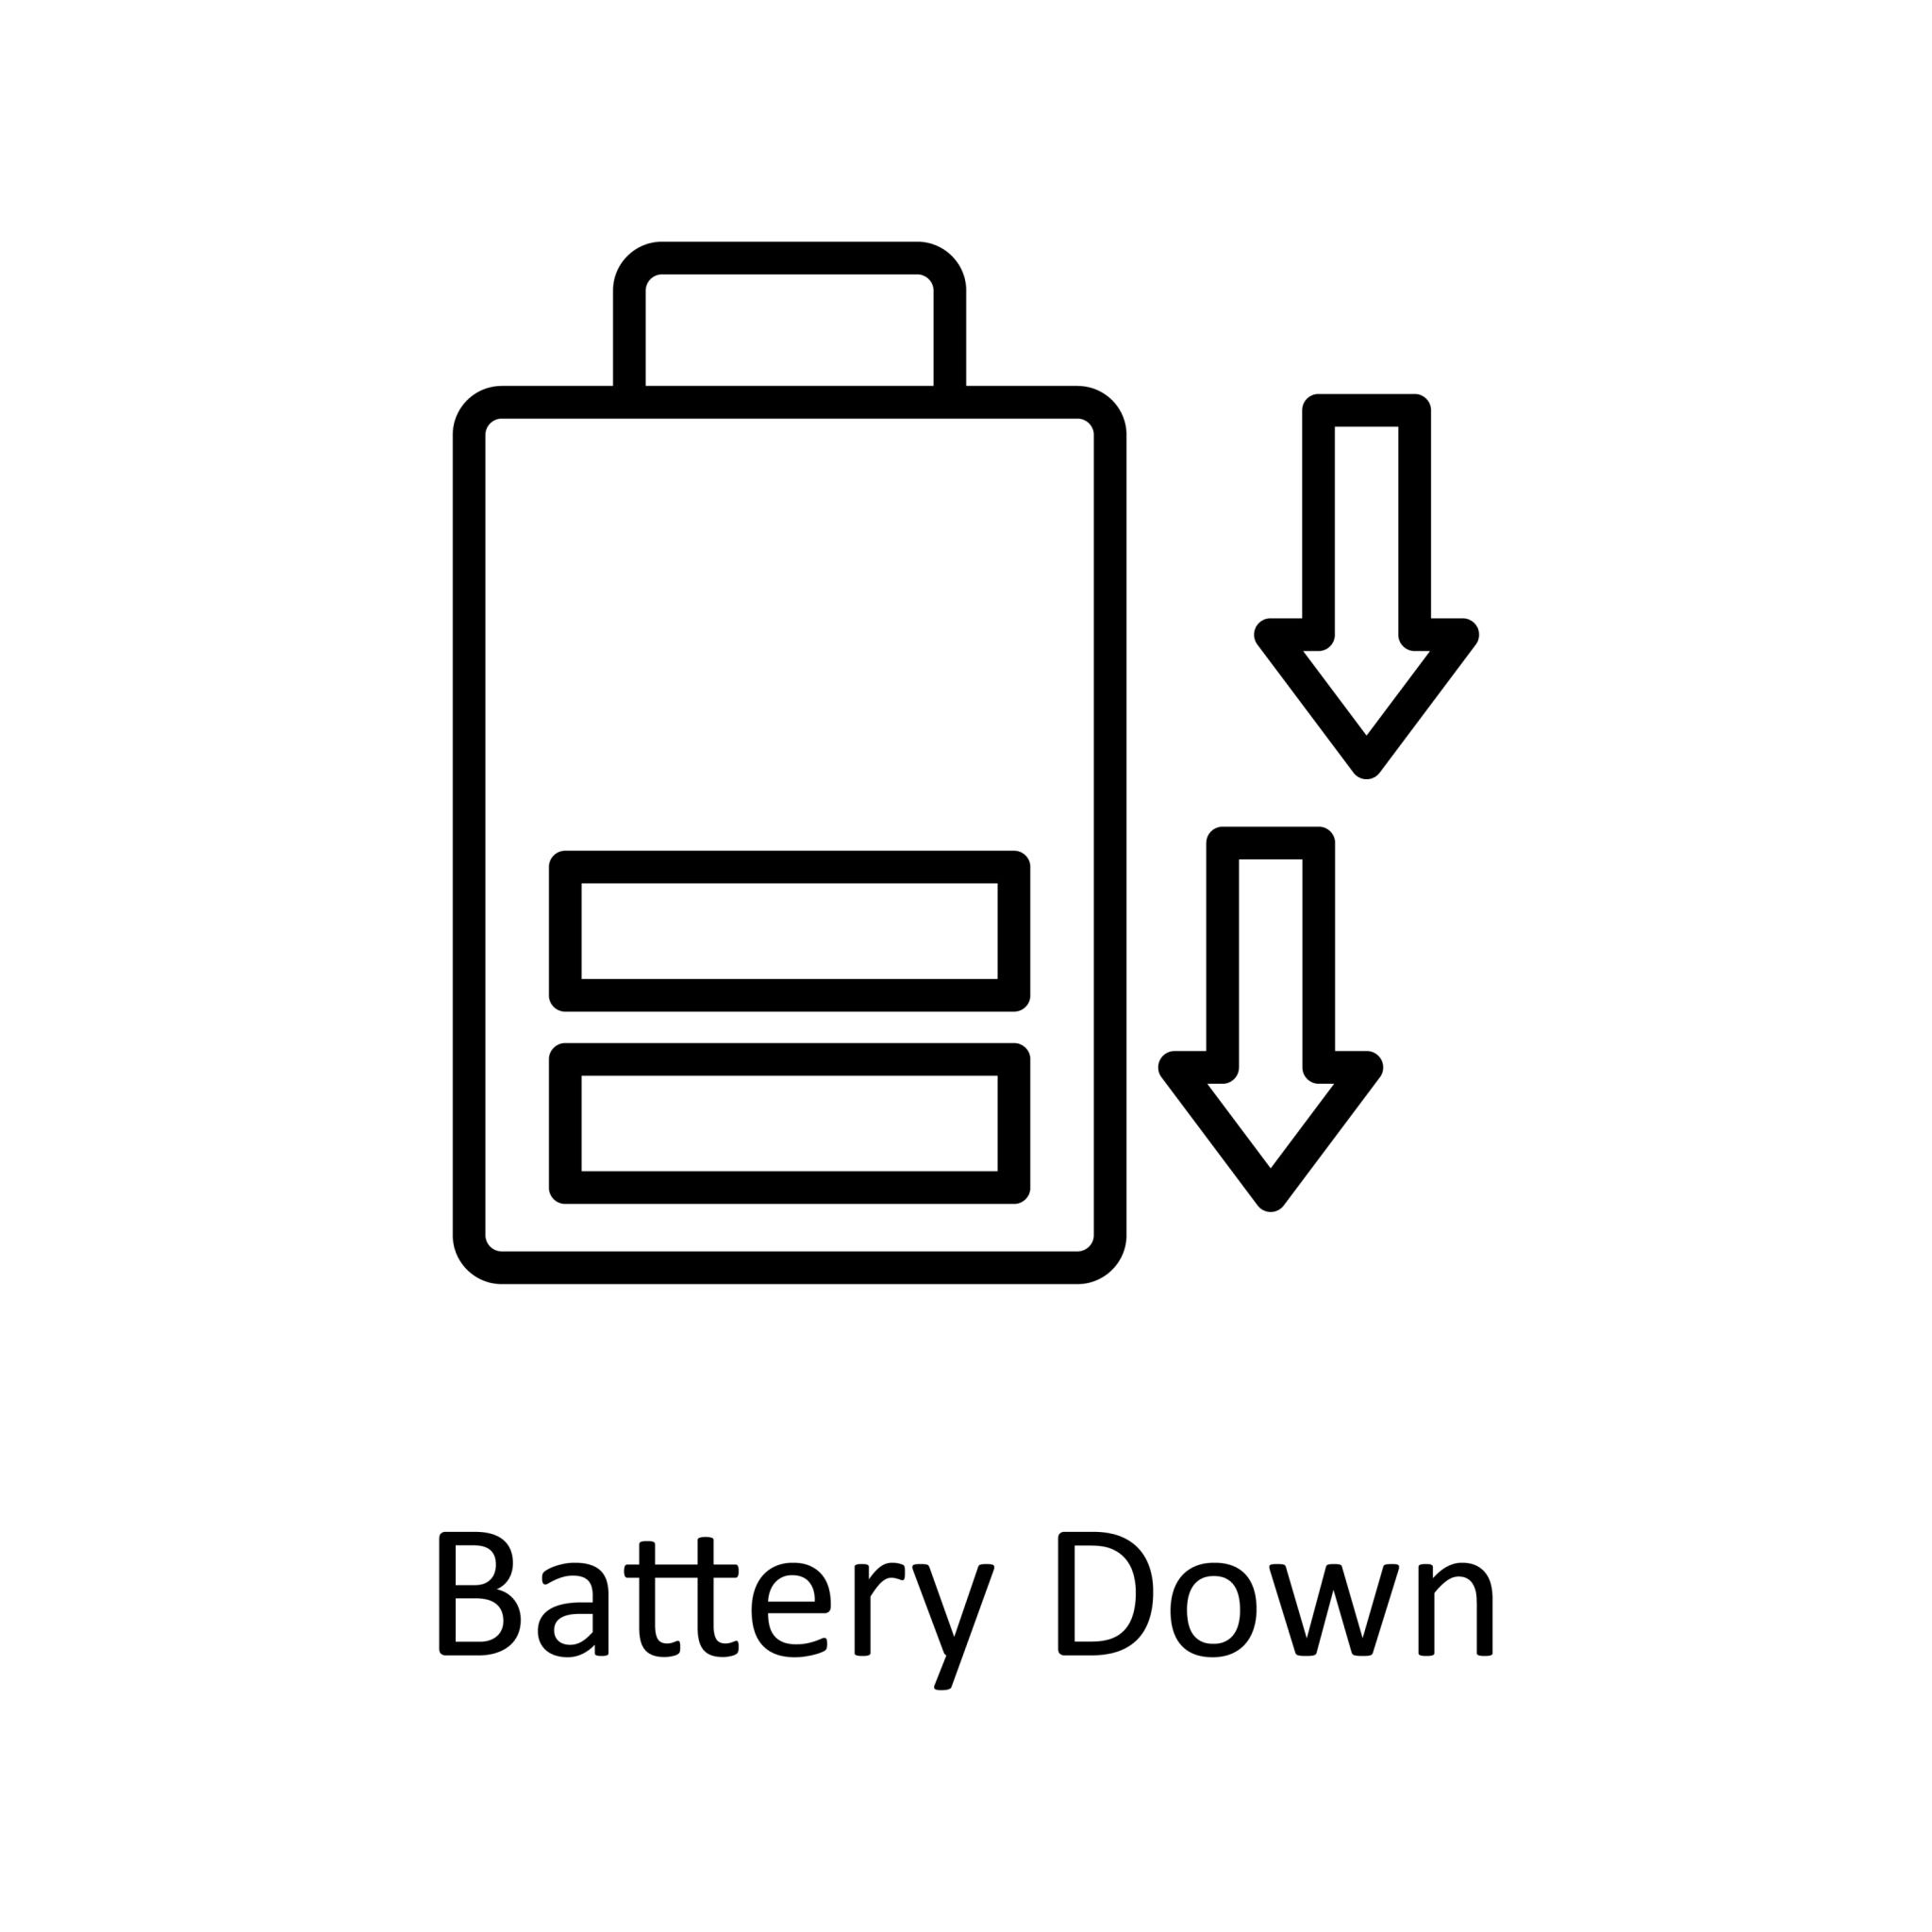
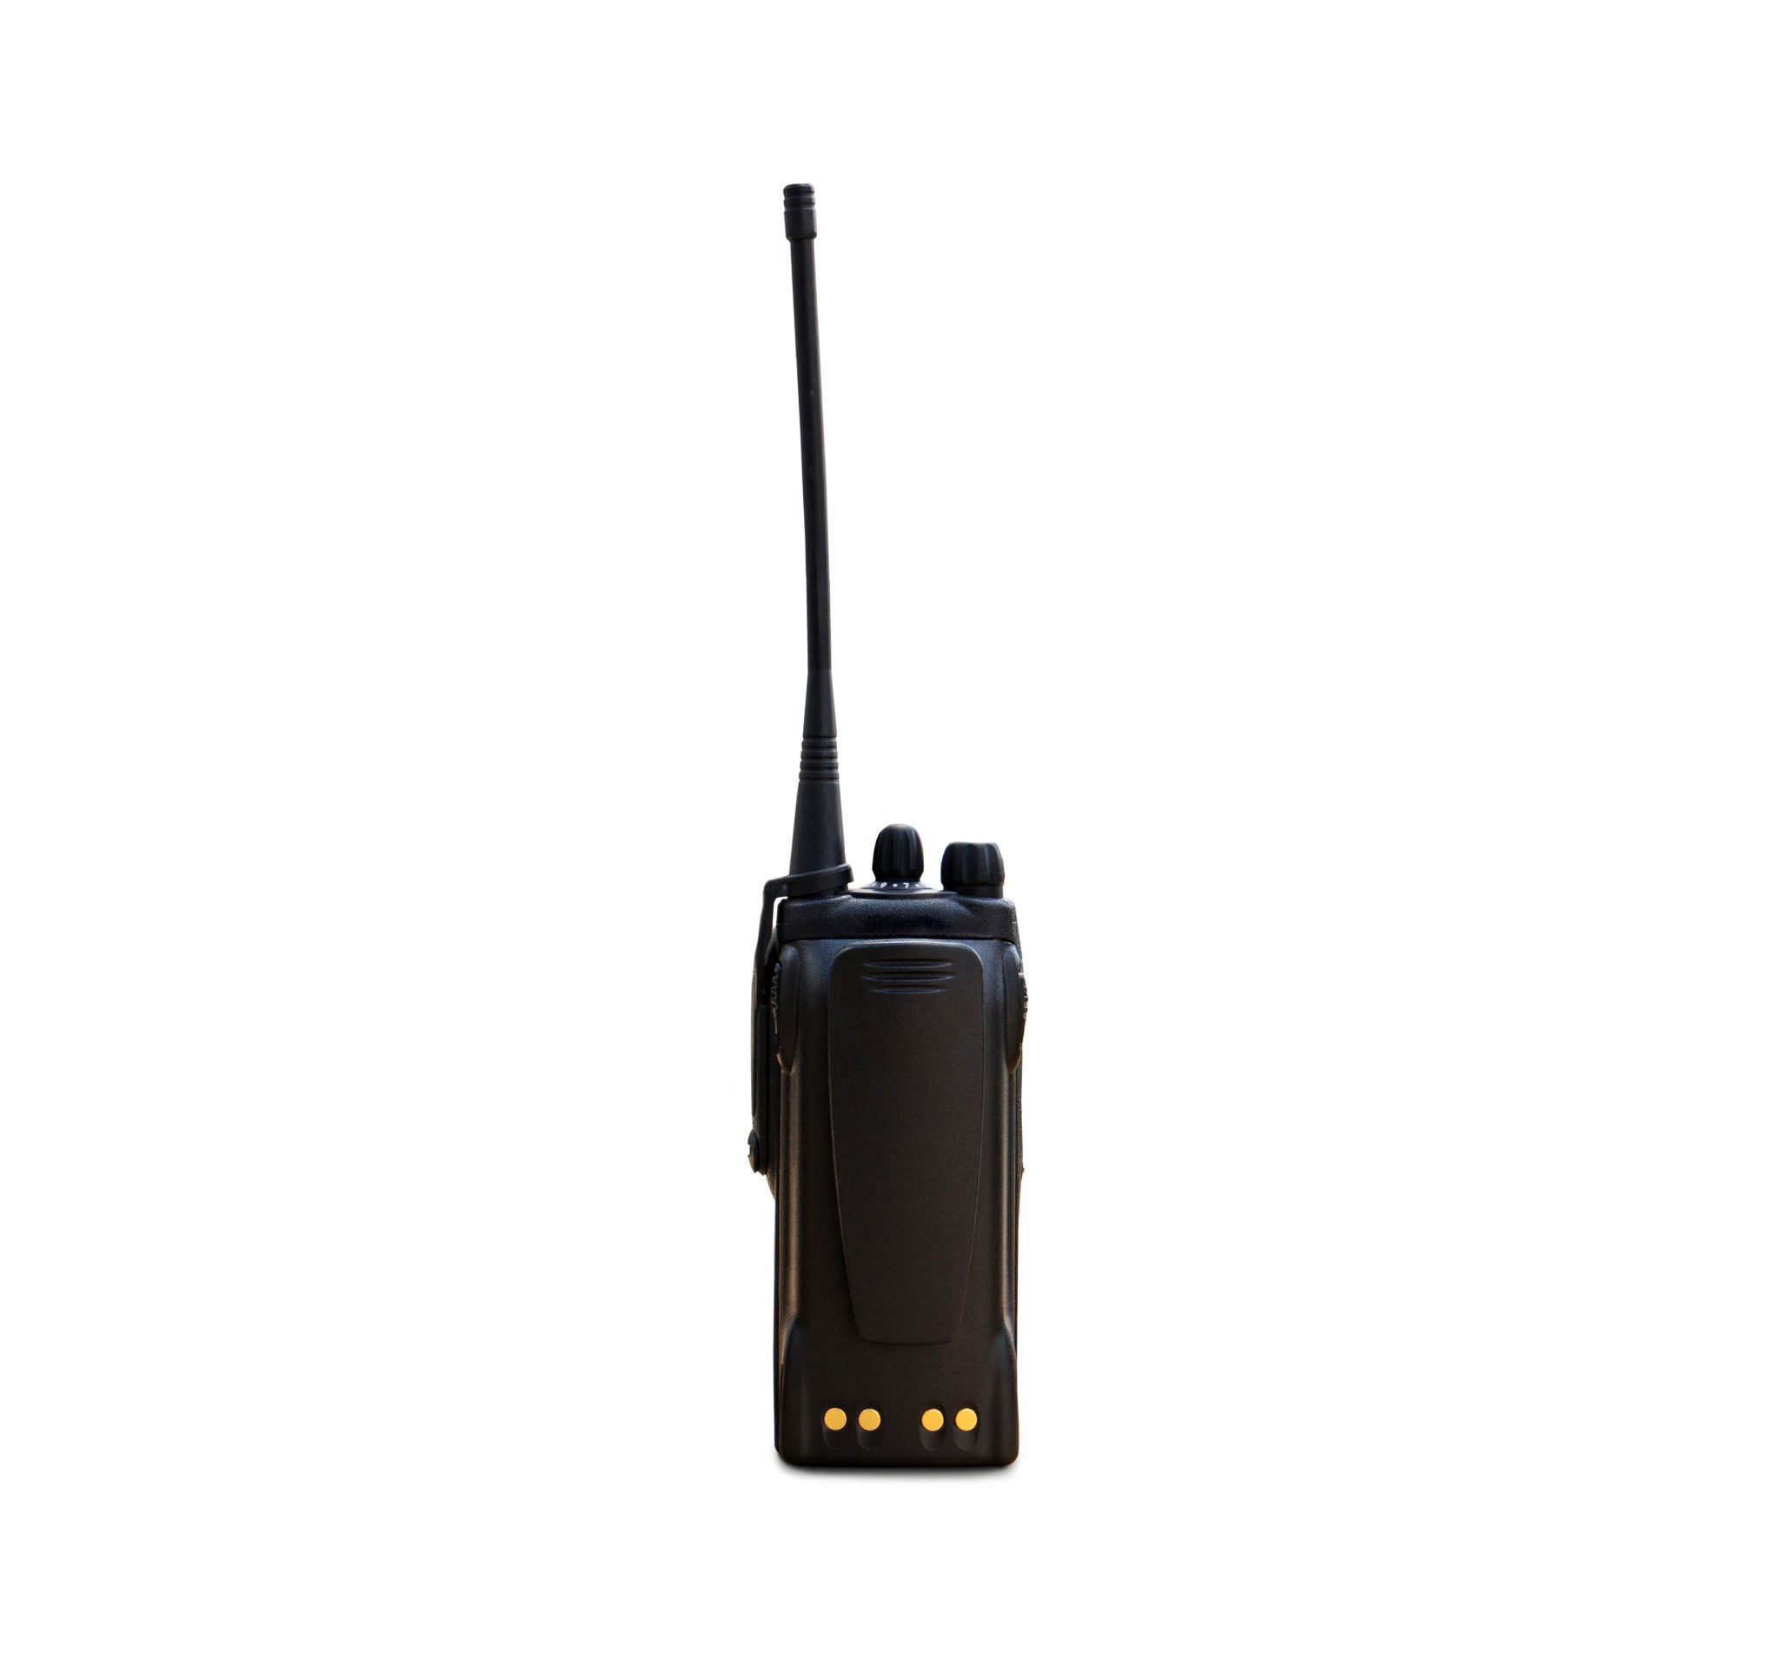
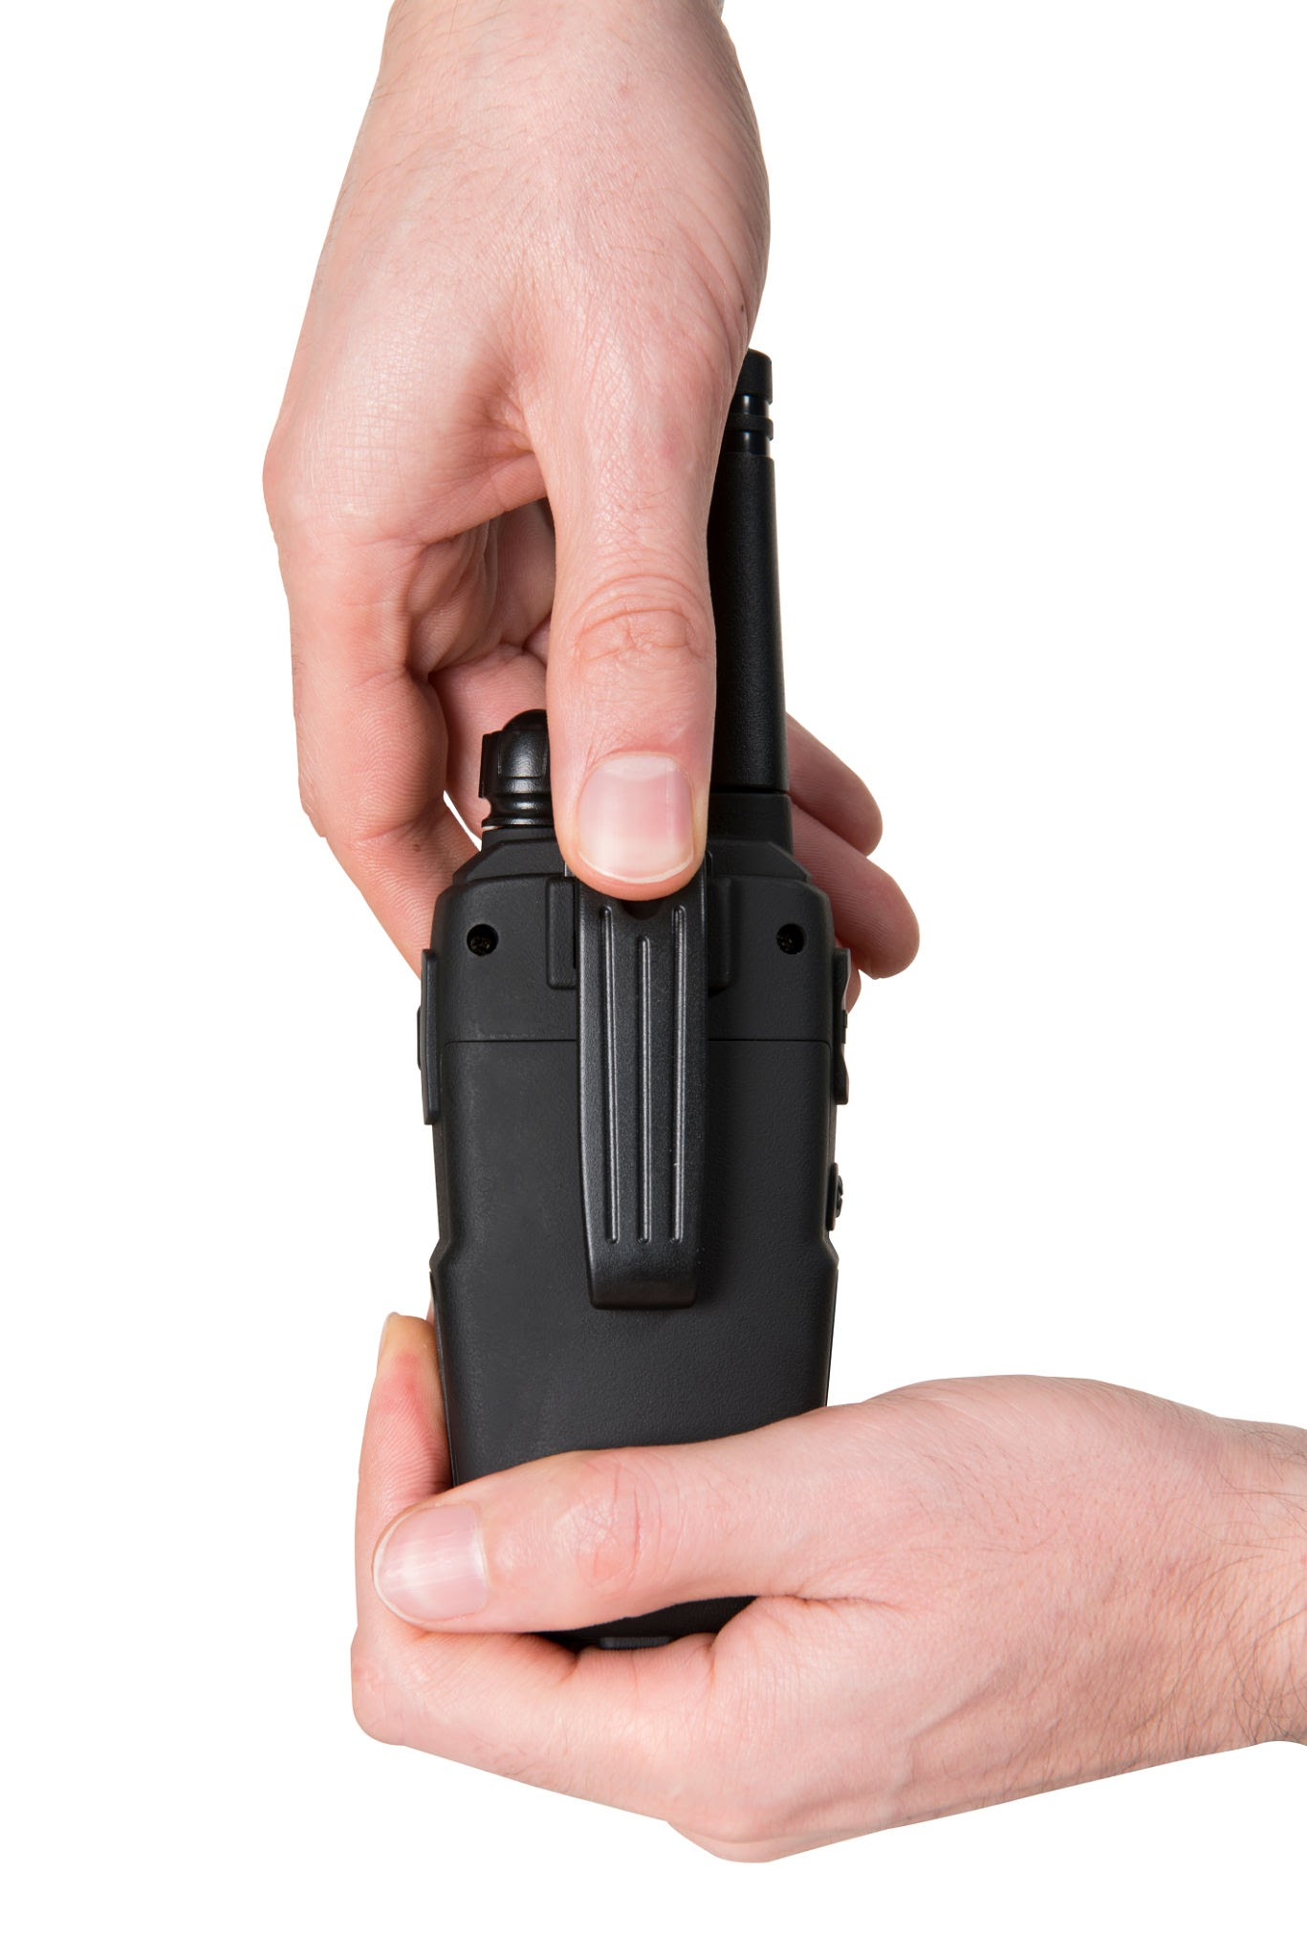
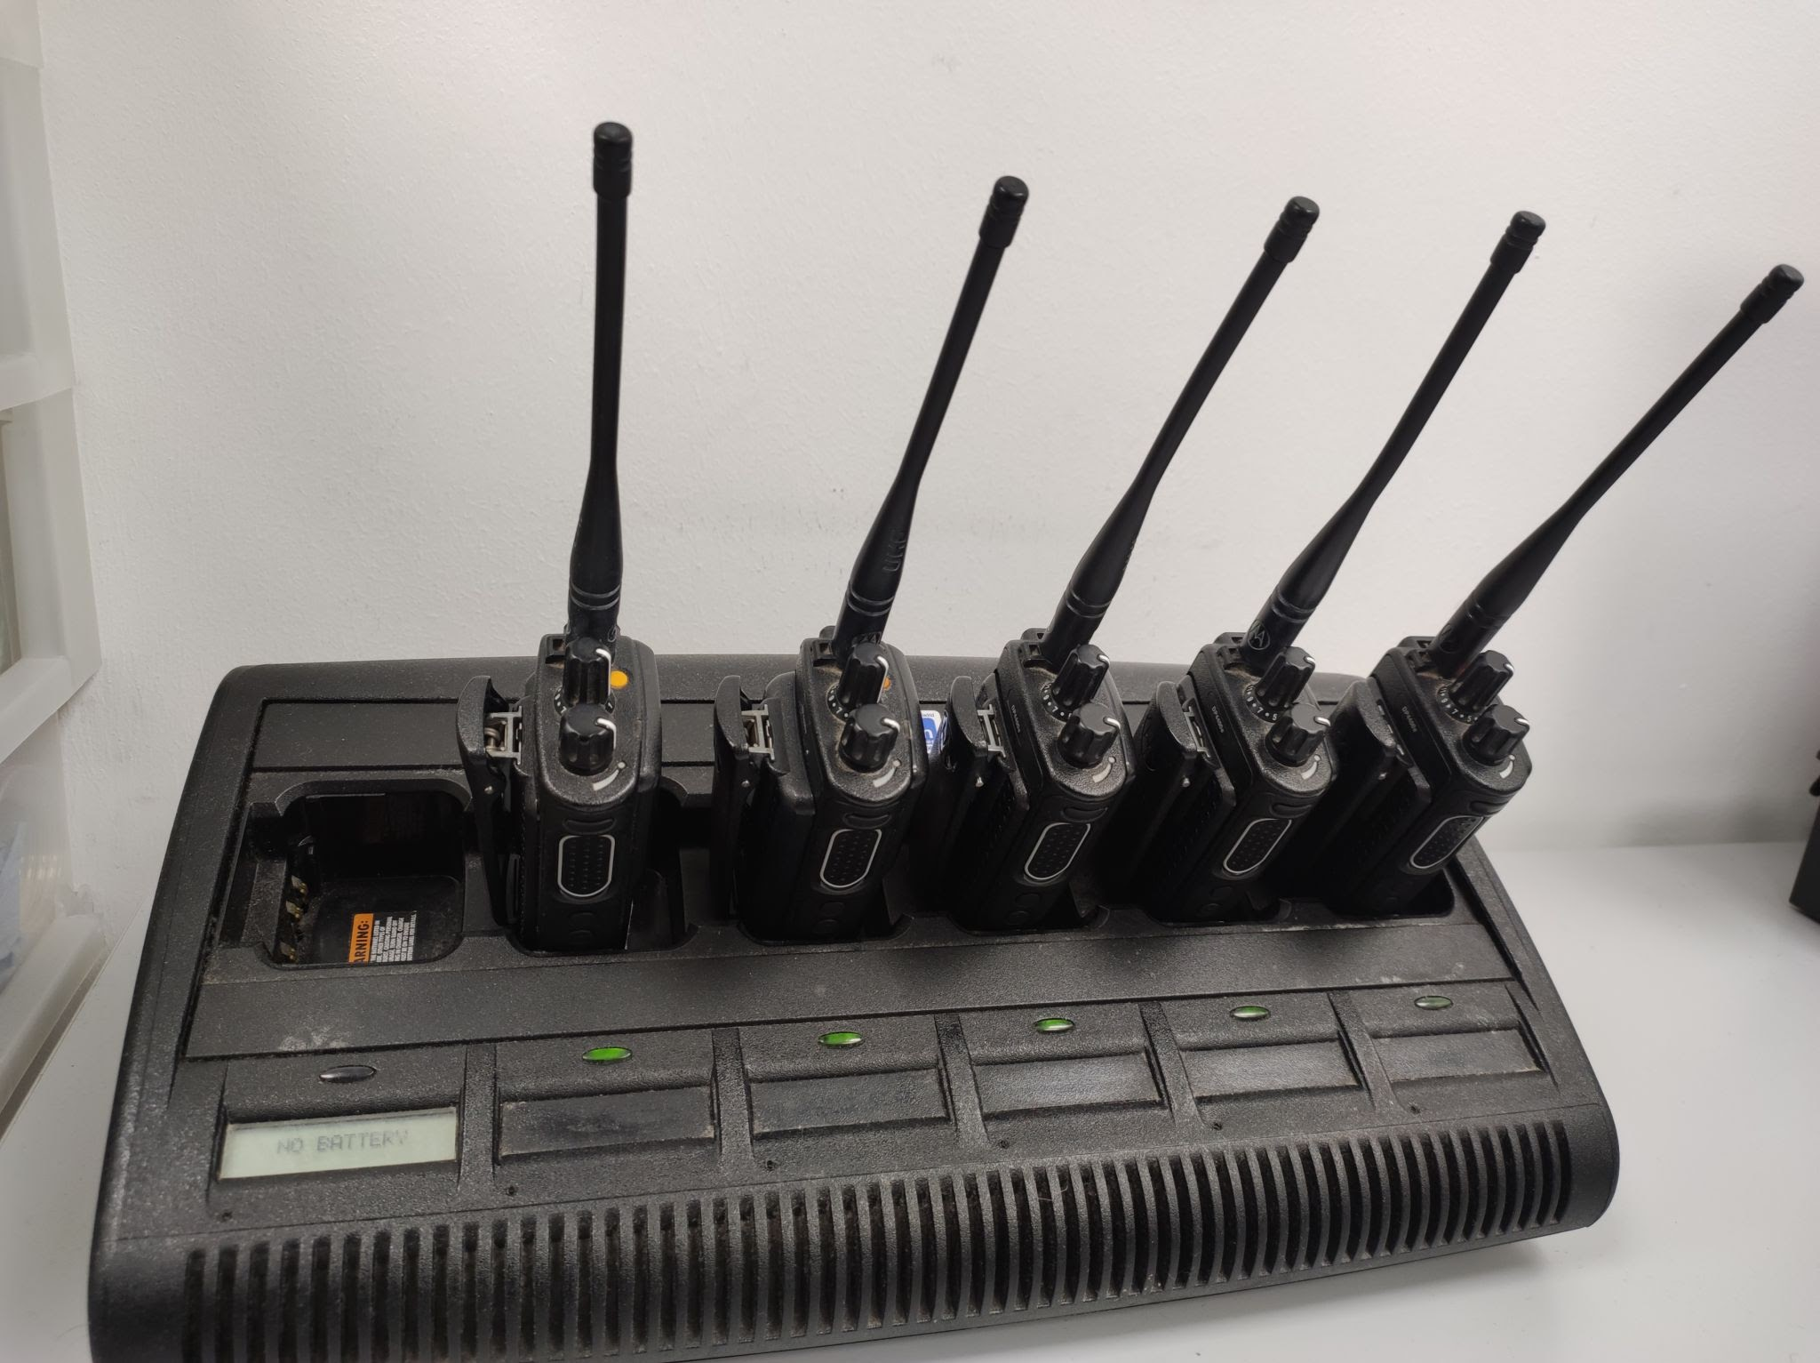
Battery Change & Charging options
Notes:
Walkthrough: Show how to replace a dead battery. Emphasize- Always start shift with full battery, and spare if available. Swap batteries from authorized charge stations. Never “borrow, or grab” a battery without it being tracked/ accounted for.
Teach to locate authorized charging station and proper logging/ accountability procedure to company SOP. Instruct on what to do with a low battery warning in the field. Teach accountability to serialized battery and radio combo.
Final words on hardware: Radios are mission critical. No power, no communication, no support. Personal Accountability for gear extends to radios and batteries. Never assume; always verify: Active Channels and batteries!

Slide 6
Radio Communication Protocols
Call signs and standard codes.
Radio etiquette: clear, concise communication.
Priority traffic and interrupting for emergencies.
Notes:
Transition script: Now that everyone understands how to physically operate the radios, let’s discuss how we speak over the radio. Radio communication is not casual. It’s clear, structured, communication often delivered under pressure.

Slide 7
Call Signs (Best Practices)
Clear (easy to pronounce)
  2 or 3 syllables long
Memorable (but not offensive)
  distinguishable from others
Notes:
Opening: Why do we use call signs instead of real names over the radio? (Responses: clarity, brevity, privacy, professionalism)
Emphasize: clear, easy to pronounce call signs.
Reinforce: memorable but not offensive. Steer away from inside jokes or nicknames the could be misunderstood by the public.
Mention: the operational value of callsigns is to avoid confusion in large events or emergency situations.
Optional engagement: have students brainstorm their own callsigns to be used on the tabletop exercise.

Slide 8
Standard Codes (Phonetic Alphabet)
Letter | Phonetic Word | Letter | Phonetic Word | Letter | Phonetic Word | Number | Phonetic Word
A | Alpha | J | Juliet | S | Sierra | 1 | Wun
B | Bravo | K | Kilo | T | Tango | 2 | Too
C | Charlie | L | Lima | U | Uniform | 3 | Tree
D | Delta | M | Mike | V | Victor | 4 | Fower
E | Echo | N | November | W | Whiskey | 5 | Fife
F | Foxtrot | O | Oscar | X | X-ray | 6 | Six
G | Golf | P | Papa | Y | Yankee | 7 | Seven
H | Hotel | Q | Quebec | Z | Zulu | 8 | Ait
I | India | R | Romeo | 0 | Zero | 9 | Niner
Notes:
Opening: Introduce slide- In loud or chaotic environments, some letters sound similar. The Phonetic Alphabet is a way to avoid miscommunication.
Highlight: NATO Phonetic Alphabet and the number equivalent. ( niner for 9, fife for 5 to distinguish from each other)
Recommend: Regular practice and develop SOP’s around usage to avoid commonly mixed up letters. (i.e M/N, B/D)
Activity: Call out letters and number and have the class respond with the equivalent. And vice versa.
Mention: this Alphabet is in common usage globally, but its not the only. Mention LEO’s version of Alphabet.

Slide 9
Standard Codes (Basic Phrases)
Phrase/Proword | Meaning/Usage
Over | Finished speaking; your turn to reply.
Out | Finished speaking; conversation ended (no reply needed).
Roger | Message received and understood.
Wilco | Will comply (receive + understand + will do).
Affirmative | Yes / Positive.
Negative | No / Incorrect.
Say Again | Repeat your last message.
Break | Pause or separate messages.
Stand By | Wait a moment.
All After [Word] | Repeat everything after [Word].
All Before [Word] | Repeat everything before [Word].
Correction | I made an error; here's the correct info.
Radio Check | Test signal strength (response: "Loud and Clear" or "5 by 5").
Call Sign [Name] | Addressing a specific person/unit (e.g., "Security One, this is Control").
Notes:
Introduce slide: Explain these phrases ensures clarity, structure, and professionalism on the radio.
Clarify: Phrases in common usage (Over, Roger, Affirmative, Negative, Say Again).
Instruct: Error correction and clarification phrases (All After, All Before, Correction, Radio Check).
Teach: Difference between Over (awaiting reply) and Out (conversation complete).
Practical Exercise: Simulate short conversations by giving a situation for students to respond using 2-3 standard codes.
Reinforce: these standard phrases are part of discipline and safety especially during dynamic environments.

Slide 10
Standard Codes (Event Codes)
Code Word | Typical Meaning
Code Blue | Non-urgent assistance needed (e.g., minor spill or found child).
Code Yellow | Immediate but non-dangerous response (e.g., suspicious bag).
Code Red | Emergency – immediate backup (e.g., fight or medical).
Code Black | Bomb threat or evacuation.
Code Silver | Active shooter or weapon sighted.
Code Adam | Missing child.
Notes:
Emphasize: Event Codes convey critical info quickly and discreetly. Companies will have their own SOP’s on Event Codes. It would behoove one to become intimately familiar with these Codes. Again, discretion over open radius, in a public setting.
Walkthrough: use examples above
Emphasize: Situational Awareness matters when making these calls. Only use these Codes when appropriate, and when Authorized.
Practice tip: Use the tabletop exercise later where one student issues a code phrase, and others respond accordingly.
Encourage Instructors to modify or add local event codes based on local venues SOP’s.

Slide 11
Radio Protocol
Basic Radio protocol is as follows:
Always listen for ongoing traffic to make sure that you are not interrupting a conversation.
Think about what you want to say, and compose the transmission in your head.
Press the PTT (Push To Talk) button, hold for two seconds (many radios will beep when ready to transmit) and then speak.
Speak the name of the person you are calling twice, then say your own name. e.g if you are “Juliet” calling for “Romeo” then you would say : “Romeo, Romeo, Juliet”.
Release the PTT (Push To Talk) button.
The responder should acknowledge that he or she is ready for a conversation. e.g. “Juliet, Romeo, go” or “go for Romeo”.
After the person you are calling answers, proceed with your message.
Speak clearly and slowly. Do not yell, even if it is loud around you, as this will overload the mic and your transmission will not come through clearly.
Shield your mike from wind and other background noise. If possible, move away from loud noise or out of the wind.
Always acknowledge that you have received a transmission after it is done; this can be communicated with a simple “10-­4” or “copy” or “roger”.
If you need the person to repeat, say: “10­-9” or “Please repeat”.
The radios transmit on public airwaves. Always assume that our radio traffic is being monitored or recorded by production, law enforcement, people wanting to sneak into the event, or others.
Never swear on the radio.
Always be cautious about the information you are sharing, such as personal information. If you have a doubt about whether you should say something over the radio, ask for a face-to-face meeting.
If you are in a complex situation with multiple people, you may want to write down pertinent details such as names, descriptions, license plates, or location details BEFORE using the radio. Always get as much information about the situation you are in and the participants of the situation as possible.
NOTE: If you are using the radio in front of the participant, you may want to walk away or turn away, or speak softly so they are not able to hear. It is not always appropriate for them to hear what the conversation is about, or the resolution may make them unhappy.
ABC’s of Radio transmission:
Actionable info first: “FIRE at (location), requesting fire response” then details.
Brief transmissions: include only pertinent info, in transmissions 30 seconds or less.
Clear communication: have a clear head, provide clear information, and then clear the channel.
General information:
You should develop the habit of building your sentences to prioritize the radio traffic for the most appropriate and timely response. If for example there is a vehicle speeding dangerously through an area, the most actionable info would be that a vehicle of a certain description is speeding dangerously, and the least actionable info would be the location, given the fact that the vehicle is speeding and thus the location may change rapidly. The most effective transmission might sound like “A blue 4x4 truck is speeding dangerously down the road to the Forest Stage.”
If you notice that the radio channel has been silent for a while, check your volume, channel, and battery to make sure you are still on comm. You should remain on comm for every moment you are on shift, unless you inform the Shift Lead that you will be temporarily off comm.

Slide 12
Examples of Radio Traffic
1. Agent Initiates Call
• Press PTT (Push-to-Talk)
• State your call sign, who you're calling, and the message
Example: “Bravo 3 to Command — requesting backup at Gate 4.”
2. Command Receives Call
• Listen to the full transmission
• Acknowledge, clarify, and give direction
Example: “Command to Bravo 3 — backup en route. Hold position.”
3. Command Notifies Relevant Units
• Relay task to others as needed
Example: “Command to Bravo 1 — respond to Gate 4 to assist Bravo 3.”
4. Other Unit Acknowledges
• Respond confirming action
Example: “Bravo 1 copies — en route to Gate 4.”
5. Event Resolution or Update
• Agent sends status update
Example: “Bravo 1 to Command — Gate 4 secure. Returning to patrol.”
6. Command Logs the Interaction
• Log time, agent, incident type, response, and outcome
• Used for reports and reviews

Slide 13
Example of Radio Traffic
Shrek, Shrek this is Goblin; Radio check, over?
Goblin, Goblin, this is Shrek, Read you Loud & Clear. (or, Broken and Quiet, Loud and Unclear)
Shrek, Shrek, this is Goblin; Roger. Read you Loud and Clear. Goblin out.
Notes:
Demonstrate: complete, basic radio exchange using plain language and proper call structure. Reinforce etiquette, signal clarity checks, and proper closing of radio transmissions.
Instructor script: Lets walk through what a proper radio check sounds like. (Walkthrough above transmission). Fun call signs, but serious structure.
Instruct Initiating: Shrek, Shrek, this is Goblin. Radio check, over?
Teach: this is a 3 part structure. Repeat the receivers name twice, Identify yourself, then make the request. End with “over” to signal your awaiting a response.
Instruct Returning Radio Check: Goblin, Goblin, this is Shrek. Read you Loud & Clear, over.
Teach: Optional variants: Broken & Unclear, Loud & Broken
Instruct Acknowledge Receipt: Shrek, Shrek, this is Goblin. Roger; read you Loud & Clear. Goblin Out
Teach: Use of Roger confirms receipt. Use of Out means conversation is complete.
Keep In Mind (K.I.M): Never use Over & Out together! It literally means; Im awaiting your reply, Im done with the conversation.
Exercise: Pair up class and perform the exact radio check using role play options.
Remind: ensure clear channel before transmission.
Emphasize: clear enunciation, brevity, and respect of time on the airwaves.
Optional close out discussion: What could go wrong if one step is skipped? What does Roger mean on the radio? Why don’t we ever say Over & Out?

Slide 14
Example of Radio Traffic
1. Agent Initiates Call
• Press PTT (Push-to-Talk) and wait for audible tone indicating the channel is open
• State the callsign of who you are calling twice and then your call sign
Example: “Command, Command — this is Bravo 3”
2. Command Acknowledges Call
• Acknowledge call received and ready for agent’s traffic
Example: “Bravo 3 — go for Command”
3. Agent Sends Traffic
• Be clear and concise
Example: “Bravo 3 to Command — requesting back-up at Gate 4.”
4. Command Receives Traffic
• Listen to the full transmission
• Acknowledge, clarify, and give direction
Example: “Command to Bravo 3 — backup en route. Hold position.”
5. Command Notifies Relevant Units
• Relay task to others as needed
Example: “Command to Bravo 1 — respond to Gate 4 to assist Bravo 3.”
6. Other Unit Acknowledges
• Respond confirming action
Example: “Bravo 1 copies — en route to Gate 4.”
7. Event Resolution or Update
• Agent sends status update
Example: “Bravo 1 to Command — Gate 4 secure. Returning to patrol.”
8. Command Logs the Interaction
• Log time, agent, incident type, response, and outcome
• Used for reports and reviews
Notes:
Instructor Script: This slide represents the meat of radio protocol. If the last slide was the “what”, this slide represents the “how”. These 8 steps are your operational checklist when transmitting information over a radio in a field setting.
Initiate Radio Transmission: State who your calling TWICE to prevent confusion on a busy net.
Command Acknowledges: Confirms receipt of initial transmission.
Agent Sends Transmission: Speak clearly and to the point. Every second counts in dynamic moments.
Command Receives and Responds: Command fully listens, confirms understanding and gives directives. If ever unsure explain usage of code phrase: Say Again
Command Notifies Relevant Units: Command may task other teams or units. This teached multi-node communications. One code Phrase can trigger several actions.
Relevant Unit Acknowledges: tasked team or unit confirms receipt of tasking. . Always require a verbal receipt of transmission.
Event Resolution or Status Update: Original reporting Agent updates command. Use this teachable moment to emphasize accountability. Never assume the job is complete until reported completed/closed.
Command Logs Interaction: Logs should contain Agents name, time, brief description of event, and resolution. If it wasn’t logged it didn’t happen.
Instructor tip: Connect this step to AAR and show how it feeds into shift briefs and supervisor logs.

Slide 15
Emergency Communication Procedures
Reporting incidents clearly, and effectively.
  Identify who, what, where, and severity. Prioritize life safety first!
Using distress signals properly.
  Use “Priority Traffic” or “Emergency Traffic” call out to break into routine comms.
Coordinating multi-agency response.
  Be informative of specific unit type requested. Relay location and hazards to Command.
Notes:
Instructor Script: In an Emergency seconds matter. Radio traffic must cut through the chaos. This slide introduces the foundation for all emergency transmissions. Being clear with your urgency, and informative in your coordination request will save seconds in response time. Fumbling with vague requests buried under incomplete information could cause a delayed response. And that delay could be catastrophic.
-Emphasize the 4 essentials: Who, What, Where, and Severity.
-Use Callsigns, not names. Avoid emotions on the radio. Don’t tell a story, transmit data. Teach your teams to speak in priority language, not in panic
Using Distress Signals: Using certain Priority or Emergency Codes should instantly clear the net.
Inform: No need for permission. If the situation warrants it, speak up.
Reinforce: Make training for this a second nature. Practice calling these Codes out until it roll of the tongue, easily.
Coordinating Multi Agency Response: Your not alone out there. And you may need to hand a situation off to other supporting units.
Information to provide- Who you are, Who you need, Why you need that unit specifically, Where to send that unit, and any hazards they may encounter enroute.
The more precise you are the faster the right response arrives.
Instructor script: In the next slide we’ll walk through an example of an Emergency Radio Transmission. Listen for the structure, tone, and what gets prioritized.

Slide 16
Example of Emergency Radio Traffic
-Command, Command this is Gate 3. Code Red at my location. Guest reporting chest pain. Requesting Medic, over.
-Gate 3 this is Command. Copy Code Red with chest pain at your location. Medics enroute. Stay with guest and monitor. Report any change. Command out.
-Med Team, Med Team this is Command. Code Red chest pain at Gate 3.
-Command, Command this is Med Team. Roger. Copy Code Red at Gate 3. Enroute, time: (now)
-Command, Command this is Gate 3. Med Team has arrived and evaluting Code Red. Time: (Now).
-Gate 3, Gate 3 this is Command. Roger. Med Team on site. Standing by for update.
-Command, Command this is Gate 3. Roger. Standby for update.
-Command, Command this is Gate 3. Code Red has been resolved by Med Team. Patient to be transported to local hospital by friend. Med Team has concured with this plan of action. Gate 3 clear of incident.
Gate 3, Gate 3 this is Command. Roger. Code Red stable for transport to local hospital via friends vehicle. Med Team concurs with plan of Action. Gate 3 clear of incident. Time (Now).
Command to all units; Resume normal traffic.
Notes:
Instructor script: This slide provides a full realistic emergency call sequence. It demonstrates the proper radio discipline, terminology,and communications flow. It reinforces clarity, brevity, proper call and response, and resolution while using a multi agency environment.
Reinforce: who speaks when and why concise call signs matter.
Discuss: radio discipline under pressure. No chatter, no guessing, only what is known.
Introduce ICS100 tentatively here. Incident reporting, clear chain of command, and unit functions can be discussed.

Slide 17
Key Notes for New Agents
Speak clearly and concisely
  Provide the necessary details in a succinct manner
Always wait 1–2 seconds before speaking after pressing and holding the PTT button
  This time varies depending on radio model, network encryption, etc and is generally indicated with an audible tone
Use standard call signs
Always use who the callsign of who you are calling twice
  This ensures the message recipient hears their call sign in high-traffic environments
Don’t speak over others unless it's a life safety priority
Always acknowledge receipt of a message
Notes:
This is the final reinforcement slide of the core radio communication practices covered by this Module. It is meant to equip new agents with a distilled checklist of what they must always remember. Especially under pressure.
Talking Points:
Speak clearly and concisely
Radios are not phones. They cut out.
Clarity + Brevity= efficiency
Avoid slang, filler words or excessive repetition
Wait 1-2 seconds after keying the mic before transmitting your traffic
Most common mistake seen in new agents: speaking to early
Reinforce to listen for the audible beep or click tone if present
This allows the system to register and transmit fully
Use standard call signs
Always identify yourself first, then the party your calling.
Use Callsign consistently to avoid confusion during emergencies.
Call signs repeated twice
Especially critical in high traffic, loud, and dynamic environments
Don’t transmit over others
Radio traffic should be respected
Only interrupt if its a Life Safety situation
Always acknowledge receipt
This closes the loop and ensures the message was received and heard.
*Radio traffic is how we maintain positive influences and calm in the chaos of a dynamic environment. When everyone follows these basic fundamentals we reduce confusion, prevent mistakes, and ensure the right help gets to the right place. Quickly and efficiently.*

Slide 18
Case Study: Communication Failure
Review a major event with poor communication.
Analyze what went wrong.
Discuss how to prevent similar issues.
What Happens When No One is Listening?
Notes:
This slide sets the stage for our Case Study. I want to transition from learning procedures to analyzing real world failures. Speaking plainly this next part is a reality check. Were about to examine what happens when poor radio discipline, lack of protocols and an overwhelmed system meet real world pressure. These mistakes in communication don’t just affect efficiency; it costs lives.
Discussion Questions:
-What happens when no one takes control on the air?
-What if no one can hear the medics call for help?
-What if teams are operating on the wrong channels?
-What happens if no one is listening?

Slide 19
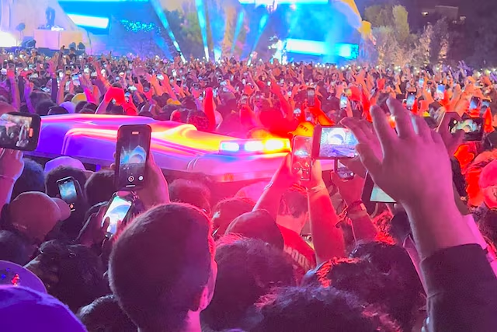
Case Study: Astroworld Tragedy (2021)
On November 5, 2021, the Astroworld Festival, an annual music event founded by rapper Travis Scott, turned into one of the deadliest crowd-control disasters at a U.S. concert in recent history. During Scott’s headline performance, a crowd surge resulted in the deaths of 10 attendees, ranging in age from 9 to 27, due to compressive asphyxiation. Hundreds more were injured, with reports of chaos unfolding as security and medical resources were overwhelmed. The tragedy sparked widespread criticism of event planning, security preparedness, and response protocols, leading to lawsuits, investigations, and calls for improved safety standards at large-scale events.
Notes:
Instructor script: Astroworld was a mass casualty event caused by a perfect storm of poor planning, failed communication, and underprepared systems.
Emphasize:
-Crowd surge began before headliner came on.
-Calls for help via radio went unanswered or were buried in unrelated radio traffic
-Critical delays in dispatch and triage
-Confusion over command structure, and channel assignments.
Guide students through hyperlink and bring up:
-Timeline or radio calls and medical response
-Any known breakdown in radio traffic, dispatch command, or call sign usage.
-The impact of having no centralized medical dispatch, or deignated emergency channel.
Tip:
-Encourage open discussion
-Ask students to ID radio failures, not just crowd failures
-Transition to solutions. “Now that we’ve seen today, how do we prevent tomorrow?

Slide 20
Hands-On Training Overview
Radio check exercises with team members.
Live simulated event drills via radio.
Correcting mistakes in real-time.
Recreate failure points from the Astroworld case study and correct them in real time.
Notes:
Instructor Script:This is where we turn lessons into muscle memory. Training must simulate the dynamic environment. A quiet room with call and response isn’t enough. In the real world your sense of hearing will be overwhelmed by crowd noise, overlapping talking/ yelling, and nearby speakers. Here’s what I want:
Simulated radio checks using all the bad habits we know. Talking too fast, stepping on each other, no call signs, etc
Then switch. Enforce clean radio discipline using everything we've learned so far. wait 1-2 seconds before speaking, call signs twice, acknowledge transmissions, etc
Using a fake incident see who follows the structure correctly.
*Ensure students rotate through medic, dispatch, and agent so everyone can practice call outs and responses from multiple angles.

Slide 21
Discussion Questions
Is Annual Maintenance performed on your radios? If so, where does it take place?
Does your crew have a refresher course on radio procedures annually?
Have you ever been in a position where you had to wait for the channel to clear? How can you mitigate this?
Have you ever had an instance when your radio antenna fell off? What was the outcome?
Notes:
Thinking we should just get rid of this slide.

Slide 22
Summary & Assessment Prep
Key takeaways from Module 1.
Prepare for written and skills demonstration.
Questions & discussion.
Notes:
Instructor script: This is our reset point before the final assessment in Module 1. We’ve covered a lot. Radio descriptions and uses, protocols, call signs, timing, emergency traffic, and real world failures. Now we lock it down.
Recap Core Takeaway:
-Wait before you speak
-Say call sign twice
-Keep transmissions short and concise
-Always acknowledge receipt of transmission
-Use plain language
-Emergency traffic takes priority. Don’t interrupt it
Tie back to the Astroworld Case Study:
-Astroworld not a crowd failure, but a communication failure
-How could those issues have been prevented with stronger radio discipline?
Set the tone for Assessment:
-This isn’t about memorized answers
-Apply what we’ve practiced
- You will see scenario based questions. Answer them as how you’d act in the field

