Slide 1

RockBuster Tableau Story
File created on: 8/12/2023 6:13:43 PM

Slide 2
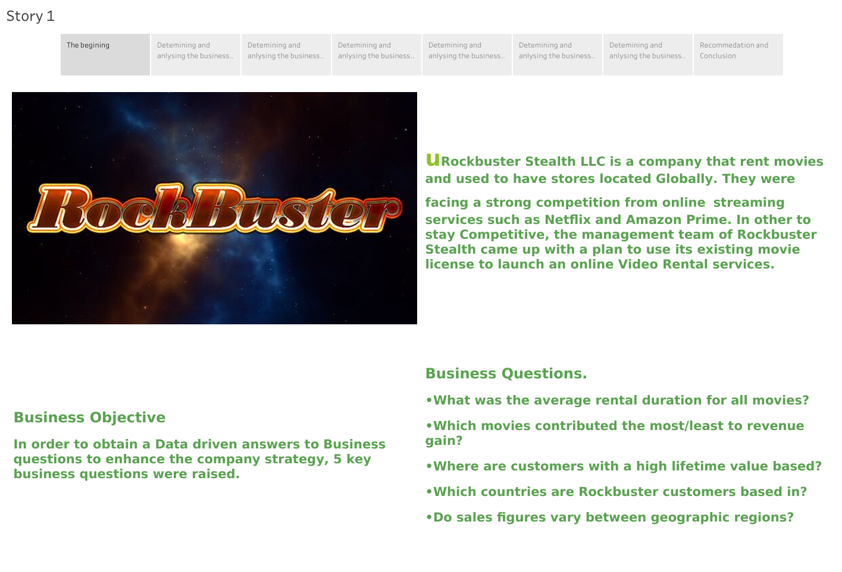

Slide 3
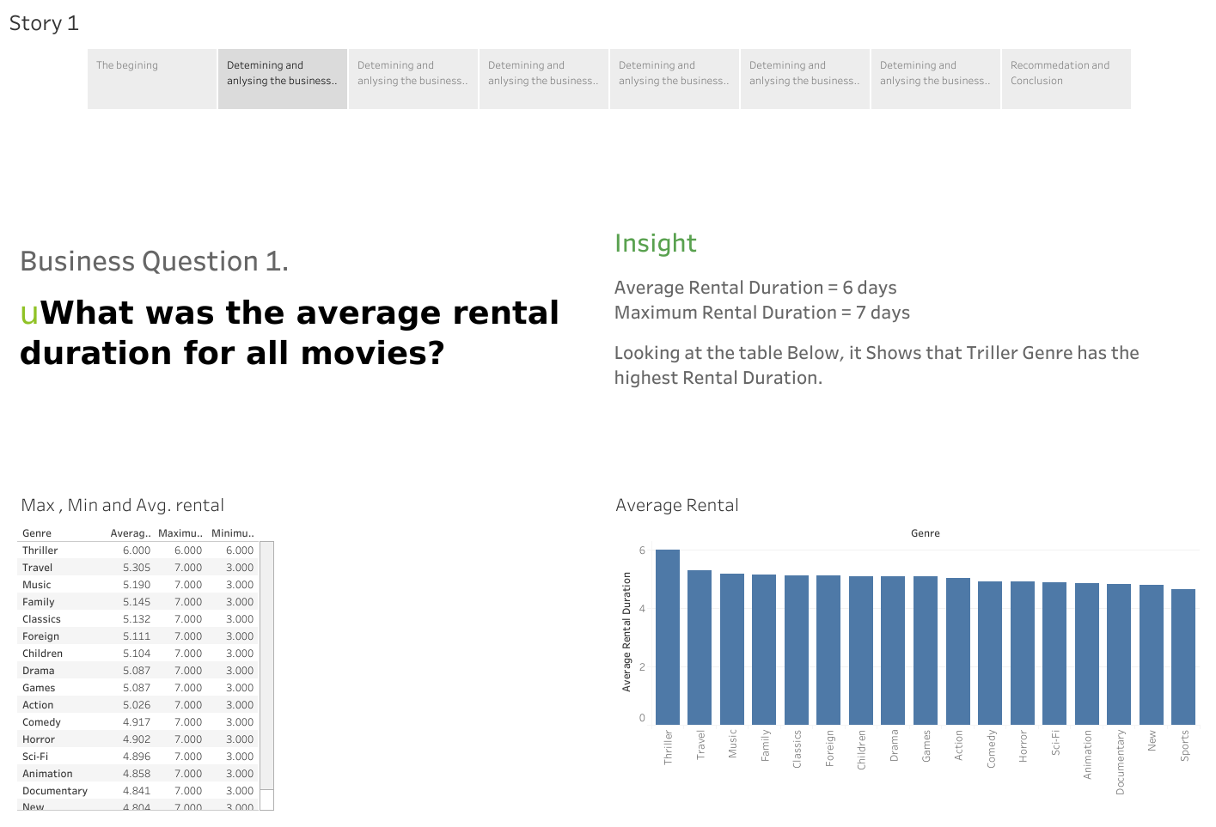

Slide 4
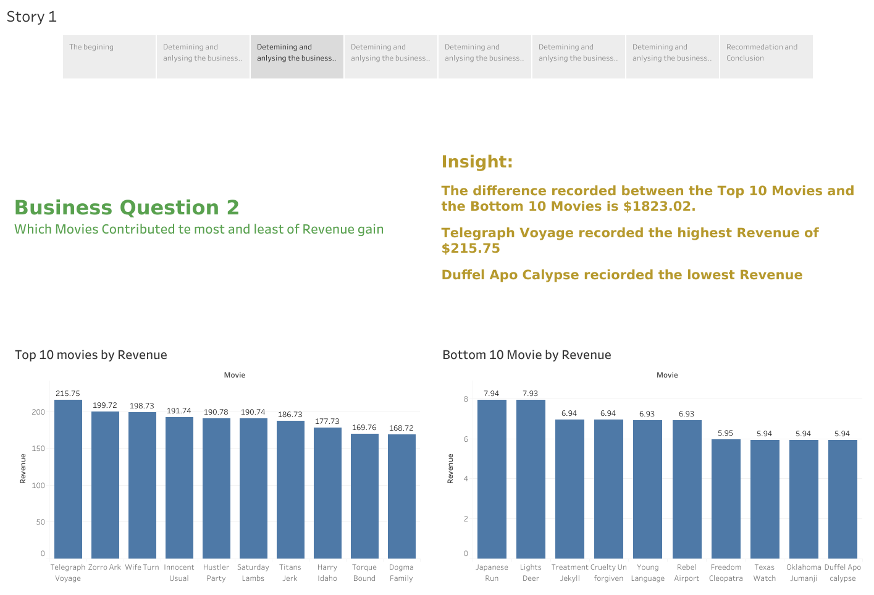

Slide 5
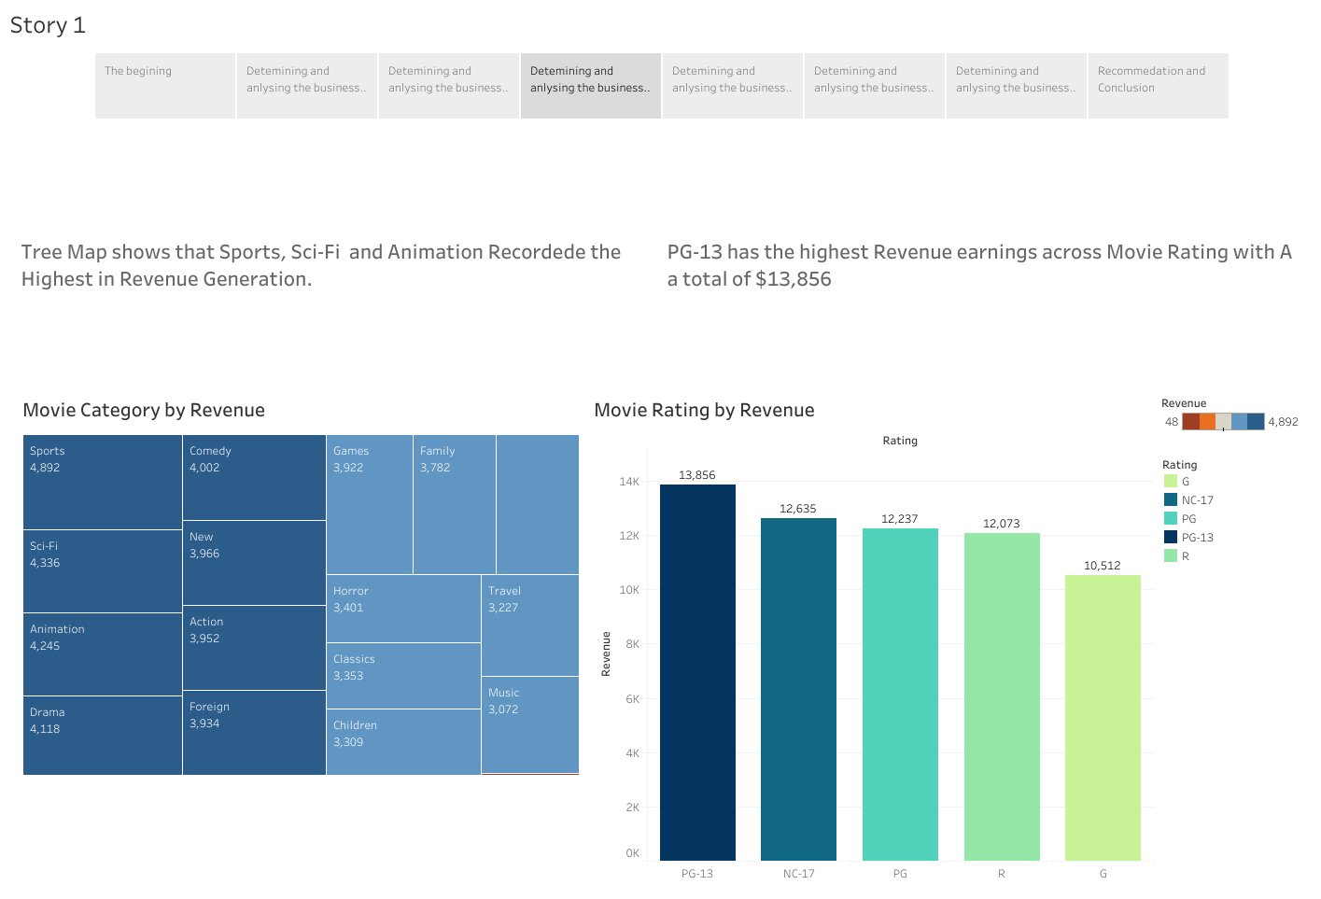

Slide 6
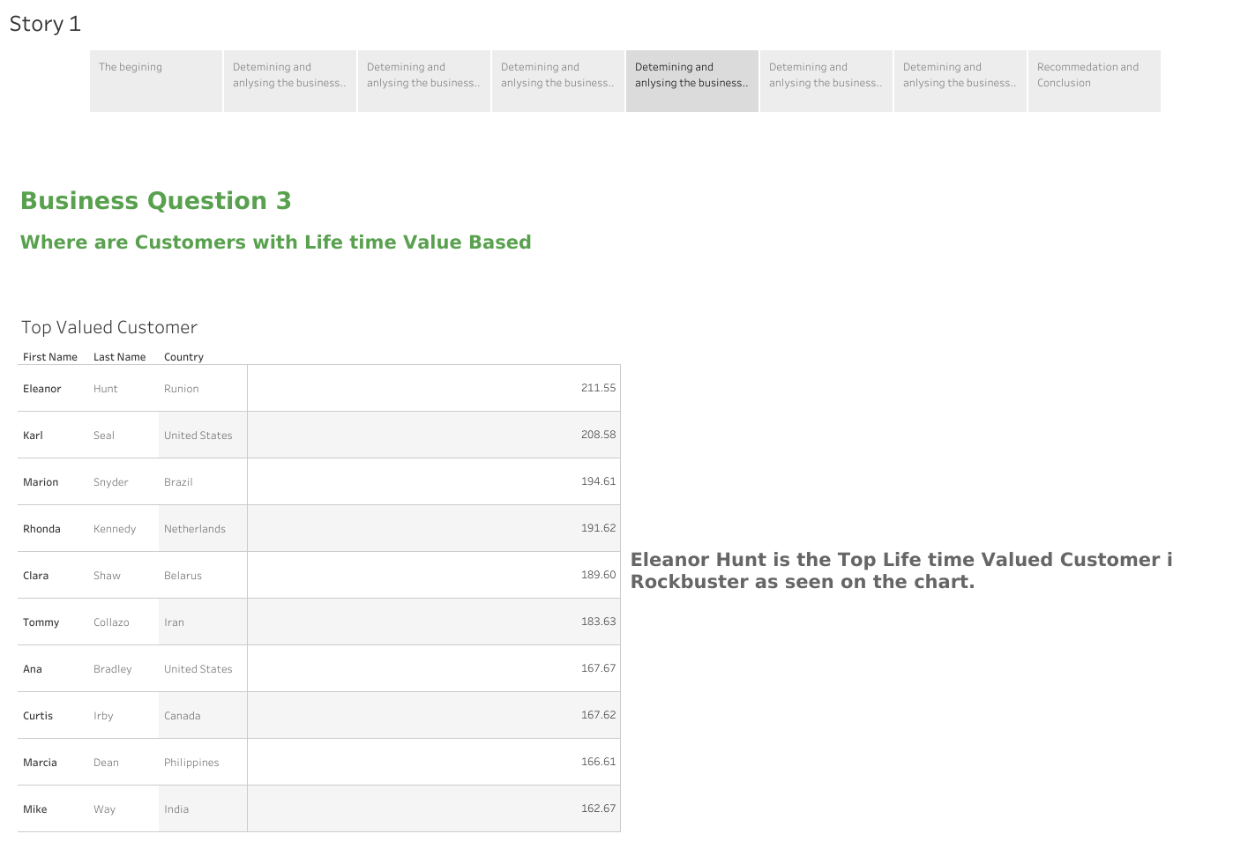

Slide 7
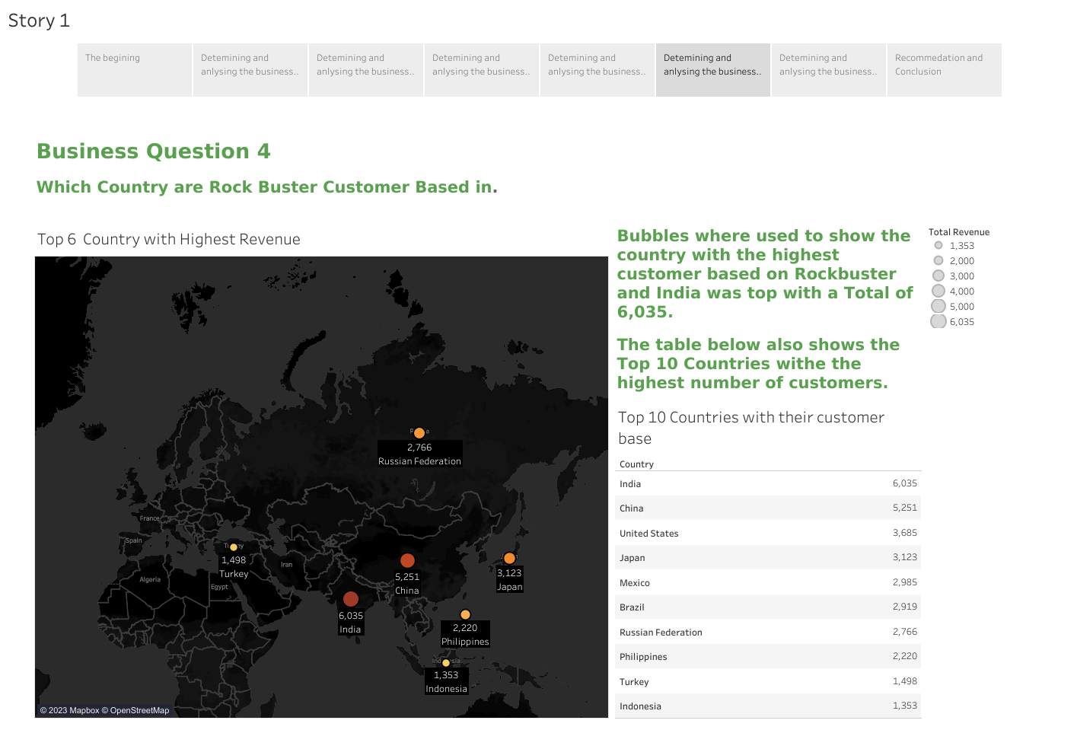

Slide 8
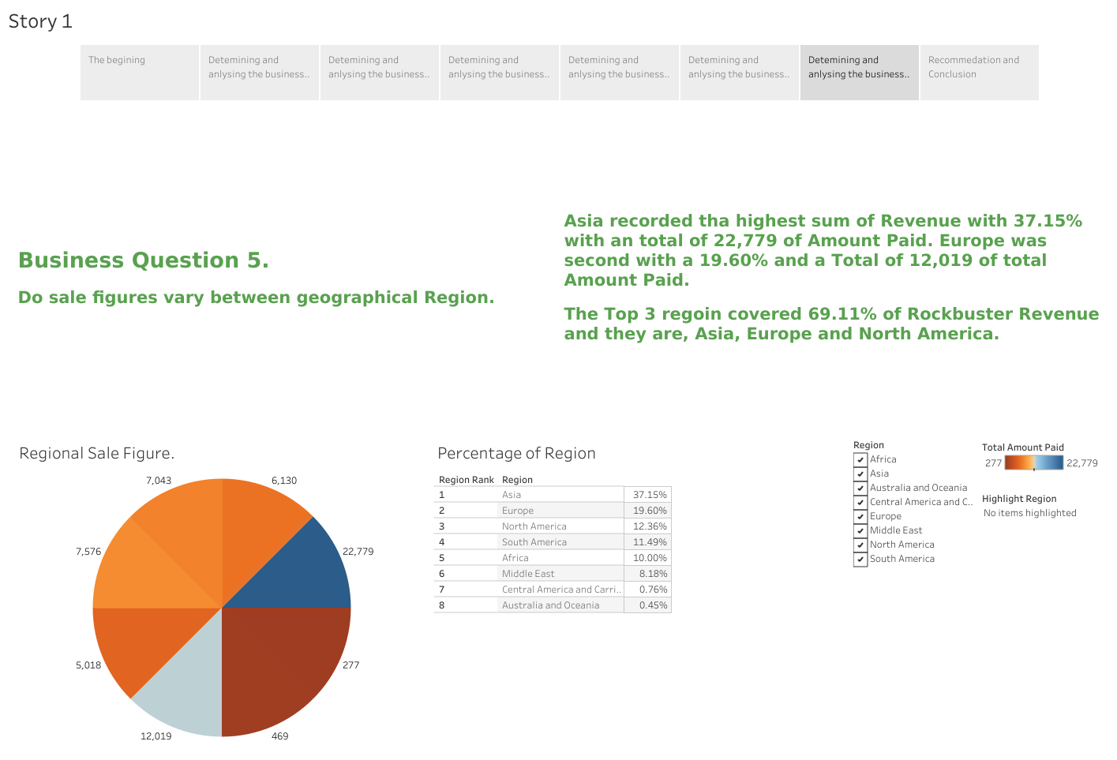

Slide 9
Recommendation and Conclusion
More Sales focus Should be on Region With High Revenue generation and Customers with High Numbers. These are Asia, Europe and North America.
High Valued Customers should be considered for Loyalty Programmes and Discounts.
Category Film s with High earning rate should have an inventory increase these are Sports, Sci-Fi, Animation.
Promotional effort and Marketing resources should be invested in Countries with high revenue and high customer base.
Bottom 10 countries should be researched to see the movies and category that are preferred as a future investment may increase when the right investment is made.

Slide 10
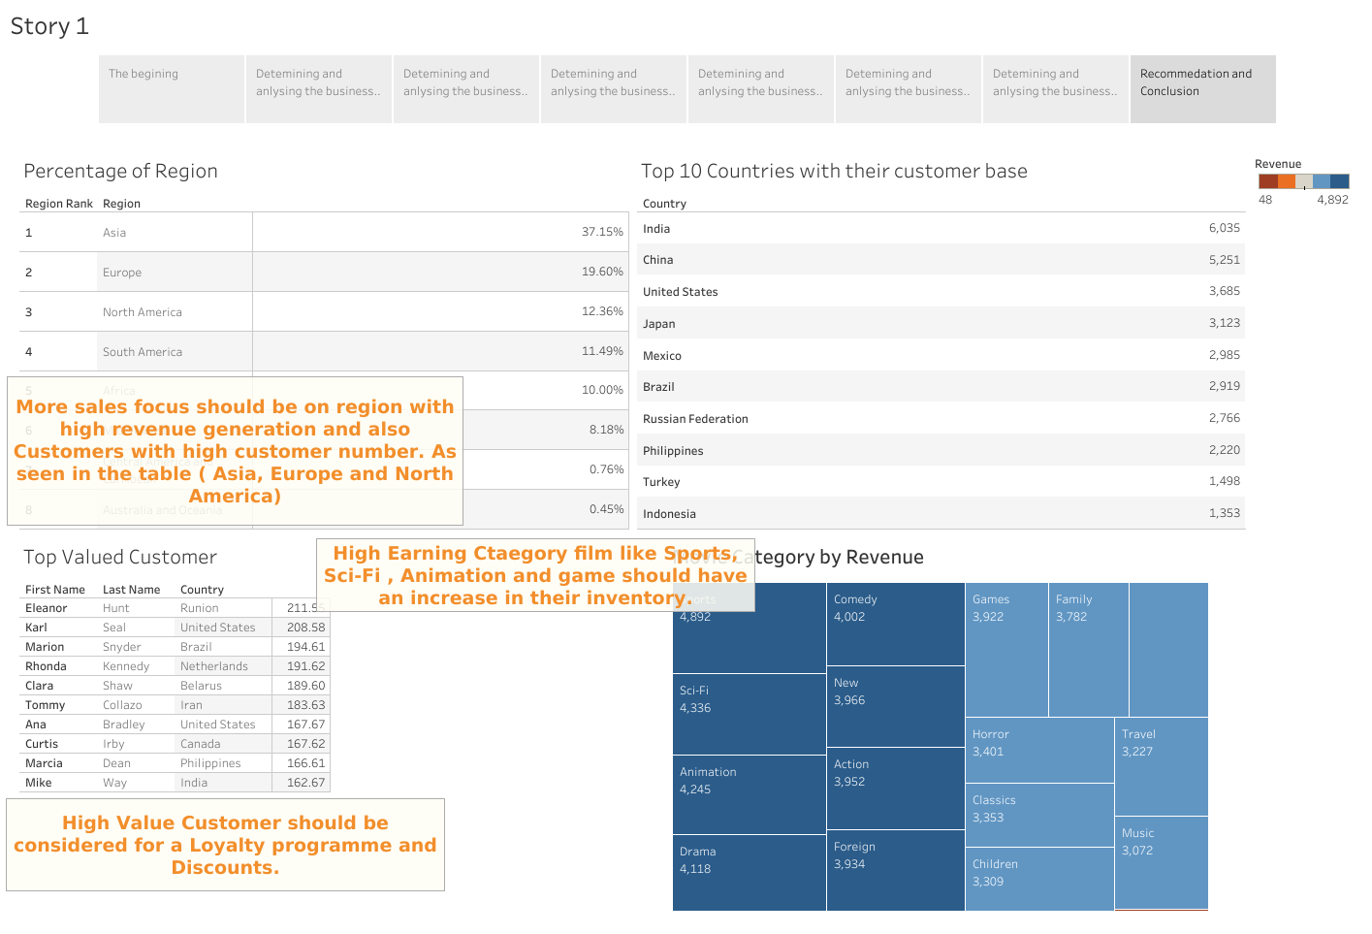

Slide 11
Thank You

