Slide 1
EventCreateAndShare
Shen Huang, Yan Li, Amir Kashipazha

Slide 2
Why EventCreateAndShare?
Create an Event to connect to your audience and spend time together in the real world.

Slide 3
Technologies Used
Maven
Spring Boot
Spring JPA
Spring MVC
Spring Session
JUnit
Mysql Database
Redis
React
Bootstrap, react-bootstrap
JSLint
axios
react-router
react-autosuggest
react-dom
react-datetime

Slide 4
Design Patterns
Singleton
Strategy
Repository
Singleton
Title, number etc. can be changed by clicking and reentering. You can change the font, font size, color, space on the Home tab. Title, number etc.
A controller object implements the strategy for one or more view objects. And it delegates to the controller all decisions about the application-specific meaning of the interface behavior.
Repository layer is added between the domain and data mapping layers to isolate domain objects from details of the database access code and to minimize scattering and duplication of query code. We use JpaRepository to implement repository pattern.
The Singleton pattern is used in the design of logger classes.
Composite
Observer
The view objects in an application are actually a composite of nested views that work together in a coordinated fashion.
The observer pattern allows models and views to be bound to each other. A separate mechanism is needed to bind a controller to one or more models.

Slide 5

Demo

Slide 6
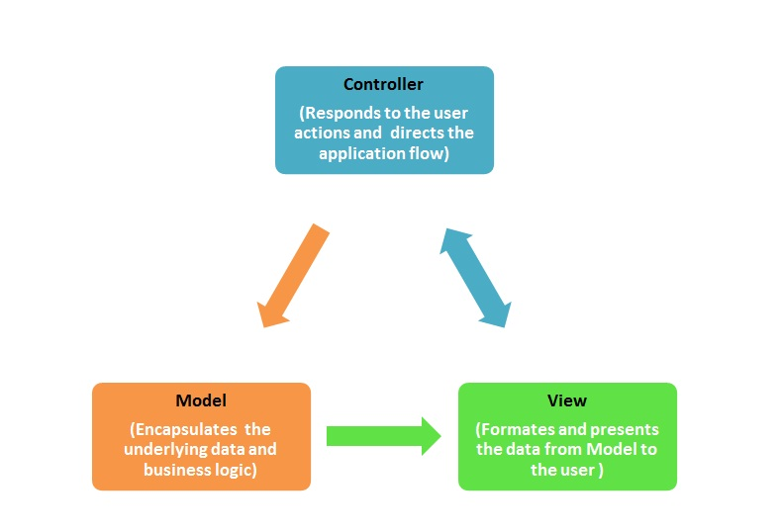
Architectural Patterns

Slide 7
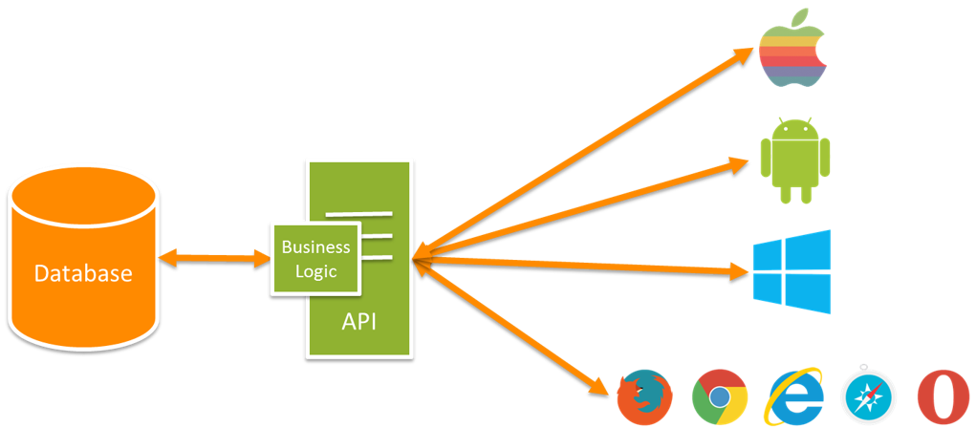
Architectural Patterns

Slide 8
What we learned:
Diagrams makes it easier to visualize how components interact.
Design patterns are a really helpful guide to implement good practices.
Analysis and design is important. Project follows use cases, class diagram and design patterns.
Requirements should be concise depending on user’s perspective.
Learned and used different design patterns and frameworks.
Learned HTML and Bootstrap for making webpages.

Slide 9
THANK YOU.

