Slide 1
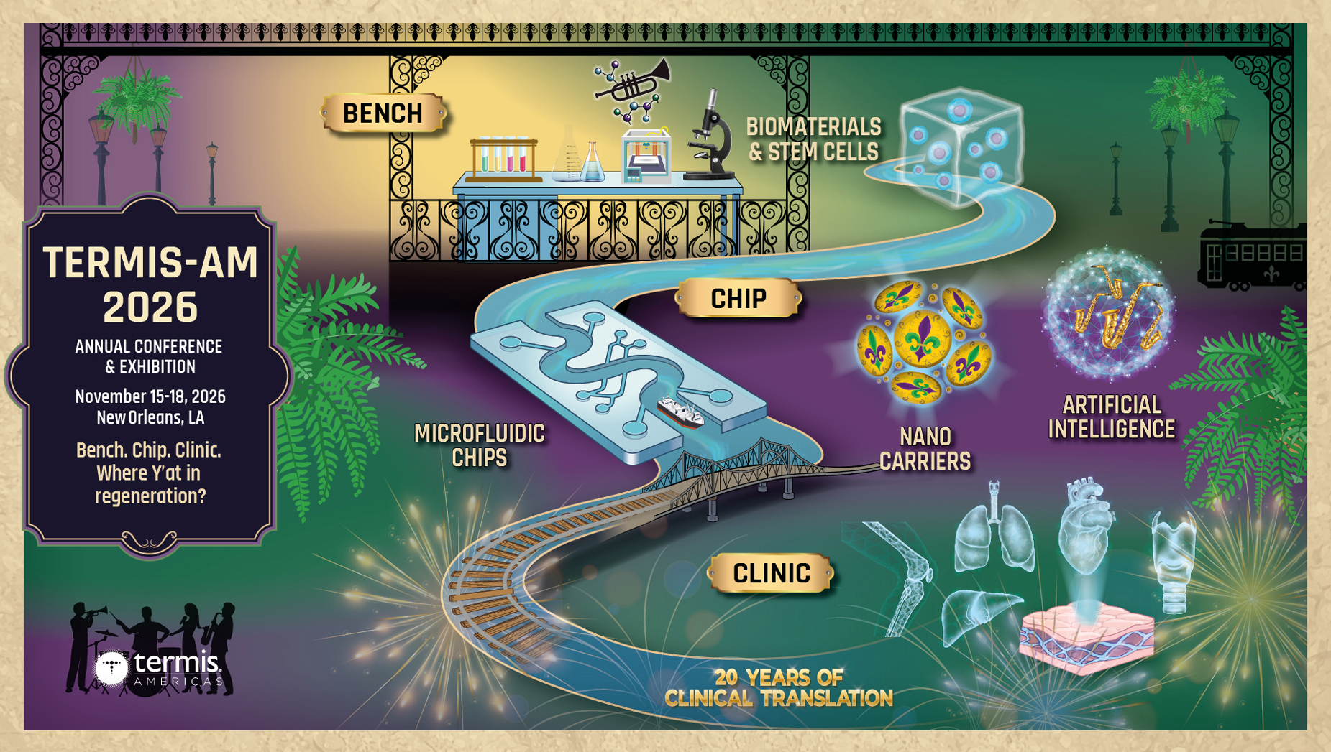

Abstract Submission Deadline: May 18, 2026

