Slide 1

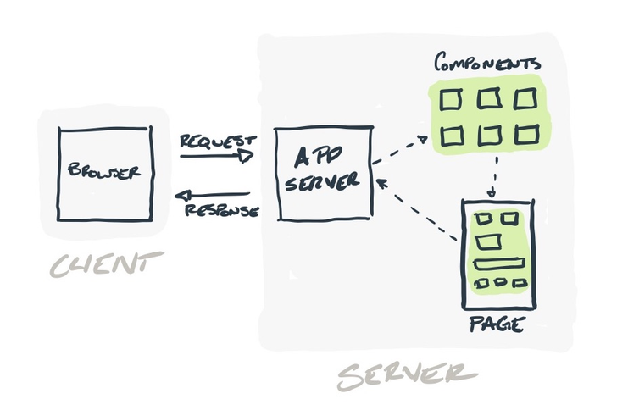
ANALYSIS OF DATA FETCHING, CACHING AND MANIPULATION TECHNIQUES WITH SERVER SIDE RENDERING
EXPLORING SERVER ACTIONS, SERVER COMPONENTS, AND PROGRESSIVE ENHANCEMENT
40110156 - BANDEPALLI SURYA ANJANI KUMAR
40110122 - ARYAN AMISH
DR. A. MARY POSONIA, M.E., Ph.D.,
17th October 2023

Slide 2


SATHYABAMA INSTITUTE OF SCIENCE AND TECHNOLOGY
DEPARTMENT OF COMPUTER SCIENCE AND ENGINEERING
PRESENTATION OUTLINE
Abstract
Introduction
Objectives of the Research
Literature Survey (Inferences)
Algorithms involved in SSR
Base Papers
Analysis
Features of the Project
Architecture
Modules
References
17th October 2023

Slide 3
SATHYABAMA INSTITUTE OF SCIENCE AND TECHNOLOGY
DEPARTMENT OF COMPUTER SCIENCE AND ENGINEERING
ABSTRACT
This research paper examines the optimization of data fetching, caching, and manipulation in Next.js by comparing traditional methods with the use of server actions, server components, and progressive enhancement.
By analyzing the performance and scalability of both approaches, this study aims to highlight the advantages and improvements offered by the newer techniques in Next.js applications.
The research will provide insights into the effectiveness of server actions, server components, and progressive enhancement in optimizing data operations, enabling developers to make informed decisions about their implementation.
17th October 2023

Slide 4
SATHYABAMA INSTITUTE OF SCIENCE AND TECHNOLOGY
DEPARTMENT OF COMPUTER SCIENCE AND ENGINEERING
INTRODUCTION
Web applications play a pivotal role in the digital landscape, and their performance is of paramount importance.
This research delves into the realm of Server-Side Rendering (SSR) and explores various techniques for data fetching, caching, and manipulation. It particularly focuses on server actions, server components, and progressive enhancement.
In this paper, we aim to analyze these techniques, uncover their merits and demerits, and shed light on their potential impact on web application optimization and user experiences.
17th October 2023

Slide 5
SATHYABAMA INSTITUTE OF SCIENCE AND TECHNOLOGY
DEPARTMENT OF COMPUTER SCIENCE AND ENGINEERING
OBJECTIVES OF THE RESEARCH
Compare performance between traditional and modern data caching and revalidation techniques in Next.js.
Evaluate the benefits and limitations of server actions and components in data fetching and manipulation compared to traditional methods.
Assess the impact of progressive enhancement on user experience in Next.js compared to traditional approaches.
Optimize data fetching, caching, and manipulation in Next.js by analyzing modern and traditional techniques.
Provide practical recommendations for developers working with data in Next.js, considering both modern and traditional approaches.
17th October 2023

Slide 6
SATHYABAMA INSTITUTE OF SCIENCE AND TECHNOLOGY
DEPARTMENT OF COMPUTER SCIENCE AND ENGINEERING
INFERENCES (LITERATURE SURVEY)
Title | Author | Year | Methodology | Inference | Merits | Demerits
React Apps with Server-Side Rendering: Next.js | Harish A Jartarghar et al. | 2022 | Server-Side Rendering (Next.js) | Compares React.js client-side rendering with Next.js server-side rendering. | Next.js improves web page loading speed by using server-side rendering. | Doesn't provide a clear outline of specific performance metrics or case studies.
Modern Front End Web Architectures with React.Js and Next.Js | Mochammad Fariz Syah Lazuardy | 2022 | Description and Comparison (Next.js) | Describes web architectures using React.js and Next.js. | Highlights advantages and disadvantages of React.js and Next.js. | White screen during initial load. Requires additional libraries for routing and state management.

Slide 7
SATHYABAMA INSTITUTE OF SCIENCE AND TECHNOLOGY
DEPARTMENT OF COMPUTER SCIENCE AND ENGINEERING
INFERENCES (LITERATURE SURVEY)
Title | Author | Year | Methodology | Inference | Merits | Demerits
Data Fetching with SSR | John K Renault | 2022 | Server-Side Rendering (SSR) | Data fetching in SSR involves retrieving data from the server during page load. | Improved initial load times for web pages. Better SEO as HTML is pre-rendered. Caching benefits for frequently visited pages. | Increased server load due to frequent data requests. May not be suitable for real-time applications.
Caching Techniques and Progressive Server Components | Sarah Brown | 2022 | Caching | Caching techniques enhance performance by storing and reusing previously fetched data. | Reduced data transfer and latency for returning users. Faster page load times for cached content. | Cache management complexity. Content may become stale if not updated properly. Limited use for dynamic data.

Slide 8
SATHYABAMA INSTITUTE OF SCIENCE AND TECHNOLOGY
DEPARTMENT OF COMPUTER SCIENCE AND ENGINEERING
INFERENCES (LITERATURE SURVEY)
Title | Author | Year | Methodology | Inference | Merits | Demerits
Data Manipulation | David Wilson | 2022 | Client-Side and Server-Side Rendering | Data manipulation can occur on both the client and server sides, depending on the application needs. | Flexibility to choose the right data manipulation approach based on specific requirements. | Potential for data synchronization issues between client and server. (Hydration Errors)
Analyzing SSR's Impact on Mobile Performance | Sarah L. Evans | 2023 | Mobile Benchmarking | Investigates how SSR affects mobile devices' performance and user engagement. | Improved mobile loading times, decreased bounce rates. | Mobile-specific optimization required, potential for over-optimization.

Slide 9
SATHYABAMA INSTITUTE OF SCIENCE AND TECHNOLOGY
DEPARTMENT OF COMPUTER SCIENCE AND ENGINEERING
ALGORITHMS INVOLVED IN SSR
Combination of LRU, FIFO and LFU.
KMP and Boyer-Moore’s algorithm are used for string matching.
Deflate and Botli’s algorithms for compression.
Summation Algorithm, Binary Search for processing and transforming data before rendering or storing.
Dijkstra’s Algorithm and BFS for route optimization.
Memoisation and State While Revalidate for validating state.
17th October 2023

Slide 10
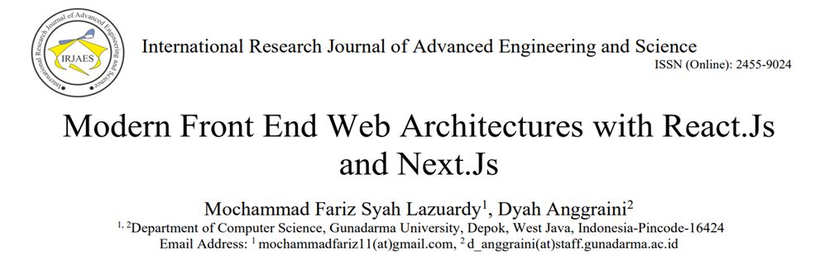
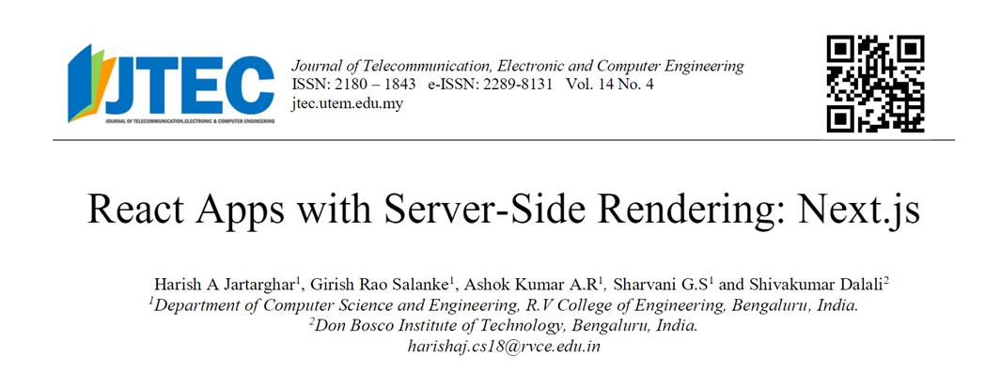
SATHYABAMA INSTITUTE OF SCIENCE AND TECHNOLOGY
DEPARTMENT OF COMPUTER SCIENCE AND ENGINEERING
BASE PAPERS
17th October 2023

Slide 11
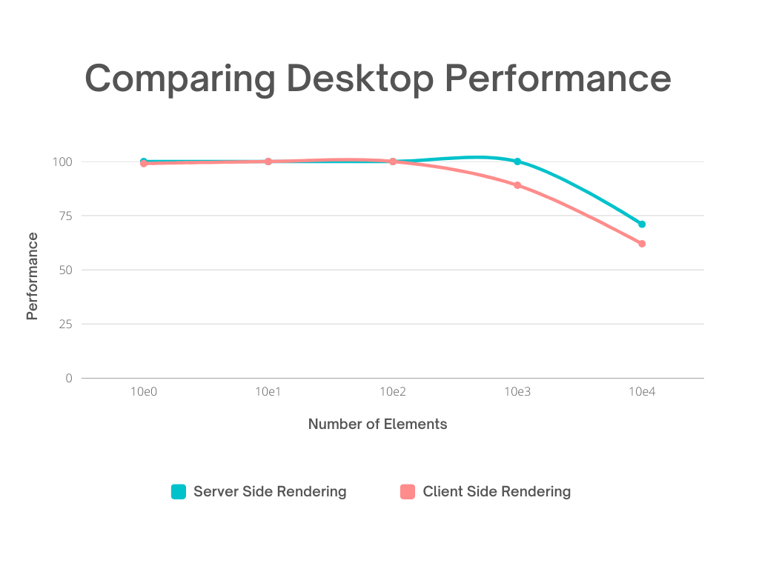
SATHYABAMA INSTITUTE OF SCIENCE AND TECHNOLOGY
DEPARTMENT OF COMPUTER SCIENCE AND ENGINEERING
COMPARING DESKTOP PERFORMANCE
The graph displays the desktop performance of Next.js server-side rendering (SSR) and React.js client-side rendering (CSR) as the number of elements increases.
The performance of SSR and CSR is the same until 10^2 elements, but when it exceeds this number, SSR provides higher performance than CSR.
17th October 2023

Slide 12
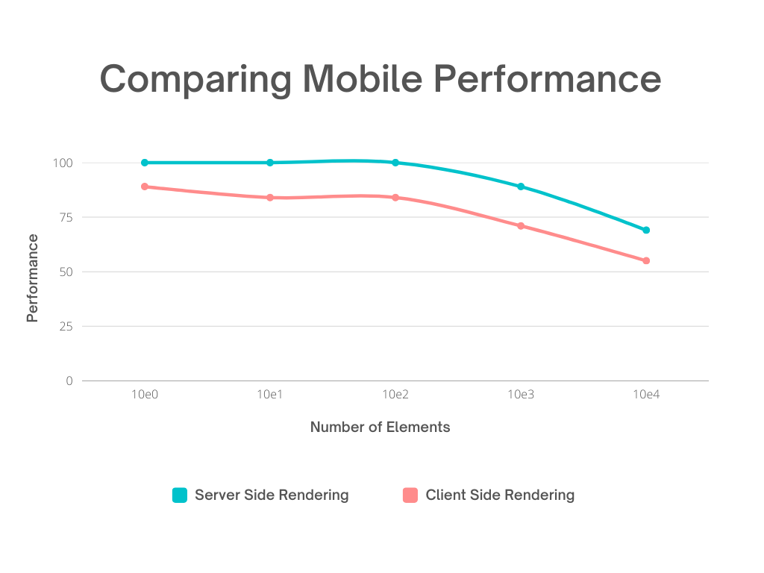
SATHYABAMA INSTITUTE OF SCIENCE AND TECHNOLOGY
DEPARTMENT OF COMPUTER SCIENCE AND ENGINEERING
COMPARING MOBILE PERFORMANCE
The graph displays the mobile performance of Next.js server-side rendering (SSR) and React.js client-side rendering (CSR) as the number of elements increases.
The performance of SSR is consistently higher than CSR from 10^0 to 10^4.
17th October 2023

Slide 13
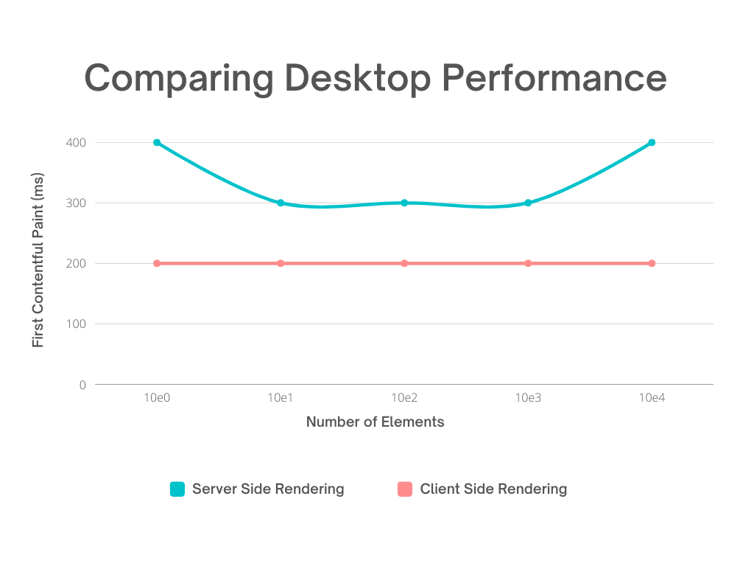
SATHYABAMA INSTITUTE OF SCIENCE AND TECHNOLOGY
DEPARTMENT OF COMPUTER SCIENCE AND ENGINEERING
COMPARING DESKTOP FIRST CONTENTFUL PAINT
The graph compares the desktop first contentful paint of Next.js server-side rendering (SSR) and React.js client-side rendering (CSR) as the number of elements increases.
CSR consistently takes 200ms for the First Contentful Paint due to its client-side nature, while SSR can take longer due to server-side rendering and dynamic content generation.
17th October 2023

Slide 14
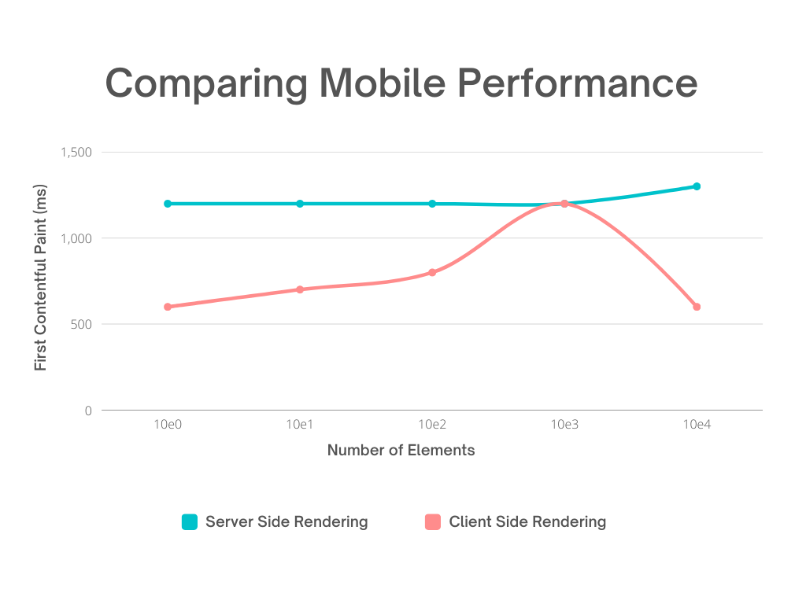
SATHYABAMA INSTITUTE OF SCIENCE AND TECHNOLOGY
DEPARTMENT OF COMPUTER SCIENCE AND ENGINEERING
COMPARING MOBILE FIRST CONTENTFUL PAINT
The graph compares the mobile first contentful paint of Next.js server-side rendering (SSR) and React.js client-side rendering (CSR) as the number of elements increases.
In mobile, CSR takes the lead, but at 10^3 elements, it matches the time taken by SSR. However, it makes a comeback for 10^4 elements.
17th October 2023

Slide 15
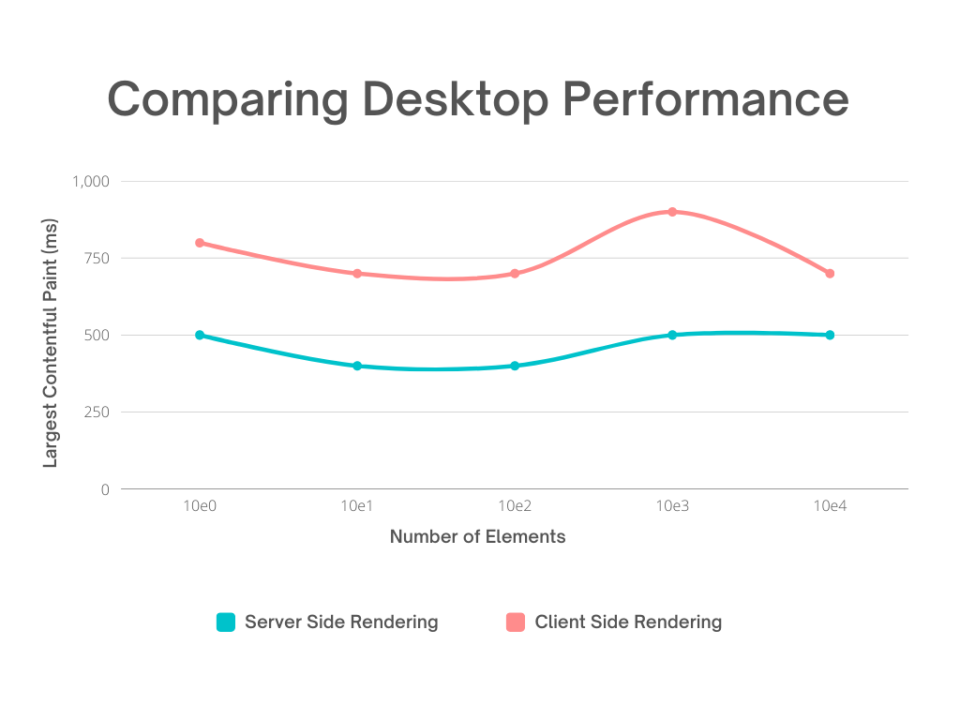
SATHYABAMA INSTITUTE OF SCIENCE AND TECHNOLOGY
DEPARTMENT OF COMPUTER SCIENCE AND ENGINEERING
COMPARING DESKTOP LARGEST CONTENTFUL PAINT
The graph compares the desktop largest contentful paint of Next.js server-side rendering (SSR) and React.js client-side rendering (CSR) as the number of elements increases.
In terms of Largest Contentful Paint, SSR always leads on Desktop.
17th October 2023

Slide 16
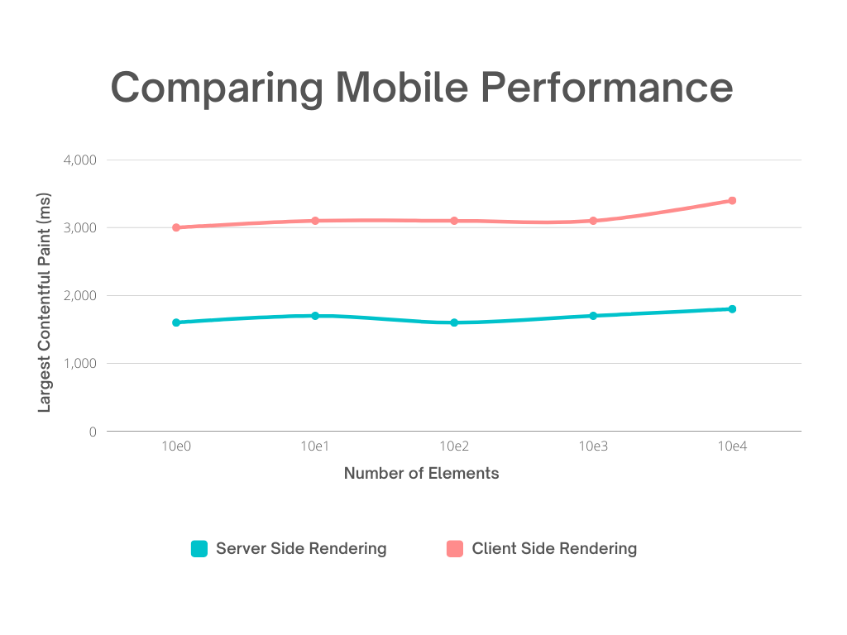
SATHYABAMA INSTITUTE OF SCIENCE AND TECHNOLOGY
DEPARTMENT OF COMPUTER SCIENCE AND ENGINEERING
COMPARING MOBILE LARGEST CONTENTFUL PAINT
The graph compares the mobile largest contentful paint of Next.js server-side rendering (SSR) and React.js client-side rendering (CSR) as the number of elements increases.
In terms of Largest Contentful Paint, SSR always leads on Mobile as well.
17th October 2023

Slide 17
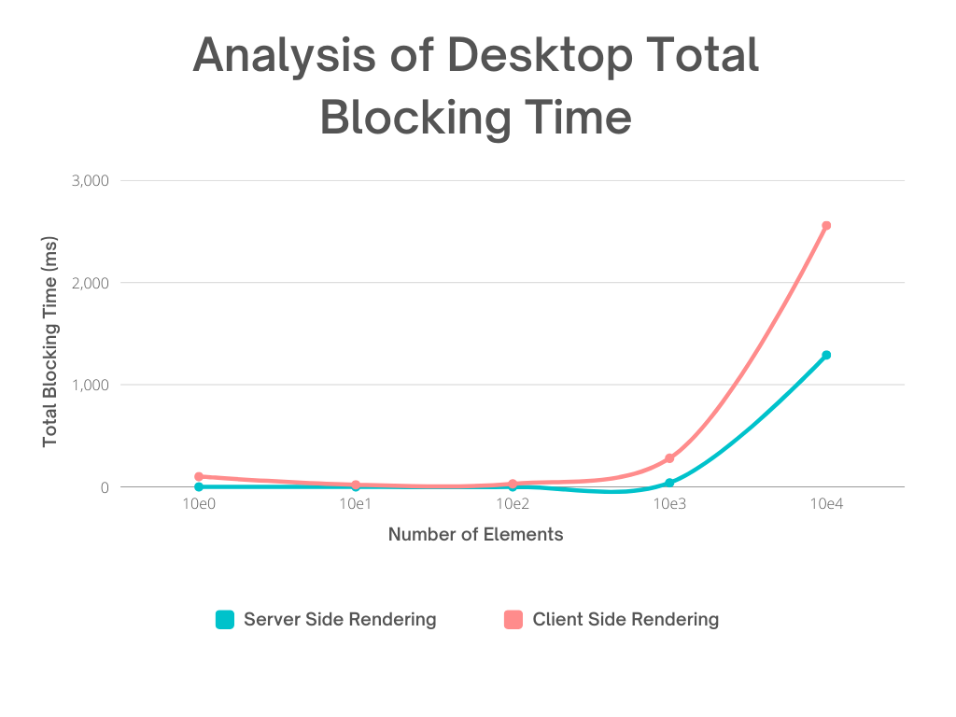
SATHYABAMA INSTITUTE OF SCIENCE AND TECHNOLOGY
DEPARTMENT OF COMPUTER SCIENCE AND ENGINEERING
ANALYSIS OF DESKTOP TOTAL BLOCKING TIME
The graph displays the desktop total blocking time of Next.js server-side rendering (SSR) and React.js client-side rendering (CSR) as the number of elements increases.
The total blocking time in desktop is comparatively lower in SSR than in CSR.
17th October 2023

Slide 18
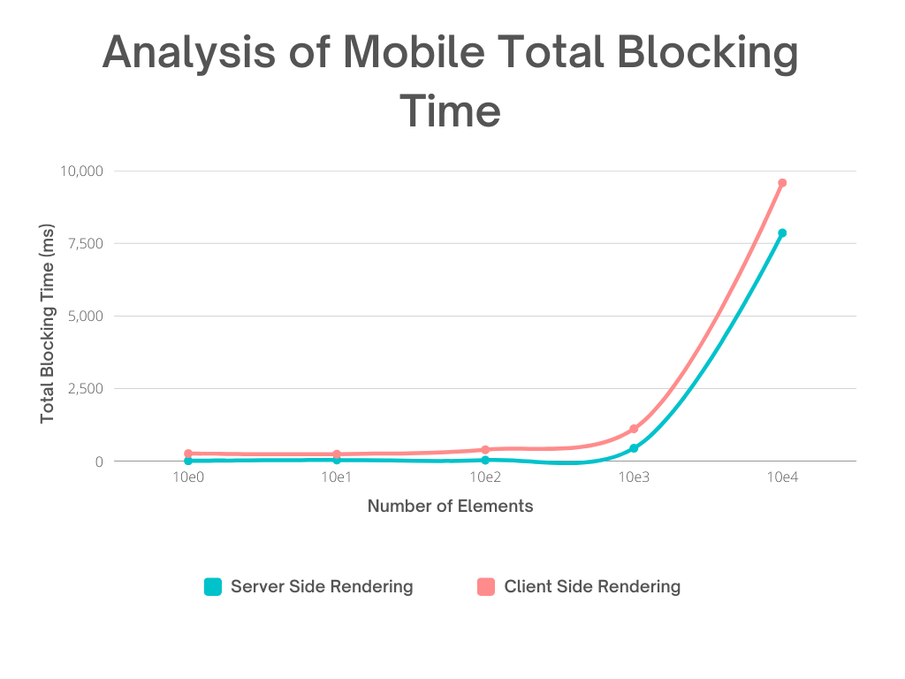
SATHYABAMA INSTITUTE OF SCIENCE AND TECHNOLOGY
DEPARTMENT OF COMPUTER SCIENCE AND ENGINEERING
ANALYSIS OF MOBILE TOTAL BLOCKING TIME
The graph compares the mobile total blocking time of Next.js server-side rendering (SSR) and React.js client-side rendering (CSR) as the number of elements increases.
The total blocking time in mobile is comparatively lower in SSR than in CSR.
17th October 2023

Slide 19
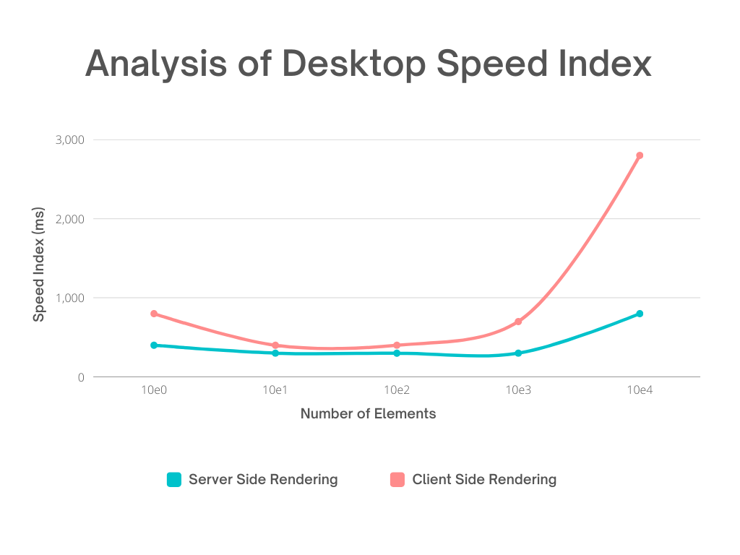
SATHYABAMA INSTITUTE OF SCIENCE AND TECHNOLOGY
DEPARTMENT OF COMPUTER SCIENCE AND ENGINEERING
ANALYSIS OF DESKTOP SPEED INDEX
The graph compares the desktop speed index of Next.js server-side rendering (SSR) and React.js client-side rendering (CSR) as the number of elements increases.
The Desktop Speed Index also underscores SSR's superior performance over CSR.
17th October 2023

Slide 20
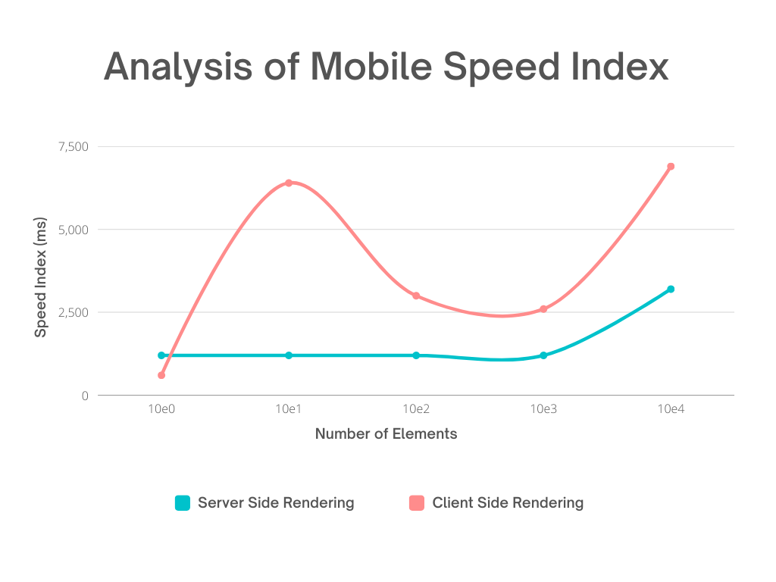
SATHYABAMA INSTITUTE OF SCIENCE AND TECHNOLOGY
DEPARTMENT OF COMPUTER SCIENCE AND ENGINEERING
ANALYSIS OF MOBILE SPEED INDEX
The graph compares the mobile speed index of Next.js server-side rendering (SSR) and React.js client-side rendering (CSR) as the number of elements increases.
The Mobile Speed Index also underscores SSR's superior performance over CSR.
17th October 2023

Slide 21
SATHYABAMA INSTITUTE OF SCIENCE AND TECHNOLOGY
DEPARTMENT OF COMPUTER SCIENCE AND ENGINEERING
DESCRIPTION OF SOFTWARE FOR IMPLEMENTATION
The application uses NextJS, ReactJS, TypeScript, ES Lint, Material UI, HTML5, CSS3, Tailwind CSS, Axios, Formik, Yup and other npm libraries on the front-end.
It also uses Django, Django REST Framework, and MySQL on the back-end.
It is deployed on Google Cloud Platform (GCP) and Vercel using Kubernetes and Docker.

Slide 22
SATHYABAMA INSTITUTE OF SCIENCE AND TECHNOLOGY
DEPARTMENT OF COMPUTER SCIENCE AND ENGINEERING
FEATURES OF THE PROJECT
Server-Side Rendering for Improved Performance
Database Password Encryption using JSON Web Tokens (JWT)
Advanced Search Functionality
Rapid Application Submission
Rapid Certificate Distribution
User-Centric Dashboard and User Interface (UI)
Intelligent Authentication
Session Management for Login State
Hierarchical Administration Structure
Multi-state Loading and Dynamic Views
Admin Panel for College Administrators

Slide 23


SATHYABAMA INSTITUTE OF SCIENCE AND TECHNOLOGY
DEPARTMENT OF COMPUTER SCIENCE AND ENGINEERING
LINKS
PRODUCTION
DEMO

Slide 24
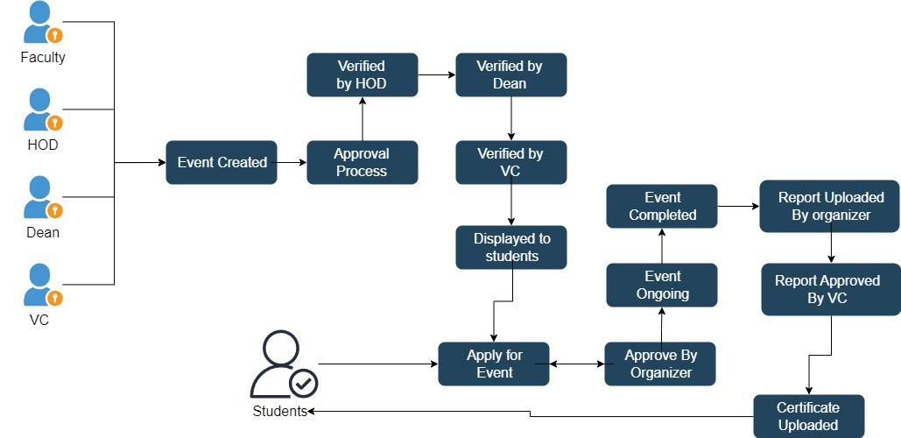
SATHYABAMA INSTITUTE OF SCIENCE AND TECHNOLOGY
DEPARTMENT OF COMPUTER SCIENCE AND ENGINEERING
FLOW CHART

Slide 25
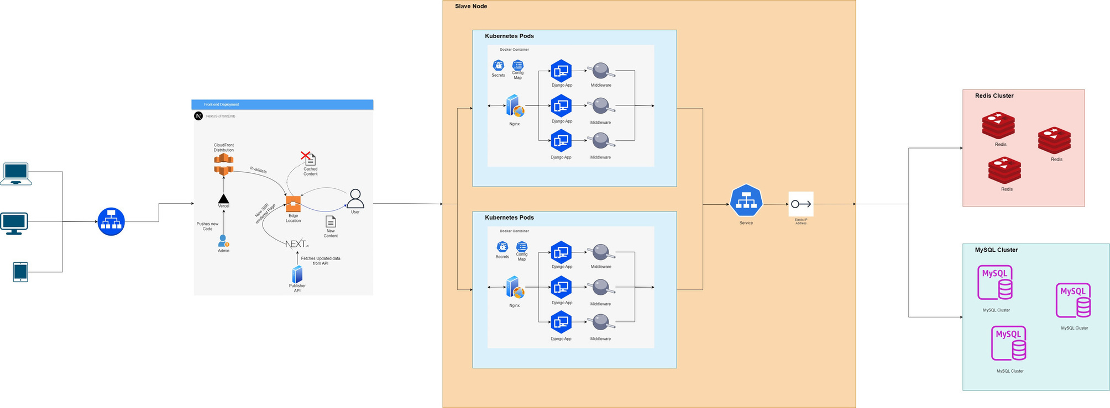
SATHYABAMA INSTITUTE OF SCIENCE AND TECHNOLOGY
DEPARTMENT OF COMPUTER SCIENCE AND ENGINEERING
SYSTEM ARCHITECTURE

Slide 26
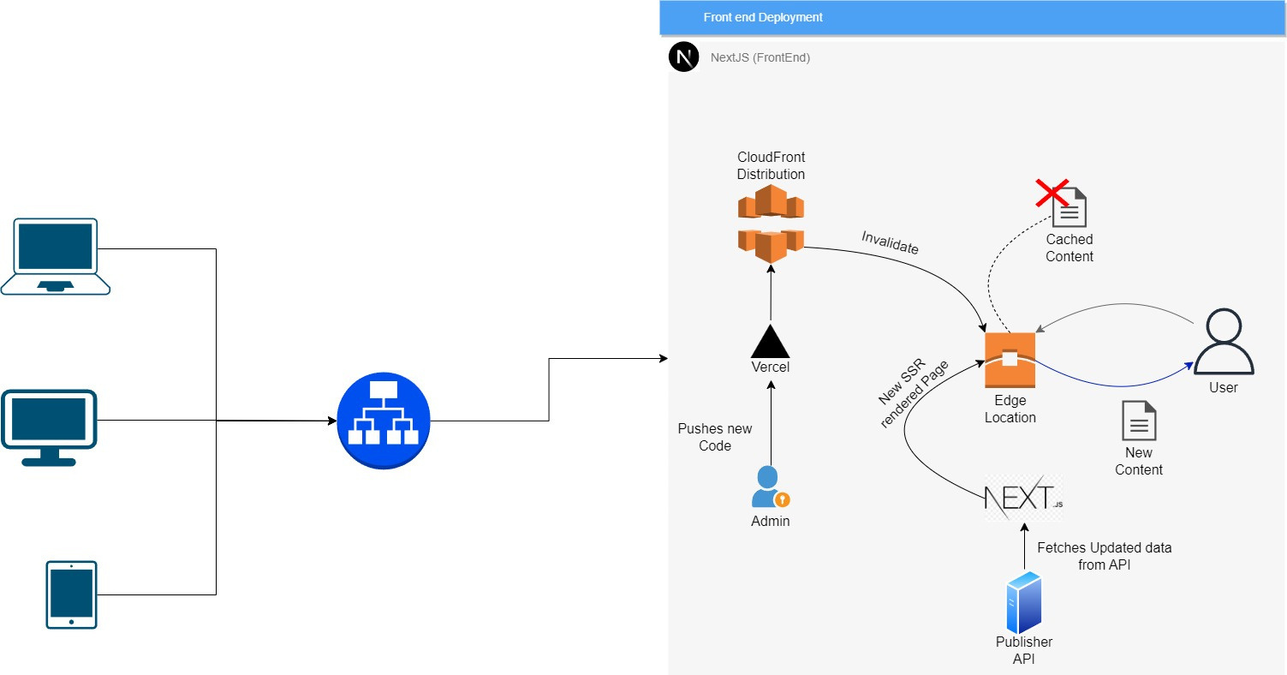
SATHYABAMA INSTITUTE OF SCIENCE AND TECHNOLOGY
DEPARTMENT OF COMPUTER SCIENCE AND ENGINEERING
SSR ARCHITECTURE

Slide 27
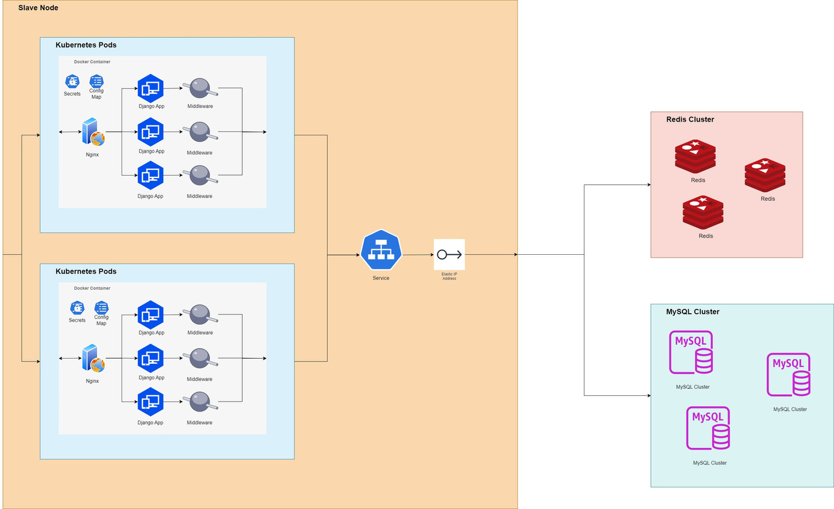
SATHYABAMA INSTITUTE OF SCIENCE AND TECHNOLOGY
DEPARTMENT OF COMPUTER SCIENCE AND ENGINEERING
BACKEND ARCHITECTURE

Slide 28
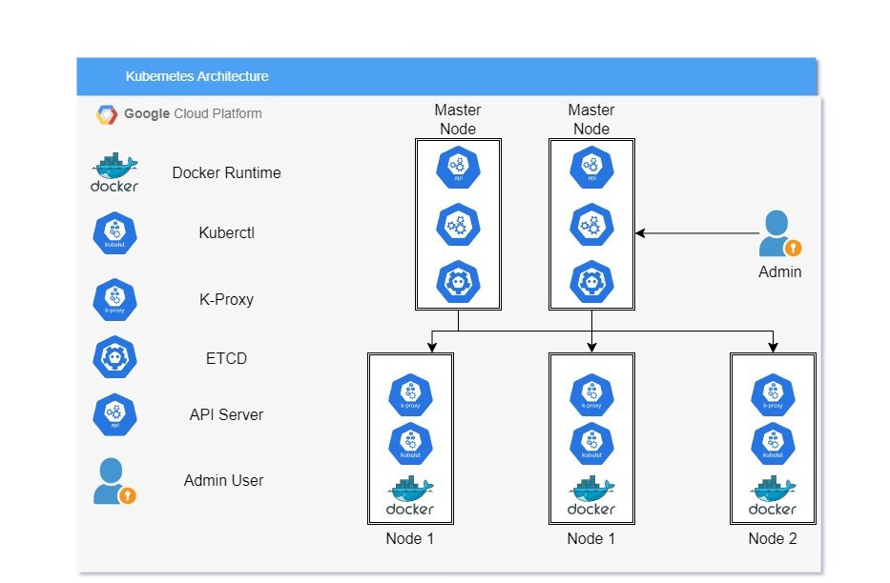
SATHYABAMA INSTITUTE OF SCIENCE AND TECHNOLOGY
DEPARTMENT OF COMPUTER SCIENCE AND ENGINEERING
KUBERNETES ARCHITECTURE

Slide 29
SATHYABAMA INSTITUTE OF SCIENCE AND TECHNOLOGY
DEPARTMENT OF COMPUTER SCIENCE AND ENGINEERING
MODULES
Authentication Service
E-mail Service
CDN (Content- Delivery Network)
CRON Jobs
Image Compression
Caching Service
Load Balancer Service
CI/CD with Jenkins
Data Pipeline Service with ERP
Bulk OTP Polling Queue
17th October 2023

Slide 30




SATHYABAMA INSTITUTE OF SCIENCE AND TECHNOLOGY
DEPARTMENT OF COMPUTER SCIENCE AND ENGINEERING
BENCHMARKS
80%
70%
65%
More Efficient Event Approval and Tracking
Faster Event Announcements
Faster Initial Load Times
17th October 2023

Slide 31
SATHYABAMA INSTITUTE OF SCIENCE AND TECHNOLOGY
DEPARTMENT OF COMPUTER SCIENCE AND ENGINEERING
REFERENCES
P. Kishore and M. B M, “Evolution of Client-Side Rendering over Server-Side Rendering,” vol. 3, no. 2, pp. 1–10, 2020.
Vercel, “Data Fetching Overview,” 2022. https://nextjs.org/docs/basicfeatures/data-fetching/index (accessed Jan. 24, 2022)
S. G. V and A. Sandeep, “Comprehensive Analysis of React-Redux Development Framework,” Int. J. Creat. Res. Thoughts www.ijcrt.org, vol. 8, no. 4, p. 4230, 2020.
B. McNamee, "Server-Side Rendering with React: A Comprehensive Guide," Smashing Magazine, Nov. 2020.
A. Bhattacharya, "The Pros and Cons of Server-Side Rendering in React Apps," The Startup, May 2022. https://medium.com/swlh/the-pros-and-cons-of-server-side-rendering-in-react-apps-3505f4a2fcd5.
A. Srinivasan, "React SSR vs CSR: Benefits and Trade-offs," LogRocket Blog, May 2021. Available: https://blog.logrocket.com/react-ssr-vs-csr-benefits-and-trade-offs/.
S. Jangra, "A Comprehensive Guide to Server-Side Rendering with Next.js," Hashnode Blog, Mar. 2023. https://hashnode.com/post/a-comprehensive-guide-to-server-side-rendering-with-nextjs-ckxwoagb100x3gvs15kxdhswf.

Slide 32








THANK YOU

