Slide 1
ICS 240
Array and List Search (mostly review of CS-1 (ICS 141) )

Slide 2
Search
We review searches that can be used for arrays and (possibly) linked lists
Sequential search
Binary search

Slide 3
Topics
Search (review/expansion of previous course)
Serial search
Binary search

Slide 4
Search
Find something in a data structure
Normally a List of some sort
Array/ArrayList
Linked List
Occasionally a tree (later this semester)
Types of list search
Serial search
A.k.a. linear or sequential search
Binary search

Slide 5
Serial Search
Look through every element of the list.
If you find what you want, return it.
If you don’t find what you want, perform appropriate action for item not found.
e.g., return null or special value.

Slide 6
Serial Search Array Example
//return the index of the first occurrence
//of target of type “Data” in data or -1 if target not found in data
public <E> serialSearch(<E>[] data, <E> target){
for(int i = 0; i < data.length; i++){
if( data[i].equals( target ) ){
return data[i];
)
}
return null;
}
You could also return the index of the element in the array.
Note that all the operations are constant time.
The running time will be driven by the number of comparisons made.

Slide 7
Running time of Serial Search
For a List of n elements,
The best case is when the first element you view is the target.
1 comparison
The worst case is when the last element you view is the target, or the target is not found in the array.
n comparisons
What is the average case? It really depends on the probability of searching for each element.
If we assume that we are equally likely to find the element at each position (counting “not found” as part of the last position) we have the mean running time is (Σ^{n}_{j=1} j) / n = n(n+1)/2n
= (n+1)/2

Slide 8
Running time of serial search II
Best case running time of serial search is O(1) = constant
Worst case running time of serial search is O(n)
Average case running time is O((n+1)/2) = O(n)
= O(n/2) + O(1/2) = O(n) + O(1) = O(n)
Because O(an) = O(n) for a > 0,
and O(f(n)) + O(g(n)) = max ( O(f(n)), O(g(n)) )
Again, this assumes that stopping at any point is equally likely.

Slide 9
Binary Search
Here we’re talking about binary search of a sorted List.
It really only works for arrays
It can be simulated for linked lists with a lot of overhead
Using something called a Skip List (not covered)
Algorithm:
Assume, the list is sorted in ascending order:
Start at the middle element in list
is that middle element equal to target?
If not, is the middle element is less than or greater than target?
If less than, then move to second half of list
If greater than, move to first half of list
repeat until target is found or sub-list size = 0

Slide 10
Divide and Conquer
Binary Search is our first example of an algorithmic design principle called Divide and Conquer
Divide a problem up into subproblems
Conquer each individual subproblem
In some cases, combine solutions of conquered subproblems to get final answer
Not done in binary search

Slide 11


Binary Search Divide & Conquer
low middle high
Set middle = ( high + low ) / 2
Is the middle item equals to target?
If not, then check whether it is greater than or less than target?
If the middle is greater than target, then the next middle is the middle element of the sub-list before current middle
low middle high and so forth…

Slide 12
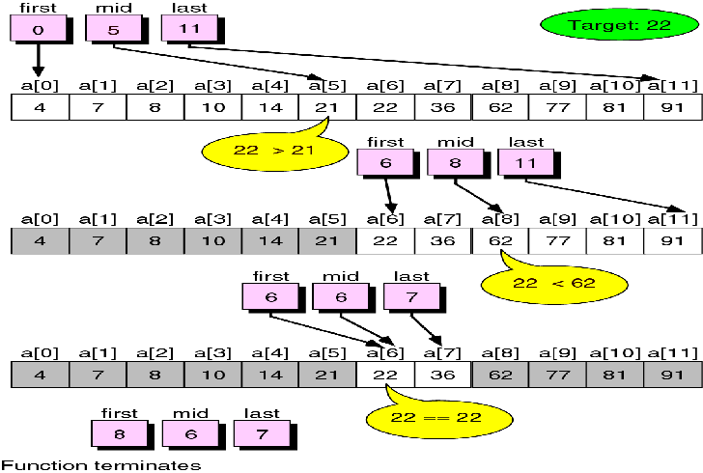
Binary Search Example 1

Slide 13
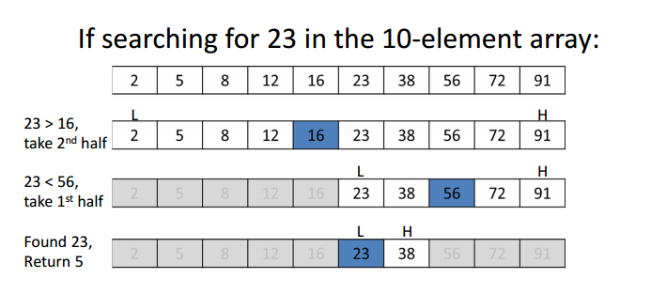
Binary Search Example 2

Slide 14
Iterative Binary Search Pseudocode
public static int itBinSrch( E [] data, E target){
int result = -1;
int low = 0;
int high = data.length - 1;
int middle = -1;
while( result == -1 && low <= high ){
middle = low + ((high - low) / 2);
if( target.equals( data[middle] ) ) {
result = middle;
}else if( target.compareTo( data[middle] ) > 0 ) {
// Probe was too low
low = middle + 1;
}else
// Probe was too high
high = middle - 1;
}
}
return result;
}

Slide 15
Running Time of Binary Search
Again, if checks for <, =, > are constant time, all operations are constant time operations.
So the running time is based on the number of comparisons.
If n = 2^{k}, there are at most log₂n comparisons.
If n = 2^{k} – 1, there are at most ⎡log₂n⎤ comparisons. (worst case)
Example: search for 11 in the array with numbers 1-15
So binary search is O(⎡log₂n⎤ ) ≤ O(log₂n + 1) = O(log₂n) = O(log n)
1 | 2 | 3 | 4 | 5 | 6 | 7 | 8 | 9 | 10 | 11 | 12 | 13 | 14 | 15
1 | 2 | 3 | 4 | 5 | 6 | 7 | 8 | 9 | 10 | 11 | 12 | 13 | 14 | 15
1 | 2 | 3 | 4 | 5 | 6 | 7 | 8 | 9 | 10 | 11 | 12 | 13 | 14 | 15
1 | 2 | 3 | 4 | 5 | 6 | 7 | 8 | 9 | 10 | 11 | 12 | 13 | 14 | 15

