Slide 1
Adaboost
Derek Hoiem
March 31, 2004

Slide 2
Outline
Background
Adaboost Algorithm
Theory/Interpretations
Practical Issues
Face detection experiments

Slide 3
What’s So Good About Adaboost
Improves classification accuracy
Can be used with many different classifiers
Commonly used in many areas
Simple to implement
Not prone to overfitting

Slide 4
A Brief History
Bootstrapping
Bagging
Boosting (Schapire 1989)
Adaboost (Schapire 1995)

Slide 5
Bootstrap Estimation
Repeatedly draw n samples from D
For each set of samples, estimate a statistic
The bootstrap estimate is the mean of the individual estimates
Used to estimate a statistic (parameter) and its variance

Slide 6
Bagging - Aggregate Bootstrapping
For i = 1 .. M
  Draw n*<n samples from D with replacement
  Learn classifier C_{i}
Final classifier is a vote of C₁ .. C_{M}
Increases classifier stability/reduces variance

Slide 7
Boosting (Schapire 1989)
Randomly select n₁ < n samples from D without replacement to obtain D₁
  Train weak learner C₁
Select n₂ < n samples from D with half of the samples misclassified by C₁ to obtain D₂
  Train weak learner C₂
Select all samples from D that C₁ and C₂ disagree on
  Train weak learner C₃
Final classifier is vote of weak learners

Slide 8
Adaboost - Adaptive Boosting
Instead of sampling, re-weight
  Previous weak learner has only 50% accuracy over new distribution
Can be used to learn weak classifiers
Final classification based on weighted vote of weak classifiers

Slide 9
Adaboost Terms
Learner = Hypothesis = Classifier
Weak Learner: < 50% error over any distribution
Strong Classifier: thresholded linear combination of weak learner outputs

Slide 10
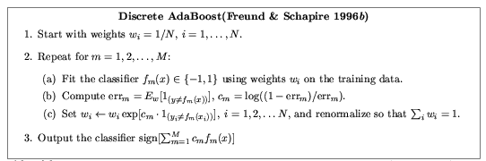
Discrete Adaboost (DiscreteAB)
(Friedman’s wording)

Slide 11
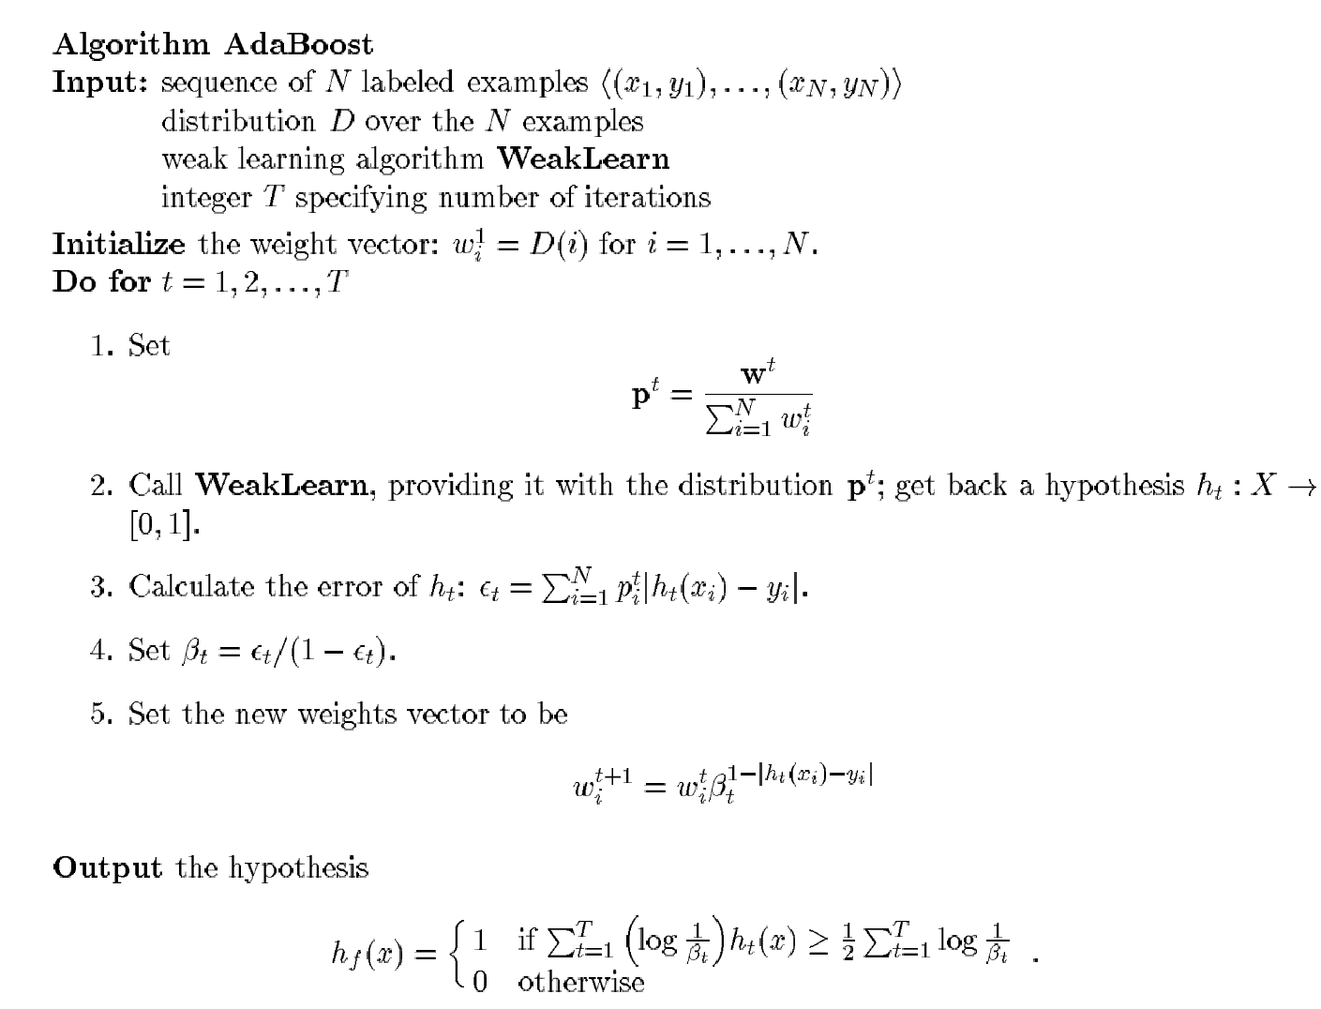
Discrete Adaboost (DiscreteAB)
(Freund and Schapire’s wording)

Slide 12
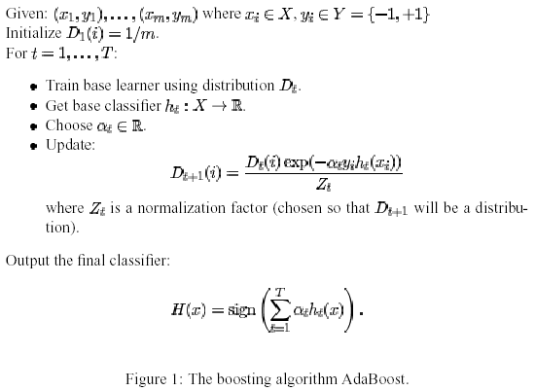
Adaboost with Confidence Weighted Predictions (RealAB)

Slide 13
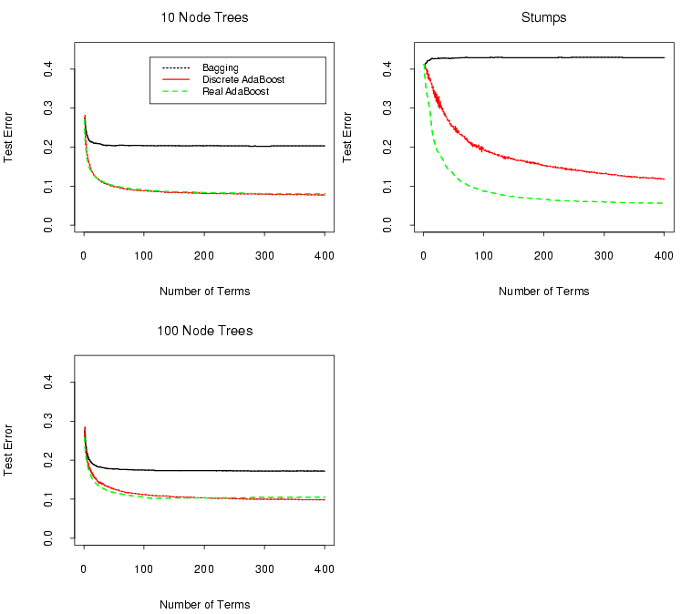
Comparison
2 Node Trees

Slide 14
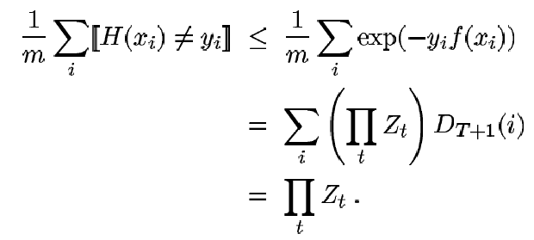

Bound on Training Error (Schapire)

Slide 15

Finding a weak hypothesis
Train classifier (as usual) on weighted training data
Some weak learners can minimize Z by gradient descent
Sometimes we can ignore alpha (when the weak learner output can be freely scaled)

Slide 16


Choosing Alpha
Choose alpha to minimize Z
Results in 50% error rate in latest weak learner
In general, compute numerically

Slide 17

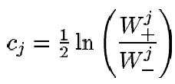

Special Case
Domain-partitioning weak hypothesis (e.g. decision trees, histograms)
P₁
x
x
P₃
x
x
x
o
W_{x}¹ = 5/13, W_{o}¹ = 0/13
W_{x}² = 1/13, W_{o}² = 2/13
W_{x}³ = 1/13, W_{o}³ = 4/13
Z = 2 (0 + sqrt(2)/13 + 2/13) = .525
x
o
o
x
o
o
P₂
o

Slide 18
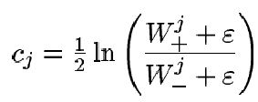

Smoothing Predictions
Equivalent to adding prior in partitioning case
Confidence bound by

Slide 19


Justification for the Error Function
Adaboost minimizes:
Provides a differentiable upper bound on training error (Shapire)
Minimizing J(F) is equivalent up to 2nd order Taylor expansion about F = 0 to maximizing expected binomial log-likelihood (Friedman)

Slide 20
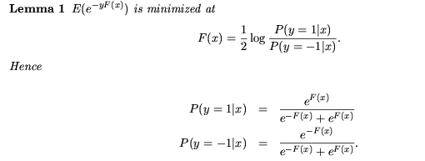
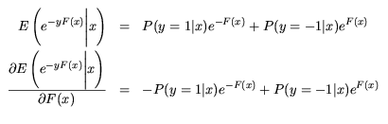
Probabilistic Interpretation (Friedman)
Proof:

Slide 21
Misinterpretations of the Probabilistic Interpretation
Lemma 1 applies to the true distribution
  Only applies to the training set
  Note that P(y|x) = {0, 1} for the training set in most cases
Adaboost will converge to the global minimum
  Greedy process → local minimum
  Complexity of strong learner limited by complexities of weak learners

Slide 22
Example of Joint Distribution that Cannot Be Learned with Naïve Weak Learners
0, 0
0, 1
P(o | 0,0) = 1
P(x | 0,1) = 1
P(x | 1,0) = 1
P(o | 1,1) = 1
o
x
x1
x
o
1, 0
1, 1
x2
H(x1,x2) = a*x1 + b*(1-x1) + c*x2 + d*(1-x2) = (a-b)*x1 + (c-d)*x2 + (b+d)
Linear decision for non-linear problem when using naïve weak learners

Slide 23
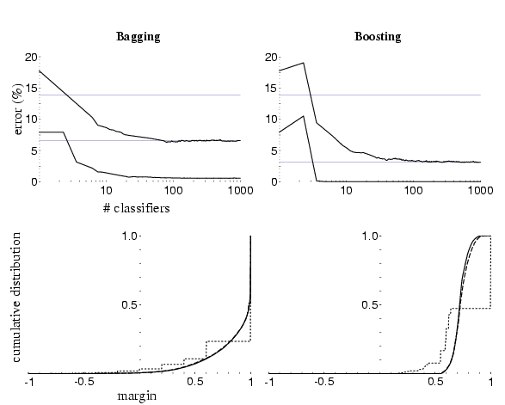
Immunity to Overfitting?

Slide 24
Adaboost as Logistic Regression (Friedman)
Additive Logistic Regression: Fitting class conditional probability log ratio with additive terms
DiscreteAB builds an additive logistic regression model via Newton-like updates for minimizing
RealAB fits an additive logistic regression model by stage-wise and approximate optimization of
Even after training error reaches zero, AB produces a “purer” solution probabilistically

Slide 25
Adaboost as Margin Maximization (Schapire)

Slide 26
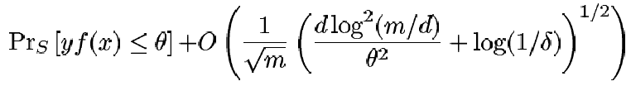
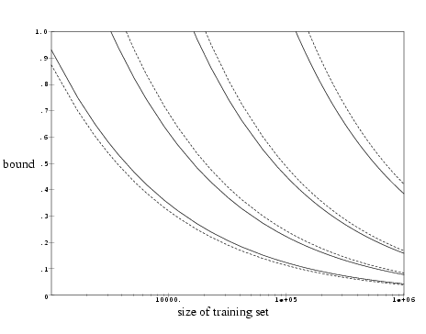

Bound on Generalization Error
Confidence of correct decision
VC dimension
Confidence Margin
Number of training examples
Bound confidence term
1/8
1/20
To loose to be of practical value:
1/2
1/4

Slide 27
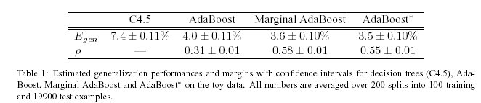
Maximizing the margin…
But Adaboost doesn’t necessarily maximize the margin on the test set (Ratsch)
Ratsch proposes an algorithm (Adaboost*) that does so

Slide 28
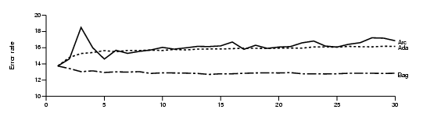
Adaboost and Noisy Data
Examples with the largest gap between the label and the classifier prediction get the most weight
What if the label is wrong?
Opitz: Synthetic data with 20% one-sided noisy labeling
Number of Networks in Ensemble

Slide 29
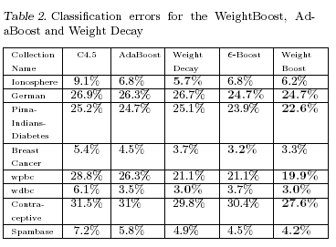
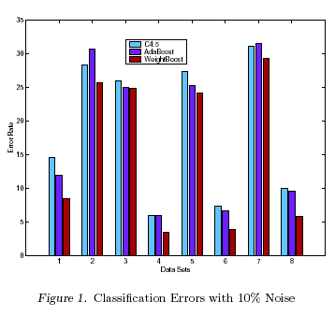
WeightBoost (Jin)
Uses input-dependent weighting factors for weak learners
Text Categorization

Slide 30
BrownBoost (Freund)
Non-monotonic weighting function
  Examples far from boundary decrease in weight
Set a target error rate – algorithm attempts to achieve that error rate
No results posted (ever)

Slide 31


Adaboost Variants Proposed By Friedman
LogitBoost
  Solves
  Requires care to avoid numerical problems
GentleBoost
  Update is f_{m}(x) = P(y=1 | x) – P(y=0 | x) instead of
    Bounded [0 1]

Slide 32
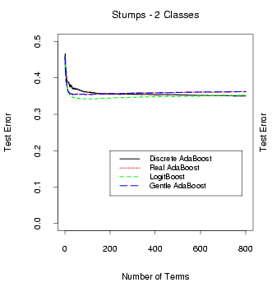
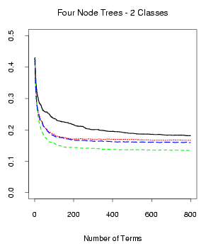
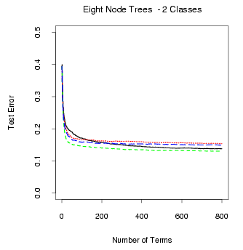
Comparison (Friedman)
Synthetic, non-additive decision boundary

Slide 33
Complexity of Weak Learner
Complexity of strong classifier limited by complexities of weak learners
Example:
  Weak Learner: stubs → WL Dim_{VC} = 2
  Input space: R^{N} → Strong Dim_{VC} = N+1
  N+1 partitions can have arbitrary confidences assigned

Slide 34
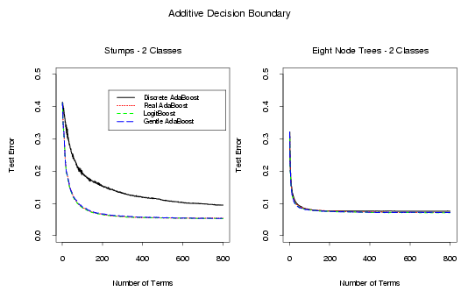
Complexity of the Weak Learner

Slide 35
Complexity of the Weak Learner
Non-Additive Decision Boundary

Slide 36
Adaboost in Face Detection
Detector | Adaboost Variant | Weak Learner
Viola-Jones | DiscreteAB | Stubs
FloatBoost | FloatBoost | 1-D Histograms
KLBoost | KLBoost | 1-D Histograms
Schneiderman | RealAB | One Group of N-D Histograms

Slide 37
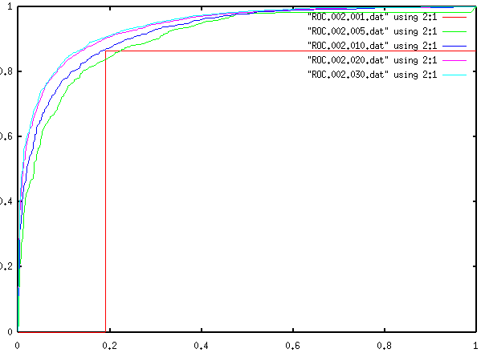
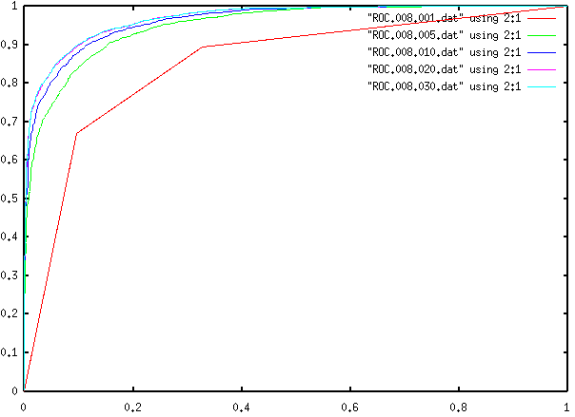
Boosted Trees – Face Detection
Stubs (2 Nodes)
8 Nodes

Slide 38
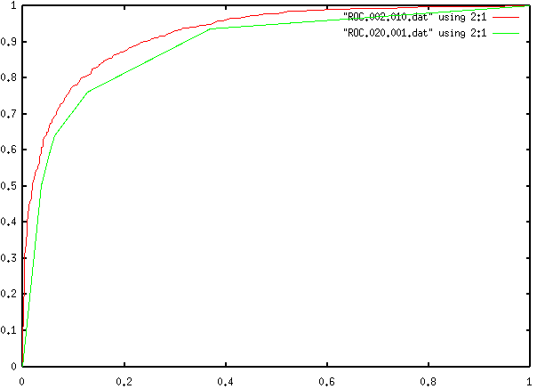
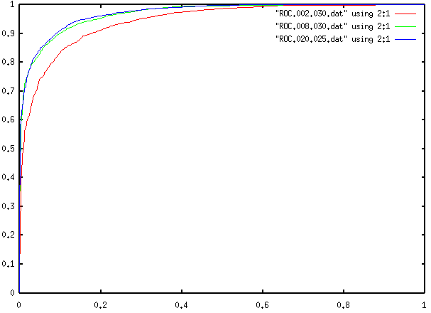
Boosted Trees – Face Detection
Ten Stubs vs. One 20 Node
2, 8, and 20 Nodes

Slide 39
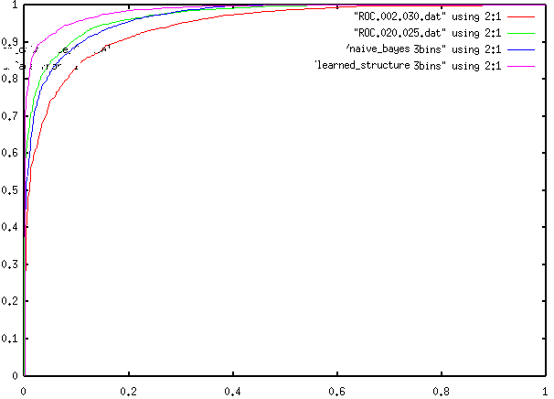
Boosted Trees vs. Bayes Net

Slide 40
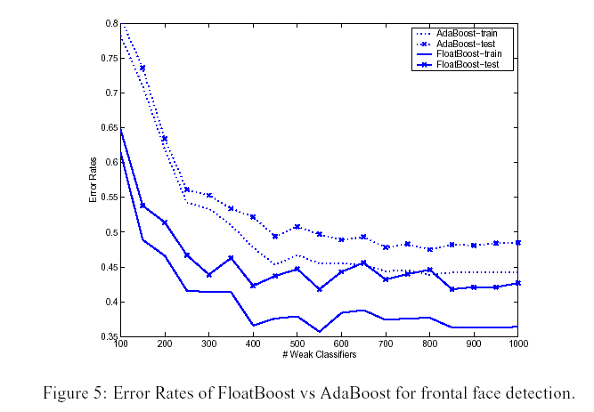
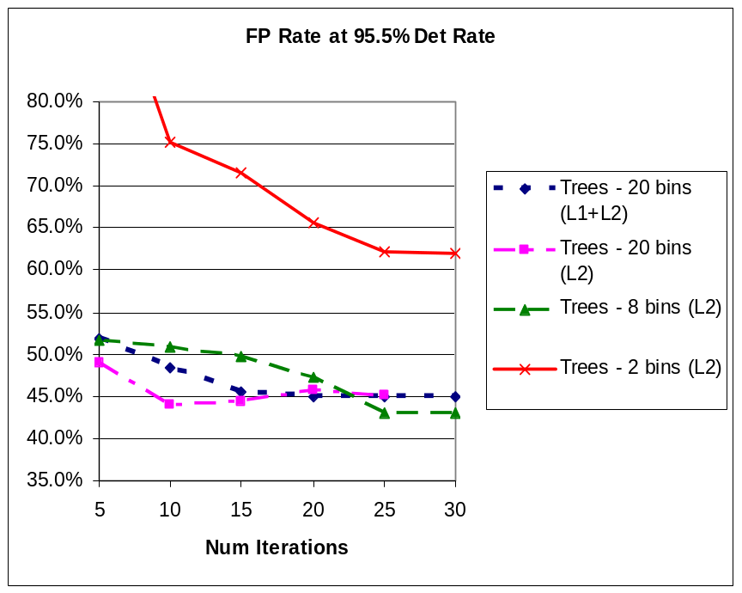
FloatBoost (Li)
1. Less greedy approach (FloatBoost) yields better results
2. Stubs are not sufficient for vision

Slide 41
When to Use Adaboost
Give it a try for any classification problem
Be wary if using noisy/unlabeled data

Slide 42
How to Use Adaboost
Start with RealAB (easy to implement)
Possibly try a variant, such as FloatBoost, WeightBoost, or LogitBoost
Try varying the complexity of the weak learner
Try forming the weak learner to minimize Z (or some similar goal)

Slide 43
Conclusion
Adaboost can improve classifier accuracy for many problems
Complexity of weak learner is important
Alternative boosting algorithms exist to deal with many of Adaboost’s problems

Slide 44
References
Duda, Hart, ect – Pattern Classification
Freund – “An adaptive version of the boost by majority algorithm”
Freund – “Experiments with a new boosting algorithm”
Freund, Schapire – “A decision-theoretic generalization of on-line learning and an application to boosting”
Friedman, Hastie, etc – “Additive Logistic Regression: A Statistical View of Boosting”
Jin, Liu, etc (CMU) – “A New Boosting Algorithm Using Input-Dependent Regularizer”
Li, Zhang, etc – “Floatboost Learning for Classification”
Opitz, Maclin – “Popular Ensemble Methods: An Empirical Study”
Ratsch, Warmuth – “Efficient Margin Maximization with Boosting”
Schapire, Freund, etc – “Boosting the Margin: A New Explanation for the Effectiveness of Voting Methods”
Schapire, Singer – “Improved Boosting Algorithms Using Confidence-Weighted Predictions”
Schapire – “The Boosting Approach to Machine Learning: An overview”
Zhang, Li, etc – “Multi-view Face Detection with Floatboost”

Slide 45
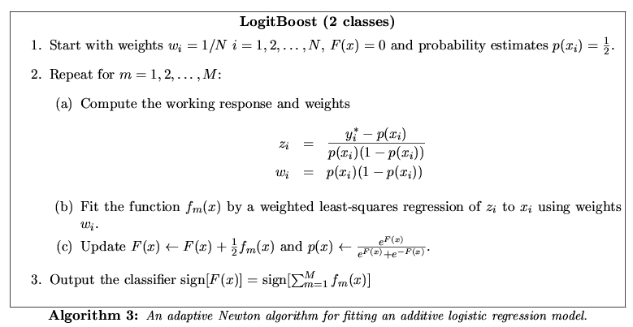
Adaboost Variants Proposed By Friedman
LogitBoost

Slide 46
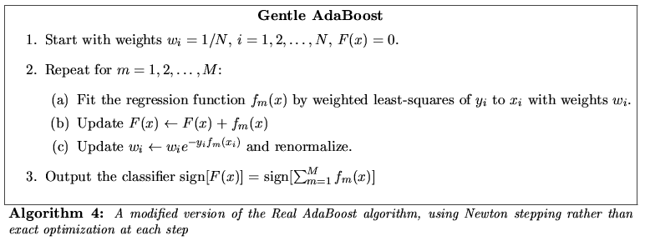
Adaboost Variants Proposed By Friedman
GentleBoost

