Slide 1
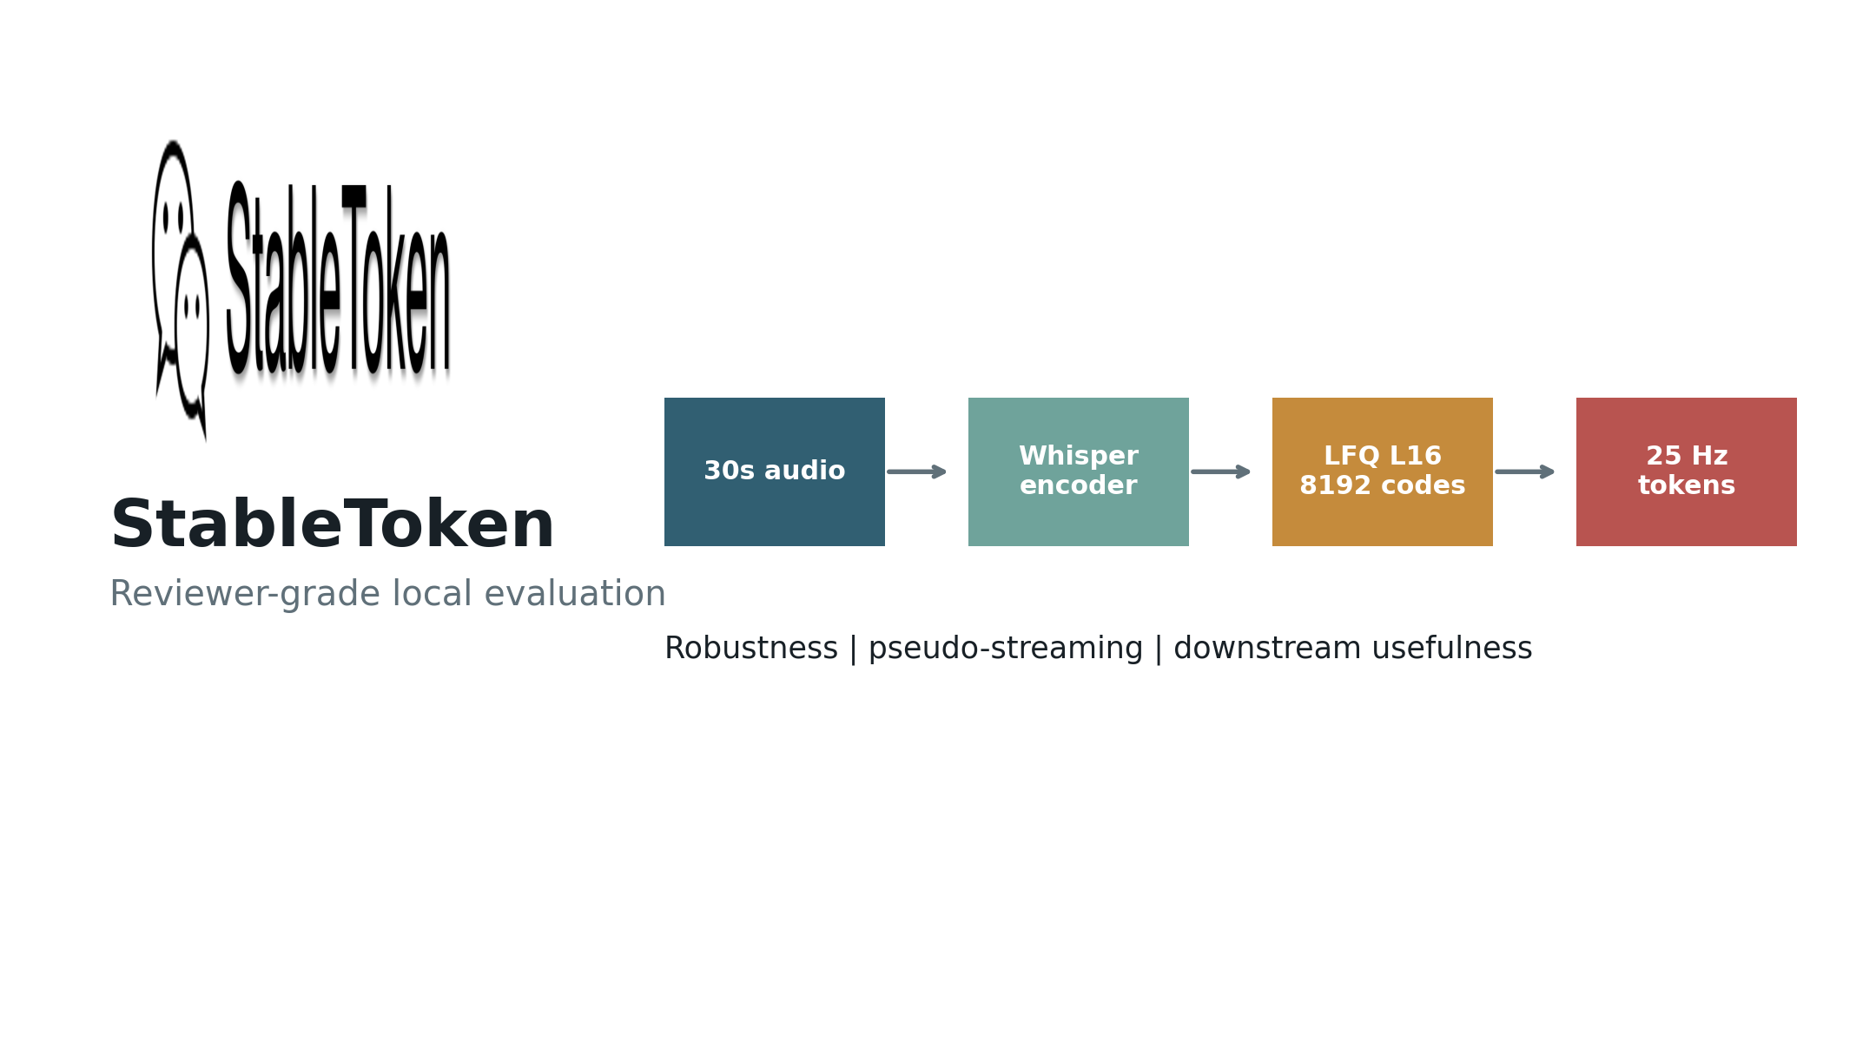
Technical interview deck
StableToken: Robust Speech Token Evaluation
PRESENTER
Changqing Fu
AFFILIATION
IFM MBZUAI Paris
DATE
May 19, 2026
A 30-minute review of reproducibility, robustness, pseudo-streaming, distribution drift, and downstream usefulness.

Slide 2
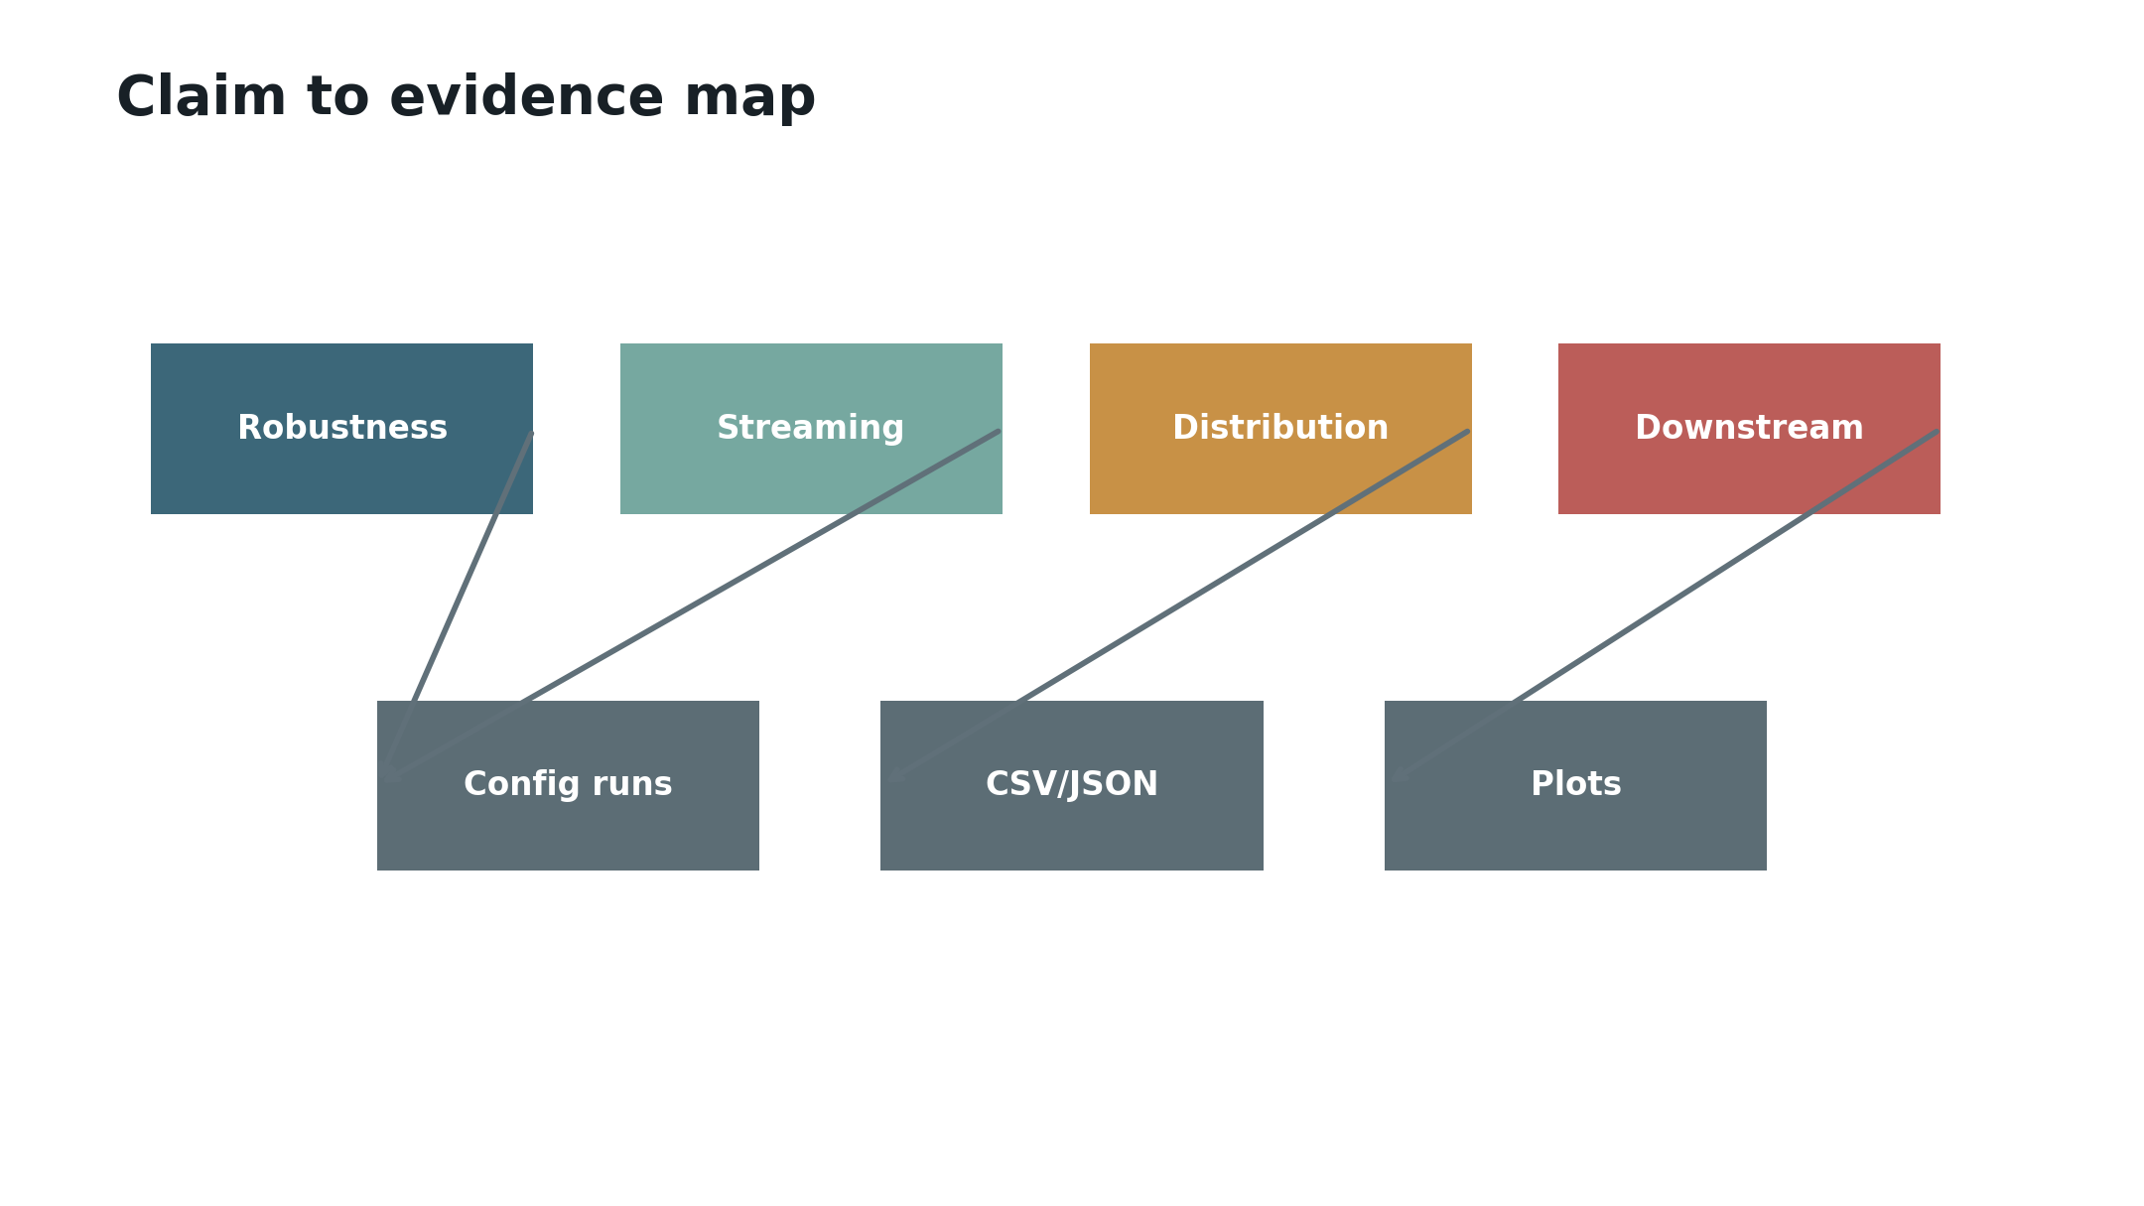
Reviewer concern map
Why This Evaluation
BASELINE
released checkpoint
EVIDENCE
10 experiment families
Robustness, streaming behavior, and downstream usefulness are separate claims that need separate evidence.

Slide 3
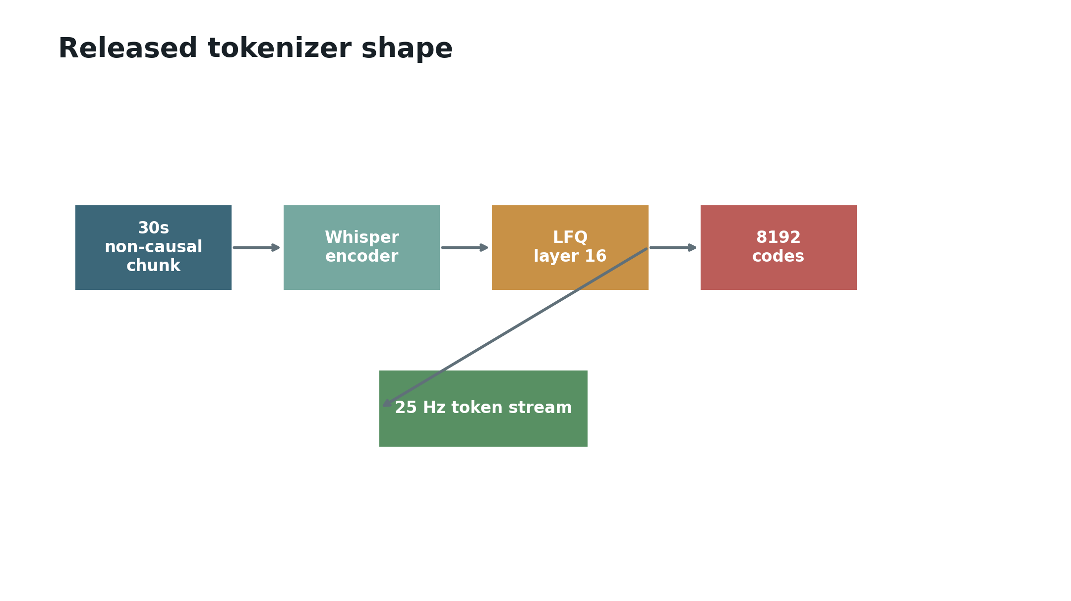
Released tokenizer shape
StableToken At A Glance
CLEAN BASELINE
30s -> 750 tokens
RESULT SHAPE
8192 vocab, 325 bps
The released tokenizer is fast and compact, but it is built around non-causal 30s chunks.

Slide 4
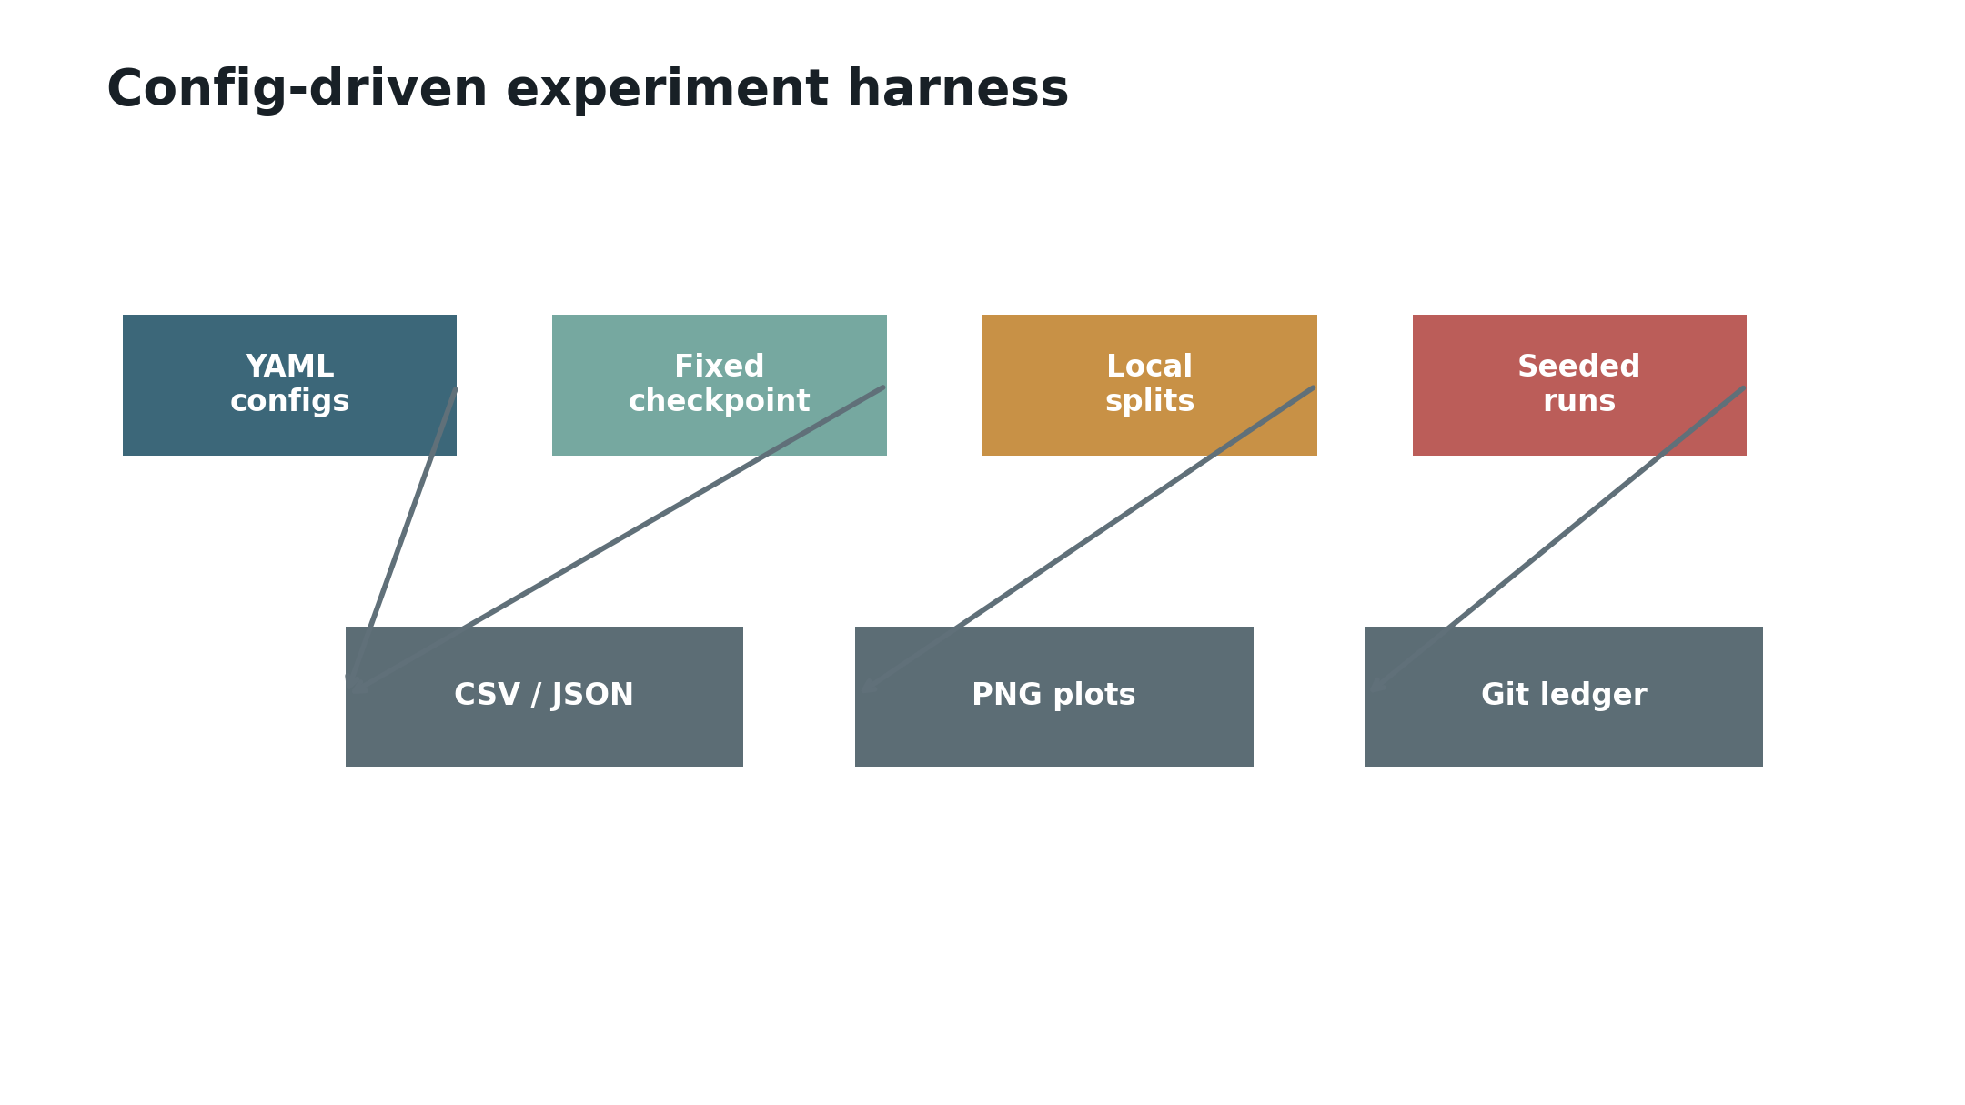
Audit-friendly runs
Experiment Harness
BASELINE
fixed HF SHA
ARTIFACTS
CSV, JSON, PNG
Every result is config-driven and tied to local splits, seeds, commands, and committed artifacts.

Slide 5
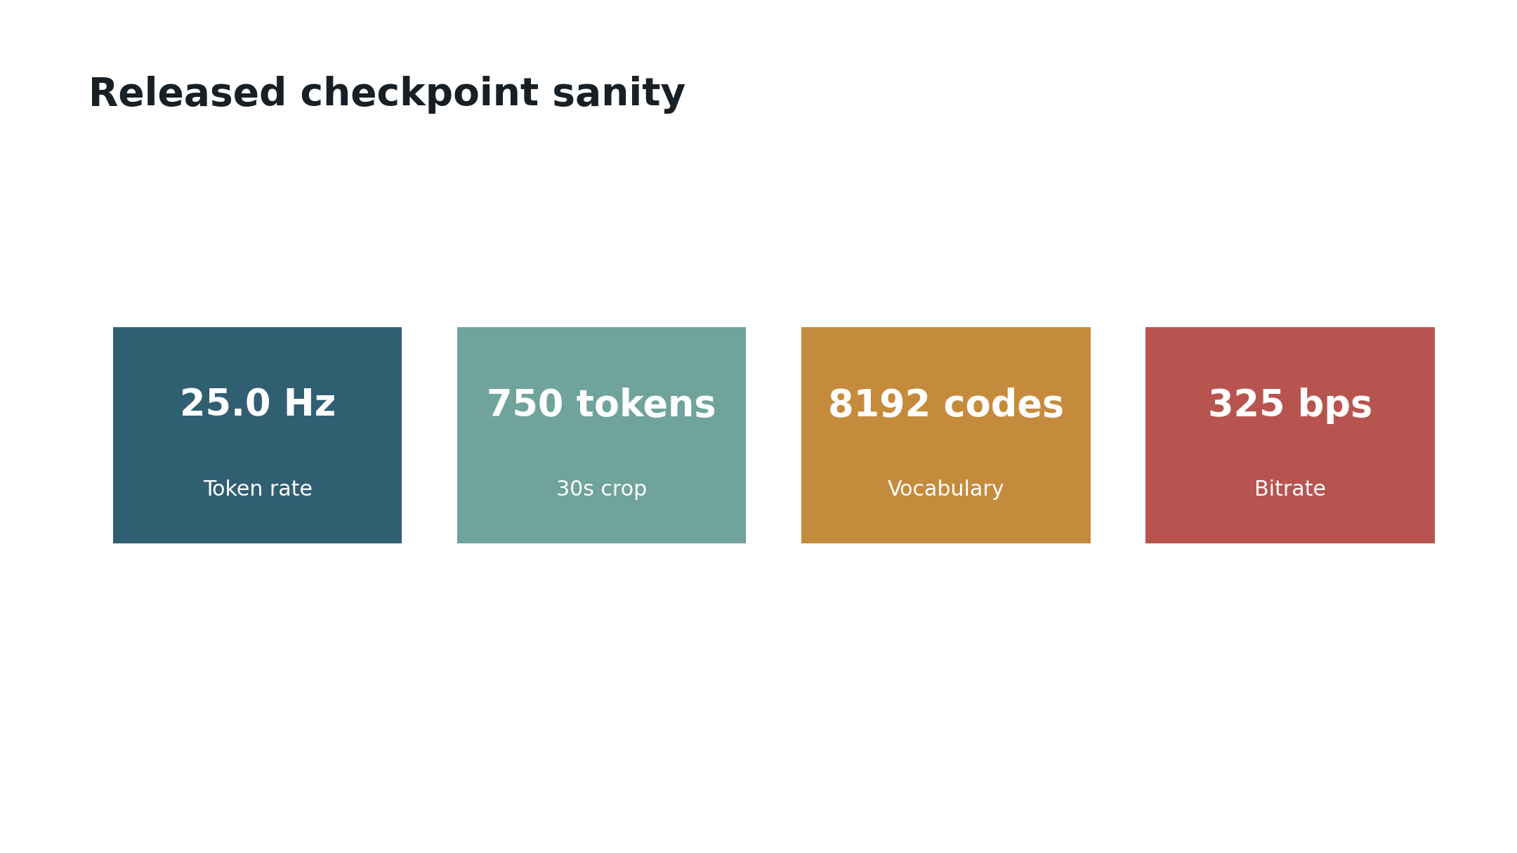
Released checkpoint loads
Reproducibility Sanity
CLEAN BASELINE
25.0 Hz
RESULT
750 tokens per 30s
The released checkpoint matches the expected token rate, vocabulary size, and bitrate.

Slide 6
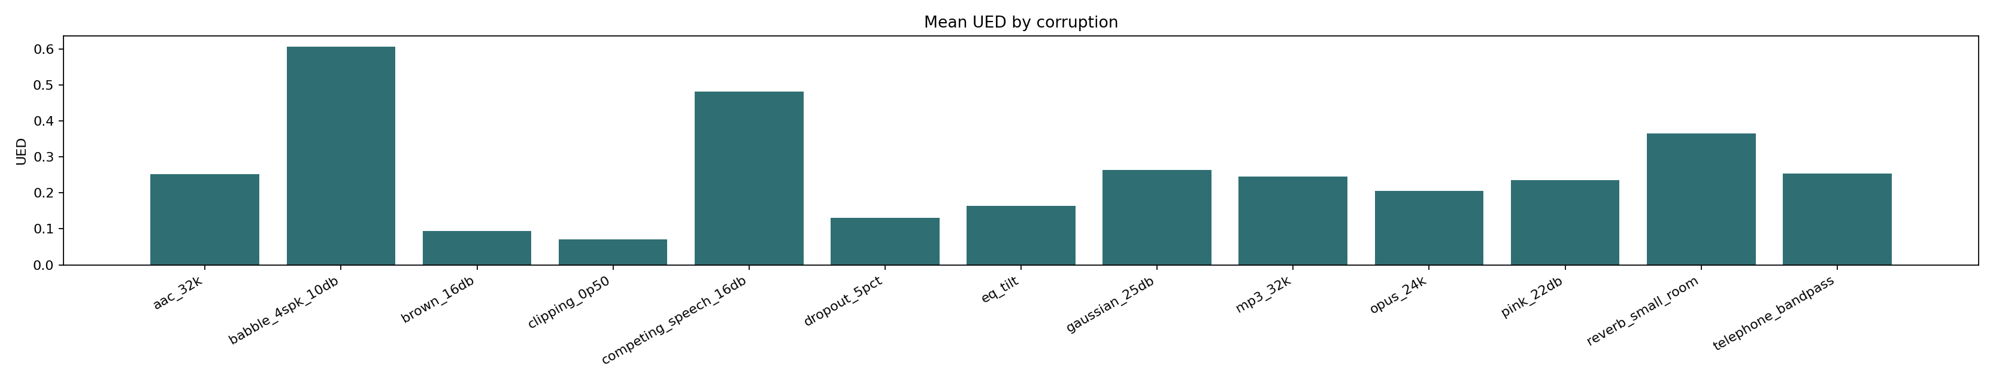
100-clip UED scale-up
Hard Degradations
CLEAN REFERENCE
UED 0
BABBLE UED
FR 0.6071, ZH 0.4170
Speech-like interference is harder than Gaussian noise and should be a headline robustness test.

Slide 7
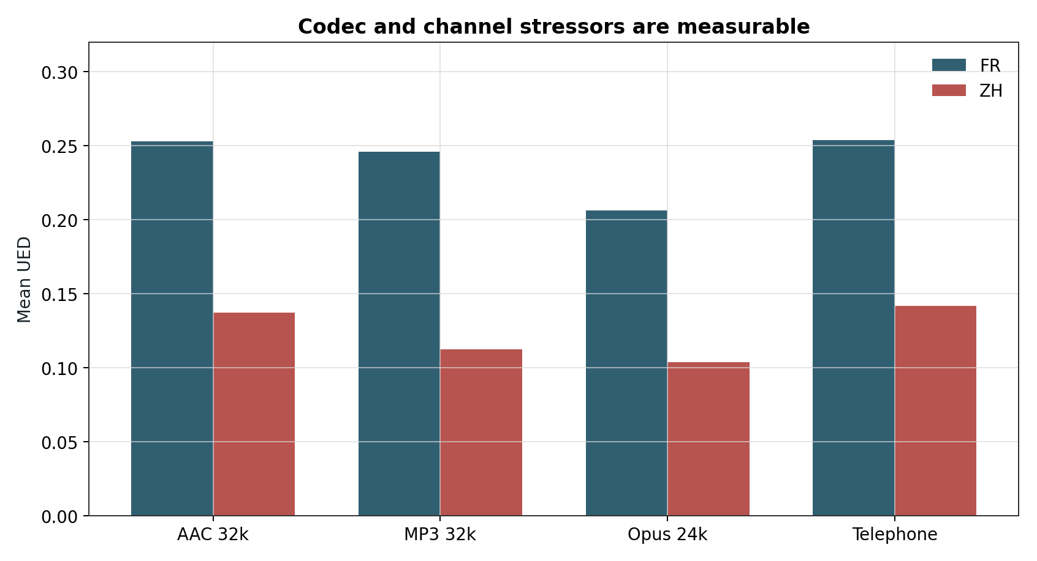
Low-bitrate and telephone stressors
Codec And Channel Effects
AAC UED
FR 0.2530, ZH 0.1371
TELEPHONE UED
FR 0.2538, ZH 0.1418
Codec and channel effects are measurable, but they are not the dominant failure mode in this slice.

Slide 8
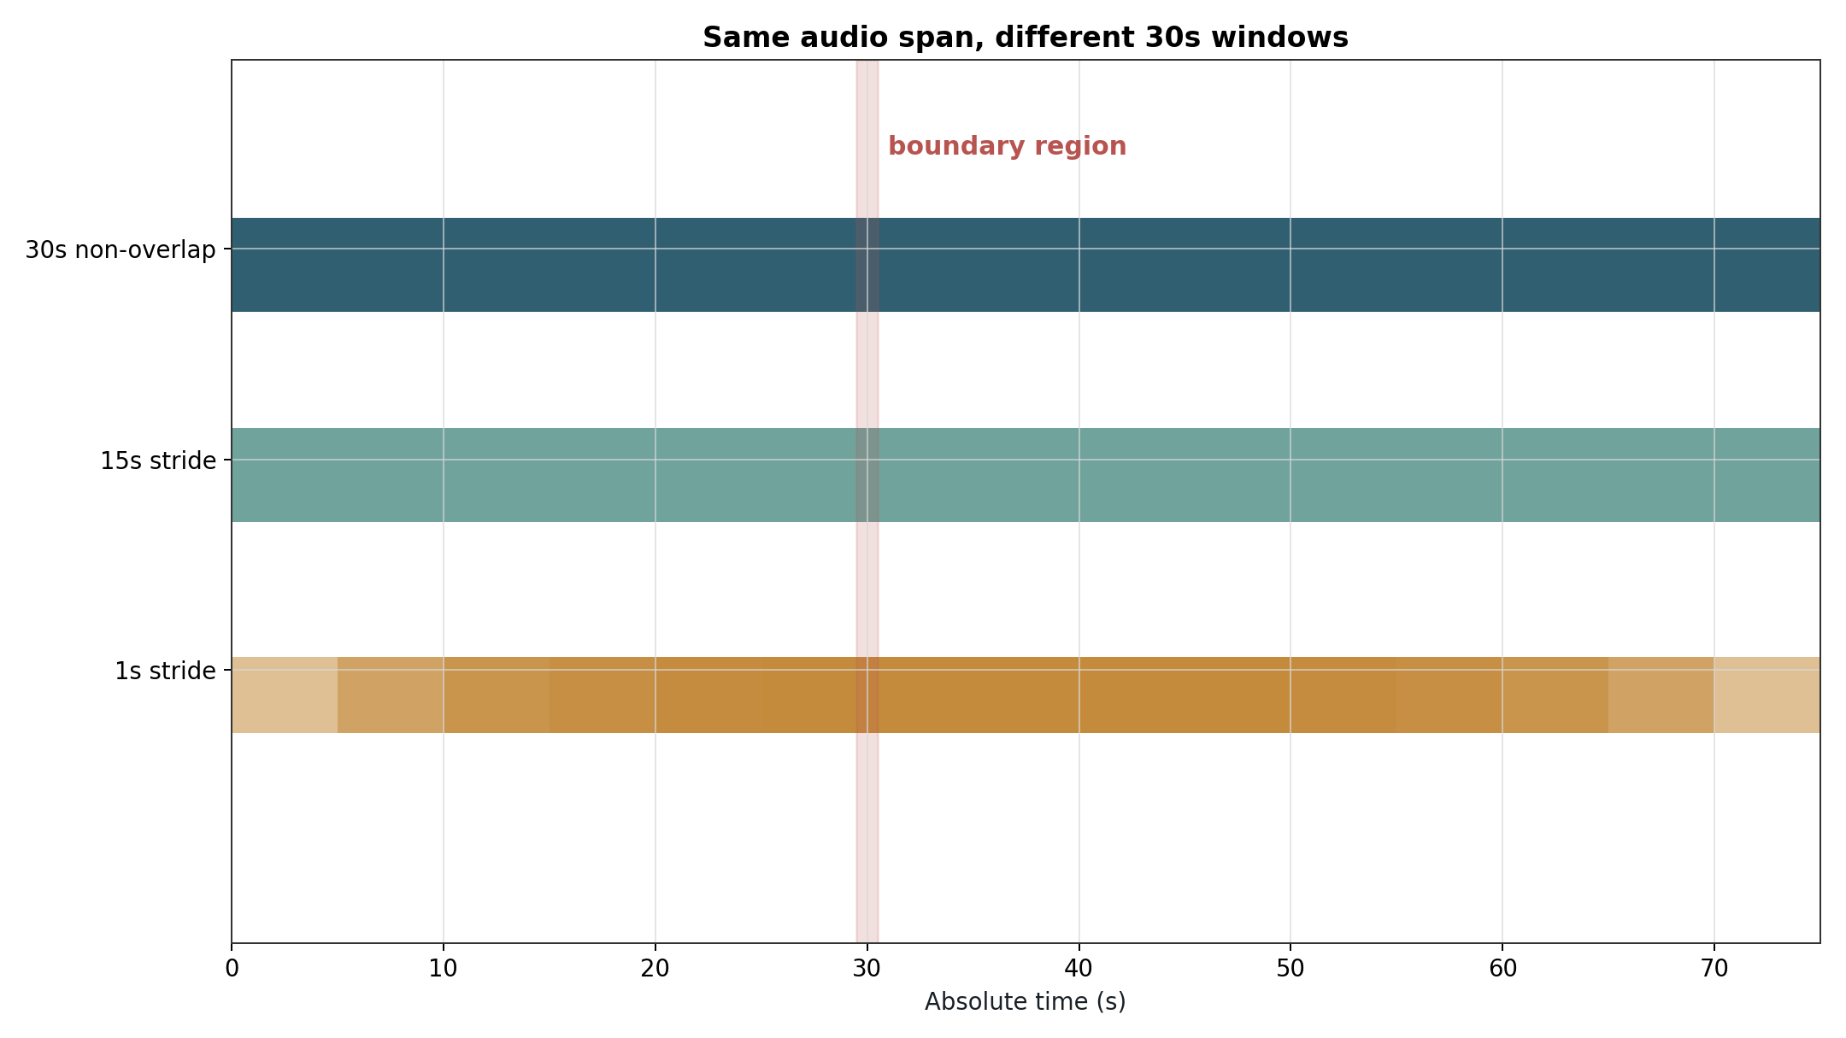
Window placement changes tokens
Pseudo-Streaming Problem
BASELINE
non-overlap = 0 mismatch
BEST OVERLAP
0.3191 mismatch
The same absolute audio can tokenize differently depending on which 30s window contains it.

Slide 9
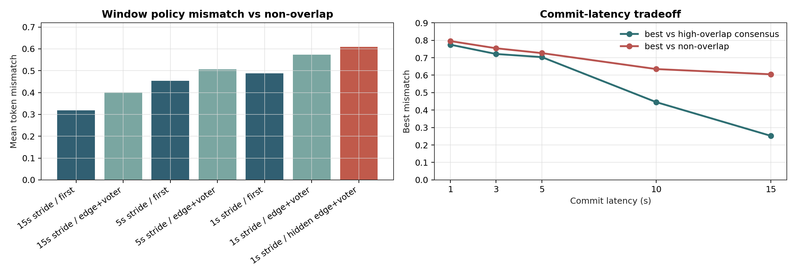
Post-hoc fixes are weak
Aggregation And Commit Latency
1S LATENCY
0.7954 mismatch
15S LATENCY
0.6051 mismatch
Confidence and hidden-state aggregation do not recover the offline non-overlap token stream.

Slide 10
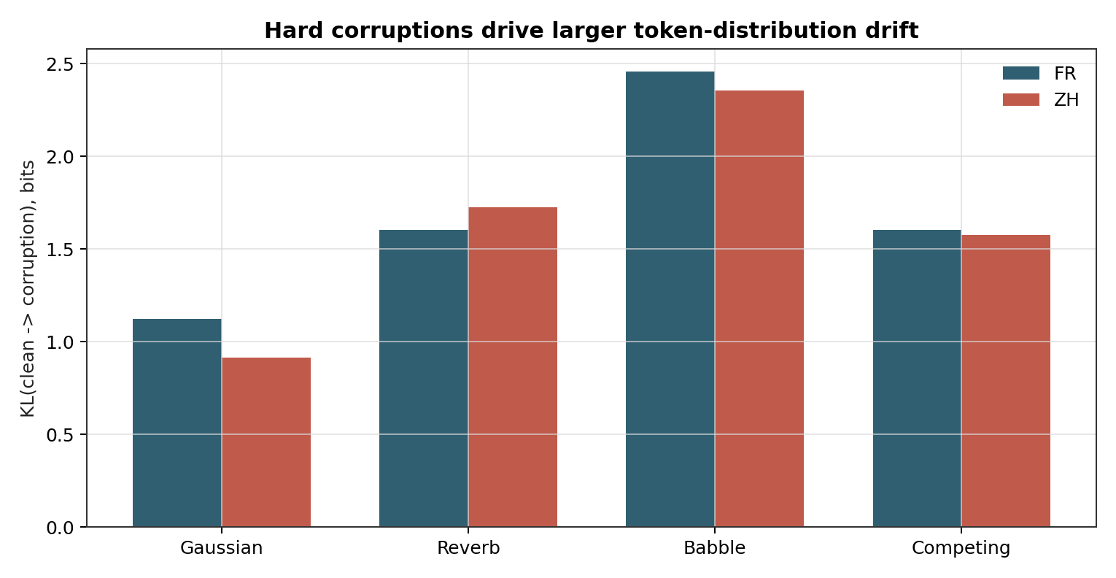
KL clean to corruption
Token Distribution Drift
GAUSSIAN KL
FR 1.124, ZH 0.913
BABBLE KL
FR 2.456, ZH 2.353
Hard corruptions shift token usage more than additive Gaussian noise.

Slide 11
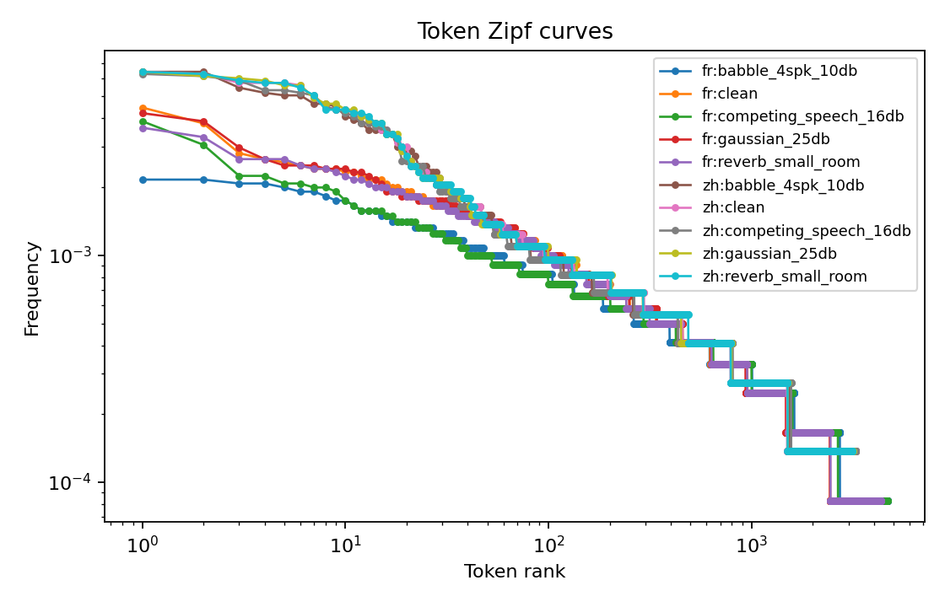
No obvious collapse
Token Usage And Zipf
FR CLEAN UNIQUE
4237 tokens
FR BABBLE UNIQUE
4665 tokens
Code usage is broad, but analyses must be stratified by language and corruption.

Slide 12
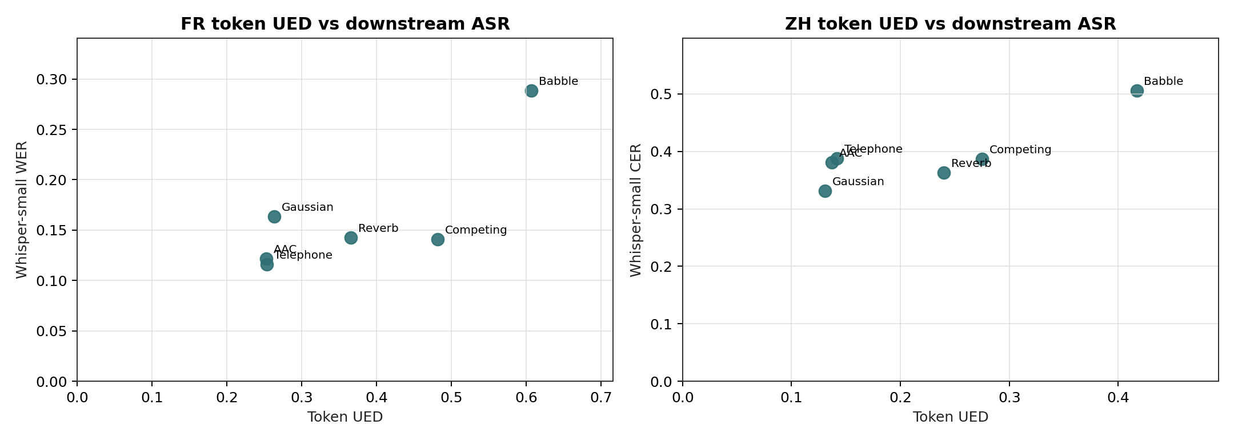
Tokenizer UED is not task WER
Downstream ASR Mismatch
CLEAN FR WER
0.1165
BABBLE FR WER
0.2885
Token robustness and direct Whisper-small ASR degradation are related but not interchangeable.

Slide 13
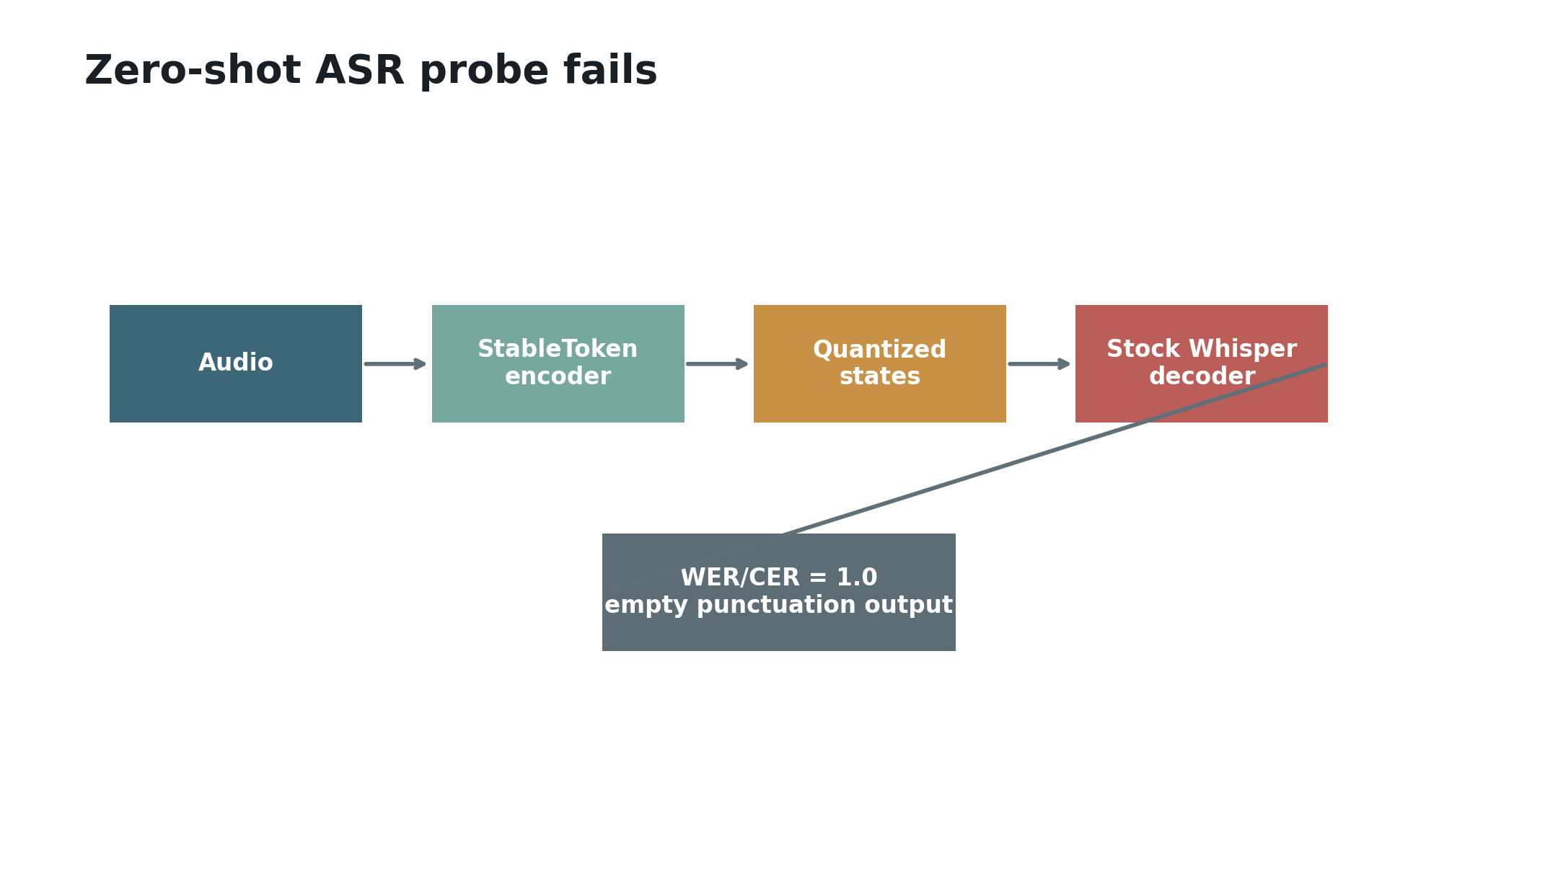
Zero-shot decoder replacement
StableToken-Token ASR Probe
CLEAN WER/CER
1.0
OUTPUT
empty or punctuation
WER through StableToken needs a trained adapter or head, not a stock Whisper decoder.

Slide 14
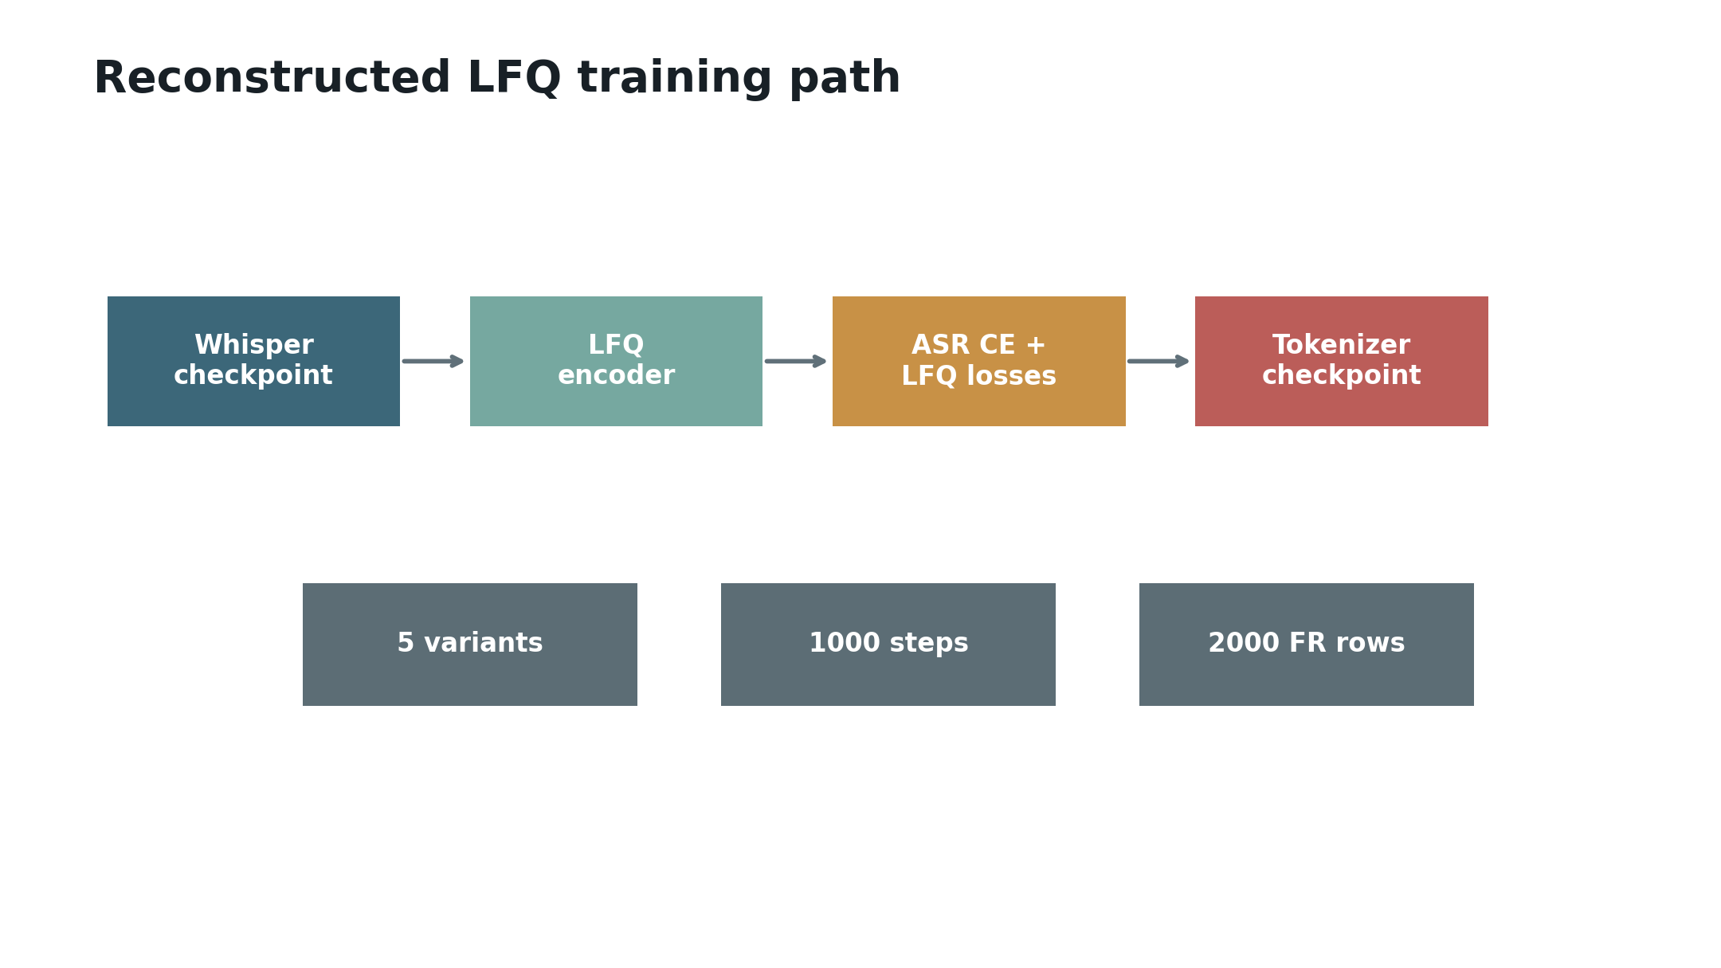
Reconstructed LFQ path
Training Harness
MATRIX
5 matched variants
BUDGET
1000 steps, 2000 FR rows
The training runs are short diagnostics and should not be treated as paper-number reproduction.

Slide 15
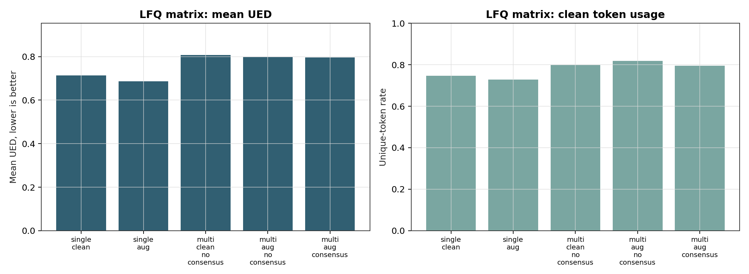
Short matched pilot
LFQ Ablation Matrix
BEST MEAN UED
single_aug 0.6869
VOTING ROW
multi_aug_consensus 0.7970
Augmentation helped modestly, while multi-branch Voting-LFQ hurt UED at this scale.

Slide 16
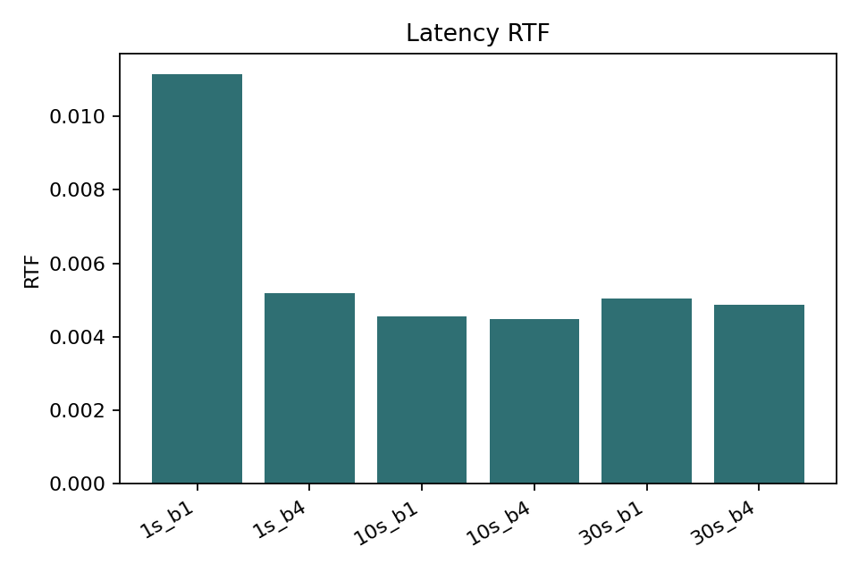
Latency smoke
Efficiency
30S BATCH 1
0.151s
RTF
0.00504
Token extraction is comfortably faster than realtime on the observed L4.

Slide 17
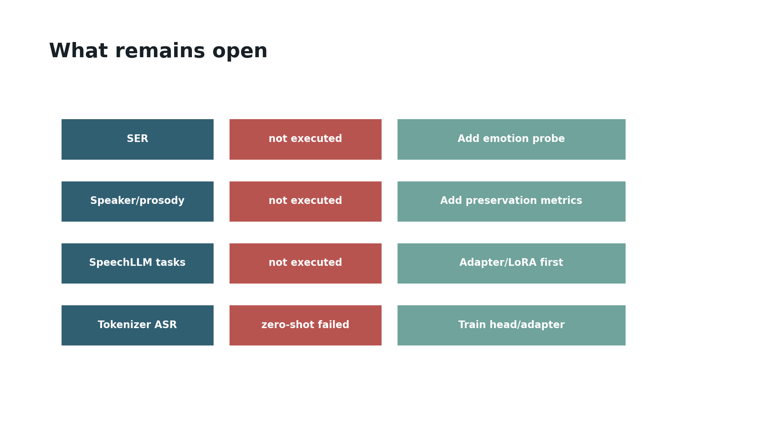
Next evidence gaps
What Failed Or Remains Open
NOT EXECUTED
SER, speaker, prosody
NEXT STEP
trained ASR/SpeechLLM adapter
The strongest next experiment is a tokenizer-through-task adapter evaluated on the fixed corruption suite.

Slide 18
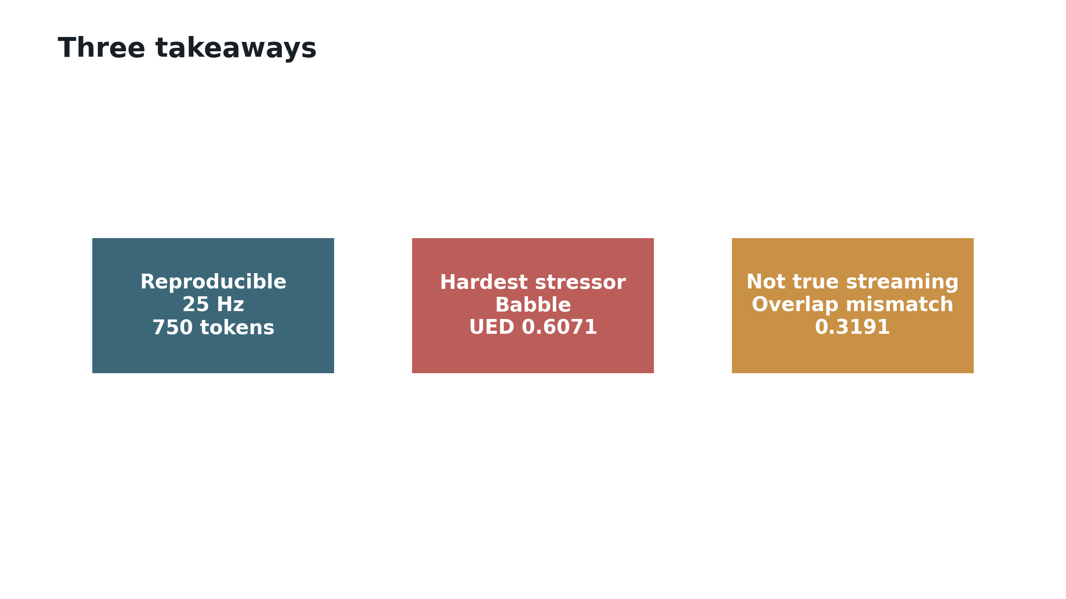
Interview close
Takeaways
REPRODUCIBLE
25 Hz
HARDEST
babble
STREAMING
not true streaming
StableToken is inspectable and efficient, but robustness claims must separate tokenizer stability from downstream task impact.

