Slide 1
CS 5/7330
NoSQL : Document Databases / MongoDB

Slide 2
Motivation: Semi-structured data
Relational model is very rigid in terms of structure
For example, consider this table:
But what if someone have more/less than one phone?
SSN | Name | Phone-#
123456789 | John Doe | 123-4567
234567890 | Mary Doe | 456-8901

Slide 3
Motivation: Semi-structured data
No phone
What can NULL means?
Brad has no phone
Brad has a phone but I don’t know his number
Possible ambiguity
SSN | Name | Phone-#
123456789 | Brad Doe | NULL
234567890 | Mary Doe | 456-8901

Slide 4

Motivation: Semi-structured data
Many phones
Cause duplication
Anomaly and/or inefficiency
SSN | Name | Phone-#
123456789 | Tai-Kwan Doe | 555-5555
123456789 | Tai-Kwan Doe | 689-0777

Slide 5
Motivation: Semi-structured Data
Many problems can be resolved by normalization (breaking into multiple tables)
But queries will require potentially many joins
Can be inefficient
Solution:
Semi-structured data

Slide 6
Semi-structured Data
Some data have a bit of a structure
E.g. item have a set of attributes
However they can still differs
some attributes may be present in some items but not all of them
Some attributes for an item may have multiple values
… or even multiple possible types
So new models are proposed. Examples:
XML
JSON

Slide 7
JSON
JavaScript Object Notation
Originally decided as a way for information interchange
Text-based
Self describing
The “schema” is described within the object
While the schema for an object is flexible, the way of describing the schema is fixed
Thus one can write standard tool(s) to interpret any JSON object, without knowing its schema beforehand

Slide 8
JSON
Each JSON object is represented as a set of name/value pairs
{"name":"John", "age":30, "car":null}
Name is a string in quotes (“name”, “age”, “car”)
Each name has a value associated with it.
Valid value types:
String
Number
Array
Boolean
Null
Another JSON object

Slide 9
JSON (Example of complex case)
https://www.sitepoint.com/twitter-json-example/

Slide 10
General idea of document databases
Database store objects
Objects are known as documents
Name/value pairs are usually termed as key/value pairs
Objects have unique IDs
Typically as Entity in E-R Model
Relations between objects can be enforced by
Nested Objects/Documents (embedding)
Key/value pairs where values are IDs of documents to be related (references)

Slide 11
General idea of document databases
Other properties
Data are often grouped into buckets (like tables)
Provide indexes for document attributes
Provide query language support to retrieve (part of) a document

Slide 12
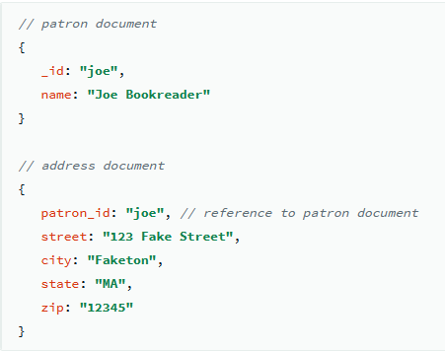
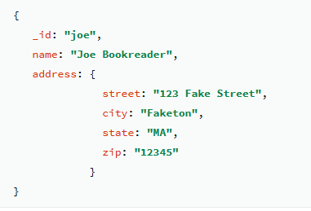
Modeling using Document Databases
One-to-one relationship
Either embedding or relationship will work
Example : (assume patron and address is a 1-1 relationship)

Slide 13
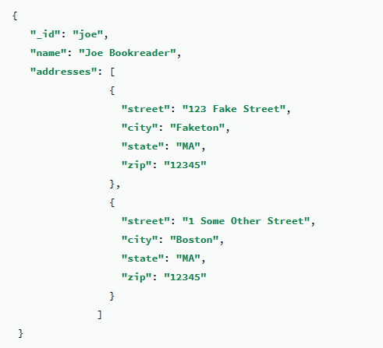
Modeling using Document Databases
One-to-many relationship
Example : (assume patron and address is a 1-m relationship)
Embedding

Slide 14
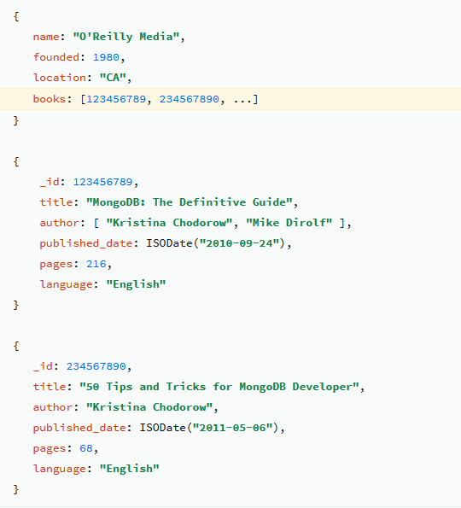
Modeling using Document Databases
One-to-many relationship
Example : (assume publisher and books is a 1-m relationship)
relationship

Slide 15
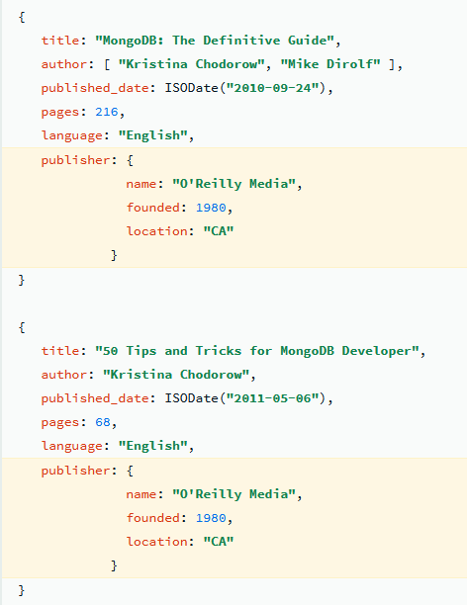
Modeling using Document Databases
What you should AVOID
Duplication of data
Same problem as in relational databases

Slide 16
Modeling using Document Databases
One thing you should never do
Whenever there is a relationship between two objects, using relationship should only be from one object to the other, BUT NOT BOTH WAYS
Why not?
Which way to go is database and application dependent
{ _id = “_1”;
name = “john doe”
address = “_add1”
}
{
_id = “_add1”
address = “SMU Blvd”
patron_id = “1”
}

Slide 17
Modeling using Document Databases
Document models tends to works well with binary relationship.
For relationship with multiple entity (e.g: supplier-restaurant-food), it may need either:
Deep embedding
Creating separate objects to store the relationships (in terms of E-R modelling, treating relationship as entity)

Slide 18
Example: MongoDB
Document-based database system
Basic unique of storage: Document
Very similar to JSON
With some additional data type support (e.g. date, binary data, code)
Each document need to have an “_id” field (can be auto-generated)
Each document have a size limit : 16 MB (in Mongo DB 4.0)
Collections: A group of Documents
No requirement that each document have the same schema
But there are advantages (in terms of implementation, and potential efficiency)
One can name sub-collections of a collection
Database: A group of collections
Typically an application will use one database

Slide 19
MongoDB: insert
Insertions:
db.collection.insertOne({…})
db.collection.insertMany([ {…}, {…}, …, {…})
Notice that the only automatic check is unique _id
NO notion of referential integrity
NO checking of name of keys (since we do not assume any scheme [even within a collection])
It’s the (virtually all) developer’s responsibility to ensure everything works.

Slide 20
MongoDB: Query -- selection
Basic method: find()
db.collection.find( {<selection>}. {<projection>})
Describe the documents to be retrieved
Each of this has the same format as a document (but without the _id).
db.collection.find({})
Return all documents in the collection
db.collection.find( {“name” : “john doe”} )
Return all documents that have key value pair (name : john doe)
db.collection.find( {“name” : “john doe”, “age” : 30} )
Return all documents that have BOTH key value pairs
Logical AND
Note:
Value in the key/value pair in find must be a constant.
Need other constructs to relate different documents from the same/different collections

Slide 21
MongoDB: Query -- projection
db.collection.find( {“name” : “john doe”}, {“name” : 1, “age”: 1} )
Return all documents that have key value pair (name : john doe), and output the name and the age
db.collection.find( {“name” : “john doe”}, {“name” : 0, “age”: 1} )
Return all documents that have key value pair (name : john doe), and output age, but not the name
Note:
_id : is output by default
Can suppress it by including {“_id” : 0} in the projection clause

Slide 22
MongoDB: Query – selection clauses
db.collection.find( {“name” : “john doe”, “age” : {“$gte”: 18}} )
Return all documents that have name john doe, and is at least 18 years old (gte = greater than or equal to)
Clause: a document, the key is a reserved word starting with “$”, to denote special condition or functions,
db.collection.find( {“name” : “john doe”, “age” : {“$gte”: 18, “$lte” : 22 } })
Return all documents that have name john doe, and is between 18 and 22 (lte = less than or equal to)

Slide 23
MongoDB: Query – OR / NOT
db.collection.find( {“dept” : “CS”, {$or, [ {“age” : {“$gte”: 18}}, {“gpa” : 4.0} ] } } )
Return all documents that have dept = “CS” and either age is >= 18, or gpa = 4.0
Notice that the term following or is an list (array) of conditions.
db.collection.find( {“dept” : “CS”, {$not, {“gpa” : 4.0} } } )
Return all documents that have dept = “CS” and either age is >= 18, or gpa ≠ 4.0

Slide 24
MongoDB: Query – NULL values
BE VERY CAREFUL!
Suppose your collection has the following documents:
{ “_id” : “1”, “name” : “john doe”, “phone” : null}
{ “_id” : “2”, “name” : “jack doe”, “age” : 28}
db.collection.find({“phone” : null}) will return BOTH documents
Null matches either “having the value null”, and “no such key exists in the document”
Use the “$exists” clause to compensate

Slide 25
MongoDB: Query – Arrays
{ “_id” : “1”, “name” : “john doe”, “x” : [1, 3, 5, 11]}
The following queries will return this document
db.collection.find( {“x” : 5} )
db.collection.find( {“x” : {“$gte”, 4, “$lte”, 11}} )
db.collection.find( {“x” : {“$gte”, 7, “$lte”, 9}} )
Why? Notice that matching an array means that every clause has to be matched, but each clause can be matched by a different element in the array
Use $elemMatch to overcome this

Slide 26
MongoDB: Query – Embedded documents
{ “_id” : “1”, “name” : “john doe”,
“course” : {“cid” : “CS 5330”, “grade”: “A”} }
db.collection.find({“course” : {“cid” : “CS 5330”, “grade”: “A”} })
will return the document
db.collection.find({“course” : {“cid” : “CS 5330”} })
Will NOT
For embedding documents, require perfect match (“_id” can be left out)
db.collection.find({“course.cid” : “CS 5330”} })
Will return the document again
Use dot notation

Slide 27
MongoDB: Query – More complicated issues
(See MongoDB manual / books for details)
Matching array of embedded documents can be very tricky
No inherit way to “join” multiple collections using the query language
Need to write program and using API
There is an option of a “$WHERE” clause where you can embed code inside a query statement

Slide 28
Mongo DB : Updates and Delete
db.collection.updateOne(), updateAll(), replaceOne(), replaceAll()
Two parameters
First one is the query condition to specify which document(s) in the collection is to be updated.
Second one specify how the document is to be updated / or what to replace the document with
For replacement, the “_id” will not change, but everything else will be replaced.
Also an “upsert” option: try to update, if the document to be updated is not found, then insert a new document.

Slide 29
Other aspects
Indexing – per collection basis, similar to relational database indices
Specific type of indices for specific data types (e.g. text, geospital)
Aggregation – group by, and computation based on groups
Replication – allow for duplication of data

