Slide 1
CS 5/7330
Review / Intro to NoSQL

Slide 2
Database Systems
Why database systems?
Provide means for user to manage data
Allow users to
Specify data to be stored (data modeling)
Specify operation on the data (query language)
Ensure consistency and integrity of data (integrity checking)
Manage how data is being stored (indexing, file organization)
Manage how data is actually retrieved (query processing, optimization)
Manage how data is being shared/not shared (concurrency control)
Recover data after a failure (recovery)
Ensure data are not accessible by people who should not (security)
Access data from a variety of sources/locations (distribution processing)

Slide 3
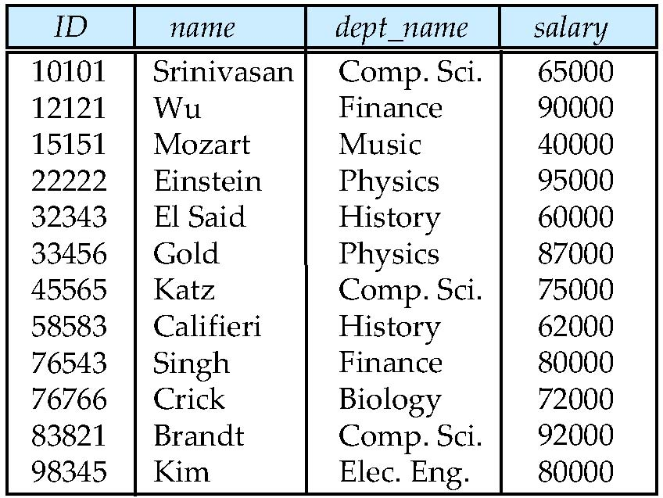
Relational Model
Data are represented as tuples in relations
Represented as tables
Rows (tuples): each unit of data
Columns (attributes) : attributes of each unit
attributes
(or columns)
tuples
(or rows)

Slide 4
Relational Model
Relation can be viewed as SETS of attributes (set in a mathematical sense)
Constraints on the table
First Normal Form
But NULL values allowed
No duplicate tuples
Thus (primary) keys
Domain values
Referential Integrity
Foreign keys

Slide 5
SQL
A typical SQL query has the form: select A₁, A₂, ..., A_{n} from r₁, r₂, ..., r_{m} where P
A_{i} represents an attribute
R_{i} represents a relation
P is a predicate.
The result of an SQL query is a relation.
API available for a variety of programming languages to interact (e.g. ODBC, JDBC)
Also database specific APIs are available

Slide 6
Relational Algebra
An abstract query language on relations
A set of operations on a relations, returning another relation
Basic operations:
Selection:
Pick tuples from the relation based on a condition, keeping all attributes
Projection:
Select all tuples, but only keep attributes on the attribute list
Set operations: ∩,∪, -
There are corresponding SQL commands for these (not often used)
σ_{condition} (R)
∏_{attribute list} (R)

Slide 7
Relational Algebra
Basic operations:
Cartesian Product:
Create a table such that every pair of tuples in r, s is match to a topic
Basis of merging multiple tables
Join: r s
Cartesian Product followed by a selection
The selection usually (not always) match the corresponding attributes (foreign keys) of the two tables.
Most common operation for merging tables.
r x s:

Slide 8
Relational Algebra and SQL
A typical SQL query has the form: select A₁, A₂, ..., A_{n} from r₁, r₂, ..., r_{m} where P
A_{i} represents an attribute
R_{i} represents a relation
P is a predicate.
The result of an SQL query is a relation.
Projection in relational algebra
Cartesian Product in relational algebra
Selection in relational algebra (remember, join = Cartesian product + selection)

Slide 9
Relational Algebra -- Extension
Each query input is a table (or set of tables)
Each query output is a table.
All data in the output table appears in one of the input tables
There are many things that relational algebra (and SQL) cannot do
E.g. things that require recursion
Extension of relational algebra to incorporate SQL statements such as
SUM
AVG
MAX
MIN
GROUP BY…HAVING

Slide 10
Relational algebra – Why?
Very straight forward way of converting SQL statements into a list of operations
Now executing a query becomes executing a program of such operations
Implementing them correctly and efficiently will ensure the database system perform well

Slide 11
Course outline
Outline of the course
NoSQL (from data modelling perspective)
Internals of a DBMS
Query execution and optimization
Concurrency Control
Recovery
Distributed databases / Big Data
NoSQL (from a performance perspective)

Slide 12
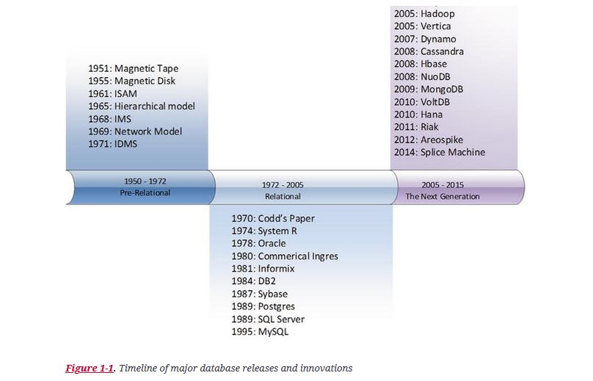
NoSQL databases
A history of database systems
From: Guy Harrison, “Next generation databases : NoSQL and Big Data”, Apress, 2015

Slide 13
First Generation Databases
Network Model/Hierarchical Model
Works on mainframes
Navigation based (i.e. you need to tell the DBMS “where” the data is)
E.g. following pointers and links (parent-child etc.)
Drawbacks
Inflexible schema structure (next to impossible to change mid-stream)
Navigation based means complex query equal to complex program
User have to specify how to get to the data

Slide 14
Second Generation Database
Relational Model
Advantages
Well-defined mathematical background
Normal forms
“all non-key attributes must be dependent on “the key, the whole key, and nothing but the key—So Help Me Codd”
Separation of physical and logical layers
Make things like optimization possible/manageable
Full transaction model (ACID)
For concurrency and recovery
Well suited for client-server systems

Slide 15
Limit of relational models
First normal form
No compound value (set/list/sequence etc.)
To store this require multiple tuples:
Student ID | Course
1 | CS 7330
1 | CS 7445
2 | CS 7330
2 | CS 7555
2 | CS 7688

Slide 16
Limit of relational model
Modeling of (undirected) graph can be very tricky
Edge ID | Node 1 | Node2
1 | 1 | 2
2 | 1 | 4
3 | 3 | 2
4 | 5 | 1
5 | 4 | 6
Do we need to duplicate edge?
Either query will be complicated (e.g. node1 = 3 or node2 = 3)
Or inconsistency may occur (deleted (1, 3) but forget to delete (3,1)

Slide 17
Limitations of relational model
Development of new applications
Large amount of data
Not necessarily structured
Potentially evolving
Required high availability and fault tolerance
ACID may not be the best options for transactions

Slide 18
NoSQL databases
More flexible data models
Semi-structured / Non-structured
Allow for evolving (non-fixed schema)
Weak consistency model
Not requiring ACID properties
Different storage management
E.g. storing via columns
Designed to allow replication
Need to handle consistency (or allow limited level of inconsistency)
Targeted for Big Data / Web applications

Slide 19
NoSQL Data Models
Key-Value stores
Wide Columns stores
Document stores
Graph stores

