Slide 1
CS 5/7330
Query Optimization

Slide 2
Query Optimization
Step of query optimization
Given an SQL query
Convert it to (enhanced) relational algebra
Build multiple parse trees
Note: Multiple ways to decorate a tree
Each decorated tree is also called a plan
Calculate the cost of each plan
Pick the best one

Slide 3
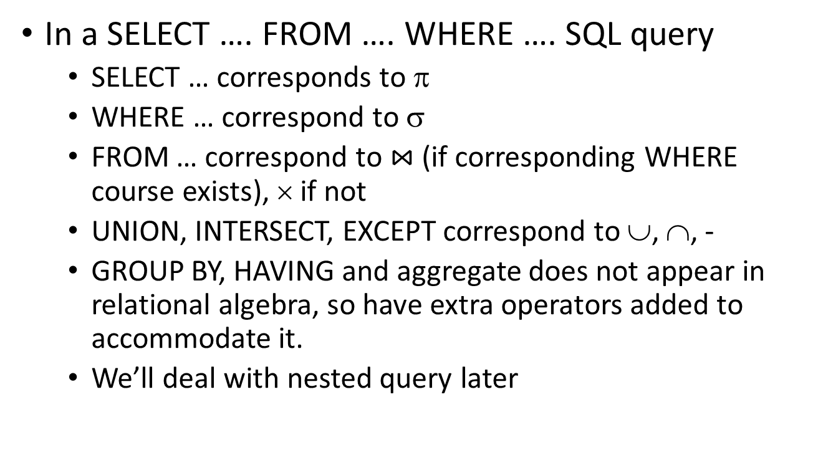
Convert to relational algebra
In a SELECT …. FROM …. WHERE …. SQL query
SELECT … corresponds to π
WHERE … correspond to σ
FROM … correspond to $⋈$ (if corresponding WHERE course exists), × if not
UNION, INTERSECT, EXCEPT correspond to ∪, ∩, -
GROUP BY, HAVING and aggregate does not appear in relational algebra, so have extra operators added to accommodate it.
We’ll deal with nested query later

Slide 4
Convert to relational algebra
From the relational algebra, one can build a parse tree
Parse tree specifies the order of execution of the opeartions
Post-order traversal of the tree
Notice that, for joins, we put the “outer loop” (if we want to do nested loop) on the left

Slide 5

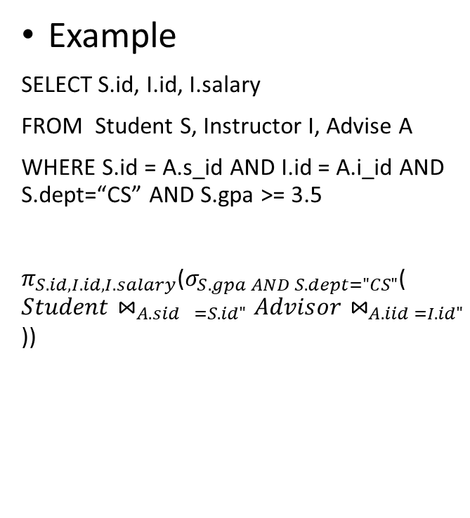



Convert to relational algebra
Example
SELECT S.id, I.id, I.salary
FROM Student S, Instructor I, Advise A
WHERE S.id = A.s_id AND I.id = A.i_id AND S.dept=“CS” AND S.gpa >= 3.5
$π_{S.id, I.id, I.salary}$($σ_{S.gpa AND S.dept="CS"}$(${Student⋈}_{A.{sid}_{}=S.id"}Advisor⋈_{A.iid =I.id"}$))
$$π_{S.id, I.id, I.salary}$$
$$σ_{S.gpa AND S.dept="CS"}$$
$$⋈_{A.{sid}_{}=S.id"}$$
$$⋈_{A.iid =I.id"}$$
Student
Advisor
Instructor

Slide 6
Generate multiple parse trees
However, there are multiple options of parse trees
For relational algebra
Joins are associative
Selection are commutative
Same as projection
Also there are some distributive properties

Slide 7
Transformation of Relational Expressions
Two relational algebra expressions are said to be equivalent if the two expressions generate the same set of tuples on every legal database instance
Note: order of tuples is irrelevant
we don’t care if they generate different results on databases that violate integrity constraints
In SQL, inputs and outputs are multisets of tuples
Two expressions in the multiset version of the relational algebra are said to be equivalent if the two expressions generate the same multiset of tuples on every legal database instance.
An equivalence rule says that expressions of two forms are equivalent
Can replace expression of first form by second, or vice versa

Slide 8
Equivalence Rules
1. Conjunctive selection operations can be deconstructed into a sequence of individual selections. σ_{θ1 ∧ θ2} (E) ≡ σ_{θ1} (σ_{θ2} (E))
2. Selection operations are commutative. σ_{θ1}(σ_{θ2}(E)) ≡ σ_{θ2} (σ_{θ1}(E))
3. Only the last in a sequence of projection operations is needed, the others can be omitted. ∏ _{L1}(∏ _{L2}(…(∏ _{Ln}(E))…)) ≡ ∏ _{L1}(E) where L₁ ⊆ L₂ … ⊆ L_{n}
4. Selections can be combined with Cartesian products and theta joins.
σ_{θ} (E₁ x E₂) ≡ E₁ ⨝ _{θ} E₂
σ _{θ1} (E₁ ⨝_{θ2} E₂) ≡ E₁ ⨝ _{θ1∧θ2} E₂

Slide 9
Equivalence Rules (Cont.)
5. Theta-join operations (and natural joins) are commutative. E₁ ⨝ E₂ ≡ E₂ ⨝ E₁
6. (a) Natural join operations are associative:
(E₁ ⨝ E₂) ⨝ E₃ ≡ E₁ ⨝ (E₂ ⨝ E₃) (b) Theta joins are associative in the following manner: (E₁ ⨝ _{θ1} E₂) ⨝ _{θ2 ∧ θ3} E₃ ≡ E₁ ⨝_{θ1 ∧ θ3} (E₂ ⨝ _{θ2} E₃) where θ₂ involves attributes from only E₂ and E₃.

Slide 10
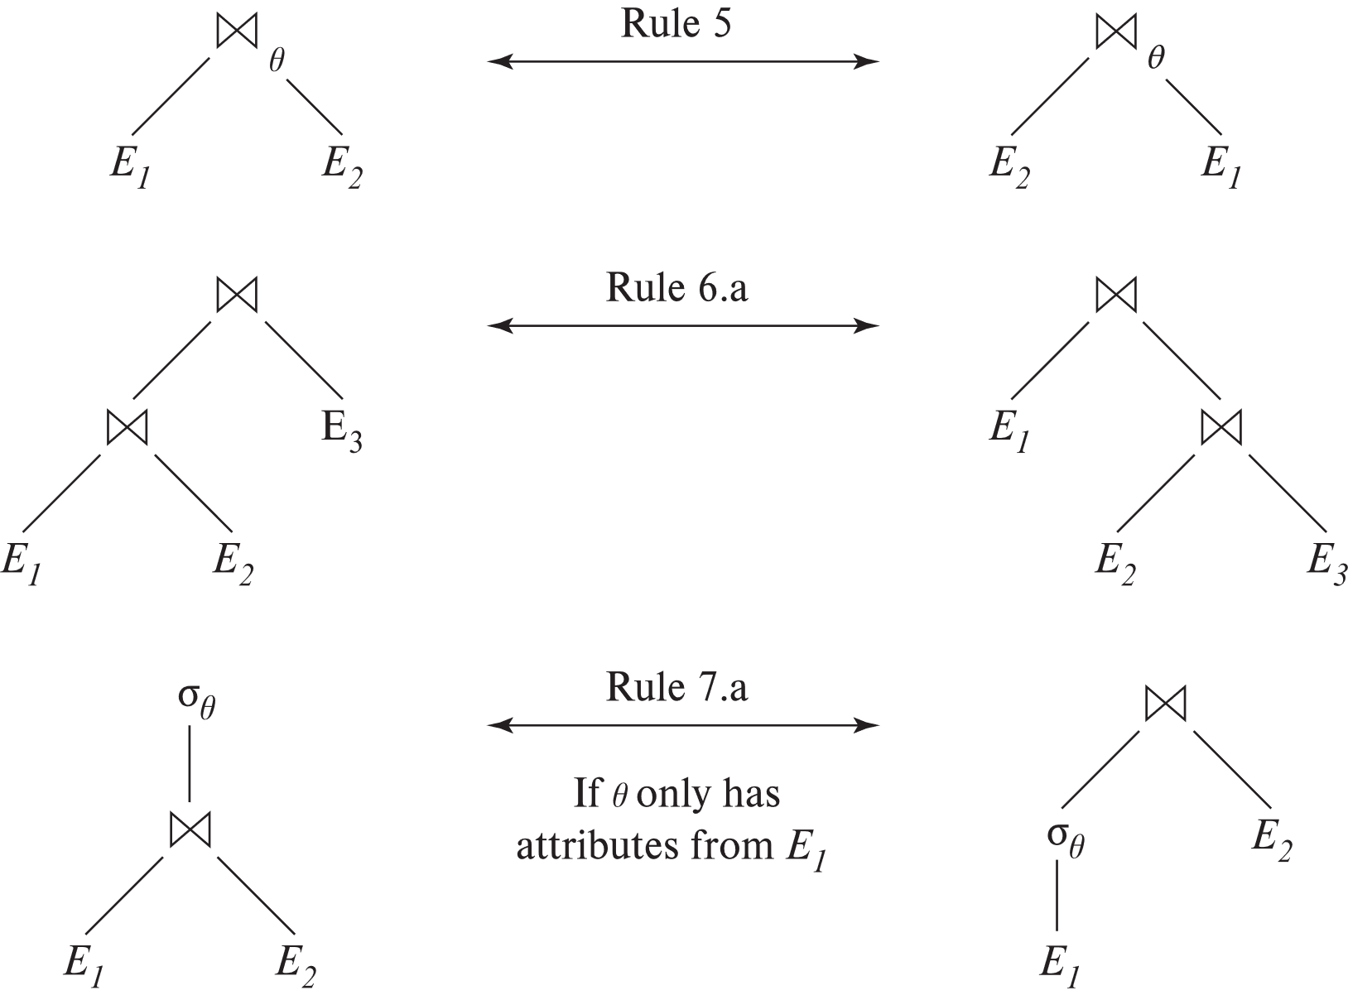
Pictorial Depiction of Equivalence Rules

Slide 11
Equivalence Rules (Cont.)
7. The selection operation distributes over the theta join operation under the following two conditions: (a) When all the attributes in θ₀ involve only the attributes of one of the expressions (E₁) being joined. σ_{θ0} (E₁ ⨝_{θ} E₂) ≡ (σ_{θ0}(E₁)) ⨝_{θ} E₂
(b) When θ₁ involves only the attributes of E₁ and θ₂ involves only the attributes of E₂.
σ_{θ1 ∧ θ2} (E₁ ⨝_{θ} E₂) ≡ (σ_{θ1}(E₁)) ⨝_{θ} (σ_{θ2}(E₂))

Slide 12
Equivalence Rules (Cont.)
8. The projection operation distributes over the theta join operation as follows:
(a) if θ involves only attributes from L₁ ∪ L₂: ∏ _{L1 ∪ L2}(E₁ ⨝_{θ} E₂) ≡ ∏ _{L1}(E₁) ⨝_{θ} ∏ _{L2}(E₂)
(b) In general, consider a join E₁ ⨝_{θ} E₂.
Let L₁ and L₂ be sets of attributes from E₁ and E₂, respectively.
Let L₃ be attributes of E₁ that are involved in join condition θ, but are not in L₁ ∪ L₂, and
let L₄ be attributes of E₂ that are involved in join condition θ, but are not in L₁ ∪ L₂. ∏ _{L1 ∪ L2}(E₁ ⨝_{θ} E₂) ≡ ∏ _{L1 ∪ L2}(∏ _{L1 ∪ L3}(E₁) ⨝_{θ} ∏ _{L2 ∪ L4}(E₂))
Similar equivalences hold for outerjoin operations: ⟕, ⟖, and ⟗

Slide 13
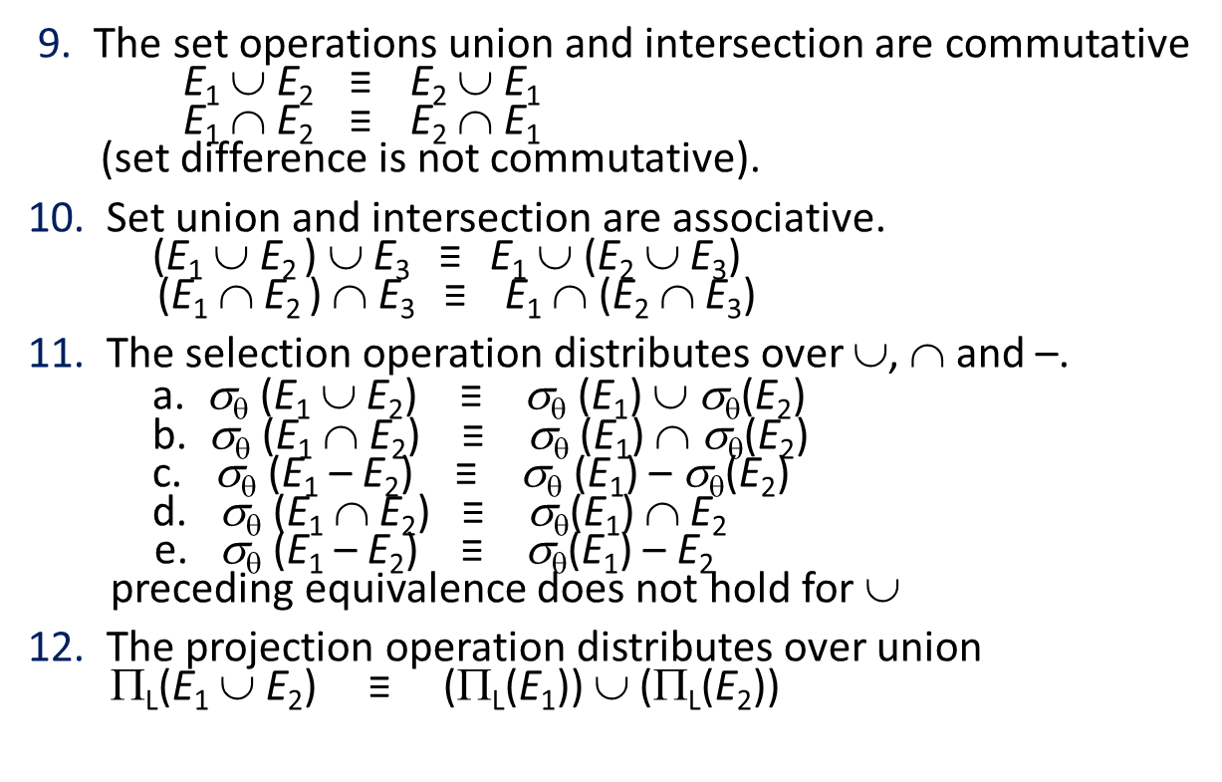
Equivalence Rules (Cont.)
9. The set operations union and intersection are commutative E₁ ∪ E₂ ≡ E₂ ∪ E₁ E₁ ∩ E₂ ≡ E₂ ∩ E₁ (set difference is not commutative).
10. Set union and intersection are associative. (E₁ ∪ E₂ ) ∪ E₃ ≡ E₁ ∪ (E₂ ∪ E₃) (E₁ ∩ E₂ ) ∩ E₃ ≡ E₁ ∩ (E₂ ∩ E₃)
11. The selection operation distributes over ∪, ∩ and –. a. σ_{θ} (E₁ ∪ E₂) ≡ σ_{θ} (E₁) ∪ σ_{θ}(E₂) b. σ_{θ} (E₁ ∩ E₂) ≡ σ_{θ} (E₁) ∩ σ_{θ}(E₂) c. σ_{θ} (E₁ – E₂) ≡ σ_{θ} (E₁) – σ_{θ}(E₂) d. σ_{θ} (E₁ ∩ E₂) ≡ σ_{θ}(E₁) ∩ E₂ e. σ_{θ} (E₁ – E₂) ≡ σ_{θ}(E₁) – E₂ preceding equivalence does not hold for ∪
12. The projection operation distributes over union Π_{L}(E₁ ∪ E₂) ≡ (Π_{L}(E₁)) ∪ (Π_{L}(E₂))

Slide 14
Equivalence Rules (Cont.)
13. Selection distributes over aggregation as below σ_{θ}(_{G}𝛾_{A}(E)) ≡ _{G}𝛾_{A}(σ_{θ}(E)) provided θ only involves attributes in G
14. a. Full outerjoin is commutative: E₁ ⟗ E₂ ≡ E₂ ⟗ E₁ b. Left and right outerjoin are not commutative, but: E₁ ⟕ E₂ ≡ E₂ ⟖ E₁
15. Selection distributes over left and right outerjoins as below, provided θ₁
only involves attributes of E₁ a. σ_{θ1} (E₁ ⟕_{θ} E₂) ≡ (σ_{θ1} (E₁)) ⟕_{θ} E₂ b. σ_{θ1} (E₁ ⟖_{θ} E₂) ≡ E₂ ⟕_{θ} (σ_{θ1} (E₁))
16. Outerjoins can be replaced by inner joins under some conditions
a. σ_{θ1} (E₁ ⟕_{θ} E₂) ≡ σ_{θ1} (E₁ ⨝_{θ} E₂) b. σ_{θ1} (E₁ ⟖_{θ} E₁) ≡ σ_{θ1} (E₁ ⨝_{θ} E₂) provided θ₁ is null rejecting on E₂

Slide 15
Equivalence Rules (Cont.)
Note that several equivalences that hold for joins do not hold for outerjoins
σ_{year=2017}(instructor ⟕ teaches) ≢ σ_{year=2017}(instructor ⨝ teaches)
Outerjoins are not associative (r ⟕ s) ⟕ t ≢ r ⟕ (s ⟕ t)
e.g. with r(A,B) = {(1,1), s(B,C) = { (1,1)}, t(A,C) = { }
Notes:
How about (r ⟕ s) ⟕ t vs (r ⟕ t) ⟕ s assuming r has common attributes with s and t? Hint: consider 2 cases where s and t have common attributes and those where they have no common attribute

Slide 16
Example with Multiple Transformations
Query: Find the names of all instructors in the Music department who have taught a course in 2017, along with the titles of the courses that they taught
Π_{name, title}(σ_{dept_name= "Music”∧year = 2017} (instructor ⨝ (teaches ⨝ Π_{course_id, title} (course))))
Transformation using join associatively (Rule 6a):
Π_{name, title}(σ_{dept_name= “Music”∧year = 2017} ((instructor ⨝ teaches) ⨝ Π_{course_id, title} (course)))
Second form provides an opportunity to apply the “perform selections early” rule, resulting in the subexpression
σ_{dept_name = “Music”} (instructor) ⨝ σ _{year = 2017} (teaches)

Slide 17
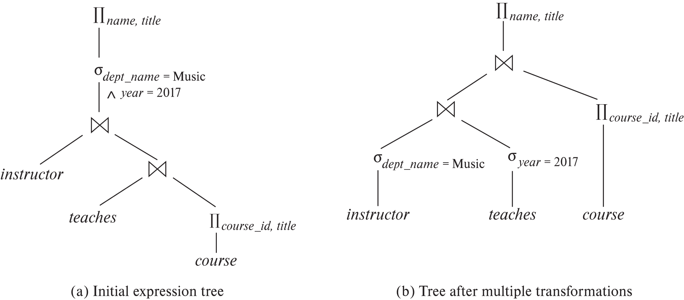
Multiple Transformations (Cont.)

Slide 18
Transformation Example: Pushing Projections
Consider: Π_{name, title}(σ_{dept_name= “Music”} (instructor) ⨝ teaches) ⨝ Π_{course_id, title} (course))))
When we compute
(σ_{dept_name = “Music”} (instructor ⨝ teaches)
we obtain a relation whose schema is: (ID, name, dept_name, salary, course_id, sec_id, semester, year)
Push projections using equivalence rules 8a and 8b; eliminate unneeded attributes from intermediate results to get: Π_{name, title}(Π_{name, course_id} ( σ_{dept_name= “Music”} (instructor) ⨝ teaches)) ⨝ Π_{course_id, title} (course))))
Performing the projection as early as possible reduces the size of the relation to be joined.

Slide 19
Join Ordering Example
For all relations r_{1,} r_{2,} and r₃,
(r₁ ⨝ r₂) ⨝ r₃ = r₁ ⨝ (r₂ ⨝ r₃ )
(Join Associativity) ⨝
If r₂ ⨝ r₃ is quite large and r₁ ⨝ r₂ is small, we choose
(r₁ ⨝ r₂) ⨝ r₃
so that we compute and store a smaller temporary relation.

Slide 20
Join Ordering Example (Cont.)
Consider the expression
Π_{name, title}(σ_{dept_name= “Music”} (instructor) ⨝ teaches) ⨝ Π_{course_id, title} (course))))
Could compute teaches ⨝ Π_{course_id, title} (course) first, and join result with σ_{dept_name= “Music”} (instructor) but the result of the first join is likely to be a large relation.
Only a small fraction of the university’s instructors are likely to be from the Music department
it is better to compute
σ_{dept_name= “Music”} (instructor) ⨝ teaches
first.

Slide 21
Enumeration of Equivalent Expressions
Query optimizers use equivalence rules to systematically generate expressions equivalent to the given expression
Can generate all equivalent expressions as follows:
Repeat
apply all applicable equivalence rules on every subexpression of every equivalent expression found so far
add newly generated expressions to the set of equivalent expressions
Until no new equivalent expressions are generated above
The above approach is very expensive in space and time
Two approaches
Optimized plan generation based on transformation rules
Special case approach for queries with only selections, projections and joins

Slide 22
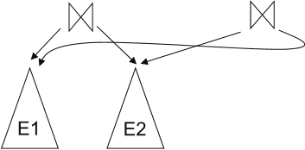
Implementing Transformation Based Optimization
Space requirements reduced by sharing common sub-expressions:
when E1 is generated from E2 by an equivalence rule, usually only the top level of the two are different, subtrees below are the same and can be shared using pointers
E.g., when applying join commutativity
Same sub-expression may get generated multiple times
Detect duplicate sub-expressions and share one copy
Time requirements are reduced by not generating all expressions
Dynamic programming is an option

Slide 23
Decorating parse trees
Once the parse trees are build, need to decorate them with algorithm for each step
Start with looking at the possible algorithms for each operators
Other consideration
Materialization vs. Pipelining
Combining operators

Slide 24
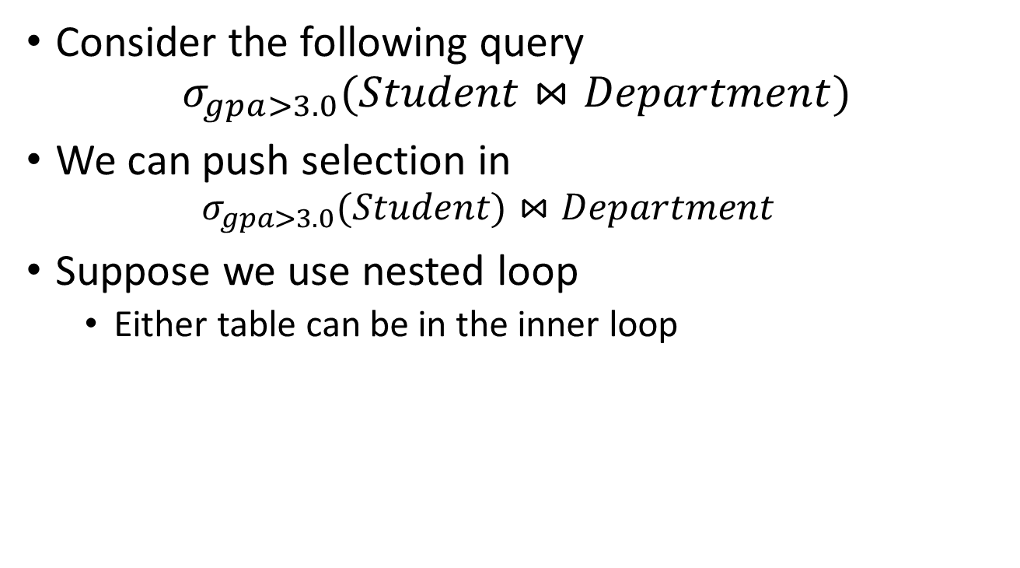
Materialization vs. Pipelining
Consider the following query
$$σ_{gpa>3.0}(Student⋈Department)$$
We can push selection in
$$σ_{gpa>3.0}(Student)⋈Department$$
Suppose we use nested loop
Either table can be in the inner loop

Slide 25
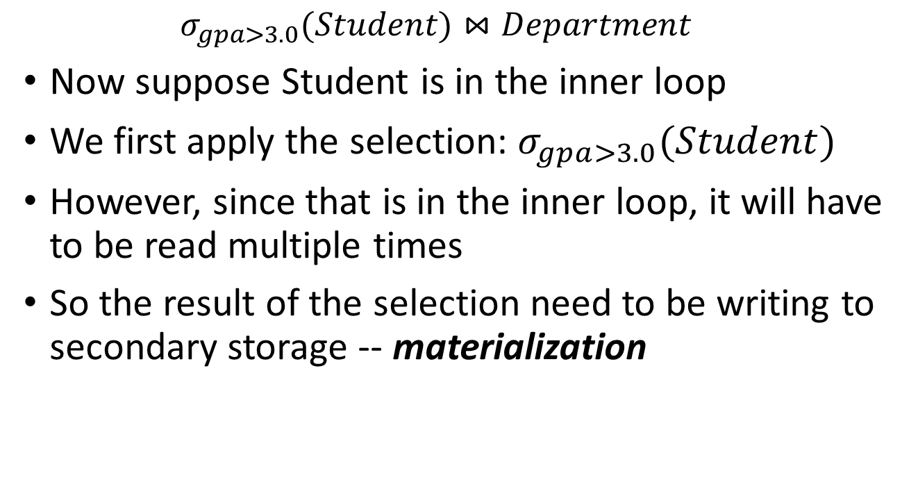
Materialization vs. Pipelining
$$σ_{gpa>3.0}(Student)⋈Department$$
Now suppose Student is in the inner loop
We first apply the selection: $σ_{gpa>3.0}(Student)$
However, since that is in the inner loop, it will have to be read multiple times
So the result of the selection need to be writing to secondary storage -- materialization

Slide 26
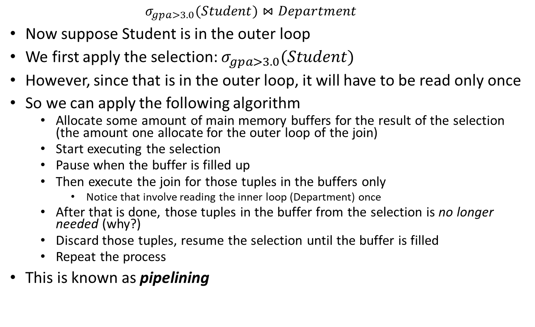
Materialization vs. Pipelining
$$σ_{gpa>3.0}(Student)⋈Department$$
Now suppose Student is in the outer loop
We first apply the selection: $σ_{gpa>3.0}(Student)$
However, since that is in the outer loop, it will have to be read only once
So we can apply the following algorithm
Allocate some amount of main memory buffers for the result of the selection (the amount one allocate for the outer loop of the join)
Start executing the selection
Pause when the buffer is filled up
Then execute the join for those tuples in the buffers only
Notice that involve reading the inner loop (Department) once
After that is done, those tuples in the buffer from the selection is no longer needed (why?)
Discard those tuples, resume the selection until the buffer is filled
Repeat the process
This is known as pipelining

Slide 27
Materialization (Cont.)
Materialized evaluation is always applicable
Cost of writing results to disk and reading them back can be quite high
Our cost formulas for operations ignore cost of writing results to disk, so
Overall cost = Sum of costs of individual operations + cost of writing intermediate results to disk
Double buffering: use two output buffers for each operation, when one is full write it to disk while the other is getting filled
Allows overlap of disk writes with computation and reduces execution time

Slide 28
Pipelining
Pipelined evaluation: evaluate several operations simultaneously, passing the results of one operation on to the next.
E.g., in previous expression tree, don’t store result of
instead, pass tuples directly to the join.. Similarly, don’t store result of join, pass tuples directly to projection.
Much cheaper than materialization: no need to store a temporary relation to disk.
Pipelining may not always be possible – e.g., sort, hash-join.
Key observation: pipelining is possible if and only if the data that is pipelined into the next operations is read only once for that operation
For pipelining to be effective, use evaluation algorithms that generate output tuples even as tuples are received for inputs to the operation.
Pipelines can be executed in two ways: demand driven and producer driven

Slide 29
Pipelining (Cont.)
In demand driven or lazy evaluation
system repeatedly requests next tuple from top level operation
Each operation requests next tuple from children operations as required, in order to output its next tuple
In between calls, operation has to maintain “state” so it knows what to return next
In producer-driven or eager pipelining
Operators produce tuples eagerly and pass them up to their parents
Buffer maintained between operators, child puts tuples in buffer, parent removes tuples from buffer
if buffer is full, child waits till there is space in the buffer, and then generates more tuples
System schedules operations that have space in output buffer and can process more input tuples
Alternative name: pull and push models of pipelining

Slide 30
Pipelining (Cont.)
Implementation of demand-driven pipelining
Each operation is implemented as an iterator implementing the following operations
open()
E.g., file scan: initialize file scan
state: pointer to beginning of file
E.g., merge join: sort relations;
state: pointers to beginning of sorted relations
next()
E.g., for file scan: Output next tuple, and advance and store file pointer
E.g., for merge join: continue with merge from earlier state till next output tuple is found. Save pointers as iterator state.
close()

Slide 31
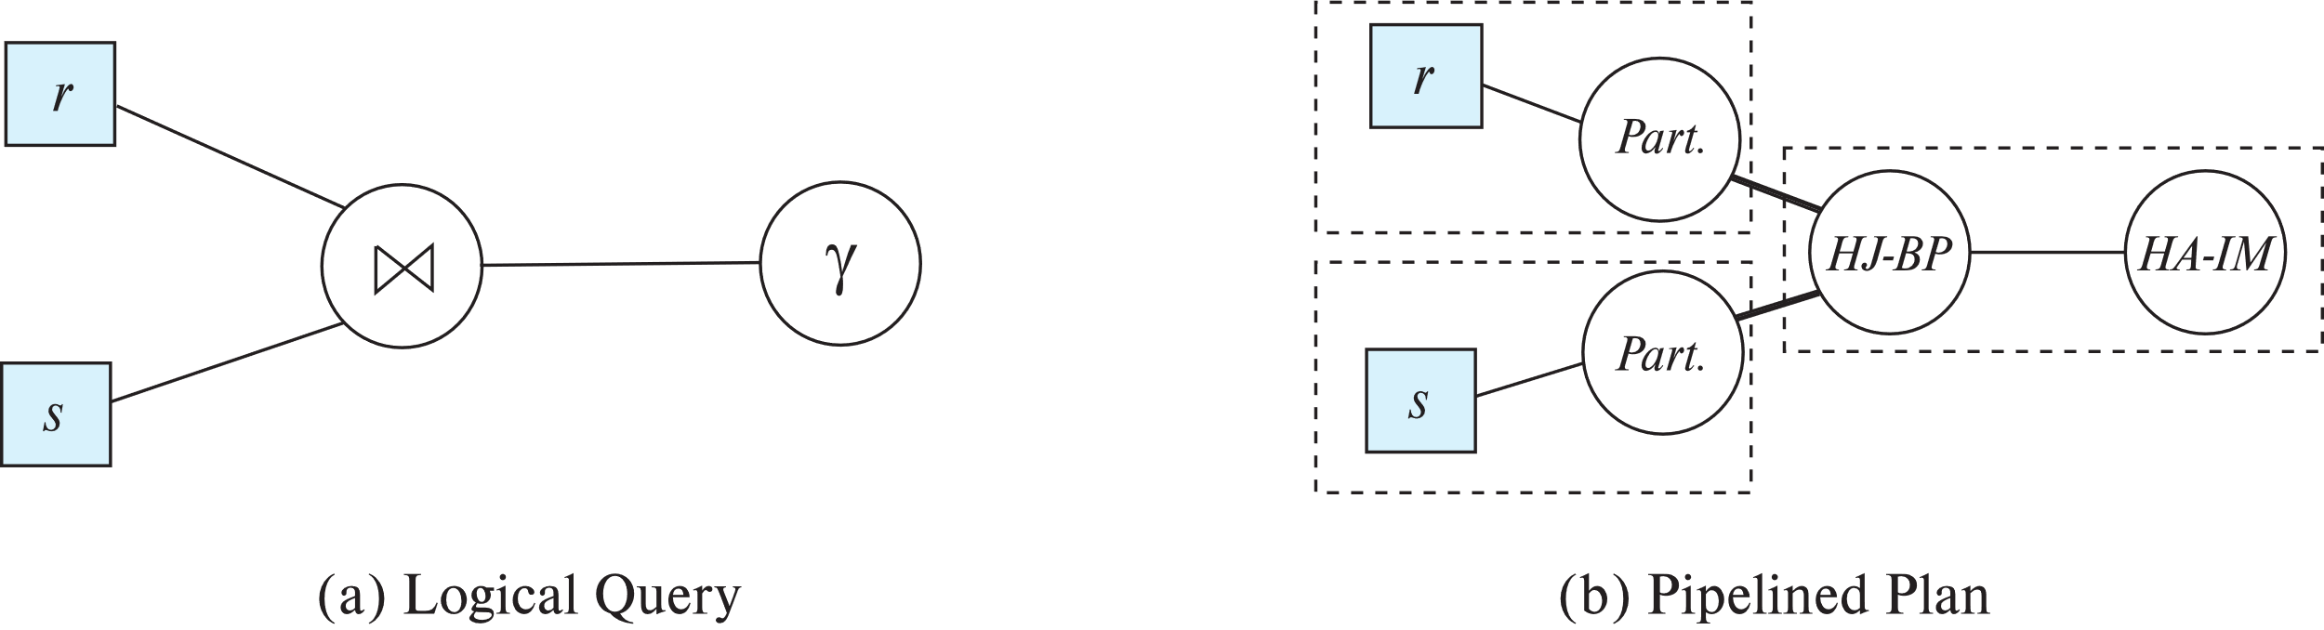
Blocking Operations
Blocking operations: cannot generate any output until all input is consumed
E.g., sorting, aggregation, …
But can often consume inputs from a pipeline, or produce outputs to a pipeline
Key idea: blocking operations often have two suboperations
E.g., for sort: run generation (during sort) and merge
For hash join: partitioning and build-probe (during the final nested loop)
Treat them as separate operations

Slide 32
Pipeline Stages
Pipeline stages:
All operations in a stage run concurrently
A stage can start only after preceding stages have completed execution

Slide 33
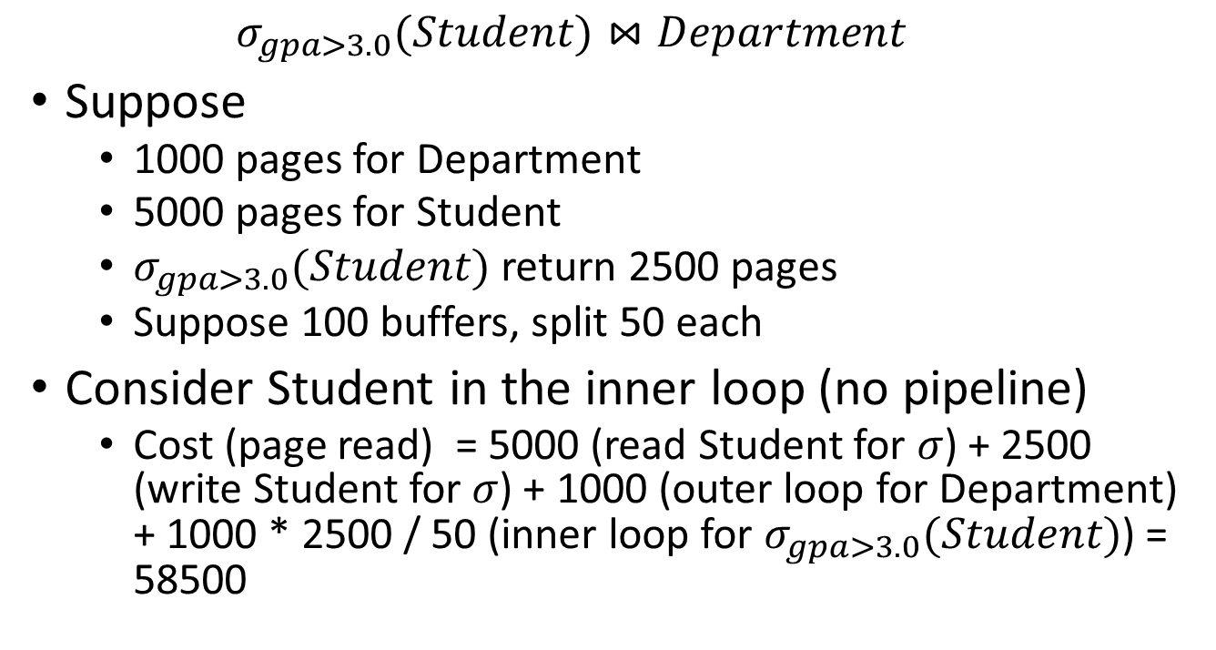
Materialization vs. Pipelining: Cost estimation
$$σ_{gpa>3.0}(Student)⋈Department$$
Suppose
1000 pages for Department
5000 pages for Student
$σ_{gpa>3.0}(Student)$ return 2500 pages
Suppose 100 buffers, split 50 each
Consider Student in the inner loop (no pipeline)
Cost (page read) = 5000 (read Student for $σ$) + 2500 (write Student for $σ$) + 1000 (outer loop for Department) + 1000 * 2500 / 50 (inner loop for $σ_{gpa>3.0}(Student)$) = 58500

Slide 34
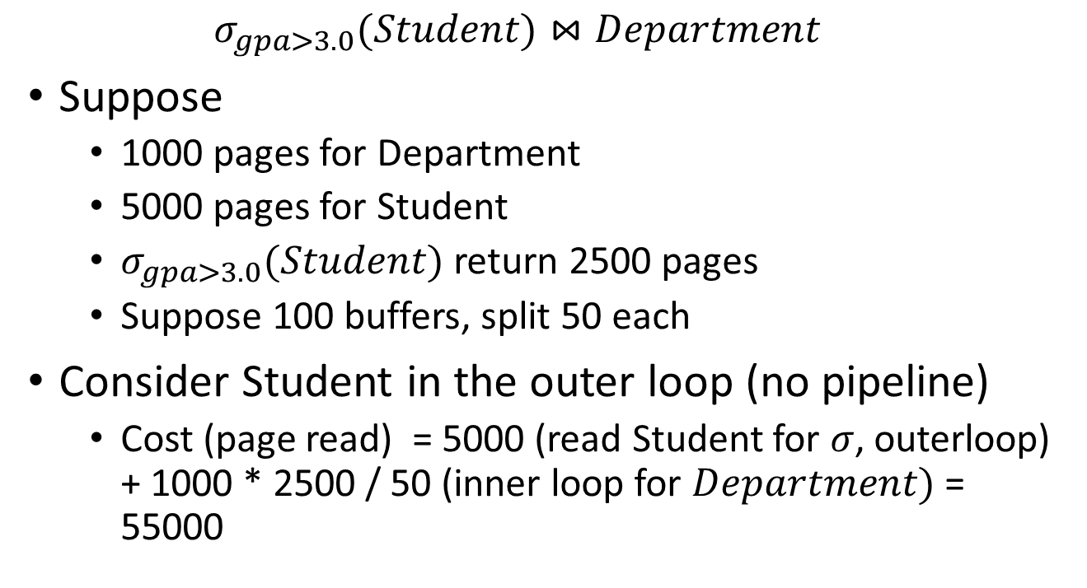
Materialization vs. Pipelining: Cost estimation
$$σ_{gpa>3.0}(Student)⋈Department$$
Suppose
1000 pages for Department
5000 pages for Student
$σ_{gpa>3.0}(Student)$ return 2500 pages
Suppose 100 buffers, split 50 each
Consider Student in the outer loop (no pipeline)
Cost (page read) = 5000 (read Student for $σ$, outerloop) + 1000 * 2500 / 50 (inner loop for $Department)$= 55000

Slide 35
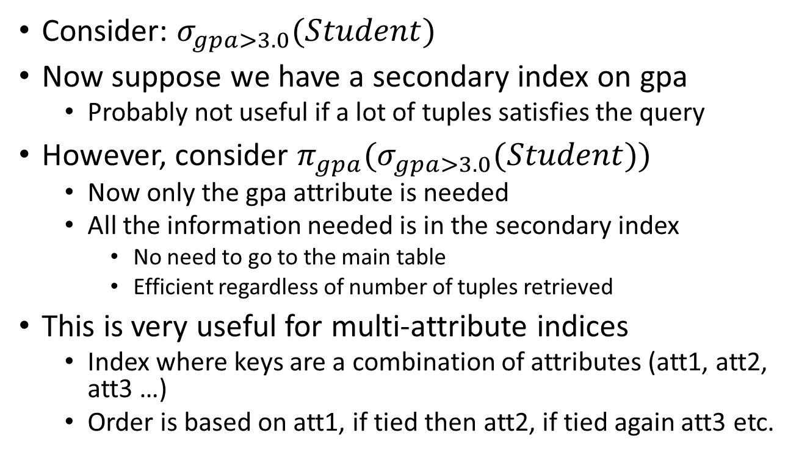
Index-only query
Consider: $σ_{gpa>3.0}(Student)$
Now suppose we have a secondary index on gpa
Probably not useful if a lot of tuples satisfies the query
However, consider ${π_{gpa}(σ}_{gpa>3.0}(Student))$
Now only the gpa attribute is needed
All the information needed is in the secondary index
No need to go to the main table
Efficient regardless of number of tuples retrieved
This is very useful for multi-attribute indices
Index where keys are a combination of attributes (att1, att2, att3 …)
Order is based on att1, if tied then att2, if tied again att3 etc.

Slide 36
Number of parse tree/plans
Each decorated parse tree is known as a plan
The number of plans can grow very quickly
E.g. a query with a N-way joins can have (n-1)! ways to order it. (why?)
This does not even consider the various option (e.g. outer vs. inner loops)
Thus we need to limit the number of parse tree generated
Also after chosen a parse tree one will need to find the best way to decorate the tree

Slide 37
Number of parse tree/plans
Also after chosen a parse tree one will need to find the best way to decorate the tree
Must consider the interaction of evaluation techniques when choosing evaluation plans
choosing the cheapest algorithm for each operation independently may not yield best overall algorithm. E.g.
merge-join may be costlier than hash-join, but may provide a sorted output which reduces the cost for an outer level aggregation.
nested-loop join may provide opportunity for pipelining

Slide 38
Cost-Based Optimization
Consider finding the best join-order for r₁ ⨝ r₂ ⨝ . . . ⨝ r_{n}.
There are (2(n – 1))!/(n – 1)! different join orders for above expression. With n = 7, the number is 665280, with n = 10, the number is greater than 176 billion!
No need to generate all the join orders. Using dynamic programming, the least-cost join order for any subset of {r₁, r₂, . . . r_{n}} is computed only once and stored for future use.

Slide 39
Dynamic Programming in Optimization
To find best join tree for a set of n relations:
To find best plan for a set S of n relations, consider all possible plans of the form: S₁ ⨝ (S – S₁) where S₁ is any non-empty subset of S.
Recursively compute costs for joining subsets of S to find the cost of each plan. Choose the cheapest of the 2^{n} – 2 alternatives.
Base case for recursion: single relation access plan
Apply all selections on R_{i} using best choice of indices on R_{i}
When plan for any subset is computed, store it and reuse it when it is required again, instead of recomputing it
Dynamic programming

Slide 40
Join Order Optimization Algorithm
procedure findbestplan(S) if (bestplan[S].cost ≠ ∞) return bestplan[S] // else bestplan[S] has not been computed earlier, compute it now if (S contains only 1 relation) set bestplan[S].plan and bestplan[S].cost based on the best way of accessing S using selections on S and indices (if any) on S else for each non-empty subset S1 of S such that S1 ≠ S P1= findbestplan(S1) P2= findbestplan(S - S1) for each algorithm A for joining results of P1 and P2 … compute plan and cost of using A (see next page) .. if cost < bestplan[S].cost bestplan[S].cost = cost bestplan[S].plan = plan; return bestplan[S]

Slide 41
Join Order Optimization Algorithm (cont.)
for each algorithm A for joining results of P1 and P2 // For indexed-nested loops join, the outer could be P1 or P2 // Similarly for hash-join, the build relation could be P1 or P2 // We assume the alternatives are considered as separate algorithms
if algorithm A is indexed nested loops Let P_{i} and P_{o} denote inner and outer inputs if P_{i} has a single relation r_{i} and r_{i} has an index on the join attribute
plan = “execute P_{o}.plan; join results of P_{o} and r_{i} using A”, with any selection conditions on P_{i} performed as part of the join condition cost = P_{o}.cost + cost of A else cost = ∞; /* cannot use indexed nested loops join */ else plan = “execute P1.plan; execute P2.plan; join results of P1 and P2 using A;” cost = P1.cost + P2.cost + cost of A
…. See previous page

Slide 42
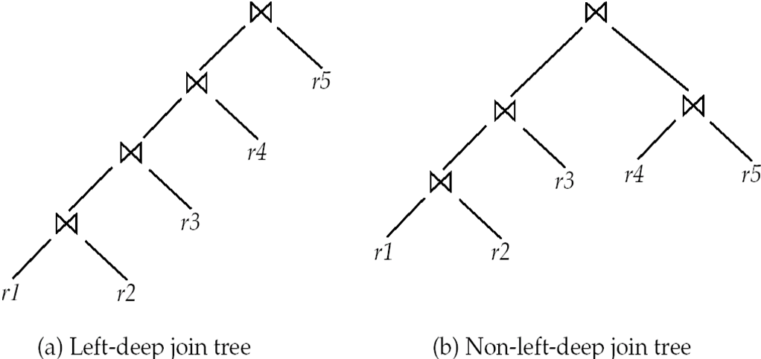
Left Deep Join Trees
In left-deep join trees, the right-hand-side input for each join is a relation, not the result of an intermediate join.

Slide 43
Cost of Optimization
With dynamic programming time complexity of optimization with bushy trees is O(3^{n}).
With n = 10, this number is 59000 instead of 176 billion!
Space complexity is O(2^{n})
To find best left-deep join tree for a set of n relations:
Consider n alternatives with one relation as right-hand side input and the other relations as left-hand side input.
Modify optimization algorithm:
Replace “for each non-empty subset S1 of S such that S1 ≠ S”
By: for each relation r in S let S1 = S – r .
If only left-deep trees are considered, time complexity of finding best join order is O(n 2^{n})
Space complexity remains at O(2^{n})
Cost-based optimization is expensive, but worthwhile for queries on large datasets (typical queries have small n, generally < 10)

Slide 44
Interesting Sort Orders
Consider the expression (r₁ ⨝ r₂) ⨝ r₃ (with A as common attribute)
An interesting sort order is a particular sort order of tuples that could make a later operation (join/group by/order by) cheaper
Using merge-join to compute r₁ ⨝ r₂ may be costlier than hash join but generates result sorted on A
Which in turn may make merge-join with r₃ cheaper, which may reduce cost of join with r₃ and minimizing overall cost
Not sufficient to find the best join order for each subset of the set of n given relations
must find the best join order for each subset, for each interesting sort order
Simple extension of earlier dynamic programming algorithms
Usually, number of interesting orders is quite small and doesn’t affect time/space complexity significantly

Slide 45
Cost Based Optimization with Equivalence Rules
Physical equivalence rules allow logical query plan to be converted to physical query plan specifying what algorithms are used for each operation.
Efficient optimizer based on equivalent rules depends on
A space efficient representation of expressions which avoids making multiple copies of subexpressions
Efficient techniques for detecting duplicate derivations of expressions
A form of dynamic programming based on memoization, which stores the best plan for a subexpression the first time it is optimized, and reuses in on repeated optimization calls on same subexpression
Cost-based pruning techniques that avoid generating all plans
Pioneered by the Volcano project and implemented in the SQL Server optimizer

Slide 46
Heuristic Optimization
Cost-based optimization is expensive, even with dynamic programming.
Systems may use heuristics to reduce the number of choices that must be made in a cost-based fashion.
Heuristic optimization transforms the query-tree by using a set of rules that typically (but not in all cases) improve execution performance:
Perform selection early (reduces the number of tuples)
Perform projection early (reduces the number of attributes)
Perform most restrictive selection and join operations (i.e., with smallest result size) before other similar operations.
Some systems use only heuristics, others combine heuristics with partial cost-based optimization.

Slide 47
Structure of Query Optimizers
Many optimizers considers only left-deep join orders.
Plus heuristics to push selections and projections down the query tree
Reduces optimization complexity and generates plans amenable to pipelined evaluation.
Heuristic optimization used in some versions of Oracle:
Repeatedly pick “best” relation to join next
Starting from each of n starting points. Pick best among these
Intricacies of SQL complicate query optimization
E.g., nested subqueries

Slide 48
Structure of Query Optimizers (Cont.)
Some query optimizers integrate heuristic selection and the generation of alternative access plans.
Frequently used approach
heuristic rewriting of nested block structure and aggregation
followed by cost-based join-order optimization for each block
Some optimizers (e.g. SQL Server) apply transformations to entire query and do not depend on block structure
Optimization cost budget to stop optimization early (if cost of plan is less than cost of optimization)
Plan caching to reuse previously computed plan if query is resubmitted
Even with different constants in query
Even with the use of heuristics, cost-based query optimization imposes a substantial overhead.
But is worth it for expensive queries
Optimizers often use simple heuristics for very cheap queries, and perform exhaustive enumeration for more expensive queries

Slide 49
Cost estimation
Recall the basic problem of query execution (slightly modified)
The best way to execute a query (operation) depends on the size of its results, which you don’t know until you execute it
Thus need to estimate the tuples return from an operation

Slide 50
Statistical Information for Cost Estimation
n_{r}: number of tuples in a relation r.
b_{r}: number of blocks containing tuples of r.
l_{r}: size of a tuple of r.
f_{r}: blocking factor of r — i.e., the number of tuples of r that fit into one block.
V(A, r): number of distinct values that appear in r for attribute A; same as the size of ∏_{A}(r).
If tuples of r are stored together physically in a file, then:

Slide 51
Histograms
Histogram on attribute age of relation person
Equi-width histograms
Equi-depth histograms break up range such that each range has (approximately) the same number of tuples
E.g. (4, 8, 14, 19)
Many databases also store n most-frequent values and their counts
Histogram is built on remaining values only

Slide 52
Histograms (cont.)
Histograms and other statistics usually computed based on a random sample
Statistics may be out of date
Some database require a analyze command to be executed to update statistics
Others automatically recompute statistics
e.g., when number of tuples in a relation changes by some percentage

Slide 53
Selection Size Estimation
σ_{A=v}(r)
n_{r} / V(A,r) : number of records that will satisfy the selection
Equality condition on a key attribute: size estimate = 1
σ_{A≤V}(r) (case of σ_{A ≥ V}(r) is symmetric)
Let c denote the estimated number of tuples satisfying the condition.
If min(A,r) and max(A,r) are available in catalog
c = 0 if v < min(A,r)
c =
If histograms available, can refine above estimate
In absence of statistical information c is assumed to be n_{r} / 2.

Slide 54
Size Estimation of Complex Selections
The selectivity of a condition θ_{i} is the probability that a tuple in the relation r satisfies θ_{i} .
If s_{i} is the number of satisfying tuples in r, the selectivity of θ_{i} is given by s_{i} /n_{r}.
Conjunction: σ_{θ1∧ θ2∧. . . ∧ θn} (r). Assuming independence, estimate of tuples in the result is:
Disjunction:σ_{θ1∨} _{θ2 ∨. . . ∨} _{θn} (r). Estimated number of tuples:
Negation: σ_{¬θ}(r). Estimated number of tuples: n_{r} – size(σ_{θ}(r))

Slide 55
Join Operation: Running Example
Running example: student ⨝ takes
Catalog information for join examples:
n_{student} = 5,000.
f_{student} = 50, which implies that b_{student} =5000/50 = 100.
n_{takes} = 10000.
f_{takes} = 25, which implies that b_{takes} = 10000/25 = 400.
V(ID, takes) = 2500, which implies that on average, each student who has taken a course has taken 4 courses.
Attribute ID in takes is a foreign key referencing student.
V(ID, student) = 5000 (primary key!)

Slide 56
Estimation of the Size of Joins
The Cartesian product r x s contains n_{r} .n_{s} tuples; each tuple occupies s_{r} + s_{s} bytes.
If R ∩ S = ∅, then r ⋈ s is the same as r x s.
If R ∩ S is a key for R, then a tuple of s will join with at most one tuple from r
therefore, the number of tuples in r ⋈ s is no greater than the number of tuples in s.
If R ∩ S in S is a foreign key in S referencing R, then the number of tuples in r ⋈ s is exactly the same as the number of tuples in s.
The case for R ∩ S being a foreign key referencing S is symmetric.
In the example query student ⋈ takes, ID in takes is a foreign key referencing student
hence, the result has exactly n_{takes} tuples, which is 10000

Slide 57
Estimation of the Size of Joins (Cont.)
If R ∩ S = {A} is not a key for R or S. If we assume that every tuple t in R produces tuples in R S, the number of tuples in R ⨝ S is estimated to be: If the reverse is true, the estimate obtained will be: The lower of these two estimates is probably the more accurate one.
Can improve on above if histograms are available
Use formula similar to above, for each cell of histograms on the two relations

Slide 58
Estimation of the Size of Joins (Cont.)
Compute the size estimates for depositor ⨝ customer without using information about foreign keys:
V(ID, takes) = 2500, and V(ID, student) = 5000
The two estimates are 5000 * 10000/2500 = 20,000 and 5000 * 10000/5000 = 10000
We choose the lower estimate, which in this case, is the same as our earlier computation using foreign keys.

Slide 59
Size Estimation for Other Operations
Projection: estimated size of ∏_{A}(r) = V(A,r)
Aggregation : estimated size of _{G}𝛾_{A}(r) = V(G,r)
Set operations
For unions/intersections of selections on the same relation: rewrite and use size estimate for selections
E.g., σ_{θ1} (r) ∪ σ_{θ2} (r) can be rewritten as σ_{θ1 or θ2} (r)
For operations on different relations:
estimated size of r ∪ s = size of r + size of s.
estimated size of r ∩ s = minimum size of r and size of s.
estimated size of r – s = r.
All the three estimates may be quite inaccurate, but provide upper bounds on the sizes.

Slide 60
Size Estimation (Cont.)
Outer join:
Estimated size of r ⟕ s = size of r ⨝ s + size of r
Case of right outer join is symmetric
Estimated size of r ⟗ s = size of r ⨝ s + size of r + size of s

Slide 61
Estimation of Number of Distinct Values
Selections: σ_{θ} (r)
If θ forces A to take a specified value: V(A,σ_{θ} (r)) = 1.
e.g., A = 3
If θ forces A to take on one of a specified set of values: V(A,σ_{θ} (r)) = number of specified values.
(e.g., (A = 1 V A = 3 V A = 4 )),
If the selection condition θ is of the form A op r estimated V(A,σ_{θ} (r)) = V(A.r) * s
where s is the selectivity of the selection.
In all the other cases: use approximate estimate of min(V(A,r), n_{σθ (r)} )
More accurate estimate can be got using probability theory, but this one works fine generally

Slide 62
Estimation of Distinct Values (Cont.)
Joins: r ⨝ s
If all attributes in A are from r estimated V(A, r ⨝ s) = min (V(A,r), n _{r ⨝ s})
If A contains attributes A1 from r and A2 from s, then estimated V(A,r ⨝ s) =
min(V(A1,r)*V(A2 – A1,s), V(A1 – A2,r)*V(A2,s), n_{r ⨝ s})
More accurate estimate can be got using probability theory, but this one works fine generally

Slide 63
Estimation of Distinct Values (Cont.)
Estimation of distinct values are straightforward for projections.
They are the same in ∏_{A (r)} as in r.
The same holds for grouping attributes of aggregation.
For aggregated values
For min(A) and max(A), the number of distinct values can be estimated as min(V(A,r), V(G,r)) where G denotes grouping attributes
For other aggregates, assume all values are distinct, and use V(G,r)

Slide 64
Optimizing Nested Subqueries**
Nested query example: select name from instructor where exists (select * from teaches where instructor.ID = teaches.ID and teaches.year = 2019)
SQL conceptually treats nested subqueries in the where clause as functions that take parameters and return a single value or set of values
Parameters are variables from outer level query that are used in the nested subquery; such variables are called correlation variables
Conceptually, nested subquery is executed once for each tuple in the cross-product generated by the outer level from clause
Such evaluation is called correlated evaluation
Note: other conditions in where clause may be used to compute a join (instead of a cross-product) before executing the nested subquery

Slide 65
Optimizing Nested Subqueries (Cont.)
Correlated evaluation may be quite inefficient since
a large number of calls may be made to the nested query
there may be unnecessary random I/O as a result
SQL optimizers attempt to transform nested subqueries to joins where possible, enabling use of efficient join techniques
E.g.,: earlier nested query can be rewritten as ∏ _{name}(instructor ⨝instructor.ID=teaches.ID ∧ teaches.year=2019 teaches)
Note: the two queries generate different numbers of duplicates (why?)
Can be modified to handle duplicates correctly using semijoins

Slide 66
Optimizing Nested Subqueries (Cont.)
The semijoin operator ⋉ is defined as follows
A tuple r_{i} appears n times in r ⋉ _{θ} s if it appears n times in r, and there is at least one matching tuple s_{i} in s
E.g.: earlier nested query can be rewritten as ∏ _{name}(instructor ⋉ instructor.ID=teaches.ID ∧ teaches.year=2019 teaches)
Or even as: ∏_{name}(instructor ⋉_{instructor.ID=teaches.ID} (σ_{teaches.year=2019} teaches))
Now the duplicate count is correct!
The above relational algebra query is also equivalent to from instructor where ID in (select teaches.ID from teaches where teaches.year = 2019)

Slide 67
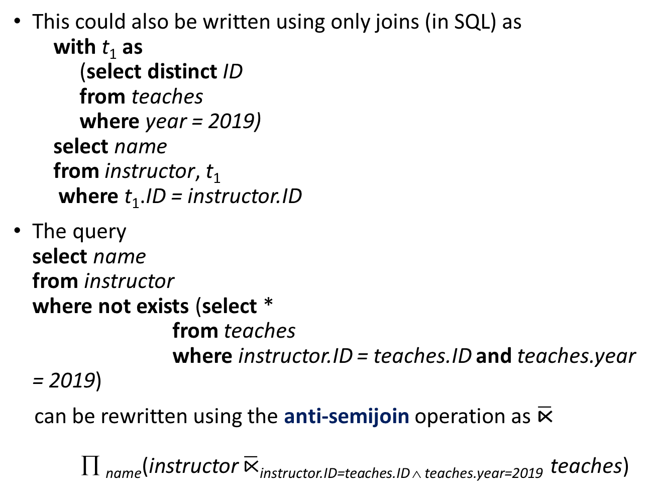
Optimizing Nested Subqueries (Cont.)
This could also be written using only joins (in SQL) as with t₁ as (select distinct ID from teaches where year = 2019) select name from instructor, t₁ where t₁.ID = instructor.ID
The query select name from instructor where not exists (select * from teaches where instructor.ID = teaches.ID and teaches.year = 2019)
can be rewritten using the anti-semijoin operation as $\overline{\text{⋉}}$ ∏ _{name}(instructor $\overline{\text{⋉}}$instructor.ID=teaches.ID ∧ teaches.year=2019 teaches)

Slide 68
Optimizing Nested Subqueries (Cont.)
In general, SQL queries of the form below can be rewritten as shown
Rewrite: select A from r₁, r₂ ,…, r_{n} where P₁ and exists (select * from s₁, s₂ ,…, s_{m} where P₂¹ and P₂² )
To: ∏ _{A}(σ _{P1} (r₁ x r₂ x … x r_{n} ) ⋉ _{P22} σ _{P21} (s₁ x s₂ x … x s_{m} )
P₂¹ contains predicates that do not involve any correlation variables
P₂² contains predicates involving correlation variables
The process of replacing a nested query by a query with a join/semijoin (possibly with a temporary relation) is called decorrelation.
Decorrelation is more complicated in several cases, e.g.
The nested subquery uses aggregation, or
The nested subquery is a scalar subquery
Correlated evaluation used in these cases

Slide 69
Decorrelation (Cont.)
Decorrelation of scalar aggregate subqueries can be done using groupby/aggregation in some cases
select name from instructor where 1 < (select count(*) from teaches where instructor.ID = teaches.ID and teaches.year = 2019)
∏ _{name}(instructor ⋉ _{instructor.ID=TID ∧ 1 < cnt} ( _{ID as TID} 𝛾_{count(*) as cnt} (σ _{teaches.year=2019} (teaches))))

