Slide 1
CS 5/7330
Recovery Overview

Slide 2
Recovery – why?
ACID properties
Atomicity: all-or-nothing
Durability: Once committed, changes must be permanent
If the system is always functional, that’s ok.
However, system may crash (failure).

Slide 3
Recovery – why?
Types of failures:
Transaction failure :
Logical errors: transaction cannot complete due to some internal error condition (e.g. your program have a division by zero error)
System errors: the database system must terminate an active transaction due to an error condition (e.g., deadlock)

Slide 4
Recovery – why?
Types of failures (ctd)
System crash: a power failure or other hardware or software failure causes the system to crash.
Fail-stop assumption: non-volatile storage contents are assumed to not be corrupted by system crash
Database systems have numerous integrity checks to prevent corruption of disk data

Slide 5
Recovery – why?
Types of failures (ctd):
Disk failure: a head crash or similar disk failure destroys all or part of disk storage
Destruction is assumed to be detectable: disk drives use checksums to detect failures
With some disk systems, some failures maybe correctable.
We focus on transaction/system failure as well as other failures that are correctable.

Slide 6
Recovery – why?
Failure can occur ANY time
Including the time that you do not want
We do assume in this class that writing a page is atomic (i.e. failure do not occur in the middle of writing a page)
Thus need to maintain atomicity and durability at all times

Slide 7
Recovery – why?
After failure, the system needs to recover
Need to recover to a consistent state
Need to ensure all transactions are atomic and durable
Thus when the system go back up and running after a failure
A recovery module is up and running – before allowing any other transaction to run
It will restore the database to the consistent state as well as ensure the ACID properties
After that transactions may continue
Notice that information need to be stored during the normal running of the transaction for the recovery module to run properly.

Slide 8
Recovery – atomicity requirement
Suppose the system crash while a transaction T is being executed (but not committed)
During recovery, one need to
Find those transactions
Ensure atomicity is held
Abort or complete?
Abort! (in many case, don’t know how to complete anyway)
Abort means restoring the database to the point where those transactions has not started (as some changes may have propagated to the disk)
Thus, after the recovery procedure, those transaction should seems to have NEVER been executed

Slide 9
Recovery – atomicity requirement
Counter-argument:
Can we just not write anything (i.e. uncommitted data) to the disk until T commits?
Problems:
When pages are to be read/written, it is moved from the disk to a buffer
If we avoid writing anything to the disk immediately, then the buffer holding that page cannot be released until end of T
If T is long, or if T write something early in the transaction, it can hold up resources
If many transactions are running, buffers can be used up very quickly
If the uncommitted data is written to the disk, then buffer replacement policy (e.g. FIFO, LRU) can utilize resources much more effectively and allow higher concurrency

Slide 10
Recovery – atomicity requirement
Thus, during recovery, one need to
Find those transactions that has started but not yet committed
Ensure atomicity is held
Find all the changes to the database that the transactions has done
Undo all the changes

Slide 11
Recovery – durability requirement
Suppose the crash occurs right after a transaction T committed.
Seems to be ok, but …
T may have written something onto the disk
However, the writes may not have propagated to the disk
Reasons
The writes may be scheduled/buffered but the system crashed before such writes can execute
The buffer manager/virtual memory management may decide to put a disk page into main memory for a long time (save disk access time)
This is especially true on a network/shared file system

Slide 12
Recovery – durability requirement
Remember, when you issue a write() command, the system does not necessary write what you have onto disk immediately.
In some systems, you may issue a flush() command to force the writes onto the disk

Slide 13
Recovery – durability requirement
Counter-argument
Don’t commit until transaction is certain that all the pages are safely written onto the disk
Problems:
Sometimes it is impossible to check for that
Even if it is possible, it may slow down the transaction significantly
As well as lead to lower concurrency (locks being held longer)

Slide 14
Recovery – durability requirement
Thus, during recovery, one need to
Find those transactions that has committed
Ensure durability is held
Check if all the changes made by the transactions is written onto the disk
If not, then redo all the changes

Slide 15
Force/No-force vs. Steal/No-steal
To sum up, what we need to do at recovery depends on how we deal with uncommitted data (especially data in buffers)
Steal/No-steal: A system is said to steal buffers if it allows buffers that contain dirty (uncommitted but updated) data to be swapped to physical storage
If steal is allowed, undo is necessary
Force/No-force: A system is said to force buffers if every committed data is guaranteed to be forced onto the disk at commit time
If force is not allowed, redo is necessary

Slide 16
Force/No-force vs. Steal/No-steal
Thus no-steal and force means no work required at recovery.
However, it is either unimplementable or impractical
Thus we need to deal with them

Slide 17
Recovery -- overview
Recovery algorithms have two parts
Actions taken during normal transaction processing to ensure enough information exists to recover from failures
Actions taken after a failure to recover the database contents to a state that ensures atomicity, consistency and durability
In order to achieve (1), we need to store the information in stable storage

Slide 18
Stable storage
Volatile storage:
does not survive system crashes
examples: main memory, cache memory
Nonvolatile storage:
survives system crashes
examples: disk, tape, flash memory, non-volatile (battery backed up) RAM
Stable storage:
a mythical form of storage that survives all failures
approximated by maintaining multiple copies on distinct nonvolatile media

Slide 19
Stable storage
Maintain multiple copies of each block on separate disks
copies can be at remote sites to protect against disasters such as fire or flooding.
Failure during data transfer can still result in inconsistent copies: Block transfer can result in
Successful completion
Partial failure: destination block has incorrect information
Total failure: destination block was never updated
Protecting storage media from failure during data transfer (one solution):
Execute output operation as follows (assuming two copies of each block):
Write the information onto the first physical block.
When the first write successfully completes, write the same information onto the second physical block.
The output is completed only after the second write successfully completes.

Slide 20
Stable storage
Copies of a block may differ due to failure during output operation. To recover from failure:
First find inconsistent blocks:
Expensive solution: Compare the two copies of every disk block.
Better solution:
Record in-progress disk writes on non-volatile storage (Non-volatile RAM or special area of disk).
Use this information during recovery to find blocks that may be inconsistent, and only compare copies of these.
Used in hardware RAID systems
If either copy of an inconsistent block is detected to have an error (bad checksum), overwrite it by the other copy. If both have no error, but are different, overwrite the second block by the first block.

Slide 21
Log files
Logs are needed to record the operations on the database during normal operations
The log is a sequence of log records, and maintains a record of update activities on the database.

Slide 22
Log files
Different types of log records during normal operations:
Begin record: <T_{i}, start> -- registered when transaction T_{i} begins
Write record: <T_{i}, X, V_{old}, V_{new}> -- registered when a database item X is updated by T_{i}, where V_{old}, V_{new} store the old and new values respectively
V_{old}, V_{new} also known as before-image & after-image respectively
Commit record: <T_{i}, commit> -- registered when T_{i} commits.
Formally, a transaction commits when the commit log record is written
Abort record: <T_{i}, abort> -- registered when T_{i} aborts

Slide 23
Log files
With such information, redoing and undoing operations can be done:
Undo: copy V_{old} back to the object.
Redo: copy V_{new} back to the object

Slide 24
Log files
Logs are written onto stable storage
Question: given an operation to be logged, should we log first or execute first?
Consider the case the system fail between the two operations

Slide 25
Log files
Suppose we execute first, and before we can log
Then when the system recovers, it cannot find the write operation on the log.
If the operation is from a transaction that is not committed, then one do not know that the operation needs to be undone
Big problem!

Slide 26
Log files
Suppose we log first and system crash before it executes
Then when the system recovers, it saw an operation that have not been executed
If the operation is from a transaction that is not committed, then one is undoing an operation that has not been done.
Undo means copying old value back to the database
In this case, overwriting the same value (since new value never make it to database)
No problem. (Maybe inefficient, but correct)

Slide 27
Log files
Thus logs must be write-ahead logs (WAL)
i.e. all operations must be logged first
Log records must be forced to stable storage before actually operations can be executed

Slide 28
Log-based recovery : basic approach
Given a write-ahead log. How should recovery proceed after the system crash?
Two major steps:
Locating the transaction that need works to be done
Apply compensatory action on these transactions

Slide 29
Log-based recovery : basic approach
Step 1: locating transactions that needed to be dealt with.
Uncommitted but active transactions
Need undo
Transactions that has <start T> in log, but not <commit T>
Committed transactions
Need redo
Transactions that has <commit T> in log

Slide 30
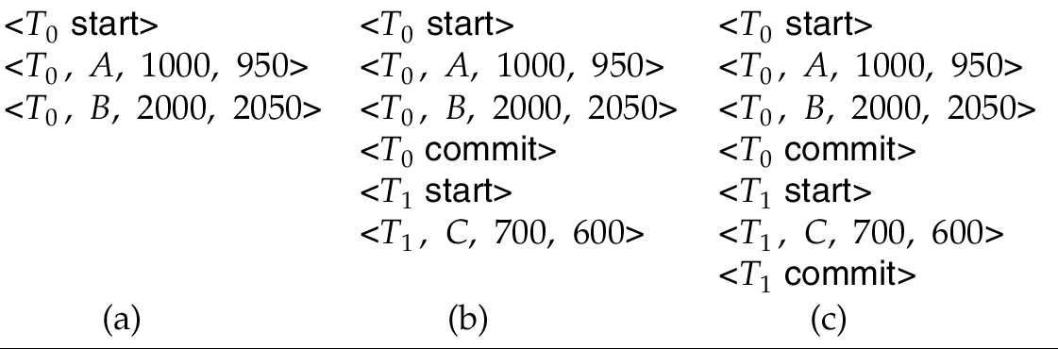
Log-based recovery : basic approach
Example
Undo T₀
Undo T₁, Redo T₀
Redo T₀, T₁

Slide 31
Log-based recovery : basic approach
Step 2: Apply compensatory actions
Redo & Undo
Requirement: actions have to be idempotent
That is, even if the operation is executed multiple times the effect is the same as if it is executed once

Slide 32
Log-based recovery : basic approach
Why idempotent?
Consider the case when system crash during recovery
Assume we do not log the compensatory actions
Then after the system go back up again we will apply the same operations.
Thus the need to be idempotent

Slide 33
Log-based recovery : basic approach
For undo: copying old value of the item from the log to the database
For redo: copying new value of the item from the log to the database
Both operations are idempotent

Slide 34
Log-based recovery : basic approach
Order of operations: redo first or undo first?
Depends on the recovery method used.
Undo first then redo is typically correct.
Undo has to go backwards (from end of the log to beginning)
Redo has to go forward (from beginning of log to the end)
Why?

Slide 35
Checkpoints
If the system have been running for a while, the log can be huge.
Some committed transactions may have result forced to the disk already
Thus need to create checkpoints to eliminate redo a large number of transactions

Slide 36
Checkpoints
The simplest checkpoint is a hard checkpoint
Normal operation of database is halted
All data that is in the buffers are forced (flushed) to the disk
A <checkpoint> record is written on the log (write-ahead)
Normal operation of database resumes

Slide 37
Recovery with checkpoints
Consider a log with a checkpoint
For recovery purpose:
Finding transactions that need to be redone:
i.e. if <commit T> record is in the log
Now, if <commit T> appears before <checkpoint> record.
We do not need to redo it, why?
Finding transactions that need to be undone:
i.e. if <start T> record is in the log, but <commit T> isn’t
Now, if <start T> is in the log before the <checkpoint> record but <commit T> is not in the log...
We still need to undo it, why?

Slide 38
Recovery with checkpoints
Thus, recovery procedure after a system crash
Start reading the log from the end
Before reaching a <checkpoint> record
If one see a <commit T> record, put it in the list of transactions to redo (redo-list)
If one see a <start T> record, such that T is not already in the redo-list, then put it in the list of transactions to undo (undo-list)
After reaching a <checkpoint> record, continue to scan backwards
If one see a <commit T> record, put it in the list of transaction that is done (done-list)
If one see a <start T> record, such that T is not already in the redo-list or the done-list, then put it in the undo-list

Slide 39
Recovery with checkpoints
Once the whole log is read, the system know which transaction to undo and redo.
Start reading the log backwards again
If a <write> record belong to a transaction in the undo-list, undo this operation (by overwriting the item with the old value)
Until the beginning of the log is reached
Start reading from the <checkpoint> record.
If a <write> record belong to a transaction in the redo-list, redo this operation (by overwriting the item with the new value)

Slide 40
Recovery with checkpoints
One way of speeding up
One still have to go through all the logs to find all transactions that need to be undone
To speed up, when checkpointing, one can write the list of all transactions that are active with the checkpoint
i.e. <checkpoint T1, T2, … Tn> where Ti are all the transactions that are running at the time of checkpointing
Save time in the first stage (but not necessarily in the second)
Other optimizations to be discussed later

Slide 41
Recovery with checkpoints -- example
<start T1>
<T1 write X, 30, 40>
<start T2>
<T1 write Y, 40, 50>
<start T3>
<T3 write Z, 8, 30>
<commit T3>
<start T4>
<T4 write A 10, 5>
<checkpoint T1, T2, T4>
<T1 write Z 30, 10>
<T2 write W 50, 9>
<commit T1>
System crashes!
Consider the log on the LHS
First, determine which transactions need to be redo/undo
Initially
Undo = {}
Redo = {}
Done = {}

Slide 42
Recovery with checkpoints -- example
<start T1>
<T1 write X, 30, 40>
<start T2>
<T1 write Y, 40, 50>
<start T3>
<T3 write Z, 8, 30>
<commit T3>
<start T4>
<T4 write A 10, 5>
<checkpoint T1, T2, T4>
<T1 write Z 30, 10>
<T2 write W 50, 9>
<commit T1>
System crashes!
T1 commits after checkpoint
Add T1 to redo
Undo = {}
Redo = {T1}
Done = {}

Slide 43
Recovery with checkpoints -- example
<start T1>
<T1 write X, 30, 40>
<start T2>
<T1 write Y, 40, 50>
<start T3>
<T3 write Z, 8, 30>
<commit T3>
<start T4>
<T4 write A 10, 5>
<checkpoint T1, T2, T4>
<T1 write Z 30, 10>
<T2 write W 50, 9>
<commit T1>
System crashes!
T2 active but not committed
Add T2 to undo
Undo = {T2}
Redo = {T1}
Done = {}

Slide 44
Recovery with checkpoints -- example
<start T1>
<T1 write X, 30, 40>
<start T2>
<T1 write Y, 40, 50>
<start T3>
<T3 write Z, 8, 30>
<commit T3>
<start T4>
<T4 write A 10, 5>
<checkpoint T1, T2, T4>
<T1 write Z 30, 10>
<T2 write W 50, 9>
<commit T1>
System crashes!
T1 already in Redo list
Undo = {T2}
Redo = {T1}
Done = {}

Slide 45
Recovery with checkpoints -- example
<start T1>
<T1 write X, 30, 40>
<start T2>
<T1 write Y, 40, 50>
<start T3>
<T3 write Z, 8, 30>
<commit T3>
<start T4>
<T4 write A 10, 5>
<checkpoint T1, T2, T4>
<T1 write Z 30, 10>
<T2 write W 50, 9>
<commit T1>
System crashes!
Checkpoint reached
T4 added to undo
Undo = {T2, T4}
Redo = {T1}
Done = {}
All the necessary transactions discovered

Slide 46
Recovery with checkpoints -- example
<start T1>
<T1 write X, 30, 40>
<start T2>
<T1 write Y, 40, 50>
<start T3>
<T3 write Z, 8, 30>
<commit T3>
<start T4>
<T4 write A 10, 5>
<checkpoint T1, T2, T4>
<T1 write Z 30, 10>
<T2 write W 50, 9>
<commit T1>
System crashes!
Notice that T3 does not need to be redo because T3 is committed before checkpoint
Thus all the pages T3 changes is forced onto the disk

Slide 47
Recovery with checkpoints -- example
<start T1>
<T1 write X, 30, 40>
<start T2>
<T1 write Y, 40, 50>
<start T3>
<T3 write Z, 8, 30>
<commit T3>
<start T4>
<T4 write A 10, 5>
<checkpoint T1, T2, T4>
<T1 write Z 30, 10>
<T2 write W 50, 9>
<commit T1>
System crashes!
Step 2 : Undo
T2, T4 need to be undone
Undo are done backwards
Read log backwards until the <start T> for all transactions to be undone reached

Slide 48
Recovery with checkpoints -- example
<start T1>
<T1 write X, 30, 40>
<start T2>
<T1 write Y, 40, 50>
<start T3>
<T3 write Z, 8, 30>
<commit T3>
<start T4>
<T4 write A 10, 5>
<checkpoint T1, T2, T4>
<T1 write Z 30, 10>
<T2 write W 50, 9>
<commit T1>
System crashes!
Step 3 : Redo
T1 needed to be redo
So logs have to be returned from the earliest start time of all transactions to be redone

Slide 49
Non log-based recovery: shadow paging
Shadow paging is an alternative to log-based recovery; this scheme is useful if transactions execute serially
Idea: maintain two page tables during the lifetime of a transaction –the current page table, and the shadow page table
Store the shadow page table in nonvolatile storage, such that state of the database prior to transaction execution may be recovered.
Shadow page table is never modified during execution
To start with, both the page tables are identical. Only current page table is used for data item accesses during execution of the transaction.
Whenever any page is about to be written for the first time
A copy of this page is made onto an unused page.
The current page table is then made to point to the copy
The update is performed on the copy

Slide 50
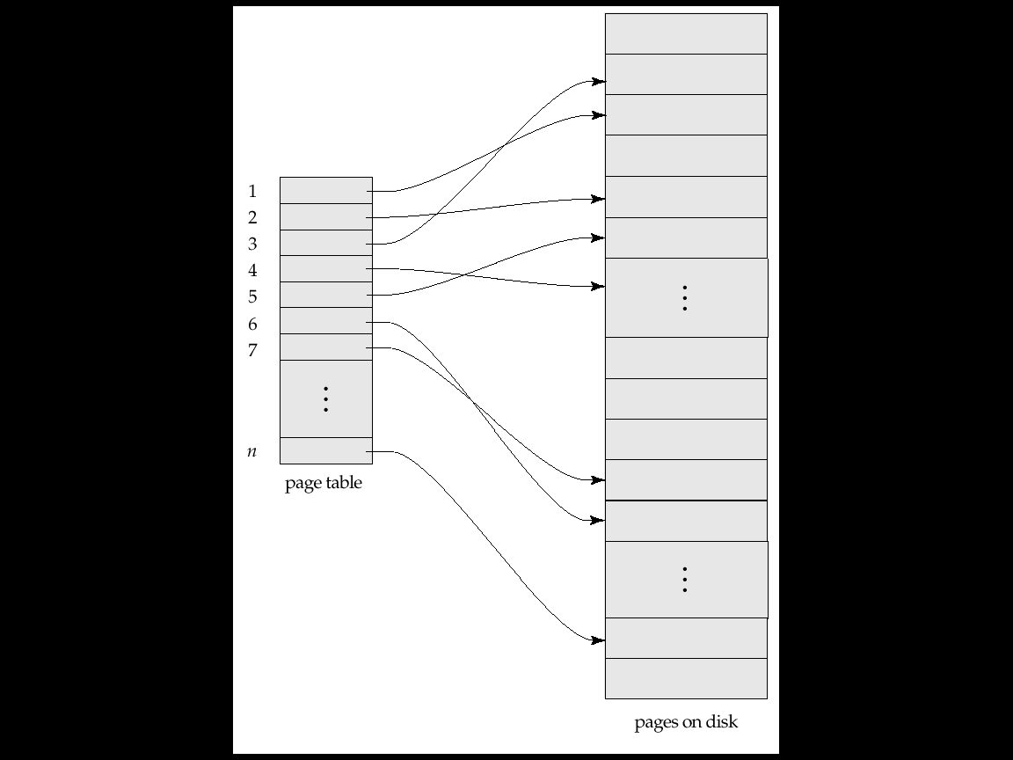
Non log-based recovery: shadow paging

Slide 51
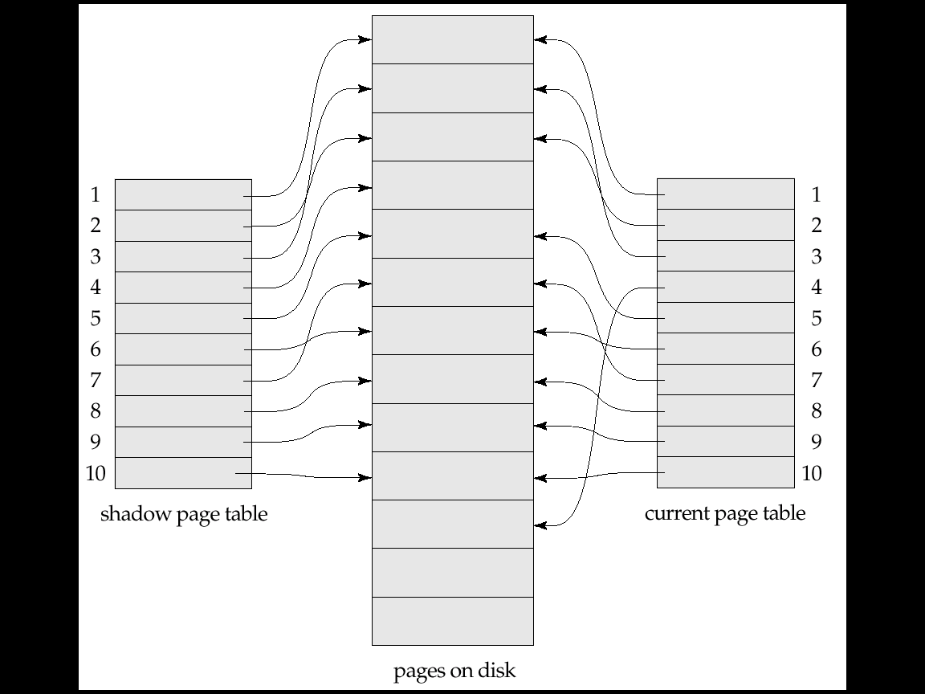
Non log-based recovery: shadow paging

Slide 52
Shadow paging
To commit a transaction :
1. Flush all modified pages in main memory to disk
2. Output current page table to disk
3. Make the current page table the new shadow page table, as follows:
keep a pointer to the shadow page table at a fixed (known) location on disk.
to make the current page table the new shadow page table, simply update the pointer to point to current page table on disk
Once pointer to shadow page table has been written, transaction is committed.
No recovery is needed after a crash — new transactions can start right away, using the shadow page table.
Pages not pointed to from current/shadow page table should be freed (garbage collected).

Slide 53
Shadow paging
Advantages of shadow-paging over log-based schemes
no overhead of writing log records
recovery is trivial
Disadvantages :
Copying the entire page table is very expensive
Can be reduced by using a page table structured like a B⁺-tree
No need to copy entire tree, only need to copy paths in the tree that lead to updated leaf nodes
Commit overhead is high even with above extension
Need to flush every updated page, and page table
Data gets fragmented (related pages get separated on disk)
After every transaction completion, the database pages containing old versions of modified data need to be garbage collected
Hard to extend algorithm to allow transactions to run concurrently
Easier to extend log based schemes

