Slide 1
CS 5/7330
Transactions : Serializability

Slide 2
Table of contents
Concurrency control
Serializability
Motivating examples
Conflict serializability
Test of serializability
Recoverability

Slide 3
Concurrency control
Why concurrency?
increased processor and disk utilization, leading to better transaction throughput: one transaction can be using the CPU while another is reading from or writing to the disk
reduced average response time for transactions: short transactions need not wait behind long ones.

Slide 4
Concurrency control
Why concurrency control?
Shared resources. Many transaction may want to access the same object/tuple.
Isolation. One of the key requirement of transactions

Slide 5
Concurrency control -- schedule
Schedules – sequences that indicate the chronological order in which instructions of concurrent transactions are executed
a schedule for a set of transactions must consist of all instructions of those transactions
must preserve the order in which the instructions appear in each individual transaction.
Assumption: at any time, only one operation from one transaction can be executed
However, DBMS may interleave operations from multiple transactions

Slide 6
Concurrency control -- schedule
Serial schedule: schedules that does not allow interleaving between transactions (i.e. one transaction finishes before the other begin)
Equivalent schedules: two schedules are equivalent if they “produce the same results”
Still need to define what it means by “produce the same results”

Slide 7
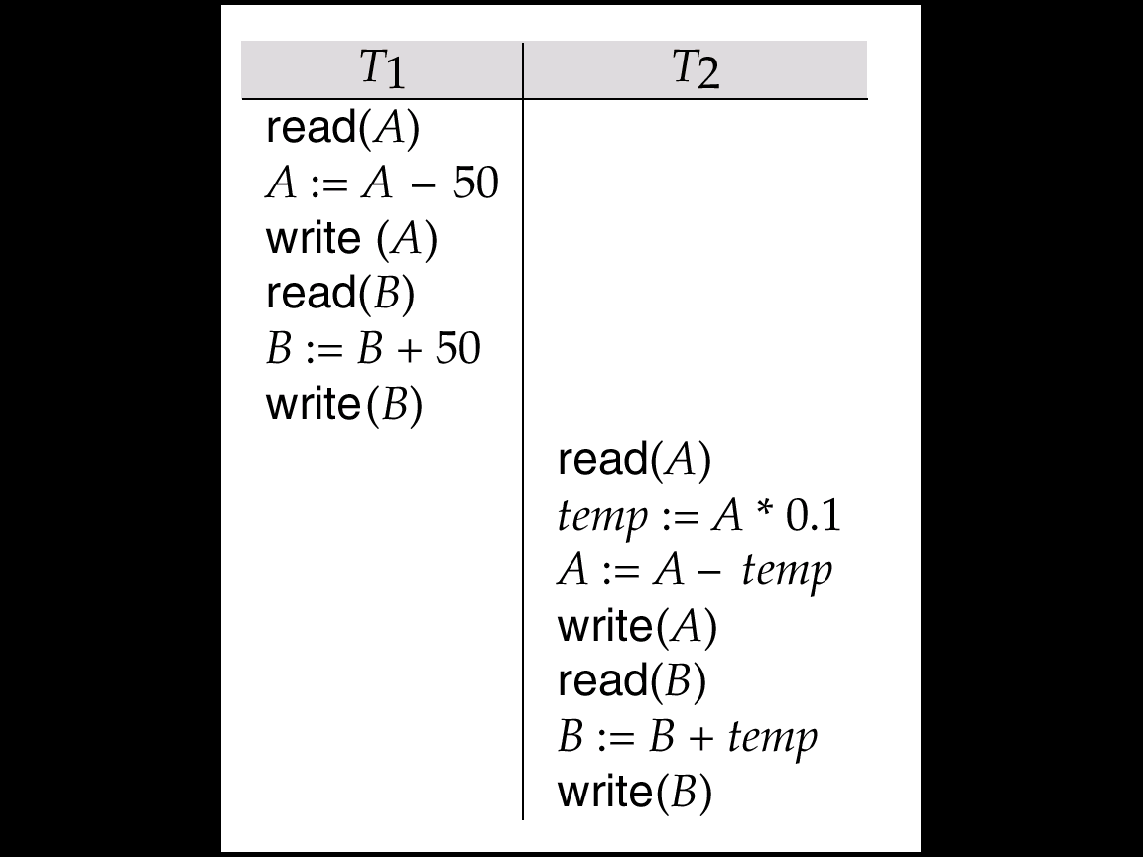
Concurrency control – schedule (example)
Let T1 transfer $50 from A to B, and T2 transfer 10% of the balance from A to B. The following is a serial schedule in which T1 is followed by T2.
Schedule 1

Slide 8
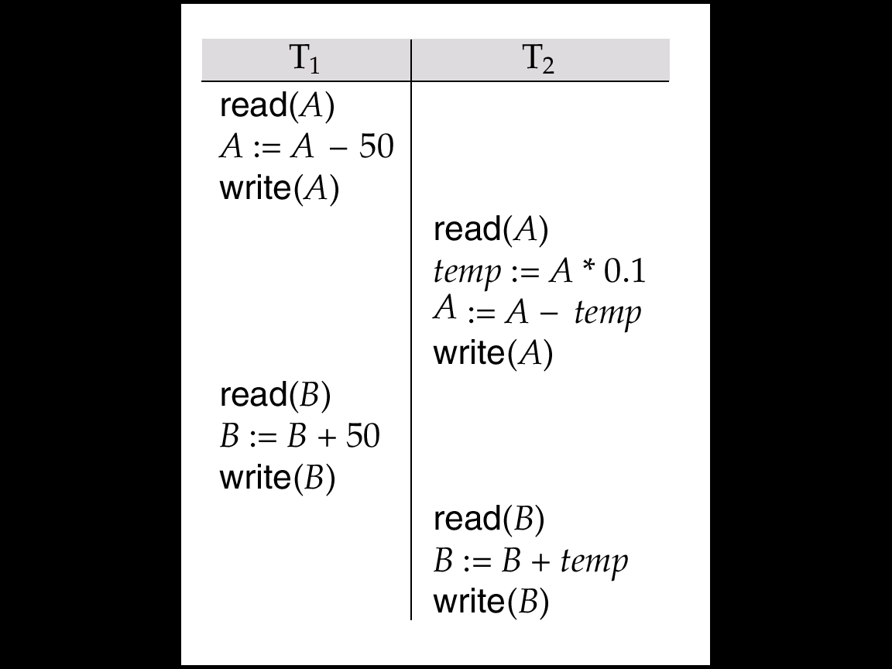
Concurrency control – schedule (example)
Let T₁ and T₂ be the transactions defined previously. The following schedule is not a serial schedule, but it is equivalent to Schedule 1.
Schedule 3

Slide 9
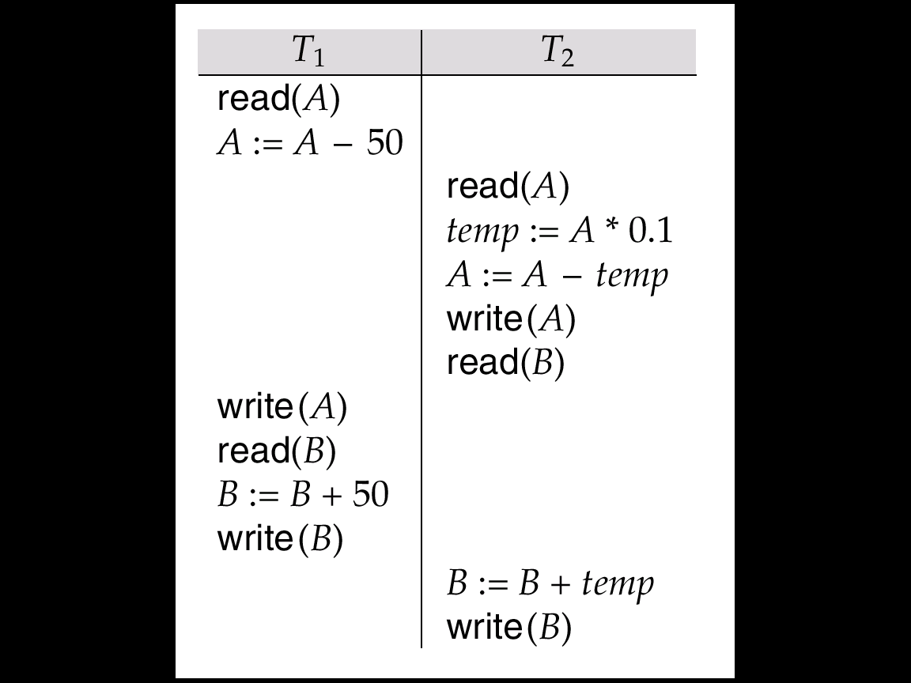
Concurrency control – schedule (example)
The following concurrent schedule does not preserve the value of the sum A + B.
Schedule 4

Slide 10
Concurrency control – big question
Why is schedule 3 equivalent to schedule 1, but schedule 4 is not?
Conflicts?
Order of conflicts?
Any general rules we can apply?

Slide 11
Serializable schedule – example (2)
Consider the fund transfer operation (last lecture)
Find tuple for x’s account (database query)
Read x’s account info into main memory
Check if x have at least $k
Subtract $k from x’s account
Write x’s new balance back to the database (database update)
Find tuple for y’s account (database query)
Read y’s account info into main memory
Add $k to y’s account
Write y’s new balance to the database (database update)
A1 <- Read(X)
A1 <- A1 – k
Write(X, A1)
A2 <- Read(Y)
A2 <- A2 + k
Write(Y, A2)
Rewrite
Using class
notation

Slide 12
Serializable schedule – example (2)
Consider the dividend operation (last lecture)
Find tuple for x’s account (database query)
Read x’s account info into main memory
Add 1% to x’s account
Write x’s new balance back to the database (database update)
Find tuple for y’s account (database query)
Read y’s account info into main memory
Add 1% to y’s account
Write y’s new balance back to the database (database update)
A1 <- Read(X)
A1 <- A1* 1.01
Write(X, A1)
A2 <- Read(Y)
A2 <- A2 * 1.01
Write(Y, A2)
Rewrite
Using class
notation

Slide 13
Serializable schedule – example (2)
Suppose x has $100, y has $200
Consider two operations
x transfer $50 to y
Dividend
For serial schedules
If transfer comes before dividend
X : 100 -> 50 -> 50.5
Y : 200 -> 250 -> 252.5
If dividend comes before transfer
X : 100 -> 101 -> 51
Y : 200 -> 202 -> 252
In both case, X + Y = 303

Slide 14
Serializable schedule – example (2)
But with the following schedule
A1 <- Read(X)
A1 <- A1 – k
Write(X, A1)
A2 <- Read(Y)
A2 <- A2 + k
Write(Y, A2)
A1 <- Read(X)
A1 <- A1* 1.01
Write(X, A1)
A2 <- Read(Y)
A2 <- A2 * 1.01
Write(Y, A2)
X : 100 -> 50 -> 50.5; Y : 200 -> 202 -> 252; X+Y = 302.5

Slide 15
Serializable schedule – example (2)
What cause the problem?
Contention of resources?
Interleaving?
Is interleaving always bad?

Slide 16
Serializable schedule – example (2)
But with the following schedule
A1 <- Read(X)
A1 <- A1 – k
Write(X, A1)
A2 <- Read(Y)
A2 <- A2 + k
Write(Y, A2)
A1 <- Read(X)
A1 <- A1* 1.01
Write(X, A1)
A2 <- Read(Y)
A2 <- A2 * 1.01
Write(Y, A2)
X : 100 -> 50 -> 50.5; Y : 200 -> 250 -> 252.5; X+Y = 303
In this case, interleaving is ok!

Slide 17
Serializable schedule – example (2)
Let’s change slightly:
A1 <- Read(X)
A1 <- A1 – k
Write(X, A1)
A2 <- Read(Y)
A2 <- A2 + k
Write(Y, A2)
A1 <- Read(X)
A1 <- A1* 1.01
Write(X, A1)
A2 <- Read(Y)
A2 <- A2 * 1.01
Write(Y, A2)
X : 100 -> 50 -> 50.5; Y : 200 -> 250 -> 202; X+Y = 252.5
In this case, interleaving is very bad!

Slide 18
Serializable schedule – example (2)
Let’s change slightly (again):
A1 <- Read(X)
A1 <- A1 – k
Write(X, A1)
A2 <- Read(Y)
A2 <- A2 + k
Write(Y, A2)
A1 <- Read(X)
A1 <- A1* 1.01
Write(X, A1)
A2 <- Read(Y)
A2 <- A2 * 1.01
Write(Y, A2)
X : 100 -> 50 -> 50.5; Y : 200 -> 250 -> 252.5; X+Y = 303
In this case, interleaving is good again!

Slide 19
Serializable schedule – example (2)
What’s going on here?
Interleaving can be very bad.
However, some interleaving does not cause problems.
How can we determine what kind of interleaving is “nice”?

Slide 20
Serializable schedule – example (2)
Notice in example
The value of X (and Y) is changed twice
Let’s call the values
Old value (before any change)
Intermediate value (after one change)
Final value (after all changes)

Slide 21
Serializable schedule – example (2)
But with the following schedule
A1 <- Read(X)
A1 <- A1 – k
Write(X, A1)
A2 <- Read(Y)
A2 <- A2 + k
Write(Y, A2)
A1 <- Read(X)
A1 <- A1* 1.01
Write(X, A1)
A2 <- Read(Y)
A2 <- A2 * 1.01
Write(Y, A2)
X : 100 -> 50 -> 50.5; Y : 200 -> 202 -> 252; X+Y = 302.5

Slide 22
Serializable schedule – example (2)
A1 <- Read(X)
A1 <- A1 – k
Write(X, A1)
A2 <- Read(Y)
A2 <- A2 + k
Write(Y, A2)
A1 <- Read(X)
A1 <- A1* 1.01
Write(X, A1)
A2 <- Read(Y)
A2 <- A2 * 1.01
Write(Y, A2)
Notice that the two transaction use inconsistent values as input.
But: how to formalize this notion?

Slide 23
Serializability
How to formalize the notion?
One can look at final results
If the schedule produce the same result as a serial schedule, then it’s fine.
However, this may be due to luck and/or “commutative” operators
A1 <- Read(X)
A1 <- A1 – k
Write(X, A1)
A2 <- Read(Y)
A2 <- A2 + k
Write(Y, A2)
A1 <- Read(X)
A1 <- A1 + m
Write(X, A1)
A2 <- Read(Y)
A2 <- A2 - m
Write(Y, A2)
A better notion is needed

Slide 24
Conflict serializability
Suppose two transactions (T₁, T₂) want to operate on the same data object (X)
Four possible scenarios
T₁ Read(X), T₂ Read(X)
T₁ Read(X), T₂ Write(X)
T₁ Write(X), T₂ Read(X)
T₁ Write(X), T₂ Write(X)
How does the order of these operations affect the results of the transactions?

Slide 25
Conflict serializability
T₁ Read(X), T₂ Read(X)
No effect.
T₁ Read(X), T₂ Write(X)
Order will determine what value of X T₁ reads
Affect the results of T₁
T₁ Write(X), T₂ Read(X)
Order will determine what value of X T₂ reads
Affect the results of T₂
T₁ Write(X), T₂ Write(X)
No effect on T₁ and T₂
But affect on the next transaction that read X
Thus, in 2nd to 4th case order matters
We denote that the pair(s) of operations are in conflict

Slide 26
Conflict serializability
What’s conflict have to do with it?
Consider a schedule of two transactions (T₁, T₂)
Suppose T₁ execute operation I₁, and than T₂ execute operation I₂
If I₁ and I₂ has conflict
Then swapping them implies potential problem
Else, (we claim) the results are not affected

Slide 27
Conflict serializability -- example
Remember this schedule?
A1 <- Read(X)
A1 <- A1 – k
Write(X, A1)
A2 <- Read(Y)
A2 <- A2 + k
Write(Y, A2)
A1 <- Read(X)
A1 <- A1* 1.01
Write(X, A1)
A2 <- Read(Y)
A2 <- A2 * 1.01
Write(Y, A2)
X : 100 -> 50 -> 50.5; Y : 200 -> 250 -> 252.5; X+Y = 303
In this case, interleaving is ok!

Slide 28
Conflict serializability -- example
Remember this schedule?
A1 <- Read(X)
A1 <- A1 – k
Write(X, A1)
A2 <- Read(Y)
A2 <- A2 + k
Write(Y, A2)
A1 <- Read(X)
A1 <- A1* 1.01
Write(X, A1)
A2 <- Read(Y)
A2 <- A2 * 1.01
Write(Y, A2)
(4) And (iii) are not in conflict, so can swap

Slide 29
Conflict serializability -- example
Remember this schedule?
A1 <- Read(X)
A1 <- A1 – k
Write(X, A1)
A2 <- Read(Y)
A2 <- A2 + k
Write(Y, A2)
A1 <- Read(X)
A1 <- A1* 1.01
Write(X, A1)
A2 <- Read(Y)
A2 <- A2 * 1.01
Write(Y, A2)
(4) And (ii) are not in conflict, so can swap

Slide 30
Conflict serializability -- example
Remember this schedule?
A1 <- Read(X)
A1 <- A1 – k
Write(X, A1)
A2 <- Read(Y)
A2 <- A2 + k
Write(Y, A2)
A1 <- Read(X)
A1 <- A1* 1.01
Write(X, A1)
A2 <- Read(Y)
A2 <- A2 * 1.01
Write(Y, A2)
(4) And (i) are not in conflict, so can swap

Slide 31
Conflict serializability -- example
Remember this schedule?
A1 <- Read(X)
A1 <- A1 – k
Write(X, A1)
A2 <- Read(Y)
A2 <- A2 + k
Write(Y, A2)
A1 <- Read(X)
A1 <- A1* 1.01
Write(X, A1)
A2 <- Read(Y)
A2 <- A2 * 1.01
Write(Y, A2)
Similarily (5) And (i) – (iii) are not in conflict, so can swap

Slide 32
Conflict serializability -- example
Remember this schedule?
A1 <- Read(X)
A1 <- A1 – k
Write(X, A1)
A2 <- Read(Y)
A2 <- A2 + k
Write(Y, A2)
A1 <- Read(X)
A1 <- A1* 1.01
Write(X, A1)
A2 <- Read(Y)
A2 <- A2 * 1.01
Write(Y, A2)
Similarily (6) And (i) – (iii) are not in conflict, so can swap
We obtain a serial schedule by this transformation (swapping process)

Slide 33
Conflict serializability -- example
Now, remember this schedule?
A1 <- Read(X)
A1 <- A1 – k
Write(X, A1)
A2 <- Read(Y)
A2 <- A2 + k
Write(Y, A2)
A1 <- Read(X)
A1 <- A1* 1.01
Write(X, A1)
A2 <- Read(Y)
A2 <- A2 * 1.01
Write(Y, A2)
X : 100 -> 50 -> 50.5; Y : 200 -> 202 -> 252; X+Y = 302.5

Slide 34
Conflict serializability -- example
Now, remember this schedule?
A1 <- Read(X)
A1 <- A1 – k
Write(X, A1)
A2 <- Read(Y)
A2 <- A2 + k
Write(Y, A2)
A1 <- Read(X)
A1 <- A1* 1.01
Write(X, A1)
A2 <- Read(Y)
A2 <- A2 * 1.01
Write(Y, A2)
(3) And (i) has conflict, so can’t swap
(4) And (vi) has conflict, so can’t swap

Slide 35
Conflict serializability -- example
Can you work through this case?
A1 <- Read(X)
A1 <- A1 – k
Write(X, A1)
A2 <- Read(Y)
A2 <- A2 + k
Write(Y, A2)
A1 <- Read(X)
A1 <- A1* 1.01
Write(X, A1)
A2 <- Read(Y)
A2 <- A2 * 1.01
Write(Y, A2)
X : 100 -> 50 -> 50.5; Y : 200 -> 250 -> 202; X+Y = 250.5
In this case, interleaving is very bad!

Slide 36
Conflict serializability -- example
From previous slides, it seems
A schedule can be transformed to a serial schedule ⇒ good! (achieve isolation)
A schedule cannot be transformed to a serial schedule ⇒ bad! (do not achieve isolation)
Can we generalize?
Yes.

Slide 37
Conflict serializability -- definitions
Schedule: – sequences that indicate the chronological order in which instructions of concurrent transactions are executed
Complete schedule: Schedule that contain commit/abort decision for each transaction in the schedule
Serial schedule: A schedule where there is no interleaving of operations by multiple transactions.
Denoted by < T1, T2, … , Tn>

Slide 38
Conflict serializability -- definitions
Given a schedule S, let p and q be two operations in S, we write p <_{S} q if p occurs before q in S.
We write < instead of <_{S} if the schedule is understood from context.
We use a subscript to indicate the transaction that issues an operation, e.g., p_{i} is an operation issued by transaction T_{i}.

Slide 39
Conflict serializability -- definitions
Conflict equivalent transformation: swapping adjacent operation on a schedule which does not conflict
Conflict equivalent: Two schedules S and S’ are conflict equivalent if S can be transformed to S’ by successive conflict equivalent transformations

Slide 40
Conflict serializability -- definitions
Given a schedule S, the committed projection of S, denoted by C(S), is the schedule obtained from S by deleting all operations that do not belong to transactions committed in S.

Slide 41
Conflict serializability -- definitions
Conflict serializability: a schedule S is conflict serializable if it is conflict equivalent to a serial schedule
Example of a schedule that is not conflict serializable:
T₃ T₄ read(Q) write(Q) write(Q) We are unable to swap instructions in the above schedule to obtain either the serial schedule < T₃, T₄ >, or the serial schedule < T₄, T₃ >.

Slide 42
Test for serializability
Consider the following schedules:
A1 <- Read(X)
A1 <- A1 – k
Write(X, A1)
A2 <- Read(Y)
A2 <- A2 + k
Write(Y, A2)
A1 <- Read(X)
A1 <- A1 – k
Write(X, A1)
A2 <- Read(Y)
A2 <- A2 + k
Write(Y, A2)
A1 <- Read(X)
A1 <- A1* 1.01
Write(X, A1)
A2 <- Read(Y)
A2 <- A2 * 1.01
Write(Y, A2)
A1 <- Read(X)
A1 <- A1* 1.01
Write(X, A1)
A2 <- Read(Y)
A2 <- A2 * 1.01
Write(Y, A2)
Not serializable
Serializable

Slide 43
Test for serializability
Label all the conflicting operations
A1 <- Read(X)
A1 <- A1 – k
Write(X, A1)
A2 <- Read(Y)
A2 <- A2 + k
Write(Y, A2)
A1 <- Read(X)
A1 <- A1 – k
Write(X, A1)
A2 <- Read(Y)
A2 <- A2 + k
Write(Y, A2)
A1 <- Read(X)
A1 <- A1* 1.01
Write(X, A1)
A2 <- Read(Y)
A2 <- A2 * 1.01
Write(Y, A2)
A1 <- Read(X)
A1 <- A1* 1.01
Write(X, A1)
A2 <- Read(Y)
A2 <- A2 * 1.01
Write(Y, A2)
Not serializable
Serializable
What is the difference?

Slide 44
Test for serializability
The serialization graph (SG) (or the precedence graph used in the textbook) for a schedule S, denoted SG(S), is a directed graph (V, E) such that:
V (nodes) = the set of transactions that are committed in S.
E (edges) = T_{i} T_{j} (i ≠ j) if one of T_{i}’s operation precedes and conflicts with one of T_{j}’s operations in S.
Theorem: A schedule is conflict serializable iff its serialization graph is acyclic

Slide 45
Test of serializability -- example
T₁ T₂ T₃ T₄ T₅ read(X) read(Y) read(Z) read(V) read(W) read(W) read(Y) write(Y) write(Z) read(U) read(Y) write(Y) read(Z) write(Z)
read(U) write(U)
T₁
T₂
T₄
T₃

Slide 46
Test of serializability
Proof: (if)
SG(S) is acyclic ⇒ there exists a topological order of the committed transactions in S.
W.l.o.g., let S’ = T₁, T₂, …, T_{m} be such an order. We can show that C(S ) ≡ S’.
Let p_{i} and q_{j} (i ≠ j) be two conflicting operations in S such that T_{i} and T_{j} are committed in S.
Clearly, p_{i} & q_{j} ∈C(S).
If p_{i} <_{S} q_{j}, we have an edge T_{i}  T_{j} in SG(S).
Therefore, T_{i} must precede T_{j} in S’. That is, all operations of T_{i} appear before all operations of T_{j} in S’.
Hence, p_{i} <_{S’} q_{j}.

Slide 47
Test of serializability
Proof: (only if)
S is serializable ⇒ C(S) ≡ to some serial schedule S’.
If an edge T_{i} T_{j} exists in SG(S), then, T_{i} must appear before T_{j} in S’.
Now, if SG(S) has a cycle, w.l.o.g., let it be T₁  T₂  …  T_{k}  T₁.
We have T₁’s operations must appear before T₂’s operations, which must appear before T₃’s operations, …, T_{k}’s operations must appear before T₁’s operations.
A contradiction.

Slide 48
Test of serializability
Cycle-detection algorithms exist which take order n² time, where n is the number of vertices in the graph.
(Better algorithms take order n + e where e is the number of edges.)
If precedence graph is acyclic, the serializability order can be obtained by a topological sorting of the graph. This is a linear order consistent with the partial order of the graph.

Slide 49
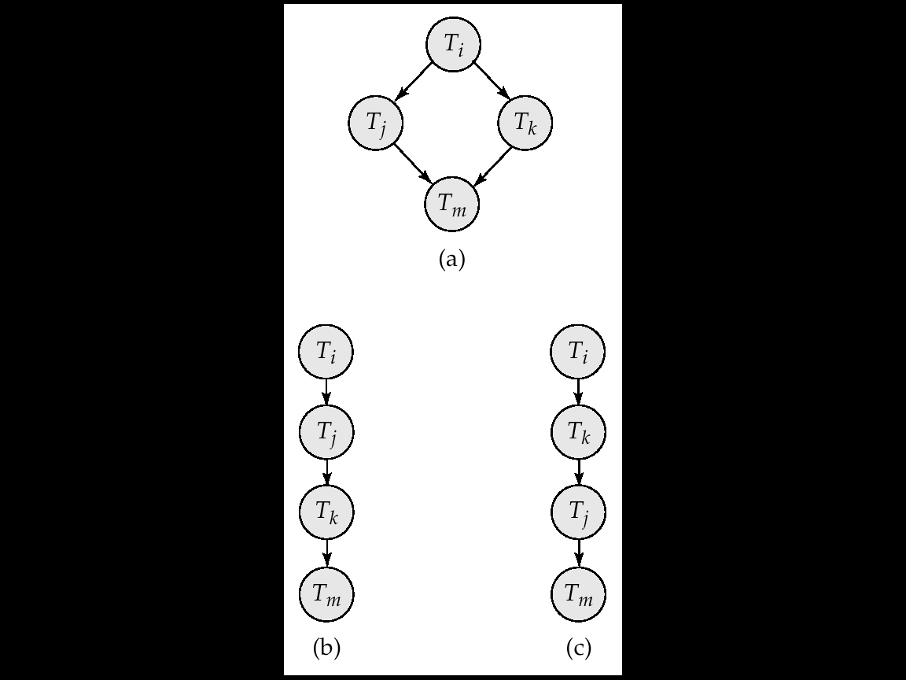
Example of topological sort

Slide 50
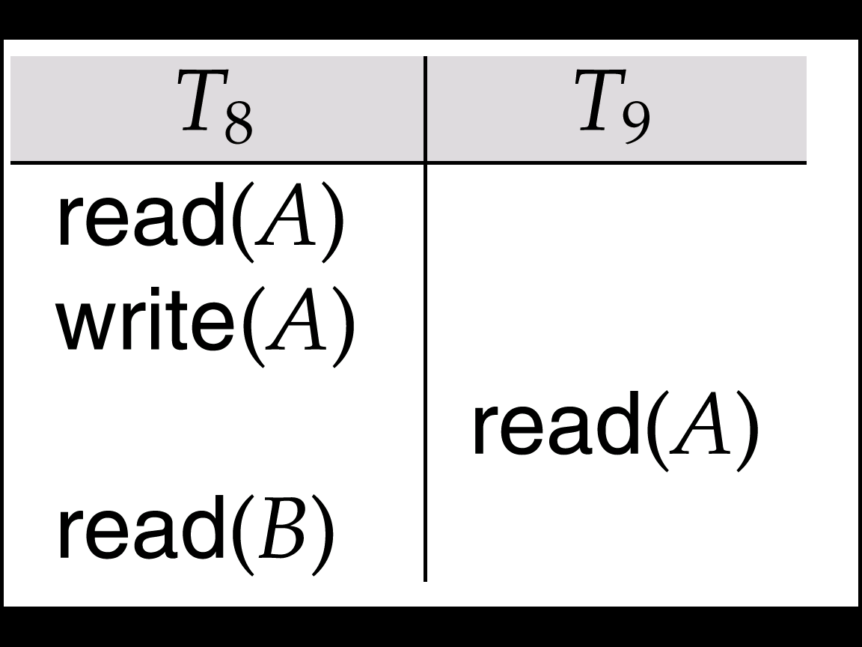
Recoverability
Abort transactions caused another problem:
Suppose T₉ commits.
What happen when T₈ has to abort after read(B)?
T₉ will in fact be reading an inconsistant value
Can be problematic (e.g. if T₉ print the value of A)

Slide 51
Recoverability
We say that T_{i} reads x from T_{j} in a schedule S if
W_{j}[x] <_{S} R_{i}[x], (Ti read an x value written by Tj)
A_{j} not <_{S} R_{i}[x], (Tj has not aborted when Ti read x)
If ∃ W_{k}[x] s.t. W_{j}[x] <_{S} W_{k}[x] <_{S} R_{i}[x], then A_{k} <_{S} R_{i}[x]. (Any transaction that update x between Tj write x and Ti read x is aborted before the read – that means the value of x read by Ti is actually written by Tj)
We say that T_{i} reads from T_{j} in S if T_{i} reads some data item from T_{j} in S.

Slide 52
Recoverability
A schedule S is called recoverable if, whenever T_{i} reads from T_{j} (i ≠ j) in S and C_{i} ∈ S then C_{j} < C_{i}
I.e., each transaction commits after the commitment of all transactions (other than itself) from which it read from
This implies all aborted transaction will not make values that are read by committed transaction obsolete/inconsistent.

Slide 53
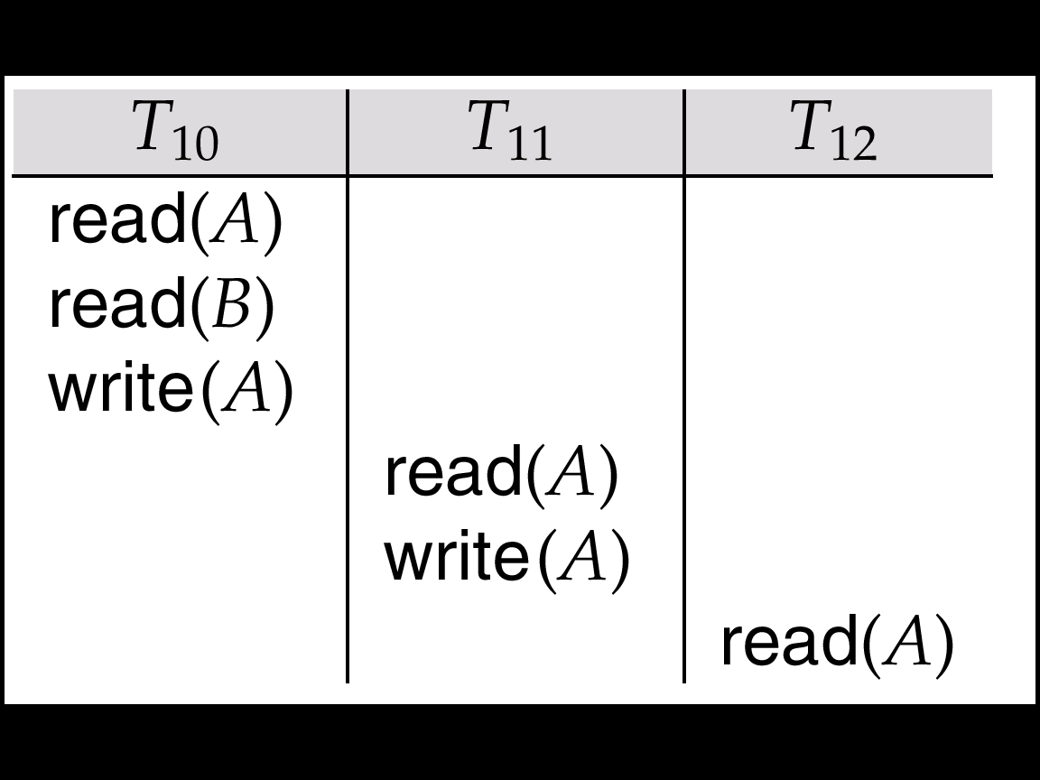
Recoverability
Even for recoverable schedule, trouble may still bestows.
Suppose none of the transactions committed yet.
Suppose T10 aborts after read(A)
T11 needs to be aborted (as it read values from T10)
T12 needs to be aborted too
Cascade aborts

Slide 54
Recoverability
We say that a schedule S avoids cascading abort if, when T_{i} reads x from T_{j} (i ≠ j), C_{j} < R_{i}[x].
I.e., a transaction may read only those values that are written by committed transaction or by itself.
A schedule S is strict if whenever W_{j}[x] < O_{i}[x] (i ≠ j), either A_{j}< O_{i}[x] or C_{j} < O_{i}[x] where O_{i}[x] is R_{i}[x] or W_{i}[x].
I.e., no data item may be read or written until the transaction that previously wrote into it terminates, either by aborting or by committing.

Slide 55
Serializability – In practice
Scheduling is usually not up to the DBMS
Operating systems do it, so why spend time reinventing the wheel?
Detection of serializability is limited in usage
Cycle detection (while not NP complete) is not very cheap
Testing for serializability after execution is not really helpful
Goal – to develop concurrency control protocols that will assure serializability.
not examine the precedence graph as it is being created;
instead a protocol will impose a discipline that avoids nonseralizable schedules.
However, test for serializability will help one to understand and proof the correctness of such protocals

Slide 56
Serializability – In practice
Data manipulation language must include a construct for specifying the set of actions that comprise a transaction.
In SQL, a transaction begins implicitly.
A transaction in SQL ends by:
Commit work commits current transaction and begins a new one.
Rollback work causes current transaction to abort.
Levels of consistency specified by SQL-92:
Serializable — default
Repeatable read
Read committed
Read uncommitted

Slide 57
Serializability – In practice
Serializable — default
Repeatable read — only committed records to be read, repeated reads of same record must return same value. However, a transaction may not be serializable – it may find some records inserted by a transaction but not find others.
Read committed — only committed records can be read, but successive reads of record may return different (but committed) values.
Read uncommitted — even uncommitted records may be read.
(We will revisit these terms later)

