Slide 1
CS 5330/7330
Transaction Processing Overview

Slide 2
Motivation
Operations on databases (e.g. SQL commands)
Queries : select … from … where
Insertions : insert … values …
Deletions : delete … where …
Updates : update … where …
Create tables, change attributes etc.
These are basic operations on tables
But are they “too basic” in real life?

Slide 3
Motivation
Consider a database for bank accounts
Basic operations (in the eye of the customers)
Withdraw
Deposit
Transfer
Dividend
Each basic operations contains multiple database operations

Slide 4
Motivation
Example : Transfer $k from x to y (Method 1)
Find tuple for x’s account (database query)
Read x’s account info into main memory
Check if x have at least $k
Subtract $k from x’s account
Write x’s new balance back to the database (database update)
Find tuple for y’s account (database query)
Read y’s account info into main memory
Add $k to y’s account
Write y’s new balance to the database (database update)

Slide 5
Motivation
One need to maintain
Consistency/Correctness
Efficiency
Correctness/consistency : The right amount of money being transferred
Easy to check for normal operations
But what if
System crashes
Multiple users want to update same data

Slide 6
Motivation
System crashes, case 1
Find tuple for x’s account (database query)
Read x’s account info into main memory
Check if x have at least $k
Subtract $k from x’s account
Write x’s new balance back to the database (database update)
Find tuple for y’s account (database query)
Read y’s account info into main memory
Add $k to y’s account
Write y’s new balance to the database (database update)
What is the database like now?
What happen if we don’t do anything about it?
System crashes! --------------------------------- System crashes!

Slide 7
Motivation
System crashes, case 2
Find tuple for x’s account (database query)
Read x’s account info into main memory
Check if x have at least $k
Subtract $k from x’s account
Write x’s new balance back to the database (database update)
Find tuple for y’s account (database query)
Read y’s account info into main memory
Add $k to y’s account
Write y’s new balance to the database (database update)
OK?
But what is output is being buffered?
System crashes! --------------------------------- System crashes!

Slide 8
Motivation
Two potential problems
System crashes in the middle
Need to make sure the system is consistent after restarting
Some tuples may be updated by others aren’t
What should one do?
System crashes at the “end”
It is unclear if all changes is saved onto the disk
When system crashes, all the unsaved changes is lost
Need to ensure that all changes are reflected

Slide 9
Motivation
Another problem: multiple users
Consider another operation, dividend:
Find tuple for x’s account (database query)
Find tuple for y’s account (database query)
Read x’s account info into main memory
Read y’s account info into main memory
Add 1% to x’s account
Write x’s new balance back to the database (database update)
Add 1% to y’s account
Write y’s new balance back to the database (database update)

Slide 10
Motivation
Suppose x has $100, y has $200
Consider two operations
x transfer $50 to y
Dividend
If transfer comes before dividend
X : 100 -> 50 -> 50.5
Y : 200 -> 250 -> 252.5
If dividend comes before transfer
X : 100 -> 101 -> 51
Y : 200 -> 202 -> 252

Slide 11
Motivation
What if we want concurrent execution?
What does concurrent mean?
Can we concurrently run commands without any limitations?
What is an acceptable schedule?

Slide 12
Motivation
Find tuple for x’s account (database query)
Read x’s account info into main memory
Check if x have at least $k
Subtract $k from x’s account
Write x’s new balance back to the database (database update)
Find tuple for y’s account (database query)
Read y’s account info into main memory
Add $k to y’s account
Write y’s new balance to the database (database update)
Find tuple for x’s account (database query)
Find tuple for y’s account (database query)
Read x’s account info into main memory
Read y’s account info into main memory
Add 1% to x’s account
Write x’s new balance back to the database (database update)
Add 1% to y’s account
Write y’s new balance back to the database (database update)
X : 100 -> 50 -> 50.5; Y : 200 -> 202 -> 252
Acceptable to the bank, but not the customer….

Slide 13
Motivation
Thus need to define an acceptable standard of consistency, in the face of concurrent execution with other commands
A plausible definition:
“If multiple commands execute concurrently, the results must looks like that the commands are executed one by one (sequentially)

Slide 14
Motivation
Many of the above problems can be eliminated if we
Disable concurrency
Forcing writes to disk immediately
Do not write anything until the end of the command
However this leads to inefficiency
Thus: how to get the best of both worlds…

Slide 15
Transaction basics -- definition
A transaction is a unit of program execution that accesses and possibly updates various data items.
Can be defined as
A set of SQL statements
Stored procedures
Initiated by high level programming languages (Java, C++ etc.)
Delimited by begin transaction & end transaction
Example:
Begin transaction
X = select salary from person where name = “Chu”
update person set salary = x * 10 where name = “”
Update person set salary = x / 10 where name = “”
End transaction

Slide 16
Transaction basics -- states
A transaction can be in any one of the 5 states:
Active, the initial state; the transaction stays in this state while it is executing
Partially committed, after the final statement has been executed.
Failed, after the discovery that normal execution can no longer proceed.
Aborted, after the transaction has been rolled back and the database restored to its state prior to the start of the transaction. Two options after it has been aborted:
restart the transaction – only if no internal logical error
kill the transaction
Committed, after successful completion.

Slide 17
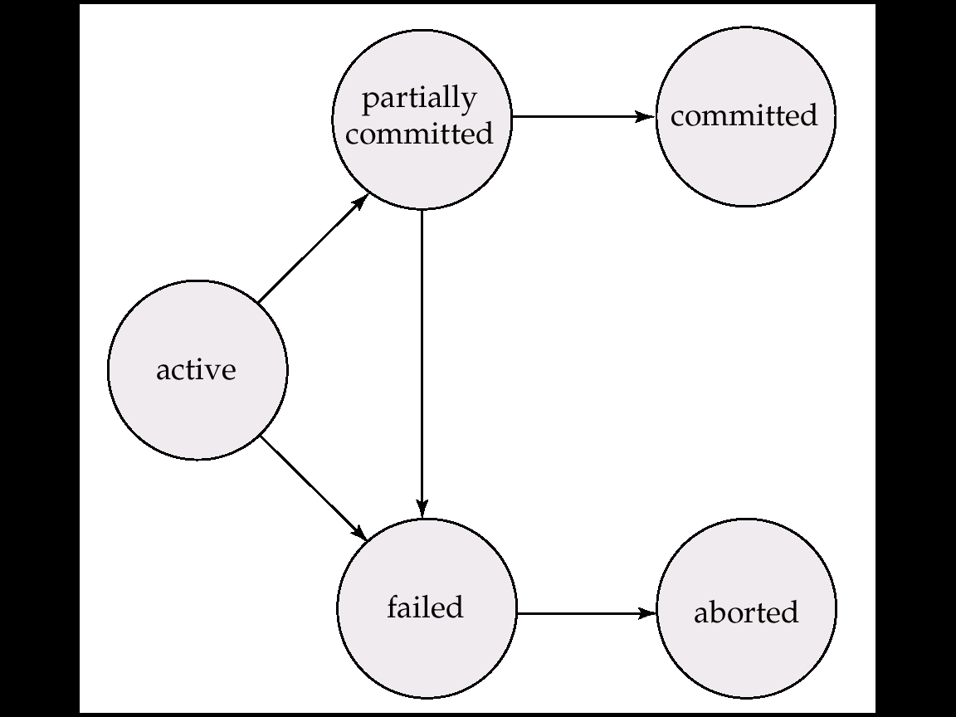
Transaction basics -- states

Slide 18
Transaction basics -- states
A transaction need not commit immediately after its last statement
Why?
It is the DBMS’s responsibility to determine which transactions can commit and which to abort
Also, it is the DBMS’s responsibility to clean up (roll back) after a transaction aborts
Possibility of cascade aborts

Slide 19
Transaction basics -- consistency
A transaction must see a consistent database.
During transaction execution the database may be inconsistent.
When the transaction is committed, the database must be consistent.
Two main issues to deal with:
Failures of various kinds, such as hardware failures and system crashes
Concurrent execution of multiple transactions

Slide 20
Transaction basics -- ACID
Four basic properties that must be maintained
Atomicity : All or nothing
Consistency : Each transaction must ensure data consistency
Isolation : Transactions “unaware” of other concurrent transaction
Durability : Once committed, changes to database must be persistent

Slide 21
Transaction basics -- ACID
Atomicity : All or nothing
i.e. : Either all operations of the transaction are properly reflected in the database or none are.
Implications
If the system crashes in the middle of a transaction T, when the system restarts, before any user can use the database again, the DBMS must ensure either
T is finished
T never started
Which do you think is easier? Make more sense?

Slide 22
Transaction basics -- ACID
Consistency: Each transaction must ensure data consistency
i.e. Execution of a transaction in isolation preserves the consistency of the database.
Thus all integrity and other constraints must be satisfied

Slide 23
Transaction basics -- ACID
Isolation : Transactions “unaware” of other concurrent transaction
Intermediate transaction results must be hidden from other concurrently executed transactions.
Implications:
for every pair of transactions T_{i} and T_{j}, it appears to T_{i} that either T_{j}, finished execution before T_{i} started, or T_{j} started execution after T_{i} finished.
Some level of interleaving are not allowed

Slide 24
Transaction basics -- ACID
Durability : Once committed, changes to database must be persistent
i.e. : After a transaction completes successfully, the changes it has made to the database persist, even if there are system failures.
Implications:
Suppose a transaction commits, and then the system crashes. When the system restarts, before any user can use the database again, the DBMS must ensure that the changes made by this transaction is stored onto the disk.
Why is this not automatically the case?

Slide 25
Transaction basics -- ACID
DBMS, not the user, is required to maintain ACID properties
The user will submit the transactions only containing the required database operations
The DBMS will
Add additional operations
Schedule the operations
Introduce various data structures and algorithms
to ensure the ACID properties hold
If needed, the DBMS will decide when a transaction will commit and/or abort
In many DBMS, users can specify when should a transaction commit/abort
Roll back is also the task of the DBMS
Need to worry about “observable external writes”

Slide 26
Transaction basics – DBMS support
2 major tasks in DBMS to handle transactions
Concurrency control
Handle how concurrent transaction is executed
Goal: Isolation
Recovery
Handle how to recover a database after a failure
Goal: Atomicity & Durability
Consistency is maintained throughout various part of the DBMS (not the focus of this course)
Many systems rolls the two part together as a “transaction manager”

Slide 27
Transaction basics – DBMS support
What is actually happening
Database is stored on the disk
DBMS allocate local memory for each transaction
Each transaction requests a set of tuples
Transaction issues read commands (e.g. select … from … where )
The set of tuples are read into main memory buffers
The value of the tuples are transferred from those buffers to the local memory for each transaction
Calculation and updates are done in local memory
The transaction issues write commands (e.g. update … set … where)
The values in the local memory is copied to the buffers
The buffers are flushed to the disk by the Operating systems (at unspecified time, unless transaction forces it)

Slide 28
Transaction basics – DBMS support
What makes transaction processing tricky
Scheduling is hidden from the DBMS
DBMS cannot enforce which transaction to execute next
Buffer management is hidden from DBMS
Although the transaction write something onto the database, it is only written to the buffers, to be transferred to the disk at unspecified time
One can force transfer immediately, but will be very inefficient

Slide 29
Notation used (rest of semester)
Database consists of objects (X, Y, Z), each of them is an integer
Transactions are labeled T₁, T₂ etc.
Each transaction has a set of local variables (not accessible by other transactions) in main memory. (Labelled as a1, a2, b1, b2 etc.)
Each transaction access the database by the read() & write() command

Slide 30
Notation used (rest of semester)
A read command read a database object into a local variables (a1 <- read(X))
A write command write a local variable into the database object (write(X, a1))
Local variables for read() & write() will not be shown if the context is clear, or if it is unimportant
Manipulation and calculation on objects can only be done on local variables (e.g. X <- X + 1 is not allowed, but a1 <- a1 + 1 is ok)
In some case, the local manipulation is not shown (to highlight the effects of read() and write())

Slide 31
Notation used (rest of semester)
Example; (transfer, assuming overdraft is allowed)
A1 <- Read(X)
A1 <- A1 – k
Write(X, A1)
A2 <- Read(Y)
A2 <- A2 + k
Write(Y, A2)

