Slide 1
CS 5330/7330
Two phase locking

Slide 2
Table of contents
Lock-based protocol
2-phase locking
Deadlocks
Lock implementation
The phantom problem

Slide 3
The story so far
Isolation: one key requirement for transaction
Isolation as conflict serializability
Why conflict serializability
Cycles in serializability
Multiple transactions share the same objects
The contention goes in both directions

Slide 4
So …
Need to provide protocol (rules on how data item is accessed) to ensure conflict serializability
Goal of protocol:
To allow access for data items that are not required by multiple transactions
For those data items required by multiple transaction, restrict access in some way, or limit it to exclusive access
Balance between safety and efficiency
Too restrictive: little or no concurrency, ineffective
Too lenient: leads to inconsistency

Slide 5
Lock-based protocols
“Exclusive” access ⇒ locks
Each database item is associated with locks
Transaction must obtain locks before accessing the object
Transaction must release lock when it finishes.

Slide 6
Lock-based protocols
Example:
Lock(X): check if object X is already locked
If not, obtain the lock
If so, wait or “do something” to handle the potential deadlock (like aborting)
One does not have to read immediately after locking
Unlock(X): release the lock on object X
The addition of Lock(X) and Unlock(X) commands are done by the DBMS
Lock(X)
Read(X)
Unlock(X)
Read(X)

Slide 7
Lock-based protocols: S and X locks
How many transaction can obtain the lock to an item?
One
Too restrictive?
Consider the two transactions
There seems to be no reason for one transaction to wait for the other
Read(X)
Read(Y)
Read(Z)
T1
Read(Y)
Read(X)
Read(Z)
T2

Slide 8
Lock-based protocols: S and X locks
Two kinds of locks on each object
Shared locks (S-locks)
Requested before reading
Multiple transactions can hold a S-lock on an object simultaneously
Exclusive locks (X-locks)
Requested before writing
Only one transaction can hold an X-lock on an object at any given time
No other transaction can hold any lock (not even a S-lock) if some transaction has an X-lock

Slide 9
Lock-based protocols: S and X locks
More on S and X locks
A transaction that holds an S-lock on an object can read the object
A transaction that holds an X-lock on an object can read and write the objects
Lock-compatibility table
 | S-lock | X-lock
S-lock | True | False
X-lock | False | False
T2 holds
T1 Request

Slide 10
Lock-based protocol
Consider the following examples (again):
A1 <- Read(X)
A1 <- A1 – k
Write(X, A1)
A2 <- Read(Y)
A2 <- A2 + k
Write(Y, A2)
A1 <- Read(X)
A1 <- A1* 1.01
Write(X, A1)
A2 <- Read(Y)
A2 <- A2 * 1.01
Write(Y, A2)
T1 (Transfer)
T2 (Dividend)

Slide 11
Lock-based protocol -- example
With a lock-based protocol, one possible way T1 is transformed
S-lock(X)
A1 <- Read(X)
A1 <- A1 – k
X-lock(X)
Write(X, A1)
X-lock(Y)
A2 <- Read(Y)
A2 <- A2 + k
Write(Y, A2)
Unlock(X)
Unlock(Y)
A1 <- Read(X)
A1 <- A1 – k
Write(X, A1)
A2 <- Read(Y)
A2 <- A2 + k
Write(Y, A2)
T1 (Transfer)

Slide 12
Lock-based protocol -- example
Notes from the previous example:
Locks must be obtained before read/write can begin
If a transaction want to read and write the same object, it can either
Obtain an X-lock before reading
Obtain an S-lock before reading, then obtain an X-lock before writing (it is not automatically granted)
A transaction does not have to release locks immediately after use
Good or bad?

Slide 13
Lock-based protocol -- example
Example of schedule with locks
S-lock(X)
A1 <- Read(X)
Unlock(X)
A1 <- A1 – k
X-lock(X)
Write(X, A1)
Unlock(X)
S-lock(Y)
A2 <- Read(Y)
Unlock(Y)
A2 <- A2 + k
X-lock(Y)
Write(Y, A2)
Unlock(Y)
S-lock(X)
A1 <- Read(X)
Unlock(X)
A1 <- A1* 1.01
X-lock(X)
Write(X, A1)
Unlock(X)
S-lock(Y)
A2 <- Read(Y)
Unlock(Y)
A2 <- A2 * 1.01
X-lock(Y)
Write(Y, A2)
Unlock(Y)
T1
T2

Slide 14
Lock-based protocol -- example
Example of schedule with locks
S-lock(X)
A1 <- Read(X)
Unlock(X)
A1 <- A1 – k
X-lock(X)
X-lock(X)
Write(X, A1)
Unlock(X)
….
S-lock(X)
A1 <- Read(X)
Unlock(X)
A1 <- A1* 1.01
X-lock(X)
X-lock(X)
No wait: S-locks
T1 waits
T1 can go ahead
T2 waits
T2 can go ahead
T1
T2

Slide 15
Lock based protocols -- questions
Does having locks this way guarantee conflict serializability?
Is there any other requirements in the order/manner of accquiring/releasing locks?
Does it matter when to acquire locks?
Does it matter when to release locks?

Slide 16
Lock based protocols – need for a protocol
Suppose we request a lock immediately before reading/writing
We release a lock immediately after each read/write
Does it guarantee serializability?

Slide 17
Lock based protocol – need for a protocol
But with the following schedule
A1 <- Read(X)
A1 <- A1 – k
Write(X, A1)
A2 <- Read(Y)
A2 <- A2 + k
Write(Y, A2)
A1 <- Read(X)
A1 <- A1* 1.01
Write(X, A1)
A2 <- Read(Y)
A2 <- A2 * 1.01
Write(Y, A2)
X : 100 -> 50 -> 50.5; Y : 200 -> 202 -> 252; X+Y = 302.5
Not conflict serializable.

Slide 18
Lock based protocol – need for a protocol
S-lock (X)
A1 <- Read(X)
A1 <- A1 – k
Write(X, A1)
A2 <- Read(Y)
A2 <- A2 + k
Write(Y, A2)
Unlock(X)
X-lock (X)
Unlock(X)
S-lock (X)
A1 <- Read(X)
A1 <- A1* 1.01
Write(X, A1)
A2 <- Read(Y)
A2 <- A2 * 1.01
Write(Y, A2)
Unlock(X)
Unlock(X), Slock(Y)
Unlock(Y)
X-lock (Y)
Unlock(Y)
S-lock (Y)
Unlock(Y)
X-lock (Y)
Unlock(Y)
Not conflict serializable.

Slide 19
Lock based protocol – need for a protocol
So the previous technique does not work.
How about, only releasing a lock after all operations on the object is finished?

Slide 20
Lock based protocol – need for a protocol
S-lock (X)
A1 <- Read(X)
A1 <- A1 – k
Write(X, A1)
A2 <- Read(Y)
A2 <- A2 + k
Write(Y, A2)
X-lock (X)
Unlock(X)
S-lock (X)
A1 <- Read(X)
A1 <- A1* 1.01
Write(X, A1)
A2 <- Read(Y)
A2 <- A2 * 1.01
Write(Y, A2)
Unlock(X), Slock(Y)
X-lock (Y)
Unlock(Y)
S-lock (Y)
X-lock (Y)
Unlock(Y)
Not conflict serializable.

Slide 21
Two-phase locking -- motivation
What is the problem?
When a transaction release a lock on an object , that means other transactions can obtain a lock on it.
In this case, there is contention from T1 to T2
To ensure serializability, we must ensure there is no conflict from T2 back to T1
How?
X-lock(X)
Write(X, 100)
Unlock(X)
S-lock(X)
Read(X)
……
T1
T2

Slide 22
Two-phase locking -- motivation
Ensure that T1 does not read/write anything that T2 read/write.
Unrealistic to check in real life
What is a sufficient condition then?
Ensure T1 does not read/write anything after releasing the lock!
⇒ (basic) Two-phase locking

Slide 23
Two phase locking – definition
The basic two-phase locking (2PL) protocol
A transaction T must hold a lock on an item x in the appropriate mode before T accesses x.
If a conflicting lock on x is being held by another transaction, T waits.
Once T releases a lock, it cannot obtain any other lock subsequently.
Note: a transaction is divided into two phases:
A growing phase (obtaining locks)
A shrinking phase (releasing locks)
Claim : 2PL ensures conflict serializability

Slide 24
Two phase locking – Notations
If the operation is immaterial, we will simply use lock_{i}[x] and unlock_{i}[x] to denote the operations that T_{i} locks and unlocks x, respectively.
o_{i}[x] : the execution of the operation o by T_{i} on x
<_{s} : the ordering relationship between operations in the schedule S (We omit the subscript s if the context is clear)

Slide 25
Two phase locking – Notations
2PL implies
o-lock_{i}[x] < o_{i}[x] < o-unlock_{i}[x] (if T_{i} commits)
i.e. you obtain a lock, than read/write, then unlock
Given two conflicting operations p_{i}[x] and q_{j}[x], we have either p-unlock_{i}[x] < q-lock_{j}[x], or q-unlock_{j}[x] < p-lock_{i}[x]
i.e. if there are two conflicting operations, they cannot both hold the lockas at the same time
For any p-lock_{i}[x] and q-unlock_{i}[y], p-lock_{i}[x] < q-unlock_{i}[y]
i.e. Every transaction is 2-phase (you cannot lock something after you unlock anything)

Slide 26
Two phase locking – Proof
By contradiction
If T_{i}  T_{j} in SG(S), we have a p_{i}[x] conflict with a q_{j}[x] and that p_{i}[x] < q_{j}[x] in S
⇒ p-unlock_{i}[x] < q-lock_{j}[x]
If T_{i}  T_{j}  T_{k} in SG(S) ⇒ ∃x, y such that unlock_{i}[x] < lock_{j}[x] and unlock_{j}[y] < lock_{k}[y]
Since lock_{j}[x] < unlock_{j}[y], we have unlock_{i}[x] < lock_{k}[y]. By induction, for any path T₁  T₂  …  T_{n} in SG(S), T₁ performs an unlock before T_{n} has acquired certain lock.
Now, if SG(S) has a cycle: T₁  T₂  …  T_{n}  T₁, we have T₁ performs an unlock before T₁ has acquired certain lock. A violation of the 2-phase rule!!

Slide 27
Two phase locking – Serializability
Lock-point: the point where the transaction obtains all the locks
With 2PL, a schedule is conflict equivalent to a a serial schedule ordered by the lock-point of the transactions

Slide 28
2-phase locking -- example
S-lock(X)
A1 <- Read(X)
A1 <- A1 – k
X-lock(X)
Write(X, A1)
S-lock(Y)
A2 <- Read(Y)
A2 <- A2 + k
X-lock(Y)
Write(Y, A2)
Unlock(X)
Unlock(Y)
S-lock(X)
1. S-lock(X)
A1 <- Read(X)
A1 <- A1* 1.01
X-lock(X)
Write(X, A1)
S-lock(Y)
S-lock(Y)
A2 <- Read(Y)
A2 <- A2 * 1.01
X-lock(Y)
Write(Y, A2)
Unlock(Y)
Unlock(X)
T2 waits
Lock point for T1
T2 waits
Lock point for T2
T1
T2

Slide 29
2 phase locking -- recoverability
Recall definitions for recoverability
Recoverability
Avoid cascade aborts
Strict
If a schedule is 2PL, does it guarantee any of the above?

Slide 30
2 phase locking -- recoverability
Consider the following schedule
X-lock(X)
A1 <- Read(X)
A1 <- A1 * 10
Write(X, A1)
Unlock(X)
Abort!
X-lock(X)
A2 <- Read(X)
A2 <- A2 + 1
Write(X, A2)
Unlock(X)
Commit
Not recoverable!

Slide 31
2 phase locking – recoverability
What’s the problem?
There is a gap between releasing locks and the decision to commit/abort
Other transactions can still access data written by a uncomitted transaction
How to solve this problem?

Slide 32
2 phase locking – recoverability
Strict 2-phase locking:
2-phase locking
X-locks can only be released when the transaction commits
Question: does strict 2-phase locking ensure
Recoverability? (yes)
Avoid cascade aborts? (yes)
Strict? (Not quite)

Slide 33
2 phase locking – recoverability
Rigorous 2-phase locking:
2-phase locking
Any lock can only be released when the transaction commits
Ensure serializability
Moreover, serial schedule is ordered by the time the transaction commits

Slide 34
Lock conversion (upgrades)
S-lock(X)
Consider the transaction on the right
Eventually transaction will need an X-lock on X
But obtaining it at the beginning seems a waste of effort
⇒ lock conversion
Obtain an S-lock on X first, then obtain an X-lock only at the end
Notice that X-lock is not automatically granted
Similarly, downgrades are allowed (X-lock -> S-lock)
Read(X)
Read(Y)
Read(Z)
…
1000 operations not involving X
Write(X)
X-lock(X)

Slide 35
Lock conversion (upgrades)
Why lock conversion?
Allow more concurrency
If the lock operations are generated automatically by CC, we have no information about whether a transaction that reads x will or will not write x later.
Upgrades are consider equivalent as obtaining a new lock (must be in growing phase)
Downgrades are consider equivalent as releasing a lock (must be in shrinking phase)

Slide 36
Deadlocks
2 phase locking is a blocking protocol (transaction has to wait if it cannot obtain a lock)
Probability of a deadlock
Example:
1. S-lock(X)
A1 <- Read(X)
A1 <- A1* 1.01
X-lock(X)
S-lock(X)
A1 <- Read(X)
A1 <- A1 – k
X-lock(X)
Can’t proceed T2 has S-lock on X
Can’t proceed T1 has S-lock on X
Deadlock!

Slide 37
Deadlocks
How to deal with deadlocks?
Ostrich
Pretend nothing happens and wait for user to hit the <ctrl-alt-del> key
Timeout
Assume deadlock after there is no progress for some time, and do something about it
Detection and recovery
Wait until a deadlock occurs and do something about it
Avoidance
Wait until a deadlock can occur if certain operations is executed and do something about it
Prevention
Set up the system such that there is never a chance of deadlocks

Slide 38
Deadlocks -- timeout
When transaction waits too long for a lock, it is aborted and restarted again from the beginning
The timeout period should be:
long enough so that most transactions that are aborted are actually deadlocked;
short enough so that deadlocked transactions don’t wait too long for their deadlocks to be broken.

Slide 39
Deadlocks -- Detection
Deadlocks can be described as a wait-for graph, which consists of a pair G = (V,E),
V is a set of vertices (all the transactions in the system)
E is a set of edges; each element is an ordered pair T_{i} →T_{j}.
If T_{i} → T_{j} is in E, then there is a directed edge from T_{i} to T_{j}, implying that T_{i} is waiting for T_{j} to release a data item.
When T_{i} requests a data item currently being held by T_{j}, then the edge T_{i} T_{j} is inserted in the wait-for graph. This edge is removed only when T_{j} is no longer holding a data item needed by T_{i}.
The system is in a deadlock state if and only if the wait-for graph has a cycle. Must invoke a deadlock-detection algorithm periodically to look for cycles.

Slide 40
Deadlocks -- Detection
When deadlock is detected :
Some transaction will have to rolled back (made a victim) to break deadlock. Select that transaction as victim that will incur minimum cost.
Rollback -- determine how far to roll back transaction
Total rollback: Abort the transaction and then restart it.
More effective to roll back transaction only as far as necessary to break deadlock. (but tricky to implement)
Drawback:
maintaining wait-for-graph is not cheap
Detecting cycles is an overhead

Slide 41
Deadlocks -- Starvation
Sometimes the same transaction may keep being aborted
This leads to starvation (really no blocking, but one transaction never get progressed)
Solution: incorporate number of times being rolled-back as part of the cost

Slide 42
Deadlocks -- Avoidance
Allow normal operation, but when there is a chance that deadlock will occur, then do something about it
Recall that deadlock cannot occur if the wait-for-graph have no cycles.
If we numbered each transaction (e.g. timestamp), then
If every edge in the wait-for graph points from T_{i} → T_{j} such that i < j, then deadlock never occurs
Why?
Works also if for every edge, i > j

Slide 43
Deadlocks -- Avoidance
When a transaction T_{i} request a lock on an object, but T_{j} currently have the lock
Two options:
Wait-die (non pre-emptive)
If i < j then wait
else T_{i} aborts
Wound-wait (pre-emptive)
If i > j then wait
Else T_{j} aborts
If i and j represent time (i.e. small number = older transactions)
Wait-die: older transactions wait for younger transactions;
Wound-wait: younger transaction wait for older transactions

Slide 44
Deadlocks -- Avoidance
How to avoid starvation?
Note that in both scheme, at any given time, at least one transaction is never going to be aborted
The one with the smallest i
Thus, to avoid starvation, ensure that when a transaction is aborted, it is restarted with the SAME i
Eventually it will becomes the one with the smallest i

Slide 45
Deadlock -- prevention
Select a scheme such that deadlock will never occurs
Conservative 2PL
2 phase locking
A transaction must request ALL the locks in the beginning, and either all the locks or none of the locks are granted
Labelling database objects
Transaction can only request locks in order of the database objects

Slide 46
Locks -- implementation
Various support need to implement locking
OS support – lock(X) must be an atomic operation in the OS level
i.e. support for critical sections
Implementation of read(X)/write(X) – automatically add code for locking
Lock manager – module to handle and keep track of locks

Slide 47
Locks -- implementation
A transaction T_{i} issues the standard read/write instruction, without explicit locking calls.
The operation read(D) is processed as:
if T_{i} has a lock on D
then
read(D)
else
begin
if necessary wait until no other
transaction has a X-lock on D (or apply any deadlock avoidance rules)
grant T_{i} a S-lock on D;
read(D)
end

Slide 48
Locks -- implementation
write(D) is processed as:
if T_{i} has a X-lock on D
then
write(D)
else
begin
if necessary wait until no other trans. has any lock on D (or apply any deadlock avoidance rules),
if T_{i} has a S-lock on D
then
upgrade lock on D to X-lock
else
grant T_{i} a X-lock on D
write(D)
end;
All locks are released after commit or abort

Slide 49
Locks – Lock manager
A Lock manager can be implemented as a separate process to which transactions send lock and unlock requests
The lock manager replies to a lock request by sending a lock grant messages (or a message asking the transaction to roll back, in case of a deadlock)
The requesting transaction waits until its request is answered
The lock manager maintains a data structure called a lock table to record granted locks and pending requests
The lock table is usually implemented as an in-memory hash table indexed on the name of the data item being locked

Slide 50
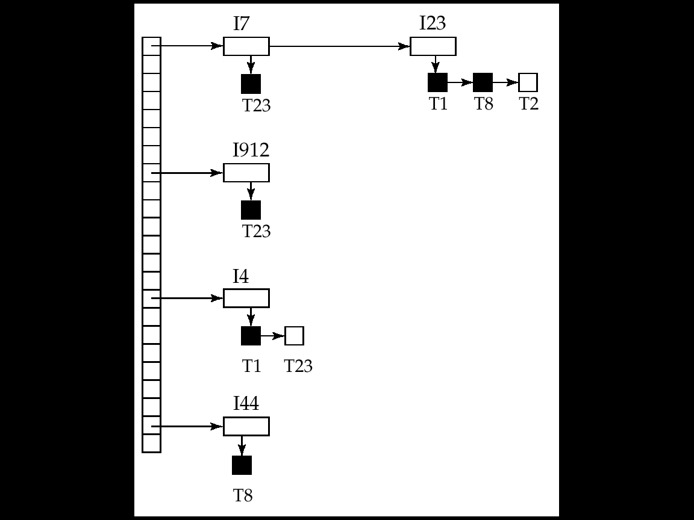
Locks – lock manager
Black rectangles indicate granted locks, white ones indicate waiting requests
Lock table also records the type of lock granted or requested
New request is added to the end of the queue of requests for the data item, and granted if it is compatible with all earlier locks
Unlock requests result in the request being deleted, and later requests are checked to see if they can now be granted
If transaction aborts, all waiting or granted requests of the transaction are deleted
lock manager may keep a list of locks held by each transaction, to implement this efficiently

Slide 51
Insertion & Deletion
Does delete(X) conflict with read(X)/write(X)?
Yes. Wrong order leads to errors
Thus delete(X) should be treated like a write operation
Request X-locks
Similar to insert(X) operation.
X-lock is given to the newly created tuple.

Slide 52
The phantom menace
Consider the following 2 transactions
There does not seems to be a conflict (in terms of tuple)
Assume initially CS faculty have total salary 1,000,000 and Math faculty have total salary 2,000,000
Then T1 -> T2 will imply the select statements return 1,000,000 and 2,000,000
T2 -> T1 will imply the select statements return 1,001,000 and 2,005,000
Select sum(salary)
From faculty
Where dept = “CS”
2. Select sum(salary)
From faculty
Where dept = “Math”
a. Insert into faculty
values (“Lin”, “CS”, 1000)
b. Insert into faculty
values (“Lam”, “Math”, 5000)
T2
T1

Slide 53
The phantom menace
But consider the following schedule
The output will be 1,000,100 and 2,000,000
Not conflict serializable!
a. Insert into faculty
values (“Lin”, “CS”, 1000)
b. Insert into faculty
values (“Lam”, “Math”, 5000)
Select sum(salary)
From faculty
Where dept = “CS”
2. Select sum(salary)
From faculty
Where dept = “Math”
T1
T2

Slide 54
The phantom problem
This is known as the phantom problem
Why does it occur?
No tuples are in conflict
However, conflict occurs for tuples that satisfy a certain condition (dept = “CS”, dept = “Math”)
T1 require access for ALL tuples satisfying the condition
However, T2 changes the number of tuples satisfying the condition
No quick solution: index-locking as a possibility (next lecture)

