Slide 1
CSE 5/7339 Computer System Security
Mark D. Hoffman
mhoffman@smu.edu
Office Hours: By Appointment

Slide 2
Chapter 1: Introduction
“Begin at the beginning,” the King said, very gravely,
“and go on till you come to the end: then stop.”
⎯ Lewis Carroll, Alice in Wonderland
Chapter 1 ⎯ Introduction 2

Slide 3
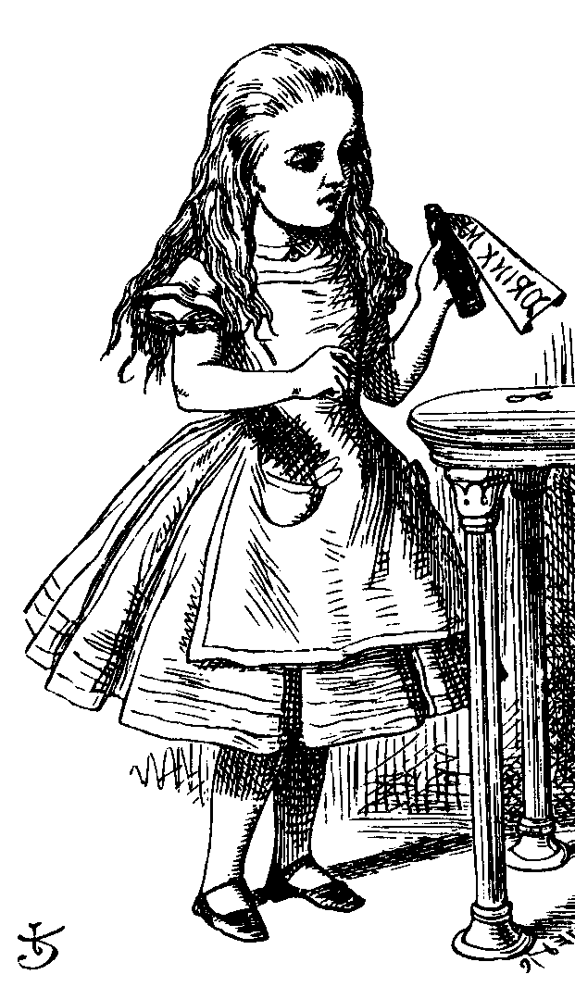
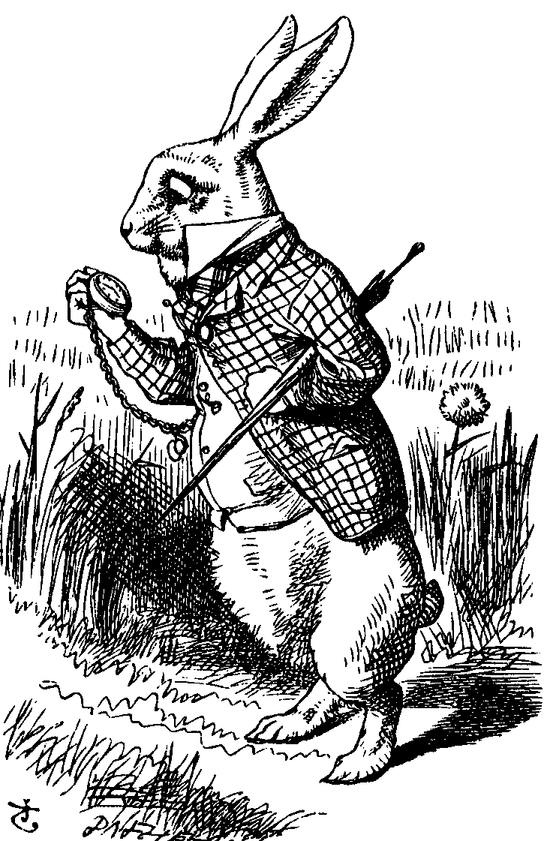
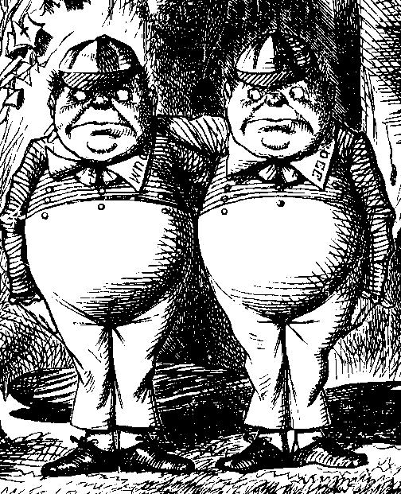
The Cast of Characters
Alice and Bob are the good guys
Trudy is the bad “guy”
Trudy is our generic “intruder”
Chapter 1 ⎯ Introduction 3

Slide 4
Alice’s Online Bank
Alice opens Alice’s Online Bank (AOB)
What are Alice’s security concerns?
If Bob is a customer of AOB, what are his security concerns?
How are Alice’s and Bob’s concerns similar? How are they different?
How does Trudy view the situation?
Chapter 1 ⎯ Introduction 4

Slide 5
CIA
CIA == Confidentiality, Integrity, and Availability
AOB must prevent Trudy from learning Bob’s account balance
Confidentiality: prevent unauthorized reading of information
Cryptography used for confidentiality
Chapter 1 ⎯ Introduction 5

Slide 6
CIA
Trudy must not be able to change Bob’s account balance
Bob must not be able to improperly change his own account balance
Integrity: detect unauthorized writing of information
Cryptography used for integrity
Chapter 1 ⎯ Introduction 6

Slide 7
CIA
AOB’s information must be available whenever it’s needed
Bob must be able to make transactions
If not, she’ll take her business elsewhere
Availability: Data is available in a timely manner when needed
Availability is a “new” security concern
Denial of service (DoS) attacks
Chapter 1 ⎯ Introduction 7

Slide 8
Beyond CIA: Crypto
How does Bob’s computer know that “Bob” is really Bob and not Trudy?
Bob’s password must be verified
This requires some clever cryptography
What are security concerns of pwds?
Are there alternatives to passwords?
Chapter 1 ⎯ Introduction 8

Slide 9
Beyond CIA: Protocols
When Bob logs into AOB, how does AOB know that “Bob” is really Bob?
As before, Bob’s password is verified
Unlike the previous case, network security issues arise
How do we secure network transactions?
Protocols are critically important
Crypto plays critical role in protocols
Chapter 1 ⎯ Introduction 9

Slide 10
Beyond CIA: Access Control
Once Bob is authenticated by AOB, then AOB must restrict actions of Bob
Bob can’t view Charlie’s account info
Bob can’t install new software, etc.
Enforcing these restrictions: authorization
Access control includes both authentication and authorization
Chapter 1 ⎯ Introduction 10

Slide 11
Beyond CIA: Software
Cryptography, protocols, and access control are implemented in software
Software is foundation on which security rests
What are security issues of software?
Real world software is complex and buggy
Software flaws lead to security flaws
How does Trudy attack software?
How to reduce flaws in software development?
And what about malware?
Chapter 1 ⎯ Introduction 11

Slide 12
Your Textbook
The text consists of four major parts
Cryptography
Access control
Protocols
Software
Note: Our focus is on technical issues
Chapter 1 ⎯ Introduction 12

Slide 13
The People Problem
People often break security
Both intentionally and unintentionally
Here, we consider the unintentional
For example, suppose you want to buy something online
To make it concrete, suppose you want to buy Information Security: Principles and Practice, 2nd edition from amazon.com
Chapter 1 ⎯ Introduction 13

Slide 14
The People Problem
To buy from amazon.com…
Your Web browser uses SSL protocol
SSL relies on cryptography
Access control issues arise
All security mechanisms are in software
Suppose all of this security stuff works perfectly
Then you would be safe, right?
Chapter 1 ⎯ Introduction 14

Slide 15
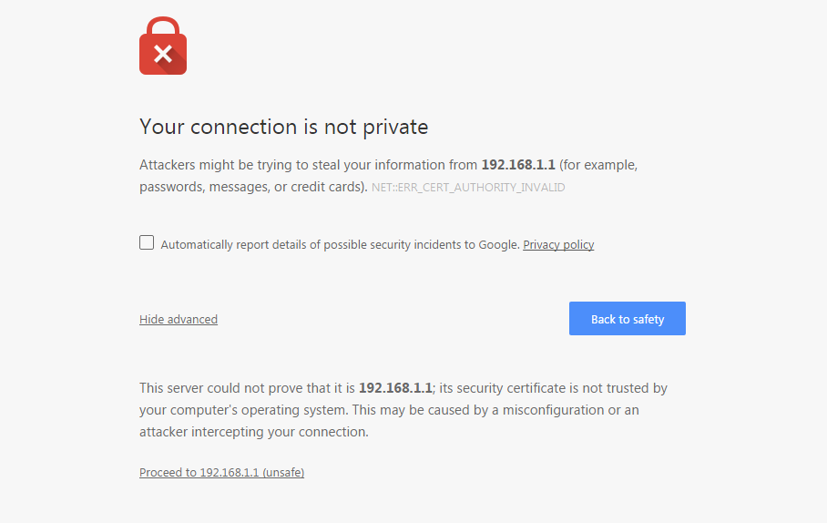
Chapter 1 ⎯ Introduction 15

Slide 16
The People Problem
What could go wrong?
Trudy tries man-in-the-middle attack
SSL is secure, so attack doesn’t “work”
But, Web browser issues a warning
What do you, the user, do?
If user ignores warning, attack works!
None of the security mechanisms failed
But user unintentionally broke security
Chapter 1 ⎯ Introduction 16

Slide 17
Cryptography
“Secret codes”
The book covers
Classic cryptography
Symmetric ciphers
Public key cryptography
Hash functions++
Advanced cryptanalysis
Chapter 1 ⎯ Introduction 17

Slide 18
Access Control
Authentication
Passwords
Biometrics
Other methods of authentication
Authorization
Access Control Lists/Capabilities
Multilevel security (MLS), security modeling, covert channel, inference control
Firewalls, intrusion detection (IDS)
Chapter 1 ⎯ Introduction 18

Slide 19
Protocols
“Simple” authentication protocols
Focus on basics of security protocols
Lots of applied cryptography in protocols
Real-world security protocols
SSH, SSL, IPSec, Kerberos
Wireless: WEP, GSM
Chapter 1 ⎯ Introduction 19

Slide 20
Software
Security-critical flaws in software
Buffer overflow
Race conditions, etc.
Malware
Examples of viruses and worms
Prevention and detection
Future of malware?
Chapter 1 ⎯ Introduction 20

Slide 21
Software
Software reverse engineering (SRE)
How hackers “dissect” software
Digital rights management (DRM)
Shows difficulty of security in software
Also raises OS security issues
Software and testing
Open source, closed source, other topics
Chapter 1 ⎯ Introduction 21

Slide 22
Software
Operating systems
Basic OS security issues
“Trusted OS” requirements
NGSCB: Microsoft’s trusted OS for the PC
Software is a BIG security topic
Lots of material to cover
Lots of security problems to consider
But not nearly enough time available…
Chapter 1 ⎯ Introduction 22

Slide 23
Think Like Trudy
In the past, no respectable sources talked about “hacking” in detail
After all, such info might help Trudy
Recently, this has changed
Lots of books on network hacking, evil software, how to hack software, etc.
Classes teach virus writing, SRE, etc.
Chapter 1 ⎯ Introduction 23

Slide 24
Think Like Trudy
Good guys must think like bad guys!
A police detective…
…must study and understand criminals
In information security
We want to understand Trudy’s methods
Might think about Trudy’s motives
We’ll often pretend to be Trudy
Chapter 1 ⎯ Introduction 24

Slide 25
Think Like Trudy
Is all of this security information a good idea?
Bruce Schneier (referring to Security Engineering, by Ross Anderson):
“It’s about time somebody wrote a book to teach the good guys what the bad guys already know.”
Chapter 1 ⎯ Introduction 25

Slide 26
Think Like Trudy
We must try to think like Trudy
We must study Trudy’s methods
We can admire Trudy’s cleverness
Often, we can’t help but laugh at Alice’s and/or Bob’s stupidity
But, we cannot act like Trudy
Except in this class…
Chapter 1 ⎯ Introduction 26

Slide 27
In This Course…
Think like the bad guy
Always look for weaknesses
Find the weak link before Trudy does
It’s OK to break the rules
What rules?
Think like Trudy
But don’t do anything illegal!
Chapter 1 ⎯ Introduction 27

