Slide 1
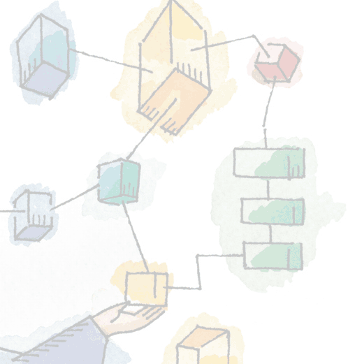
Chapter 6 Concurrency: Deadlock and Starvation
Operating Systems: Internals and Design Principles, 6/E William Stallings
Notes:
These slides are intended to help a teacher develop a presentation. This PowerPoint covers the entire chapter and includes too many slides for a single delivery. Professors are encouraged to adapt this presentation in ways which are best suited for their students and environment.

Slide 2
Roadmap
Principals of Deadlock
Deadlock prevention
Deadlock Avoidance
Deadlock detection
An Integrated deadlock strategy
Dining Philosophers Problem
Concurrency Mechanisms in UNIX, Linux, Solaris and Windows

Slide 3
Deadlock
A set of processes is deadlocked when each process in the set is blocked awaiting an event that can only be triggered by another blocked process in the set
Typically involves processes competing for the same set of resources
No efficient solution
Notes:
A set of processes is deadlocked when each process in the set is blocked awaiting an event that can only be triggered by another blocked process in the set
typically processes are waiting the freeing up of some requested resource.
Deadlock is permanent because none of the events is ever triggered.
Unlike other problems in concurrent process management, there is no efficient solution in the general case.

Slide 4

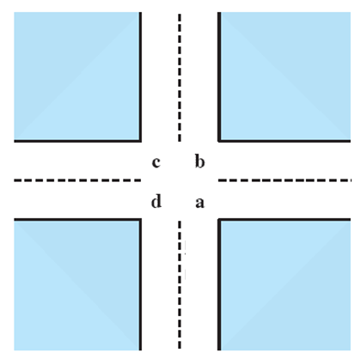
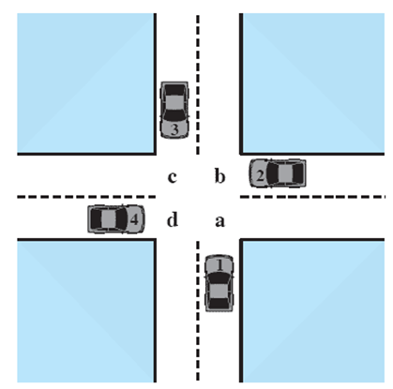



Potential Deadlock
I need quad C and B
I need quad B and C
I need quad A and B
I need quad D and A
Notes:
Animated Slide
Click 1 Cars approach intersection
Then Cars announce their resource needs
All deadlocks involve conflicting needs for resources by two or more processes. A common example is the traffic deadlock.
The typical rule of the road in the United States is that a car at a four-way stop should defer to a car immediately to its right.
This rule works if there are only two or three cars at the intersection.
If all four cars arrive at about the same time, each will refrain from entering the intersection, this causes a potential deadlock.
The deadlock is only potential, not actual, because the necessary resources are available for any of the cars to proceed.
If one car eventually does proceed, it can do so.

Slide 5
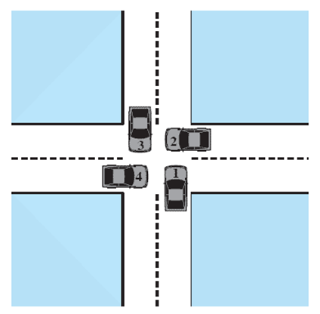
Actual Deadlock
HALT until D is free
HALT until C is free
HALT until B is free
HALT until A is free
Notes:
Animated Slide
Click 1 Cars move to deadlock
Then Cars announce their resource need
But if all four cars ignore the rules and proceed (cautiously) into the intersection at the same time, then each car seizes one resource (one quadrant) but cannot proceed because the required second resource has already been seized by another car.
This is an actual deadlock.

Slide 6
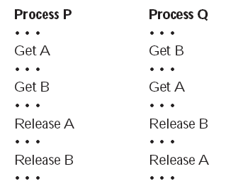
Two Processes P and Q
Lets look at this with two processes P and Q
Each needing exclusive access to a resource A and B for a period of time
Notes:
Each process needs exclusive use of both resources for a certain period of time.
Two processes, P and Q, have the following general form:

Slide 7
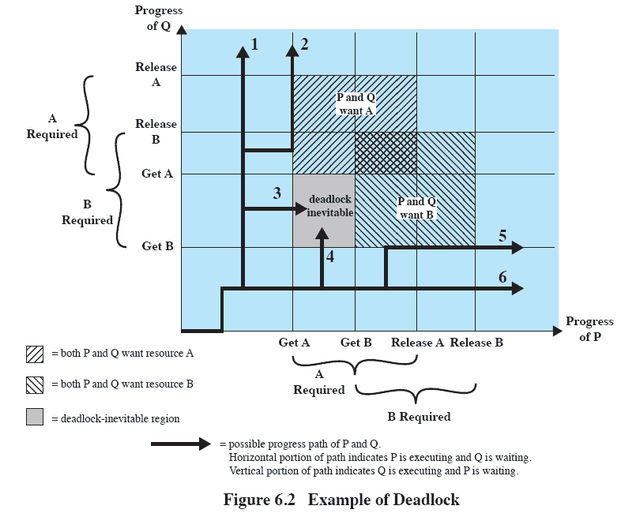
Joint Progress Diagram of Deadlock
Notes:
This illustrates the progress of two processes competing for two resources.
The x-axis represents progress in the execution of P
The y-axis represents progress in the execution of Q.
Six different paths of execution are shown.
The gray-shaded area can be referred to as a fatal region, applies to paths 3 and 4.
If an execution path enters this fatal region, then deadlock is inevitable.
Note that the existence of a fatal region depends on the logic of the two processes.
However, deadlock is only inevitable if the joint progress of the two processes creates a path that enters the fatal region.

Slide 8
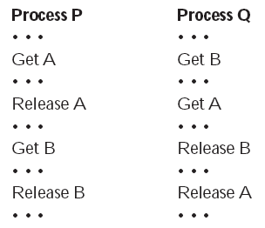
Alternative logic
Suppose that P does not need both resources at the same time so that the two processes have this form
Notes:
Whether or not deadlock occurs depends on both the dynamics of the execution and on the details of the application.

Slide 9
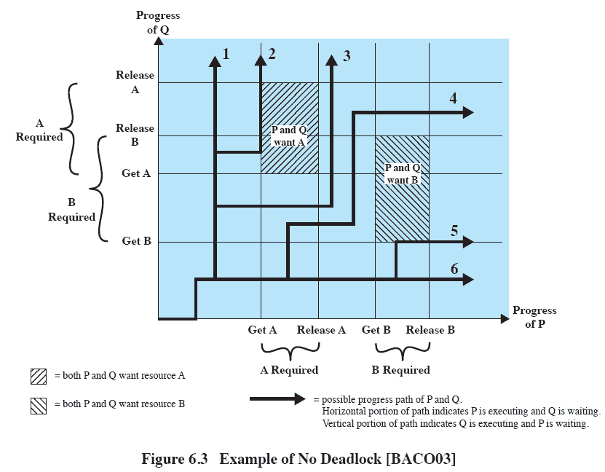
Diagram of alternative logic
Notes:
Discuss this diagram with students until they see that regardless of the relative timing of the two processes, deadlock cannot occur.

Slide 10
Resource Categories
Two general categories of resources:
Reusable
can be safely used by only one process at a time and is not depleted by that use.
Consumable
one that can be created (produced) and destroyed (consumed).

Slide 11
Reusable Resources
Such as:
Processors, I/O channels, main and secondary memory, devices, and data structures such as files, databases, and semaphores
Deadlock occurs if each process holds one resource and requests the other

Slide 12
Example of Reuse Deadlock
Consider two processes that compete for exclusive access to a disk file D and a tape drive T.
Deadlock occurs if each process holds one resource and requests the other.

Slide 13
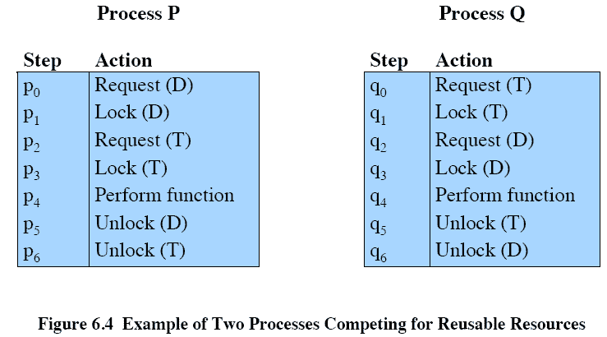
Reusable Resources Example

Slide 14
Example 2: Memory Request
Space is available for allocation of 200Kbytes, and the following sequence of events occur
Deadlock occurs if both processes progress to their second request
P1
P2
. . .
. . .
Request 80 Kbytes;
Request 70 Kbytes;
. . .
. . .
Request 60 Kbytes;
Request 80 Kbytes;
Notes:
If the amount of memory to be requested is not known ahead of time, it is difficult to deal with this type of deadlock by means of system design constraints.
The best way to deal with this particular problem is, in effect, to eliminate the possibility by using virtual memory, which is discussed later (ch 8)

Slide 15
Consumable Resources
Such as Interrupts, signals, messages, and information in I/O buffers
Deadlock may occur if a Receive message is blocking
May take a rare combination of events to cause deadlock

Slide 16
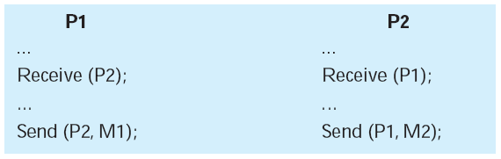
Example of Deadlock
Consider a pair of processes, in which each process attempts to receive a message from the other process and then send a message to the other process
Notes:
Deadlock occurs if the Receive is blocking (i.e., the receiving process is blocked until the message is received).
A design error is the cause of the deadlock.
Such errors may be quite subtle and difficult to detect.
Furthermore, it may take a rare combination of events to cause the deadlock; thus a program could be in use for a considerable period of time, even years, before the deadlock actually occurs.

Slide 17
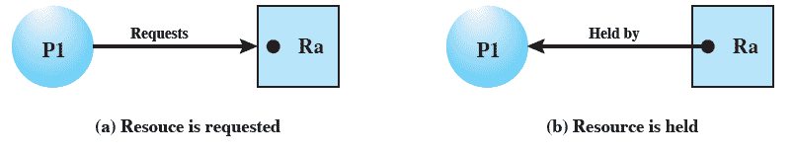
Resource Allocation Graphs
Directed graph that depicts a state of the system of resources and processes
Notes:
A graph edge directed from a process to a resource indicates a resource that has been requested by the process but not yet granted.
Within a resource node, a dot is shown for each instance of that resource.
A graph edge directed from a reusable resource node dot to a process indicates a request that has been granted

Slide 18
Conditions for possible Deadlock
Mutual exclusion
Only one process may use a resource at a time
Hold-and-wait
A process may hold allocated resources while awaiting assignment of others
No pre-emption
No resource can be forcibly removed form a process holding it
Notes:
All three must be present for deadlock to occur.

Slide 19
Actual Deadlock Requires …
All previous 3 conditions plus:
Circular wait
A closed chain of processes exists, such that each process holds at least one resource needed by the next process in the chain
Notes:
This is actually a potential consequence of the first three.
Given that the first three conditions exist, a sequence of events may occur that lead to an unresolvable circular wait.
The unresolvable circular wait is in fact the definition of deadlock.
The circular wait listed as condition 4 is unresolvable because the first three conditions hold.
Thus, the four conditions, taken together, constitute necessary and sufficient conditions for deadlock.

Slide 20
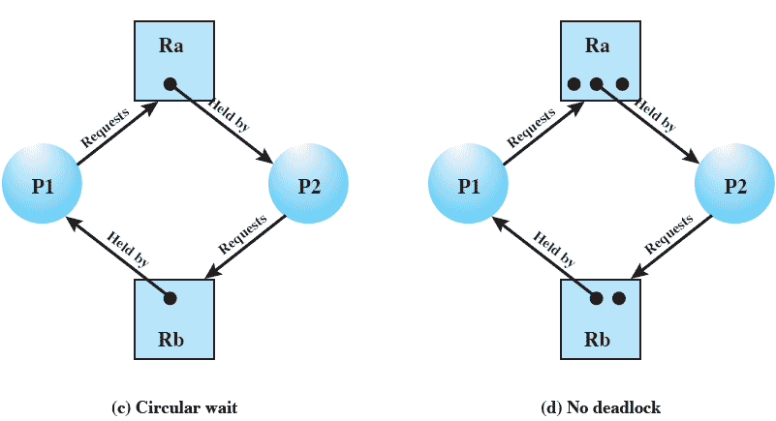
Resource Allocation Graphs of deadlock

Slide 21
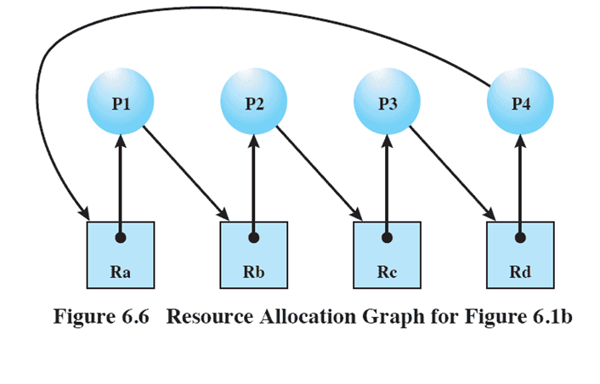
Resource Allocation Graphs

Slide 22
Dealing with Deadlock
Three general approaches exist for dealing with deadlock.
Prevent deadlock
Avoid deadlock
Detect Deadlock
Notes:
Three general approaches exist for dealing with deadlock.
prevent deadlock
adopt a policy that eliminates one of the conditions (conditions 1 through 4).
avoid deadlock
by making the appropriate dynamic choices based on the current state of resource allocation.
detect the presence of deadlock
(conditions 1 through 4 hold) and take action to recover.
We discuss each of these approaches in turn.

Slide 23
Roadmap
Principals of Deadlock
Deadlock prevention
Deadlock Avoidance
Deadlock detection
An Integrated deadlock strategy
Dining Philosophers Problem
Concurrency Mechanisms in UNIX, Linux, Solaris and Windows

Slide 24
Deadlock Prevention Strategy
Design a system in such a way that the possibility of deadlock is excluded.
Two main methods
Indirect – prevent all three of the necessary conditions occurring at once
Direct – prevent circular waits
Notes:
Deadlock prevention is strategy simply to design a system in such a way that the possibility of deadlock is excluded.
We can view deadlock prevention methods as falling into two classes.
indirect method of deadlock prevention is to prevent the occurrence of one of the three necessary conditions listed previously (items 1 through 3).
direct method of deadlock prevention is to prevent the occurrence of a circular wait (item 4).
We now examine techniques related to each of the four
conditions.

Slide 25
Deadlock Prevention Conditions 1 & 2
Mutual Exclusion
Must be supported by the OS
Hold and Wait
Require a process request all of its required resources at one time
Notes:
Mutual Exclusion
The first of the four listed conditions cannot be disallowed (in general).
If access to a resource requires mutual exclusion, then mutual exclusion must be supported by the OS.
Some resources, such as files, may allow multiple accesses for reads but only exclusive access for writes.
Even in this case, deadlock can occur if more than one process requires write permission.
Hold an Wait
Can be prevented by requiring that a process request all of its required resources at one time and blocking the process until all requests can be granted simultaneously.
This approach is inefficient in two ways.
1) a process may be held up for a long time waiting for all of its resource requests to be filled, when in fact it could have proceeded with only some of the resources.
resources allocated to a process may remain unused for a considerable period, during which time they are denied to other processes.
Another problem is that a process may not know in advance all of the resources that it will require.
There is also the practical problem created by the use of modular programming or a multithreaded structure for an application.
An application would need to be aware of all resources that will be requested at all levels or in all modules to make the simultaneous request.

Slide 26
Deadlock Prevention Conditions 3 & 4
No Preemption
Process must release resource and request again
OS may preempt a process to require it releases its resources
Circular Wait
Define a linear ordering of resource types
Notes:
No Preemption
can be prevented in several ways.
If a process holding certain resources is denied a further request, that process must release its original resources and, if necessary, request them again together with the additional resource.
If a process requests a resource that is currently held by another process, the OS may preempt the second process and require it to release its resources.
This latter scheme would prevent deadlock only if no two processes possessed the same priority.
This approach is practical only with resources whose state can be easily saved and restored later, as is the case with a processor.
Circular Wait
Can be prevented by defining a linear ordering of resource types.
As with hold-and-wait prevention, circular-wait prevention may be inefficient, slowing down processes and denying resource access unnecessarily.

Slide 27
Roadmap
Principals of Deadlock
Deadlock prevention
Deadlock Avoidance
Deadlock detection
An Integrated deadlock strategy
Dining Philosophers Problem
Concurrency Mechanisms in UNIX, Linux, Solaris and Windows

Slide 28
Deadlock Avoidance
A decision is made dynamically whether the current resource allocation request will, if granted, potentially lead to a deadlock
Requires knowledge of future process requests
Notes:
Deadlock avoidance allows the three necessary conditions
but makes judicious choices to assure that the deadlock point is never reached.
Avoidance allows more concurrency than prevention.
With deadlock avoidance, a decision is made dynamically whether the current resource allocation request will, if granted, potentially lead to a deadlock.
Deadlock avoidance requires knowledge of future process resource requests.

Slide 29
Two Approaches to Deadlock Avoidance
Process Initiation Denial
Do not start a process if its demands might lead to deadlock
Resource Allocation Denial
Do not grant an incremental resource request to a process if this allocation might lead to deadlock

Slide 30
Process Initiation Denial
A process is only started if the maximum claim of all current processes plus those of the new process can be met.
Not optimal,
Assumes the worst: that all processes will make their maximum claims together.
Notes:
A process is only started if the maximum claim of all current processes plus those of the new process can be met.
This strategy is hardly optimal, because it assumes the worst:
that all processes will make their maximum claims together.

Slide 31
Resource Allocation Denial
Referred to as the banker’s algorithm
A strategy of resource allocation denial
Consider a system with fixed number of resources
State of the system is the current allocation of resources to process
Safe state is where there is at least one sequence that does not result in deadlock
Unsafe state is a state that is not safe
Notes:
Movie button goes to http://gaia.ecs.csus.edu/~zhangd/oscal/Banker/Banker.html

Slide 32
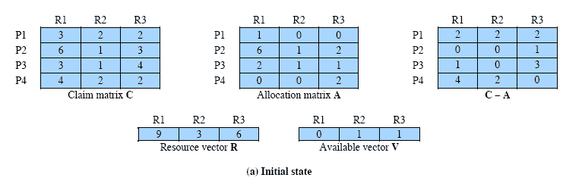
Determination of Safe State
A system consisting of four processes and three resources.
Allocations are made to processors
Is this a safe state?
Resources available after allocation
Amount of Existing Resources
Notes:
Animation: Callouts explain resource parts of figure
This figure shows the state of a system consisting of four processes and three resources.
Total amount of resources
R1 = 9
R2 = 3
R3 = 6
In the current state allocations have been made to the four processes, leaving available
1 unit of R2
1 unit of R3
Is this a safe state?
To answer this question, we ask an intermediate question:
Can any of the four processes be run to completion with the resources available?
That is, can the difference between the maximum requirement and current allocation for any process be met with the available resources?

Slide 33
Process i
C_{ij} - A_{ij} ≤ V_{j}, for all j
This is not possible for P1,
which has only 1 unit of R1 and requires 2 more units of R1, 2 units of R2, and 2 units of R3.
If we assign one unit of R3 to process P2,
Then P2 has its maximum required resources allocated and can run to completion and return resources to ‘available’ pool

Slide 34
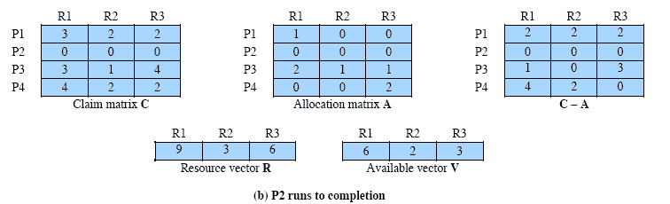
After P2 runs to completion
Can any of the remaining processes can be completed?
Note P2 is completed
Notes:
In this case, each of the remaining processes could be completed as shown on the next slides

Slide 35
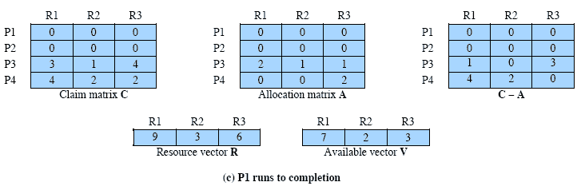
After P1 completes
Notes:
Suppose we choose P1,
allocate the required resources,
complete P1,
and return all of P1’s resources to the available pool.
We are left in the state shown in Figure 6.7c on this slide

Slide 36
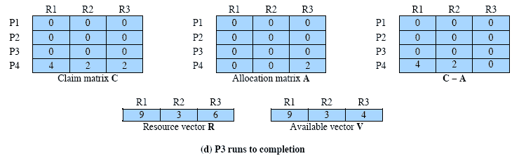
P3 Completes
Thus, the state defined originally is a safe state.
Notes:
P3 completes, resulting in the state of Figure 6.7d shown on this slide
Finally, we can complete P4. At this point, all of the processes have been run to completion.
Thus, the state defined by Figure 6.7a is a safe state.

Slide 37
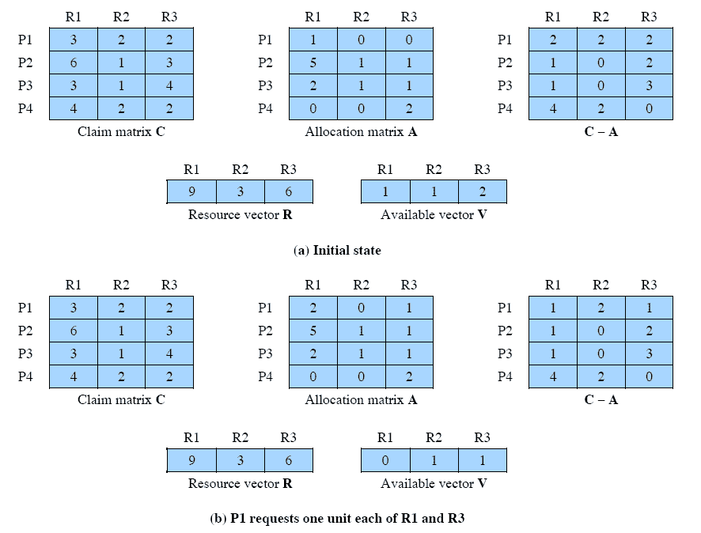
Determination of an Unsafe State
This time Suppose that P1 makes the request for one additional unit each of R1 and R3.
Is this safe?
Notes:
Suppose that P1 makes the request for one additional unit each of R1 and R3; if we assume that the request is granted,
Is this a safe state?
No,
because each process will need at least one additional unit of R1, and there are none available.
Thus, on the basis of deadlock avoidance, the request by P1 should be denied and P1 should be blocked.
NOTE: This is not a deadlocked state.
It merely has the potential for deadlock.
It is possible, for example, that if P1 were run from this state it would subsequently release one unit of R1 and one unit of R3 prior to needing these resources again.
If that happened, the system would return to a safe state.
Thus, the deadlock avoidance strategy does not predict deadlock with certainty; it merely anticipates the possibility of deadlock and assures that there is never such a possibility.

Slide 38
Deadlock Avoidance
When a process makes a request for a set of resources,
assume that the request is granted,
Update the system state accordingly,
Then determine if the result is a safe state.
If so, grant the request and,
if not, block the process until it is safe to grant the request.
Notes:
This suggests the following deadlock avoidance strategy,
which ensures that the system of processes and resources is always in a safe state.
When a process makes a request for a set of resources, assume that the request is granted, update
the system state accordingly, and then determine if the result is a safe state. If so,
grant the request and, if not, block the process until it is safe to grant the request.

Slide 39
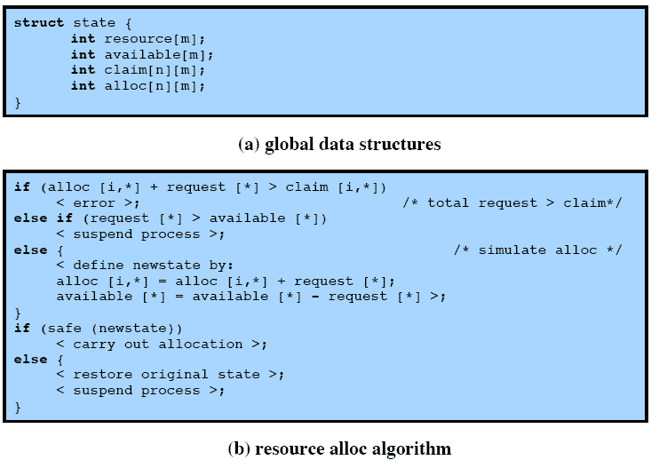
Deadlock Avoidance Logic
Notes:
This slide gives an abstract version of the deadlock avoidance logic.
The main algorithm is shown in part (b).
With the state of the system defined by the data structure state, request[*] is a vector defining the resources requested by process i.
First, a check is made to assure that the request does not exceed the original claim of the process.
If the request is valid, the next step is to determine if it is possible to fulfill the request (i.e., there are sufficient resources available).
If it is not possible, then the process is suspended.
If it is possible, the final step is to determine if it is safe to fulfill the request. To do this, the resources are tentatively assigned to process i to form newstate.

Slide 40
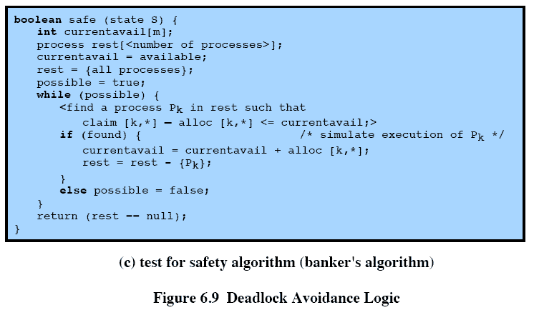
Deadlock Avoidance Logic
Notes:
Then a test for safety is made using the algorithm in Figure 6.9c.

Slide 41
Deadlock Avoidance Advantages
It is not necessary to preempt and rollback processes, as in deadlock detection,
It is less restrictive than deadlock prevention.
Notes:
Deadlock avoidance has the advantage that it is not necessary to preempt and
rollback processes, as in deadlock detection, and is less restrictive than deadlock
prevention.

Slide 42
Deadlock Avoidance Restrictions
Maximum resource requirement must be stated in advance
Processes under consideration must be independent and with no synchronization requirements
There must be a fixed number of resources to allocate
No process may exit while holding resources
Notes:
However, it does have a number of restrictions on its use:
• The maximum resource requirement for each process must be stated in advance.
• The processes under consideration must be independent;
that is, the order in which they execute must be unconstrained by any synchronization requirements.
• There must be a fixed number of resources to allocate.
• No process may exit while holding resources.

Slide 43
Roadmap
Principals of Deadlock
Deadlock prevention
Deadlock Avoidance
Deadlock detection
An Integrated deadlock strategy
Dining Philosophers Problem
Concurrency Mechanisms in UNIX, Linux, Solaris and Windows

Slide 44
Deadlock Detection
Deadlock prevention strategies are very conservative;
limit access to resources and impose restrictions on processes.
Deadlock detection strategies do the opposite
Resource requests are granted whenever possible.
Regularly check for deadlock
Notes:
Deadlock checks can be made as frequently as each resource request or, less frequently, depending on how likely it is for a deadlock to occur.
Checking at each resource request has two advantages:
it leads to early detection,
the algorithm is relatively simple because it is based on incremental changes to the state of the system.
On the other hand, such frequent checks consume considerable processor time.

Slide 45
A Common Detection Algorithm
Use a Allocation matrix and Available vector as previous
Also use a request matrix Q
Where Qij indicates that an amount of resource j is requested by process I
First ‘un-mark’ all processes that are not deadlocked
Initially that is all processes
Notes:
A common algorithm for deadlock detection is one described in [COFF71].
The Allocation matrix and Available vector described in the previous section are used.
In addition, a request matrix Q is defined such that Qij represents the amount of resources of type j requested by process i.
The algorithm proceeds by marking processes that are not deadlocked. Initially, all processes are unmarked.

Slide 46
Detection Algorithm
1. Mark each process that has a row in the Allocation matrix of all zeros.
2. Initialize a temporary vector W to equal the Available vector.
3. Find an index i such that process i is currently unmarked and the ith row of Q is less than or equal to W.
i.e. Q_{ik} ≤ W_{k} for 1 ≤ k ≤ m.
If no such row is found, terminate

Slide 47
Detection Algorithm cont.
4. If such a row is found,
mark process i and add the corresponding row of the allocation matrix to W.
i.e. set W_{k} = W_{k} + A_{ik}, for 1 ≤ k ≤ m
Return to step 3.
A deadlock exists if and only if there are unmarked processes at the end
Each unmarked process is deadlocked.
Notes:
The strategy in this algorithm is to find a process whose resource requests can be satisfied with the available resources,
and then assume that those resources are granted and that the process runs to completion and releases all of its resources.
The algorithm then looks for another process to satisfy.
Note that this algorithm does not guarantee to prevent deadlock;
That will depend on the order in which future requests are granted.
All that it does is determine if deadlock currently exists.

Slide 48
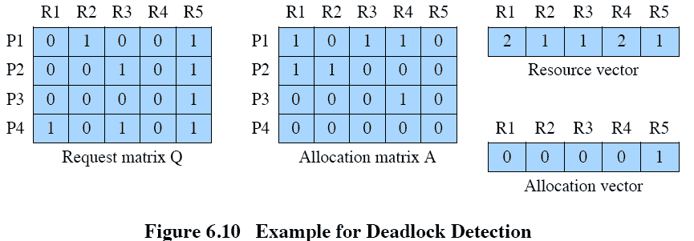
Deadlock Detection
Notes:
1. Mark P4, because P4 has no allocated resources.
2. Set W = (0 0 0 0 1).
3. The request of process P3 is less than or equal to W, so mark P3 and set W=W + (0 0 0 1 0) = (0 0 0 1 1).
4. No other unmarked process has a row in Q that is less than or equal to W.
Therefore, terminate the algorithm.
The algorithm concludes with P1 and P2 unmarked, indicating that these processes are deadlocked.

Slide 49
Recovery Strategies Once Deadlock Detected
Abort all deadlocked processes
Back up each deadlocked process to some previously defined checkpoint, and restart all process
Risk or deadlock recurring
Successively abort deadlocked processes until deadlock no longer exists
Successively preempt resources until deadlock no longer exists

Slide 50
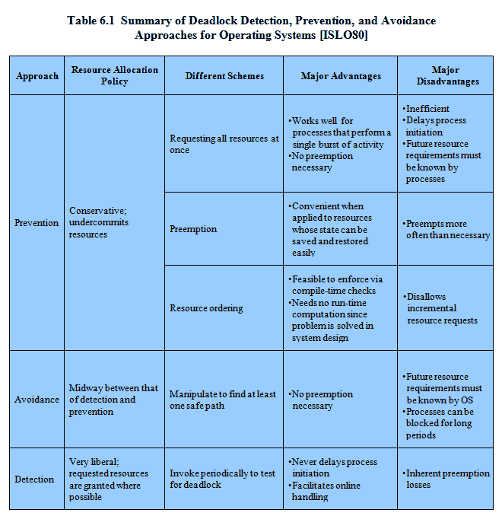
Advantages and Disadvantages
Notes:
There are strengths and weaknesses to all of the strategies for dealing with deadlock.
Rather than attempting to design an OS facility that employs only one of these strategies, it might be more efficient to use different strategies in different situations.

Slide 51
Roadmap
Principals of Deadlock
Deadlock prevention
Deadlock Avoidance
Deadlock detection
An Integrated deadlock strategy
Dining Philosophers Problem
Concurrency Mechanisms in UNIX, Linux, Solaris and Windows

Slide 52
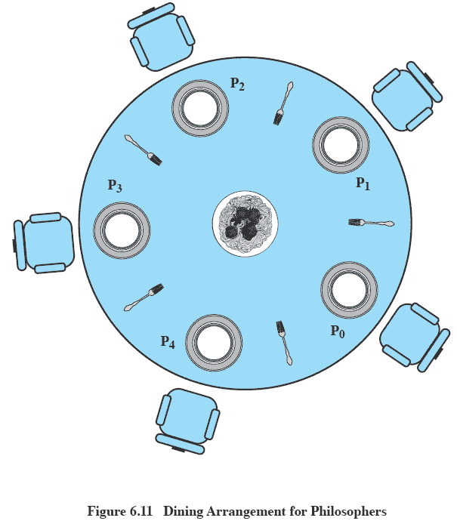
Dining Philosophers Problem: Scenario
Notes:
Five philosophers live in a house, where a table is laid for them.
The life of each philosopher consists principally of thinking and eating, and through years of thought, all of the philosophers had agreed that the only food that contributed to their thinking efforts was spaghetti.
Due to a lack of manual skill, each philosopher requires two forks to eat spaghetti.
A philosopher wishing to eat goes to his or her assigned place at the table and, using the two forks on either side of the plate, takes and eats some spaghetti.

Slide 53
The Problem
Devise a ritual (algorithm) that will allow the philosophers to eat.
No two philosophers can use the same fork at the same time (mutual exclusion)
No philosopher must starve to death (avoid deadlock and starvation … literally!)

Slide 54
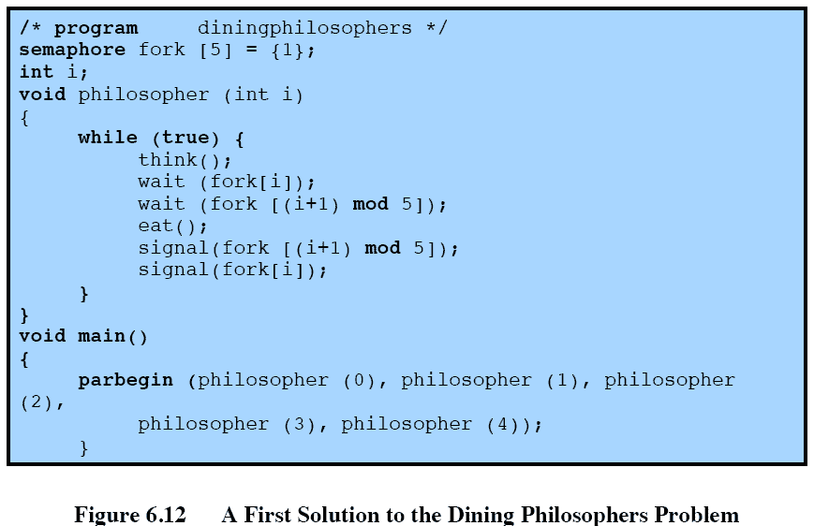
A first solution using semaphores
Notes:
Each philosopher picks up first the fork on the left and then the fork on the right.
After the philosopher is finished eating, the two forks are replaced on the table.
This solution, alas, leads to deadlock:
If all of the philosophers are hungry at the same time, they all sit down, they all pick up the fork on their left, and they all reach out for the other fork, which is not there.
In this undignified position, all philosophers starve.

Slide 55
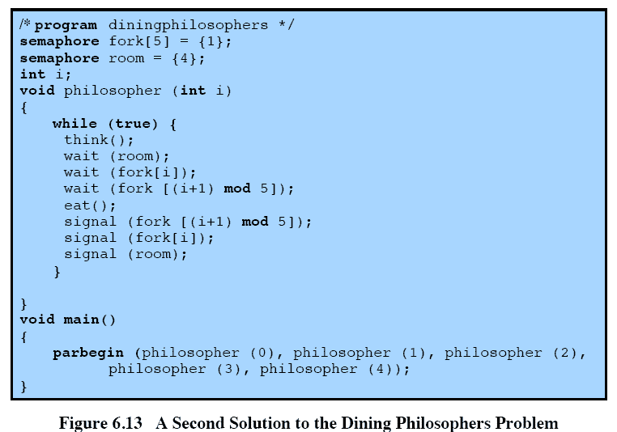
Avoiding deadlock
Notes:
We could consider adding an attendant who only allows four philosophers at a time into the dining room.
With at most four seated philosophers, at least one philosopher will have access to two forks.
This slide shows such a solution, again using semaphores. This solution is free of deadlock and starvation.

Slide 56
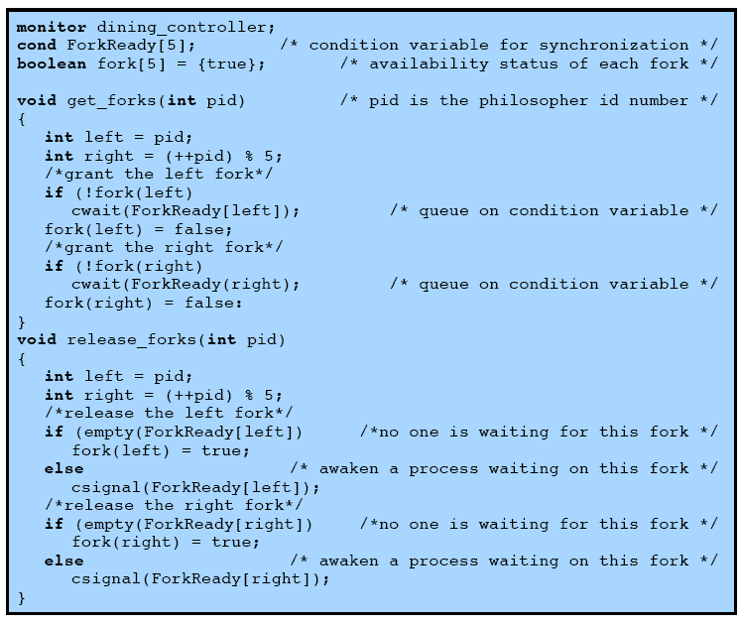
Solution using Monitors
Notes:
This slide shows a solution to the dining philosophers problem using a monitor – and is continued on next slide
A vector of five condition variables is defined, one condition variable per fork.
These condition variables are used to enable a philosopher to wait for the availability of a fork.
In addition, there is a Boolean vector that records the availability status of each fork (true means the fork is available).
The monitor consists of two procedures.
The get_forks procedure is used by a philosopher to seize his or her left and right forks.
If either fork is unavailable, the philosopher process is queued on the appropriate condition variable.
This enables another philosopher process to enter the monitor.
The release-forks procedure is used to make two forks available.
Note that the structure of this solution is similar to that of the semaphore solution proposed in Figure 6.12.
In both cases, a philosopher seizes first the left fork and then the right fork.
Unlike the semaphore solution, this monitor solution does not suffer from deadlock, because only one process at a time may be in the monitor.
For example, the first philosopher process to enter the monitor is guaranteed that it can pick up the right fork after it picks up the left fork before the next philosopher to the right has a chance to seize its left fork, which is this philosopher’s right fork.

Slide 57
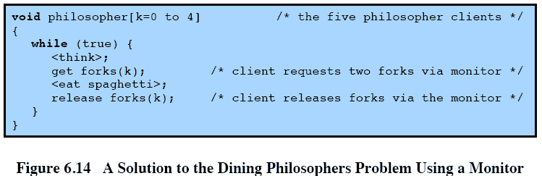
Monitor solution cont.

Slide 58
Roadmap
Principals of Deadlock
Deadlock prevention
Deadlock Avoidance
Deadlock detection
An Integrated deadlock strategy
Dining Philosophers Problem
Concurrency Mechanisms in UNIX, Linux, Solaris and Windows

Slide 59
UNIX Concurrency Mechanisms
UNIX provides a variety of mechanisms for interprocessor communication and synchronization including:
Pipes
Messages
Shared memory
Semaphores
Signals

Slide 60
Pipes
A circular buffer allowing two processes to communicate on the producer-consumer model
first-in-first-out queue, written by one process and read by another.
Two types:
Named:
Unnamed
Notes:
a pipe is a circular buffer allowing two processes to communicate on the producer-consumer model.
Thus, it is a first-in-first-out queue, written by one process and read by another.
There are two types of pipes: named and unnamed.
Only related processes can share unnamed pipes,
while either related or unrelated processes can share named pipes.

Slide 61
Messages
A block of bytes with an accompanying type.
UNIX provides msgsnd and msgrcv system calls for processes to engage in message passing.
Associated with each process is a message queue, which functions like a mailbox.

Slide 62
Shared Memory
A common block of virtual memory shared by multiple processes.
Permission is read-only or read-write for a process,
determined on a per-process basis.
Mutual exclusion constraints are not part of the shared-memory facility but must be provided by the processes using the shared memory.

Slide 63
Semaphores
SVR4 uses a generalization of the semWait and semSignal primitives defined in Chapter 5;
Associated with the semaphore are queues of processes blocked on that semaphore.

Slide 64
Signals
A software mechanism that informs a process of the occurrence of asynchronous events.
Similar to a hardware interrupt, without priorities
A signal is delivered by updating a field in the process table for the process to which the signal is being sent.
Notes:
A software mechanism that informs a process of the occurrence of asynchronous events.
A signal is similar to a hardware interrupt but does not employ priorities.
i.e., all signals are treated equally; signals that occur at the same time are presented to a process one at a time, with no particular ordering.
Processes may send each other signals, or the kernel may send signals internally.
A signal is delivered by updating a field in the process table for the process to which the signal is being sent. Because each signal is maintained as a single bit, signals of a given type cannot be queued.
A signal is processed just after a process wakes up to run or whenever the process is preparing to return from a system call. A process may respond to a signal by performing some default action (e.g., termination), executing a signal handler function, or ignoring the signal.

Slide 65
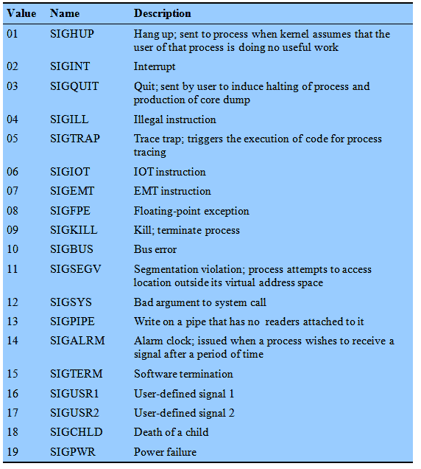
Signals defined for UNIX SVR4.

Slide 66
Linux Kernel Concurrency Mechanism
Includes all the mechanisms found in UNIX plus
Atomic operations
Spinlocks
Semaphores (slightly different to SVR4)
Barriers

Slide 67
Atomic Operations
Atomic operations execute without interruption and without interference
Two types:
Integer operations – operating on an integer variable
Bitmap operations – operating on one bit in a bitmap
Notes:
Two types of atomic operations are defined in Linux:
integer operations, which operate on an integer variable, and
bitmap operations, which operate on one bit in a bitmap

Slide 68
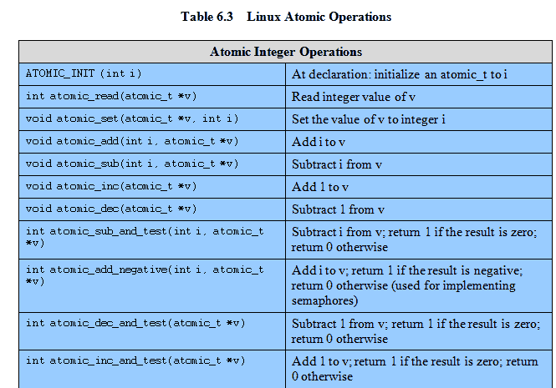
Linux Atomic Operations

Slide 69
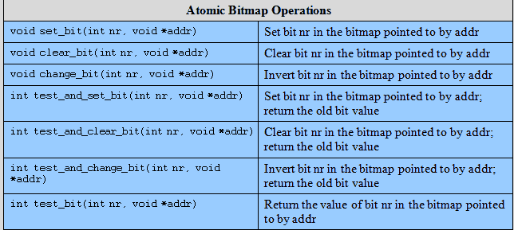
Linux Atomic Operations

Slide 70
Spinlock
Only one thread at a time can acquire a spinlock.
Any other thread will keep trying (spinning) until it can acquire the lock.
A spinlock is an integer
If 0, the thread sets the value to 1 and enters its critical section.
If the value is nonzero, the thread continually checks the value until it is zero.
Notes:
Only one thread at a time can acquire a spinlock.
Any other thread attempting to acquire the same lock will keep trying (spinning) until it can acquire the lock.
In essence a spinlock is built on an integer location in memory that is checked by each thread before it enters its critical section.
If the value is 0, the thread sets the value to 1 and enters its critical section.
If the value is nonzero, the thread continually checks the value until it is zero.
The spinlock is easy to implement but has the disadvantage that locked-out threads continue to execute in a busy-waiting mode.
Thus spinlocks are most effective in situations where the wait time for acquiring a lock is expected to be very short, say on the order of less than two context changes.

Slide 71
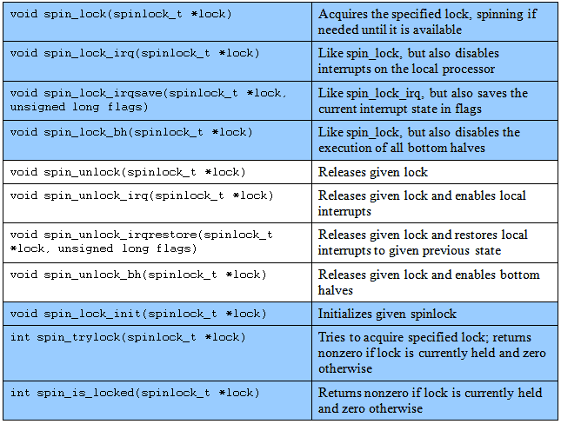
Linux Spinlocks

Slide 72
Semaphores
Similar to UNIX SVR4 but also provides an implementation of semaphores for its own use.
Three types of kernel semaphores:
Binary semaphores
counting semaphores,
reader-writer semaphores.
Notes:
Linux provides a semaphore interface corresponding to that in UNIX SVR4.
Internally, Linux provides an implementation of semaphores for its own use.
That is, code that is part of the kernel can invoke kernel semaphores.
These kernel semaphores cannot be accessed directly by the user program via system calls.
They are implemented as functions within the kernel and are thus more efficient than user-visible semaphores.
Linux provides three types of semaphore facilities in the kernel:
binary semaphores,
counting semaphores, and
reader-writer semaphores.

Slide 73
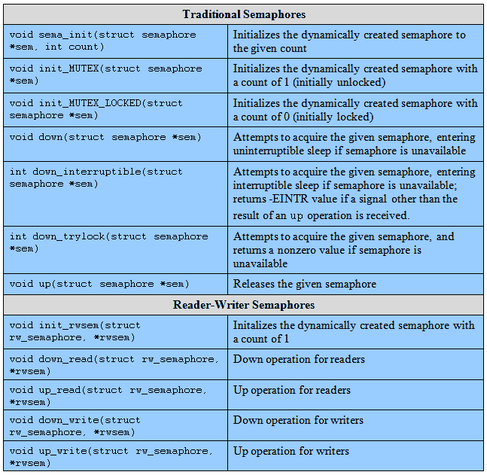
Linux Semaphores

Slide 74
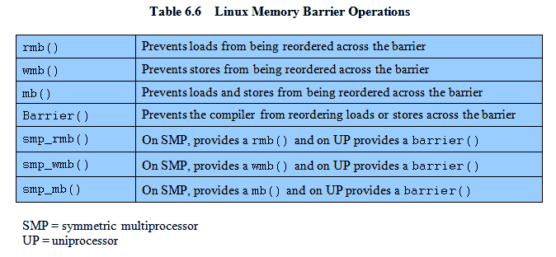
Barriers
To enforce the order in which instructions are executed, Linux provides the memory barrier facility.

Slide 75
Solaris Thread Synchronization Primitives
In addition to the concurrency mechanisms of UNIX SVR4
Mutual exclusion (mutex) locks
Semaphores
Multiple readers, single writer (readers/writer) locks
Condition variables
Notes:
In addition to the concurrency mechanisms of UNIX SVR4, Solaris supports four thread synchronization primitives:
• Mutual exclusion (mutex) locks
• Semaphores
• Multiple readers, single writer (readers/writer) locks
• Condition variables

Slide 76
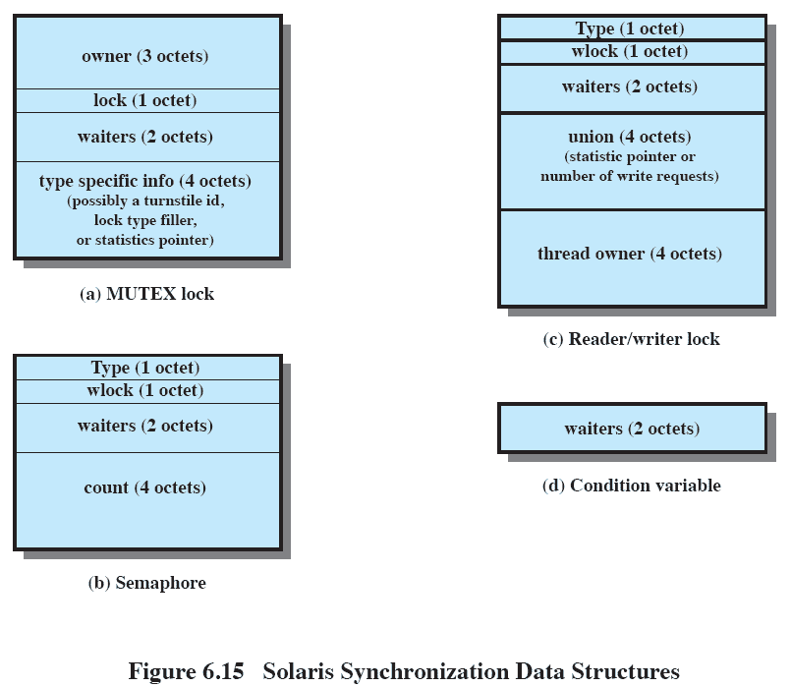
Solaris Synchronization Data Structures
Notes:
The initialization functions for the primitives fill in some of the data members.
Once a synchronization object is created, there are essentially only two operations that can be performed:
enter (acquire lock) and
release (unlock).
There are no mechanisms in the kernel or the threads library to enforce mutual exclusion or to prevent deadlock.
If a thread attempts to access a piece of data or code that is supposed to be protected but does not use the appropriate synchronization primitive, then such access occurs.
If a thread locks an object and then fails to unlock it, no kernel action is taken.
All of the synchronization primitives require the existence of a hardware instruction that allows an object to be tested and set in one atomic operation.

Slide 77
MUTEX Lock
A mutex is used to ensure only one thread at a time can access the resource protected by the mutex.
The thread that locks the mutex must be the one that unlocks it.

Slide 78
Semaphores and Read/Write locks
Solaris provides classic counting semaphores.
The readers/writer lock allows multiple threads to have simultaneous read-only access to an object protected by the lock.
It also allows a single thread to access the object for writing at one time, while excluding all readers.
Notes:
Movie button links to Solaris RW Lock animation/simulation http://gaia.ecs.csus.edu/~zhangd/oscal/SolarisRWLock/SolarisRWLock.html

Slide 79
Condition Variables
A condition variable is used to wait until a particular condition is true.
Condition variables must be used in conjunction with a mutex lock.

Slide 80
Windows concurrency mechanisms
Windows provides synchronization among threads as part of the object architecture.
Important methods of synchronization are
Executive dispatcher objects (using Wait functions),
user mode critical sections,
slim reader-writer locks, and
condition variables.
Notes:
Windows provides synchronization among threads as part of the object architecture.
The most important methods of synchronization are
Executive dispatcher objects,
user mode critical sections,
slim reader-writer locks, and
condition variables.
Dispatcher objects make use of wait functions.
We first describe wait functions and then look at the synchronization methods.

Slide 81
Wait Functions
The wait functions allow a thread to block its own execution.
The wait functions do not return until the specified criteria have been met.
The type of wait function determines the set of criteria used.
Notes:
The wait functions allow a thread to block its own execution.
The wait functions do not return until the specified criteria have been met.
The type of wait function determines the set of criteria used.
When a wait function is called, it checks whether the wait criteria have been met.
If the criteria have not been met, the calling thread enters the wait state.
It uses no processor time while waiting for the criteria to be met.

Slide 82
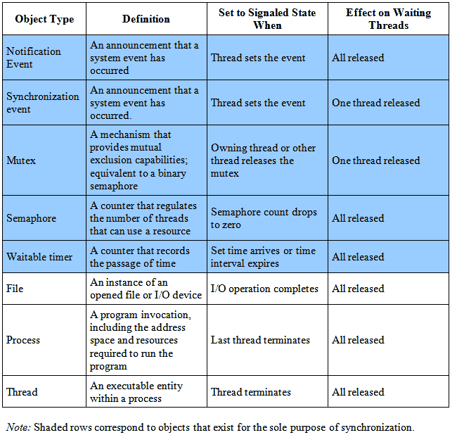
Dispatcher Objects
Notes:
The first five object types in the table are specifically designed to support synchronization.
The remaining object types have other uses but also may be used for synchronization.
Each dispatcher object instance can be in either a signaled or unsignaled state.
A thread can be blocked on an object in an unsignaled state;
the thread is released when the object enters the signaled state

Slide 83
Critical Sections
Similar mechanism to mutex
except that critical sections can be used only by the threads of a single process.
If the system is a multiprocessor, the code will attempt to acquire a spin-lock.
As a last resort, if the spinlock cannot be acquired, a dispatcher object is used to block the thread so that the Kernel can dispatch another thread onto the processor.
Notes:
Critical sections provide a synchronization mechanism similar to that provided by mutex objects,
except that critical sections can be used only by the threads of a single process.
Event, mutex, and semaphore objects can also be used in a single process application, but critical sections provide a much faster, more efficient mechanism for mutual-exclusion synchronization.
Critical sections use a sophisticated algorithm when trying to acquire the mutex.
If the system is a multiprocessor, the code will attempt to acquire a spin-lock.
Effectively the spinlock optimizes for the case where the thread that currently owns the critical section is executing on another processor.
If the spinlock cannot be acquired within a reasonable number of iterations, a dispatcher object is used to block the thread so that the Kernel can dispatch another thread onto the processor.
The dispatcher object is only allocated as a last resort.
Most critical sections are needed for correctness, but in practice are rarely contended. By lazily allocating the
dispatcher object the system saves significant amounts of kernel virtual memory.

Slide 84
Slim Read-Writer Locks
Windows Vista added a user mode reader-writer.
The readerwriter lock enters the kernel to block only after attempting to use a spin-lock.
‘Slim’ as it normally only requires allocation of a single pointer-sized piece of memory.

Slide 85
Condition Variables
Windows Vista also added condition variables.
The process must declare and initialise a CONDITION_VARIABLE
Used with either critical sections or SRW locks
Notes:
The process must declare a CONDITION_VARIABLE and initialize it in some thread by calling InitializeConditionVariable.
Condition variables can be used with either critical sections or SRW locks, so there are two methods which sleep on the specified condition
and releases the specified lock as an atomic operation:
SleepConditionVariableCS
SleepConditionVariableSRW,
There are two wake methods, which wake one or all of the sleeping threads:
WakeConditionVariable and
WakeAllConditionVariable,

Slide 86
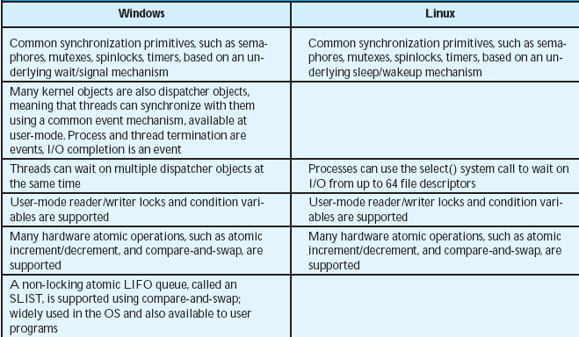
Windows/Linux Comparison

Slide 87
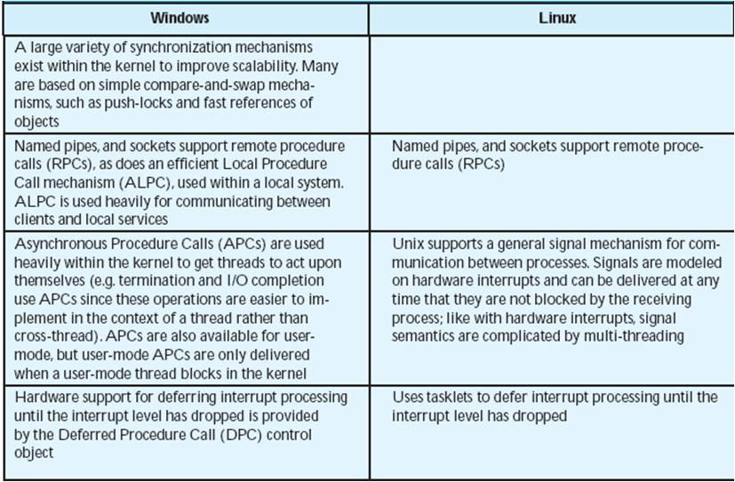
Windows/Linux Comparison cont.

