Slide 1
CHAPTER 01
Trade-Offs in Data Systems Architecture
Designing Data-Intensive Applications, Second Edition
Detailed English Study Edition
01 / 15
Notes:
Source: Martin Kleppmann and Chris Riccomini, Designing Data-Intensive Applications, 2nd ed., Chapter 1, book pages 1-25.
Source file: /Users/eve/projects/Designing-Data-Intensive-Applications/Designing Data Intensive Applications 2nd.pdf

Slide 2
CHAPTER 01
Chapter map
01
Operational and analytical systems
OLTP serves frequent, low-latency reads and writes over small data slices.
02
Systems of record and derived data
A system of record owns the authoritative business facts.
03
Cloud services and self-hosting
Managed services exchange operational control for elasticity and reduced administration.
04
Distributed and single-node systems
A single node is easier to reason about and may satisfy many workloads.
05
Architecture decisions
Start with workload, data volume, SLOs, and the assumed failure model.
02 / 15
Notes:
Source: Martin Kleppmann and Chris Riccomini, Designing Data-Intensive Applications, 2nd ed., Chapter 1, book pages 1-25.
Source file: /Users/eve/projects/Designing-Data-Intensive-Applications/Designing Data Intensive Applications 2nd.pdf

Slide 3
CHAPTER 01
Operational and analytical systems
01
OLTP serves frequent, low-latency reads and writes over small data slices.
Analytical systems scan large histories and compute aggregates.
Separating the workloads enables independent optimization but creates integration work.
Core question
What problem does it solve, and what does it cost under failure, growth, and change?
03 / 15
Notes:
Source: Martin Kleppmann and Chris Riccomini, Designing Data-Intensive Applications, 2nd ed., Chapter 1, book pages 1-25.
Source file: /Users/eve/projects/Designing-Data-Intensive-Applications/Designing Data Intensive Applications 2nd.pdf

Slide 4
CHAPTER 01
Operational and analytical systems: design trade-offs
01
Fit: OLTP serves frequent, low-latency reads and writes over small data slices.
Cost: evaluate latency, throughput, consistency, and operational complexity.
Failure check: what state becomes visible when a node, network path, or dependency fails?
Evolution check: can formats, interfaces, and topology change through rolling upgrades?
04 / 15
Notes:
Source: Martin Kleppmann and Chris Riccomini, Designing Data-Intensive Applications, 2nd ed., Chapter 1, book pages 1-25.
Source file: /Users/eve/projects/Designing-Data-Intensive-Applications/Designing Data Intensive Applications 2nd.pdf

Slide 5
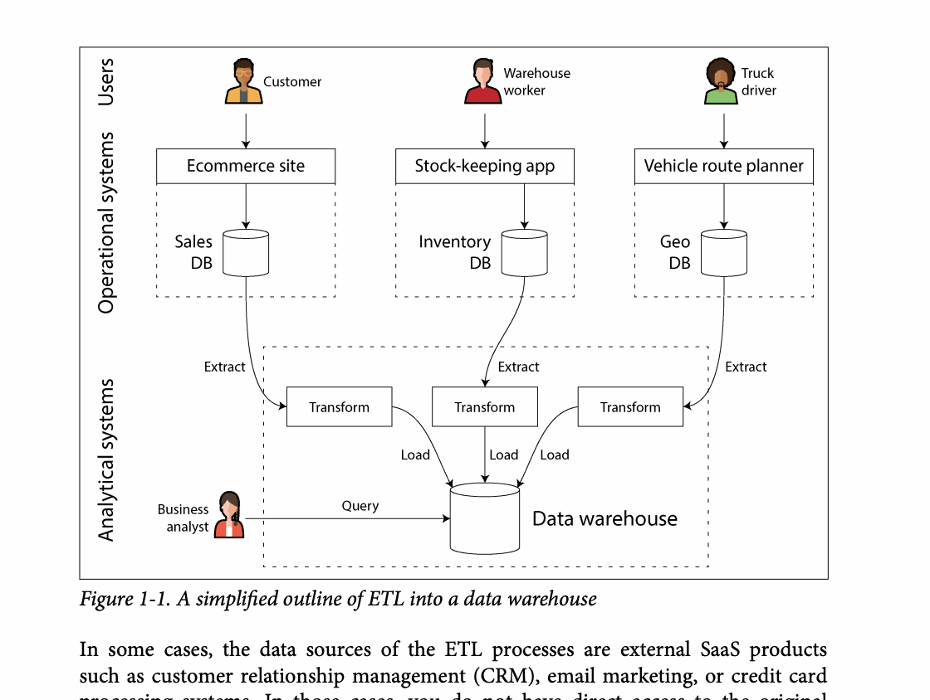
CHAPTER 01
Figure 1-1: mechanism explained
What it shows
Data moves from operational sources through transformation into an analytical store.
Why it matters
The warehouse is derived data, so repeatable loads and lineage are essential.
What to watch
Follow the arrows or timeline and test whether the conclusion still holds under failure, retry, and concurrency.
05 / 15
Notes:
Source: Martin Kleppmann and Chris Riccomini, Designing Data-Intensive Applications, 2nd ed., Chapter 1, book pages 1-25. Figure 1-1, PDF page 32. Original caption: Figure 1-1. A simplified outline of ETL into a data warehouse
Explanation: Data moves from operational sources through transformation into an analytical store. The warehouse is derived data, so repeatable loads and lineage are essential. Follow the arrows or timeline and test whether the conclusion still holds under failure, retry, and concurrency.
Source file: /Users/eve/projects/Designing-Data-Intensive-Applications/Designing Data Intensive Applications 2nd.pdf

Slide 6
CHAPTER 01
Systems of record and derived data
02
A system of record owns the authoritative business facts.
Indexes, caches, search stores, and warehouses are derived and rebuildable.
Architecture must make ownership, propagation, and recovery paths explicit.
Core question
What problem does it solve, and what does it cost under failure, growth, and change?
06 / 15
Notes:
Source: Martin Kleppmann and Chris Riccomini, Designing Data-Intensive Applications, 2nd ed., Chapter 1, book pages 1-25.
Source file: /Users/eve/projects/Designing-Data-Intensive-Applications/Designing Data Intensive Applications 2nd.pdf

Slide 7
CHAPTER 01
Systems of record and derived data: design trade-offs
02
Fit: A system of record owns the authoritative business facts.
Cost: evaluate latency, throughput, consistency, and operational complexity.
Failure check: what state becomes visible when a node, network path, or dependency fails?
Evolution check: can formats, interfaces, and topology change through rolling upgrades?
07 / 15
Notes:
Source: Martin Kleppmann and Chris Riccomini, Designing Data-Intensive Applications, 2nd ed., Chapter 1, book pages 1-25.
Source file: /Users/eve/projects/Designing-Data-Intensive-Applications/Designing Data Intensive Applications 2nd.pdf

Slide 8
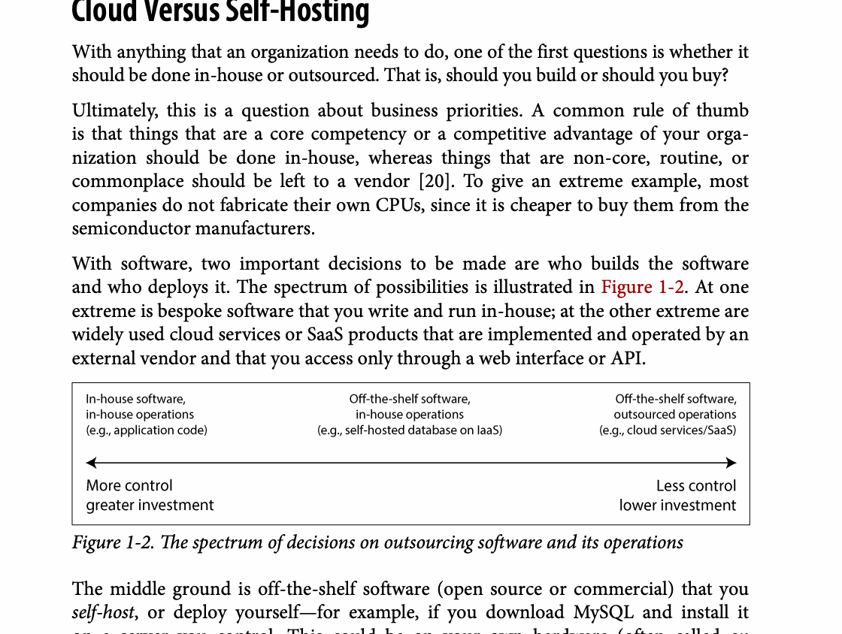
CHAPTER 01
Figure 1-2: mechanism explained
What it shows
The spectrum of decisions on outsourcing software and its operations
Why it matters
It turns the chapter concept into a concrete dataflow, timeline, or state transition.
What to watch
Check the actors, data direction, operation order, and hidden system assumptions.
08 / 15
Notes:
Source: Martin Kleppmann and Chris Riccomini, Designing Data-Intensive Applications, 2nd ed., Chapter 1, book pages 1-25. Figure 1-2, PDF page 36. Original caption: Figure 1-2. The spectrum of decisions on outsourcing software and its operations
Explanation: The spectrum of decisions on outsourcing software and its operations It turns the chapter concept into a concrete dataflow, timeline, or state transition. Check the actors, data direction, operation order, and hidden system assumptions.
Source file: /Users/eve/projects/Designing-Data-Intensive-Applications/Designing Data Intensive Applications 2nd.pdf

Slide 9
CHAPTER 01
Cloud services and self-hosting
03
Managed services exchange operational control for elasticity and reduced administration.
Cloud-native systems often separate compute, storage, and control planes.
Team skills, regulation, cost behavior, and exit options shape the decision.
Core question
What problem does it solve, and what does it cost under failure, growth, and change?
09 / 15
Notes:
Source: Martin Kleppmann and Chris Riccomini, Designing Data-Intensive Applications, 2nd ed., Chapter 1, book pages 1-25.
Source file: /Users/eve/projects/Designing-Data-Intensive-Applications/Designing Data Intensive Applications 2nd.pdf

Slide 10
CHAPTER 01
Cloud services and self-hosting: design trade-offs
03
Fit: Managed services exchange operational control for elasticity and reduced administration.
Cost: evaluate latency, throughput, consistency, and operational complexity.
Failure check: what state becomes visible when a node, network path, or dependency fails?
Evolution check: can formats, interfaces, and topology change through rolling upgrades?
10 / 15
Notes:
Source: Martin Kleppmann and Chris Riccomini, Designing Data-Intensive Applications, 2nd ed., Chapter 1, book pages 1-25.
Source file: /Users/eve/projects/Designing-Data-Intensive-Applications/Designing Data Intensive Applications 2nd.pdf

Slide 11
CHAPTER 01
Distributed and single-node systems
04
A single node is easier to reason about and may satisfy many workloads.
Distribution adds capacity and resilience but introduces partial failure.
Microservices and serverless help only when their organizational or scaling benefits are concrete.
Core question
What problem does it solve, and what does it cost under failure, growth, and change?
11 / 15
Notes:
Source: Martin Kleppmann and Chris Riccomini, Designing Data-Intensive Applications, 2nd ed., Chapter 1, book pages 1-25.
Source file: /Users/eve/projects/Designing-Data-Intensive-Applications/Designing Data Intensive Applications 2nd.pdf

Slide 12
CHAPTER 01
Distributed and single-node systems: design trade-offs
04
Fit: A single node is easier to reason about and may satisfy many workloads.
Cost: evaluate latency, throughput, consistency, and operational complexity.
Failure check: what state becomes visible when a node, network path, or dependency fails?
Evolution check: can formats, interfaces, and topology change through rolling upgrades?
12 / 15
Notes:
Source: Martin Kleppmann and Chris Riccomini, Designing Data-Intensive Applications, 2nd ed., Chapter 1, book pages 1-25.
Source file: /Users/eve/projects/Designing-Data-Intensive-Applications/Designing Data Intensive Applications 2nd.pdf

Slide 13
CHAPTER 01
Architecture decisions
05
Start with workload, data volume, SLOs, and the assumed failure model.
Compare total operating cost, not only unit prices.
Treat privacy, law, and social impact as architecture constraints.
Core question
What problem does it solve, and what does it cost under failure, growth, and change?
13 / 15
Notes:
Source: Martin Kleppmann and Chris Riccomini, Designing Data-Intensive Applications, 2nd ed., Chapter 1, book pages 1-25.
Source file: /Users/eve/projects/Designing-Data-Intensive-Applications/Designing Data Intensive Applications 2nd.pdf

Slide 14
CHAPTER 01
Architecture decisions: design trade-offs
05
Fit: Start with workload, data volume, SLOs, and the assumed failure model.
Cost: evaluate latency, throughput, consistency, and operational complexity.
Failure check: what state becomes visible when a node, network path, or dependency fails?
Evolution check: can formats, interfaces, and topology change through rolling upgrades?
14 / 15
Notes:
Source: Martin Kleppmann and Chris Riccomini, Designing Data-Intensive Applications, 2nd ed., Chapter 1, book pages 1-25.
Source file: /Users/eve/projects/Designing-Data-Intensive-Applications/Designing Data Intensive Applications 2nd.pdf

Slide 15
CHAPTER 01
Review and application
State the chapter’s central problem in one sentence.
Choose one mechanism and list the assumptions it relies on.
Describe a failure scenario and explain the recovery path.
Apply one trade-off from the chapter to a system you are designing.
15 / 15
Notes:
Source: Martin Kleppmann and Chris Riccomini, Designing Data-Intensive Applications, 2nd ed., Chapter 1, book pages 1-25.
Source file: /Users/eve/projects/Designing-Data-Intensive-Applications/Designing Data Intensive Applications 2nd.pdf

